Slide 1

UKUBAMBANA NGOKUTHOBEKA
Isifundo sesine ilanga lamatshumi amabili lane kuZibandlela ku2026, 2026

Slide 2

“Gcwalisani intokozo yami ngokuba lomqondo munye, lokuba lothando olufananayo, lokuba nhliziyonye, umqondo munye.” Filipi 2:2NKJV,

Slide 3







UPawulu usanda kukhuthaza amakholwa aseFilipi ukuba ame aqine lapho ebhekene lezinselele zokuphila kobuKristu. Ubacele ukuba baziphathe ngendlela efaneleyo izakhamuzi zasezulwini, egcizelela ubunye.
Ngenkulumo ethi “ngakho-ke”, uPawulu uqala ingxenye entsha lapho asinika khona izihluthulelo zokuqonda indlela yokufinyelela lobo bunye obupheleleyo: ngokulingisa isibonelo sikaJesu.
Isisusa sokungabambani (Filipi 2:1-3a)
Ubunye ngokuthobeka (Filipi 2:3b-4)
Cabanga njengoJesu (Filipi 2:5)
Isimo sengqondo sikaJesu (Filipi 2:6-8)

Slide 4



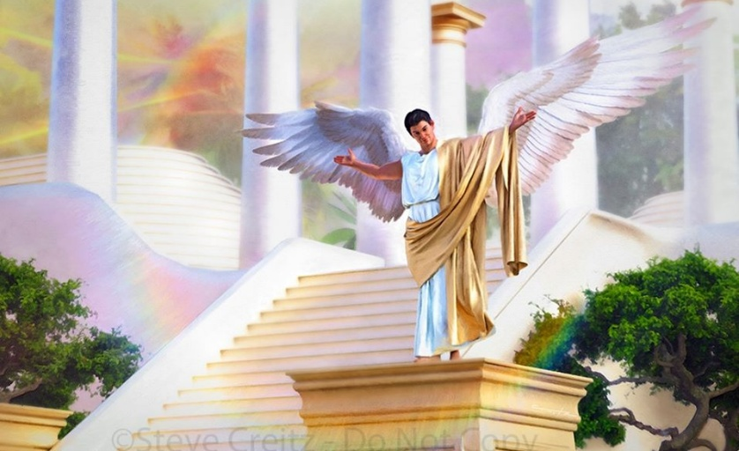

ISISUSA SOKUNGABAMBANI
“Lingenzi lutho ngokubanga loba ngokuzazisa” (Filipi 2:3a)
Ngaphambi kokuba abeke umunwe esikh esibuhlungu, aveze izizathu zokuhlukana okwakubonakala phakathi kwabaseFilipi, yiziphi izeluleko zokuqala azinikezayo ukuze bathole ubunye, bephelelisa injabulo yakhe ( Fil. 2:1-2 )?
Induduzo kuKristu
Induduzo othandweni
Isidlo sikaMoya
Uthando olusuka enhliziyweni
Umusa
Ubunye bomuzwa lothando
Ubakhuthaza ukuba batadishe futhi balingise ukuphila kukaKristu okuyisibonelo
Uthando lwabo ngoKristu lulamandla atshukumisayo ezingqondweni zabo
Kufanele bazithobe ekulawuleni kukaMoya
Kufanele zibonise imizwelo emnene nefudumele yothando lomuntu
Mababonise ukuba khona kothando lwangempela ngezenzo zomuntu ngamunye zomusa.
Ukuthandana kwenza imicabango ifane futhi iholele esenzweni esibumbene
Konke lokhu babengakuzuza kuphela uma bebeka eceleni lokho okubahlukanisayo: ukuzidla lezingxabano (Fil. 2:3a).
Zombili lezi zinkinga zazikhona ekuhlubukeni kukaLusifa, futhi ziphakathi kwezinkinga ezinkulu kakhulu ebudlelwaneni (Gal. 5:26; Jak. 3:16 NIV)

Slide 5




UKUBAMBANA NGOKUZEHLISA
“… ngokuzehlisa khangelani abanye ngaphezu kwenu, 4 lingakhangeli okwenu, kodwa yilowo lalowo ebheke okomunye.” ( Filipi 2:3b-4 )
Indlela yobubambana uPawulu ayiphakamisayo ayisiyona into yangaphandle, kodwa yisimo sengqondo sangaphakathi: ukuthobeka. Ngaphandle kokuba isici sikaJesu, wakhuthaza izilaleli Zakhe ukuba zithobeke ( Mt. 11:29; 18:4; 23:12 ).
Ukuze sithole lokhu kuzithoba, uPawulu uphakamisa ukuthi sibheke abanye njengabaphezulu kulathi (Fil. 2:3). Kodwa asilingani sonke phambi kukaNkulunkulu? Akufanele yini kube lokulingana ukuze kube lobunye?
UPawulu akatsho ukuthi siphansi kulabanye, kodwa kulalokho kufanele sizibheke njengabanjalo. Njengoba nje inceku ifuna okuhle enkosini yayo, lathi kufanele sifune okuhle kulabo esibakhangela njengabakhulu kulathi ( Fil. 2:4 ).
Ukuze sikwazi ukusiza abanye, kumelwe sifunde ukubalalela futhi siqonde umbono wabo. Konke lokhu ngokungathandabuzi kungumsebenzi kaMoya oNgcwele

Slide 6




CABANGAA NJENGOJESU
“Lowo mqondo mawube kini owawukuKristu Jesu” (KwabaseFilipi 2:5).“
Imicabango yethu yakheke kanjani? “Ngezindlela zomphefumulo,” okungukuthi, izinzwa zethu. Konke esikufundayo, esikubonayo, noma esikuzwayo kusilolonga ngandlela thize. Yebo, uSathane uhlasela izinzwa zethu ukuze alolonge izingqondo zethu zivumelane nendlela yakhe yokucabanga.
UPawulu uneqili. Akagcini nje ngokusimema ukuba sibheke imicabango yethu, kodwa usicela ukuba sicabange njengoba uKristu ayecabanga (Fil. 4:8; 2:5).
Mhlawumbe singakwazi, ngomzamo omkhulu, sifinyelele esokuqala. Kodwa ukuguqula ingqondo zethu ukuze zivumelane lomcabango kaJesu kungenziwa kithi kuphela ngoMoya oNgcwele
Lokhu kungenxa yokuthi imicabango yethu ingeyenyama, futhi inhliziyo yethu ilenkohliso (Jer. 17:9). UMoya uyoguqula ingqondo yethu yenyama ibe yingqondo kamoya, efana nekaKristu ( Roma 8:1, 5 ).1

Slide 7

EGW (Patriarchs and Prophets, p. 460)
“Ngakho silomsebenzi okufanele siwenze ukuze simelane lesilingo. Labo abangeke bawele ekubanjweni kwamaqhinga kaSathane kufanele baqaphele kahle izindlela zomphefumulo; kufanele bavike ukufunda, ukubona, loba ukuzwa lokho okuzosikisela imicabango engcolileyo..”

Slide 8

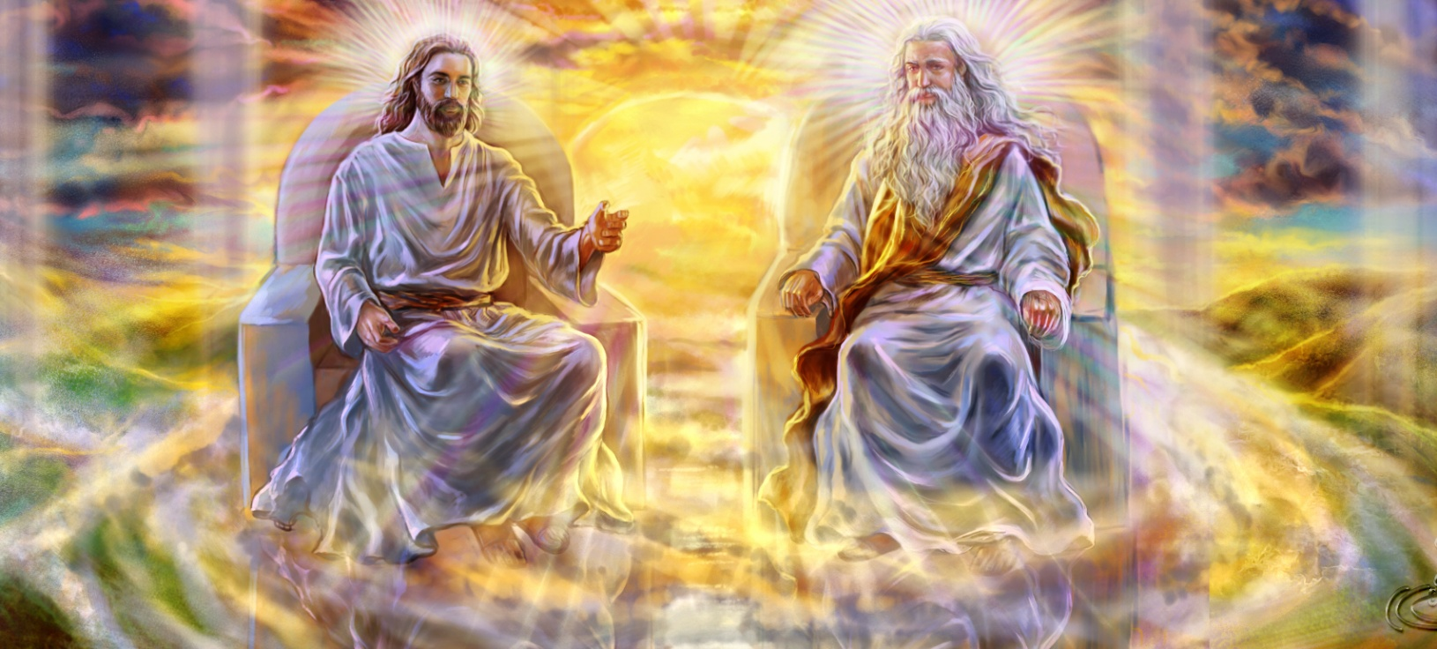


ISIMO SIKAJESU (1)
“owathi elesimo sikaNkulunkulu, akakubonanga njengokuphanga ukulingana loNkulunkulu” ( KwabaseFilipi 2:6 )
UPawulu uqokomisa izimfanelo ezintathu zikaJesu:
Walahla ubukhosi bakhe baphezulu ( Flp. 2:6 ).
Waba ngumuntu ukuze asikhonze ( Flp. 2:7 )
Wazithoba ngokuthobeka kukho konke, kwaze kwaba sekufeni kwakhe ( Fil. 2:8 )
EnguMdali, Waba isidalwa. Wavuma ukuphathwa kabi lokufa esiphambanweni ukuze asihlenge
Laphezu kokulingana labanye abantu ababili bobuNkulunkulu, ukuzithoba kukaJesu entandweni kaYise kwakuphelele ngaso sonke isikhathi. Akuzange kube lamzuzu lapho enqaba ukuzithoba.
Uma sicabanga ngalokhu, singakhothama futhi sikhonze uMsindisi wethu omangalisayo.
Uyisibonelo sethu. Kumele sizimisele ukuzithoba futhi sizidele ukuze kuzuze abanye.

Slide 9


ISIMO SIKAJESU (2)
““Futhi ngokungelampikiso enkulu imfihlakalo yokumesaba uNkulunkulu: UNkulunkulu wabonakaliswa enyameni;
Kuthiwe balungile ngoMoya, babonwa yizingelosi, batshunyayelwa phakathi kwabezizwe, bakholwa emhlabeni,
Lamukelwe ngenkazimulo” (1 Thimothewu 3:16).
Ukuzehlisa kukaKristu okumangalisayo ekubeni umuntu kuzoba yisifundo kwabahlengiweyo ingunaphakade
Kuyamangalisa ukuthi uMuntu ongapheliyo futhi ongunaphakade waba ngumuntu olesiphetho, ofanele ukufa. Yilokhu uPawulu akubiza ngokuthi “imfihlakalo yokumesaba uNkulunkulu” ( 1 Thim. 3:16 ).
UJesu wasuka ebukhosini bendawo yonke waya ebugqileni obupheleleyo. Lokhu kuphambene mpela lalokho uLusifa ayekufisa, owathi, eyinceku, wafisa ukuphakama kwendawo yonke.
Lesi sibonelo sisibiza ukuba silahle ubugovu bethu lesifiso sethu sokukhonzwa, futhi esikhundleni sako sibeke ukuthobeka lokuzimisela ukukhonza abanye.

Slide 10

“UNkulunkulu uvumela wonke umuntu ukuba asebenzise ubuntu bakhe. Akafisi muntu ukuthi afake ingqondo yakhe engqondweni yomuntu ofayo. Labo abafisa ukuguqulwa engqondweni lasengqondweni akufanele babheke kubantu, kodwa babheke esibonelweni saphezulu. UNkulunkulu unikeza isimemo, “Lowomqondo kawube kini owawukuKristu Jesu.” Ngokuguqulwa nokuguqulwa kwabantu kufanele bamukele umqondo kaKristu..”
EGW (That I May Know Him, May 8)

