Slide 1
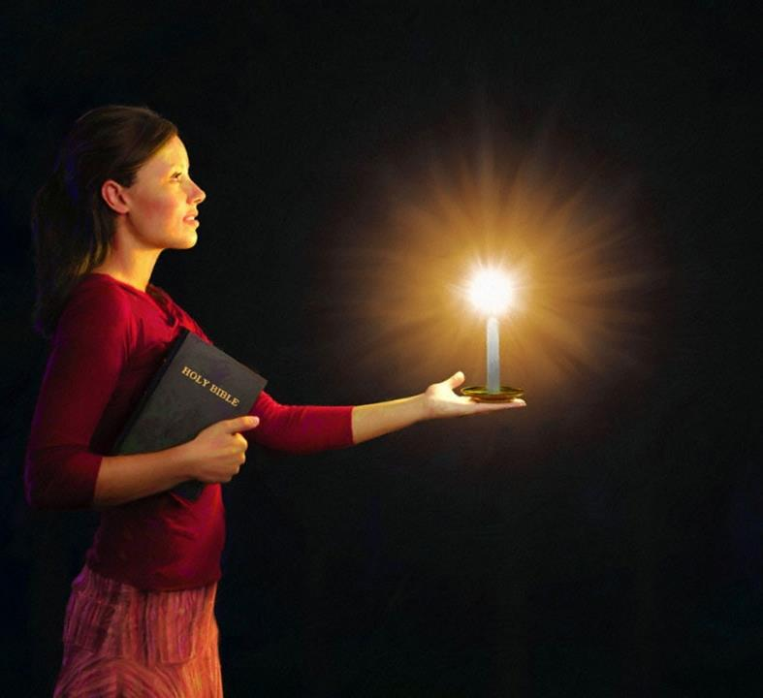
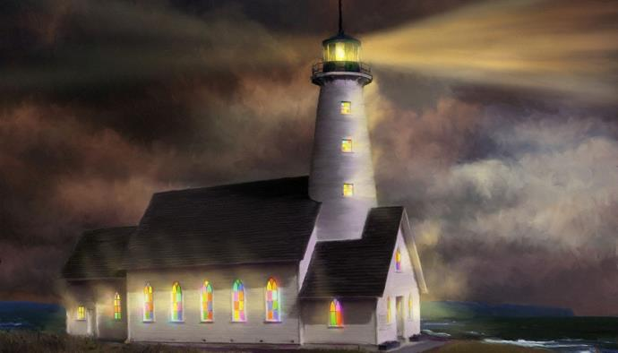

Isifundo sesihlanu kZibandlela ilanga lamatshumi amathathu lanye ku2026
UKUKHANYISA NJENGEZIBANE EBUSUKU

Slide 2

“Yenzani zonke izinto ngaphandle kokukhonona lokuphikisana, ukuze libe ngabangasolwayo labangelacala, abantwana bakaNkulunkulu abangelasici phakathi kwesizukulwane esingaqondile lesiphambeneyo, elikhanya phakathi kwaso njengezinkanyiso ezweni.” Filipi 2:14-15

Slide 3

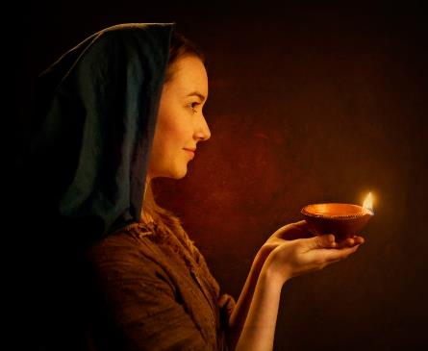



Kanjalo-ke, makukhanye ukukhanya kwenu phambi kwabantu, ukuze babone imisebenzi yenu emihle, badumise uYihlo osezulwini” ( Mt. 5:16 ).
KwabaseFilipi 2:12-18 singafunda inguqulo kaPauline yalomyalo kaJesu.
Njengoba siphila ezweni lapho uMthetho kaNkulunkulu unyathelwa khona njalo, thina maKristu, esifisa ukukhonza uNkulunkulu ngokuphila ngokuvumelana lawo, siyizinkanyiso ezikhanya ebunyameni.
Izibani Emhlabeni:
  Ukubonakaliswa kukaNkulunkulu (Filipi 2:12-13)
  Ukukhanya emhlabeni (Filipi 2:14-16)
  Umhlatshelo ophilayo (Filipi 2:17-18)
Izibonelo zokukhanya:
  Thimothewu (Filipi 2:19-24)
  U-Ephafrodithu (Filipi 2:25-30)

Slide 4

IZIBANE EZWENI

Slide 5




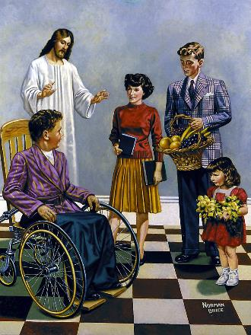
ISIBONAKALISO SIKANKULUNKULU.
“Ngokuba nguNkulunkulu osebenzayo kini ukuthanda lokwenza, ukufeza injongo yakhe enhle” (KwabaseFilipi 2:13).
Ngemva kokuchaza ngobuciko ukuthotshiswa lokuphakanyiswa kukaJesu, uPawulu ulenzela inkulumo ethi “ngakho-ke.” Okuyikuthi, njengoba uJesu azithoba futhi waphakanyiswa ukuze “zonke izilimi zivume ukuthi uJesu Kristu uyiNkosi, kube-yinkazimulo kaNkulunkulu uBaba.” ( Fil. 2:11 ) Amakholwa aseFilipi (futhi, ngokwandisa, lathi sonke) kumele eenze okuthile ngakho.
Umsebenzi wethu wokuqala ykusebenzela ukusindiswa kwethu “ngokwesaba langokuthuthumela” (Fil. 2:12). Uma uNkulunkulu kunguye osisindisayo ( Thithu 2:11 ) kungani kufanele sizikhathaze ngakho?
Ukwesaba lokuthuthumela yizinkulumo ezisetshenziswa njengeminqodo yokukhonza uNkulunkulu (IHubo 2:11). Ngakho, uPawulu ugcizelela ukuthi nguNkulunkulu oveza kithi isifiso sokwenza okuhle, futhi osinika amandla okukwenza kube ngokoqobo ( Filipi 2:13 ).

Slide 6




UKUKHANYA EMHLABENI
“ukuze libe ngabangelasici labamsulwa, “abantwana bakaNkulunkulu abangelasici esizukulwaneni esiphambeneyo lesingaqondile.” Khona-ke liyokhanya phakathi kwabo njengezinkanyezi esibhakabhakeni. ( Filipi 2:15 )
UPawulu ukhomba izici ezintathu ezizakwenza amakholwa akhanye emhlabeni:
Gcina ubunye ( Flp. 2:14 )
Lapho sisebenza ndawonye, akufanelanga kube lokuhleba, ukuxegana, ukuqhudelana, loba izingxabano.Phakathi kwethu
Ukuziphatha ngokungelasici ( Fil. 2:15 )
Ukulalela uBaba wethu ngendlela elula kuhluke kakhulu ebubini lokushabalala okukhona kuyo yonke indawo.
Ukwethembeka eZwini likaNkulunkulu ( Flp. 2:16 )
Izenzo zethu lokucabanga kwethu kumele kuvumelane lalokho okufundiswa iBhayibhelini
Lapho ubumnyama bukhulu kakhulu, ukukhanya kukhanya kakhulu. Ezweni lapho uNkulunkulu enqatshwa ngokuhlelekileyo, thina amaKristu kumelwe sikhanye ngokukhanya kukaKristu

Slide 7




UMNIKELO OPHILAYO
“Kodwa loba ngithululwa njengomnikelo wokuphuzwayo emhlatshelweni lasenkonzweni evela ekukholweni kwenu, ngiyajabula futhi ngijabula kanye lani lonke.” ( Filipi 2:17 )
Langobaba uPawulu wayelethemba lokukhululwa, kwakungenzeka ukuba alahlwe. Uveza lokhu okungenzeka ngokuthi “kuthululwa njengomnikelo wokuphuzwayo” udumo (Fil. 2:17).
Umnikelo wokuphuzwa [umnikelo wokuphuzwayo] wawuhlanganisa ukuthela okungamanzi phezu komhlatshelo owawunikelwa ( Eks. 29:39-40 ). Kulokhu, umhlatshelo okukhulunywa ngawo kwabaseFilipi.
Ingabe abaseFilipi babezafa? Ngitsho qha. Umhlatshelo wabo wawuhlanganisa “inkonzo yokholo lwakho.” Kwakungumnikelo ophilayo, umhlatshelo okufanele sonke siwunikele kuNkulunkulu (Roma 12:1).
UPawulu akazange akhathazeke ngokufa ngoba ubufakazi bakhe babuzakupha amandla engeziweyo kumakholwa kukade ayesengofakazi abathembekileyo beVangeli, ekhuluma ngalo ngesibindi, futhi eziphatha njengabantwana bakaNkulunkulu abafaneleyo.

Slide 8
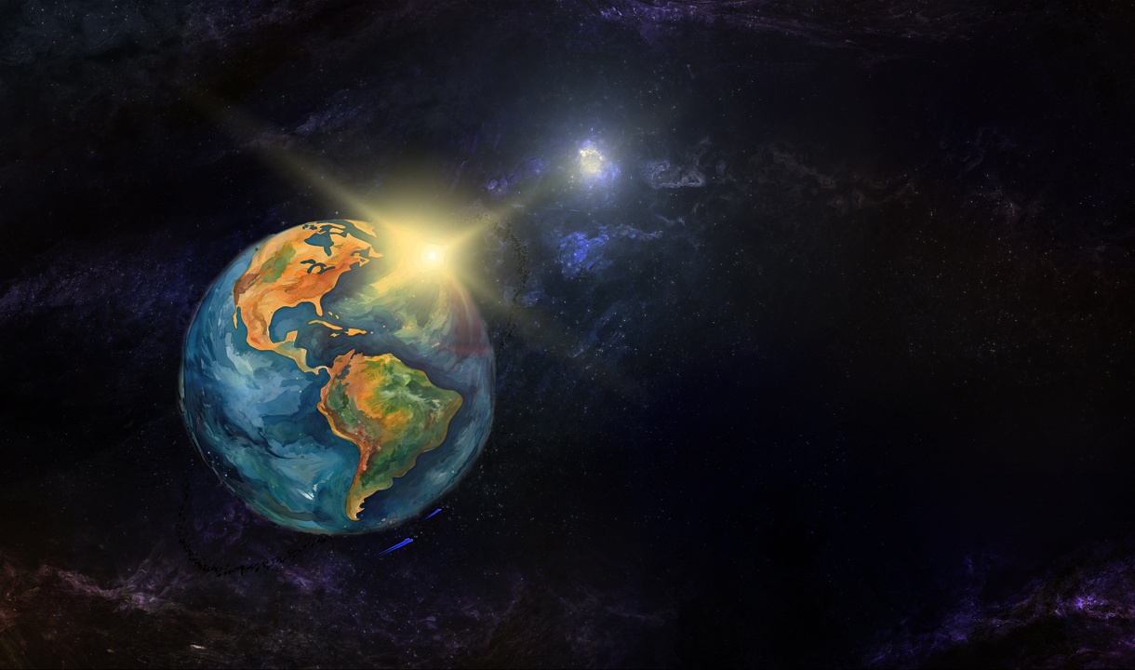
IZIBONELO ZOKUKHANYA

Slide 9

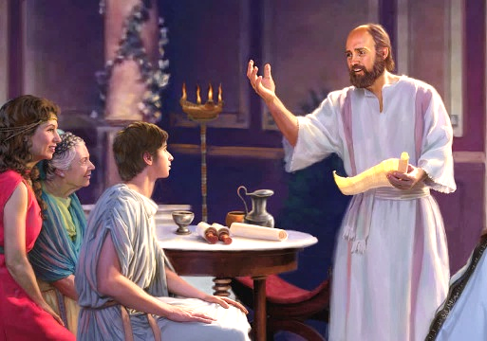


TIMOTHEWU
““Kepha liyazi ukuthi uThimothewu ufakazile, ngokuba njengendodana kuyise usebenzile kanye lami emsebenzini wevangeli” (KwabaseFilipi 2:22).
UThimothewu wayengumhlanganyeli okhuthele kaPawulu futhi engumlobi-munye wezincwadi eziyisithupha (2 Korinte, Filipi, Kolose, 1 Thesalonika, 2 Thesalonika, Filemoni). KwakunguPawulu ngokwakhe owamkhetha njengomvangeli (IZenzo 16:1-3). Yini uPawulu ayibona eyayikhethekile ngale nsizwa?
Okokuqala, wonke umuntu “wayekhuluma kahle ngaye.” Ukufaneleka kwakhe enkonzweni kwaqinisekiswa ngamazwi esiprofetho. ( 1 Thim. 1:18 ). Esemutsha, uPawulu wayembheka njengendodana ( 1 Thim. 1:2; 4:12 ). Ngakolunye uhlangothi, uThimothewu wayephatha uPawulu ngenhlonipho lothando indodana enalo ngoyise ( Fil. 2:22 ).
UPawulu wayembheka njengesisebenzi esiphumelelayo njengaye (1 Kor. 16:10). Wamnikeza ukwengamela amasonto amaningana, njengeKorinte ( 1 Kor. 4:17 ); Filipi ( Fil. 2:19 ); naseThesalonika ( 1 Thes. 3:2 ). Laye wabhekana lokubotshwa njengoPawulu ( Heb. 13:23 ).

Slide 10

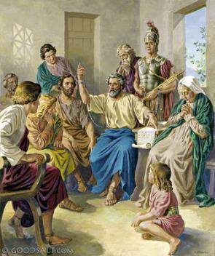


EPAPHRODITUS
“But I think it is necessary to send back to you Epaphroditus, my brother, co-worker and fellow soldier, who is also your messenger, whom you sent to take care of my needs” (Philippians 2:25)
Lapho abaseFilipi besizwa ukuthi uPawulu wayebotshiwe eRoma, banquma ukumthumela usizo ukuze anelise lezidingo zakhe (bamkhokhela indawo yokuhlala, ukudla, izingubo zokugqoka, njalo) U-Ephafrodithu wayelomthwalo wemfanelo wokuletha lolu sizo kumphostoli ( Flp. 4:18; 2:25 ).
U-Ephafrodithu akacinanga nje ngokuletha usizo, kodwa waphelezela uPawulu, wamsiza ezidingweni zakhe, futhi wabambisana laye ekusakazeni ivangeli.
Ngokutshisekela kwakhe ivangeli, wabeka ukuphila kwakhe engozini futhi wagula kakhulu ( Fil. 2:27, 30 ). Lapho abaseFilipi besizwa lokhu, bakhathazeka ngaye. Lesi kwakuyisizathu esikhulu uPawulu anquma ukumthuma ukuba ahambise incwadi kibo ( Fil. 2:26, 28 ).
UPawulu ucela lokho “futhi lihloniphe abantu abanjengaye” (Fil. 2:29 NIV). Ngokungelakuthandabuza u-Ephafrodithu wayengumKristu othembekileyo.

Slide 11

“Lapho uJesu, uMthetheleli wethu, esinxusela ezulwini, uMoya oNgcwele usebenza kithi, ukuthanda lokwenza intando yakhe enhle. Izulu lonke lntshukuntshu ekusindisweni komphefumulo. Khona-ke silasiphi isizathu sokuthandabuza ukuthi iNkosi izosisiza futhi iyasisiza? Thina esifundisa abantu kumelwe sibe lokuxhumana okubalulekileyo loNkulunkulu. kungase kuvivinye ukubekezela kwethu lokholo lwethu; kodwa ukukhanya kobukhona bokungabonwa kukithi, futhi kumele sizifihle ngemva kukaJesu.”
EGW (You Shall Receive Power, December 8)

