Slide 1

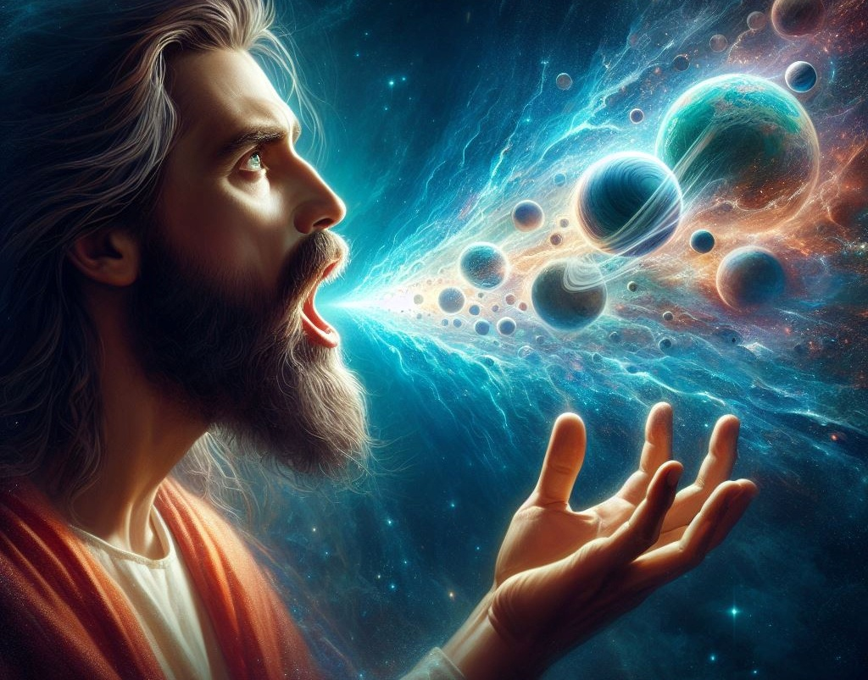
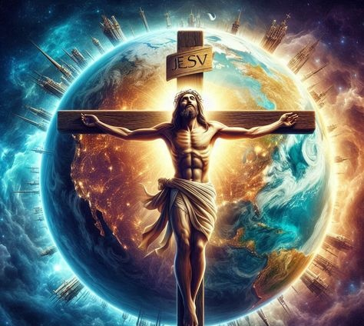
Isifundo setshiyangalombili kuNhlolanja ilanga lamatshimi amabili lanye ku2026
UBUKHULU BUKAKRESTU

Slide 2
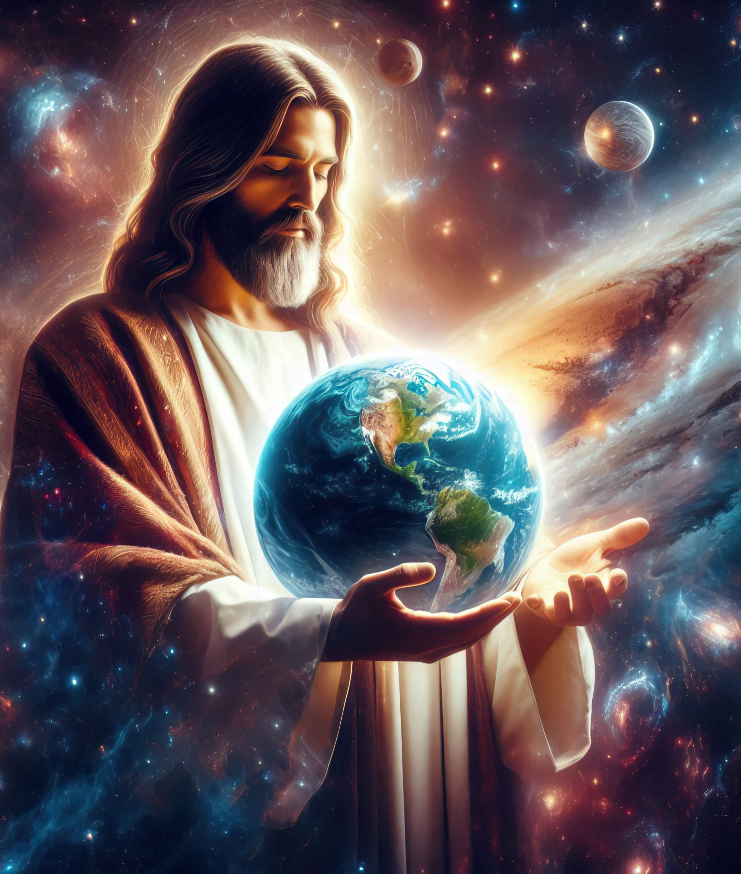
“[UKristu] ungumfanekiso kaNkulunkulu ongabonakaliyo, izibulo layo yonke indalo, ngokuba kwadalwa ngaye zonke izinto ezisezulwini lezisemhlabeni, ezibonakalayo lezingabonakali, kungakhathalekile ukuthi izihlalo zobukhosi loba ubukhosi loba izikhulu loba amandla.Futhi ungaphambi kwazo zonke izinto, futhi zonke izinto zimi kuye.” Kolose 1:15-17

Slide 3


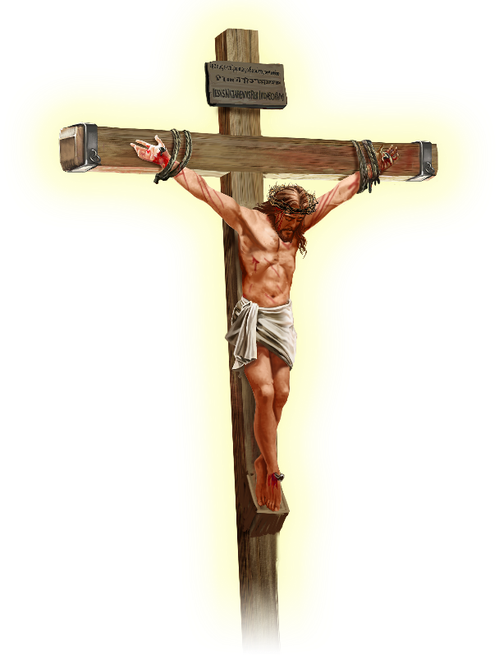






UPawulu uthi uJesu ulethe ukuthula endaweni yonke, “kungakhathalekile ukuthi kusemhlabeni loba okusezulwini” (Kol. 1:20 NIV).
Ngaphambi kokuba afike kula mazwi, umphostoli usitshela ukuthi ungubani ngempela uJesu. Hatshi umfundisi omkhulu, loba isazi sokuqeqetsha, loba umprofethi, loba umshumayeli, loba isithunywa sezindaba ezinhle
UJesu Kristu...
Umfanekiso kaNkulunkulu (Kolose 1:15a)
Izibulo (Kolose 1:15b-17)
Inhloko yeBandla (Kolose 1:18a)
Isiqalo (Kolose 1:18b)
Ukubuyisana ( Kolose 1:19-20 )

Slide 4





UMFANEKISO KANKULUNKULU
“INdodana ingumfanekiso kaNkulunkulu ongabonakaliyo” (Kolose 1:15a)“
Isithombe singaba lifuzo lwezinto ezingokoqobo (isithombe, ihologram, umfanekiso), loba into eqanjiweyo (umdwebo). Kodwa umqondo weBhayibheli wesithombe udlulela ngalé kwalokho.
UNkulunkulu wadala u-Adamu lo-Eva ngomfanekiso wakhe ( Gen. 1:27 ), futhi u-Adamu wazala indodana ngomfanekiso wakhe ( Gen. 5:3 ). Lawa akusilo ufuzo lwezinto ezingokoqobo, okulingiswayo, loba izinto eziqanjiweyo zemicabango yabo. Zifana ngokomzimba, ngokwengqondo, langokwenhlalo...
UPawulu uthi umthetho wemikhosi wawuyisithunzi, “hatshi umfanekiso wazo uqobo” ( Heb. 10:1 ), okutsho ukuthi “umfanekiso = okwempela.”
Umbuzo uyikuthi: Ingabe uJesu wayefana loNkulunkulu, loba wayelingana loNkulunkulu? Ngaphezu kokuzibiza ngokuphindaphindiwe ngegama laphezulu elithi “nginguye,” uJesu watsho ngokucacileyo: “Mina loBaba simunye” ( Johane 10:30 ); “Ongibonileyo mina umbonile uBaba” (Johane 14:9).

Slide 5

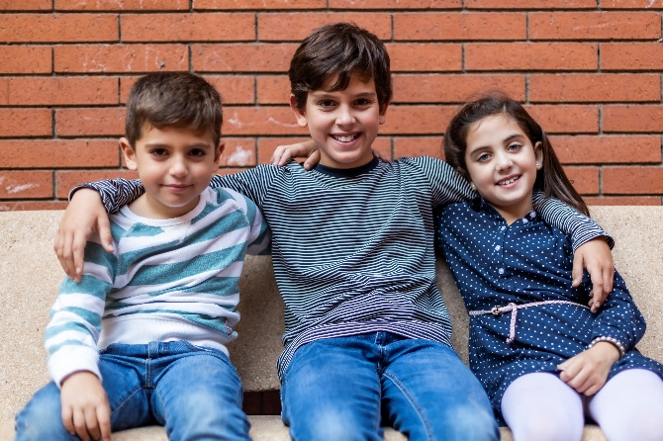


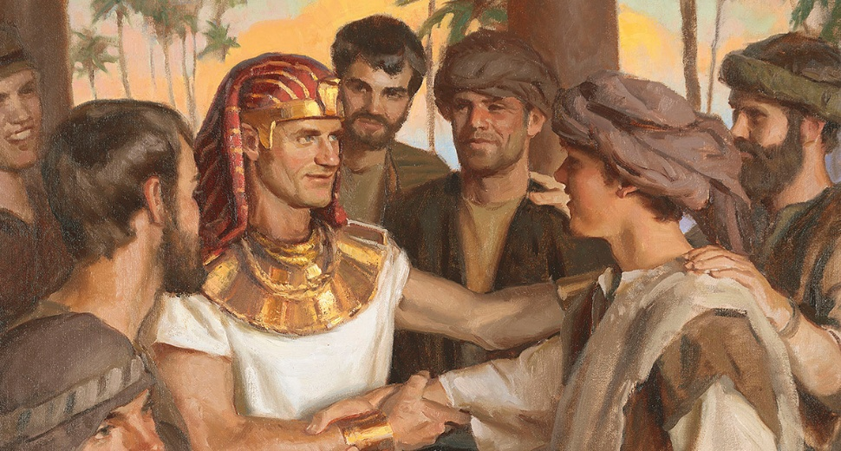
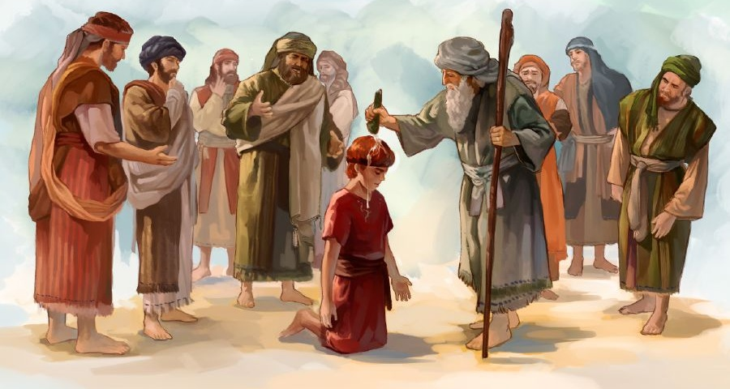

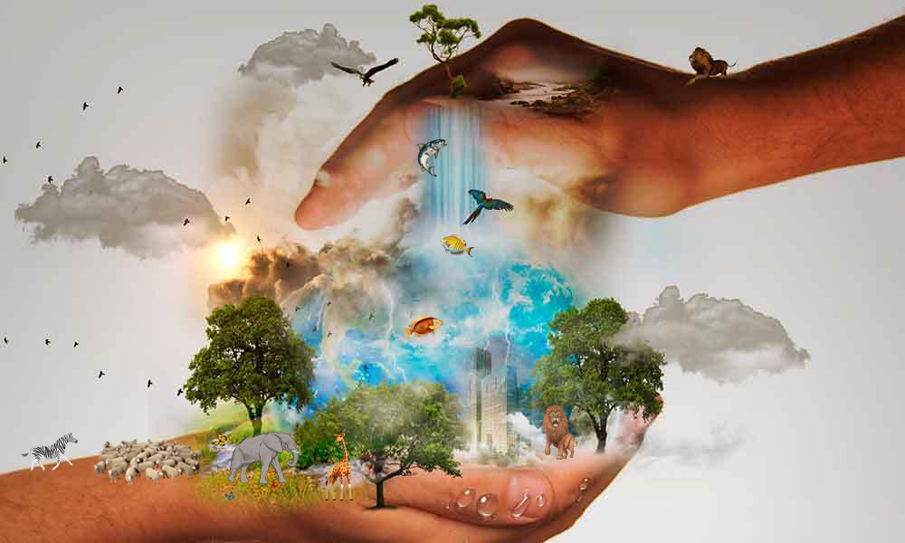
IZIBULO
“Ukhona ngaphambi kwazo zonke izinto, futhi zonke izinto zihlangana kuye.” ( Kolose 1:17 )
“Izibulo” litsho izibulo. Ngakho, abanye bafundisa ukuthi uJesu uyisidalwa sokuqala sikaNkulunkulu. ( Kol. 1:15 ). Kodwa, njengegama elithi “isithombe,” igama elithi “izibulo” linencazelo ebanzi yeBhayibheli.
u-Isaka wayelizibulo esikhundleni sika-Ishmayeli; uJakobe wayelizibulo esikhundleni sikaEsawu; UJosefa wayelizibulo esikhundleni sikaRubeni; UDavide wayeyizibulo esikhundleni sika-Eliyabe (IHubo 89:27). Bonke babengamazibulo ngoba babelesikhundla esiphakemeyo kulabafowabo, hatshi ngoba bezelwe kuqala.
UPawulu ubhekisela kulokhu kuvelela kweyabaseKolose. Ukuze angathandabuzi loba yikuphi ukungabaza ngobunjalo bawo, uthi izimfanelo ezimbili zaphezulu zivela kuYe: ukudalwa kwakho konke okukhona ( Kol. 1:16; Isaya 45:18 ); kanye lokudla kwayo.( Kol. 1:17; IHu. 119:91 )

Slide 6



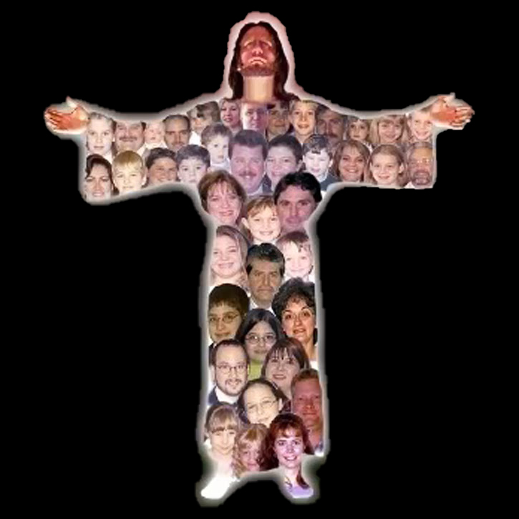
INHLOKO YEBANDLA
“Futhi uyinhloko yomzimba, ibandla” (Kolose 1:18a)
Kwezinye ilimi (njengesiCatalan loba isiNgisi) igama elithi “ikhanda” libuye lihunyutshwe ngokuthi “induna” loba “uthishanhloko,” ngoba leyo incazelo engokomfanekiso yelithi “ikhanda.” Lokhu kunjalo langesiHeberu. Isibonelo, “bazibekele inhloko eyodwa” (Hos. 1:11 NKJV) kufanele kuhunyutshwe ngokuthi “bazabeka umholi oyedwa” (NIV).
Sonke siyadingeka ( 1 Kor. 12:15 )
Yilowo lalowo ulomsebenzi wakhe ( 1 Kor. 12:17 ).
Ngeke sadelela muntu ( 1 Kor. 12:21 )
Awekho amakholwa “aphansi” ( 1 Kor. 12:22-24 )
Siyakhathalelana ( 1 Kor. 12:25-26 ).
Lo futhi umqondo uPawulu asebenzisa ngawo leli gama lapho elisebenzisa kuKristu (Kol. 1:18a).
Kodwa uPawulu futhi wengeza incazelo engokomfanekiso emzimbeni. Uma uKristu eyinhloko, thina-ibandla singumzimba. Kulo mbono kulandela ukuthi:

Slide 7


ISIQALO
“Uyisiqalo lezibulo kwabafileyo, ukuze abe mkhulu kukho konke.” ( Kolose 1:18b )
Igama elihunyutshwe ngokuthi “isiqalo” lithi archē (ἀρχή), igama lesiGreki elisho isiqalo, imvelaphi, imbangela yokuqala noma isimiso, kodwa futhi lisho umbusi, amandla, igunya noma inhloko, kuye kakhulu umongo.
Singatsho ukuthi leli gama, elisetshenziswa kuKristu, lingaba lazo zonke lezi zincazelo (Kol. 1:18). UJesu uyisisusa sazo zonke izinto [umfanekiso kaNkulunkulu], isizathu esenza konke kwadalwa [izibulo lendalo], umbusi ophakemeyo [inhloko]. Konke lokhu kumnika ukuvelela.
UPawulu ufaka igama elithi “izibulo kwabafileyo” lapha (ngokuba uJesu wayengasuye owokuqala ukuvuswa, kodwa uMose). Ukunqoba kwakhe ukufa kusikisela futhi ukunqoba kwakhe isono lamandla akhe okusidala kakutsha ngomfanekiso wakhe

Slide 8

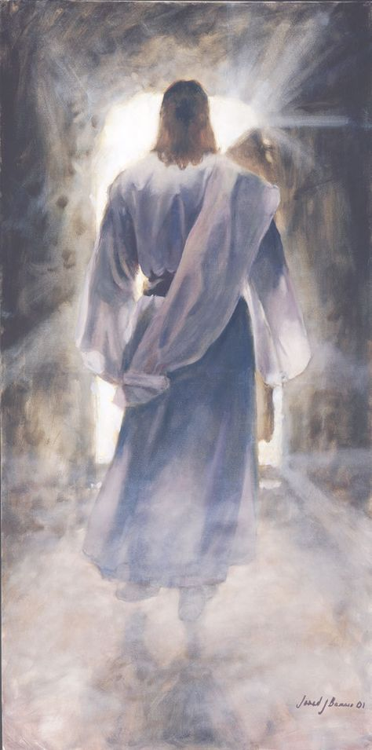



UMBUYISI
“futhi ngaye abuyisane lazo zonke izinto, kungakhathalekile ukuthi okusemhlabeni loba okusezulwini, ngokwenza ukuthula ngegazi lakhe, elachithwa esiphambanweni” (Kolose 1:20)
Lokho uJesu akwenza kwaphumela ekubeni athathe indawo yokuqala kukho konke. NgokukaPawulu, uKristu ukufanelekela zonke lezi ziqu “ngokuba uNkulunkulu wathanda ukuba ukugcwala kwakhe konke kuhlale kuye” (Kolose 1:19). Ngamanye amazwi, uJesu wayenguNkulunkulu ngokupheleleyo futhi engumuntu ngokupheleleyo. “Sibonile inkazimulo yakhe, […] egcwele umusa leqiniso” (Johane 1:14).
Ngokufa esiphambanweni lokuvuka futhi, uJesu wagcwalisa izimfuneko ezidingekayo ukuze abantu babuyisane loNkulunkulu (Kol. 1:20).
Singaqonda ukuthi “izinto ezisemhlabeni” uye wabuyisana loNkulunkulu. Kodwa uye wabuyisana njani laye labo abasezulwini?
Umhlaba wonke ukwazile ukubona ngokucacileyo ubunjalo bobubi. Ngakho, isimo sikaNkulunkulu siqinisekiswa kokubili eZulwini lasemhlabeni

Slide 9

“UJesu wayeyibukhosi bezulu, engumkhuzi wezingelosi othandekayo, owayekujabulela ukwenza intando Yakhe. Wayemunye loNkulunkulu, “esifubeni sikaYise” (Johane 1:18), lokho wayecabanga ukuthi kwakungesiyo into efiselekayo ukulingana loNkulunkulu kuyilapho umuntu elahlekile esonweni lasosizini. wazithoba kwaze kwaba sekufeni kwesiphambano, ukuze umuntu aphakanyiswe ahlale Laye esihlalweni Sakhe sobukhosi […].”
EGW (Selected Messages, Volume 1, p. 321)

