Slide 1
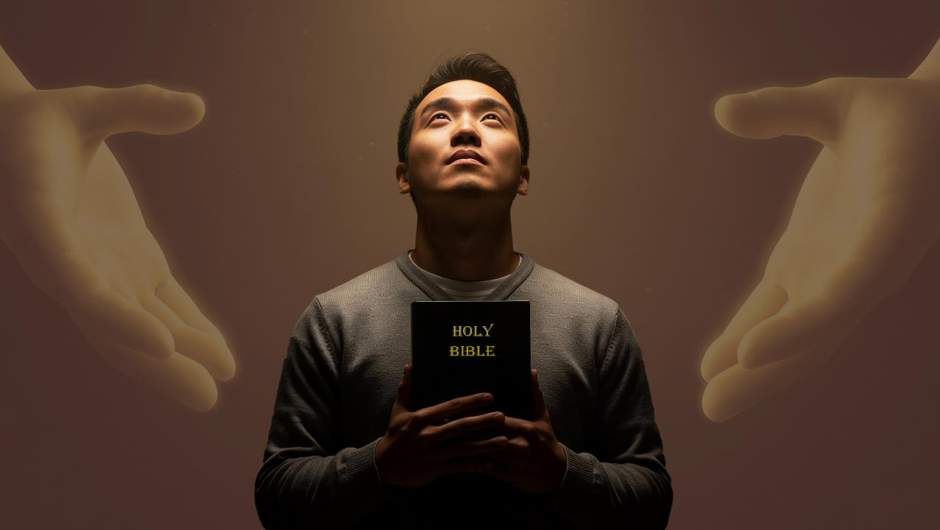
UKUBUYISWA LETHEMBA
Isifundo setshiyangalonye kuNhlolanja ilanga lamatshumi amabili latshiyambili ku2026

Slide 2


2 AbaseKorinte 5:21
“Ngokuba yena ongazanga isono wamenza isono ngenxa yethu, ukuze kuyena senziwe ukulunga kukaNkulunkulu. ”

Slide 3


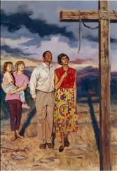
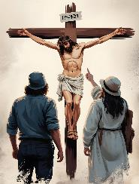
Ngemva kokutsho ukuthi isiphambano sikaKristu sibuyisele iZulu lomhlaba ( Kol. 1:20 ), uPawulu uyaqhubeka echaza imipumela engokoqobo kithi yalokhu kubuyisana
Lokhu kusintshintshe kanjani? UNkulunkulu wakubona njani konke lokhu kusengaphambili? Yini esingayenza ukuze sisize abanye bahlanganyele ekubuyisaneni futhi bathole ithemba?
UKUBUYISWA LETHEMBA NGEVANGELI
Impumela yokubuyisana
Kusukela kubenzi bokubi kuye kwabangcwele ( Kol. 1:21-22 )
Sigxilile futhi siqinile ( Kol. 1:23 )
Ithemba
Ukuletha ithemba ( Kol.1:24-25 )
Imfihlakalo kaNkulunkulu ( Kol. 1:26-27 )
Amandla evangeli
Ukumemezela ivangeli ( Kol. 1:28-29 )

Slide 4

IMPUMELA YOKUBUYISWA

Slide 5

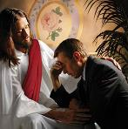
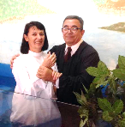
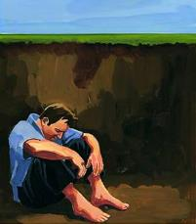
UKUSUKA KUBABI KUYA KWABANGCWELE
“Lani elalikade lehlukanisiwe lezitha engqondweni yenu ngemisebenzi emibi, ngakho manje uselibuyise ngomzimba wenyama Yakhe ngokufa, ukuze alimise phambi kwakhe lingcwele, lingenasici, lingenasici.” ( Kolose 1:21-22 )
Indaba ilula. Saphila senza okubi, ngakho-ke, sagwetshelwa ukufa okuphakade (Roma 6:23; IsAm. 21:8).
Wafa esiphambanweni ukuze akhokhe inhlawulo yezono zethu ( Roma 5:8 ).
Ngokholo, ukuphenduka, lobhapathizo, sikhululiwe esonweni sethu futhi asilasici futhi asinasici phambi kukaNkulunkulu [ukulungisiswa] ( Roma 5:10; Kol. 1:22 ) Ngokuvumelana lalokho, sikhululwe esonweni futhi singenasici futhi asinasici phambi kukaNkulunkulu.
Ngomsebenzi kaMoya oNgcwele izimpilo zethu ziyaguquka kancane kancane futhi sibe ngcwele phambi kukaNkulunkulu [ukungcweliswa] ( Roma 8:1; 2 Kor. 5:17 )
Thina ngokwethu asikwazanga ukuguqula lesi simo, loba ukukhokhela insindiso yethu (IHubo 49:7-8).
Kodwa uNkulunkulu wayelesu elikhulu elilungiselelwe thina:

Slide 6

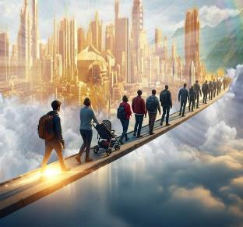
SIGXILILE FUTHI SIQINILE
“Aluba ngempela limi ekukholweni, lisekelwe futhi liqinile, futhi lingasuswa ethembeni levangeli elalizwayo” (Kolose 1:23a).
Sesilungisisiwe, siyangcweliswa, kepha uhambo alukapheli. Sizifaka engcupheni yokuduka futhi singafinyeleli umgomo. Kungakho uPawulu eseluleka ngezinto ezintathu (Kol. 1:23a):
Qhubeka ekukholweni
Phikelela, njengoPetru lapho, ngemva kokukhululwa ejele, eqoqoda emnyango waze wavulelwa ( IzEnzo 12:11-16 )e
Gxilile
Ukholo lwethu kumele lugxile, lusekelwe emaqinisweni esiwafunde eBhayibhelini
Qinile
Kumele siqine, singayekeli ukuthembela “ethembeni levangeli”

Slide 7

ITHEMBA

Slide 8

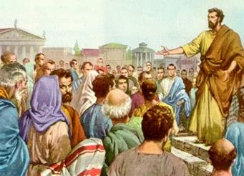
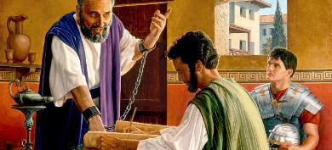
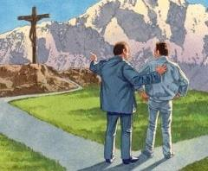
UKULETHA ITHEMBA
“engaba yisikhonzi sakho ngokobuphathi obuvela kuNkulunkulu enganikwa bona ngenxa yenu, ukugcwalisa izwi likaNkulunkulu,” (Kolose 1:25)
Njengoba sibonile, icebo likaNkulunkulu lokusindiswa kwethu lisekelwe ekufeni kukaJesu futhi lihlanganisa ukulungisiswa lokungcweliswa kwethu. Kodwa kulento ebalulekileyo eyayisilela: ngendlela ethize, sidinga ukwazi lolu hlelo ukuze silwamukele. Sidinga umuntu ozosambulela.
Kulapho “ukuqondisa kukaNkulunkulu” [indlela kaNkulunkulu yokuhlela izimo, imicabango, abantu, njalonjalo.] kungena khona, uPawulu ayeyisikhonzi sakho (Kol. 1:25).
UPawulu wajabula ngokuba yingxenye yalelisu, ngokuba lalidonsela izinhlupheko, (Kol. 1:24). Kusukela ekubotshweni kwakhe eRoma kuze kube sekufeni kwakhe, wabhala okungenani izincwadi eziyisikhombisa kwezilitshumi nane ezilondolozwe eTestamenteni Elitsha.
UPawulu wayeyingxenye ebalulekileyo yecebo likaNkulunkulu, futhi wajabula ngalo. Lathi singaba ingxenye yalolu hlelo ngokuholela abanye olwazini ngoKristu. Lokho kuyinjabulo yethu!

Slide 9

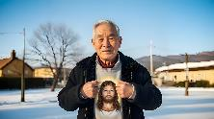
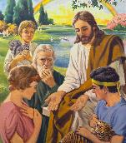

IMFIHLAKALO KANKULUNKULU
“imfihlakalo ebifihliwe kusukela ezikhathini zasendulo lasezizukulwaneni, kepha manje yembulwe kwabangcwele bakhe” (KwabaseKolose 1:26).
UPawulu ukhuluma ngemfihlakalo eyembulwa ebandleni ngemva kokuvuka kukaKristu (Kol. 1:26). Kuze kube yileso sikhathi, kwakulokuthitshazi nje ngakho. Kodwa iyini le mfihlakalo? “UKristu kini, ithemba lenkazimulo” (Kol. 1:27).
Yasungulwa ngaphambi kokusekelwa kwezwe ( 1 Petru 1:20 )
Ingxenye yadluliselwa ezingelosini (1 Petru 1:12)
Umbono wokuqala wanikezwa ngo-Adamu no-Eva (Gen. 3:15)
Kwembulwa kubaprofethi (1 Petru 1:10-11)
UJesu wembula okokuqala kumaJuda ( Mt. 15:24 )
Khona-ke kwembulwa ngokugcwele kubo bonke abantu ( Kol. 1:27 )
Kuselezigaba okufanele zembuleke kule mfihlakalo. Manje siphila ethembeni lokukhazinyuliswa. Yeka ushintsho! Yeka imfihlakalo! Abantu abalesono bayalungisiswa, bangcweliswe, futhi bakhazinyuliswe ngegazi likaJesu elihlengayo. Le mfihlakalo izoqhubeka lokuba isifundo kuze kube phakade.

Slide 10

AMANDLA EVANGELI

Slide 11

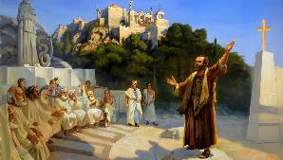
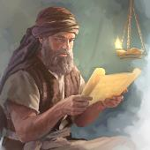
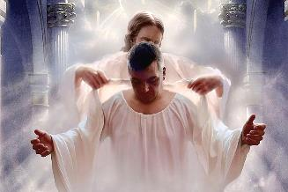
UKUMEMEZELA IVANGELI
“Sitshumayela yena, sixwayisa wonke umuntu futhi sifundisa wonke umuntu ngokuhlakanipha konke, ukuze sethule wonke umuntu ephelele kuKristu Jesu.” ( Kolose 1:28 )
UPawulu walitshumayela kanjani ivangeli? Inhloso yokutshumayela kwakhe kwakunguKristu obethelwe esiphambanweni (1 Korinte 1:23). Lapho abantu sebemamukele uJesu, wabayala futhi wabafundisa baze baphelele (Kolose 1:28-29). Wakwenza njani lokhu?
Wabachazela imfundiso yobuKristu lokwenza (2 Thesalonika 2:15)
Wabaxwayisa ngempumela yokulahla ivangeli ( Heb. 10:25-29 ).
Wabaxwayisa ngezingozi zabafundisi bamanga ( IzEnzo 20:29-30 )
Yima kancane… ubenze baphelele? Futhi hatshi abambalwa nje… “wonke umuntu”! ( Kol. 1:28b ).
Igama lesiGreki elihunyutshwe ngokuthi “ukuvuthwa” (teleios) litsho ukuphelela lokungenasici. Ngenqubo yokukhula kobuKristu, sikuqaphela ngokujulileyo ukujula komthetho kaNkulunkulu lezimfuneko zawo. Ngakho-ke umgomo wethu uwukuba siphelele kuKristu Jesu.

Slide 12

“Uma sibheka uMhlengi obethelwe esiphambanweni, siqonda ngokugcwele ubukhulu lencazelo yomhlatshelo owenziwe nguMkhulu wezulu.Isu lensindiso liyakhazinyuliswa phambi kwethu, futhi umcabango weKalvari uvusa imizwelo ephilayo lengcwele ezinhliziyweni zethu. Ukudumisa uNkulunkulu leWundlu kuyoba ezinhliziyweni zethu futhi ekukhulekeleni okungelakukwazi ukugcina umphefumulo wethu uhlanzekile ezindebeni zethu; izigcawu zaseKalvari.”
EGW (The Desire of Ages, p. 661)

