Slide 1
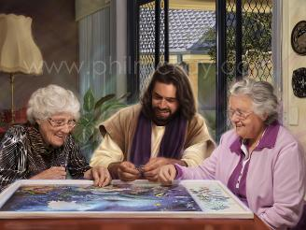
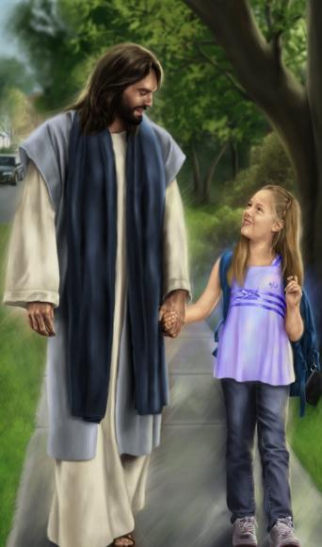
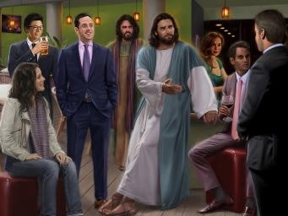
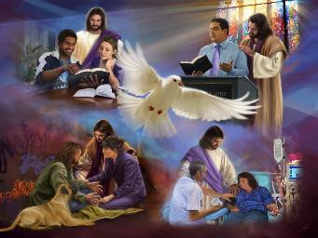
UKUPHILA LOKRESTU
Isifundo setshumi lanye kuMbimbitho ilanga letshumi lane ku2026

Slide 2

“Phezu kwazo zonke lezi zimfanelo yembathani uthando, oluyisibopho esipheleleyo ebunyeni.”
Kolose 3:14

Slide 3

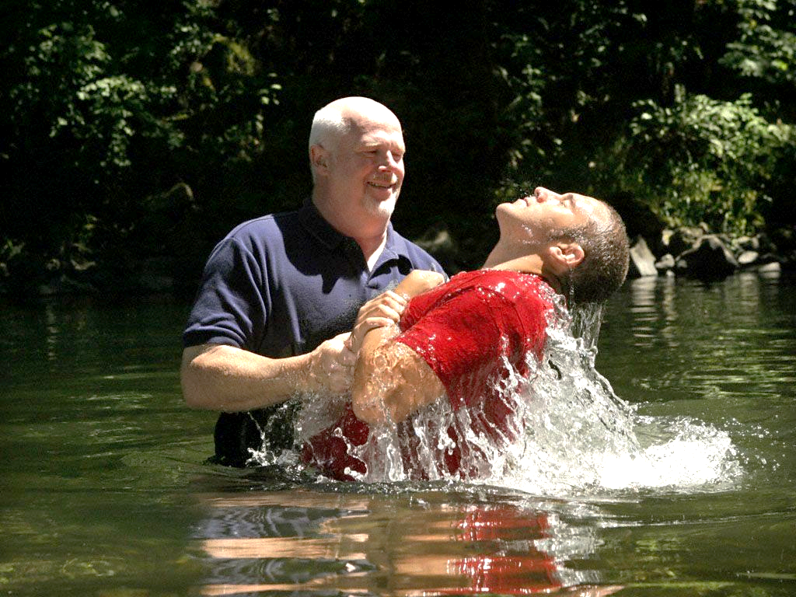






Uma singcwatshwa emanzini ombhapathizo, siyafa empilweni yethu endala yesono. Lapho siphuma emanzini, sikhuphuka njengezidalwa ezintsha.
Sayitshiya indlela yethu yakudala yokuphila lokucabanga. Kusukela lapho, saphila ngendlela ehlukileyo futhi sacabanga ngendlela ehlukileyo. Sayeka ukuba lomqondo wasemhlabeni futhi sazuza umqondo wasezulwini.
Ngesizathu esithile, izindlela zethu zakudala zilokhu zizama ukuvela futhi. Kungakho umphostoli uPhawuli esikhuthaza ukuthi sibeke amehlo ethu ezulwini, sifulathele izinto zasemhlabeni.
Umqondo wasemhlabeni loba owasezulwini?
Ukugxila kwethu (Kolose 3:1-4)
Ukufa ezintweni zasemhlabeni (Kolose 3:5-6)
Ukuzembathisa okwasezulwini (Kolose 3:7-11)
Izimo zempilo entsha kuKristu:
Isibopho sokuphelela (Kolose 3:12-14)
Ukudla kwasezulwini (Kolose 3:15-17)

Slide 4

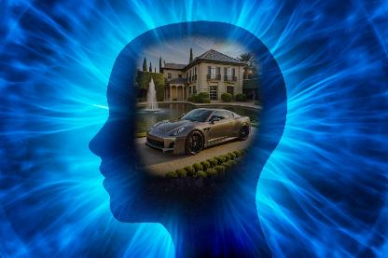
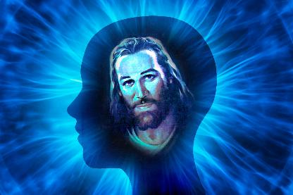
UMQONDO WASEMHLABENI LOBA OWASEZULWINI?

Slide 5

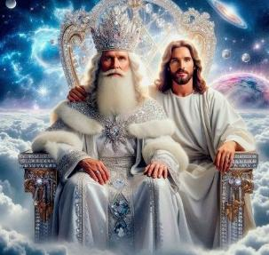
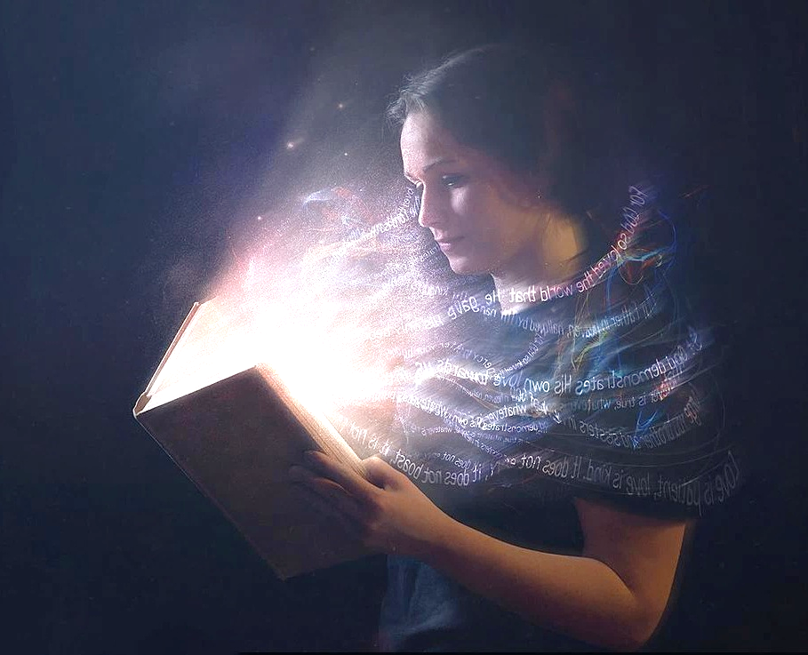
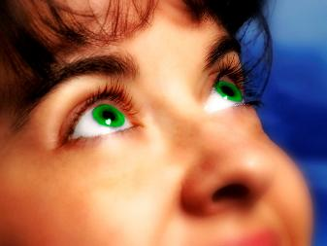
UKUGXILA KWETHU
“Bekani izingqondo zenu ezintweni zaphezulu, hatshi ezintweni zasemhlabeni.” ( Kolose 3:2 )
Eqala emcabangweni wokuthi savuswa kanye loKristu ngokubhapathizwa (Kol. 2:12), uPawulu usikhuthaza ukuba silandele uJesu siye endaweni aya kuyo ngemva kokuvuka kwakhe: isihlalo sobukhosi sikaNkulunkulu (Kol. 3:1).
Kunjalo, sizakwazi kuphela ukwenza lokhu ngokwenyama lapho uJesu esiyisa lapho ekuBuyeni kwakhe kwesiBili (Kol. 3:4). Okwamanje, kufanele sigxilise amehlo ethu—umgomo wethu—ezintweni zasezulwini (Kol. 3:2).
“Sesifile,” futhi ukuphila kwethu “kufihliwe loKristu kuNkulunkulu” (Kol. 3:3). Impilo okukhulunywa ngayo lapha yileyo esiyitholayo uma sisamukela uKristu.
Kodwa leyompilo, ukuze siqhubeke siyiphila, idinga ukondliwa nsuku zonke (2 Kor. 4:16). Nsuku zonke kufanele sifune “izinto zaphezulu,” “sigxilise amehlo ethu kuJesu” (Heb. 12:2 NIV).

Slide 6






UKUFA EZINTWENI ZASEMHLABENI
Ngakho bulalani konke okwemvelo yenu yasemhlabeni: ubufebe, ukungcola, inkanuko, izifiso ezimbi, lobuhwaba, okuyikukhonza izithombe.” ( Kolose 3:5 )
Njengoba sivusiwe kanye loKristu futhi siphila sicabanga ngezasezulwini, kufanele sibulale lokho okusivimbela ekufezeni umgomo wethu: owasemhlabeni.
Ukuze kungabikhona muntu olephutha, uPawulu uveza izinsika eziyisisekelo zokucabanga kwasemhlabeni (azozithuthukisa kamuva ngamaphuzu aqinileyo): “ubufebe, lokungcola, lenkanuko, lezifiso ezimbi, nokuhwaba, okuyikukhonza izithombe” (Kol. 3:5).
Imvelo yomuntu ayikashintshi kangako kusukela ngesikhathi sikaPawulu, njengoba sisazungezwe zinkanuko ezifananayo ezephula kokubili incwadi lomoya weMithetho Elitshumi.
Futhi kungani kumele ‘sibulale’—silahle, sisuse—lezi zinto emicabangweni lasezenzweni zethu? Ngoba ziletha “ulaka lukaNkulunkulu” futhi ngenxa yalokho azihambisani lemvelo yethu yasezulwini (Kolose 3:6). Bulala okwasemhlabeni ngaphambi kokuthi okwasemhlabeni kubulale!

Slide 7




UKUZEMBATHISA OKWASEZULWINI
“lembathe umuntu omutsha, owenziwa musha ekwazini ngomfanekiso woMdali wakhe” (Kolose 3:10).
Ngendlela yesaga sangempela, uPawulu ulezela ezinsikeni ezinhlanu zokucabanga kwasemhlabeni izenzo ezinhlanu zasemhlabeni okufanele zivikwe: “intukuthelo, lolaka, lenzondo, lokuhlambalaza, lenkulumo ehlambalazayo” ( Kol. 3:8 NIV ), futhi uphetha ngesenzo sesithupha—esibi kulazo zonke—: “Lingaqambelani amanga” ( Kol. 3:9 ).
UPawulu uthatha ngokuthi sesivele “njengoba senikhumule ubuntu benu obudala kanye lemikhuba yabo” (Kol. 3:9 NIV). Sikhumule “izingubo ezingcolile” lapho sivumele uJesu ukuba asuse izono zethu (Zak. 3:4 NIV).
Lapho sikhumula lezo zingubo, kudingeka sigqoke “izingubo ezinhle.” Sembethe lezi zingubo ezintsha, sivuselelwa ngokuqhubekayo, sikhula ebungcweleni usuku losuku (Kol. 3:10).
Njengoba sivuselelwa ngomsebenzi kaMoya oNgcwele kanye lokufunda iZwi, imigoqo esihlukanisayo iyanyamalala (Kol. 3:11).

Slide 8


IMPAWU ZEMPILO ENTSHA KUKRISTU

Slide 9
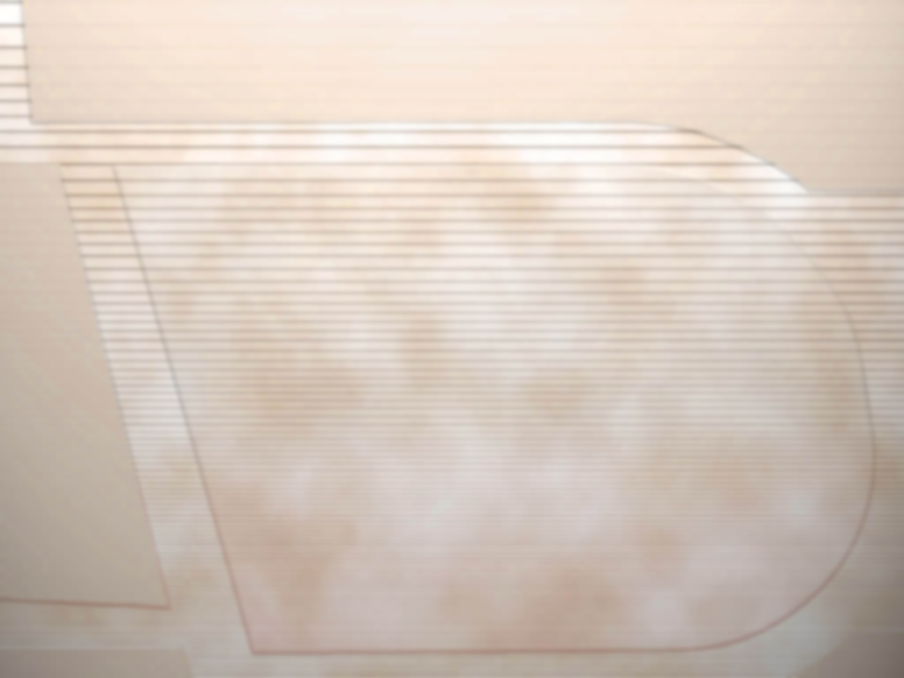
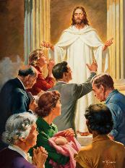


ISIBOPHO SOKUPHELELEYO
Futhi phezu kwakho konke lokhu yembathani uthando, oluyisibopho sokuphelela” (Kolose 3:14“)
Singabantu “abakhethiweyo bakaNkulunkulu, abangcwele labathandwayo” (Kol. 3:12 NIV). UPetru usitshela ukuthi lokhu kusilethela izinzuzo ezinkulu kanye lomthwalo wemfanelo omkhulu ( 1 Pet. 2:9 ). Kodwa uziphatha kanjani omunye wabakhethiweyo bakaNkulunkulu (Kol. 3:12-13)?
1
2
3
4
Ngomusa othobileyo
Ngomusa
Ngokuzithoba
Ngobumnene
Ngokubekezela
Libekezelelana
Ukuthethelelana
5
6
7
Futhi konke lokhu ngaphakathi kwenjongo yesibopho sokuphelela: uthando (Kol. 3:14). Futhi lezi zinzuzo lezibopho zethu:
INZUZO
UMTHWALO
Ngokuziphatha ngale ndlela, siyisibusiso kwabanye lakithi.
Kwangathi ukuziphatha kwethu kungakhazimulisa uNkulunkulu, futhi kwangathi kungakhuthaza labanye ukuba bakholwe kuJesu futhi bamlandele

Slide 10


UKUDLA KWASEZULWINI
“Izwi likaKristu alihlale phakathi kwenu ngokucebileyo, lapho lifundisana futhi lilayana ngakho konke ukuhlakanipha ngamahubo, lezihlabelelo, lamaculo kaMoya, lihubela uNkulunkulu ngokubonga ezinhliziyweni zenu.” ( Kolose 3:16 )
KwabaseKolose 3:15-17 usikhombisa indlela yokondla imvelo yethu yasezulwini (futhi kuvele ukuthi ngeke sikwazi ukuyondla sodwa, kodwa sidinga ukuhlanganyela kwebandla kulokhu):
Ukuvumela ukuthula kukaNkulunkulu kusibuse
Ukuhlala ngazwi linye njengomzimba owodwa
Ukubonga
Ukuhlolisisa iBhayibheli kakhulu
Ukufundisana esikufundileyo
Ukuhlabelela amahubo, izihlabelelo, lezingoma zakomoya
Ukwenza konke ngegama likaJesu
“Ingoma iyisikhali esingasisebenzisa ngaso sonke isikhathi ngokumelene lokudumazeka. Njengoba ngaleyo ndlela sivula inhliziyo ekukhanyeni kwelanga lobukhona boMsindisi, sizoba lempilo kanye lesibusiso saKhe, "(Ellen G. White, "The Ministry of Healing," p. 254).

Slide 11
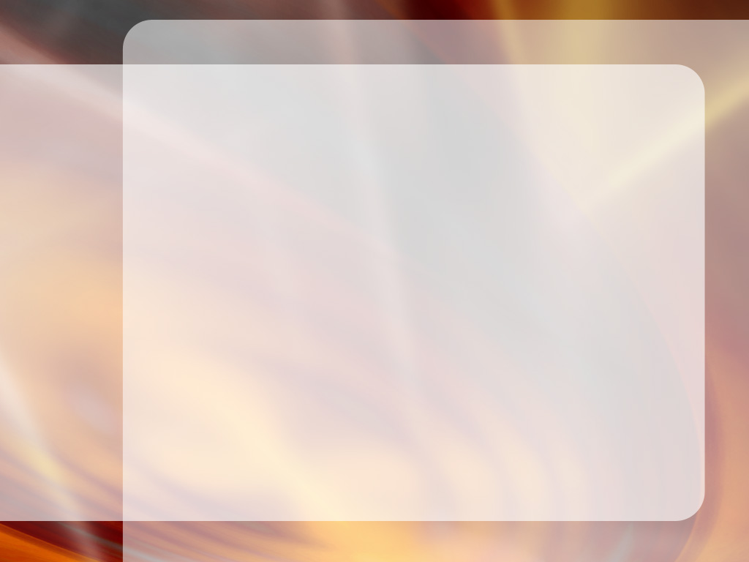
“Hlakulela inhliziyo elomusa, emnene, elozwelo, futhi ungalokothi ubize lezi zimfanelo ngobuthakathaka, ngoba ziyizimfanelo zikaKristu. Qaphela indonsela yakho. Ma ube ngolesimilo esimsulwa futhi esilephunga elimnandi kangangokuthi awusoze waba lamahloni ukuthi siphinde sivele kwabanye.
Njengoba amathonsi amanzi esenza umfula, kanjalo lezinto ezincane zakha ukuphila. Impilo ingumfula, ilokuthula, izothile, futhi ingethokozisayo, loba ingumfula olezinkathazo, ohlezi ukhipha udaka lokungcola. Kulempilo ungazibeka ngaphansi kwesiyalo sikaMoya oNgcwele. Ngokungcweliswa kukaMoya ngalokho uzokhula kakhulu njengoKristu.
EGW ( That I May Know Him , July 22)

