Slide 1
K&R INTE JSS K&&R% DIAAL
Xiic 1 Du`t 6, 2024

Slide 2
“K` cu k7r tusk nhial. Cu Mi-ka-el kvnv j11kv nyi22ny kv nyax in d55t, min cu k7r tvr kvnv j11kv. K` duundv f66cua nyax pu]t, k` cuv cu thil gu11th kv ku5divn nhial.” (Nyuuth 12:7, 8, NKJV)

Slide 3
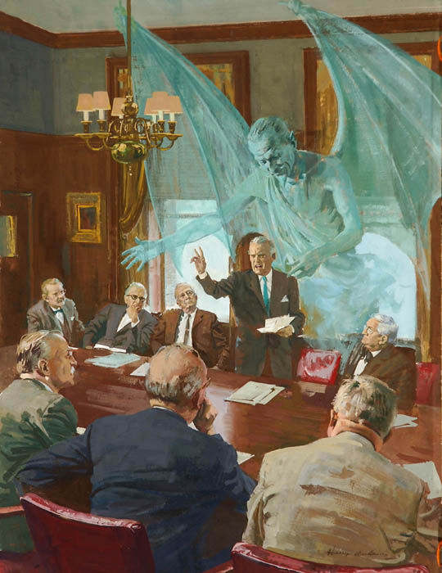
Ciexksn v t` ksn rvy k77r mi baap ni fsw kvvliw. V c`x /ci jv x`c, kiv /ci jv x`th vn f66 derv tu]]k, vn k7r tee thin ala thusk.
Kvn bum tin nyieny kv bum yi22k`, ti /ci ksn kv nvvn (Vpv. 6:12). Duxdv f66, j`k ksn rik tin n66x k7r vmv kv. D1k, ciax dueeri, li11…
Mvn t` rvy rik` v ku``r Kusth, luth j11kni kv mu]n tin /k`n p00n. Vn walv ludu kvnv luthd` t` kvn rvy rik`.
Tuk K77r
L6k Ruac Kusth R77l Nhial
L6k Ruac Kusth wi mu]]n
Cu nh6k gu11th j`k
K7r vn walv

Slide 4
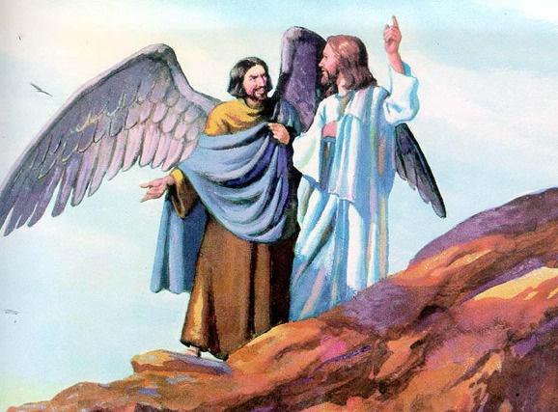
TUK K&&R
“Kä curi thil bɛ̈l rɛy duɔ̱pniku nikɛ cäŋ ëë cakɛ ni ji̱, cu mäni mëë ca duer jek kä ji̱” (Yɛdh-ki-el 28:15)
Kv thu]k, rvy kak` k` E-dvn, cuv t` kv mi cu Iib com kv f66 cv riet Kusth dee lusth, mi nyooth f66 l6k Ruac Kusth cv tusk v /k`n raan ni t` wans. (Tuk. 3:1).
Ci Yecu ram vmv csl 5 v jvn mvn piith thivl x`th` rvy xsaani tin ci Kuoth kv cak v jvn “gua̱n tɛ̈r” cv jv nyoth vn f66 v jɛn gua̱n jiäkni (M0th. 13:39).
Thiec vn nhiam vn dee ksnv thiec ni rsdan v f66: Kuoth v jvn cak gu1n jiakni ms, mi lot ni f66, ci Kuoth ji`k mi tek cak?
Ci Bay-bol v l1t ksn vn f66 gu1n ji`kni v j``k mi csali Lu-thi-per (I-ca-yaa. 14:12). V jvn j``k vn thi`x kv pvl k` r7x gssydv (Yvdh-ki-el. 28:12). Cua jv kapni nhial gu11th vn g66r j11k diaal ni jv: caa jv lvy ala g``x (Yvdh-ki-el. 28:13-14).
Mi thivlv Lu-ci-per bvvl, cuv kulv ben ala gu1n ji`kni idi? Cu k7r kulv tussk idi k1mdv kvnv Kuoth? Ci Kuoth v moc kv mek v l]r c3tni kv tin ksx tin ci Kuoth kv cak. K` kv du]]p mi /caa dee lu`x kv lat, ci lu-ci-per, mvk ni f66 bv thiay, k` cuv g6r ni f66 derv nyuur wii ksam Ku`r` Kusth (Yvdh. 28:15; Ica. 14:13-14).

Slide 5
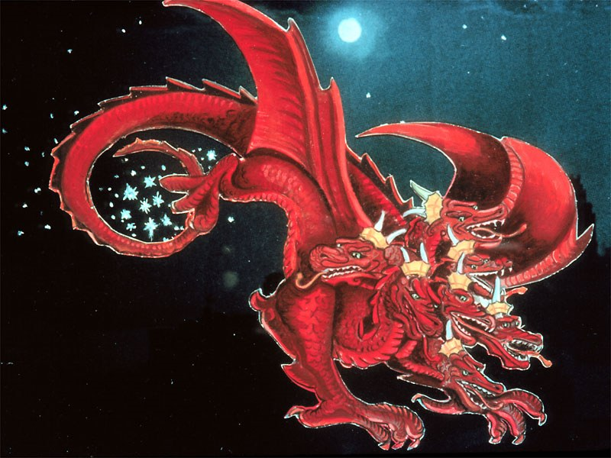
L^K RUAC KUSTH R&&L NHIAL
“Cu juälɛ pek ciɛri in diɔ̱ɔ̱kdiɛn nhial rol, kä yorɛ kɛ piny wi̱i̱ muɔ̱ɔ̱n…” (Nyuuth 12:4a)
Kv g6rv kv m1c ksaam Ku`r` R77l Nhial, cu Lu-ci-p`r diw jaa tusk k` j11k kv ku5 Ku``r` Kusth mvn luk kv cu]]x. A /ci kvn ku l1ar kvn diaal? V xu dee raan rsdv lu1r xut ti bvc bvvc, ti /ci cu]x l`th gu1thdv, ti thivl gu5r?
Cu Lu-ci-p`r cu1 Cvy-tan mvn la g66ny (Nyuuth. 12:10; I-yob 1:6, 9-10). Cv dup diaal l6k, dup tin ci Kuoth v csl kv kv, kv f66 derv lscdv gvr l6k.
Ci ciax nyussni cop ni k` f66 baa k7r mi jsc, k7r mi bi j11k diaal dhil mvvk rvydv. 1/3 k` j11k ci kvn gu]]r ni Cvy-tan, ci tin ci dusth xot kv mi luth kvn ni Kuoth (Nyuuth. 12:4a).
Vn k7r xotdv thin m`ni t`mv. Cvy-tan xotdv kv mi l`tdv. Th6tdv nvy diaal k` f66 dee kvn Kuoth nyusth ciax nyussni. Kv ku5c d1x rvw k` rs t` thin ts. Nvy tin g6rkv f66 bi kvn xut Kusth lu]th, kiv nvy tin l6kv kv. Vn mek v duxdan (Xut. 30:11, 16, 19; Js-cua. 24:15).

Slide 6
“Dee Kuoth vn leny Busmdv ti diaal gu1n m00td` nvmv yusr piny k` kvvl R77l Nhial; duxdv f66 vn nvmv /civ jvn ciaxdv. Cuv tin ci l6k ruacdv nyoth moc kv bax ti p``r kv themdivn kv busm kvnv lu1xdivn kv gatdv kvnv j11k tin lusthkv jv. Rvy k77r vmv bi j11k diaal dhil mvvk kv ku5c vn bi raan t` thin k` baa jv nyusth kvn diaal. […] Mi ci Kuoth bu]mdv cu l1th l`t kv duecdv kv b66th vn took nyusth l6k ruacdv, /ci j11k tin cv y1r dee rsdivn dee nyoth; kv f66 ns, ci Kuoth mvk ni du]]p mi dsx, kv f66 bv nyusth tin ciex R77l Nhial v jsc vn th6pnidv kv cu]]x kvnv lukdv.”
EGW (Lvx Luel, p`c. 17)

Slide 7
L^k RUAC KUSTH W5 MU}}N
“Mëë ci Kuoth mɔmɔ liŋ, cuɛ wut cu thi̱ec i̱, “Ɛŋa mi lär jɛ ji̱ ɛn ɣöö thil ji̱ kuum? A ci ku mi̱th jiaath ëë cä ji̱ luek thi̱n?’” (Tuk 3:11)
Kuoth cv j11k cak rvy gu1th mi thivl duer, gu11th mi rvl rs. C3tkv j11k, ci Kuoth raan cak rvy gu1th mi rvl rs, mi lsr k` duer (Tuk.1:31).
C3tkv mee cv radv l11t k` jaak, ci Kuoth ksn cak b` kv lu1x mek` v lsr. Kv f66 ns, A-dam kvnv Iib dee kvn lsar vmv l1th l`t, cv k1mni kv gu5r mi thiak thiak: “/cu mi̱th jiaath in jak raan kä ŋäc mi gɔaa kɛnɛ mi jiäk” (Tuk. 2:17).
V jvn du]]p vms k` rsa dee Cvy-tan kv jak` bi kvn t` kv diw kv jv ms. Kv du]]p m00td`, cuv mvn g66rv j`k. cu A-dam kvnv Iib Kuoth cu diw, cukv Ruacdv cu l6k, k` cu kvn cu jivn k` gu11th vn took tek rsdv thin (Tuk.3:6, 9-13, 19). Cu A-dam duer cu lep bap kv f66 bv ben rvc, k` cu li11 cu ben k` nvy diaal (R6m. 5:12).
V tookv niv gu11th vms, ci ksn cu ciex rvy fsaa mi ci thiax kv bvvc, juey kvnv li11. Cuc ksn diaal kv ku5 duir` A-dam?
Kvl kvvli cuc rams kv ku5 du5r`dv: “ci kɛn diaal duer, kä pɛnkɛ a ciɛk kä gɔɔy puɔnyä Kuɔth” (R6m. 3:23).

Slide 8
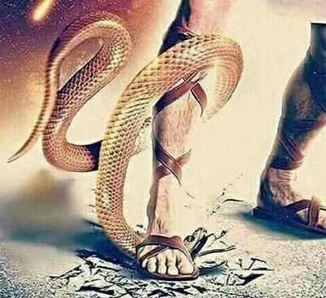
CU NH^K GU!!TH J~K
“Te nhök rɛy kä nɛmɛ, /ciɛ ɣöö nhɔaknɛ Kuoth, kä ɛ ɣöö nhɔk Kuoth kɔn, kä cɛ Gatdɛ ja̱k ala muc mi luɛlɛ ni dueerkɔn” (1 J]]n. 4:10)
V xotdv /k`n Kuoth raan ni l1t f66 v xu bi tu]]k k` jv ms kv ksr duir`, cuv A-dam kvnv Iib l1t c1p k`n` mvn cv rialik` kv ku5divn (Tuk.3:15).
Ci raan rsdv cu d11k kv c``kdv v nhsk jvn. Duxdv f66, /k`nv g6r ni f66 bv gaatkv tin ci civ p1l w`, cuv nyusthni kv ciaxdv min thu]k kv nyuthdv kv nh6kdv min thusk, nh6k mi b``l x1thdan (J]]n 3:16).
Li11 /cv bi a jvn la guut j5 dueeri. Ci Yecu nh6kdv nyoth kv yorv piny kv mvn g6rkv, kv th6pnidv kv tekdv (R6m. 5:8).
Thivlv du]]r k` ksn mi dee ksn jak` rsx kv nh6k vn ci Kuoth v nhsk ksn. Duxdv f66, kv rivm vn ci k` k`l-b`-ri, ci Kuoth ksn ji6k 5: “Nhsak` J5.”

Slide 9
CU NH^K GU!!TH J~K
“Te nhök rɛy kä nɛmɛ, /ciɛ ɣöö nhɔaknɛ Kuoth, kä ɛ ɣöö nhɔk Kuoth kɔn, kä cɛ Gatdɛ ja̱k ala muc mi luɛlɛ ni dueerkɔn” (1 J]]n. 4:10)
Ci Yecu ksn nyusth nh6kdv idi?
Yecu cv xsaani diaal tin t` wans cak (J]]n. 1:3)
Cuv ben ala mi cakvni jv (J]]n 1:14)
Cv ret kv rvy k` ti bu]m bu]]m, cu]c busth, kvn bvc pu1ny, c3tkv ksn (I-ca-yaa. 53:3; Mak 11:12)
Caa jv f]n c3tkv ksn (Fib-ru. 4:15)
V xotdv v gu1n cuxni cuv nhsk ni cu]c kv ku5 dueeriksn (1 Pi-tsr. 3:18; J]]n 10:17-18)
Kv li1dv kvnv jiecdv kv rs lith, cv jv nyusth ksn vn f66 t` ksn kv tek mi thivl pek Rvydv (R6m. 6:3-4)
L`tdv ti diaal titi kv nh6k (1J]]n. 4:10)

Slide 10
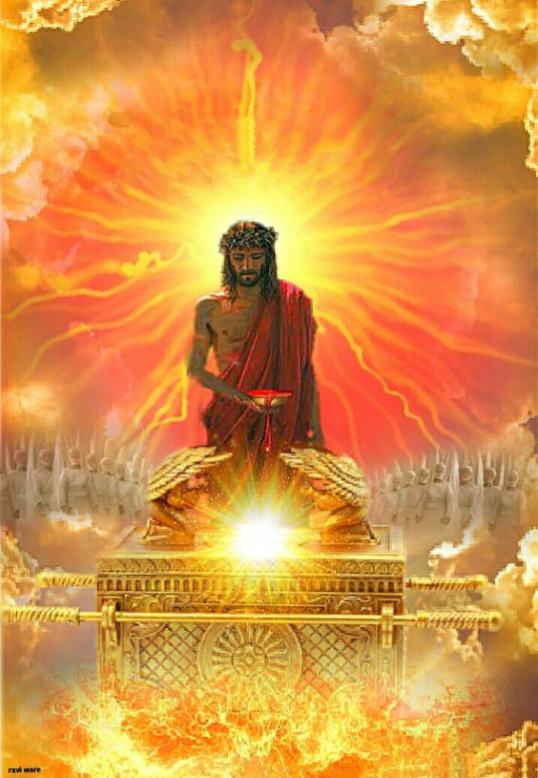
K&R VN WALV
“Kɛ kui̱ ɛmɔ tëëkɛ lua̱ŋ gua̱thni diaal kɛ ka̱n nɛɛni tin bä kä Kuoth kɛ jɛ, kä tëkɛ ni ciaŋ kɛ ɣöö bɛ la̱ŋ kɛ kui̱diɛn.” (Fib-ru 7:25)
Vn walv, l`t Yecu kv ku5dan rvy Luak Kusth vn t` R77l Nhial (Fib-ru. 9:24; 7:25).
Kv ku5 rivmdv min ci l66ny jss jiath vn gvvr, cux Yecu kv gu11thdan nhiam Gu1n – kvnv nhiam xsaani diaal tin ciaxkv fsw vms – cuxv kv gu1thdan ala nvy ti j5 cuxni, ti wic wiic, ti r7x kv f66 dee kvn t` kv gu11th R77l Nhial.
Kv f66 ns, caa ksn ci6l kv f66 dee ksn ben thiek` Kusth v thivl dual kv Yecu (Fib-ru. 4:15-16).
Yecu g6rv f66 dee ksn x`th ni jv kv xsaani diaal tin g6r ksn kv rvy teek`dan (J]]n. 14:13-14). Gu1th vn t` dual thin, bv ksn n66x mal; gu1th vn t` kueth thin, bv ksn n66x p`lik`; gu11th vn t` nyu``n thin, bv ksn n66x busm.
Mvn g6r Yecu v vlsx v f66 derv ciex kv ksn kvvl kv tek mi d7raar (J]]n. 17:24). Vn nvmv v jvn g6ri ms b`?

Slide 11
“Kv gu11th vn ci f]]ni ben k` j5, mvn cv jssc c3tkv mi ci t55t, nusn c`ri, kvnv muth tieydu g6l piny, g6rni gu11th ee nvvni buay thin kv gu1th vn jsak. L]xni rvy nh66k` Kri-tho piny titd` g1xdv. Gu11th vn ku5r duer kv f66 derv lsc ruac, gu11th vn miit kueth du5r` tiey k` r5kv l]ar, kv gu1th vn ci thivl x`th` c1r kum, timv vn f66 pusth baax Kritho r7xv kv f66 bv duer tiam k` bv muth woc. W`dan rvy matd` kv K``n, naxv ksn rvy ciex mal`."
EGW (L1t loc` gsy`, P`c. 193)

