Slide 1
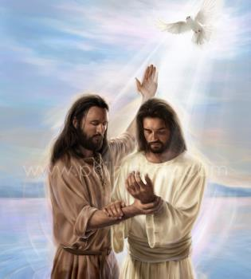
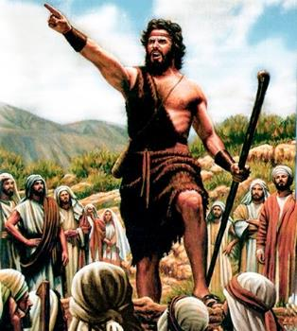
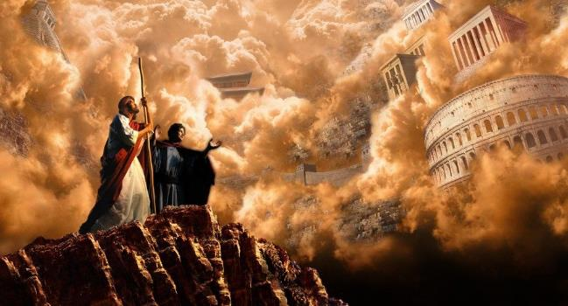
Tuk Thukn5 Kusth T5 Gsw
X55c 1 Th77r 6, 2024

Slide 2
“Täämɛ mëë ca Jɔ̱ɔ̱n yian, cu Yecu wä kä Gɛ̈-lɛ-li, latdɛ thuk Kuɔth ti gɔw, cuɛ wee i̱, ‘Ci gua̱a̱th cop, kä ci ciaŋ rui̱cä Kuɔth thia̱k. Rietdɛ rɔ̱ dueerikun, kä ŋa̱thɛ thuk Kuɔth ti gɔw’”
(Mak 1:14, 15, NKJV)

Slide 3
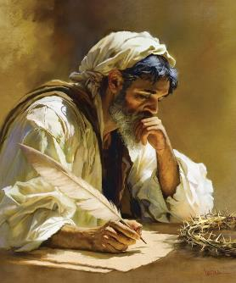
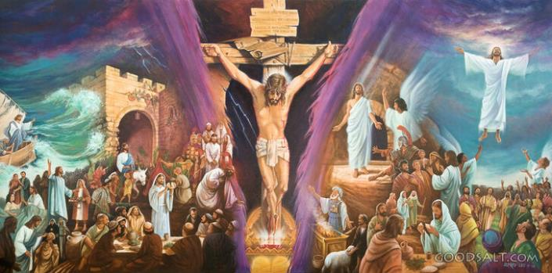
Thuk Kusth tin gsw tin caa gsr v Mak v kvn tin ku5ynikvn k` thuk Kusth ti gsw d1x xuaan tin latkv tek Yecu.
V l0x m5 pvth, m5 bum, gvrs, k` caa cox kvvl. Vn min l``t rsdv mvvrv nhiam w`xniksn. Thivlv dusr kvl mi dee raan v b1ny j]]r, c3tkv m5 caa gsr ni xsaani tin te kv lust k` rsdivn.
V civk, Mak v bok thukni Kusth ti gsw kv ku5 21 thvn-cuv-ri, gu11th in tu]]k ti diaal kv pvth kv pvth, k` thaak v yi6w. Cvnv thaak kiv gu11th vms l11t kv ku5 x`c` du]]r` min t` kv lust mi d55t: “thuk Kusth ti gɔw kɛ kui̱ Yecu Kritho, min la Gat Kuɔth.” (Mak 1:1).
Ram in gssr Thuk Kusth ti gsw:
L``t Ruac Kusth m5 c5 Th6l.
T22 lust kv ku5 l1t Kusth.
Tuk Thukn5 Kusth T5 Gsw:
Rialik`. Mak 1:1-8.
Boony. Mak 1:9-13.
Thok in latkv. Mak 1:14-15.

Slide 4
RAM IN GSSR THUK KUSTH TI GSW

Slide 5
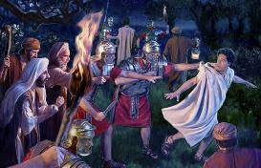
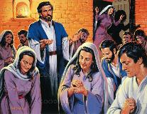
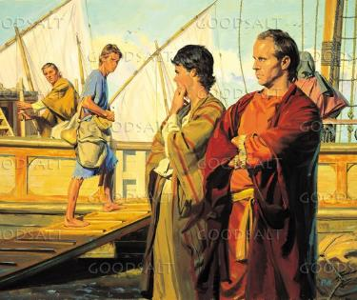
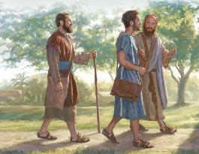
L~~T RUAC KUSTH M% C% TH^L
“Cu Bar-na-bäth kɛnɛ Thɔɔl loc jɔk kä Jɛ-ru-tha-lɛm mëë ci la̱tdiɛn thuɔ̱k, kä cukɛ Jɔ̱ɔ̱n in cɔal i̱ Mak naŋkɛ kɛ kɛɛl.” (Lät 12:25)
C3tkv l11t ruac Kusth tin ksx, /ken Mak rsdv kvk kv ci6tdv jvn k` rsa. V dh6l kv gu11th ee l``t titi rsdivn kv jv, min dsx jak jv k` jek v xiic vmv kv ku5 thieek`dv vlsx kv j``k ni P5-tsr (1 P5-tsr. 5:13).
Man J]]n Mak v jvn la gu1n gu11th in laa c56c v r6m thin k` Jv-ru-tha-lvm, min laa kvn rsdivn v dol kv pal kv ku5 yieen` P5-tsr (L`t 12:12).
Kv gu11th m5 civk vlsx kv ksrv, cu Bar-na-b`th kvnv Thssl (Tee ci w` k` Jv-ru-tha-lvm kv f66 bi kvn muc w` n77x) cu kvn J]]n Mak nax k` Vn-ti-sk (L`t 12:25).
K` Vn-ti-sk, gu11th ee ci Y522 in Gsaa in Rvlrs Bar-na-b`th kvnv Thssl csl kv ku5 lat Ruach Kusth rvy Juri, cu kvn J]]n Mak nax kv rsdivn kvvl v laa l``t kv kv kvvl (L`t 13:2-5).
Duxdv f66 ciax raam m5 l``t Ruach Kusth caa jv nyoth vn f66 cv b00c kv Mak rvy xuvvtd`dv, mee cuv car ni f66 bv loc k` Jv-ru-tha-lvm (L`t 13:13).

Slide 6
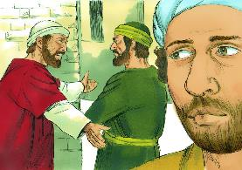
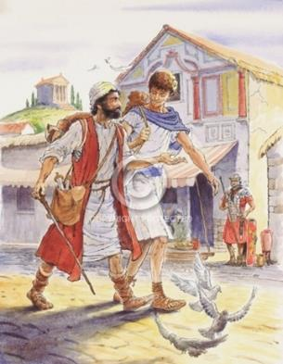
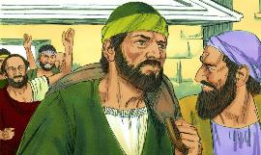
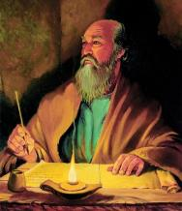
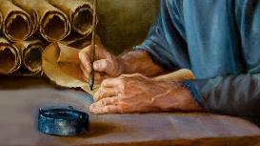
T@@ LUST KV KU% L!T KUSTH
“Ɛ Luk kärɔaadɛ tekɛ ɣä kɛɛl ɔ. Käni Mak, kä no̱o̱ŋni jɛ kɛ ji̱ kɛɛl, kɛ ɣöö derɛ ɣä ben luäk kɛ la̱tdä” (2 Ti-mo-thi 4:11)
Kv gu11th ee ci Pusl j1l latd` Ruac Kusth in rvwdv car, cuv jv l6k vn f66 derv Mak nhsk 5 baa jvn ram in bi kvn j1l kvvl (L`t 15:36-38). G6r Pusl ni lu``k mi bum, m5 bi lu`k ni jv v /cv bi a f1c k` jv. Mak /cv titi thi`x.
Duxdv f66, x`c Bar-na-b`th v vn f66 gatnyiman/gatd`man ni Mak, tee kv lu1x m5 r7x kv f66 derv al``t ruac Kusth m5 gsaa. Kv f66 ns cuv Mak nax k` Ki-ti-yim kv rsdv kvvl, gu11th in w` Pusl kvnv Thay-l`th k` E-cia (L`t 15:39-41).
Ku5c ksn min ci tussk kv ksrv, duxdv f66, x`c ksnv vn f66 Bar-na-b`th l`tdv ni cu]]x. Kv gu1th d1x disk tin cv jv kvk thin rvy wargak`dv, cv jssc vn f66 ci Pusl v x1c vn f66 te Mak “kv lust kv l1t Ruac Kusth,” v la l``t kvvl mi te kv lust (Ko-ls-thi. 4:10; Pay-le-mon. 24; 2 Ti-mo-thi. 4:11).
V tvth lsaac kv ku5 baxni tin rvwdv, kv f66 vn walv cv ksn moc kv bax kv jakdv kv ksn k` f66 dee ksn tvth lsac jek k` thuk Kusth tin gsw tin caa gsr v Mak.

Slide 7
TUK THUKN% KUSTH T% GSWPEL

Slide 8
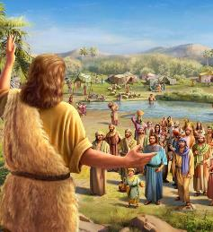
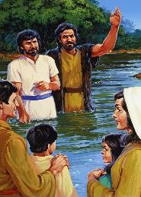
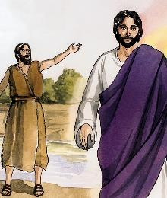
RIALIK~
“Kä cuɛ ruac lat, laarɛ jɛ i̱, “Ram mia̱ bëë kɔɔrä ni, bumni jɛn kä ɣä, a cäŋɛ läk wa̱a̱rikɛ /ci gɔɔydä ro̱ŋ i̱ dëë rɔ goŋ a bäkɛ lony” (Mak 1:7)
Mak tookv jv kv l`tdv kv ksn Kuoth kv rialik`dv kv du]]p gatdv (Mak. 1:1-2; Mɛ̈l-a-ki. 3:1). V j1l mi tu]]k ni k` gu11th lusk R77l Nhial, k` bv Yecu Kritho nax js jiath, kv f66 baa jv nysk kv lu]r v nysk R77l Nhial (Mak 16:19).
Kv riali du]p vmv 5k`, ci Kuoth J]]n in l``k mvvk, min la “jɔw raam mi cio̱t där dɔaar” (Mak. 1:3; I-ca-yaa. 40:3).
V xot ken Yecu J1lv ni took kv th6pnidv kv tekdv kv ku5dan, ci J]]n l6c naath rialik` kv nyuthdv kv naath riet dueeri kvnv ci77lidv kv naath k` f66 dee kv bu]]ny. (Mak 1:4-6).
Cv kv rialik` kv f66 dee kvn gat Kusth lor: min bumni jvn v lsx v leny J]]n pu]nydv; k` r7xni jvn v lsx; k` jvn bv naath busny kv boony in t` kv lust. (Mak 1:7-8).

Slide 9
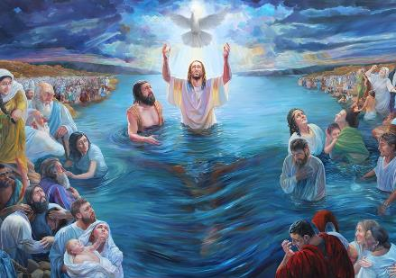
BOONY
“Kɛ ni̱n tɔ̱tɔ̱ cu Yecu ben kä Na-dha-rɛth, ro̱o̱l Gɛ̈-lɛ-li, kä cua jɛ lak ɛ Jɔ̱ɔ̱n kiir Jɔr-dɛn” (Mak 1:9)
Cu Yecu j1lv took kv du]]p m5 g``y naath: ci Kuoth in Gu1n v nyusth ksn v la Gatdv, k` cu Y522 in Gsaa in Rvlrsa rsdv nyoth nhiamdv kv pu]ny (Mak 1:10-11). V tookv ni tuk`dv, caa Yecu lat v la ram mi Kuoth, min la Gat Kusth. Duxdv f66 caa jv lat b` v la raan:
Caa jv busny v J]]n, v civ kv du]]p m5 dsx (Mak 1:9)
B6th kv jv v Y522 in gsaa in rvl rs (Mak 1:12)
Cuv te k` rsa kvnv Kuoth (Mak 1:13a)
Cu1 jv fsn v gu1n ji`kni (Mak 1:13b)
Cuv te kv r5k pu1ny (Mak 1:13c)
Cua jv l`tdik` v j11k
(Mak 1:13d)
Nvmv v jvn du]]p vn caa Yecu n7x ksn kv jv: v Kuoth v r7x k` v raan v r7x. V K``n k` v d`mandan, v Ku``r k` v c``t. V jvn nyuuth nh6k` Kusth m5 thi`x kv ku5 ran.

Slide 10
«Gssy Pu]ny` min te kv Kritho v m5 nyooth ni nh6k Kusth kv ksn. L`tdv ksn lu1x pal` - du]p in dee jsw ran j5th Kusth cop kv jv kvnv f66 ci l1xdan nh6k jek nhiam lusk R66l Nhial… Buay in b` raar thok th5`k in caa lvp min pvn w55 K``n`dan bv pvn k` ksn b` gu11th in palksn kv luek min dee ksn v tiam ni fssn. Jsw in ruac kv Yecu ji6kv tieyni diaal tin x1th 5, “Mɛmɛ ɛ jɛn Gatdä min nhɔakä, in tɛth lɔcdä kɛ jɛ.”»
EGW (Rvy gu1thni tin te R77l Nhial – ci Kuoth f` mvvk, paykvl 20)

Slide 11
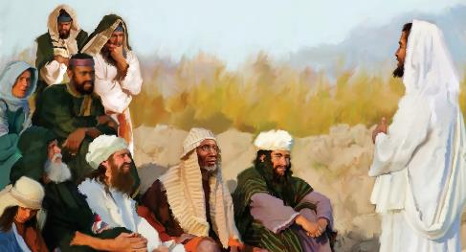
70 Juskni = 490 Run
THOK IN LATKV
7 Juskni
62 Juskni
½ Jusk
½ Jusk
49 Run
434 Run
7 Run
“Täämɛ mëë ca Jɔ̱ɔ̱n yian, cu Yecu wä kä Gɛ̈-lɛ-li, latdɛ thuk Kuɔth ti gɔw” (Mak 1:14)
Ruac Yecu in nhiam t` rvydv kv disk titi (Mak 1:15)
“Ci ciaŋ rui̱cä Kuɔth thia̱k”
“Rietdɛ rɔ̱ dueerikun, kä ŋa̱thɛ thuk Kuɔth ti gɔw”
“Ci gua̱a̱th cop”
M5 nyooth ni ruac g66k` juskni ti 70 (Da-ni-yel . 9:24).
V took v ni kv l1t ruac Ku1r ni ~r-t0k-c0th-tv, kv ru]n 457 v k1n Yecu ni dap, v w` ni k` y5eer Mv-thia, bi juskni ti 69 cu thusk (b`th. 25).
Vn nvmv cv pvn gu`thdv kv boony Yecu, kv rusn 27. Kv ksr nuth` jok`, kv rusn 31, cu Yecu l5w (b`th. 27).
V y1c m5 nyooth ni f66 ci guk matd` ruac kv ku5 k`n` teek` rsdv took kv w` gu`thdv
V ci6t kv kv mat rvy guk` ruach, kv nh6kdan kv p`lik` kv x1th kv Yecu.
Thok vn baa l1t kv jvn gu11th vmv t` rvy xsaani dax disk: ci gu11th pvn thin; Yecu jaa beeni; k` dee ksn rsdan rit dueeriksn k` dee ksn t` kv x1th kv f66 dee ksn w` kvvl kv Jv.

Slide 12
“Min la f1c k` lat Kr5tho kv ruac Kusth, v f66 “c5 gu11th cop, k` c5 ciax Ku``r` Kusth ben; k` r5`tv r7dun k` dueerkun, k` x1thv ruac Kusth. K` 5ns ruac thukn5 Kusth t5 gsw, min ca lat v K``n pu]nydv, t22 k` ruaacn5 g77k`. K` vn “gu1th” in latv vn f66 c5 cop, v jvn gu11th 22 ca l1r Da-n5-yel v Gab-ri-yel…
M22 c5 ruac ben` Kr5tho in nhiam ciax Ku``r` puth` baaxdv lat, k` 5ns b5 ruac ben`dv in rvwdv ciax Ku``r` gssy` pusny`dv lat. K` ruac in rvwdv, ciet kv ruac in nhiam be kvn diaal k` ruac g77k`.
EGW (Min G77r R5c D5aal N5 Jv, p`c 169-170, 171)

