Slide 1
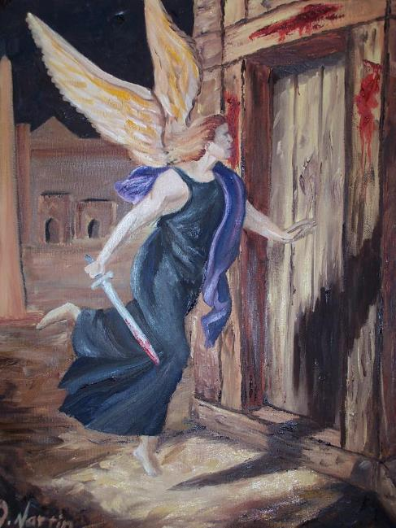
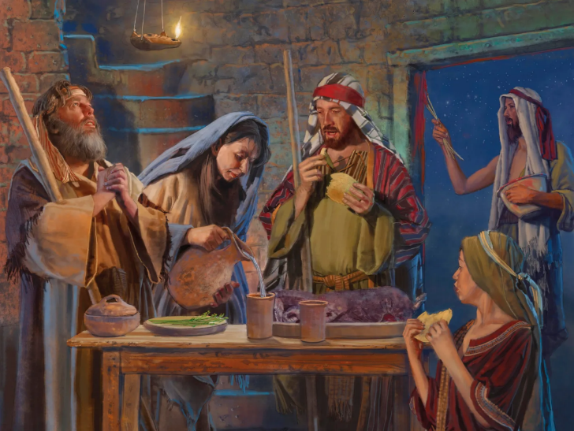
PASAKA
Phunziro 5, August 2, 2025

Slide 2
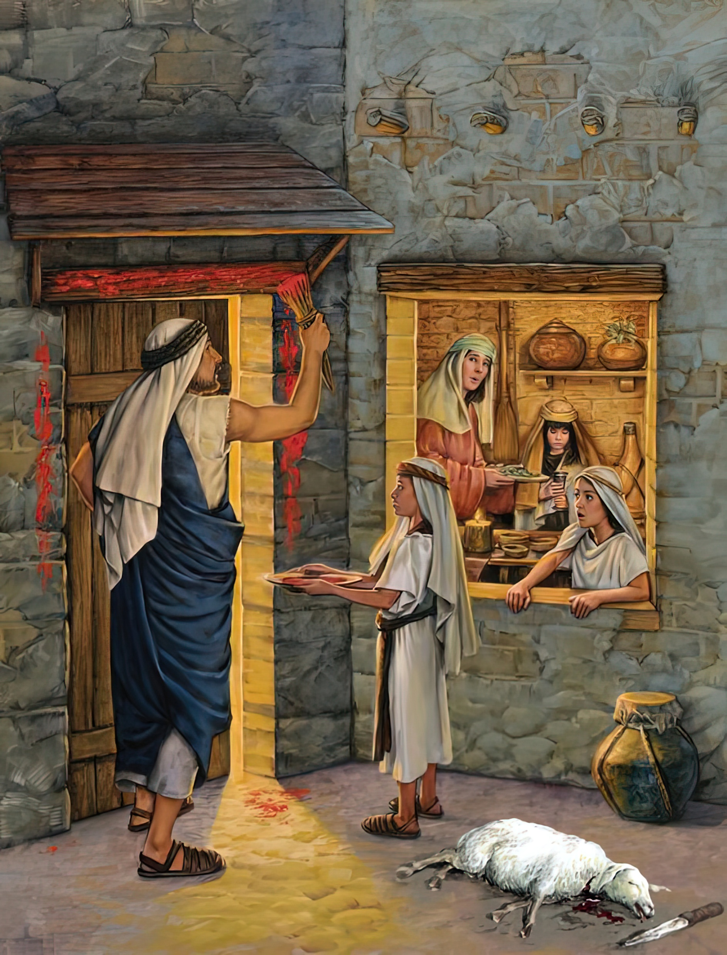
“Ndipo ana anu akakakufunsani kuti, ‘Mwambo umenewu ukutanthauza chiyani?’ Inu mukawawuze kuti, ‘Ndi nsembe ya Paska ya Yehova, popeza pamene ankakantha nyumba za Aigupto anasiya nyumba zathu.’ ”‘And it shall be, when your children say to you, “What do you mean by this service?” that you shall say, “It is the Passover sacrifice of the Lord, who passed over the houses of the children of Israel in Egypt when He struck the Egyptians and delivered
our households” ’ ”
Eksodo 12:26, 27

Slide 3

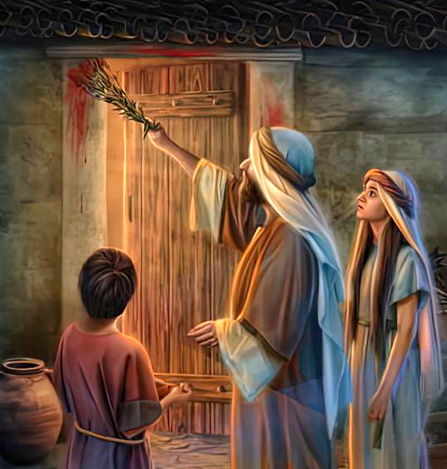
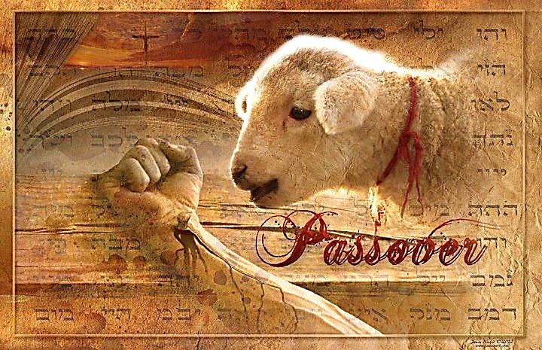
Mliri wachikhumi unakantha banja lirilonse ku Iguputo limene linakana kutsatira malangizo a Mulungu. Sizinabwere mwadzidzidzi, koma zinalengezedwa masiku ambiri zisanachitike.
Kunena zoona, awa anali mayeso achikhulupiriro. Palibe amene anafunikira kufa usiku umenewo. Aliyense anali ndi mwayi wopulumutsa moyo wa mwana wake woyamba kubadwa.
Mwanawankhosa yekha ndi amene anaweruzidwa. Iye yekha ndiye anayenera kufa. mwazi wake okha ndiumene ukanachititsa owonongayo kudutsa. Chifukwa chiyani? Chifukwa KHRISTU YEKHA AMAPULUTSA. Ndipo ichi chinali choti chikumbukiridwe kuchokera ku kam'badwo kupita ku kam'badwo… mpaka Iye adzabwere.
Chenjezo (Eksodo 11)
Kukonzekera (Eksodo 12:1-16)
Mwazi ndi Chofufumitsa (Eksodo 12:17-23)
Kumbukirani ndi Kuphunzitsa (Eksodo12:24-28)
Mliri wa khumi (Eksodo 12:29-30)

Slide 4


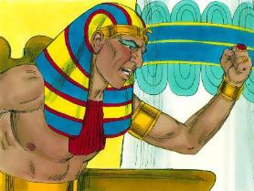
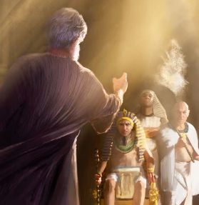
CHENJEZO
“Tsopano Yehova anati kwa Mose, “Ine ndidzalanga Farao pamodzi ndi Aigupto onse ndi mliri umodzi wotsiriza. Zikadzachitika izi iye adzakulolani kuti mutuluke mʼdziko lino. Ndithu pamene azidzakutulutsani adzachita ngati akukuyingitsani.’” (Eksodo 11:1)
Nthawi ya chiweruzo cha Mulungu yafika (Eksodo 12:12 ):
Patatha masiku atatu mumdima, Farao anakwiyira Mose ndipo anamuletsa kubwerera ku nyumba yachifumu (Eksodo 10:28).
Kwa onyada, odzikuza ndi opondereza: chilango, ndi udindo wobwezera zomwe adagwidwa.
(Eksodo 11:4-5, 2 )
Kwa anthu omvera malamulo a Mulungu: kunyalanyaza chilango, ndi kumasulidwa
(Eksodo 11:7-8)
Koma Mose sanathe kumvera lamuloli, chifukwa moyo wa mwana woyamba wa Farao unali pangozi. Pa udindo wake monga “mulungu” wa Farao (Eksodo 7:1 ) anafunika kumuchenjeza za zimene anali atatsala pang’ono kuchita (Amosi 3:7 ).
Tsopano Mose ndi amene anachoka pamaso pa Farao ndi mkwiyo. Kukwiya chifukwa cha kuuma mtima kwake ndi zotsatira za chisankho chake. Ngakhale kuti ankalemekeza Mose, Aigupto ambiri anakana kumvera chenjezoli (Eksodo 11:3 ).

Slide 5


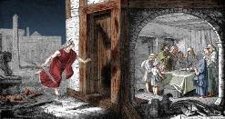
KUKONZEKERA
“Muliwuze khamu lonse la Israeli kuti pa tsiku la khumi la mwezi uno, munthu aliyense asankhire banja lake mwana wankhosa mmodzi. Banja lililonse litenge mwana wankhosa mmodzi. ” (Eksodo 12:3)
Mulungu anafotokoza mwatsatanetsatane zimene anayenera kuchita kuti Wowonongayo “apitirire” ( Paskha, Paskha), ndipo woyamba kubadwa asafe:
Pa tsiku la 10 anafunika kupatula mwana wankhosa wopanda chilema pa banja lililonse kapena mabanja angapo (Eksodo12:3-5).
Pa tsiku la 14, madzulo, anafunika kuipereka nsembe (Eksodo 12:6).
Anayenera kudzoza mafelemu a chitseko ndi pamwamba pa mwazi (Eksodo 12:7)
Anayenera kudya nyama yowotcha yonse pamodzi ndi mkate wopanda chotupitsa ndi zitsamba zowawa (Eksodo 12:8-10)
Pamene anali kudya mopupuluma, anafunika kuvala ndi kukonzeka kupita (Eksodo 12:11).
Pamene anatuluka mu Igupto, anayenera kupitiriza kudya mkate wopanda chotupitsa kwa masiku asanu ndi awiri (Eksodo 12:15)
Mulungu anakonzekeretsa anthu ake kuti amvetse chisomo chake, ndi kumulambira (Eksodo 12:27b).

Slide 6


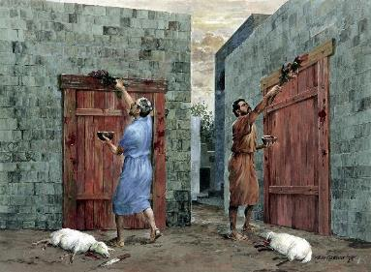
MWAZI NDI CHOTUPITSA
“Ndipo Mose anasonkhanitsa akuluakulu onse a Israeli nati, “Pitani msanga kukasankha nkhosa zokwanira pa mabanja anu, ndipo muziphe ngati Paska.” (Eksodo 12:21)
Pa tsiku la 14, zinthu ziwiri zidagwira ntchito yofunika kwambiri pamwambowu: mwazi ndi chotupitsa.
Anayenera kuchotsa chotupitsa (yisiti) m’nyumba zawo ndi kuphika mkate wopanda chotupitsa (mkate wopanda chotupitsa). Popeza kuti kunyamuka kunali pafupi, iwo sakanakhala ndi yisiti panthawi yake yoyamba (Eksodo 12:17–20). Chotupitsa ichi ndi chizindikiro cha uchimo, ndipo mkate wopanda chotupitsa umaimira moyo watsopano mwa Khristu Yesu (1 Akorinto 5:6–8; 2 Akor. 5:17).
Ka chitsamba kamene mwazi anayenera kuwaza nawo (Eksodo 12:22) ndi chizindikiro cha kuyeretsedwa kwa uchimo (Masalimo 51:7).
Mwazu unali gawo la salvific. Ilo linkaimira mwazi wa Yesu—omwe anakhetsa pa mtanda—kuti, pa Chiweruzo, Mulungu ‘apitirire’ kutsutsidwa kwathu. (1 Yohane 1:7; 2:1-2).

Slide 7

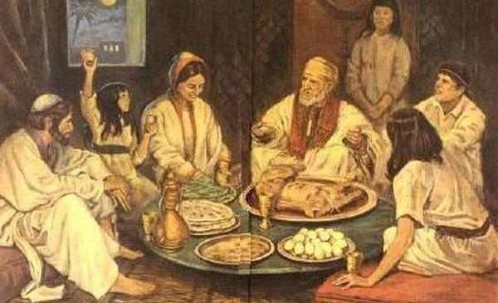
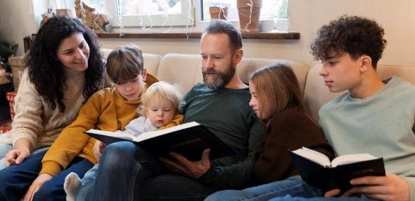
KUMBUKIRANI NDI KUPHUNZITSA
“Muzimvera malamulo amenewa kwa muyaya, inu ndi zidzukulu zanu.” (Eksodo 12:24)
Ngakhale asanawatulutse mu Igupto, Mulungu anaphunzitsa mabanja achihebri kusunga mbiri yawo mwa kuiuza kwa ana awo chaka ndi chaka (Eksodo 12:24-27 ).
Kuyambira nthawi imeneyo, Paskha adzakhala phwando labanja. Mwayi woti makolo apereke chidziŵitso chonena za Mulungu kwa ana awo.
Nkhani ya kumasulidwa inayenera kufotokozedwa mwatsatanetsatane, komanso mwa munthu woyamba (Deuteronomo 26:5-9).
Zimenezi zili ndi phunziro lapadera kwambiri kwa ife. Tiyenera kupereka chikhulupiriro chathu kwa ana athu. Tiyenera kuwauza zimene Mulungu wachita, osati m’mbiri yokha, komanso m’miyoyo yathu. Tiyenera kuwagwadira ndi kuwalambira (Eksodo 12:27).

Slide 8
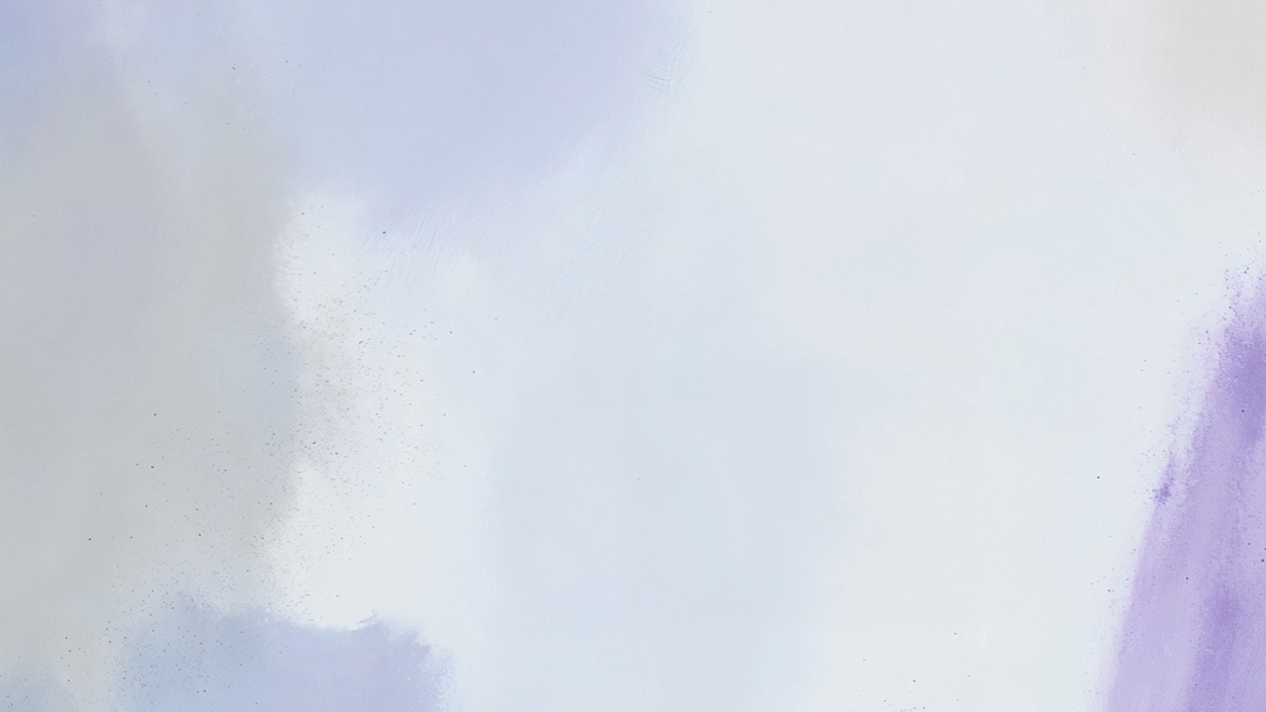

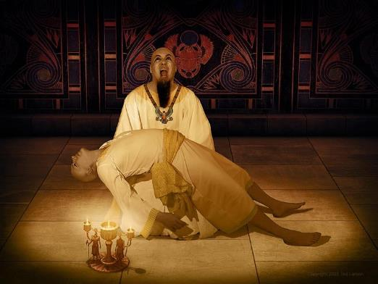
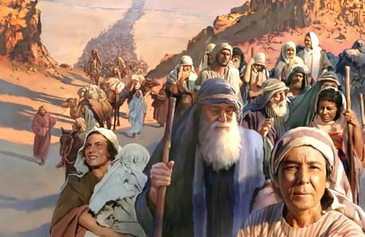
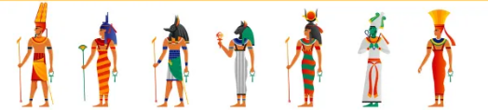
MLIRI WA KHUMI
“Pakati pa usiku Yehova anakantha ana onse oyamba kubadwa mʼdziko la Igupto, kuyambira woyamba kubadwa wa Farao, amene amakhala pa mpando waufumu wa Faraoyo, mpaka mwana woyamba kubadwa wa munthu amene anali mʼdzenje, pamodzinso ndi ana oyamba kubadwa a ziweto zawo.” (Eksodo 12:29)
Farao analamula kuti anyamata onse achihebri aphedwe popanda kuchotserapo (Eksodo 1:22). Mulungu anakonzeratu imfa ya ana oyamba kubadwa (Eksodo 12:29). M’nyumba zonse zimene mwazi wa mwana wankhosa sunadzozedwe, munthu mmodzi anafa (Eksodo 12:30).
Ziweruzo za Mulungu zidagwera mwamphamvu pa milungu ya Aigupto, imene Farao anali woimirira (Eksodo 12:12).
Palibe mulungu wa Aigupto amene anakweza dzanja lake kuti athandize, ndiponso Farao sakanatha kuchita chilichonse kuti aletse chionongekocho.
Mofanana ndi Farao, uchimo wathu ukhoza kusokoneza anthu ena. Koma mofanana ndi Mose, kukhulupirika ndi kusasunthika kwathu kungapulumutse anthu ambiri.

Slide 9

“Anayenera kudzipatula okha ndi ana awo kwa Aigupto, ndi kuwasonkhanitsira m’nyumba zawo; pakuti akapezeka Aisrayeli m’nyumba za Aigupto, adzagwa ndi dzanja la mngelo woononga, ndipo analamulidwa kusunga chikondwerero cha pasika monga lamulo;
kuti pamene ana awo adzafunsa chimene utumiki woterowo umatanthauza, awafotokozere za kusungidwa kwawo kodabwitsa ku Igupto. Kuti pamene mngelo woonongayo anaturuka usiku kukapha woyamba kubadwa wa munthu, ndi woyamba kubadwa wa nyama, iye anapitirira nyumba zao, ndipo palibe mmodzi wa Ahebri anaphedwa amene anali ndi chizindikiro cha mwazi pa mafelemu a makomo awo. […] Iwo [Aigupto ena] anachonderera kuti aloledwe kupita ku nyumba za Aisrayeli pamodzi ndi mabanja awo, pausiku wowopsa umenewo pamene mngelo wa Mulungu anapha ana oyamba kubadwa Aigupto. Iwo ankakhulupirira kuti milungu yawo imene ankailambira inali yosadziwa, ndipo inalibe mphamvu zopulumutsa kapena kuwononga. Aisrayeli analandira Aaigupto okhulupirira m’nyumba zawo”.
EGW ( Spiritual Gifts, vol. 3, p. 223)

