Slide 1
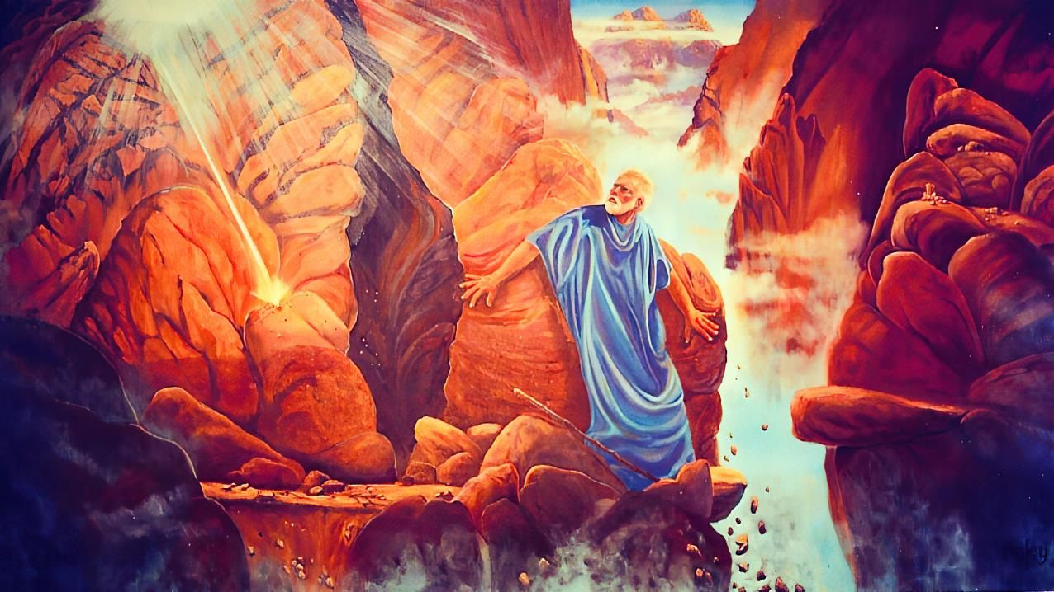
“CHONDE, NDIONETSENI ULEMERERO WANU”
Phunziro 12 September 20, 2025

Slide 2
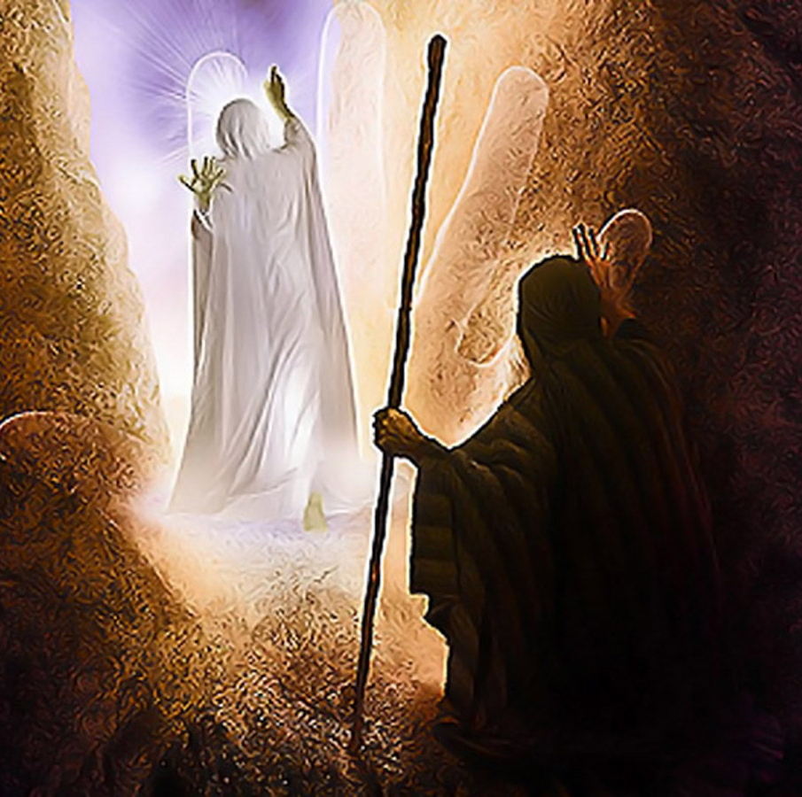
“Ndipo Iye anadutsa kutsogolo kwa Mose akulengeza kuti, “Yehova, Yehova, Mulungu wachifundo ndi wokoma mtima, wosapsa mtima msanga, wodzaza ndi chikondi chosasinthika ndi kukhulupirika, waonetsa chikondi chosasinthika kwa anthu miyandamiyanda, wokhululukira zoyipa, kuwukira, ndiponso tchimo, komatu salekerera ochimwa kuti asalangidwe. Iye amalanga ana ndi zidzukulu chifukwa cha machimo a makolo awo mpaka mʼbado wachitatu ndi wachinayi.’ ”
Eksodo 34:6, 7

Slide 3

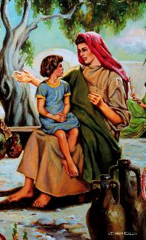
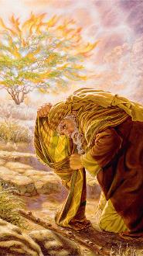
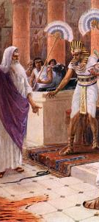



Palibe kukayika konse. Mulungu ndi Mose anakhala abwenzi apamtima.
Izi sizinachitike mwadzidzidzi. Zinachitika mwapang’onopang’ono. Zinayamba ali mwana, pamene amayi ake anamuwuza za Mulungu wodabwitsa amene ankamutumikira.
Ubwenzi wawo unalimbitsidwa muzochitika zosiyanasiyana zimene anali nazo pa Phiri la Sinai, ndipo unkakula kufikira tsiku limene Mulungu anayitana Mose kuti apume.
Machaputala 33 ndi 34 a m’buku la Eksodo analemba za nthawi yapadera mubwenzi umenewu: pempho la Mose lofuna kuona ulemerero wa Mulungu.
Mulungu ndi Mose:
  Kukumana ndi Mulungu (Eksodo 33:7-11)
  Kumudziwa Bwino Mulungu (Eksodo 33:12-17)
Ulemelo wa Mulungu:
  Chilakolako chofuna kudziwa ulemerero wa Mulungu (Eksodo 33:18-23)
  Masomphenya a ulemerero wa Mulungu (Eksodo 34:1-28)
  Zotsatira za kuona ulemerero wa Mulungu (Eksodo 34:29-35)

Slide 4

MULUNGU
NDI MOSE

Slide 5

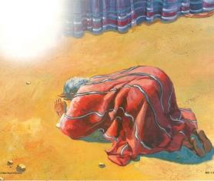
KUKOMANA NDI MULUNGU
Ubwenzi wa pakati pa Mulungu ndi Mose unakula pang’onopang’ono
Mulungu anamuyitana iye kuchokera mu chitsamba choyaka moto
Mose anaona mmene Mulungu anagonjetsera milungu ya Aigupto
Anawona Nyanja Yofiira ikutseguka kuti Israeli amasulidwe ku ukapolo
Iye ankaona mmene Yehova ankatsogolera Aisiraeli pa Phiri la Sinai
Anakhala limodzi pa phiri kwa masiku 40 athunthu
Ubwenzi wawo anapitiriza kukula tsiku ndi tsiku
Mulungu anauzira Mose kulemba Yobu ndi Genesis
“Mose akamalowa mu tenti, chipilala cha mtambo chimatsika ndi kukhala pa khomo pamene Yehova amayankhula ndi Mose.” (Eksodo 33:9)
Mose anakumana ndi Mulungu mu chihema, pamene analankhula naye maso ndi maso (Eksodo 33:7-11).
Kufotokoza pang’ono: mawu akuti ‘maso ndi maso’ sanatanthauze kuti ankaonana maso ndi maso mwa kuthupi, koma kuti ankakhala ndi ankakambirana momvana bwino (Ngakhale Mose sanawone nkhope ya Mulungu konseko.
Mose anakhala mtumiki wokhulupirika wa Mulungu (Ahebri 3:5 ), nyale yosazimitsa mumdima, ndiponso mneneri wachitsanzo chabwino.

Slide 6


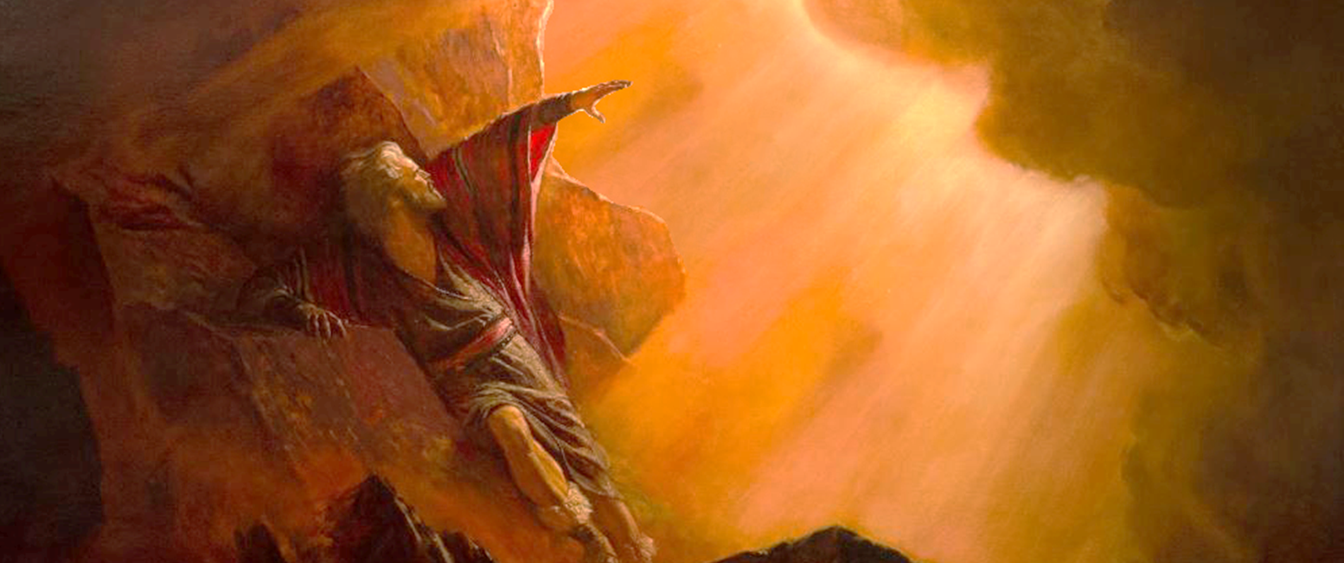
KUDZIWA BWINO MULUNGU
Ngati mwakondwera nane ndiphunzitseni njira zanu kuti ndikudziweni ndi kupitiriza kupeza chisomo pamaso panu. Kumbukirani kuti mtundu uwu ndi anthu anu.” (Eksodo 33:13)
Pamene Mulungu anauza Mose kuti Iye sadzapita ndi anthuwo ku Kanani (Eksodo 33:1-3 ), zokambirana zosangalatsa zinayambika (Eksodo 33:12-17).
Mulungu
Mulungu
Mose
Mose
Mulungu
Ndiwe bwenzi langa ndipo wapeza chisomo pamaso panga
Ngati ndi choncho, ndiphunzitseni njira zanu kuti ndikudziweni.
Ine ndemwe ndidzapita pamodzi ndi iwe, ndipo ndidzakupatsa mpumulo.
Ngati inu simupita nafe, musatitumize kuti tipite, kutichotsa pano.
Kodi wina adzadziwa bwanji kuti inu mwandikomera mtima ngati simupita nafe?
Chabwino, ndidzachita zimene iwe wandipempha chifukwa Ine ndikukondwera nawe, ndipo ndiwe bwenzi langa.
Mose
Mose anakhala ndi Mulungu kwa masiku 40, akulandira Malamulo Khumi ndi malangizo omangira kachisi. Tsopano iye anali kachiwiri pamaso pa Mulungu, kupembedzera anthu. Ankaoneka kuti amamudziwa bwino Mulungu chifukwa ankalankhula naye bwinobwino. (Eksodo 33:13 ) Kodi anafunika kumudziwa mu njira yotani? Kodi inunso mufuna mutamudziwa mu njira yotani?

Slide 7

ULEMELERO WA MULUNGU

Slide 8


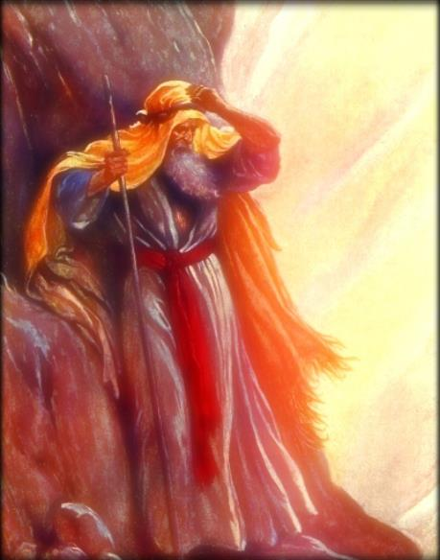
CHIKHUMBO CHA KUDZIWA ULEMERERO WA MULUNGU
“Kenaka Mose anati, “Tsopano ndionetseni ulemerero wanu.”” (Eksodo 33:18)
Mose anafunsa kuti: “Ndionetseni ulemerero wanu (Eksodo 33:18 )
Mulungu anayankha kuti: “Ndidzakusonyezani ubwino wanga (Eksodo 33:19)
Ulemerero wa Mulungu ndi ubwino wake, ndilo khalidwe lake
Zimene Mulungu anamuonetsa zinali khalidwe lake (Eksodo 34:6-7)
Ellen G. White akuwonjezera kuti ulemerero wa Mulungu uli m’kuthandiza ana ake; kulandira ochimwa amene atembenuka; ndi kupereka zonse zofunika kuti asinthe.
Choncho, “ulemerero” wathu ndi kusonyeza makhalidwe a Mulungu m’miyoyo yathu ( 2 Ako. 1:12; 3:18 .
Pamene tiyang'ana pa Mtanda, timakhala ndi vumbulutso lalikulu la ulemerero wa Mulungu, ubwino wake, ndi makhalidwe ake.

Slide 9

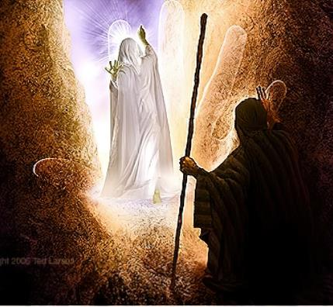
MASOMPHENYA A ULEMERERO WA MULUNGU
“'Ndipo Iye anadutsa kutsogolo kwa Mose akulengeza kuti, “Yehova, Yehova, Mulungu wachifundo ndi wokoma mtima, wosapsa mtima msanga, wodzaza ndi chikondi chosasinthika ndi kukhulupirika,'” (Eksodo 34:6)
Mulungu anasonyeza ulemerero wake kwa Mose panthawi yachisanu ndi chiwiri pamene anakwera phiri la Sinai. Mose ankadzionetsera pamaso pa Mulungu kangati, ndipo ndi pa nthawi yanji komanso ndi cholinga chotani?
1
2
3
4
5
6
7
Kulandira maziko a pangano (Eksodo 19:3-7)
Kupereka yankho la anthu ndi kulandira malangizo okhudza kuonekera kwa Mulungu ku Sinai (Eksodo19:8-14)
Kulandira malangizo atsopano (Eksodo 19:20-25 )
Kulandira malamulo ogwirizana (Eksodo 20:21; 24:3 )
Kulandira Malamulo Khumi olembedwa ndi chala cha Mulungu, ndi chitsanzo cha Malo Opatulika (Eksodo 24:12, 18; 32:15)
Kupembedzera tchimo la mwana wa ng’ombe wagolide (Eks. 32:30)
Kuti Mulungu amuonetse ulemerero wake, ndi kulandira magome atsopano okhala ndi Malamulo Khumi (Eksodo 34:1-5)
Masomphenya a ulemerero wa Mulungu anasonyeza kudziwitsa kwa Mulungu yekha za khalidwe lake (Eksodo 34:6-7). Ataona chikondi cha Mulungu m’njira imeneyi, Mose analambira (Eksodo 34:8; 1 Yohane 4:19). Potsiriza, Mulungu anatsimikiziranso pangano lake ndi Israeli ndipo anakhululukira tchimo la mwana wa ng’ombe wagolide.

Slide 10

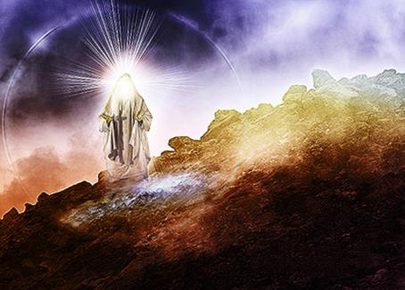
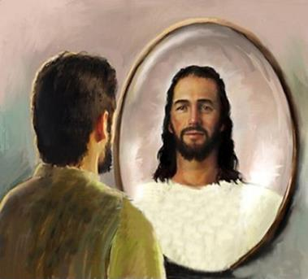
ZOTSATIRA ZAKUONA ULEMERERO WA MULUNGU
“Mose anatsika kuchokera mʼPhiri la Sinai pamodzi ndi miyala iwiri ija ya pangano mʼmanja mwake. Iye sanazindikire kuti nkhope yake imanyezimira pakuti anayankhula ndi Yehova.” (Eksodo 34:29)
Mose anali atalankhula ndi Mulungu “maso ndi maso” kangapo konse m’mbuyomo, ndipo kufikira nthawiyi, nkhope yake inali isanawaleko. N’chifukwa chiyani nthawi imeneyi zinasiyana? Ndipo dziwani kuti kusintha kumeneku kunapitiriza nthawi yayitali (Eksodo 34:34-35).
Tsopano Mose anamudziwa bwino Mulungu. Ubwenzi wake unali utakhwima. Anali kusinkhasinkha za ulemerero wa Mulungu, ndipo anasandulika ndi ulemerero umenewo.
Pofotokoza nkhani imeneyi, Paulo akutipempha kuti titsatire chitsanzo cha Mose ndi kulingalira za ulemerero wa Mulungu kuti tisandulike monga mmene iye anakhalira (2 Akorinto 3:12-18) .
Mose ndi chitsanzo chimene chimasonyeza zimene Mulungu angatichitire tikamulola kuti asinthe makhalidwe athu n’kutiumba m’chifanizo chake.

Slide 11

EGW (In Heavenly Places, August 22)
“Mukuganiza kuti Mulungu adadzudzula Mose chifukwa cha kudzikuza kwake? Ayi, ndithudi. Mose sanapemphe izi mwachidwi chopanda pake. Anali ndi cholinga. Anaona kuti ndi mphamvu zake yekha sangathe kuchita ntchito ya Mulungu moyenera. Anadziwa kuti ngati angalandire masomphenya omveka bwino a ulemerero wa Mulungu, adzatha kupitiriza ntchito yake yofunika kwambiri osati ndi mphamvu zake, koma ndi mphamvu ya Yehova Mulungu Wamphamvuyonse. Moyo wake wonse unkalakalaka Mulungu; ankafuna kudziwa zambiri za Iye, kuti amve kuyandikira kwaumulungu munthawi ya mavuto kapena chisokonezo chilichonse. Sikunali kudzikonda komwe kunapangitsa Mose kupempha kuona ulemerero wa Mulungu. Cholinga chake chokhacho chinali kufuna kulemekeza Mlengi wake bwino kwambiri”

