Slide 1

KUUNIKA KUMAWALA MU MDIMA
Phunziro 3, April 20, 2024

Slide 2

“Kenaka Yesu anawawuza kuti, “Inu mukhala ndi kuwunika kwa nthawi pangʼono. Yendani pamene mukanali ndi kuwunika, kuti mdima usakupitirireni. Munthu amene amayenda mu mdima sadziwa kumene akupita’ ”
(Yohane 12:35, CCL)

Slide 3

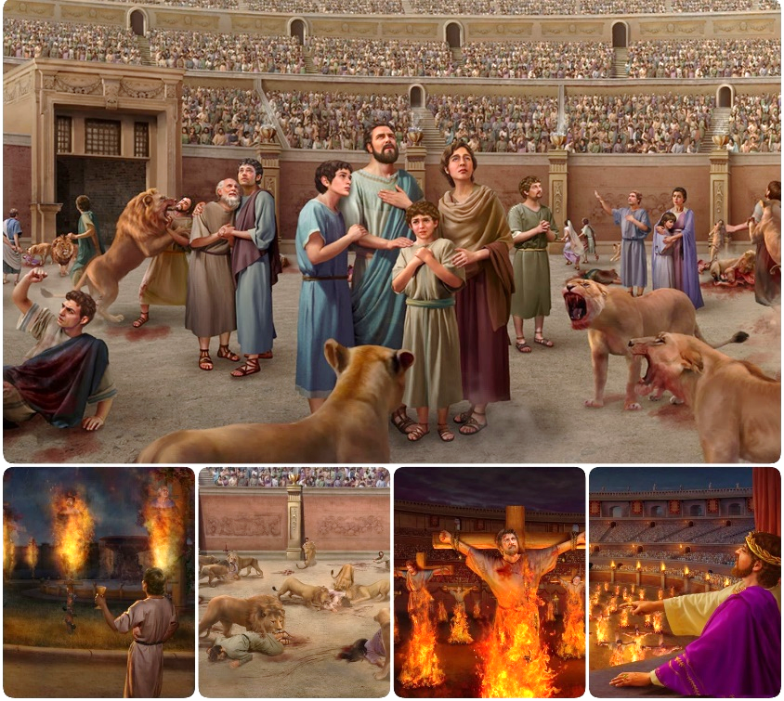
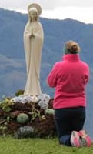

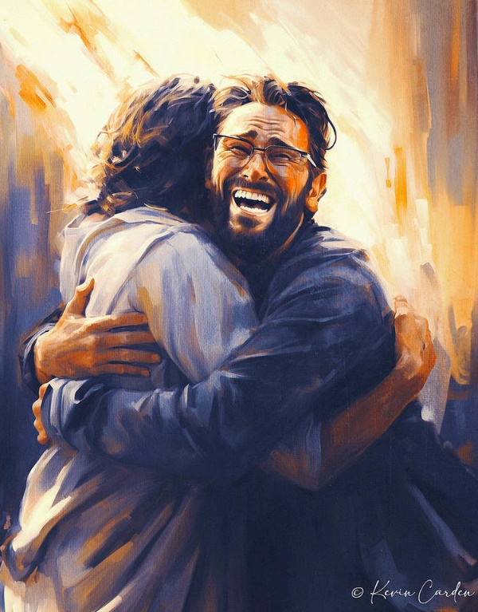








Pomenya nkhondo kupambana kapena kulephera kumafikiridwa pang’onopang’ ono.
Pamene Satana anagonja pankhondo ya mazunzo anakonza dongosolo latsopano: kunyengerera. Kusakanizika kwa choonadi ndi mabodza kwakopa anthu miyandamiyanda kulandira chikhululupiriro chopotoka, chopanda moyo.
Chitetezo chathu pankhondoyi ndicho kukakamira Yesu kokha, yemwe ali Choonadi ndi Moyo, ndi Mawu ake Opatulika.
Nkhondo ya choonadi :
  Choonadi kapena bodza.
  Kuumitsa mtima kwa Mpingo.
Nkhondo ya Mawu a Mulungu :
  Chitetezo kuchokera mu Baibulo.
  Kuganiza mwa umunthu.
Nkhondo ya m’maganizo.

Slide 4

NKHONDO YA CHOONADI

Slide 5


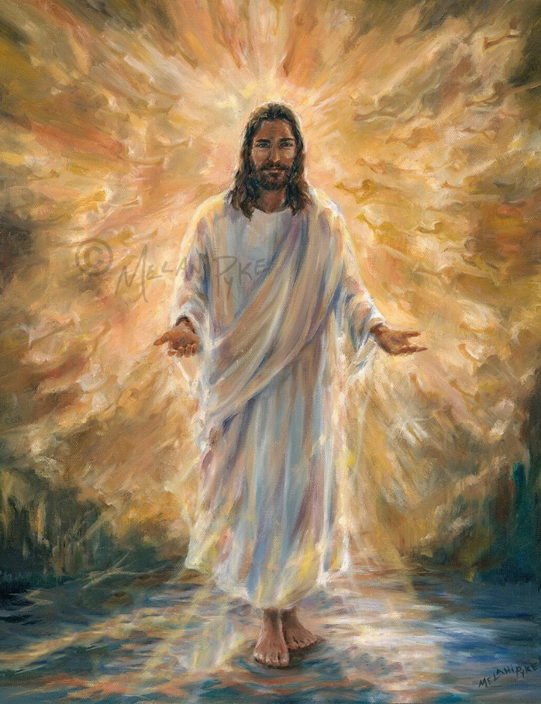
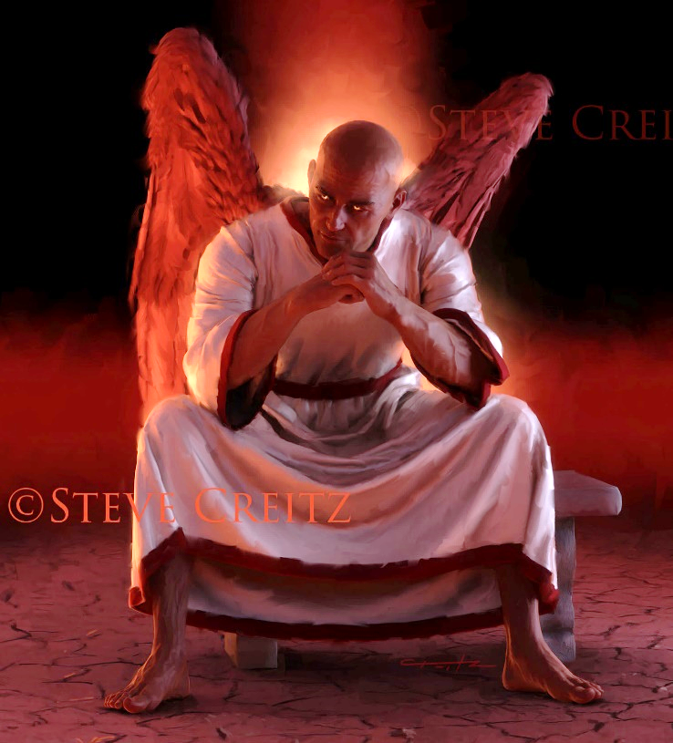
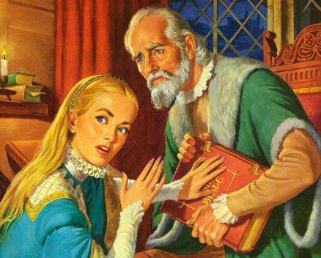
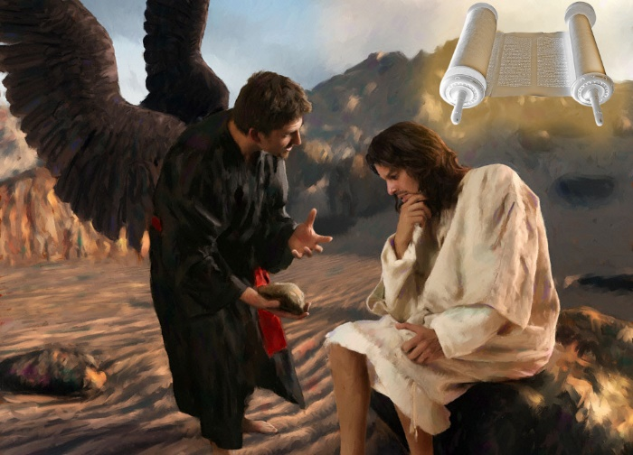
CHOONADI KAPENA BODZA
“Yesu anayankha kuti, ‘Ine ndine njira, choonadi ndi moyo. Palibe munthu angafike kwa Atate popanda kudzera mwa Ine’ ” (Yohane 14:6 CCL)
Yesu ndiye Choonadi chotero ali tate wa choonadi chonse (Yohane 14:6). Chirichonse chowona, chirichonse chodalirika, chirichonse chomwe chiri chokhulupirika, chimachokera kwa Iye. Ndipo choonadi chake chimabala moyo mwa ife.
Motsutsana ndi izi, Satana ndiye atate wake wa bodza (Yohane 8:44 ). Chinyengo chonse, machenjerero onse anjiru, chowonadi chonyenga chonse, zimachokera kwa iye. Ndipo bodzalo limabala imfa mwa ife.
Polimbana ndi mdaniyo, Yesu anagwiritsa ntchito Baibulo monga magwero a choonadi chonse : “Kwalembedwa” (Mateyu 4:4; 21:13).
Chotero, Mdyerekezi wakhala akugwira ntchito yowononga Baibulo, kulibisa kapena kulipotoza. Ndipo anakwaniritsa izi (ngakhale zinali kwakanthawi) kupyolera mu Mpingo wa Akatorika, munthawi ya Middle Age (zotchedwanso “Nyengo Zamdima”).

Slide 6


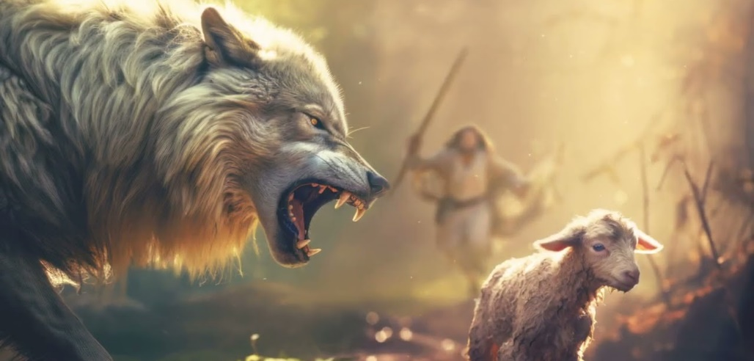
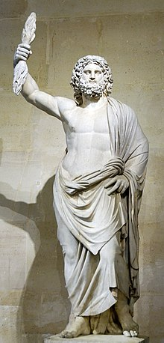
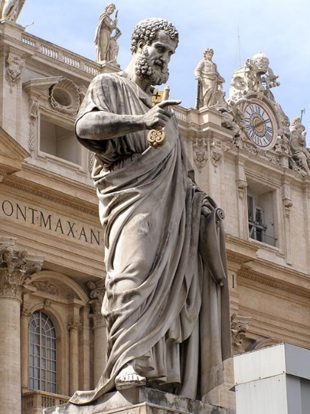
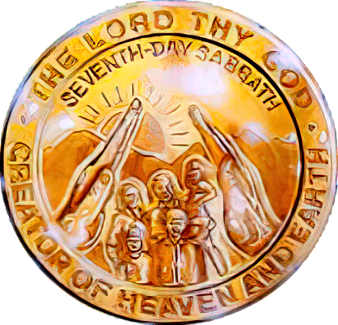
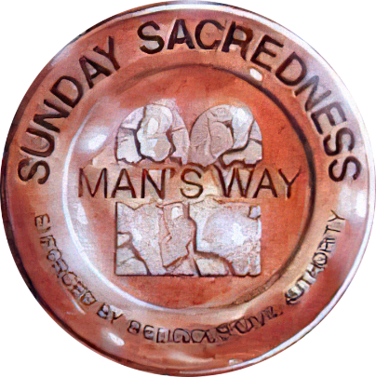
KUUMITSA KHOSI KWA MPINGO
“Ndikudziwa kuti ndikachoka ine, padzafika mimbulu yolusa pakati panu imene sidzalekerera gulu lankhosalo. Ngakhale pakati pa inu nokha padzapezeka anthu oyankhula zonama ndi cholinga chofuna kukhala ndi ophunzira kuti awatsate.” (Machitidwe 20:29-30 CCL).
Potsanzikana ndi akuluakulu a ku Efeso, Paulo anafotokoza za nkhawa yake ya mavuto omwe adzakumane nawo mtsogolo kuchokera kunja komanso mkati ( Machitidwe 20:29-30).
Mimbulu yolusa. Kuchokera mu chaka cha 64 mpaka 311 ( Lamulo la kulekerera kwa Serdica ), Mpingo unazunzidwa koopsa ndi Ufumu wa Roma.
Anthu opotoka maganizo. Kuyambira mu zaka za m’ma 400, anthu osatembenuka mtima analowetsedwa mumpingo ndipo anasakaniza chipembedzo chawo chachikunja ndi choonadi.
Zochena cha mulungu wachiroma wotchedwa Jupiter pa Phiri la Capitoline ku Rome chinagwiritsidwanso ntchito ndipo chinasandulika kukhala fano la Petro Woyera
Satana anasokoneza mpingo kuchokera “mkati” poipitse choonadi ndi kuyambitsa chipembedzo chamafano komanso kusunga tsiku loyamba lapamlungu.
Monga Paulo analosera, zolakwa izi zinalandiridwa, ndipo zidzakhalabe kupezeka pakati pa omwe safuna kudziwa choonadi (2 Atesalonika 2:7-12). Nkhondo yomaliza idzazikidwa pa kulolera kuswa Sabata.

Slide 7

NKHONDO YA MAWU A MULUNGU

Slide 8

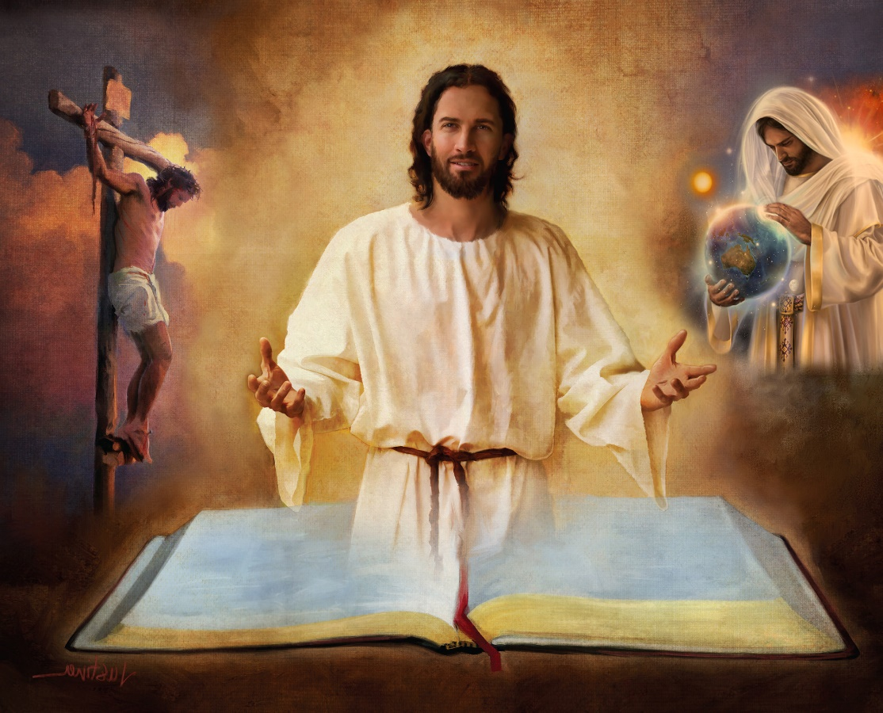
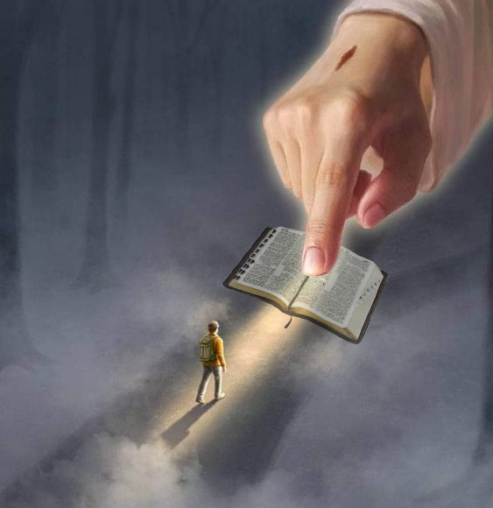
CHITETEZO MU BAIBULO
“Ayeretseni ndi choonadi chanu. Mawu anu ndiye choonadi. ” (Yohane 17:17 CCL)
Baibulo ndi vumbulutso lenileni la chifuniro cha Mulungu. Limapereka dongosolo la Kumwamba la chipulumutso cha anthu.
Choncho, chitetezo chathu chimapezeka mu Baibulo mokha, kupyolera mu mabuku ake, machaputala ndi mavesi onse( 2 Timoteo 3:16).
Momwemo timapezamo njira ya satana; chilengedwe; kubadwa, moyo, imfa, kuuka ndi kupembedzera kwa Yesu; kukhululukidwa kwa machimo; Kudza Kwachiwiri; moyo wosatha mu Dziko Latsopano …
“Mawu anu ndi nyale ya kumapazi kwanga
ndi kuwunika kwa pa njira yanga” (Masalimo 119:105 CCL)
Ngati tikana mbali imodzi (mwachitsanzo, nkhani ya chilengedwe mu Genesis 1 ndi 2 ) tingafike pokana chiphunzitso chilichonse chimene Baibulo limaphunzitsa. Tsono, tingakhale bwanji ndi chitetezero kuti titha tizidalira Baibulo lonse?
“Mawu anu akamaphunzitsidwa amapereka kuwunika;
ngakhale anthu wamba amamvetsetsa”
(Masalimo 119:130 CCL)

Slide 9



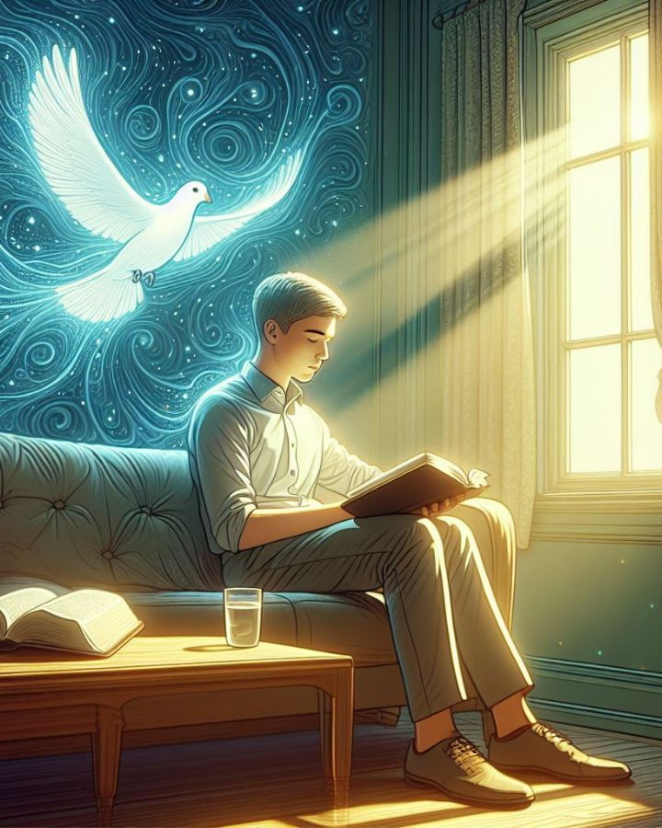
KUGANIZA MWA UMUNTHU
“There is a way that appears to be right,
but in the end it leads to death” (Miyambo 16:25)
Ngati Mulungu ndi amene anauzira Baibulo, angalimasulire ndani (2 Petro 1:20; Yohane 14:26)?
Munthu amane alibe mzimu sangathe kulandira zinthu zochokera kwa Mzimu wa Mulungu, ndipo amaziyesa izo zopusa, sangathe kuzizindikira, chifukwa chidziwitso chake chimachokera kwa Mzimu Woyera Yekha. (1 Akorinto 2:14 ).
Chitsanzo cha kulingalira kwaumunthu ndilo langizo lalikulu, kuti kuyambira muchaka cha mazana 18, kumasulira kwa Baibulo kukhale kodzera “maphunziro a ukadaulo” kokha.
Njira yake yaikulu ndiyo kukana zozizwitsa ndi ulosera wa zamtsogolo. Pansi pa njira imeneyi, tingapeze phindu lotani kuchokera mu mawu a Mulungu ngati tikana mphamvu yake kapena kukhekera kwake kudziwitsa zamtsogolo zimene zikutiyembekezera?
Mosakayikira, mdani amakonza njira zooneka ngati zolondola, koma mapeto ake ndi imfa (Miyambo 16:25).

Slide 10

EGW (Selected Messages, volume 1, page 17)
“Mdima wauzimu waphimba dziko lapansi komanso mdima wandiweyani wazinga anthu. Mipingo yambiri muli kukayikira ndi kusakhulupirika pomasulira Malemba. Ambiri, akukayikira kulondola ndi choonadi cha Malemba. Malingaliro a mtima wa munthu akupeputsa kudzoza kwa Mawu a Mulungu[…]
Bukhu lopatulika lakhala likulimbana ndi zowukira za Satana, yemwe walumikizana ndi anthu oyipa kuti apangitse chilichonse cha umulungu kuphimbidwa ndi mitambo komanso mdima. Koma Yehova wasunga Bukhu Lopatulika mu mphamvu Yake yozizwitsa mmene lirili—bukhu lokhonza kutsogorera banja laumunthu kulisonyeza njira yopita kumwamba..

Slide 11

NKHONDO YA M’MAGANIZO

Slide 12



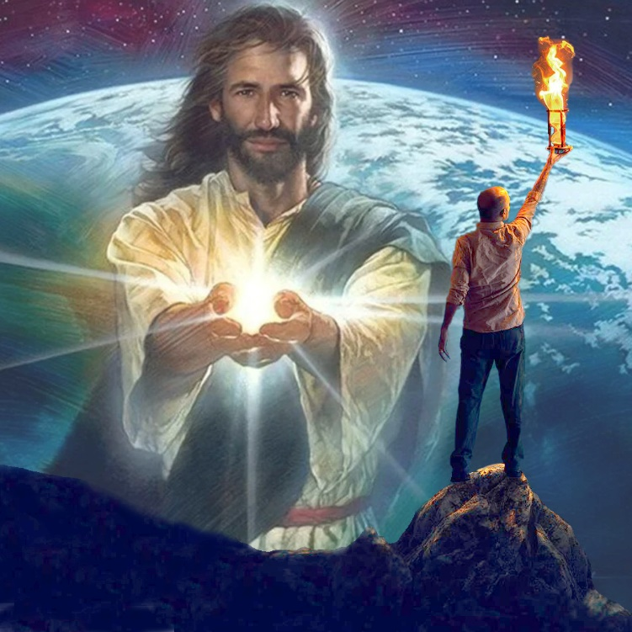
“Mulungu wa dziko lapansi anachititsa khungu anthu osakhulupirira, kuti asathe kuona kuwala kwa Uthenga Wabwino umene umaonetsa ulemerero wa Khristu, amene ndi chifaniziro cha Mulungu” (2 Akorinto 4:4 CCL )
Mwambi wina wachisipanishi umati: “Palibe wakhungu woipitsitsa kuposa amene safuna kuona.” Kuthanthauza kuti, ndizopanda phindu kuyesera kutsimikizira munthu kuti awone zomwe sakufuna kuziwona. Ndi mmene zililinso ndi iwo amene “mulungu wa dziko lapansi” wawachititsa khungu (2 Akorinto 4:4).
Kusowa chidziwitso kwa otayika si chifukwa chakuti alibe mphamvu yodziwa. Koma ndi chifukwa chakuti sakufuna kudziwa. Mdyerekezi wadzaza maganizo awo ndi zinthu zambiri zimene zimawalepheretsa kuganizira zimene zili zofunikira: chipulumutso chawo.
Koma palibe amene ayenera kukhalabe mu mdima otere. Pamene maganizo ali mumdima wauzimu, pamakhala kuunika kumene kumawalira momwemo: “Kuunikako [Yesu] kumawala mumdima, ndipo mdimawo sudzakhalaponso”(Yohane 1:5).
Ife amene timavomereza kuunikaku tingathe kuthetsa ntchito ya mdaniyo, ndi kupangitsa kuunika kwa Yesu kuwalira mumdima.

Slide 13

“Onse amene akuyenda m’njira yopita kumwamba amafunikira chotsogolera chotetezeka. Tisayende mu nzeru za umunthu. Ndi mwai wathu kumvetsera mau a Khristu akulankhula nafe pamene tikuyenda pa ulendo wa moyo, ndipo mau ake ndi mau anzeru nthawi zonse....
Chitetezo chathu chokha ndicho kutsatira mosamalitsa Khristu, kuyenda mu nzeru Zake, ndi kuchita choonadi Chake. Sitingathe nthawi zonse kuzindikira kagwiridwe ntchito ka Satana; sitidziwa kumene watchera ndi misampha yake. Koma Yesu amamvetsetsa kuchenjera kwa mdani, ndipo akhoza kusunga mapazi athu m’njira zotetezeka."
EGW (Our High Calling, January 10)

