Slide 1
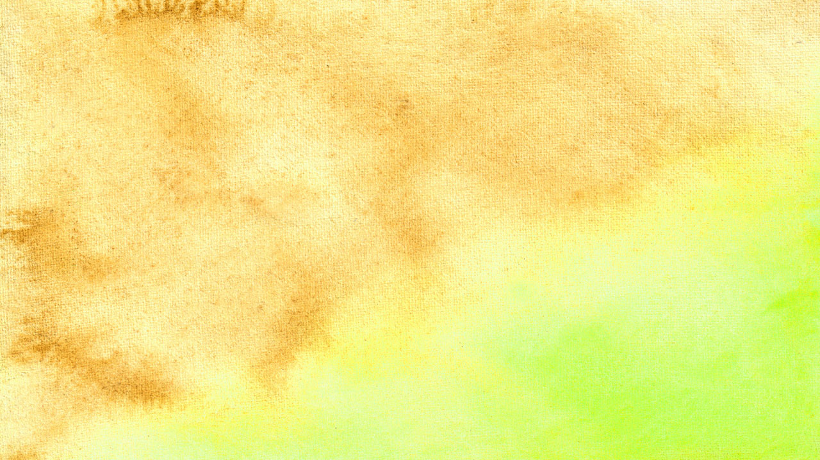
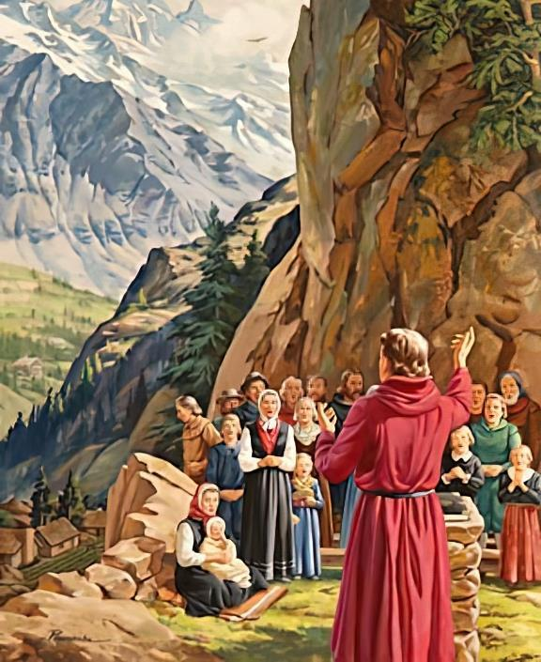
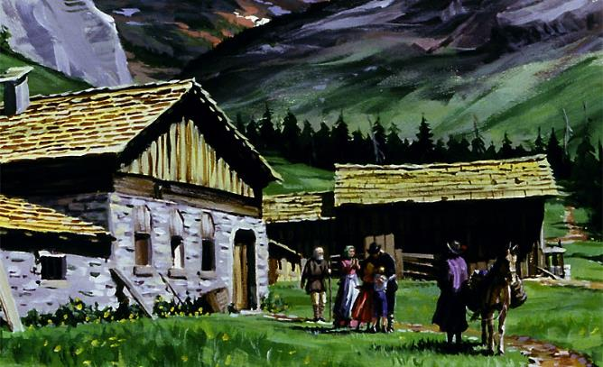
KUYIMA PA CHOONADI
Phunziro 4, April 27, 2024

Slide 2
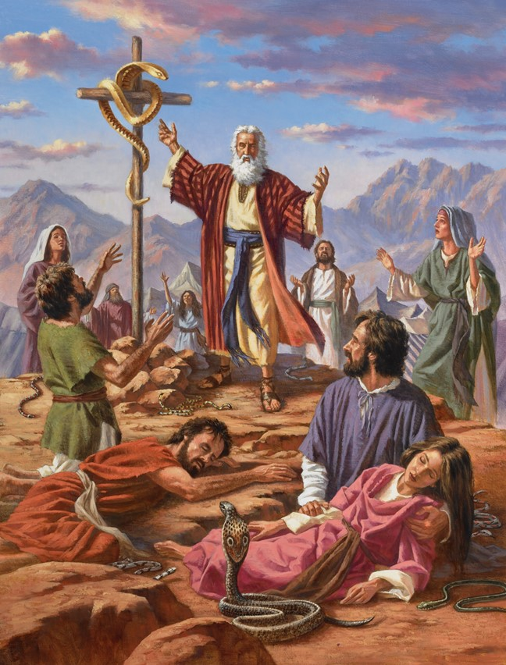
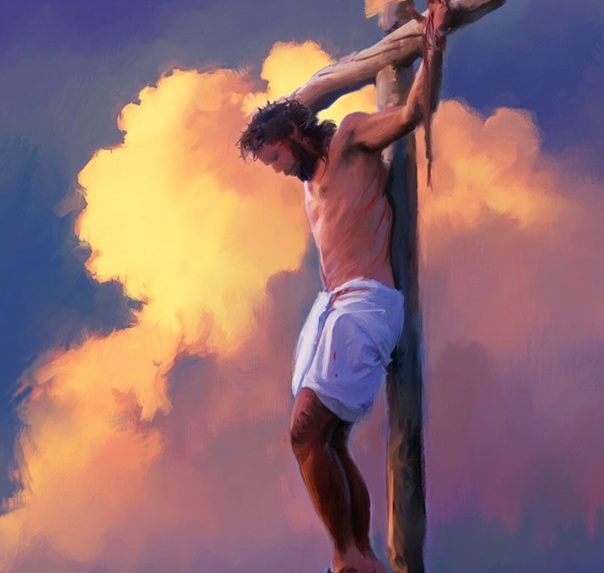
“Tsono monga Mose anapachika njoka mʼchipululu, moteronso Mwana wa Munthu ayenera kupachikidwa, kuti aliyense amene akhulupirira Iye akhale ndi moyo wosatha” (Yohane 3:14, 15, CCL)

Slide 3

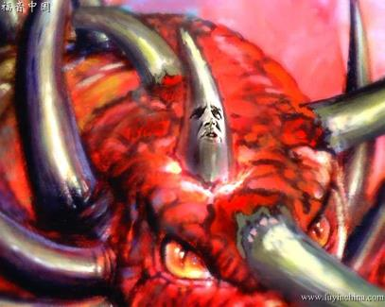
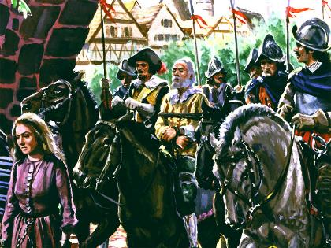
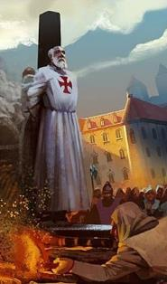


Mabuku a Danieli ndi Chivumbulutso amalengeza za nthawi imene Satana adzagwiritse nchito mphamvu zandale ndi zachipembedzo kuzunza ndi kuononga anthu amene ali olimba pa choonadi.
Mphamvu iyi “inapondereza choonadi pansi” (Danieli 8:12). Panthawi imeneyi “Ena mwa anzeruwo adzaphedwa ndi cholinga chakuti ayengedwe, otsala mwa iwo ayeretsedwe ndi kukhala wopanda banga kufikira nthawi yomaliza, popeza idzafika ndithu nthawi imene Mulungu wayika.” (Danieli 11:35)
Munthawi imeneyi – Zaka Zamdima – choonadi chinayesedwa. Koma panali anthu amene anateteza choonadi, ndipo anali okonzeka kupereka moyo wawo chifukwa cha choonadicho.
Choonadi chiyesedwa:
  Nthawi ya masautso.
  Kukhulupirika mu masautso.
Kutetezera choonadi:
  Kugawana Baibulo: Awadensi.
  Nthanda okonzanso: John Wycliffe.
  Kulimbikitsidwa ndi chikhulupiriro: John Huss ndi ena.

Slide 4
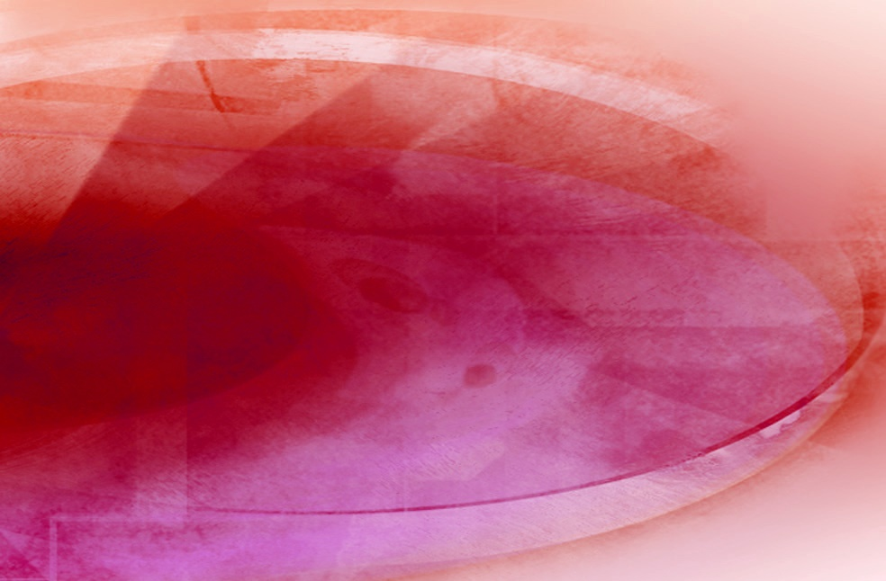
CHOONADI CHIYESEDWA

Slide 5

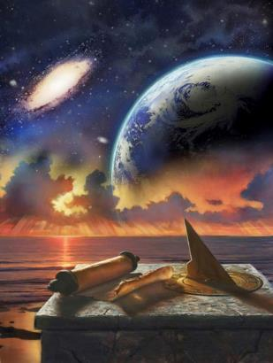
NTHAWI YA MASAUTSO
“Idzayankhula motsutsana ndi Wammwambamwamba ndipo adzazunza oyera mtima ndi kusintha masiku azikondwerero ndi malamulo. Oyera mtimawo adzalamulidwa ndi mfumuyi kwa zaka zitatu ndi theka” (Danieli 7:25)
Nthawi ya masautso imalengezedwa mu njira zitatu zosiyana
“zaka zitatu ndi theka” (Danieli 7:25; 12:7; R 12:14)
1,260 Masiku (Chivumbulutso 11:3; 12:6)
42 Miyezi (Chivumbulutso 11:2; 13:5)
Liwu lakuti “nthawi” likufanana ndi “chaka,” pamene liwu lakuti “nthawi zina” lomwe likugwiritsiridwa ntchito ndi Danieli limatanthauza “nthawi ziwiri.”.
Kalero komanso masiku ano, masiku 30 amapanga mwezi:
42 Miyezi
30 Masiku
1,260 Masiku
Chaka
2 Zaka
½ Chaka
3 ½ Zaka
Mawu onsewa amasonyeza nthawi imodzi: masiku 1,260.
12 Miyezi
24 Miyezi
6 Miyezi
42 Miyezi
Pogwiritsa ntchito mfundo yakuti “tsiku ndi chaka” ( Ezekieli 4:6; Numeri 14:34 ) nthawi ya masautso imeneyi inachitika mu zaka 1,260 za mbiri yakale.
42 Miyezi
30 Masiku
1.260 Masiku

Slide 6
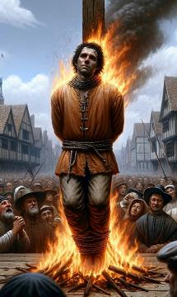
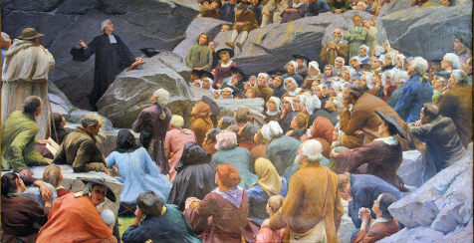
NTHAWI YA MASAUTSO
“Idzayankhula motsutsana ndi Wammwambamwamba ndipo adzazunza oyera mtima ndi kusintha masiku azikondwerero ndi malamulo. Oyera mtimawo adzalamulidwa ndi mfumuyi kwa zaka zitatu ndi theka” (Daniel 7:25)
Kodi mu mbiri ya dziko ndi nthawi iti imene imayambira masautso a zaka 1,260 wolembedwa mu mabuku a Danieli ndi Chibvumbulutso?
Zaka 538
Zaka 1798
Mpingo wa Aroma unapeza mphamvu zandale pamene mafuko atatu omwe adalandira Chiaria adagonjetsedwa: Heruli, Vandals ndi Ostrogoths.
Mtsogoleri wamkulu wa nkhondo ku France a Berthier, motsogozedwa ndi Napoleon, anatenga Apapa ukapolo, kuthetsa ukulu wa mpingo wa Aroma.
Pamene maufumu khumi andale anauka ku Aroma (mafuko amene anaukira), ufumu wina udzawonekera ndi kugonjetsa maufumu atatu mwa khumiwo. (Daniel 7:23-25).
Monga mmene ulosi unanenera, Mulungu anakonza malo oti mpingo wokhulupilika uthandizidwe : muchipululu, kutanthauza pa kamalo kochepa. (Chivumbulutso 12:6, 14).
Mu nthawi ya mavuto ndi masautso, okhulupirira okhulupirika anaima nji kutetezera choonadi, pothawira pa chikondi ndi chisamaliro cha Mulungu (Masalimo 46:1-3).
Mwatsoka, ambiri anayenera kulipira chikhulupiriro chawo ndi mwazi wawo.

Slide 7



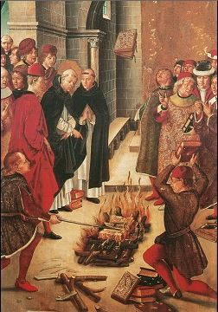
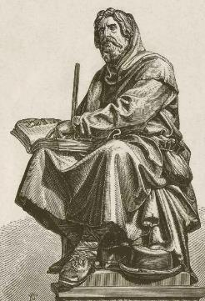
KUKHULUPIRIKA MU MASAUSTO
“Okondedwa, ngakhale ndinkafunitsitsa kukulemberani za chipulumutso cha tonsefe, ndakakamizidwa kuti ndikulembereni ndi kukupemphani kolimba kuti mumenye ndithu nkhondo yotchinjiriza chikhulupiriro chimene Mulungu anachipereka kamodzi kokha kwa anthu onse oyera mtima. ” (Yuda 1:3)
Pamene Mpingo wa Aroma unakhala ndi mphamvu zandale, unayamba kugwiritsa ntchito mphamvuzo kukakamiza aliyense kutsatira malamulo ake achipembedzo, amene ambiri mwa iwo anali atapotozedwa.
Kuwonjezera apa ziphuphu pakati pa atsogoleri achipembedzo zinachuluka. Pofuna kuletsa anthu ambiri kupandukira ulamuliro wa Mpingo, anawachotsera iwo chinthu chamtengo wapatali kwambiri: “Mawu a Mulungu”.
Koma sanakwanitse kuwononga Mawu a Mulungu kotheratu. Panauka okhulupirika omwe, motsogozedwa ndi chiphunzitso cha Baibulo ndi kutsatira uphungu wa Yuda, anamenya nkhondo mwamphamvu kuteteza chikhulupiriro chawo (Yuda 1:3).
Polimbikitsidwa ndi mphamvu ya Mawu, iwo mopanda mantha anafalitsa chiphunzitso chake. Atalimbikitsidwa ndi malonjezo ake monga Chivumbulutso 2:10 , iwo anakhala okhulupirika kufikira imfa, podziwa kuti adzalandira korona wa moyo.

Slide 8

KUTETEZERA CHOONADI

Slide 9

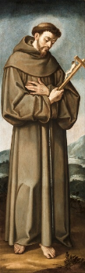
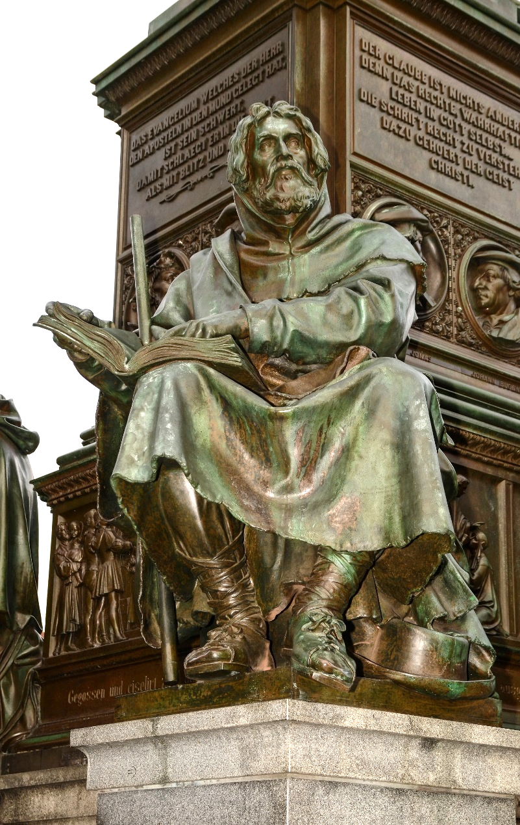
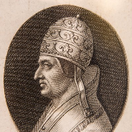
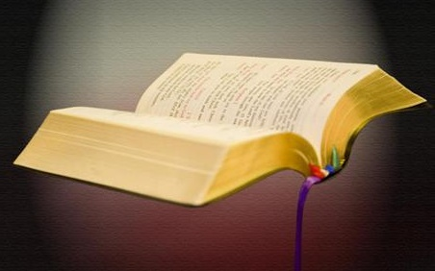
KUGAWANA BAIBULO: AWADENSI
“Petro ndi atumwi enawo anayankha kuti, “Ife tiyenera kumvera Mulungu osati anthu!’ ” (Machitidwe 5:29)
Peter Waldo (1140-1218), wamalonda wina wolemera wa ku France amene anasiya chuma chake kuti alalikire Khristu, anayambitsa gulu la “Poor of Lyon,” lotchedwa “Awadensi.” Papa Alexander III anavomereza lumbiro lake la umphawi.
Posakhalitsa, Francis wa ku Assisi (1181-1226), yemwenso anachita lumbiro laumphawi, lovomerezedwa ndi Papa Innocent III, anayambitsa gulu lotchedwa Franciscan.
Munthawi imeneyi, Papa Lucius Wachitatu anali atadzudzula otsatira a Peter Waldo kuti anali opanduka. Koma, a Franciscan anakhala mzati wa Mpingo wa Aroma pamene Awadensi anazunzidwa mpaka anatha. Chifukwa chiyani?
Chifukwa cha kukhulupirika kwawo. Gulu loyambalo linali otumikira a Papa, pamene lomalizirawo linali lokhulupirika ku chiphunzitso cha Baibulo.

Slide 10
KUGAWANA BAIBULO: THE WALDENSES
Kodi Awadensi ankadziwika bwanji?
Iwo anali oyamba kukhala ndi Baibulo m’chinenero chawo (kumbuyo konse, linali kupezeka mu Chilatini, Chigiriki komanso Chihebri chokha).
Popeza bukhuli linali loletsedwa, amalilembera mumapanga, mmalo obisika kwa Apapa omwe adawazinga.
Nthawi zonse ankanyamula ndime zosiyanasiyana za m’Baibulo akamayenda, kuti akangopeza mpata wabwino atgawane ndi anthu ena, kuwapatsa chiyembekezo ndi chilimbikitso mwa Ambuye.
Anasunga choonadi cha Baibulo chimene anachidziwa kwa zaka zambiri. Iwo ankadziwika chifukwa cha kukhulupirika kwawo ndi kudzipereka kwawo.
Midzi yonse inatembenuka kumwera kwa France komanso kumpoto kwa Italy, Piedmont.
Yambiri mwa midzi imeneyi inawonongedwa ndi Apapa, ndipo anthu ake anaphedwa.

Slide 11

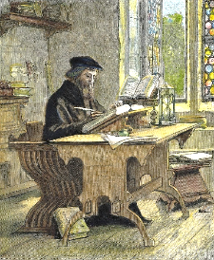
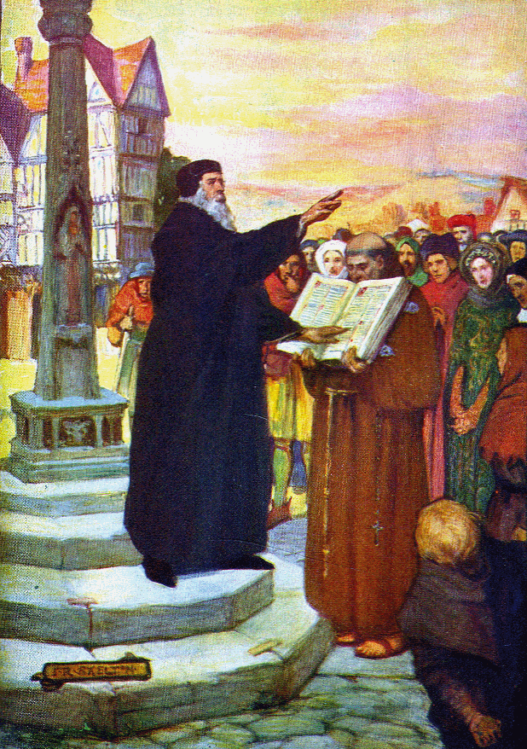
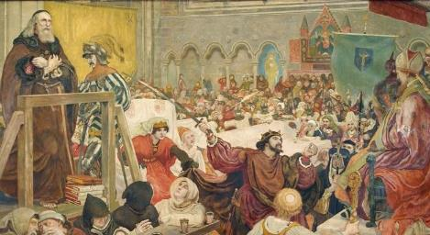
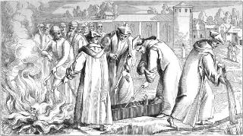
NTHANDA YA OKONZANSO: JOHN WICLEF
“Koma njira ya anthu olungama ili ngati kuwala kwa m’bandakucha kumene kumanka kuwalirawalira mpaka dzuwa litafika pa mutu” (Miyambo 4:18 CCL)
John Wycliffe (1324-1384) anadzipereka kwambiri pa ntchito yomasulira Baibulo kupita mu Chingelezi. Kodi chinamulimbikitsa kuchita zimenezi ndi chiyani? Zifukwa ziwiri: Khristu anamusintha iye kupyolera mu Mawu; ndipo ankafuna kugawana ndi ena chikondi cha Khristu.
Iye amene amaphunzira Baibulo moona mtima, ndi kutsegula mtima wake ku chikoka cha Mzimu Woyera, amasanthika (Ahebri 4:12).
Izi zinamupangitsa kuti ayambe kutsutsana ndi chiphunzitso cha Mpingo chovomerezeka. Chifukwa chakuti anali ndi ubale wabwino and akuluakulu a boma ku England, John anapewa kuphedwa ndi Mpingo.
Mu 1428 thupi lawokonzanso uyu linawotchedwa, ndipo phulusa lake linaponyedwa mumtsinje. Phulusa lake lomwazikana linakhala chizindikiro cha cholowa chake.
Kuunika pang’ono kwa choonadi kumene John Wycliffe kunafikira kudera lotchedwa Bohemia, kumene John Hus anatenga cholowa chake. Mwa njira imeneyi, chowonadi chinayenda mpaka m’mawa wa kukonzanso zinthu. Tsiku linayambo kuwala.

Slide 12

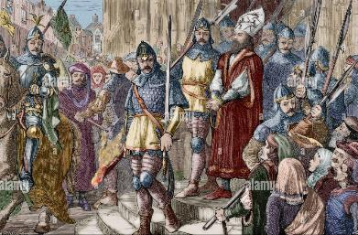
KULIMBIKITSIDWA NDI CHIKHULUPIRIRO: JOHN HUSS NDI ENA
“Iye amene ali ndi Mwana ali ndi moyo, amene alibe Mwana wa Mulungu alibe moyo.” (1 Yohane 5:12)
Pambuyo pa John Wycliffe, panabukanso anthu ena osintha zinthu :
John Huss (1370-1415)
Jerome (1360-1416)
Tyndale
(1494-1536)
Hugh Latimer (1490-1555)
Kodi ndi chiyani chomwe chinawathandiza kukhala olimba mtima kuti apitirize kukonzanso ndikuyang’anana ndi mavuto komanso imfa?
Iwo anakhulupira malonjezano a Khristu
Mphamvu ya Khristu inali yokwanira kwa iwo kugonjetsa mayesero
Anapeza chimwemwe potengamo mbali mumasautso a Khristu
Kukhulupirika kwake kunali umboni wamphamvu kudziko lapansi
Iwo anayang’ana tsogolo laulemerero kopasa zochitika panthawiyo
Iwo ankadziwa kuti imfa ndi mdani wogonjetsedwa kale
Iwo anagwira kolimba malonjezo a Mawu a Mulungu
John Hus anatsekeredwa m’ndende ndipo pomalizira pake anawotchedwa pamtengo. Ali m’ndende analemba kuti: “Mulungu wandichitira chifundo, ndipo wandichirikiza modabwitsa.” Monga momwe malonjezo a Mulungu anachirikizira anthu ake mu nthawi zakale, amatithandiza nso ife lero lino.

Slide 13

“Onse amene pa tsiku loipa limenelo adzatumikira Mulungu mopanda mantha molingana ndi zonena za chikumbumtima chawo, adzafunika kulimba mtima, kuima nji, ndi kukhala nacho chidziwitso cha Mulungu ndi mawu Ake; pakuti iwo amene ali owona kwa Mulungu adzazunzidwa, zolinga zawo zidzatsutsidwa, zoyesayesa zawo zidzatanthauziridwa molakwika, ndipo mayina awo adzatayidwa kunja monga oipa. Satana adzagwira ntchito ndi mphamvu zake zonse zachinyengo kusokoneza mtima ndi kulepheretsa kumvetsetsa. […] Chikhulupiriro cholimba ndi choyera cha anthu a Mulungu, ndi kutsimikiza mtima kwawo pa kummvera Iye, ndipamenenso Satana adzalimbikire kwambiri kuutsa mkwiyo wa anthu amene akudzinenera kuti ali olungama, koma akupondereza Malamulo a Mulungu. Padzafunika kudalira kolimba, cholinga champhamvu kwambiri, kugwiritsitsa chikhulupiriro chomwe chinaperekedwa kwa oyera mtima”
EGW (The Acts of the Apostles, pg. 431.1)

