Slide 1
TSIKU MU UTUMIKI WA YESU
Phunziro 2, July 13, 2024

Slide 2
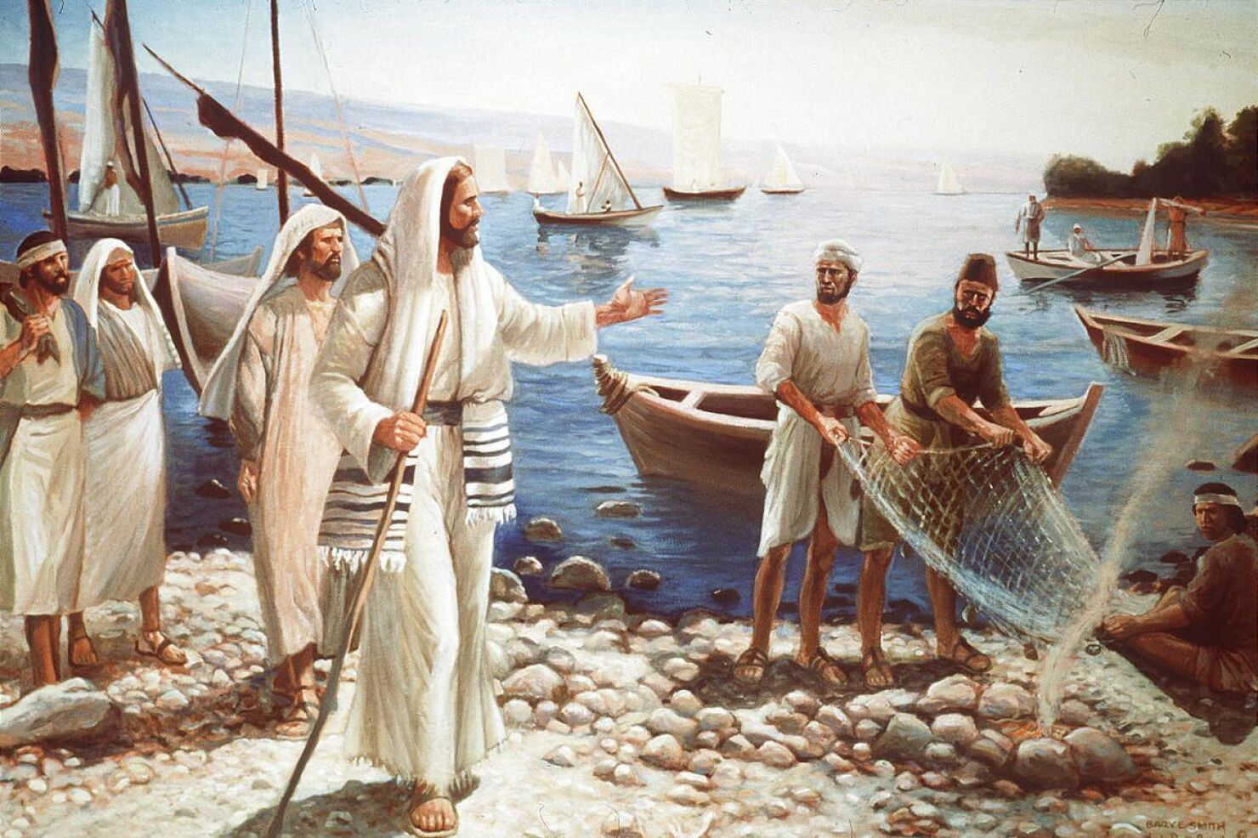
“Yesu anati, “Bwerani, tsateni Ine, ndipo ndidzakusandutsani asodzi a anthu.”
(Marko 1:17)

Slide 3
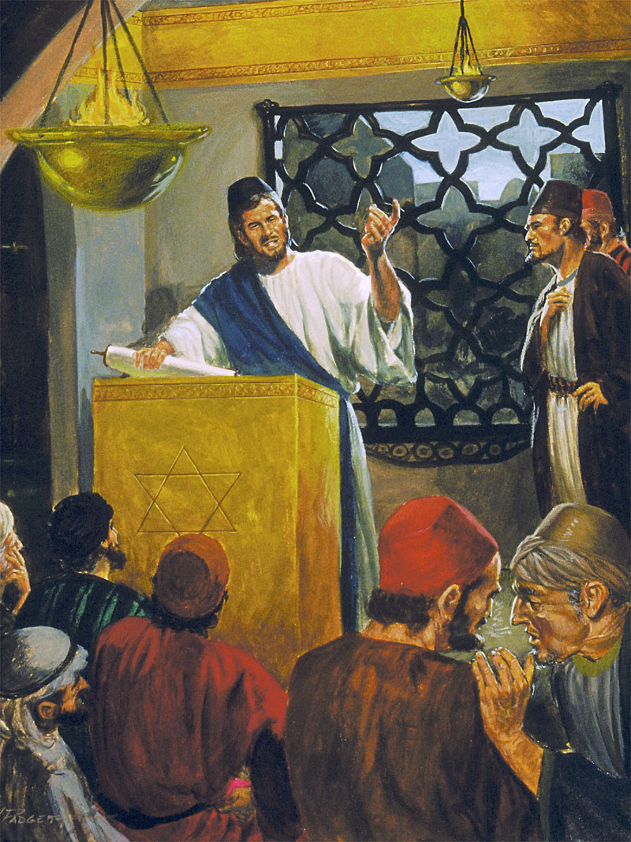
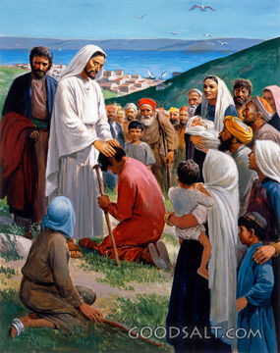
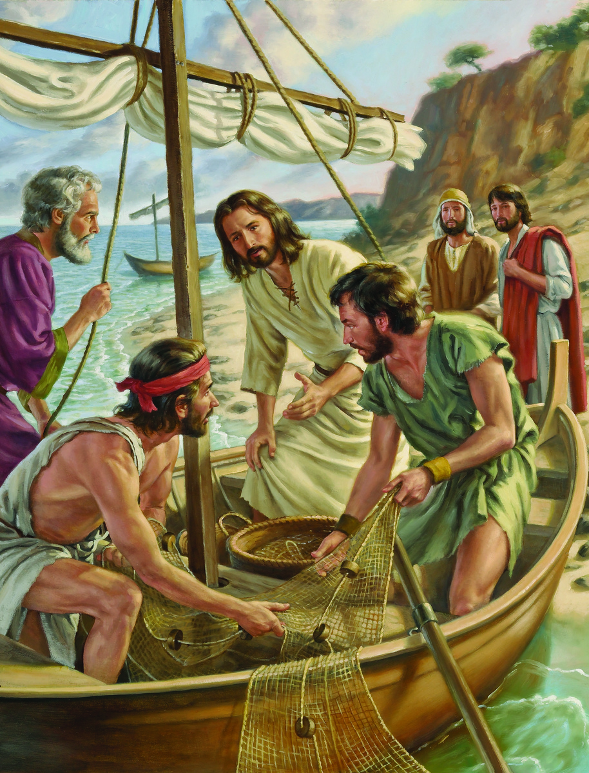
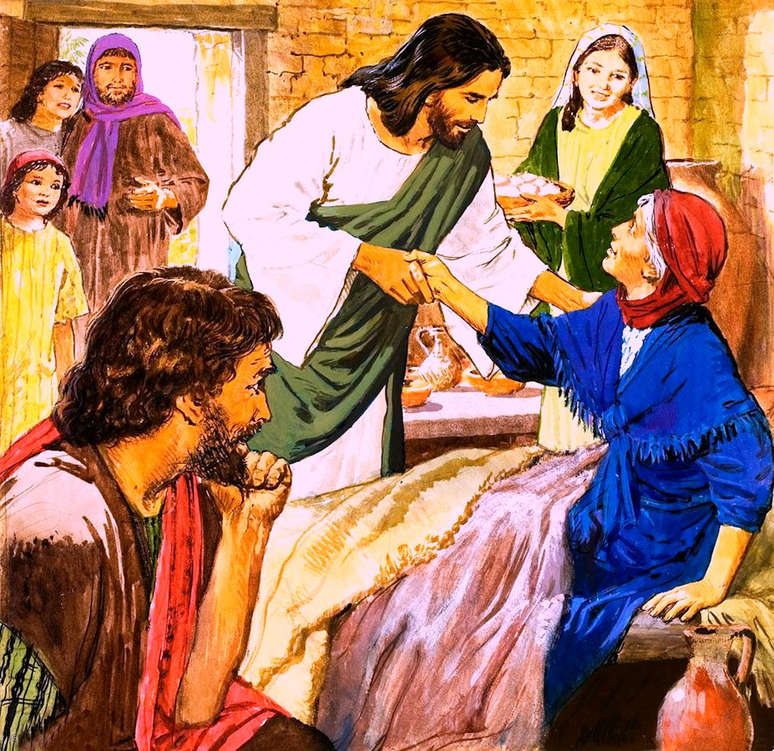
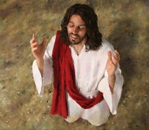
Kodi tsiku mu moyo wa Yesu likanakhala lotani? Nanga ngati tikadayenda naye kwa sabata lathunthu zikanakhala bwanji?
Marko akutithandizira kulingalira momwe moyo wotere unalili mu mdime yomalizira ya la chaputala chake choyamba (Markoo 1:16-45).
Titsagana naye Yesu pamene akuitana gulu la asodzi kuti limutsatire nthawi zonse; kusangalala ndi tsiku la Sabata lotanganidwa; ndipo, potsiriza, tiwona kuti miyambo yawo ya tsiku ndi tsiku inali yotani.
Ntchito za padera:
Kuitana ophunzira. Marko 1:16-20.
Zochita pa Sabata:
Kulalikira mʼsunagoge. Marko 1:21-28.
Kuchidza. Marko 1:29-34.
Zochitika za tsiku ndi tsiku:
Kupemphera ndi kulalikira. Marko 1:35-39.
Kuchiza ndi kulemekeza Malamulo. Marko 1:40-45.

Slide 4
NTCHITO ZA PADERA

Slide 5
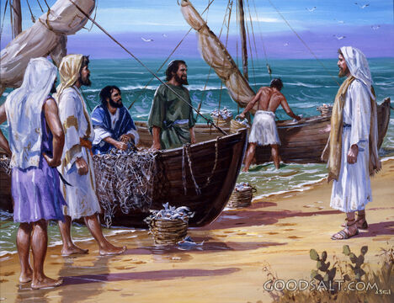
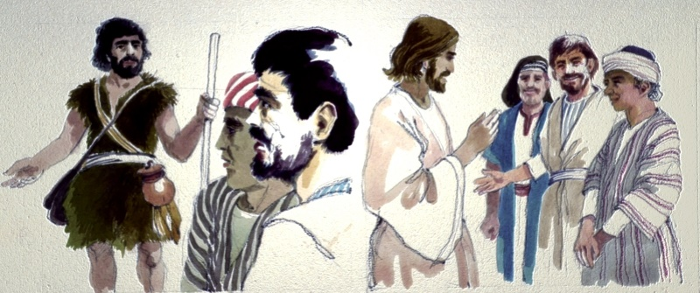
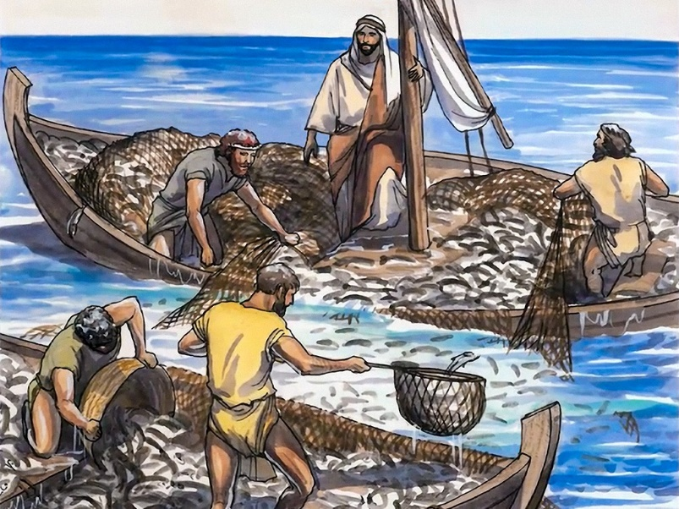
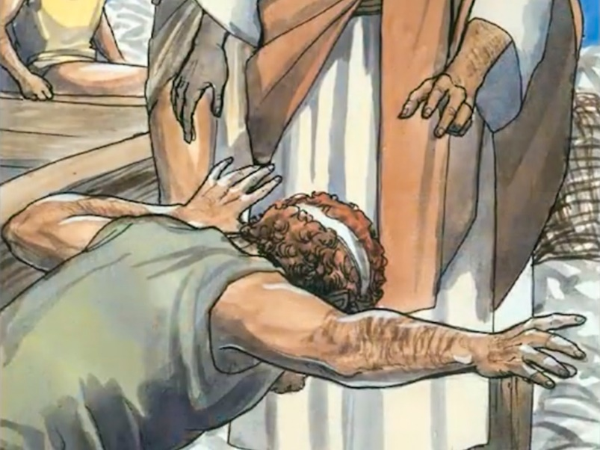
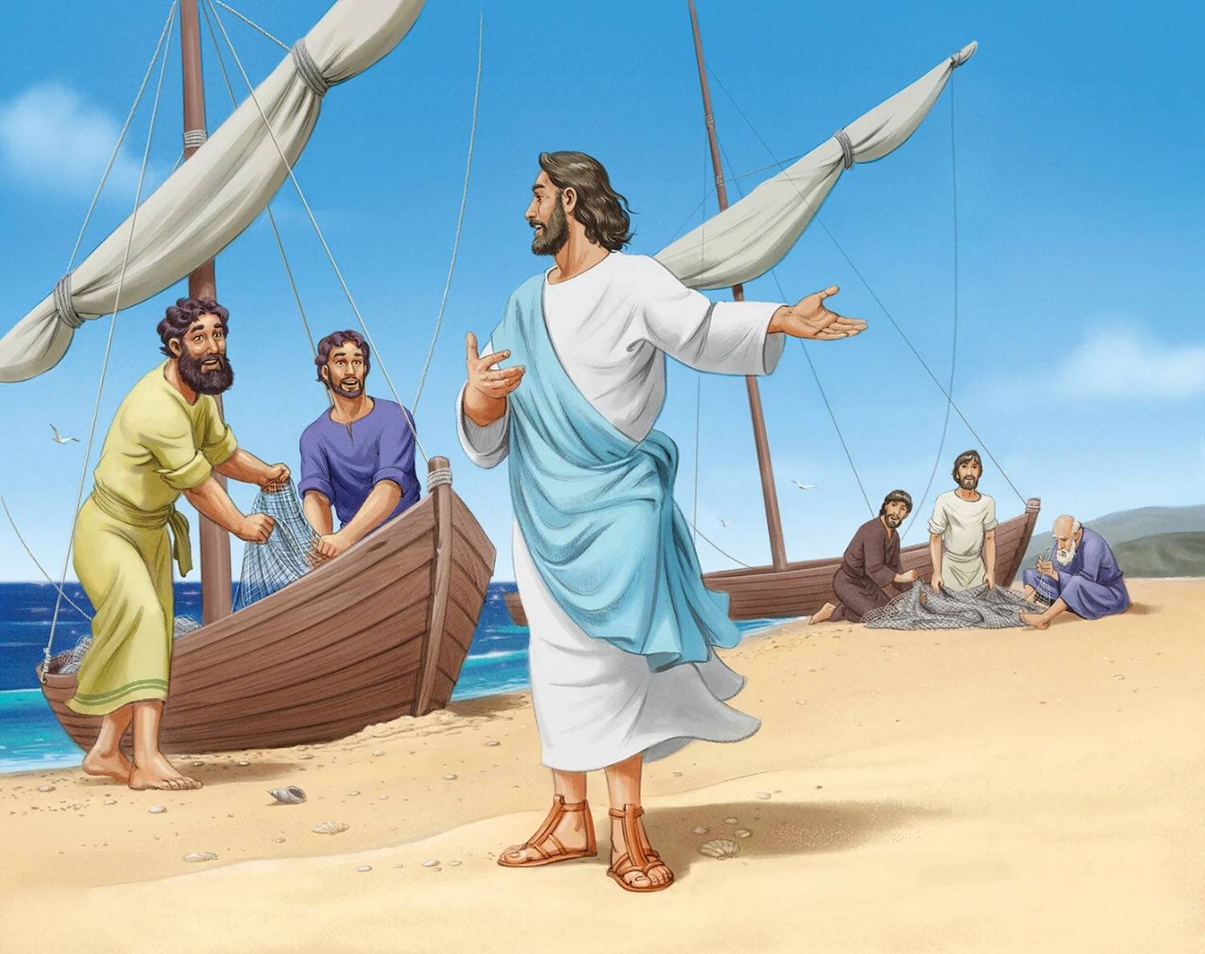
KUITANA OPHUNZIRA
“Yesu anati, “Bwerani, tsateni Ine, ndipo ndidzakusandutsani asodzi a anthu (Marko 1:17)
Marko amadziwika ndi uthenga wake waufupi wachindunji. Ngati sitingafufuze bwino Mauthenga Abwino ena, tingathe kufika pa maganizo olakwika pa nkhani ya maitanidwe amenewa.
Aka sikanali koyamba kuti anthuwa akumane ndi Yesu. Pamene anali otsatira a Yohane M’batizi, anamvapo mawu ake (Yohane) okhuzana ndi Yesu, ndipo anamutsatira iye (Yesu). Oyamba kuchita zimenezi anali Andreya ndi Yohane, kutsatiridwa ndi abale awo ( Yohane 1:35-42 ).
Yesu akulalikira kuchokera mu bwato la Petro, kenako akukoka nsomba zochuluka mozizwitsa. Khoka la abale anayiwo linatsala pang’ono kung’ambika ndi kuchuluka kwa nsomba ( Luka 5:1-7 ). Pamene Yakobo ndi Yohane akukonza maukonde, Petro akugwa pa mapazi a Yesu ( Luka 5:8-11 ).
Yakobo ndi Yohane anasiya atate wawo kuti aziyang’anira bizinesi ya pa banja lowo, ndipo Petro ndi Andreya anasiya ntchito yawo yothandizira pa umoyo wawo kukhala okopa miyoyo. Pomvera maitanidwe a Yesu, anasintha miyoyo yawo, ndi miyoyo ya dziko lonse lapansi.

Slide 6
ZOCHITA PA SABATA

Slide 7
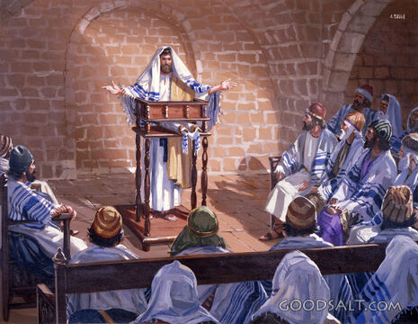
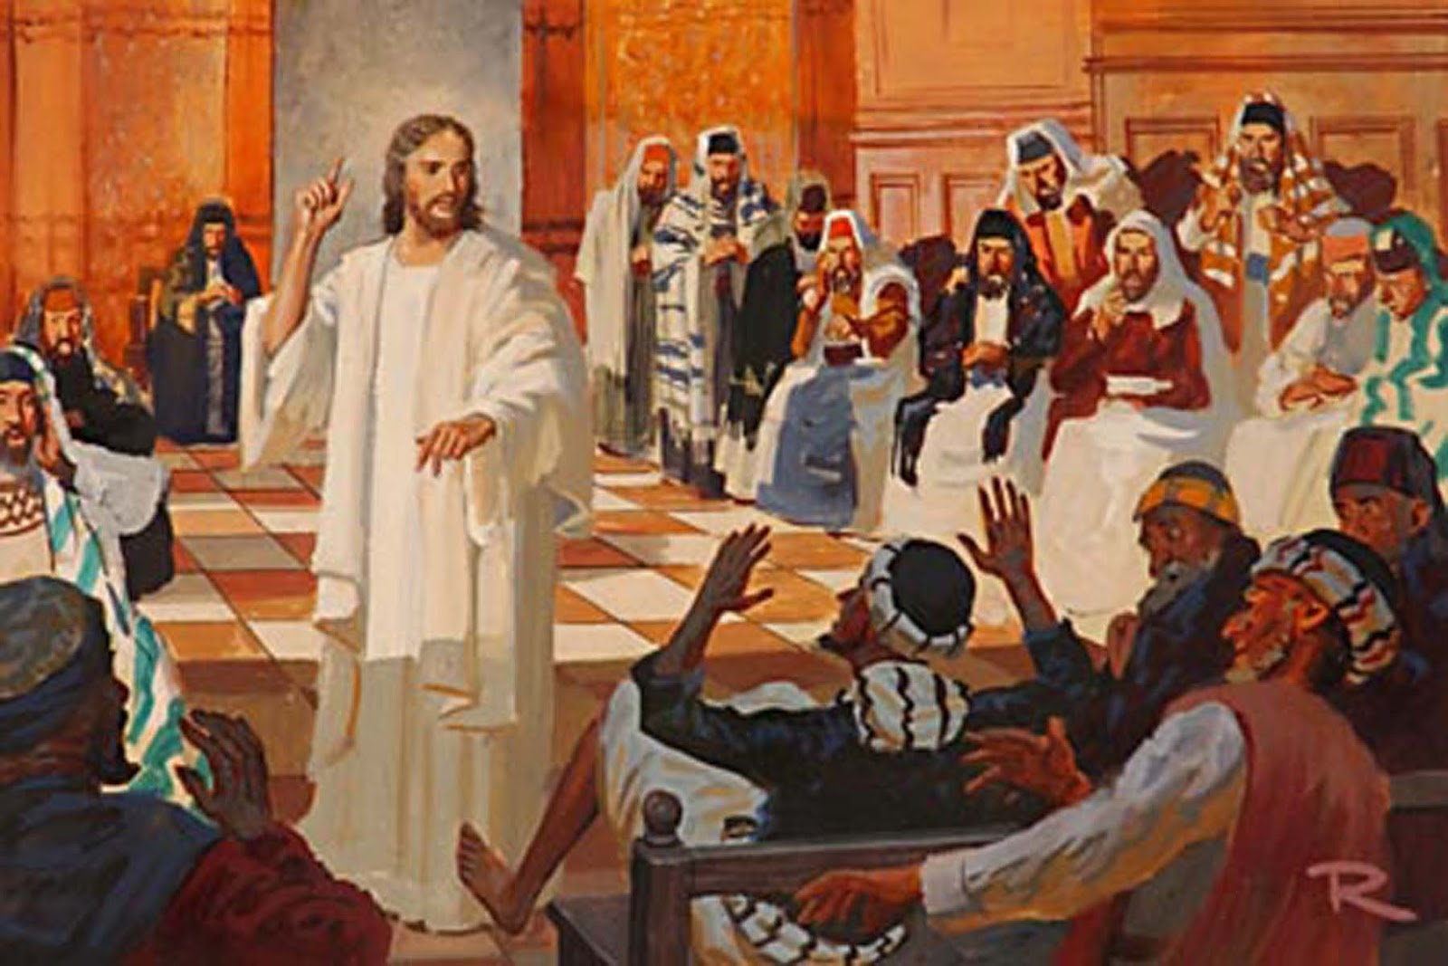
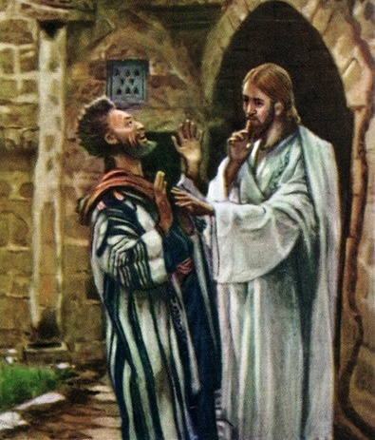
KULALIKIRANI MʼSUNAGOGE
“'Iwo anapita ku Kaperenawo, ndipo tsiku la Sabata litafika, Yesu analowa mʼsunagoge nayamba kuphunzitsa. (Marko 1:21)
Uthenga wa Bwino umanena momveka bwino lomwe kuti kupita ku kachisi pa tsiku la Sabata linali khalidwe lokhazikika la Yesu, osati chochitika chapadera cha pakanthawi (Luka 4:16).
Kodi anthu anachita chiyani atamva ulaliki wa Yesu? ( Marko 1:22 )
Koma si onse amene anasangalala. Mdani anaganiza zosokoneza utumikiwo, ndi chiyembekezo chothetsa chikoka cha Yesu (Marko 1:23-26). Kulowererapo mwachangu kunapangitsa kuti anthu akopeke naye kwambiri (Marko 1:27-28).
Mfundo zitatu zikuonekera poyera mu nkhaniyi
Munali chiwanda m’kachisi. Muli “namsongole” m’kacisi, ndipo sitikutha kuwalekanitsa (Mateyu 13:24-30).
Chiwandacho chinkadziwa kuti Yesu anali ndani, ndipo chinasakasaka njira yochopetsera mphamvu ya chikoka Chake.
Yesu adamuuza kuti akhale chete. Iyi sinali nthawi yoti adziulule poyera kuti iye ndi Mesiya.

Slide 8
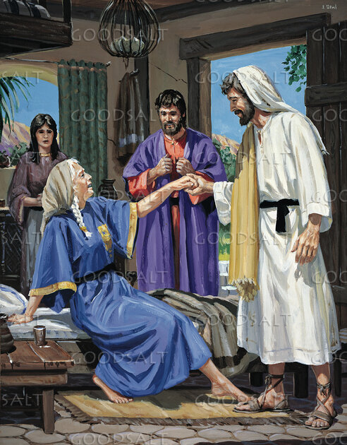
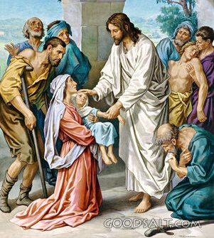
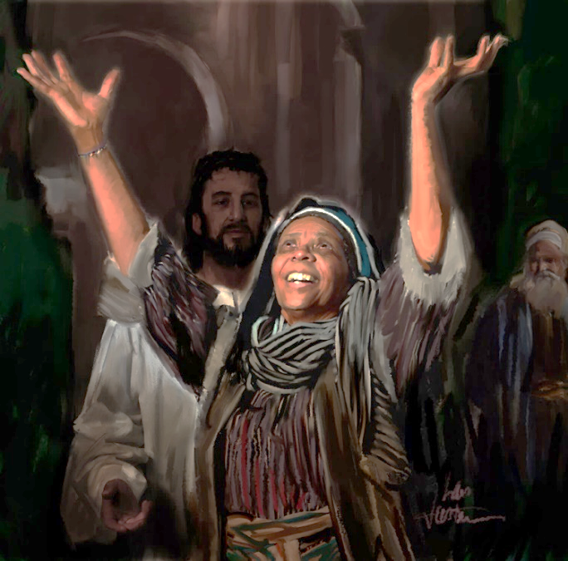
KUCHIZA
“Madzulo omwewo dzuwa litalowa anthu anabweretsa kwa Yesu anthu onse odwala ndi ogwidwa ndi ziwanda. (Marko 1:32)
Pamaliza pa utumiki wa m’sunagoge, Yesu ndi ophunzira ake anayi anapita kukapumula ndi kudya kunyumba ya Petro ( Marko 1:29 ).
Pamene anali kukonza gome, anauza Yesu za apongozi ake a Petro, amene anadwala malungo ( Marko 1:30 ). Atachiritsidwa, mkaziyu anadzipereka kutumikira alendo (Marko 1:31). Madalitso omwe Yesu amatitsanurira amadzutsa mwa ife chilakolako choti tigawane ndi ena.
Chozizwitsa cha munthu wogwidwa ndi ziwanda chinali nkhani yokambirana m’nyumba zambiri ku Kaperenao. Kotero pakutha kwa maola opatulika a Sabata, dzuwa litalowa, anabweretsa odwala ambiri kwa Yesu kuti awachiritse (Marko 1:32-34).
Chisangalalo chodzadza tsaya! Mfuu wa matamando zikumveka m’nyumba ya Simoni! Si ochiritsidwa okha omwe anatamanda, Yesu mwini anakondwera powachiritsa.
Pakutha pa tsiku lotopetsa, mkati mwa usiku, Yesu anapumula.

Slide 9
ZOCHITA ZA TSIKU NDI TSIKU

Slide 10
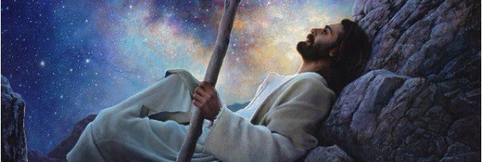
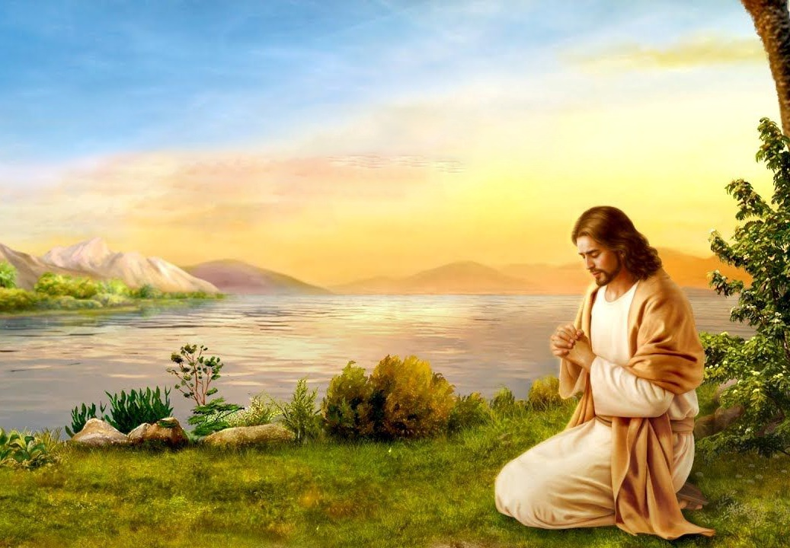
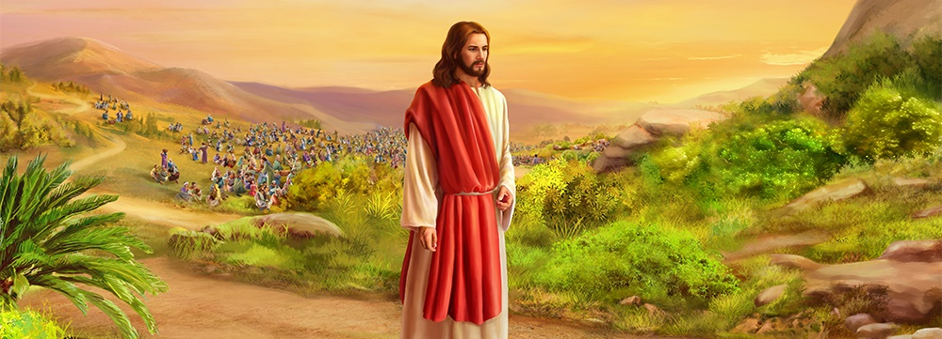
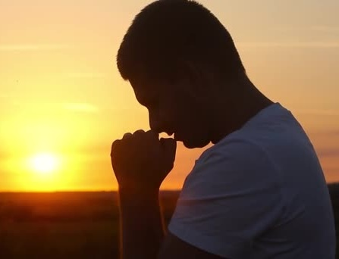
KUMPHERA NDI KULALIKIRA
'Mmamawa, kukanali kamdima, Yesu anadzuka, nachoka pa nyumbapo kupita kumalo kwa yekha, kumene anakapemphera.(Marko 1:35)
Tsiku loyamba la pa mulungu, ophunzira anadikira kuti Yesu alalikire mumzindawo. Koma zimene Yesu anakonza zinali zosiyana. Anayenera kupindulitsa ena ambiri ndi mawu ake komanso zochita zake (Marko 1:36-39).
Koma Yesu sanali kuchita mwanzeru zayekha. Monga mwa nthawi zonse, iye anali atapita kaye kukalankhula ndi Atate wake kuti amuuze zimene zinali zofunika kuchita pa tsiku imenelo ( Marko 1:35; Yohane 8:28 ).
Tsiku liri lonse Yesu ankakonda kufunafuna Mulungu mu pemphero, ndipo akutipempha kuti tizimutsanzire Iye ( Marko 6:46; Luka 3:21; 5:16; 9:18; 11:1; 18:1 ). Munyengo zapadera, Iye ankapatulira mwapadera usiku onse ku kupemphera ( Luka 6:12-13; Mateyu 14:21-23 ).
Mofanana ndi Yesu, kodi sitiyenera kufunafuna Mulungu tsiku liri lonse mu pemphero kuti tidziwe chifuniro chake? Mu zochitika zapadera, kodi siyenera kumufuna Iye kudzera mu pemphero?

Slide 11
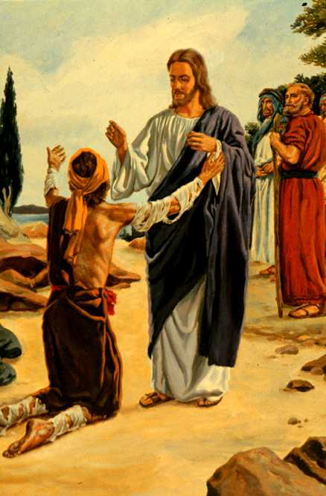
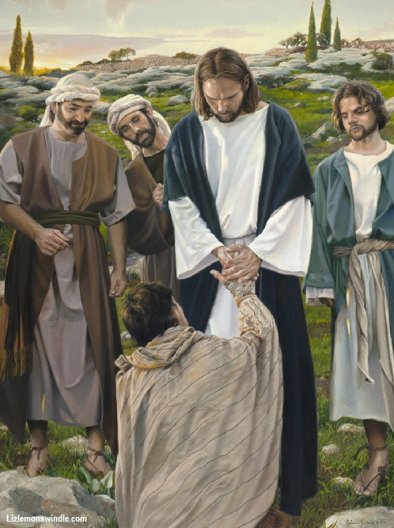
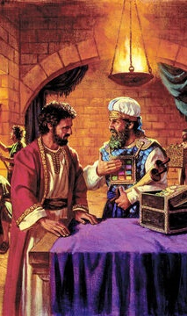
KUCHIDZA NDI KULEMEKEZA LAMULO
“Wonetsetsa kuti usawuze aliyense za zimenezi. Koma pita, kadzionetse wekha kwa wansembe ndi kukapereka nsembe zimene Mose analamulira zotsimikizira kuyeretsedwa kwanu, ngati umboni kwa iwo.” (Marko 1:44)
Wakhate, wosalidwa ndi anthu onse, chifukwa cha matenda ake, anagwada pamaso pa Yesu kupempha machilitso (Levitiko 13:45; Marko 1:40).
Mu kuona kwa khamu la anthu lalikulu, Yesu akuchita chinthu china chake chosemphana ndi chilamulo: akukhudza wakhateyo, ndipo pakutero Iye akukhala odetsedwa. Koma, m’malo molandira chidetso cha wakhateyo, wakhateyo analindira machilitso a Yesu.
Pamene tibwera kwa Yesu ndi machimo ndi nyansi zathu, Iye sadzatichokera ife. Adzatipatsa chikhululukiro ndi machiritso, kutipanga ife kukhala oyera/angwiro monga Iye.
Atamuchiritsa, anamupatsa malamulo awiri ndi zolinga ziwiri
( Mk. 1:44 )
Kadzionetsere kwa ansembe
Iye anasonyeza kuti ankalemekeza malamulo
Zinapereka mwayi kwa ansembe womuvomereza kuti Iye ndi Mesiya.
Khala chete
Iye analepheretsa ansembe kukhala ndi mtima wofuna kulimbana ndi wakhateyo
Iye anapewa kudzutsa chiyembekezo cha mesiya mu khamulo

Slide 12
“Moyo wa Mpulumutsi padziko lapansi sunali wophweka. Koma sanatope kugwira ntchito yopulumutsa anthu otaika. Anakhala moyo wosadzikonda kuyambira pa kubadwa kwake mpaka imfa yake. Iye sanayese kumasuka ku ntchito zolimba ndi maulendo otopetsa. Iye ananena kuti Mwana wa munthu “sanabwere kudzatumikiridwa, koma kudzatumikira ndi kupereka moyo wake kuwombola anthu ambiri.” Mateyu 20:28 . Ichi chinali cholinga chimodzi chachikulu cha moyo Wake. Zina zonse zinali zocheperapo. Kuchita chifuniro cha Mulungu ndi kutsiriza ntchito yake kunali ngati chakudya ndi zakumwa kwa Iye. Panalibe kudziganizira yekha mu ntchito Yake."
EGW (Steps to Christ, pg. 77)

