Slide 1
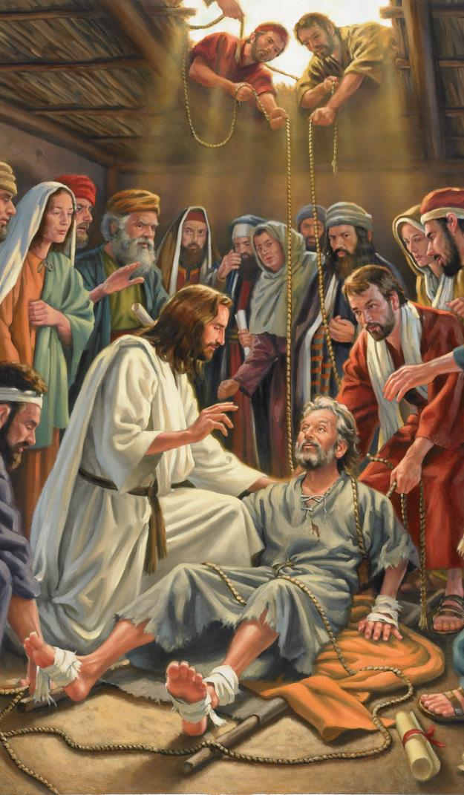
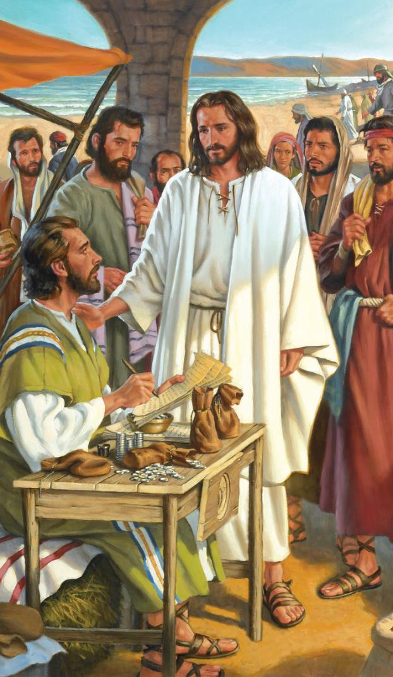
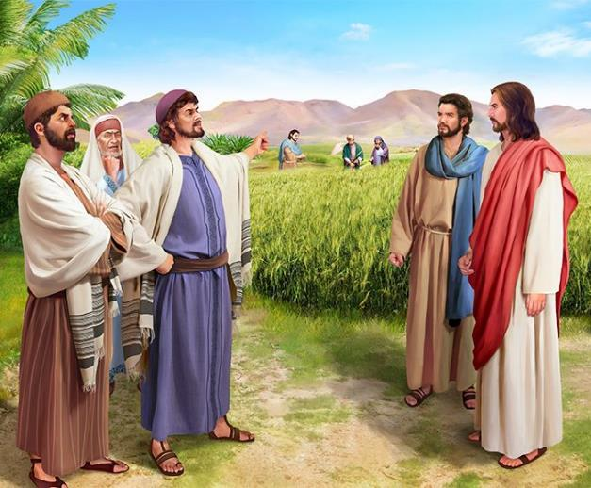
MIKANGANO
Phunziro 3, July 20, 2024

Slide 2
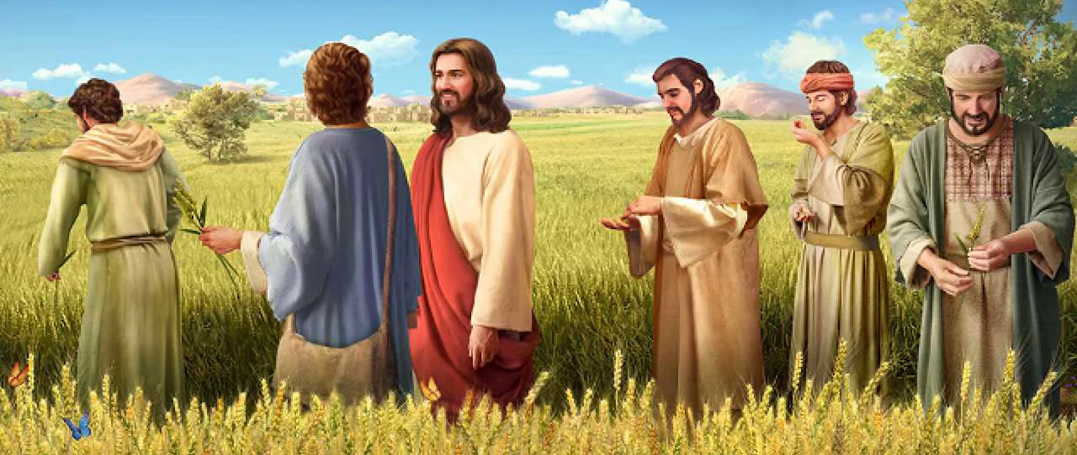
“Pamenepo anawawuza kuti, “Sabata linapangidwira munthu, osati munthu kupangidwira Sabata. 28Choncho Mwana wa Munthu ali Ambuye ngakhale wa Sabata.” (Marko 2:27, 28,)

Slide 3
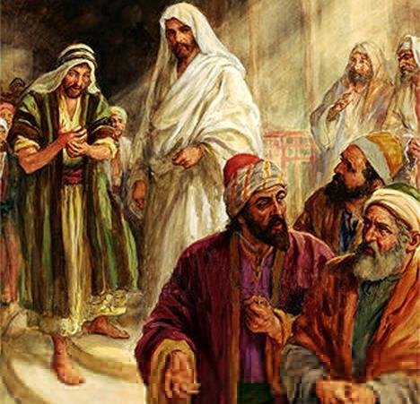
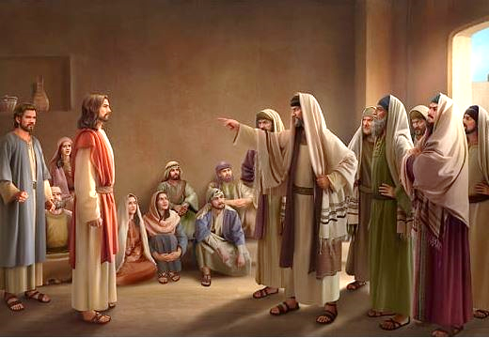
Khalidwe la Yesu, njira yakalalikidwe kake, ngakhale machiritsidwe kwake, zinatsutsana kotheratu ndi miyambo ya atsogoleri achipembedzo.
Iwo adamuyesa Iye ochitira mwano Mulungu; wadyera komanso bwenzi la ochimwa; Wolakwira Sabata… Iwo anamuimba mlandu kuti amagwira ntchito kwa Belezebubu!
Abale ake enieniwo anakhulupirira kuti Yesu wasokonezeka maganizo chifukwa chogwira ntchito mowirikiza.
Mosakayikira, moyo wa Yesu unali wa mikangano.
Mkangano pa kukhululuka. Marko 2:1-12.
Mkangano wa chakudya. Marko 2:13-22.
Mkangano pa Sabata Marko 2:23-3:6.
Mafunso odzetsa mtsuto okhudza Yesu:
Kodi iye amachita zozizwitsa ndi mphamvu iti? Marko 3:22-30.
Kodu Yesu ndi wopenga? Marko 3:20-21, 31-35.

Slide 4
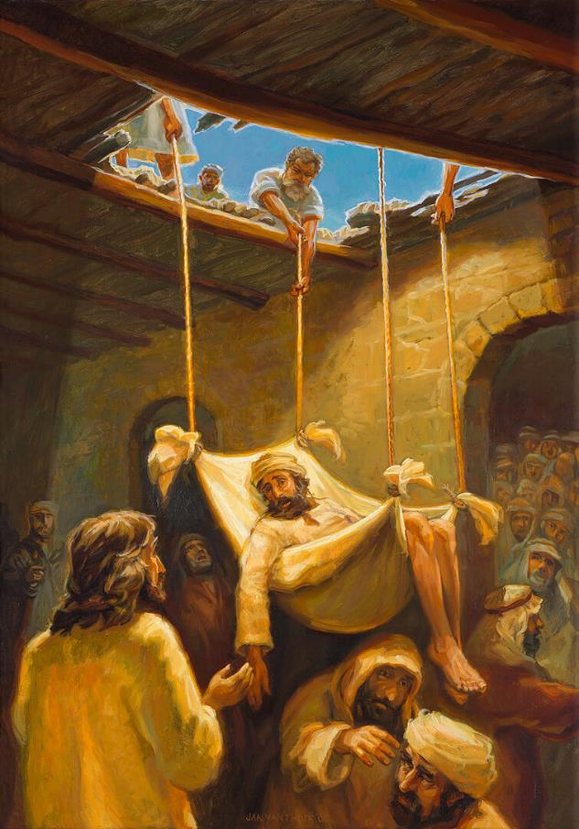
MKANGANO PA KUKHULULUKA
“Yesu ataona chikhulupiriro chawo, anati kwa wofa ziwaloyo, “Mwana, machimo ako akhululukidwa.”
Marko 2:5
Yesu atabwerera kunyumba kwa Petulo ku Kaperenao, anthu ambiri anabwera kudzamumvetsera (Marko 2:1-2). Abwenzi anayi anafuna kuti Yesu achiritse bwenzi lawo lakufa ziwalo, koma sanathe kumuyandikira Iye. Pofunitsitsa kumufikitsa kwa Yesu, anakwera pa denga ndi kuboola dengalo, kupanga malo omutsitsira mnzawoyo. Kulankhula kwa Yesu anajejemetsegwa, ndipo aliyense anakhala chete, kuyembekezera kuona zomwe Yesu angachite (Marko 2:3-4).
“Machimo ako akhululukidwa” (Marko 2:5). Wofa ziwaloyo akanatha kunena kuti: “Chimene ndikufuna ndicho kuyenda.” Koma iye sanachite izo. Yesu anachiritsa gwero la matenda ake. Iye sanasamale za kusayendanso, koma za chikhululukiro chimene chinapereka mtendere ku moyo wake.
Kwa alembi, uku kunali kuchitira mwano Mulungu (zowona, ngati Yesu sanali Mulungu). Kuti asonyeze kuti anali ndi mphamvu zokhululukira, Yesu anachiritsa wakufa ziwalo (Marko 2:8-11).
Anthu anatamanda Mulungu chifukwa chopatsa Yesu mphamvu zokhululukira machimo (Marko 2:12; Mateyu 9:8). Wofa ziwaloyo anayenda; koma alembi anasiyidwa akhungu, osapenya kuti Yesu anatha kuwerenga maganizo awo, kukhululukira wochimwayo, ndi kum’chiritsa.

Slide 5
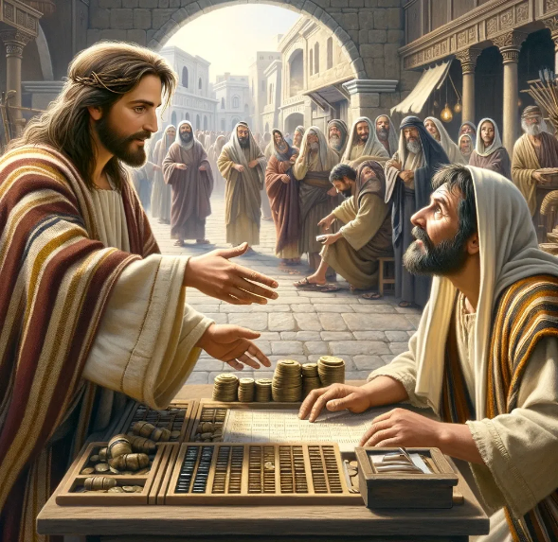
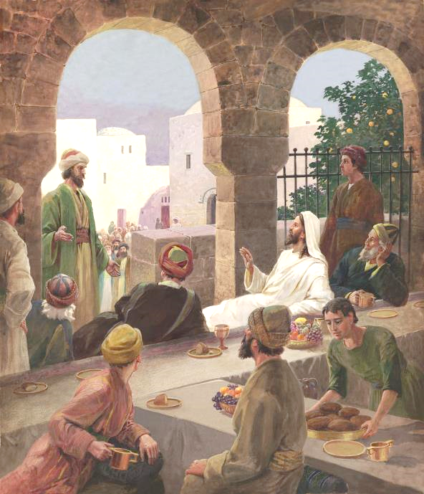
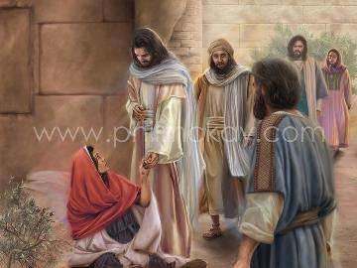
MKANGANO PA CHAKUDYA
“Pamene ankayendabe, anaona Levi mwana wa Alufeyo atakhala mʼnyumba ya msonkho. Yesu anamuwuza kuti, “Tsate Ine.” Ndipo Levi anayimirira namutsata Iye.” (Marko 2:14).
Sizovuta kulingalira mkangano umene kuitanidwa kwa Levi kunadzutsa (Marko 2:13-14 ). Kwa Myuda weniweni, okhometsa msonkho anali woipa kuposa wamitundu. Iye anali Myuda opanduka, ogwirizana ndi adani awo. Samadya ngakhale kugwirizana naye;
Koma zinthu zinayipirabe pamene Yesu anakadya kunyumba ya okhometsa msonkho, namacheza nawo (Marko 2:15). Anthu omutsutsa anapeza mpta onena: “ndani uyu akudya ndi kumwa limodzi ndi anthu okhometsa msonkho ndi ochimwa? (Marko 2:16)
Yesu anawatsutsa momveka bwino: “anthu ochimwa ndikawapezanso kuti koposa awa? (Marko 2:17). Kuonjezela apo, anawalangiza kuti asamale kaganizidwe kawo. aphunzire kukonda (Mateyu 9:12-13 ).

Slide 6
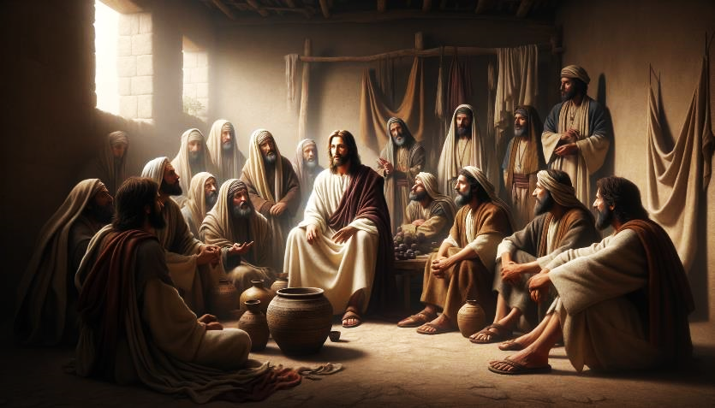
MKANGANO PA CHAKUDYA (2)
“Yesu anayankha nati, “Kodi alendo a mkwati angasale kudya bwanji pamene iye ali nawo pamodzi? Iwo sangatero, pamene iye ali nawo pamodzi”. (Marko 2:19)
M’malo mophunzira kukondana, Afarisiwo anasonkhezera ophunzira a Yohane kuti nawonso ayambe kuwadzudzula kuti: “Bwanji ophunzira a Yohane ndi ophunzira a Afarisi akusala kudya, koma anu sasala kudya?” ( Marko 2:18 )
Fanizo la ukwati (Marko 2:19-20).
Kodi munthu angasale bwanji ali paukwati? Mkwati ndi Yesu; alendowo ophunzira. Pamene Yesu anafa ndi kuukitsidwa, ophunzira ake anafunikira kusala kudya.
Fanizo la zatsopano ndi zakale (Marko 2:21-22).
Ziphunzitso zamoyo za Yesu zinalibe malo m’ziphunzitso zakufa za miyambo; komanso ziphunzitso zakufa za miyambo zinalibe malo m’ziphunzitso za moyo za Yesu.
Yankho la Yesu linadza mwa mafanizo:

Slide 7
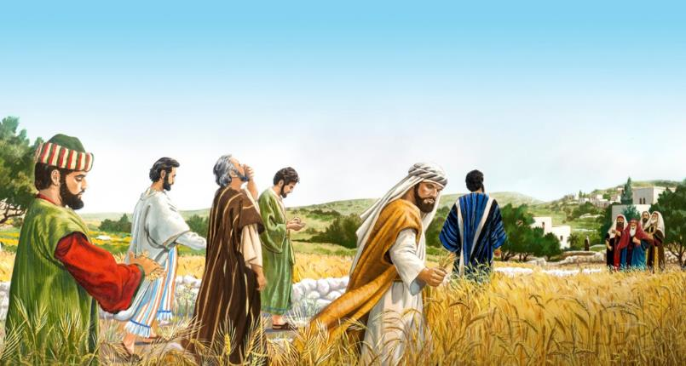
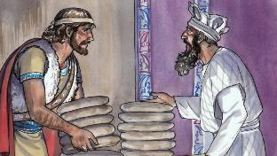
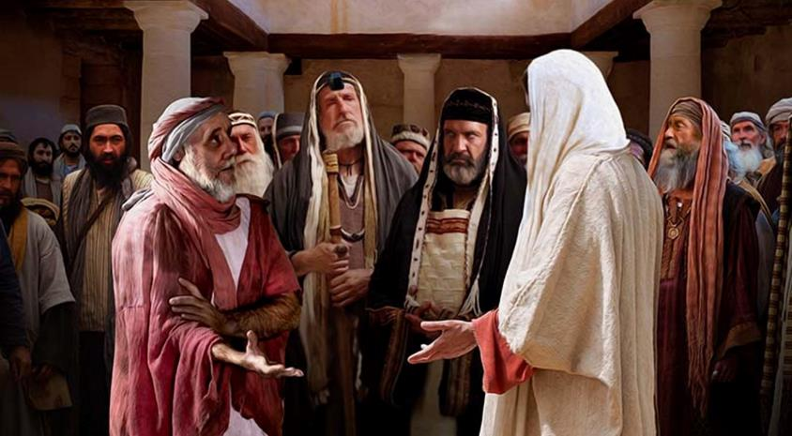
MKANGANO PA SABATA
“Afalisi anati kwa Iye, “Taonani, chifukwa chiyani akuchita chosaloledwa ndi lamulo pa Sabata?” (Marko 2:24)
Afalisi anaphunzitsa anthu ntchito 39 zomwe zimamphwanya kasungidwe ka Sabata la Yehova.
Pamene akuphunzira a Yesu anatenga tirigu ndi kuchotsa kuchotsa mankhusu ake kuti adye, anachita ntchito zitatu zoletsedwa pa Sabata: kukolola; kuphunda ndi kupeta. ( Marko 2:23-24; Mateyu 12:1-2 ).
Yankho la Yesu: Kodi simukumbukira kuti Davide, pamene anali ndi njala, anadya mkate wopatulika, umene ansembe okha ndiwo anadya? ( Marko 2:25-26 ).
Pambuyo pake, Yesu anachita “ntchito” imene sinaphatikizidwe pakati pa 39, koma yomwe inalingaliridwanso kukhala kulakwa pa Sabata: kuchiza ( Marko 3:1-3 ).
Yesu anayankha kuti: “Kodi chololedwa kuchita pa tsiku la Sabata ndi chiyani: kuchita chabwino kapena kuchita choipa, kupulumutsa moyo kapena kupha?
Mkumangirira zonse, Yesu ndi Mbuye wa Sabata, ndipo analipereka kwa ife kuti litichitire ubwino (Marko 2:27-28).
Chodabwitsa n’chakuti osunga Sabata motengekawo anakonza chiwembu chopha munthu ( Marko 3:6 ).

Slide 8
MAFUNSO ODZETSA MTSUTSO OKHUDZA YESU

Slide 9
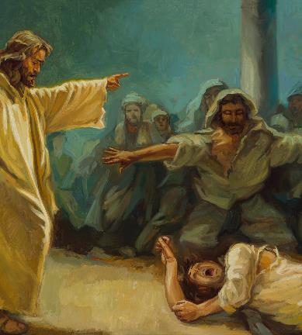
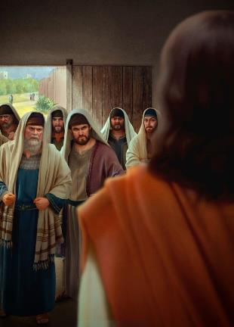
KODI AMACHITA ZOZIZWITSA NDI MPHAMVU YITI?
“Ndipo aphunzitsi amalamulo omwe anachokera ku Yerusalemu anati, “Iye wagwidwa ndi Belezebabu! Ndi ulamuliro wa mkulu wa ziwanda akutulutsa ziwanda.” (Marko 3:22)
Marko akuyamba nkhani ya banja la Yesu, koma akuilekezera panjira kuti akambepo za mkangano umene unalipo ndi Afalisi. Kenaka, akubwereranso ku nkhani yoyamba. Ndondomeko ya kalembedwe yotere ikugwiritsidwa ntchito ndi Marko m’malo angapo kuti agwirizanitse nkhani ziwiri zofanana, kuti atsindike kufunikira kwambiri kwa Mfundo ya pakatiyo.
Banja la Yesu likumufunafuna
Marko 3:20-21
Afalise
Marko 3:22-30
Banja la Yesu likumufunafuna
Pamenepa, nkhani yofunikira kwambiri ndiyo kuneneza kwa alembi za mphamvu yomwe imalola Yesu kutulutsa ziwanda ( Marko 3:22 ).
Marko 3:31-35
Apanso, Yesu akugwiritsa ntchito fanizo kusonyeza kupusa kwa zomunenezazo (Marko 3:23-27). Yesu akulowa m’nyumba ya munthu wamphamvu (Satana), akum’manga, ndipo potero akhoza kulanda chuma chake (kumasula wogwidwa ndi chiwandacho).
Akutengeraponso mwayi ochenjeza za kuopsa kokaikira ntchito ya Mzimu Woyera ndi ya mdierekezi (Marko 3:28-30).

Slide 10
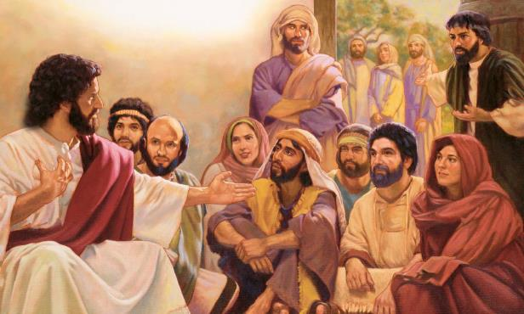
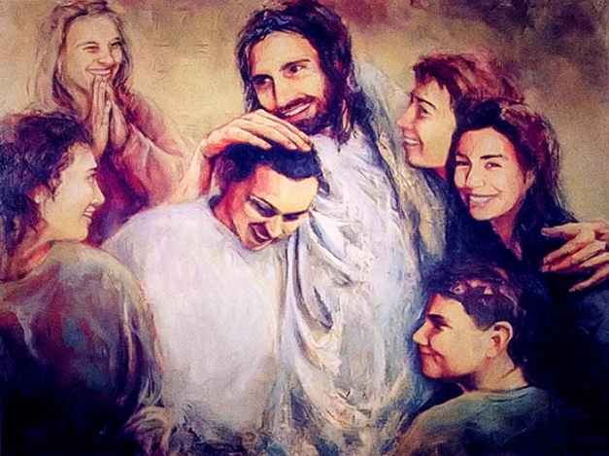
KODI YESU NDI OPENGA?
“Anthu a ku banja lake atamva zimenezi, anapita kuti akamutenga, pakuti ankanena kuti, “Wazungulira mutu.”(Marko 3:21)
Kodi ndichiyani chinachititsa abale ake a Yesu kuganiza kuti wapenga ( Marko 3:20-21 )?
Amagwiritsa ntchito mozipanikiza, samadya mokwanira, amaoneka wankhawa chifukwa cha zokambirana mosalekeza ndi alembi ndi Afarisi...
Atatha kulankhula mwachidule, Marko akuyambiranso kukamba za , abale omwe ankafuna Yesu: amayi ake ndi abale ake (Marko 3:31).
Ndi kupanda kulingalira kotani nanga kwa banja lake kwa Yesu! (Marko 3:32-33).
Koma maonekedwe oputsitsa. Mayi ndi azichimwene ake analakwitsa. Sanazindikire kuti Yesu amayenera kuthandiza anthu pa nthawi imeneyi.. Kusiya ntchito Yake ndi kusamalira iwo pa nthawiyo kunapereka chipseza ku ntchito Yake komanso kwa iwo eni.
Chofunika kwambiri kuposa maubwenzi akuthupi ndi maubwenzi omwe amagwirizanitsa, Yesu anali ndi chidwi ndi banja lake lauzimu kuti liphunzire choonadi : "Iye amene achita chifuniro cha Mulungu ndiye mbale wanga, ndi mlongo wanga, ndi amayi" (Marko 3:35).

Slide 11
“Mzimu wobweretsa mazunzo sudzakhala ndi chidwi pa iwo amene alibe chiyanjano ndi Mulungu, potero alibe mphamvu zamakhalidwe amunthu. Udzautsidwa motsutsana ndi okhulupirika, amene salolerana ndi dziko lapansi, ndipo sasunthika ndi maganizidwe ake, zokondweretsa zake, kapenanso kutsutsana nawo kwake. Chipembedzo chokhala ndi umboni wamoyo wokomera chiyero, chomwe chidzudzula kunyada, kudzikonda, dyera, ndi machimo ooneka amakono ndi apamwamba, chidzadedwa ndi dziko lapansi ndi akhristu onyenga; Pamene mukuvutika ndi chitonzo ndi mazuzo, dziwani kuti muli mukuyenda mu uphungu wabwino. pakuti Yesu analakika mu zonsezo, ndi zina zambiri. Tikakhala okhulupirika kutsatira Yesu tiyembekezere zomwe zinamuchitikira Iye. Tidzalandira korona wa moyo tikapanda kutsata zofuna za dziko. "
EGW (The Medical Ministry, pg. 282)

