Slide 1
MAFANIZO
Phunziro 4, July 27, 2024

Slide 2
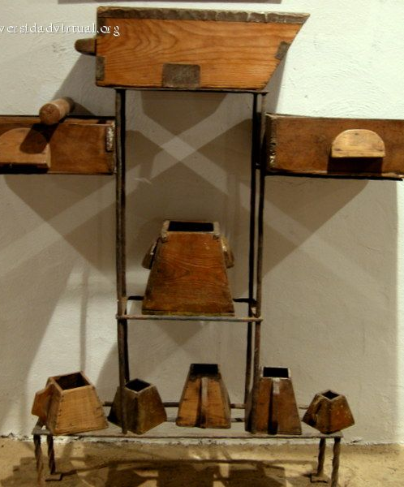
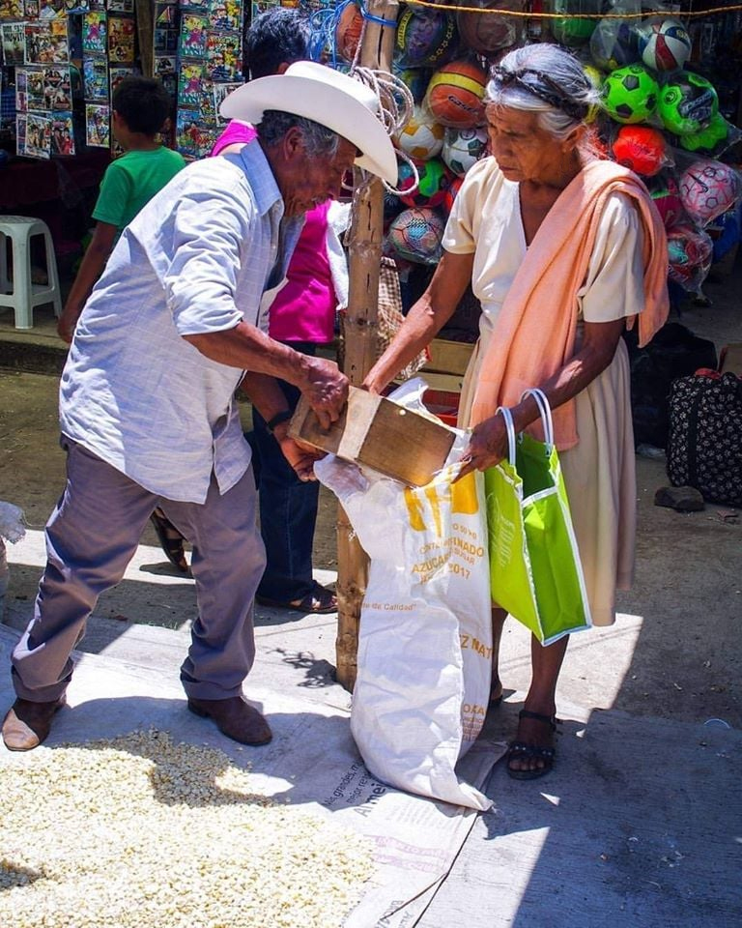
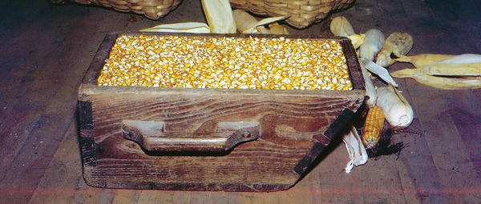
“Anapitiriza nati, Ganizirani mosamala zimene mukumva, ndi muyeso umene mugwiritsa ntchito, mudzayesedwa nawo, ndipo ngakhale kwambiri. Amene ali nazo adzapatsidwa zochuluka; amene alibe, ngakhale zimene ali nazo zidzachotsedwa kwa iwo” (Marko 4:24, 25)

Slide 3
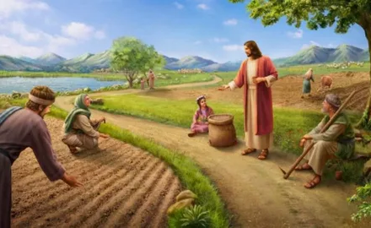
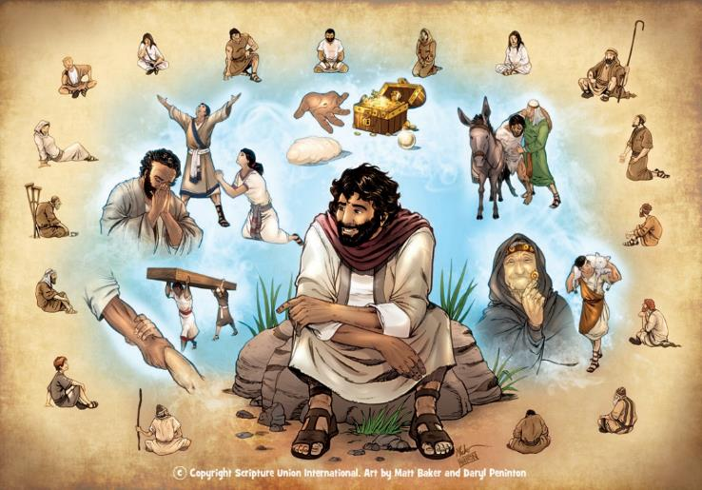
Fanizo ndi kufotokoza kwa zochitika zongopeka (kuchokera pa zochitika zenizeni kapena ai) zomwe zimanena choonadi chofunika kapena chiphunzitso cha makhalidwe abwino posiyanitsa kapena kufananitsa.
Iyi ndi njira imene Yesu ankagwiritsa ntchito pophunzitsa (Marko 4:34). Mafanizo ake kawirikawiri ankachokera muzochitika za m’moyo watsiku ndi tsiku, kotero, anali osavuta kukumbukira komanso kuwagwiritsira ntchito.
Omvera ake akabwerera kunyumba zawo, anakagawana zimwe aphunzira ndi mabanja komanso abwenzi awo.
Zifukwa za kukhalapo kwa mafanizo. Marko 4:10-12.
Fanizo la wofesa mbewu:
Wofesa adapita kukafesa…Marko 4:1-9.
Kufotokozerapo za fanizo. Marko 4:13-20.
Mafanizo ena:
Nyali ndi muyeso Marko 4:21-25.
Kukula ndi mpiru. Marko 4:26-32.

Slide 4
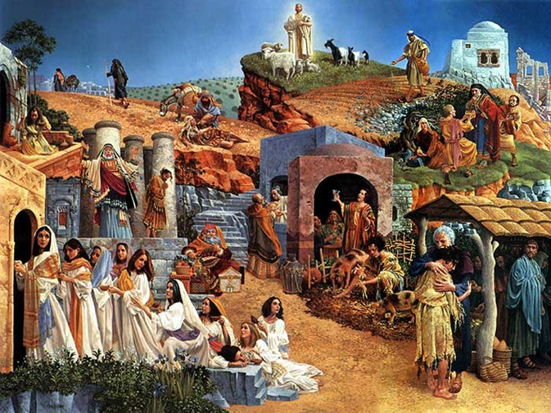
CHIFUKWA CHOKHALAPO MAFANIZO
“kotero kuti,“ ‘Kupenya mudzapenya koma osaona kanthu, kumva mudzamva koma osamvetsetsa, kuti mwina angatembenuke ndi kukhululukidwa!’ (Marko 4:12)
Ulaliki wa Yesu unali wokhudza Ufumu wa Kumwamba (Marko 1:14-15 ). Mafanizo Ake ambiri ananenedwa kufotokozera chikhalidwe cha Ufumu omwe umanenedwawo(Marko 4:30 ).
Mopatsa chidwi, chifukwa chimene Yesu mwini ankapereka pogwiritsa ntchito mafanizo ndi chodabwitsadi: ndicholinga choti athe kumvetsetsa, kutembenuzidwa, kapena kukhululukidwa! (Marko 4:12 ).
Izi sizinali zachilendo. Pomuuza kuti azilalikira, Mulungu anauza Yesaya kuti: “Imvani bwino, osazindikira; onani, koma osazindikira. […] kuti angawone ndi maso ake, kapena kumva ndi makutu ake, kapena asamvetse ndi mtima wake, kapena angatembenuke, ndipo pakhale machiritso kwa iye” (Yesaya 6:9-10 ).
Iye amene amva njala ya Mawu a Mulungu adzamva choonadi ndi kukondwera. Koma iwo omwe sakufuna kumva, mosatengera kuti choonadichi chaperekedwa mophweka bwanji, adzakana kuti amvetsetse, kuti asinthe, ndi kupeza chipulumutso.

Slide 5
FANIZO LA WOFETSA

Slide 6
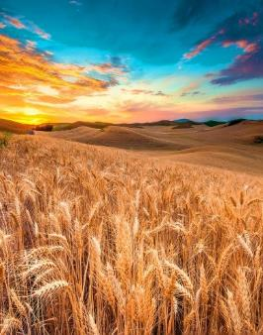
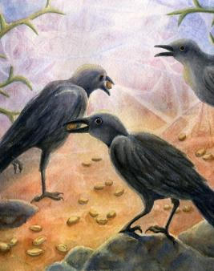
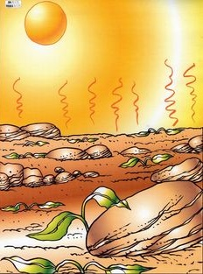
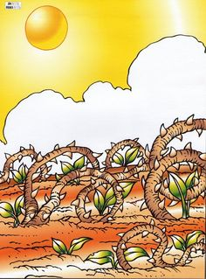
WOFESA ANATULUKA KUKAFETSA
“Anawaphunzitsa zinthu zambiri mʼmafanizo, ndipo mʼchiphunzitso chake anati:Tamverani! Mlimi anapita kukafesa mbewu zake”. (Marko 4:2-3)
Munjira
M’masiku ochepa, mbewuyo imafa (Marko 4:4)
Pakati pa minyala
M’milungu ingapo, mbeuyo imafa (Marko 4:5-6)
pakati paminga
M’miyezi yoŵerengeka, mbewuyo imafa (Marko 4:7)
pachonde
Pamapeto pa nyengo, mbewuyo imabala zipatso (Marko 4:8)
Wofesa ndi mbewu sizikusinthanitsidwa. Komabe, zotsatira zake ndi zosiyana kotheratu pagawo lililonse la madera anayiwo. Zonse zimatengera momwe mbewu imalandiridwa.

Slide 7
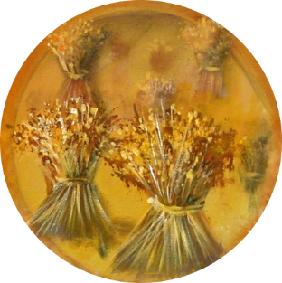
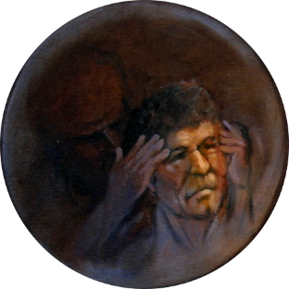
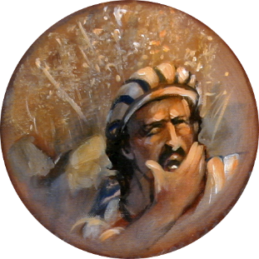
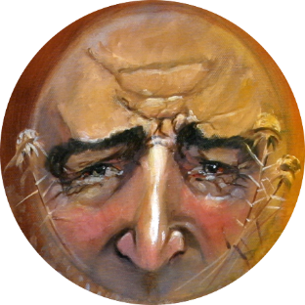
KUFOTOKOZERA ZA FANIZO
“Wofesa amafesa mawu.“(Marko 4:14)
Mbewuzo ndi Mawu a Mulungu, ndipo wofesa ndi aliyense amene amagawa mbeuyi.
Munjira
Iwo alibe chidwi, ndipo Satana amawasokeretsa (Marko 4:15)
Pakati pa minyala
Iwo amalandira mawu, koma sapilira mayesero (Marko 4:16-17)
Pakati pa minga
Amalandira mawu, koma amakhala pa mtambasale (Marko 4:18-19)
Panthaka ya chonde
Amalimbana ndi mayesero ndipo sagonja. Amabala zipatso (Marko 4:20)
Kodi ndine nthaka yamtundu wanji? Kodi ndingachite chiyani kuti ndibale zipatso?

Slide 8
MAFANIZO ENA

Slide 9
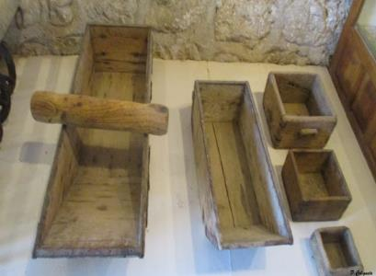
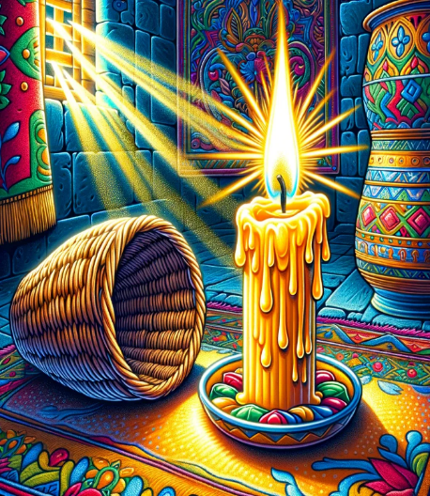
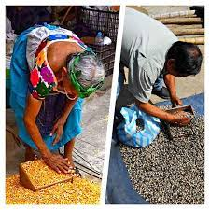
NYALI NDI MUYESO
“Kotero kuti,“ ‘Kupenya mudzapenya koma osaona kanthu,kumva mudzamva koma osamvetsetsa,
kuti mwina angatembenuke ndi kukhululukidwa!’ ”? (Marko 4:21)
“Anapitiriza nati, “Ganizirani mosamala zimene mukumva, ndi muyeso umene mugwiritsa ntchito, mudzayesedwa nawo, ndipo ngakhale kwambiri.” (Marko 4:24).
Taganizirani zokambiranazo: "Kodi mukubweretsa ...?" "Ayi!"; "simukuyika…?" "Chabwino!"
M’misewu ya m’mizinda, amalonda ankagulitsa zinthu zawo pogwiritsa ntchito milingo yochulukirapo kapena yocheperako poyeza kuchuluka kwa katundu yomwe ogula ankufuna.
Yesu ankadziwa kukopa chidwi cha omvera ake. Tsopano anali okonzeka kulandira phunziro lauzimu.
Pang’ono ndi pang’ono, Yesu amawulula choonadi cha uthenga wabwino kuti udziwike kwa onse (Marko 4:22).
Ngati ogulitsayo anali wabwino, ankpyolerako pa mulingo wa katundu ofunidwa kuti ogula wake akhutitsidwe
Usiku umenewo, pamene anayatsa nyale zawo kunyumba, “iwo amene ali ndi makutu akumva” ( Marko 4:23 ) mosakayikira anakumbukira phunzirolo.
Ngati wina alandira choonadi, adzalandira zochuluka. Koma mukachikana, ngakhale chowonadi chimene muli nacho chidzatayika (Marko 4:25).

Slide 10
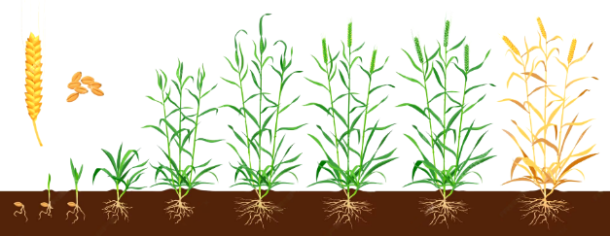
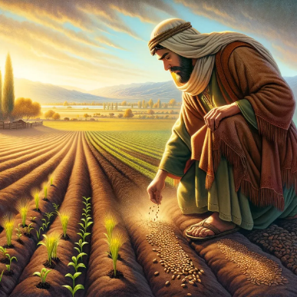
KUKULA NDI MPIRU
“Iye anatinso, “Umu ndi mmene ulili ufumu wa Mulungu. Munthu amafesa mbewu mʼnthaka.” (Marko 4:26)
“'Uli ngati mbewu ya mpiru imene ndi mbewu yayingʼono kwambiri yomwe mumadzala mʼnthaka.’
(Marko 4:31)
Yesu amakumbukira mmene mbewu zimakulira (Marko 4:28):
Ufumu wa Kumwamba ndi wofanana ndi kambewu kakang’ono ka mpiru (Marko 4:30-31).
Udzu
Tsinde
Mbeu
Pambuyo pa masiku 50 akufesa, mpiru umafika kutalika kwa 30-40 cm, ndipo ukhoza kutulutsa kale zipatso zokolola. Imatha kukula mpaka 7 metres (23 Ft.).
Ndi ndondomeko yomwe imadalira pa Mulungu, osati munthu (Marko 4:27).
Iyi ndi mbewu ya Uthenga Wabwino yobzalidwa mu nthaka yachonde ya okhulupirira.
Chaching'ono, ndithudi, chinali chiyambi: anthu 120 "osaphunzira" obisika m'chipinda ku Yerusalemu.
Kupyolera mu machitidwe a Mzimu Woyera timakula mochuluka mu choonadi... mpaka Yesu abwere (Marko 4:29; Mateyu 13:39).
Koma kufutukuka kwake kwafika pa dziko lonse lapansi, kukhala chipembedzo chokhala ndi chiŵerengero chachikulu cha okhulupirira.

Slide 11
M’mafanizo ndi m’kufananiza, Iye anapeza njira yabwino koposa yolankhulira choonadi chaumulungu. M’mawu achindunji, pogwiritsa ntchito zifanifani ndi mayankhulidwe ofanizira zopezeka mçhilengedwe, Anatsegula choonadi chauzimu kwa omvera Ake, ndi kupatsa ziganizo kumfundo zamtengo wapatali zomwe zikanachoka m’malingaliro awo, osasiyanso chokumbukirika chirichonse, Iye akanapanda kulunzanitsa mau Ake ndi zithunzithunzi zoutsa moyo za m’chilegendwe. Mu njira iyi, Iye anautsa chidwi chawo, nakweza mtima wakauniuni, ndipo pamene anakopa kumvetsera kwawo kwathunthu, Iye anatsimikizika kutsindika mwa iwo umboni wa choonadi. Mwanjira imeneyi Iye anali wokhoza kupanga chikoka chokwanira pa mtima kotero kuti pambuyo pake omvera Ake akanatha kuyang’ana pa chinthu chimene Iye anagwirizanitsa nacho phunziro Lake, ndi kukumbukira mawu a Mphunzitsi waumulungu.
EGW ( Fundamentals of Christian Education, 236)

