Slide 1
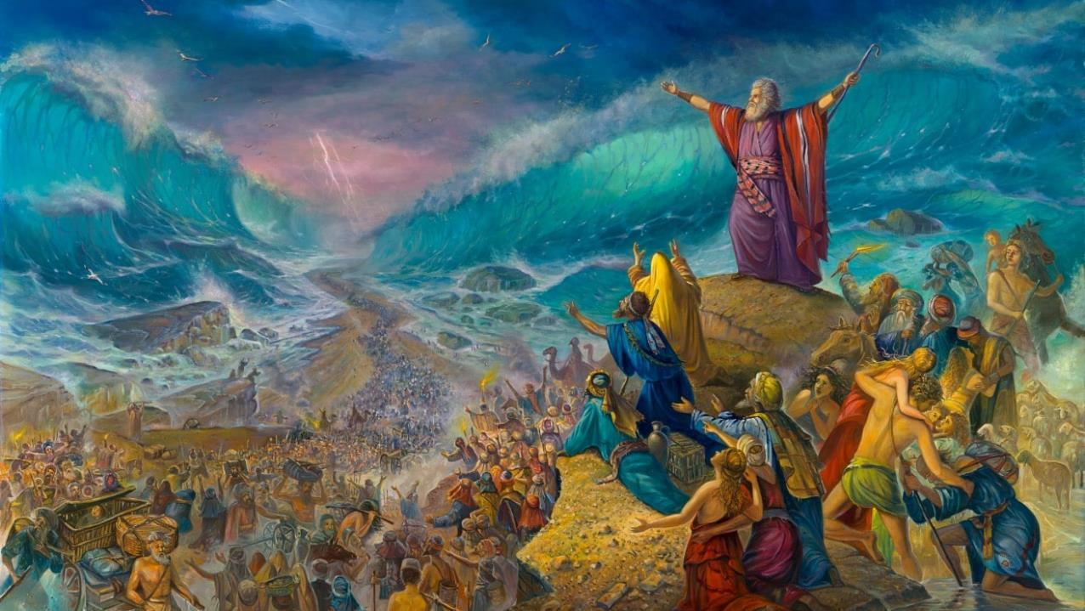
KUOLOKA NYANJA YOFIIRA
Phunziro 6, August 9, 2025

Slide 2
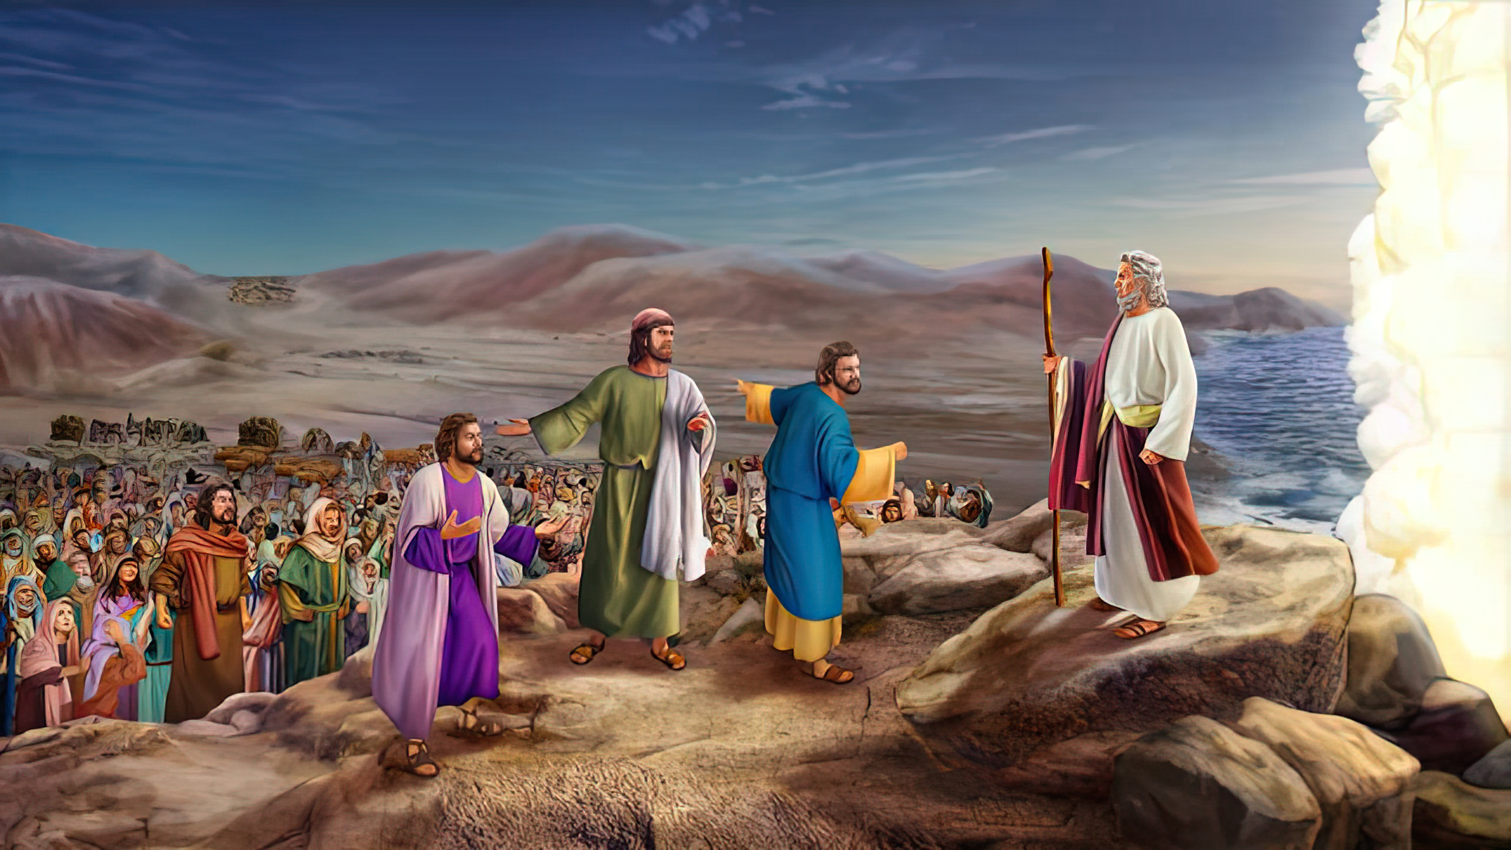
“Ndipo Mose ananena ndi anthu, Musaope, chilimikani, ndipo penyani chipulumutso cha Yehova, chimene adzakuchitirani lero; pakuti Aejipito mwawaona lerowa, simudzawaonanso konse.Yehova adzakugwirirani nkhondo, ndipo inu mudzakhala chete ” Eksodo 14:13, 14

Slide 3

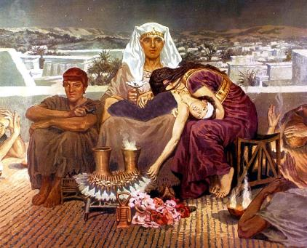
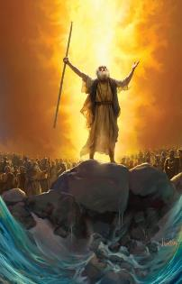
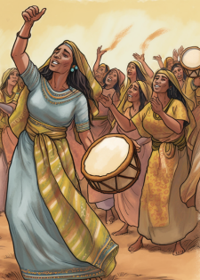



Mulungu anachenjeza kuyambira pachiyambi kuti kutuluka mu Igupto kudzakhudza imfa — kapena chiopsezo cha imfa — ya mwana woyamba wa Farao (Eksodo 4:22–23).
Kuti apewe imfa ya ana oyamba kubadwa ndiponso kuti athe kuwatsogolera kutuluka mu Igupto, Mulungu anawapempha kuchitapo kanthu mwachikhulupiriro: mwambo wa Paska. Tsopano, mmene anali kuwatsogolera kufika pamapeto popanda njira, inali nthawi yakuti chikhulupiriro chawo chikwere pa mulingo wina: kupitabe chitsogolo.
Atawoloka Nyanja Yofiira, atamasulidwa ku ukapolo waku Igupto, Aisraeli anayimba nyimbo yolambira Owamasulayo.
Kutuluka kwa Aisraeli mu Igupto :
Nyamukani! (Eksodo 12:31-36)
Kupatulidwa kwa Ana oyamba Kubadwa (Eksodo 13:1-16)
Kuoloka Nyanja Yofiira:
Kukakamira mu Chipululu (Eksodo 13:17-14:12)
Njira pa Nyanja (Eksodo 14:13-31)
Chikondwerero :
Nyimbo ya Mose (Eksodo 15:1-21)

Slide 4
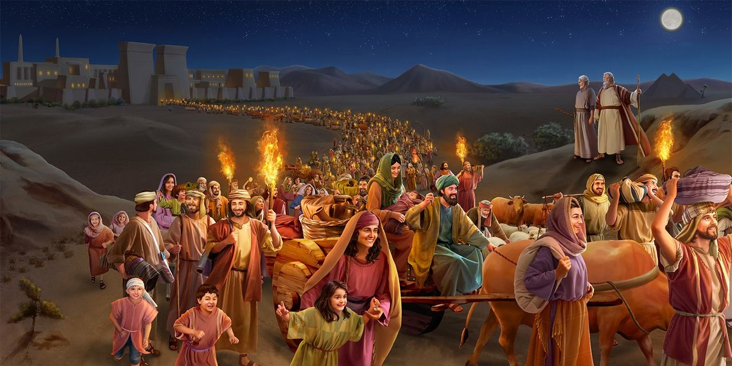
ULENDO WOTULUKA KU
IGUPTO

Slide 5


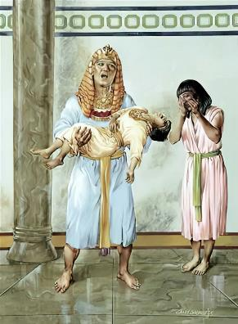
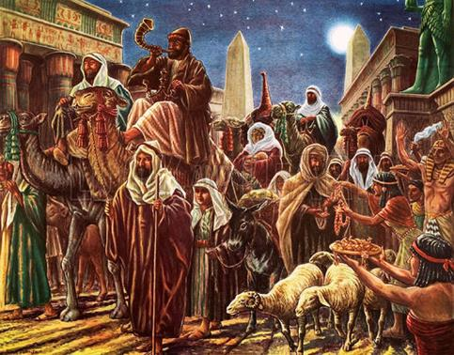
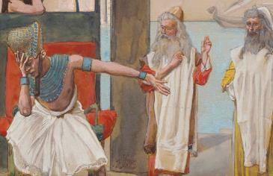
NYAMUKANI!
“Aigupto anawawumiriza anthuwo kuti atuluke mofulumira ndi kusiya dziko lawo. Iwo anati, “Ngati sitiwalola kutero, tonse tidzafa!” (Eksodo 12:33)
Dziko lonse la Aigupto linali bwinja, “pakuti panalibe nyumba imene munalibe munthu wakufa” (Eksodo 12:30 ). Chilolezo cha Farao kuti Aisraeli achoke chinabwera mochedwa kwambiri.
Ndi mawu akuti “Ndiponso mundidalitse” ( Eks. 12:32 ) Farao anasonyeza mmene anthu ake onse akumvera!
Sichinali chisonyezo cha chisoni chenicheni chifukwa cha zolakwa zake, koma chikhumbokhumbo choti masautsowo aleke.
Pamene Aisraeli anafunsa malipiro a zaka zawo zogwira ntchito, Aigupto 'anawapatsa zomwe anapempha' (Eksodo 12:36). Munjira imeneyi, Mulungu anaonetsetsa kuti mwana wake woyamba kubadwa atuluke mu Igupto mwamtendere—ndipo ndi manja odzadza.

Slide 6

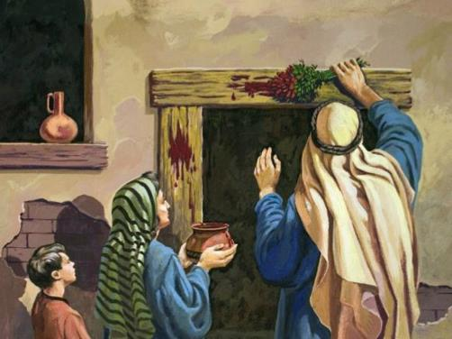
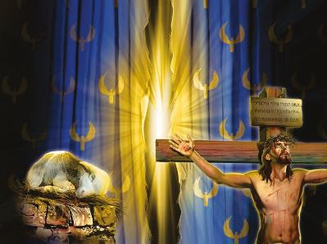

KUPATULIDWA KWA ANA OYAMBA KUBADWA
“Ana onse aamuna oyamba kubadwa uwapatule, ndi anga. Aliyense woyamba kubadwa pakati pa Aisraeli ndi wanga, kaya ndi wa munthu kapena wa chiweto.” (Eksodo 13:2)
Ana oyamba kubadwa ankapatulidwa bwanji?
Ankapatulidwa kudzera mu imfa. Mwana wamwamuna woyamba kubadwa aliyense ankayenera kufa. Koma panakonzedwa njira ina yomwe idaperekedwa m'malo mwa mwana woyamba kubadwa, kuti wina afe m'malo mwake.
Taonani kuludzanitsa komwe kulipo: Israeli ndi mwana woyamba wa Mulungu (Eksodo 4:22); lero Mpingo ndi Israeli wauzimu (Agalatia 6:16); kotero, tonse tiyenera kufa kuti tipatulidwire kwa Mulungu; koma pali Wina amene anafa m'malo mwathu.
Yesu, “Mwanawankhosa wa Mulungu” (Yohane 1:29 ), anafa kuti aliyense wothira mwazi wake pakhomo la mtima wake asafe, koma akhale ndi MOYO WOSATHA.
Mulungu wachita kale mbali yake. Tsopano ndi udindo wathu kudzilola kuti tikutidwe ndi mwazi wake opulumutsa.

Slide 7
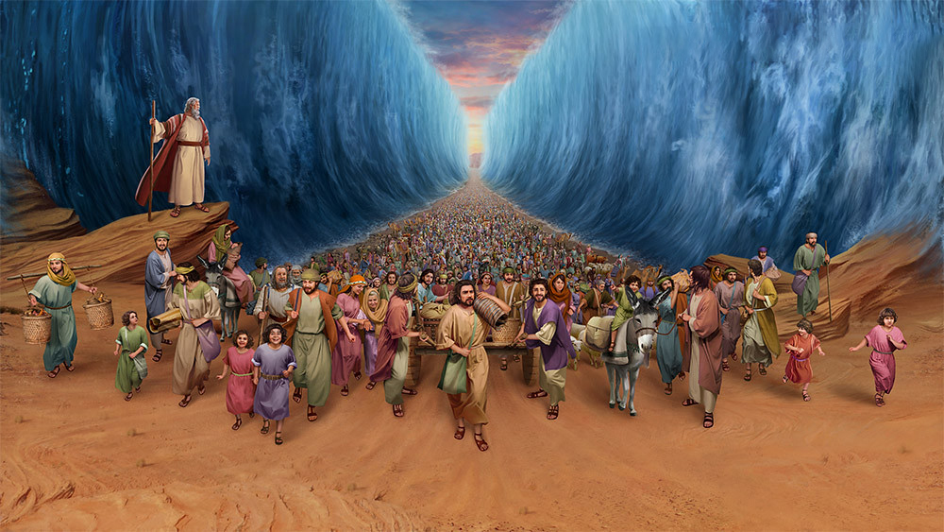
KUOLOKA PA NYANJA YOFIIRA

Slide 8


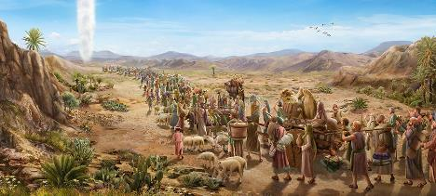
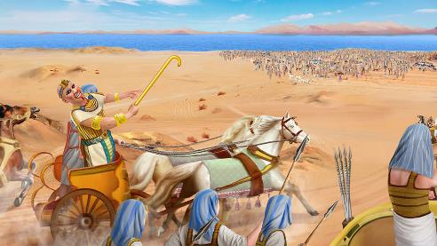
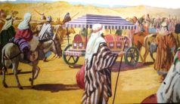
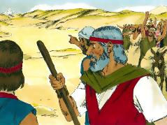
KUKAKAMIRA MU CHIPULULU
“'Farao adzaganiza kuti ‘Aisraeli asokonezeka nʼkumangozungulirazungulira mu dzikomo, chipululu chitawazinga.” (Exodus 14:3)
Atalandira chilolezo cha Farao, Aisraeli anatuluka “atakonzekera nkhondo” (Eksodo 13:18). Koma Mulungu sanafune kuti akumane ndi nkhondo, choncho anawadutsitsa njira ina (Eksodo 13:17).
Pa nthawiyi, Farao anadandaula kuti analapa ndipo anatsatira Aisiraeli (Eksodo 14:5 ). Aisraeli anali atatsekedwa mu chipululu, opanda njira yothawira (Eksodo 14:2-3, 9).
Monga chizindikiro cha chikhulupiliro, iwo anatenga bokosi la Yosefe (Eksodo 13:19). Kuphatikiza apo, Mulungu anali kuwatsogolera mozizwitsa (Eksodo 13:21).
Koma, pamene anaona ankhondo a Farao, chikhulupiriro chawo chinatheratu (Eksodo 14:10-12). Iwo anaiwala mwamsanga zozizwitsa zimene Mulungu anawachitira. Kodi ifenso tingachite chimodzimodzi?
“Kumbukirani ntchito zodabwitsa wazichita,zozizwitsa zake” (1 Mbiri 16:12)

Slide 9

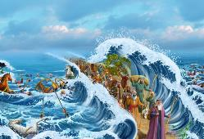
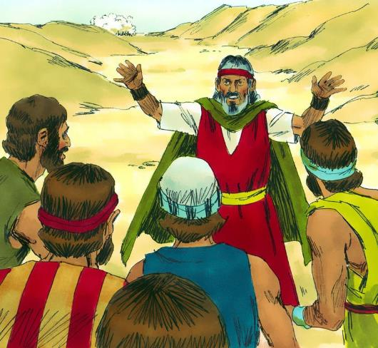
NJIRA PA NYANJA
“Mose anayankha anthu kuti, “Musachite mantha. Imani, ndipo muone chipulumutso chimene Yehova akuchitireni lero. Aigupto amene mukuwaona lerowa simudzawaonanso. Yehova adzakumenyerani nkhondo. Inu mungokhala chete.” (Eksodo 14:13-14)
Pokumana ndi kusakhulupilira kwa anthuwo, Mose anawalimbikitsa kuti adalire Mulungu (Eksodo 14:13-14):
“Musachite mantha”
Chinthu choyamba kuti tipambane ndi kudalira Mulungu
“Imani nji”
Tiyenera kukhala oleza mtima pomwe tiripo, popanda kung'ung'udza.
“Muone chipulumutso”
Tikalola Mulungu kutitsogolera, kupambana kuli kotsimikizika.
Mulungu amatimenyera nkhondo motsutsana ndi Satana ndi tchimo. Kalvari ndi umboni waukulu kwambiri wa izi.
“Yehova adzakumenyerani nkhondo”

Slide 10

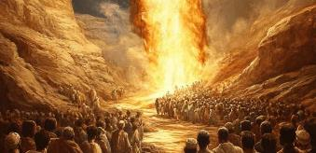
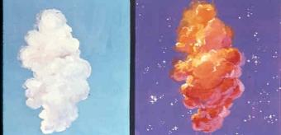
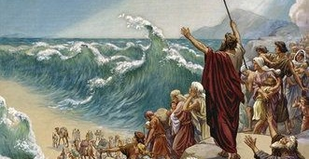
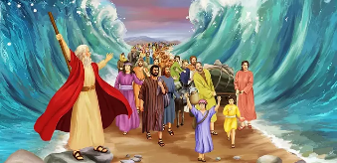
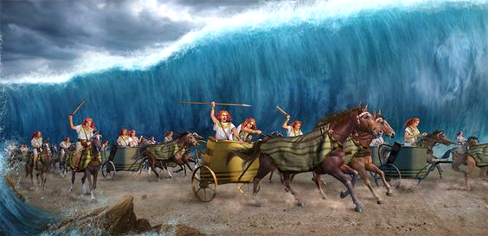
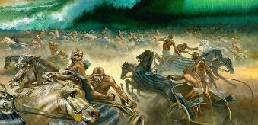
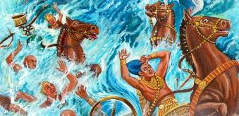
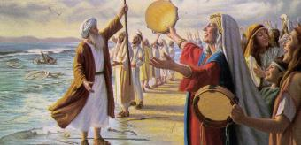
NJIRA PA NYANJA
Mulungu anapereka kwa anthu lamulo limodzi lokha: “Pitani chitsogolo” (Eksodo 14:15). Kuyambira nthawi imeneyo, zinthu zosayembekezeka zinayamba kuchitika (Eksodo 14:19-31):
Mngelo wa Mulungu ndi mtambo anaima pakati pa msasa wa Aisraeli ndi msasa wa Aigupto
Usiku wonse, mtambowo unali mdima kwa Aigupto, koma kuwala kwa Aisraeli
Mose anakweza ndodo yake, ndipo nyanja inagawanika kuti Aisraeli adutse pa nthaka youma.
Aisraeli analowa m’nyanja, madzi ali ngati makoma kudzanja lamanja ndi lamanzere
Nawonso Aigupto analowa m’nyanja
M’bandakucha, Mulungu anakwiyitsa Aigupto
Pamene ankayesa kuthawa, nyanja inabwerera m’mbuyo, ndikuwononga gulu lonse lankhondo.
Kuchoka mphepete mwa nyanja, Aisiraeli anawona kupambana, ndipo anakhulupilira Mulungu ndi Mose

Slide 11
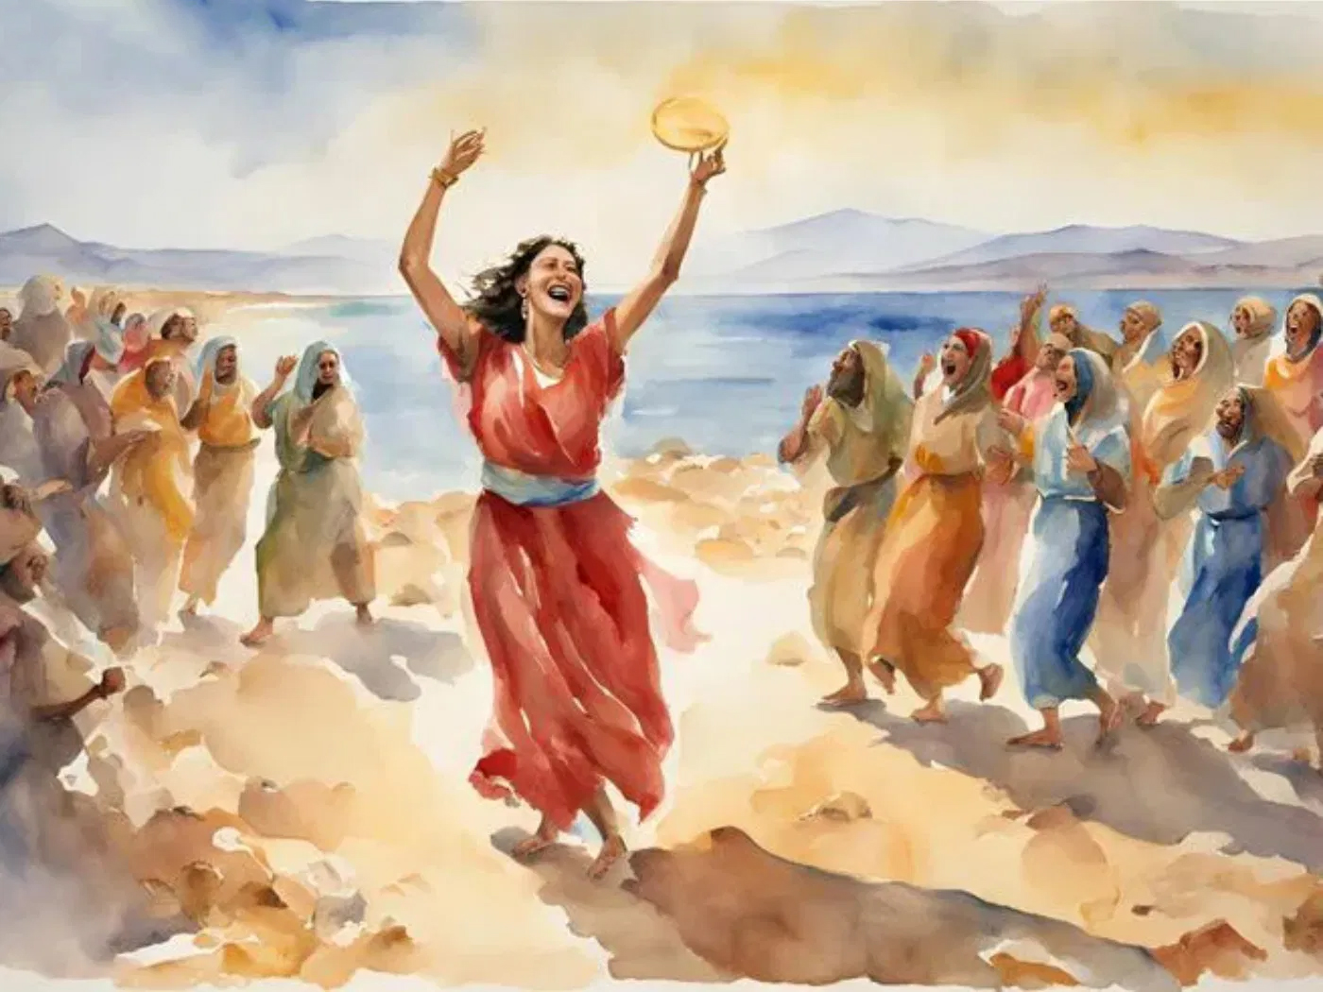
^{CHIKONDWERERO}

Slide 12


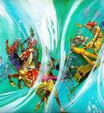
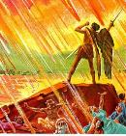
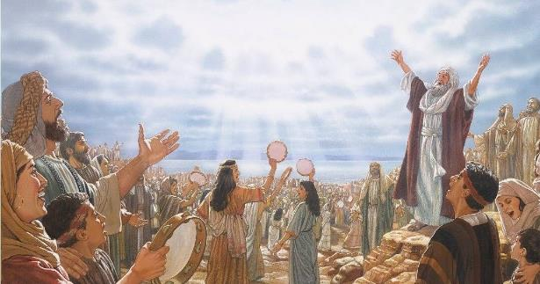
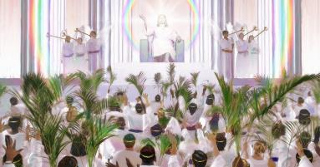
NYIMBO YA MOSE
“Iwo ankayimba nyimbo ya Mose, mtumiki wa Mulungu, ndi nyimbo ya Mwana Wankhosa. Nyimbo yake inkati, “Zochita zanu ndi zazikulu ndi zodabwitsa, Ambuye Mulungu Wamphamvuzonse Njira zanu ndi zachilungamo ndi zoona, Mfumu ya mitundu yonse” (Chivumbulutso 15:3)
Poona zimene zinachitika, Mose anatsogolera Aisiraeli poimba nyimbo yotamanda Mulungu, pamene Miriamu anaimba limodzi ndi gulu loimba pamodzi ndi akazi (Eksodo 15:1, 20-21).
Munyimboyi, siinangonena zomwe Aisiraeli anachita. Siikungokamba za kulambira Mulungu chifukwa chochotsa adani kokha(Eksodo 15:6), komanso imayamikira ntchito zake (Eksodo 15:11). Zomwe zinachitika kwa ena amene anamva za zomwe zachitika kumafotokozedwa pa (Eksodo 15:14).
Kuphatikiza apo, zimene Mulungu watsala pang’ono kuchita zikulengezedwa kuti: “mudzawalowetsa ndi kuwakhazikitsa pa phiri lanu” (Eksodo 15:17).
Pamene chiweruzo cha Mulungu chidzaonetsedwa, ndipo zoipa ndi masautso zidzachotsedwa, opulumutsidwa a mitundu yonse adzamuyamika chifukwa cha chiweruzo chake cholungama, ndipo adzayimba nyimbo ya Mose ndi ya Mwanawankhosa (Chivumbulutso 15:3).

Slide 13

“Pomasula miyoyo yathu ku ukapolo wa uchimo, Mulungu watipatsa ife chiwombolo choposa cha Aisraeli pa Nyanja Yofiira. Monga Aisiraeli, tiyenera kunena mawu a kuyamikira kwa Ambuye ndi mtima, mzimu, ndi mawu chifukwa cha ‘zomwe amachita zochititsa chidwi kwa ana a anthu.’ Iwo amene amaganizira za chifundo chachikulu cha Mulungu, komanso osaiwala mphatso zake zazing'ono, adzavala lamba la chimwemwe ndi kupembedza mu mitima yawo kwa Ambuye. Mphatso zatsiku ndi tsiku zomwe timalandira kuchokera m’manja mwa Mulungu, komanso kuposa zonse imfa ya Yesu yomwe imatibweretsera chimwemwe ndi kumwamba m’manja mwathu, ziyenera kukhala mutu wa kukondwera kosatha.”
EGW (Conflict and Courage, March 28)

