Slide 1
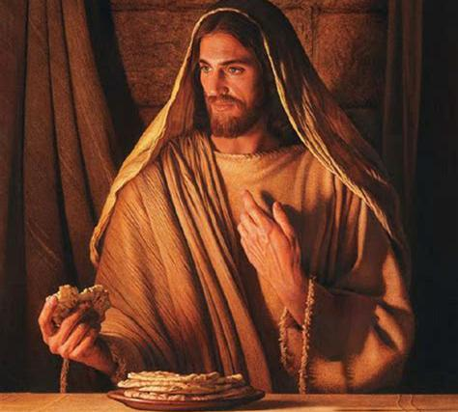
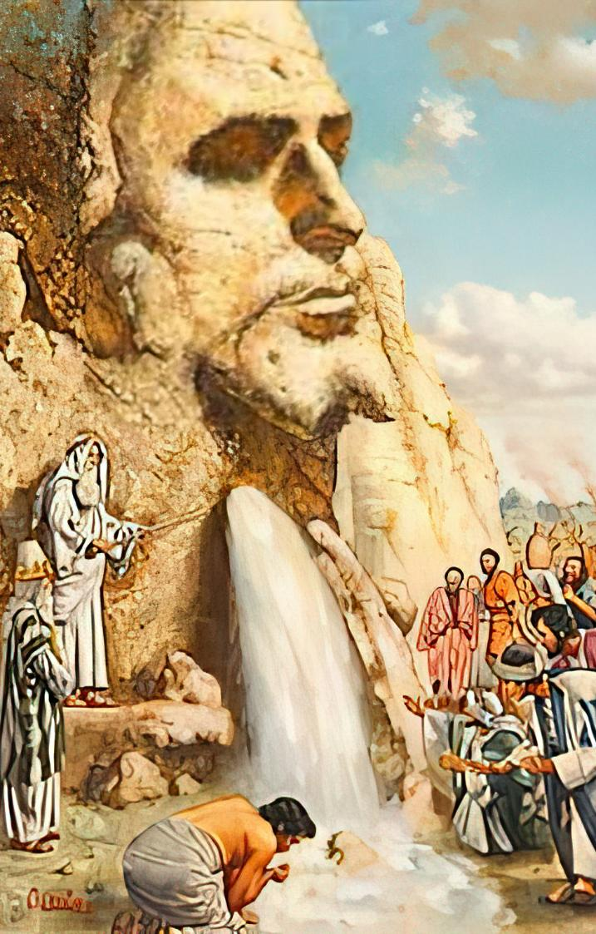
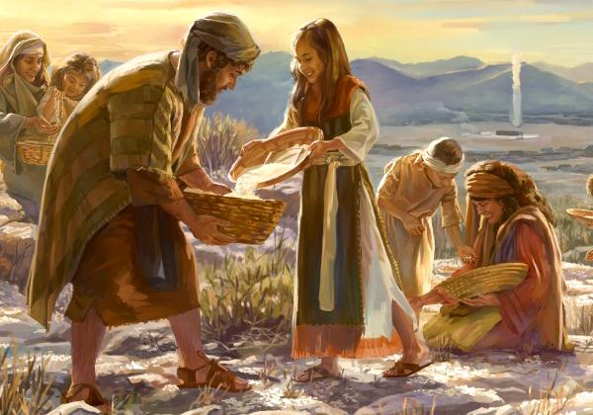
MKATE NDI MADZI A MOYO
Phunziro 7, August 16, 2025

Slide 2
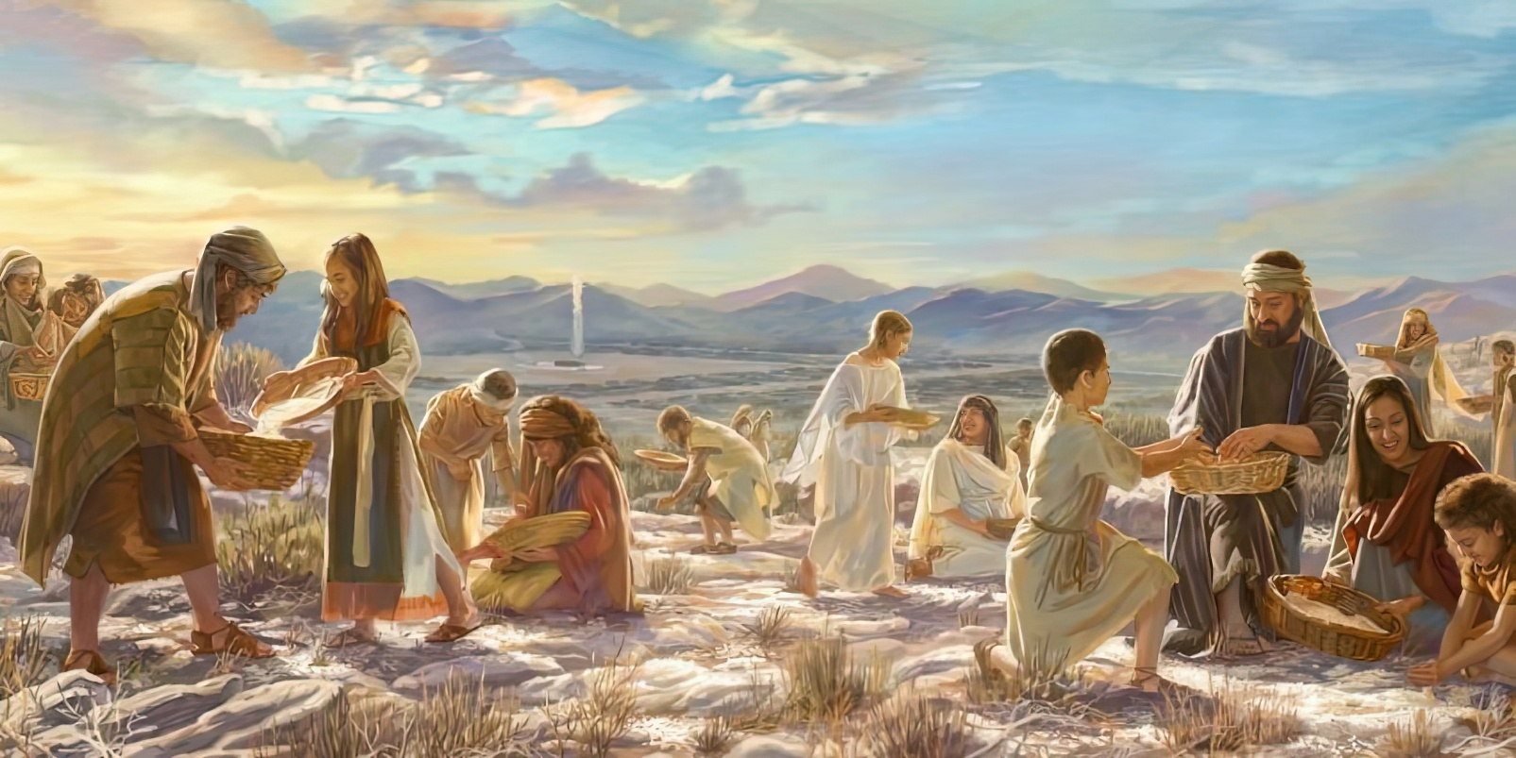

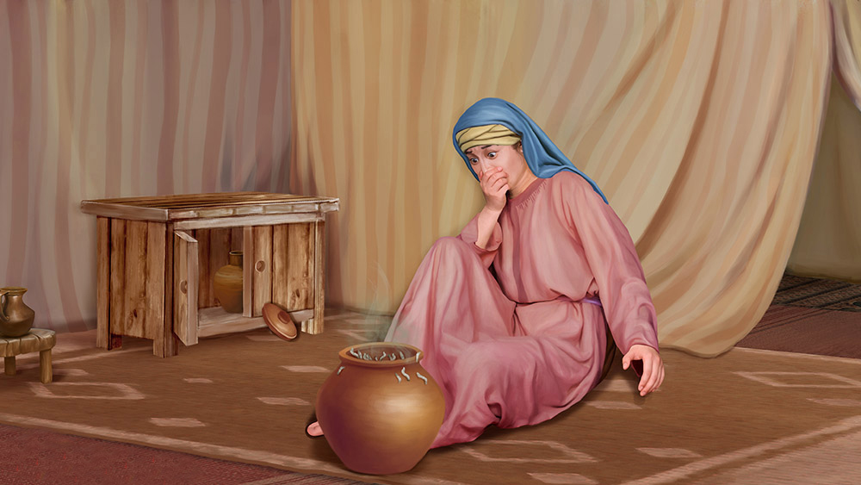
“Ndipo Yehova anafunsa Mose nati, “Kodi inu muzipitirira kukana kusunga malamulo ndi malangizo anga mpaka liti? Taonani, popeza Yehova wakupatsani Sabata nʼchifukwa chake tsiku lachisanu ndi chimodzi amakupatsani chakudya cha masiku awiri. Aliyense azikhala pamene ali pa tsiku lachisanu ndi chiwiri, pasapezeke wotuluka kunja.” Kotero anthu anapuma tsiku lachisanu ndi chiwiri”
Eksodo 16:28–30

Slide 3

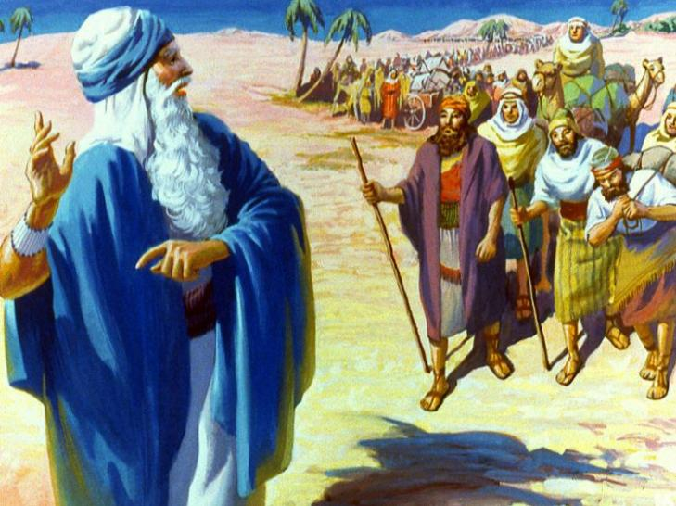
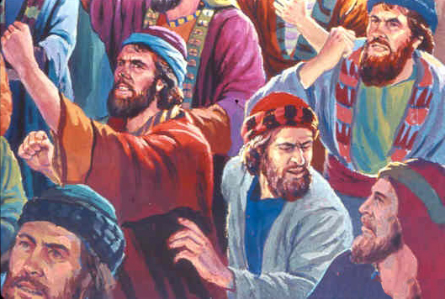
Pomaliza pake anawoloka malire a Igupto. Tsopano anali paulendo wopita ku Kanani, dziko loyenda mkaka ndi uchi.
Kwa masiku atatu, zonse zinkawoneka bwino. Koma zinthu zimene anali nazo zinayamba kutha. Kodi akanakhoza bwanji kudyetsa anthu zikwi ziwiri mu chipululu?
Pongoona zizindikiro zoyambirira za mavuto, anthu anayamba kudandaula. Akanakonda akanafera ku Igupto! Zinali zomveka kuti chikhulupiliro chawo chinayenera kukula ndi kulimba. Choncho Mulungu anawapatsa madzi ndi mkate; anawateteza kwa adani awo; ndipo anawathandiza kukonzekera bwino.
Madzi Aukhondo (Eksodo 15:22-27)
Mkate Ochokera Kumwamba (Eksodo 16:1-36)
Thanthwe la ku Horebu (Eksodo 17:1-7)
Manja Okwezedwa (Eksodo 17:8-16)
Malangizo Abwino (Eksodo 18:1-27)
Mkate ndi Madzi a Moyo: Yesu

Slide 4

“Zochitika zosiyanasiyana kwa Aheberi zinali sukulu yokonzekeretsa za kwawo kolonjezedwa ku Kanani. Mulungu akufuna kuti anthu ake masiku ano aziwunikanso ndi mtima wodzichepetsa komanso wofunitsitsa kuphunzira, mayesero amene Israeli wakale anakumana nawo, kuti aphunzitsidwe kukonzekera kwawo ku Kanani Wakumwamba.”
EGW (Patriarchs and Prophets, p. 293)

Slide 5


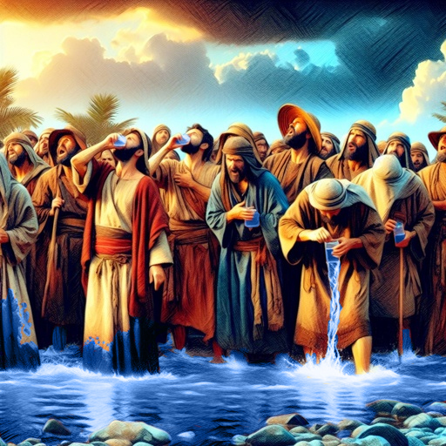
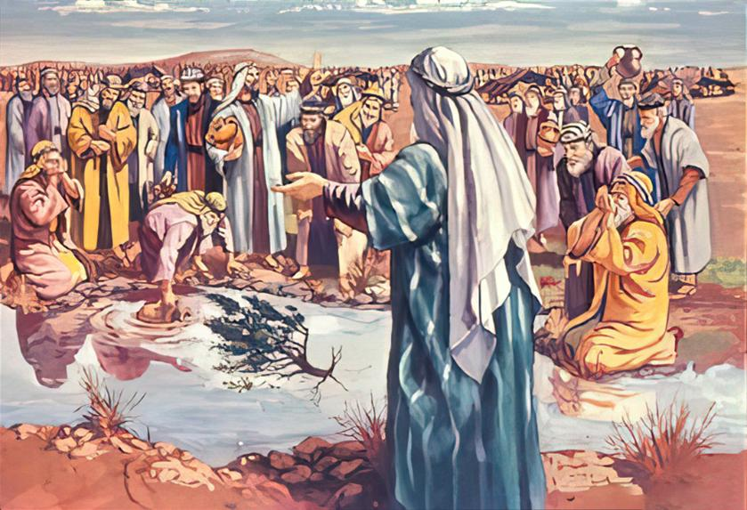
MADZI AUKHONDO
“'Ndipo anafika ku Mara. Koma sanathe kumwa madzi akumeneko chifukwa anali owawa. (Ndi chifukwa chake malowo amatchedwa Mara.)” (Eksodo 15:23)
Ngati Mulungu ali nafe, kodi chilichonse choipa chingatichitikire? Izi zikuoneka ngati nzeru za anthu Aisrayeli atangowoloka Nyanja Yofiira.
Atapeza kuti madziwo sanali abwino kumwa, anayamba kudandaula kuti, “Tidzamwa chiyani?” (Eksodo 15:24). Mulungu akanatha kuyeretsa madziwo iwo asanafike pamalopo, koma Iye anadikira nthawi yoyenera.
Komanso, Mulungu anapempha Mose kuti atenge nawo mbali pochita chozizwitsa, ndipo anamulamula kuti aponya mtengo m'madzi kuti awayeretse (Eksodo 15:25).
Mulungu akufuna kuti tizindikire kuti ali pafupi nafe, timvere malamulo ake, ndipo tigwirizane naye.
Aisraeli akanakwaniritsa zofuna za Mulungu, kutsatira malamulo amene Iye anawapatsa, akanakhala otsimikiza kuti adzatetezedwa ku zoipa (Eksodo 15:26)

Slide 6


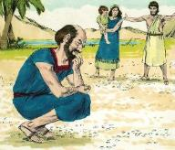
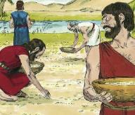
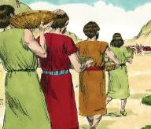
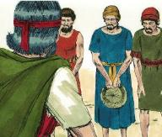
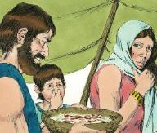
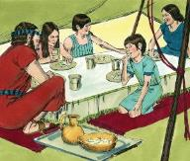
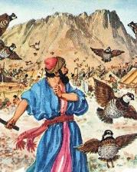
MKATE OCHOKERA KUMWAMBA
“Aisraeli atationa anafunsana wina ndi mnzake nati, “Kodi timeneti nʼchiyani?” Popeza sanatidziwe. Mose anawawuza kuti, “Uyu ndi buledi amene Yehova wakupatsani kuti mudye” (Eksodo 16:15)
Kufunitsitsa kudya nyama kunachititsa Aisraeli kudandaulira motsutsana Mose ndi Aaroni (Eksodo 16:2-3). Koma kung'ung'udza kwawo kunali kotsutsana ndi Mulungu Mwini (Eksodo 16:8). Kodi vuto lawo linali chiyani?
Mkate ochokera kumwamba chinalidi chozizwitsa chenicheni:
Anaiwala Zakale
Anaika maganizo awo pa zovuta zomwe anakumana nazo tsopano
Anataya pangano lamtsogolo
Dzuwa likatuluka amasungunuka
(Eksodo 16:21)
Mlingo ofanana umagwa kwa masiku asanu (Eksodo 16:16)
Patsiku lachisanu ndi chimodzi ankagwa mowirikiza kawiri
(Eksodo 16:22)
Atawapatsa zinziri kuti adye, Mulungu anawapatsa mkate wokwanira tsiku lililonse kwa zaka 40! (Eksodo 16:35)
Patsiku la Sabata mkate siumapezeka
(Eksodo 16:26)
Kuchokera tsiku lina kufikira linzake ankadzadza mphutsi (Eksodo 16:20)
Kuchokera lachisanu ndi chimodzi kufikira la Sabata sanjaonongeka (Eksodo 16:23-24)

Slide 7


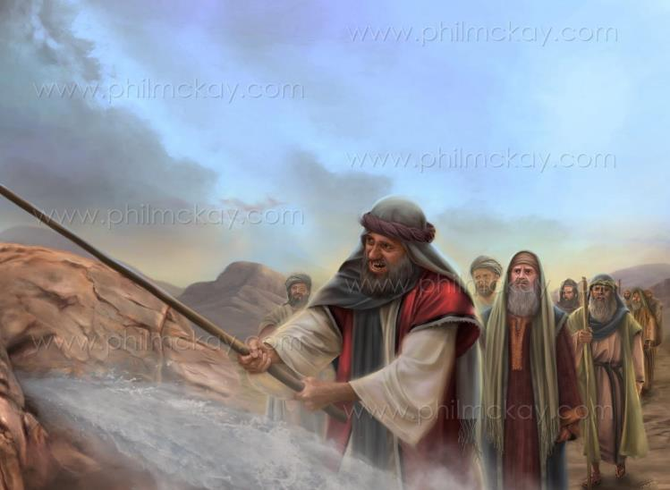
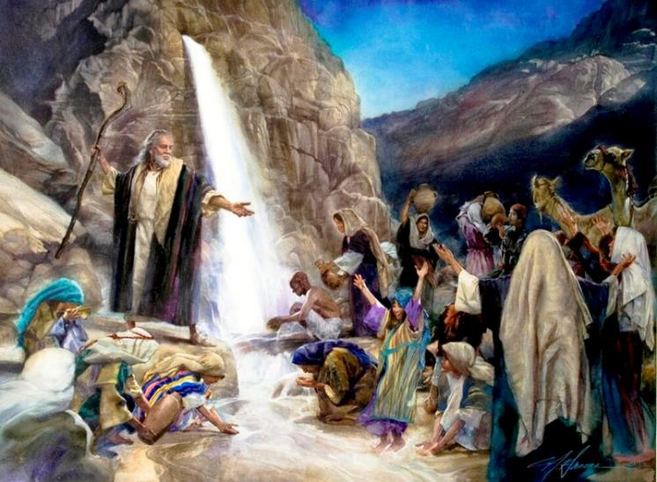
THANTHWE LA KU HOREBU
“Ine ndidzayima patsogolo pako pafupi ndi thanthwe la ku Horebu. Ukamenye thanthwelo, madzi adzatuluka kuti anthu amwe.” Motero Mose anachita zimenezi pamaso pa akuluakulu a Israeli” (Eksodo 17:6)
“Kodi Yehova ali pakati pathu kapena ayi?” ( Eksodo 17:7 ) Kodi Mulungu sanawatumizire mkate kuchokera kumwamba tsiku lirilonse?
Kusakhulupirika komwe Iseraeli anasonyeza kunali kodabwitsa. Koma Paulo amatilimbikitsa ndikutichenjeza kuti tisakhale anthu osakhulupirika monga mwa chitsanzo chawo (Ahebri 3:12).
Ngakhale kuti sanakhulupilire, Yesu mwini anagawanitsa thanthwe ndipo anapitiriza kuwapatsa madzi pa ulendo wawo wonse. Iye ndiye “thanthwe lauzimu lomwe anayenda nalo.” (1 Akorinto 10:4).
Kwa iwo, monganso ziliri kwa ife, Khristu ndiye Gwero la moyo ndi Wopereka moyo wosatha.

Slide 8

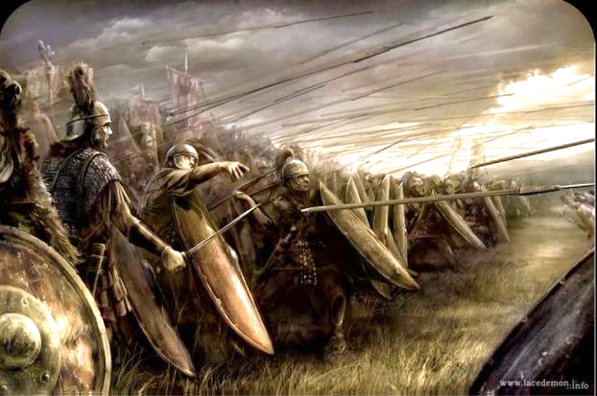
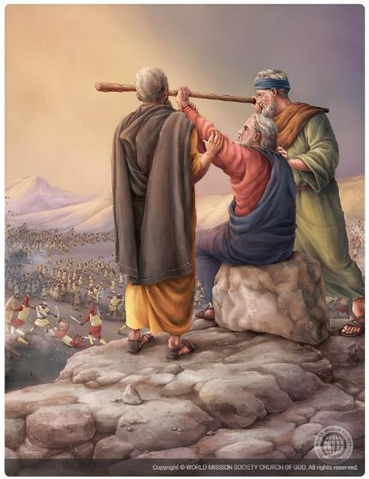
MANJA OKWEZEDWA
“Amaleki anabwera ku Refidimu kudzamenyana ndi Aisraeli” (Eksodo 17:8)
Pamene anali kupitilira mu chipululu, Aamaleki anaukira Aisraeli, ndipo Mose anapempha Yoswa kuti awateteze pamene iye, Aroni ndi Huri anakwera phiri ali ndi “ndodo ya Mulungu” (Eksodo 17:8-10).
Ndichifukwa chiyani Aamaleki anaukira?
Iwo anali atamva zimene Mulungu anachita ku Igupto. Koma mosiyana ndi ena Akanani, sanachite mantha. Ananyoza Mulungu ndi kumutsutsa poukira anthu ake, pofuna kutsimikizira kuti anali amphamvu kuposa Iye (Eksodo 17:16).
Mose akakweza ndodo ya Mulungu mwamba, Aisraeli ankagonjetsa adani awo. Koma pamene manja ake anatopa, Aisraeli ankagonjetsedwa (Eksodo 17:11).
Inali nthawi yoti udindo wochita zinthu ugawidwe kwa atsogoleri ena. Aroni ndi Huri anathandiza Mose, kuti ntchito ya Mulungu ikhale yopambana, ndipo potero anagonjetsa mdani (Eksodo 17:12).

Slide 9


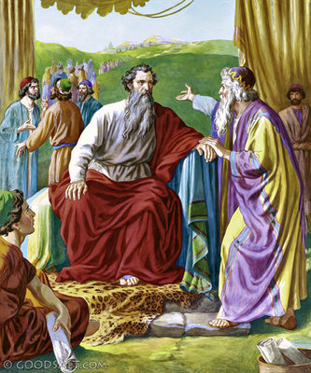
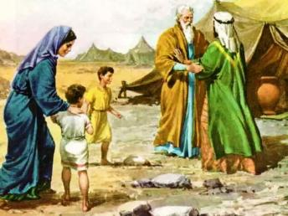
MALANGIZO ABWINO
“Koma sankhani amuna odziwa ntchito yawo, anthu owopa Mulungu, anthu odalirika amene amadana ndi kupeza phindu mwachinyengo. Tsono muwayike kuti akhale oyangʼanira anthu motere: atsogoleri a anthu 1,000, ena a anthu 100, ena a anthu 50 ndi ena a anthu khumi.” (Eksodo 18:21)
Ataona chizindikiro chimene Yehova analengeza kwa Mose, Yetero, pamodzi ndi Zipora ndi ana ake, anapita kukamuona ku Horebu (Eksodo 3:12; 18:1-5).
Yetero, ngakhale kuti sanali MuIsiraeli, ankalambira Mulungu. Chotero, atamva zimene Mulungu anachita ndi Mose ku Igupto, iye anatamanda Mulungu ndi kupereka nsembe kwa Iye (Eksodo 18:8-12).
Tsiku lotsatira, ataona Mose akuweruza anthu onse yekha, anamupatsa malangizo anzeru: gawani maudindo komanso ntchito ndi ena (Eksodo 18:17-23).
Modzichepetsa Mose anavomereza mawu a Mulungu pa uphungu umenewu. Choncho, iye anamvera malangizo a apongozi ake n’kusankha anthu oti azigwira ntchitoyo.
Makhalidwe ake (Eksodo 18:21):
Lemekezani Mulungu
Khalani odalirika
Danani ndi ziphuphu

Slide 10


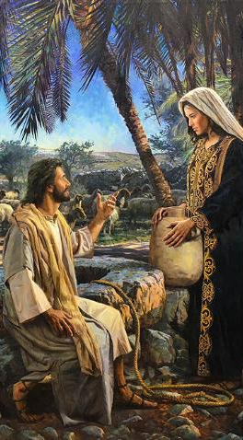
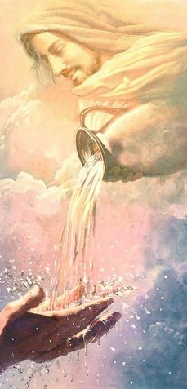
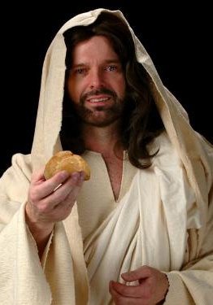
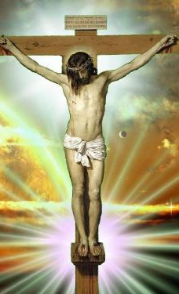
MKATE NDI MADZI A MOYO: YESU
“Mkate wamoyo wotsika Kumwamba Ndine amene. Ngati munthu wina akadyako mkate umene, adzakhala ndi moyo kosatha. Inde, ndipo mkate umene ndidzapatsa Ine, ndiwo thupi langa, ukhale moyo wa dziko lapansi” (John 6:51)
Paulo akutiuza kuti nkhani ya kutuluka mu Igupto inalembedwa kuti tiziphunzire, kusonyeza kuti, ziri ndi ntchito pa moyo wathy wauzimu (1 Akorinto 10:1-11).
Nkhaniyi imatichenjeza za kusilira mwa nsanje; kupembedza mafano; dama; kuyesa Mulungu; ndi miseche.
Komanso, Yesu anagwiritsa ntchito mwachindunji kwa iye mwini nkhani za madzi kuchokera mu thanthwe komanso mkate kuchokera kumwamba.
Iye ndiamene amapereka madzi a moyo, omwe amatanthauza Mzimu Woyera (Yohane 4:14; 7:37-39). Ndiye yekha amene angathe kukwaniritsa nkhawa ya mkati mwathu yokhudza mtendere, chisomo, ndi chimwemwe..
Yesu anati Iye ndiye mkate woona wochokera kumwamba. Mkate umenewu ndi thupi lake (Yohane 6:51). Ndi thupi Lake, lomwe linathyoledwa pa mtanda kuti lipereke chipulumutso kwa aliyense amene “adzadye”—kutanthauza kuti kumulandira Iye monga Mpulumutsi ndi kukhala naye paubale wa tsiku ndi tsiku. Khristu yekha ndiye angathetse ludzu ndi njala yathu yauzimu.

Slide 11
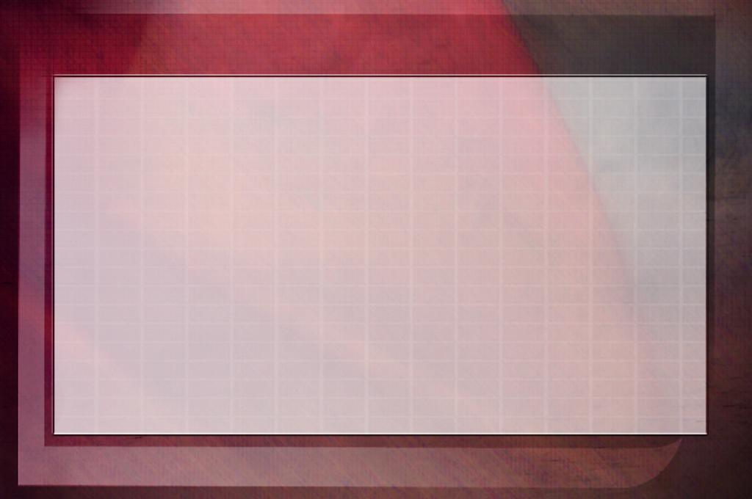
“Mpulumutsi wadziko lapansi amadziwa zofunikira pa moyo uliwonse. Pamene tikuponderezedwa ndi kulefuka, iye amadziwa, ndipo amapereka chitsitsimutso chauzimu. Funsani kwa iye; dikirani m’kupemphera, ndipo adzakupatsani. Yesu ndiye mkate wa moyo, wodyedwa tsiku ndi tsiku; ndiye madzi a moyo kwa mzimu wopweteka ndi wotopa, ndipo onse atha kulandira chisomo chake. Zitsime za dziko lapansi zidzatha, madzi ake adzauma; koma mwa Khristu muli kasupe wamoyo amene tingatuleko mosalekeza. Ngakhale titatunga ndi kupereka kwa ena, ochuluka adzatsala. Palibe chiopsezo chothetsa gwero la madzi iri; chifukwa Khristu ndiye gwero losatha la choonadi.”
EGW (The Signs of the Times, April 22, 1897)

