Slide 1
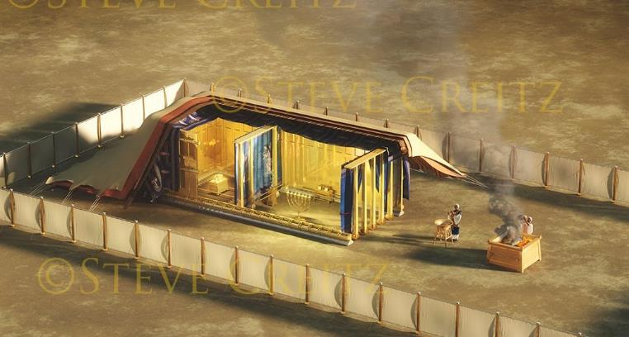
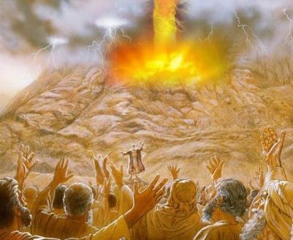
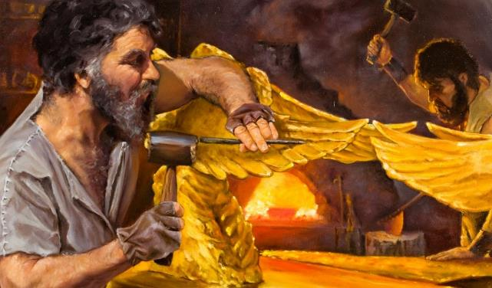
Phunziro 10, September 6, 2025
PANGANO NDI NDONDOMEKO

Slide 2
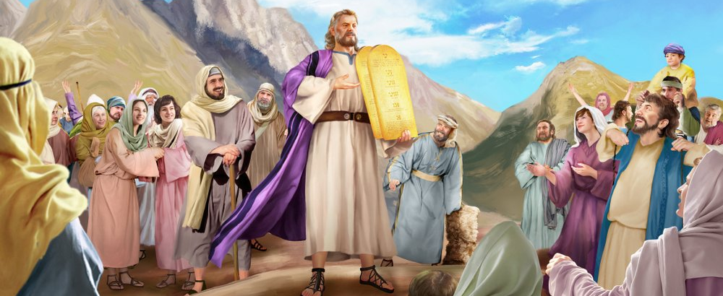
“Tsono Mose anapita kukawuza anthu mawu onse a Yehova ndi malamulo onse, ndipo anthu onse anayankha mogwirizana kuti, “Tidzachita zonse zimene Yehova wanena.”
Eksodo 24:3

Slide 3

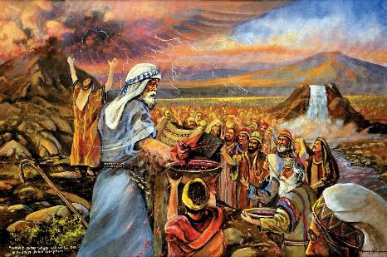
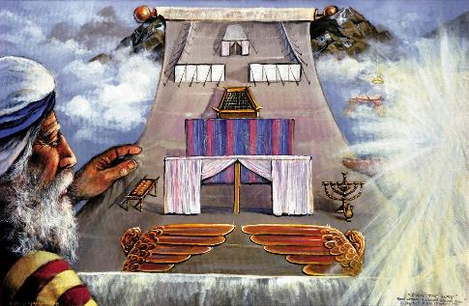


Atamaliza kulengeza mokweza Malamulo Khumi ndikupereka kwa Mose malamulo oyambira, Mulungu anafuna kupanga pangano ndi Israyeli.
Panganolo linali losavuta: Ine ndidzakhala Mulungu wanu, ndidzakusungani ndi kukudalitsani; inu mverani malamulo anga.
Atalemba panganolo m’buku, mbali zonse ziwiri zinkafunika kulitsimikizira. Anthu anatsimikizira polonjeza kuti adzalisunga. Koma Mulungu anatsimikizira bwanji? Ndi mwazi; ndi chikondwerero; komanso ndi chitsanzo chothandiza kuti amvetsetse pangano.
Pangano:
Mwazi wa pangano (Eksodo 24:1-6, 8)
Kukwaniritsidwa kwa pangano (Eksodo 24:7)
Chakudya cha Pangano (Eksodo 24:9-18)
Chitsanzo:
Cholinga cha chitsanzo (Eksodo 25:1-9)
Kukonzetsera kwa Chitsanzo (Eksodo 31:1-18)

Slide 4
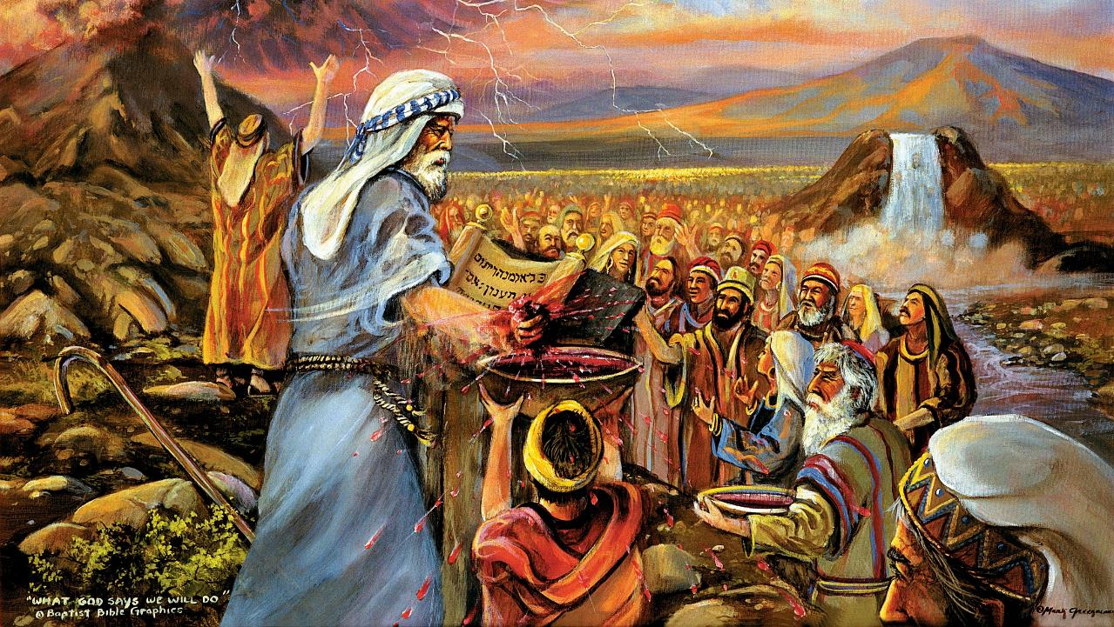
PANGANO

Slide 5

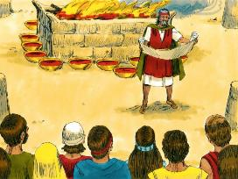
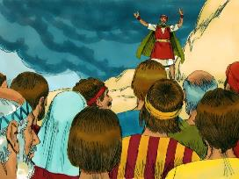
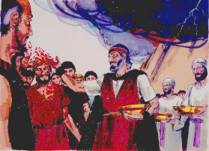
MWAZI WA PANGANO
Ndipo Mose anatenga mwaziwo, nawaza pa anthu, nati Taonani mwazi wa chipangano, chimene Yehova anachita nanu, kunena za mau awa onse.’ ” (Eksodo 24:8)
Pangano linapangidwa bwanji?
Pangano linawerengedwa (Eksodo 24:3a)
Anthu anayankha motsimikiza (Eksodo 24:3b)
Linasungidwa muzolembera (Eksodo 24:4a)
Guwa la nsembe linamangidwa (Eksodo 24:4b)
Mizati 12 inamangidwa (Eksodo 24:4c)
Nsembe zopsereza zinkaperekedwa (Eksodo 24:5)
Theka la mwazi linawazidwa pa guwa lansembe(Eksodo 24:6)
Panganoli linawerengedwanso (Eksodo 24:7a)
Anthu adayankhanso motsimikiza (Eksodo 24:7b)
Theka lina la mwazi linawazidwa pa anthu (Eksodo 24:8a)
Mose anaulengeza kukhala “mwazi wa pangano” (Eksodo 24:8b; Mateyu 26:28)
Anachita phwando kuti atsindike panganolo (Eksodo 24:9-11)
Mulungu anazindikira Israyeli monga mtundu (mizati 12); anapereka mtengo wapadera kwa achinyamata; ndipo anadzipereka kwa munthu aliyense payekha (kuwaza mwazi wake pa iwo).
Mulungu amafuna kukhala paubale ndi ife, aliyense payekha komanso monga gulu la okhulupirira.

Slide 6

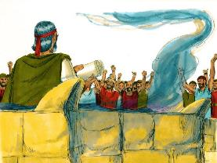
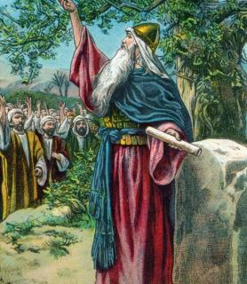


KUKWANIRITSIDWA KWA PANGANO
“Anatenganso Buku la Chipangano ndi kuwerengera anthu. Anthuwo anayankha kuti, ‘Zonse zimene Yehova wanena tamva, ndipo tidzazichita.’ ” (Eksodo 24:7)
Moona mtima kotheratu, anthu anadzipereka kusunga pangano. Koma kudzipereka kumeneku kunakhala kwa kwakanthawi kochepa(Eksodo 32:8).
M’badwo wotsatira nawonso unadzipereka kusunga pangano (Yoswa 24:18b). Koma Yoswa anawachenjeza momveka bwino kuti: “Simudzatha kutumikira Yehova.” (Yoswa 24:19 )
Chimene chimatilepheretsa kumvera Mulungu, ngakhale tili ndi zolinga zabwino, ndi chiyani?
Mwachibadwa, ndife osamvera (Aroma 7:18) ndipo palibe chimene tingachite kuti tisinthe khalidwe lathu (Aroma 7:24).
Koma tikamulola, Mulungu akhoza kusintha chikhalidwe chathu (Ezekiel 36:26-27). Iye amayeretsa, amachotsa, amapereka, ndi kuyika zinthu kuti ife timumvere. Ndi Iye yekha amene amatipatsa mphamvu (2 Akorinto 12:10 ).

Slide 7

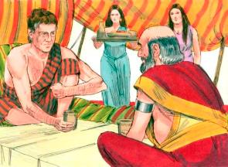
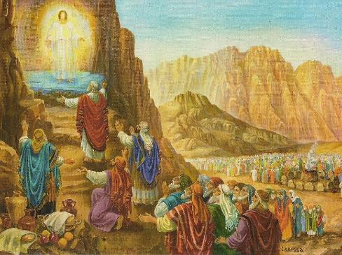
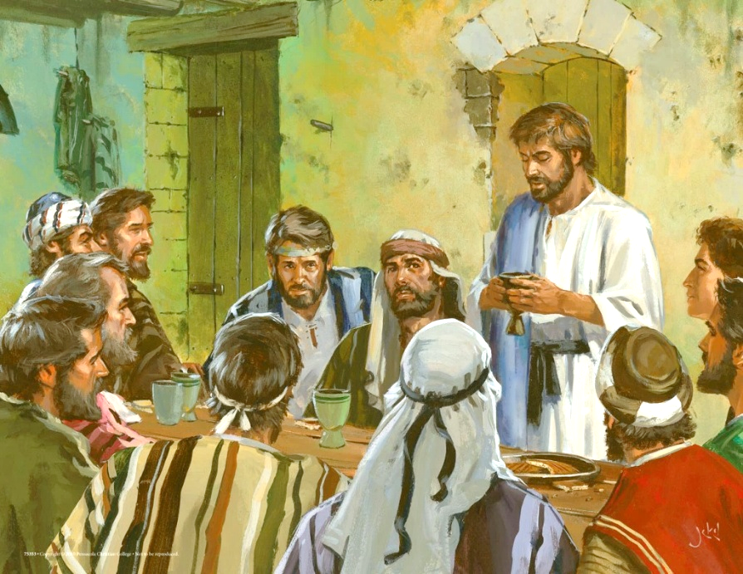
CHAKUDYA CHA PANGANO
“Kenaka Mose pamodzi ndi Aaroni, Nadabu, Abihu ndi akuluakulu makumi asanu ndi awiri a Israeli aja anakwera ku phiri,; […] mʼmalo mwake anadya ndi kumwa.” (Eksodo 24:9, 11b)
Monga mmene tikuwonera pa chitsanzo cha Yakobo ndi Labani, Kale anthu a Kum’mawa akamatsimikizira pangano amaphatikizapo chakudya chomwe mbali ziwiri zinkadya Pamodzi (Genesis 31:44-54 ).
Pa Sinai, Mulungu anapereka “chakudya cha pangano” kwa anthu 74: Mose, Aroni, Nadabu, Abihu, ndi akuluakulu 70, omwe anali oyimira anthu onse (Eksodo 24:9-11).
Pamene Yesu ankakhazikitsa pangano latsopano, anachitanso zimenezi podyera limodzi ndi atumwi Ake 12 (Mateyu 26:26-28 ).
Nthawi zonse tikamadya Mgonero wa Ambuye, timakonzanso pangano lathu ndi Mulungu. Pakudya mkate ndi vinyo, timakondwerera chikhululukiro ndi chipulumutso chimene tili nacho mwa Yesu (1 Akorinto 11:26).
Ngakhale kuti potsiriza anakana chipulumutso, Nadabu, Abihu komanso Yudasi sanachotsedwe konse ku “mgonero wa pangano” umenewu.

Slide 8
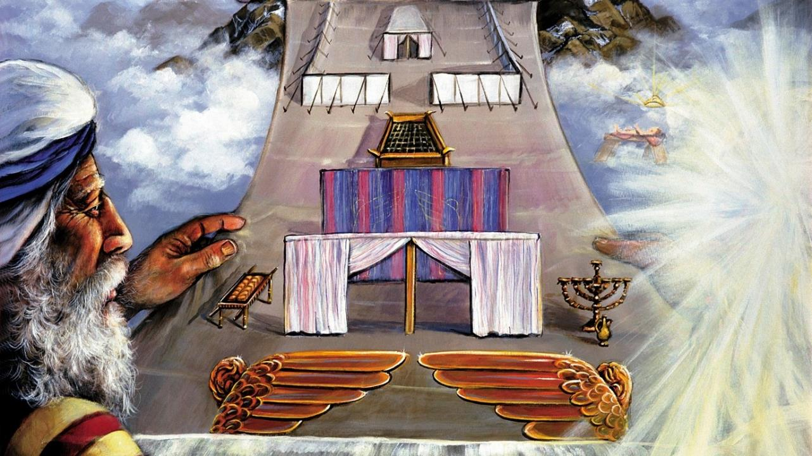
CHITSANZO

Slide 9

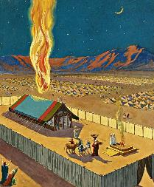
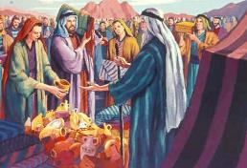
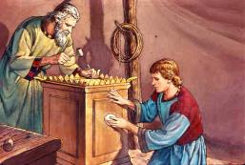
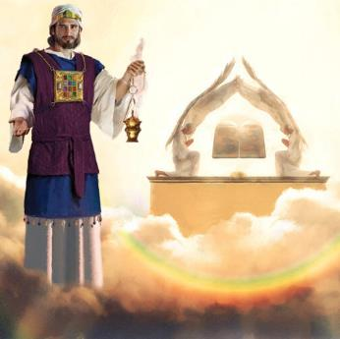
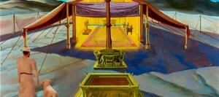
CHOLINGA CHA CHITSANZO
“Iwo andipangire malo wopatulika, ndipo Ine ndidzakhala pakati pawo. ” (Eksodo 25:8)
Monga chitsimikizo chakuti adzachita mbali yake ya pangano, Mulungu anaganiza zokhala pakati pa anthu.
Koma kupezeka kwa Mulungu pakati pawo kukanatanthauza imfa ya nthawi yomweyo kwa anthu onse (Eksodo 33:20). Chotero, anawalamula kuti amange malo opatulika kumene akanatha kusonyeza kupezeka kwake pakati pawo. Kupezeka kumeneku kunasonyezedwa mophiphiritsa, popeza kuti Mulungu sakhala kuthupi mukachisi aliyense wapadziko lapansi (Machitidwe 17:24).
Mose anasonyezedwa chitsanzocho ndipo anapatsidwa malangizo achindunji a kamangidwe ka Nyumba Yopatulika. Anthu anapemphedwa kuti apereke zinthu zofunikira (Eksodo 25:2-7).
Nyumba Yopatulika ndi kachisi amene Solomoni anamanga zinali chitsanzo cha Nyumba Yopatulika yomwe ili Kumwamba (Ahebri 8:1-2; 1 Mafumu 8:27, 30 ).
Pamene MuIsraeli ankalowa amalowa mu Nyumba Yopatulika, ankalowa—mophiphiritsira—pamaso pa Mulungu Mwini… kufikira pamene chinsalu chophimba chinang’ambika pamene Yesu anafa.

Slide 10

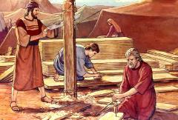
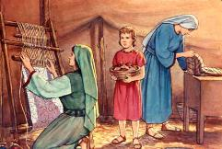
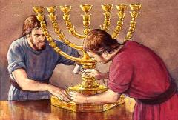
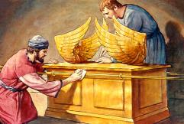
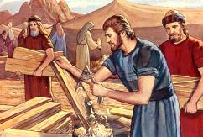
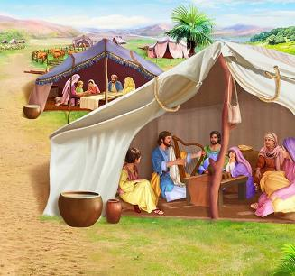
KUKONZETSERA KWA CHITSANZO
“Taona, ndasankha Bezaleli mwana wa Uri, mwana wa Huri, wa fuko la Yuda. Ndipo ndamudzaza ndi Mzimu wa Mulungu kotero kuti ali ndi luso ndi nzeru zomvetsa zinthu ndipo akudziwa bwino ntchito zonse zamanja monga izi:” (Eksodo 31:2-3)
Ngakhale kuti Mulungu anapereka kwa Mose malangizo atsatanetsatane okhudza zomangazo, sanamuwuze tsatanetsatane wa zinthu zonse. Kodi mkhate wamkuwa, akerubi, zisoti za ansembe, ndi zina zotero zikanawoneka bwanji? Izi zinapatsa Mzimu Woyera mwayi wogwirizana ndi mphatso za aluso omanga.
Pa tsatanetsatane umenewu, Mzimu Woyera anapatsa ena mphatso zapadera :
Bezaleli, amene ankatsogolera ntchito yonseyi (Eksodo 31:2 )
Oholiabu, yemwe anali womuthandizira wake wamkulu (Eksodo 31:6a)
Anthu ena amene anathandiza pa ntchitoyi (Eksodo 31:6b)
Pakati pa malangizo omangira Nyumba Yopatulika, pali kutchulidwa kwapadera kwa Sabata (Eksodo 31:12-17). Kodi Sabata ili ndi chiyani chokhudzana ndi zonsezi?
Chiyero ndicho mfundo yaikulu. Kuti tiyandikire kwa Mulungu Woyera, tiyenera kukhala oyera monga Iye. Sabata ndi chizindikiro cha chiyero (Eksodo 31:13; Ezekiel 20:12, 20).
Notes:
Eksodo31:2
See, I have called by name Bezalel the son of Uri, the son of Hur, of the tribe of Judah;
Eksodo31:6a
And behold, I have set with him Aholiab the son of Ahisamach , of the tribe of Dan;
Eksodo31:6b
and I have put wisdom in the minds of every wise-hearted person, so that they may do all that I have commanded you;
Eksodo31:12-17 And the LORD spake unto Moses, saying, (13) Thou shalt speak unto the children of Israel, saying, Ye shall surely keep my sabbaths: for it is a sign between me and you throughout your generations, that ye may know that I am the LORD that sanctifies you. (14) Therefore ye shall keep the sabbath day, for it is holy unto you: whoso profaneth it shall surely be put to death: for whosoever doeth any work in it, that soul shall be cut off from among his people. (15) Six days shall work be done: but the seventh day is a sabbath of rest holy to the LORD: whosoever doeth any work on the sabbath day shall surely be put to death. (16) Therefore shall the children of Israel keep the sabbath, to observe the sabbath throughout their generations for a perpetual covenant. (17) It is a sign between me and the children of Israel for ever: for in six days the LORD made heaven and earth, and on the seventh day he rested, and was refreshed.

Slide 11

“Pomanga Nyumba Yopatulika monga malo okhalamo Mulungu, Mose analangizidwa kupanga zinthu zonse molingana ndi chitsanzo cha zinthu zakumwamba.” Mulungu anamutana ku phiri, ndipo anamuwonetsa zinthu zakumwamba, ndipo mogwirizana ndi chitsanzo chake, chihema chinapangidwa, pamodzi ndi zonse zimene zinali nazo.
Chotero kwa Israyeli, Iye anafuna kukhale malo okhalamo Ake, Iye anavumbulutsa chithunzi ulemerero wa khalidwe Lake […] Koma mwa iwo okha analibe mphamvu yokwaniritsa chithunzi chimenechi. Kuzionetsera kwa pa Sinayi kunangowawonetsera kusowa ndi kufooka kwawo.”
EGW (Education, p. 35-36)

