Slide 1
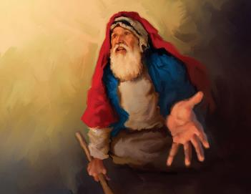
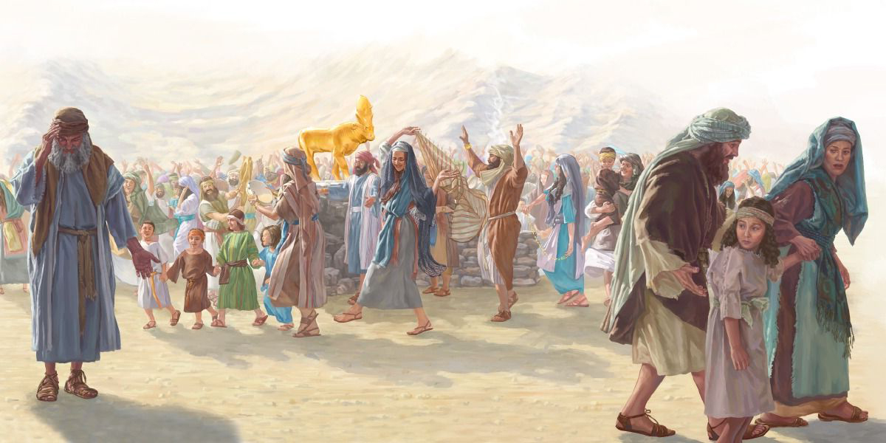
KUBWERERA MBUYO NDI KUPEMBEDZERA
Phunziro 11, September 13, 2025

Slide 2
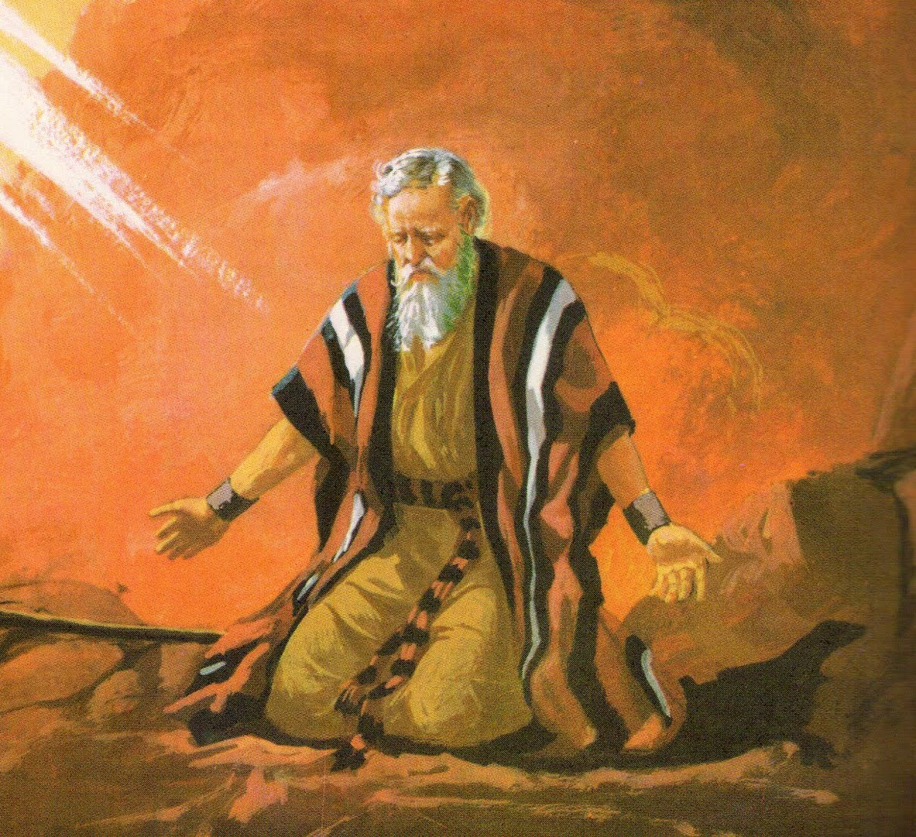
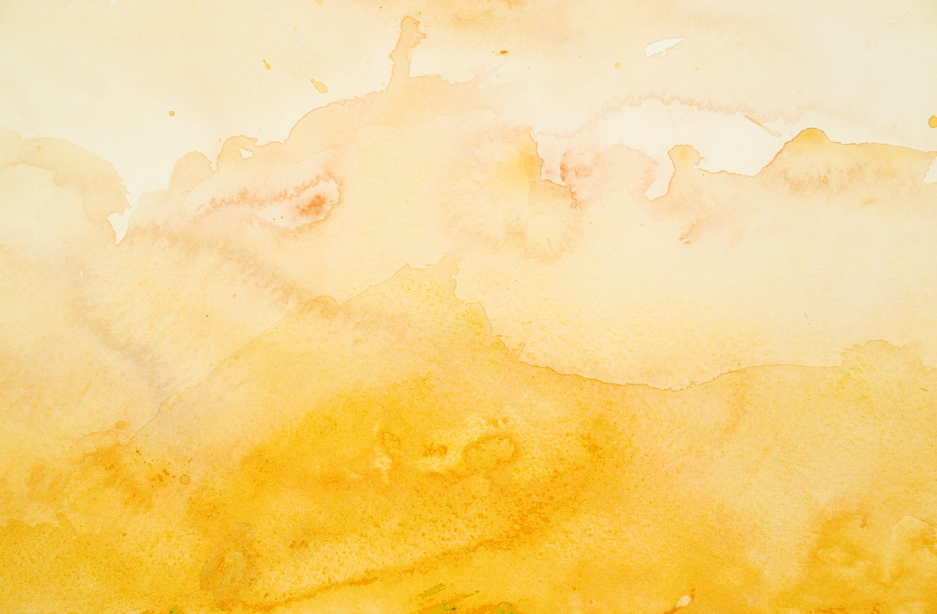
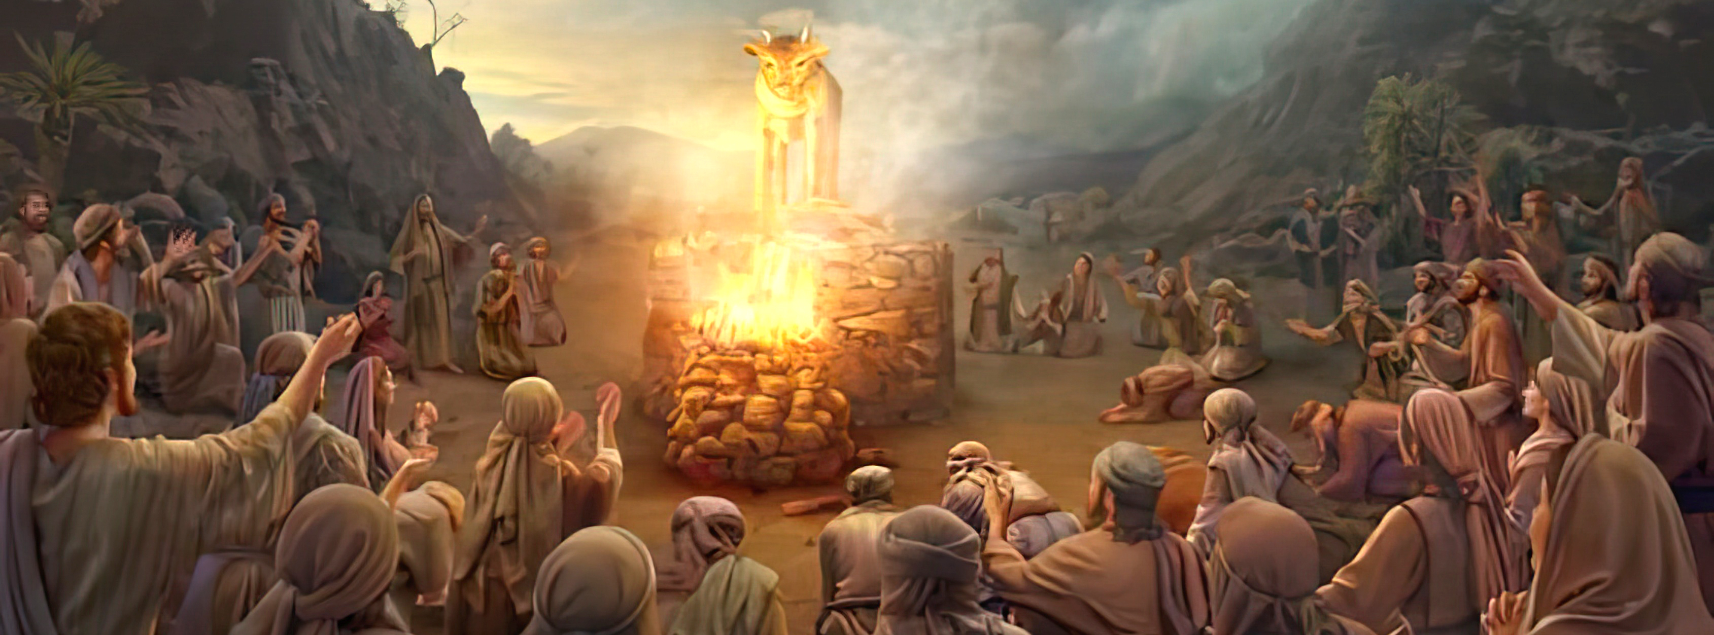
“Kotero Mose anabwereranso kwa Yehova ndipo anati, “Aa! Anthu awa achita tchimo lalikulu! Iwo adzipangira milungu yagolide. Koma tsopano, chonde akhululukireni tchimo lawo. Ngati simutero, ndiye mundifute ine mʼbuku limene mwalemba.’ ”
Eksodo 32:31, 32

Slide 3

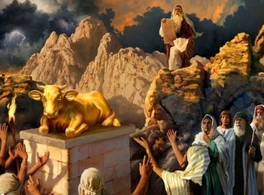
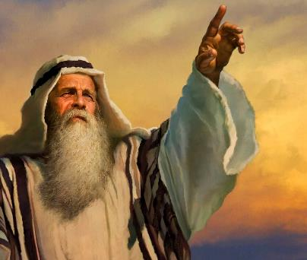


“Iwo apatuka mwamsanga kuleka kutsatira zimene ndinawalamula.” (Eksodo 32:8 ).
Posakhalitsa atangolandira Malamulo Khumi, ndiponso kulangizidwa kachiwiri kuti asapange mafano(Eksodo 20:23), Aisraeli anapanga fano la mwana wa ng’ombe wagolide kuti alambire.
Poyang’anizana ndi mpatuko umenewu, Mulungu anapempha Mose kuti amulole kuwononga Israyeli ndi kupanga mtundu watsopano (Eksodo 32:10). Ngakhale kuti anthuwo anali atampatuka, Mose anapembedzera kawiri pamaso pa Mulungu, kupempha chikhululukiro chimene sanayenere.
Mpatuko :
  Kufooka kwa Aroni (Eksodo 32:1-5)
  Phwando la Mwana wang'ombe (Eksodo 32:6)
  Kuipa kwa kupembedza mafano (Eksodo 32:7-8)
Kupembedzera :
  “Tembenukani ku mkwiyo wanu waukulu! ” (Eksodo 32:9-29)
  “Ndifufuteni m’buku limene mwalemba!” (Eksodo 32:30-32)

Slide 4

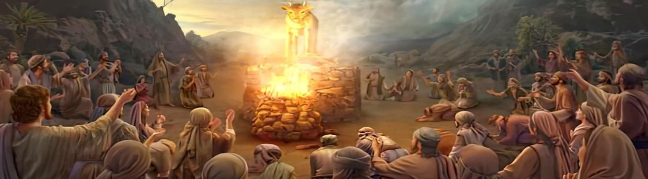
MPATUKO

Slide 5

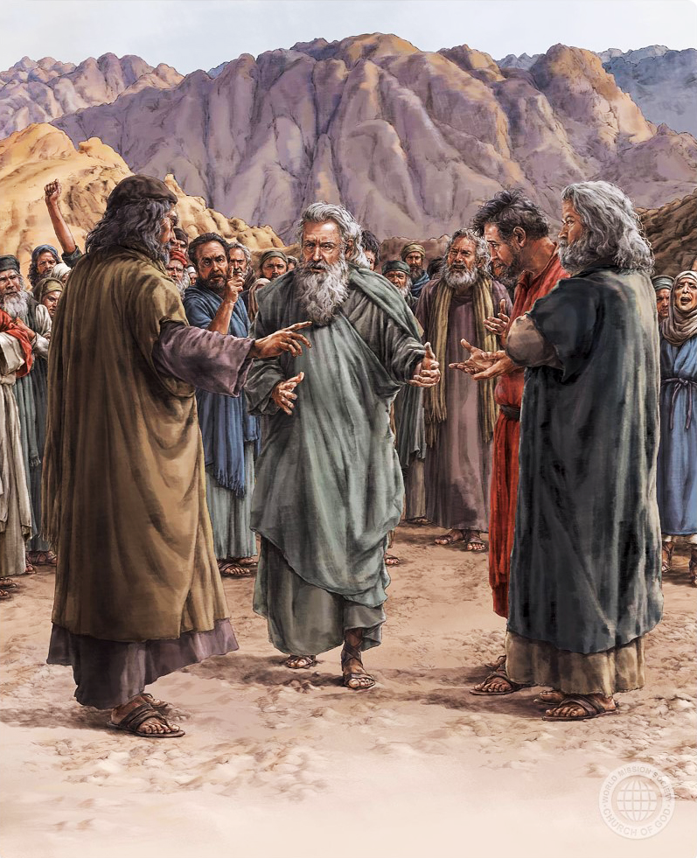
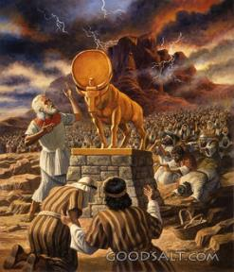
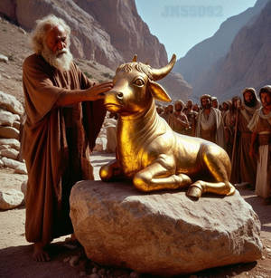
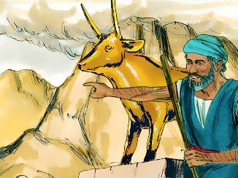
KUFOOKA KWA ARONI
“Aaroni ataona izi, anamanga guwa lansembe patsogolo pa mwana wangʼombeyo ndipo analengeza kuti, “Mawa kudzakhala chikondwerero cha Yehova.’ ” (Eksodo 32:5)
Ngakhale kuti mawu achihebri akuti elohim ali mugulu la mawu otchula zambiri ‘milungu,’ nthawi zambiri amagwiritsidwa ntchito pofotokoza Mulungu mmodzi yekha : “Ine ndine Yehova Mulungu wako [Elohim], amene ndinakutulutsa m’dziko la Aigupto.” (Eksodo 20:2)
Mose atachokapo, anthu anapempha Aroni kuti awapangire mulungu wooneka amene adzimulambira (Eksodo 32:1 ). Sanachedwe kuiwala malamulo amene analandira komanso lonjezo lawo loti adzawatsatira (Eksodo 24:7).
Kuzengereza koyamba kwa Aroni poyesa kukambirana ndi anthu (Eksodo 32:2 ) kunamupangitsa kutsogolera mpatuko mmalo moti authetse.
M’malo mowakumbutsa za lamulo loletsa kupanga mafano, Aroni anawapangira mwana wa ng’ombe wagolidi, nati: “Inu Aisraeli, nayu mulungu wanu amene anakutulutsani mʼdziko la Igupto! (Eksodo 32:4 ).

Slide 6

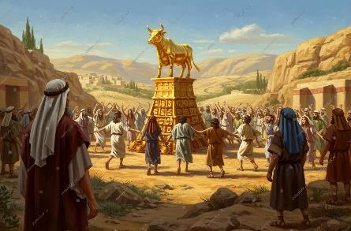
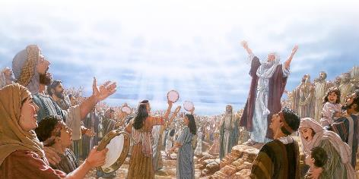

PHWANDO LA MWANA WANG'OMBE
“Kotero tsiku linalo anthu anadzuka mmamawa ndithu ndi kupereka nsembe zopsereza ndi nsembe zachiyanjano. Atatha kupereka nsembezo, anthuwo anakhala pansi nayamba kudya ndi kumwa. Kenaka anayimirira nayamba kuvina mwachilendo.” (Eksodo 32:6)
Popanga fano la mwana wa ng’ombe, Aisraeli anachepetsa Mulungu Wamphamvuyonse kukhala chifanizo cha nyama, nalambira chilengedwe m'malo mwa Mlengi (Aroma 1:23 ).
Iwo ankaganiza mopanda nzeru kuti chifaniziro chosemadwa ndi manja chingathe kuwatsogolera. Ndikutheka kuti ankaganiza kuti Elohim mwiniyo wasanduka mwana wa ng’ombe! (Eksodo 32:24 )
Ndipotu iwo anasiya kulambira Mulungu ndipo anayamba kulambira ziwanda (Deut. 32:17). Pamene ankalambira Mulungu, makhalidwe awo ankakula, chifukwa ankakhala ofanana ndi Mulungu.
Polambira ziwanda, anayamba kudzinyozetsa, chifukwa ankafanana ndi ziwanda zimene ankazilambira.
Tikamalephera kupereka mitima yathu kwa Mlengi, koma kutumikira fano lina (ndipo mafano ndi ambiri), posakhalitsa zimenezi zimatitsogolera ku kuonongeka kwa makhalidwe.

Slide 7

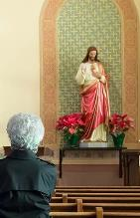



KUIPA KOPEMBEDZA MAFANO
“Pamenepo Yehova anati kwa Mose, “Tsika msanga, chifukwa anthu ako amene unawatulutsa mʼdziko la Igupto aja adziyipitsa kwambiri.’” (Eksodo 32:7)
Kugwadira fano (ngakhale likuimira Mulungu Mwiniwake, Khristu, kapena oyera mtima) ndi kusamvera Lamulo la Mulungu (Eksodo 20:3-6 ) ndipo, chotero, kulowa mu uchimo ndi chivundi.
Kodi kulambira mafano m’zaka za mma 21 kumatanthauza chiyani? Kulambira mafano ndi kulambira chilichonse chimene chimatenga malo a Mulungu. Fano ndi chilichonse chimene chimakopa maganizo athu, chikondi chathu, nthawi yathu, ndi malingaliro athu kuposa Mulungu, ndiponso chimene chimapangitsa malingaliro athu kukhala mwaukapolo.
Kodi timalambira mafano otani? Mukhoza kupanga mndandanda wanu. Malingaliro ena: kunyada, ndalama, mphamvu, kugonana, chakudya, ntchito, malo ochezera a pa Intaneti…
Kodi kulambira mafano kumatanthauza chiyani? Umunthu wathu, kaganizidwe, kamvedwe kathu, ngakhalenso mmene timakhalira ndi anthu zimasintha. Timasinthanitsa ubale weniweni ndi Mulungu ndi kuchita zopanda pake komanso zopanda tanthauzo zomwe sizingatipulumutse.

Slide 8

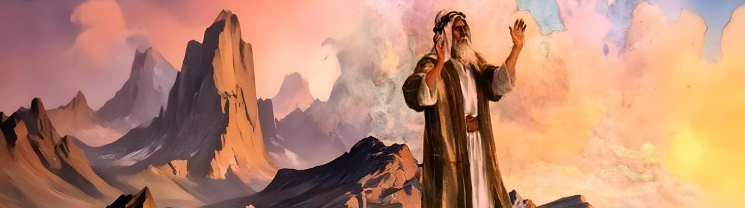
KUPEMBEDZERA

Slide 9

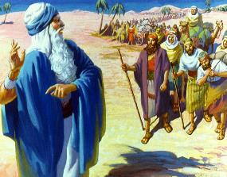
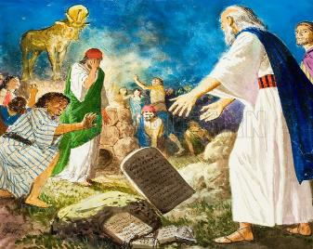
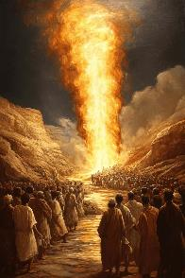
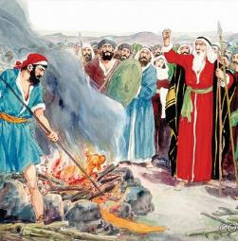
“TEMBENUKANI KU MKWIYO WANU WAUKULU
“Kodi mukufuna kuti Aigupto azinena kuti, ‘Munali ndi cholinga choyipa chofuna kuwaphera ku mapiri kuno ndi kuwawonongeratu pa dziko lapansi pamene munkawatulutsa ku Igupto kuja?’ Ayi, chonde mkwiyo wanu woyaka ngati motowu ubwezeni ndipo sinthani maganizo ofunira zoyipa anthu anu!’ ” (Eksodo 32:12)
Mulungu anauza Mose kuti: “Chifukwa anthu AKO amene unawatulutsa mʼdziko la Igupto aja adziyipitsa kwambiri (Eksodo 32:7 ).
Mose anayankha moyenera kuti: ‘Sikuti ndi anthu anga, koma Anu; sindinali ine amene ndinawatulutsa, koma inu’.” (Eksodo 32:11 ) . Mulungu ankamupempha kuti amulole awononge Israeli (Eks. 32:10), koma Mose anakana kupereka chilolezo chimenechi.
Mkwiyo wa Mulungu unali wolungama, koma Mose anadziwa kuti “chifundo chipambana chiweruzo” (Yakobo 2:13). Atatha kupembedzera Israyeli, ndi chikhulupiriro chakuti Mulungu watontholetsa mkwiyo wake, iye (mokwiya) anatsika kuchokera m’phiri (Eksodo 32:12-15). Ataona mpatuko, anaphwanya chizindikiro cha pangano: magome amiyala (Eksodo 32:19).
Atamvetsera zifukwa zofooka za m’bale wake, Mose anachitapo kanthu mwamphamvu kuti athetse chipwirikiticho (Eksodo 32:20-28).

Slide 10

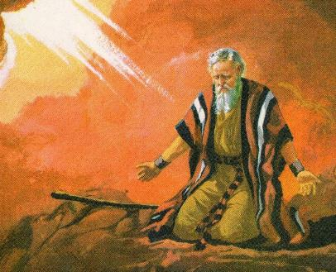
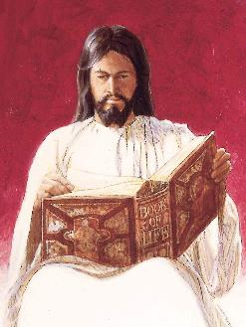

“NDIFUFUTENI M’BUKU LIMENE MWALEMBA!”
“Koma tsopano, chonde akhululukireni tchimo lawo. Ngati simutero, ndiye mundifute ine mʼbuku limene mwalemba!” (Eksodo 32:32 NIV)
Ndi kupembedzera kwake koyamba, Mose analetsa kuwonongedwa kwa anthu. Koma zinali zoonekeratu kuti Mulungu sangawadalitsenso pambuyo pa tchimo limeneli. Choncho anaganiza zopanga pembedzero lachiwiri (Eksodo 32:30).
Mose anali wokonzeka kutaya chipulumutso chake ngati anthu sanakhululukidwe (Eksodo 32:31-32). Komabe, ichi sichinali chikhululukiro chachibadwa chimene Mose anali kupempha, pakuti sanagwiritse ntchito liwu lachihebri lachizolowezi lotanthauza “kukhululukira.” Iye anapempha kuti Mulungu “asenze” machimo a anthu.
Izi zinkatanthauza kuti Mulungu adzatenga tchimo pa Iye mwini ndi kulinyamula, kulipira mtengo wake: imfa (Yesaya 53:6; Aroma 6:23 ). Izi ndi ndendende zomwe Yesu anachita pamtanda. Iye anatenga machimo athu pa Iye mwini nafa imfa imene tinkayenera kufa ife.(1 Petro 2:24 ).

Slide 11

EGW (Patriarchs and Prophets, p. 315)
Panthawi ya kudikira kumeneku, panali nthawi yoti asinkhesinkhe ndi kuganizira Lamulo la Mulungu limene anamva, ndi kukonzekera mitima yawo kulandira zinsinsi zina zimene Iye akanawawulula. Nthawi yawo sinali yochuluka; ndipo akanakhala akufuna kumvetsa bwino zimene Mulungu amafuna, ndi kudzichepetsa pamaso pa Iye, akanatetezedwa ku mayesero. Koma sanatero, ndipo posakhalitsa anakhala osasamala, osamvetsera, ndi osamvera malamulo. […] Poona kuti alibe chochita chifukwa mtsogoleri wawo palibe, anabwerera ku zikhulupiriro zawo zakale. […] Anthu analakalaka fano loimirira Mulungu, ndi kuti liwatsogolere m'malo mwa Mose.”

