Slide 1

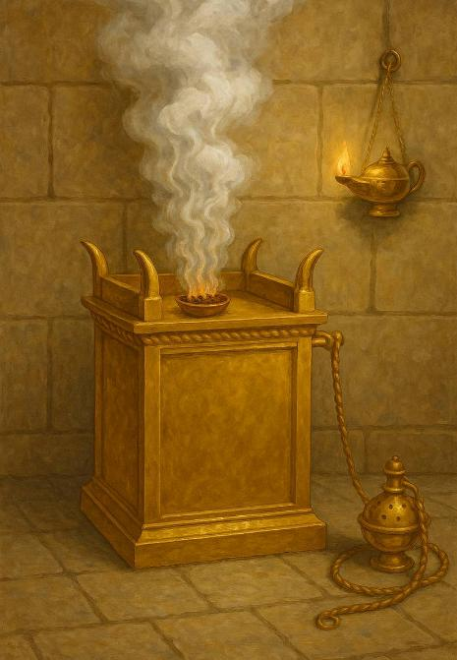
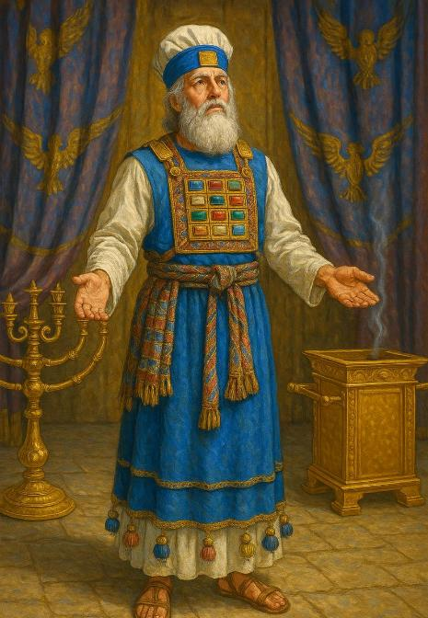
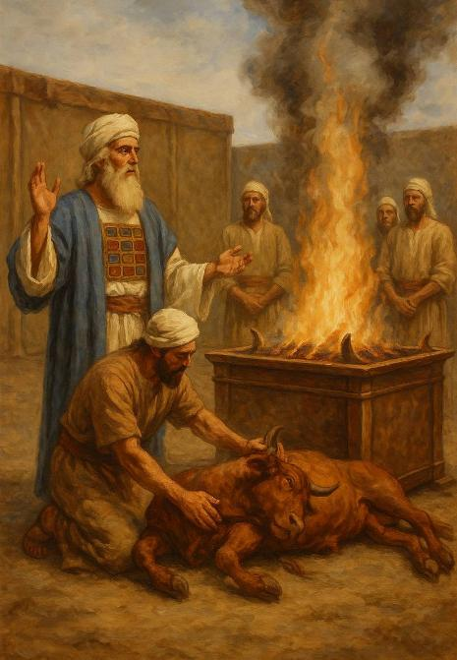
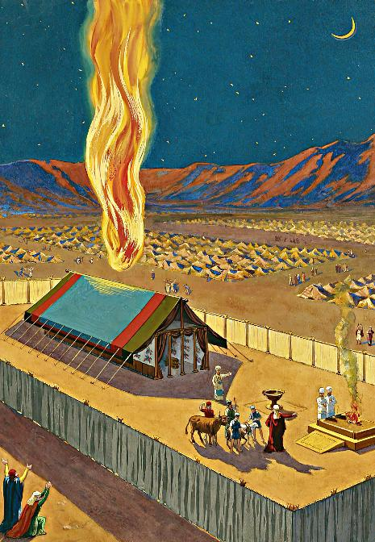
CHIHEMA
Phunziro 13 September 27, 2025

Slide 2
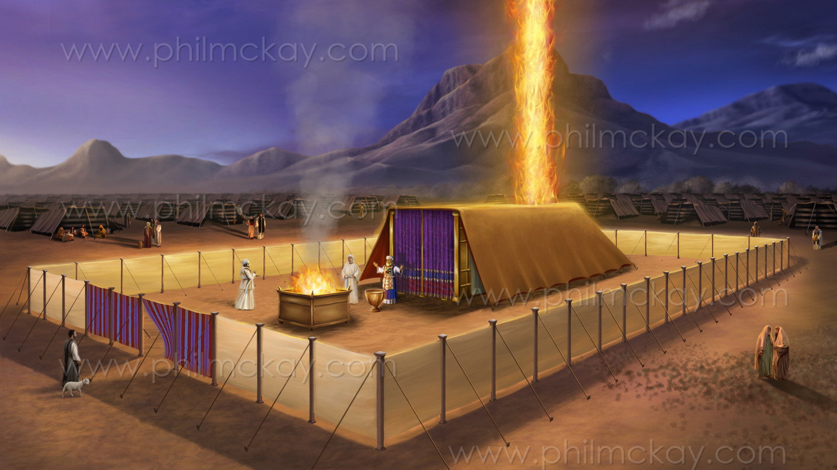
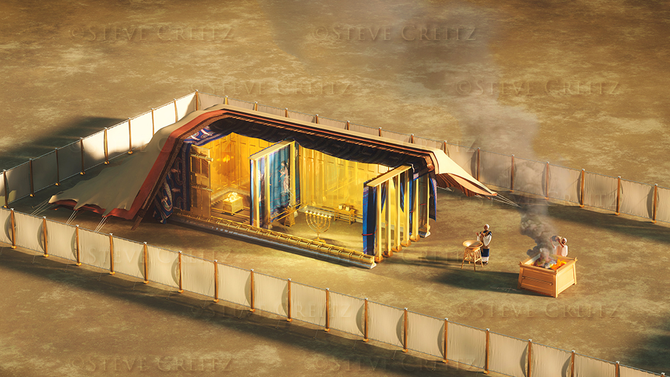
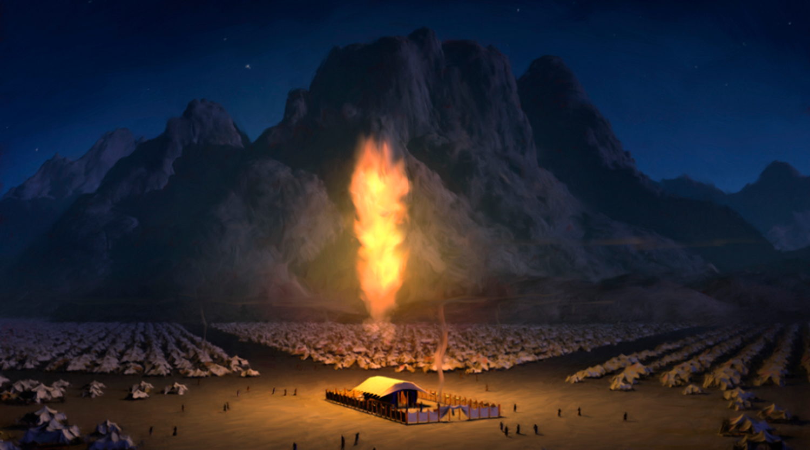
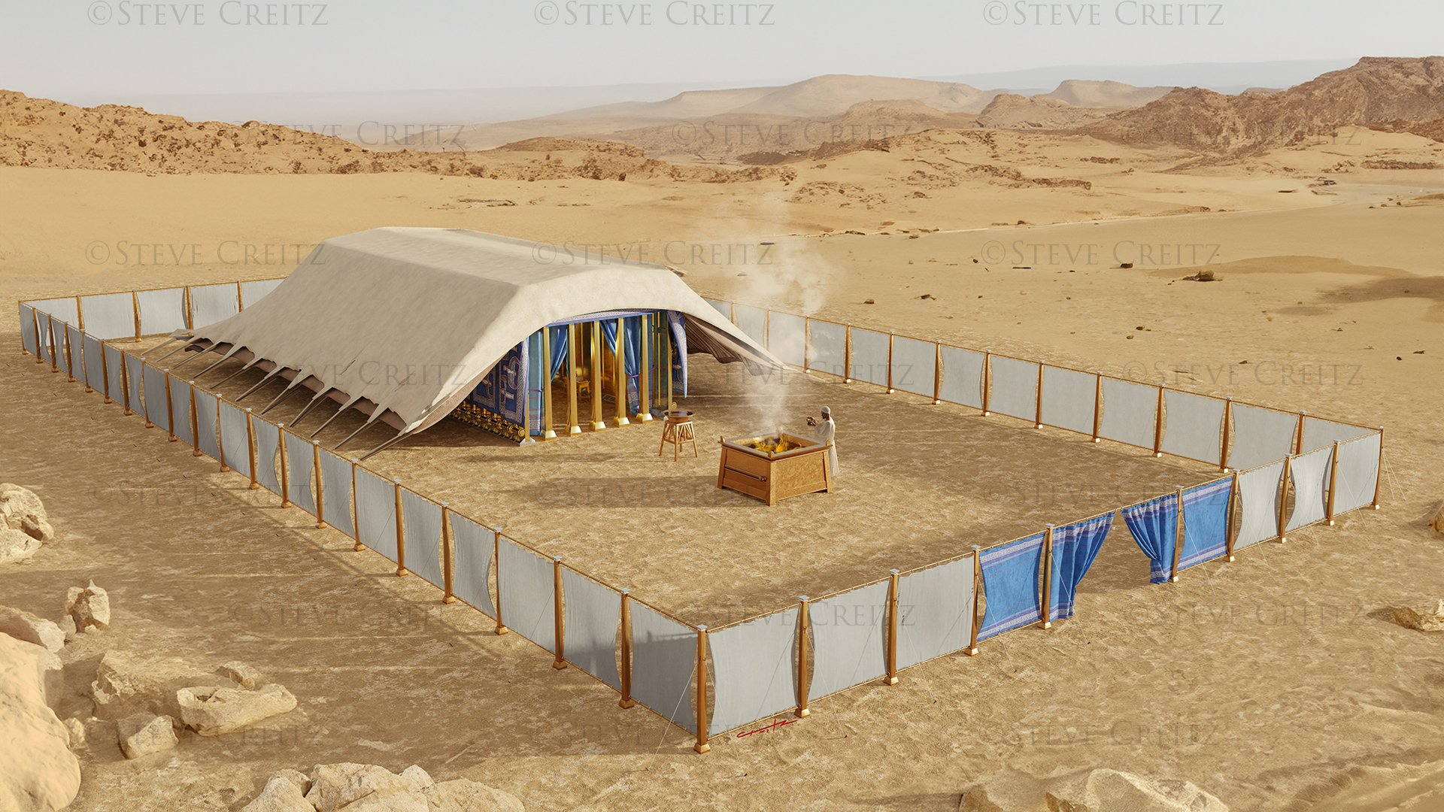
“Kenaka mtambo unaphimba tenti ya msonkhano, ndipo ulemerero wa Yehova unadzaza mʼchihemacho…. Kotero mtambo wa Yehova unkakhala pamwamba pa chihema usana, ndi mtambo wamoto umakhala usiku, pamaso pa nyumba yonse ya Israeli pa masiku onse aulendo wawo”
Eksodo 40:34, 38

Slide 3

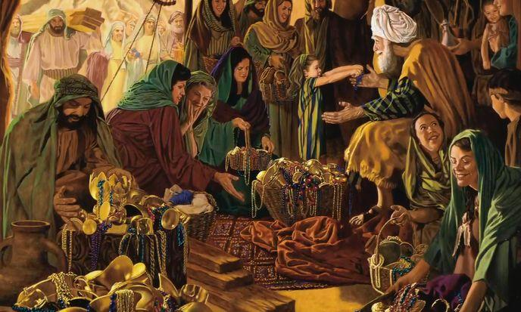

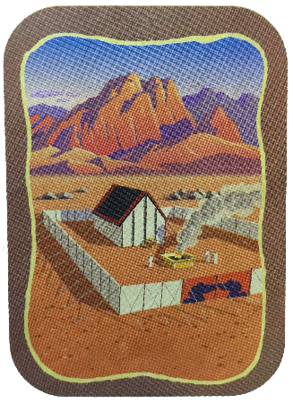
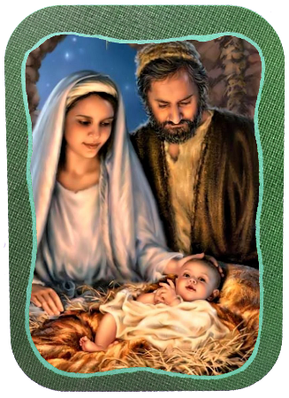
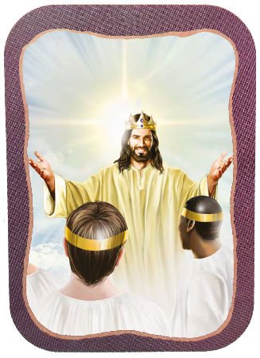







Mitu yomaliza ya Eksodo yafotokoza za kumangidwa ndi kuperekedwa kwa Chihema.
Izi zinali nthawi zapadera, pamene anthu adatenga nawo mbali mokondwera, kupereka-aliyense momwe angathere-ku ntchito yaikulu iyi ya Mulungu.
Chifukwa chachikulu chimene Mulungu amapereka pomangira Kachisi wonyamulika ndi kufuna kwake kukhala pakati pa anthu ake (Eksodo 25:8). Chikhumbo chimenechi chinakwaniritsidwa mwa Yesu, ndipo chidzakwaniritsidwa pamene tonse tidzakhala ndi Iye mu Dziko Latsopano.
Kukonzekera:
Sabata Eksodo 35:1-3)
Nsembe ya Ufulu Eksodo 35:4-36:7)
Chihema:
Kumanga (Eksodo 36:8-39:43)
Kudzipatulira (Eksodo 40:1-38)
Mahema ena:
Yesu ndi Yerusalemu wa Tsopano

Slide 4
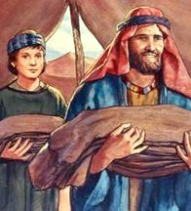
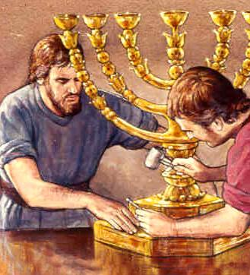
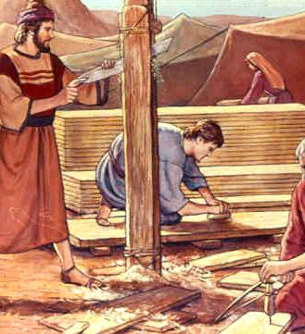
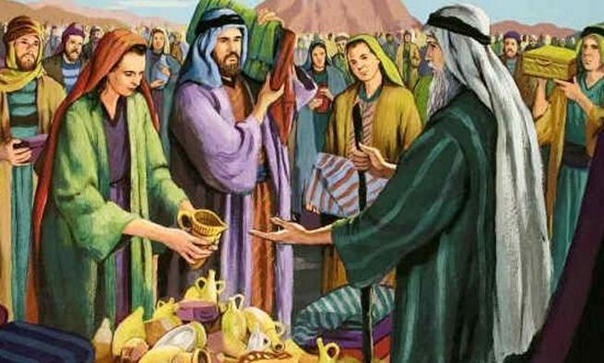
KUKONZEKERA

Slide 5

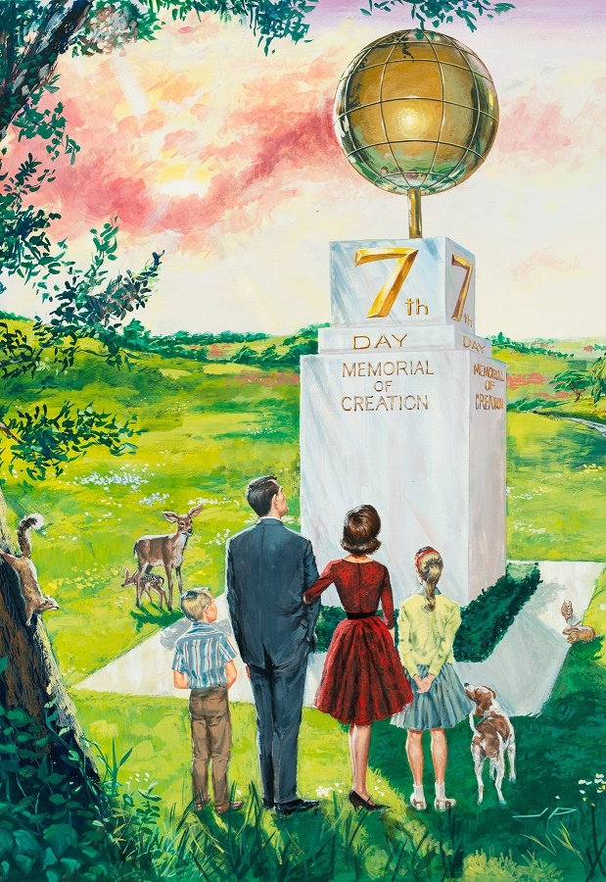
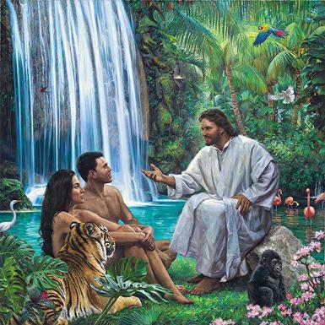
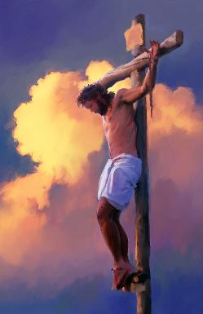
SABATA
“Muzigwira ntchito zanu pa masiku asanu ndi limodzi, koma tsiku la chisanu ndi chiwiri likhale la Sabata, tsiku lanu lopuma, lopatulika kwa Yehova. Aliyense amene adzagwira ntchito iliyonse pa tsikuli ayenera kuphedwa. ” (Eksodo 35:2)
Atatha kuona ulemerero wa Mulungu, Mose anauza anthu “zimene Yehova analamula” (Eksodo 35:1, 4). Malangizo amenewa anaphatikizapo ubale wao ndi Mulungu mu nthawi (Sabata) ndi mu mlengalenga (Chihema).
Mulungu anapatula Sabata kukhala nthawi yapadera yoti tisangalale ndi kukhala naye mu Chilengedwe chenicheni (Genesis. 2:1-3; Eksodo 20:11), ndipo anakumbutsa Aisrayeli zimenezi atangotsala pang’ono kulengeza Malamulo Khumi (Eksodo 16:22-29).
Sabata likutikumbutsa kuti Mulungu ndiye Mlengi wathu ndi Mombolo wathu (Deuteronomo 5:15), ndipo limatifikitsa ku nthawi ya m’tsogolo imene tidzasangalala ndi kukhala naye kwamuyaya (Yesaya 66:22-23 ).

Slide 6
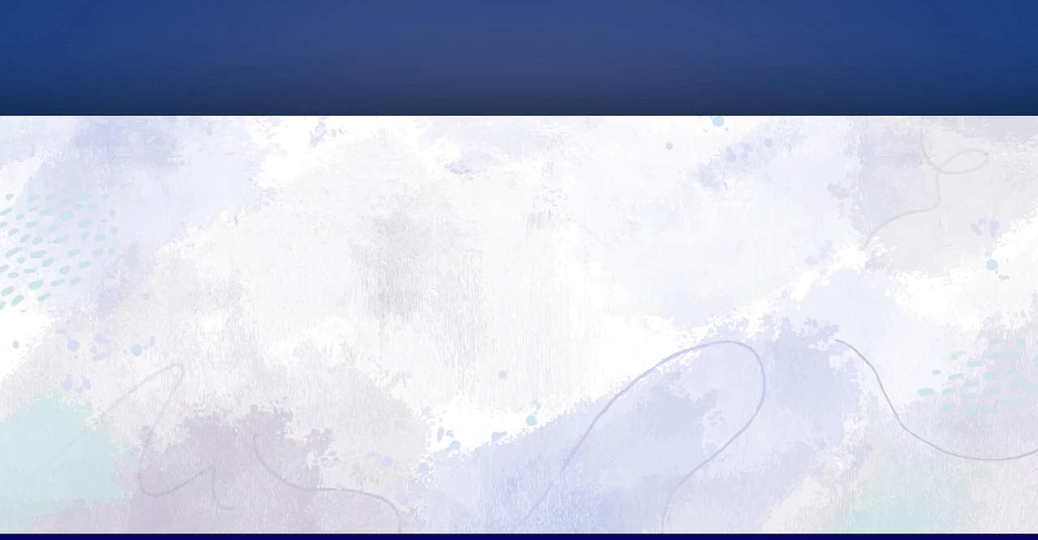
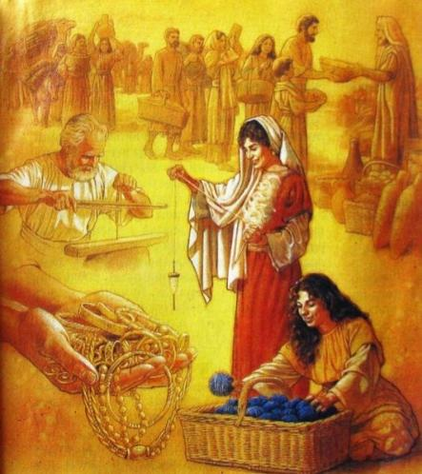
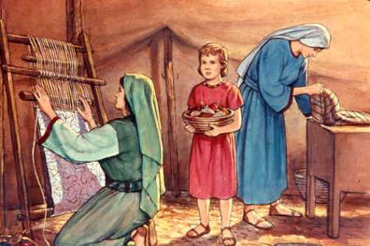
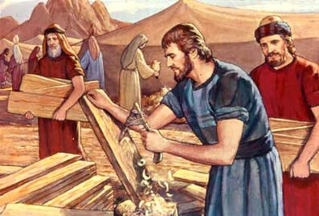
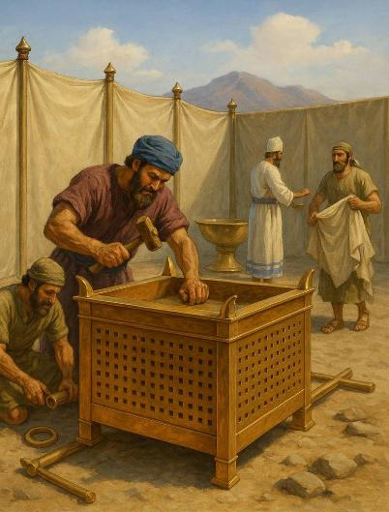
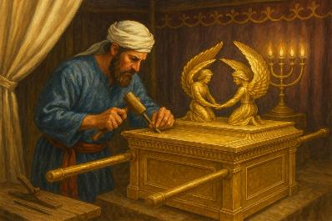
ZOPEREKA KWAUFULU
“Kuchokera pa zomwe muli nazo, mutenge chopereka cha Yehova. Aliyense amene ali ndi mtima wofuna kupereka abweretse kwa Yehova zopereka izi: Golide, siliva ndi mkuwa [ …] Anthu onse aluso pakati panu abwere ndi kupanga zonse zimene Yehova walamula: (Eksodo 35:5,10)
Panali njira ziwiri zothandizira ntchito ya Chihema: zopereka ndi ntchito.
Golide oposa tani imodzi, Siliva okwana 3.75 tani, ndi mkuwa mlingo wa 2.5 tani, komanso matabwa ndi nsalu zosiyanasiyana (Eksodo 38:21-31 ).
Kodi zonsezi zinachokera kuti? Zambiri mwa izo ndizimene ana a Israeli anapatsidwa ku Igupto pamene amanyamuka ulendo wawo (Eksodo 11:2).
Kuphatikiza apo, ntchito ya opota, osoka ndi osoka, akalipentala, osema, osema miyala yamtengo wapatali, ndi zina zotero.
Aliyense anali wofunitsitsa kuthandiza moti Bezaleli, Oholiabu, ndi antchito ena anapempha Mose kuti aletse anthu kubweretsa nsembe (Eksodo 36:3-7).
Kuti akwaniritse ntchitoyi, Mzimu Woyera anapatsa onse ogwira nawo ntchito mphatso (Eksodo 35:30–36:2). Mofananamo, Iye akupitiriza kupereka mphatso zofunika kwa onse amene akugwira ntchito ya Mulungu.

Slide 7

“Mulungu wapatsa amuna ndi akazi kukhala ndi mphatso za mtengo wapatali. Kwa osiyanasiyana Iye wapereka mphatso zosiyanasiyana. Si onse amene ali ndi nyonga yofanana ya khalidwe kapena kuzama kwa chidziwitso. Koma aliyense ayenera kugwiritsa ntchito mphatso zake mu utumiki wa Mbuye, mosasamala kanthu kuti mphatsoyo ingaonekere yaying’ono motani.”
EGW (The Upward Look , December 31)

Slide 8

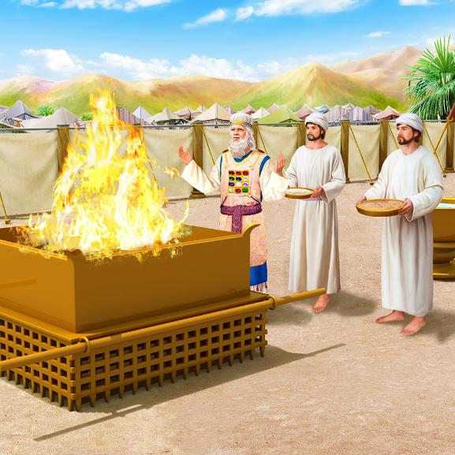
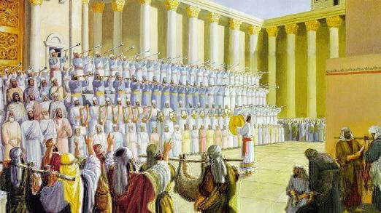
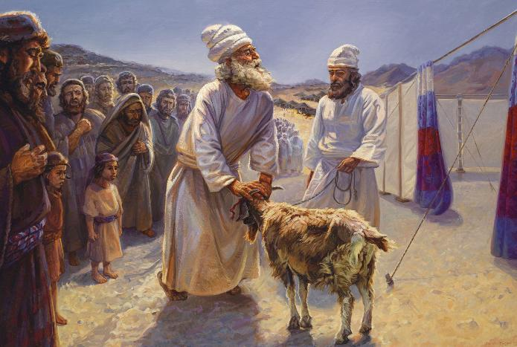
KUMANGA
Atamangidwa, Malo Opatulika (Chihema ndi Bwalo) anali ndi misonkhano iwiri yosiyana: tsiku ndi tsiku komanso pachaka. Miyambo yawo yosiyanasiyana, yotengedwa pamodzi, imatiphunzitsa kuti:
Mulungu amadana ndi tchimo
Mulungu amapulumutsa wochimwa
Mulungu adzawononga oipa
Mulungu amatitsimikizira za tsogolo labwino kwambiri
Kudzera mu utumiki wa tsiku ndi tsiku, Mulungu anasonyeza njira imene Iye amakhululukira ochimwa, mwa Chisomo: ndi imfa ya nyama yosalakwa, “Mwanawankhosa wa Mulungu amene achotsa uchimo wa dziko lapansi” (Yohane 1:29 ).
Ndi utumiki wapachaka (Tsiku Lachitetezero), Mulungu anasonyeza mmene Iye adzachotsera uchimo muchilengedwe chonse, kusonyeza njira yomalizira ya vuto la kuipa (Masalimo 73:17 ).
Malo Opatulika analinso malo olambirirapo Mulungu, kumutamanda ndi kumuthokoza.

Slide 9

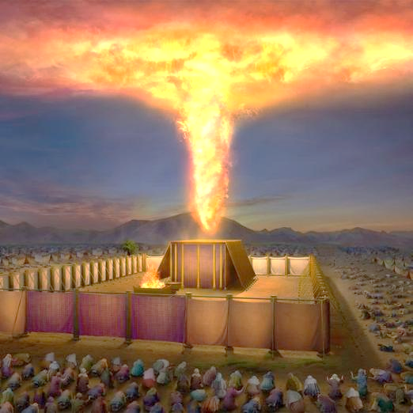
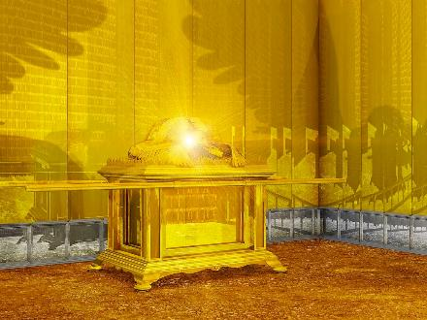
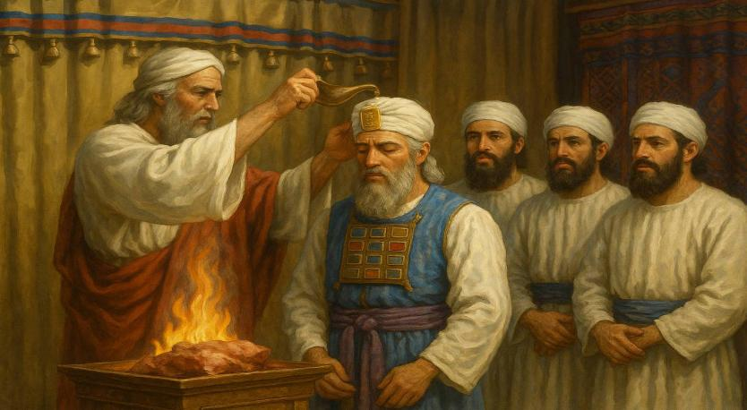
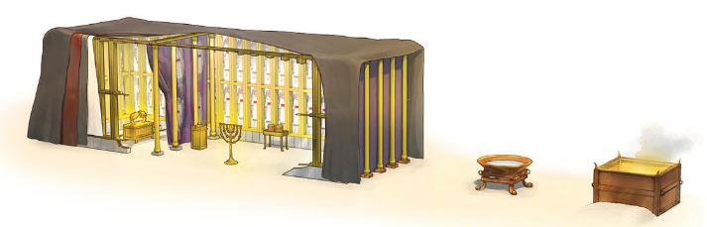
KUDZIPEREKA
“Kenaka mtambo unaphimba tenti ya msonkhano, ndipo ulemerero wa Yehova unadzaza mʼchihemacho” (Eksodo 40:34)
Buku la Eksodo likumaliza ndi kuperekedwa kwa Malo Opatulika ndi ansembe ake. Wopambana wa mutu uwu mosakayikira ndi Mulungu, amene amadzaza chirichonse ndi kukhalapo kwake kwaulemerero (Eksodo 40:34). Kukhalapo kumeneku kunapitiriza kutsagana ndi Kachisi mumtambo ndi mu Shekina (mawonekedwe a ulemerero waumulungu pakati pa akerubi a likasa).
Pambuyo pa miyezi ya ntchito, malo opatulika anamangidwa pa tsiku loyamba la mwezi woyamba wa chaka chachiwiri atatuluka mu Igupto (Eksodo 40:2, 17 ). Chilichonse chinakonzedwa mwadongosolo (chingalawa, chophimba, tebulo, nyali, guwa lansembe lagolide, guwa lansembe lamkuwa, beseni), ndikupatulidwa (Eksodo 40:9).
Pomaliza, Aroni ndi ana ake anavekedwa zovala zawo zansembe, ndipo anadzozedwa ku ntchito yawo (Eksodo 40:12-15).

Slide 10

EGW (Patriarchs and Prophets, p. 349)
“Palibe chilankhulo chimene chingafotokoze ulemerero wa zochitika zomwe zinali m’kati mwa malo opatulika—makoma ophimbidwa ndi golide akuwonetsa kuwala kwa nyali yagolide, mitundu yowala ya nsalu zokongola zosokedwa bwino ndi angelo owala, tebulo ndi guwa la nsembe za fungo labwino, zonse zili ndi kuwala kwa golide; kuseri kwa chinsalu chachiwiri kunali bokosi lopatulika, lokhala ndi akerubi achinsinsi, ndipo pamwamba pake panali Shekina, chizindikiro chooneka cha kupezeka kwa Yehova; zonsezi zinali chithunzithunzi chochepa cha ulemerero wa kachisi wa Mulungu kumwamba, malo aakulu a ntchito ya chipulumutso cha anthu.”

Slide 11
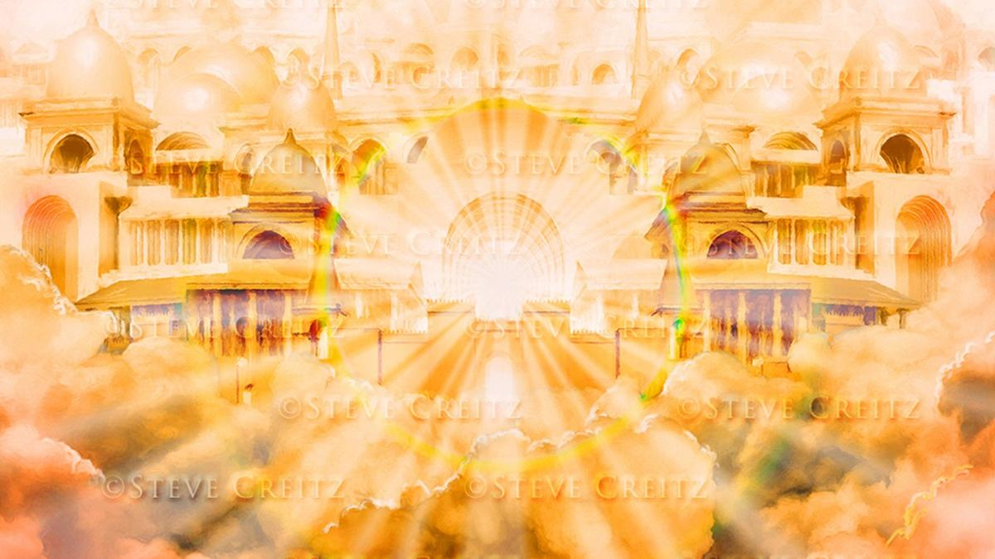
CHIHEMA

Slide 12
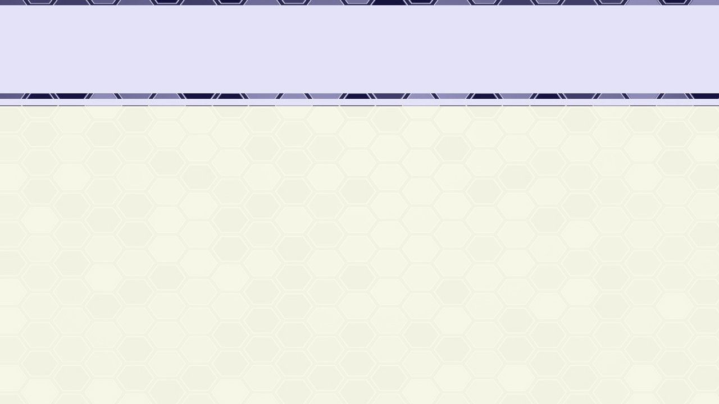
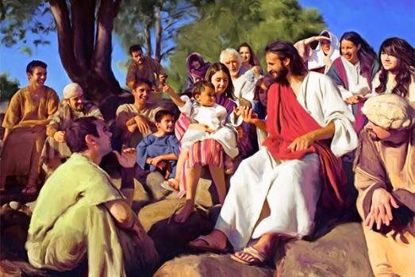

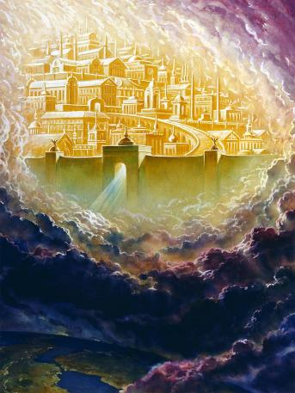
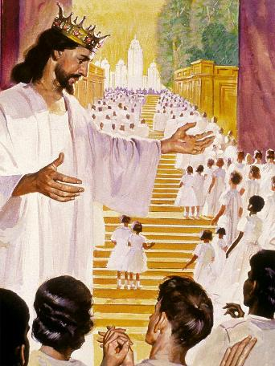
YESU NDI YERUSALEMU WATSOPANO
“Mawu anasandulika thupi ndipo anakhala pakati pathu.” (Yohane 1:14a)
“Ndipo ndinamva mawu ofuwula kuchokera ku Mpando Waufumu kuti, “Taonani! Malo wokhalapo Mulungu ali pakati pa anthu, ndipo Iye adzakhala ndi anthuwo. Iwo adzakhala anthu ake ndipo Mulungu mwini adzakhala nawo nakhala Mulungu wawo (Chivumbulutso 21:3).
Yohane 1:14 amanena kwenikweni kuti Yesu anasandulika thupi nakhala “chihema” (anali chihema) pakati pathu. Ndi thupi lake, Yesu, Mulungu wamuyaya, anakwaniritsa chikhumbo chake chokhala ndi ife mwakuthupi. Anakhala Emanuele, Mulungu nafe (Mateyu 1:23).
Kudzera mwa Mzimu Woyera, Mulungu akupitiriza kukhala nafe lero (Mateyu 18:20; 1 Akorinto 3:16).
Koma posachedwapa zidzafika pamene tidzatha kuima maso ndi maso ndi Mulungu wathu, ndi kukhala ndi Iye m’chihema chachifumu chimene Iye mwini watikonzera: Yerusalemu Watsopano (Chivumbulutso 21:3).
Izi zidzachitika Dongosolo la Chipulumutso likadzamalizidwa, ndipo zoipa zidzathetsedwa.

Slide 13

EGW (The Desire of Ages, p. 23)
“Mulungu analamulira Mose chifukwa cha Israyeli, “Andipangire Ine malo opatulika; kuti ndikhale pakati pawo” ( Eksodo 25:8 ) ndipo anakhala m’malo opatulika, pakati pa anthu Ake. Kupyolera m’kutopa kwawo konse m’chipululu, chizindikiro cha kukhalapo Kwake chinali nawo. Chotero Kristu anakhazikitsa chihema Chake pakati pa msasa wathu waumunthu.

