Slide 1
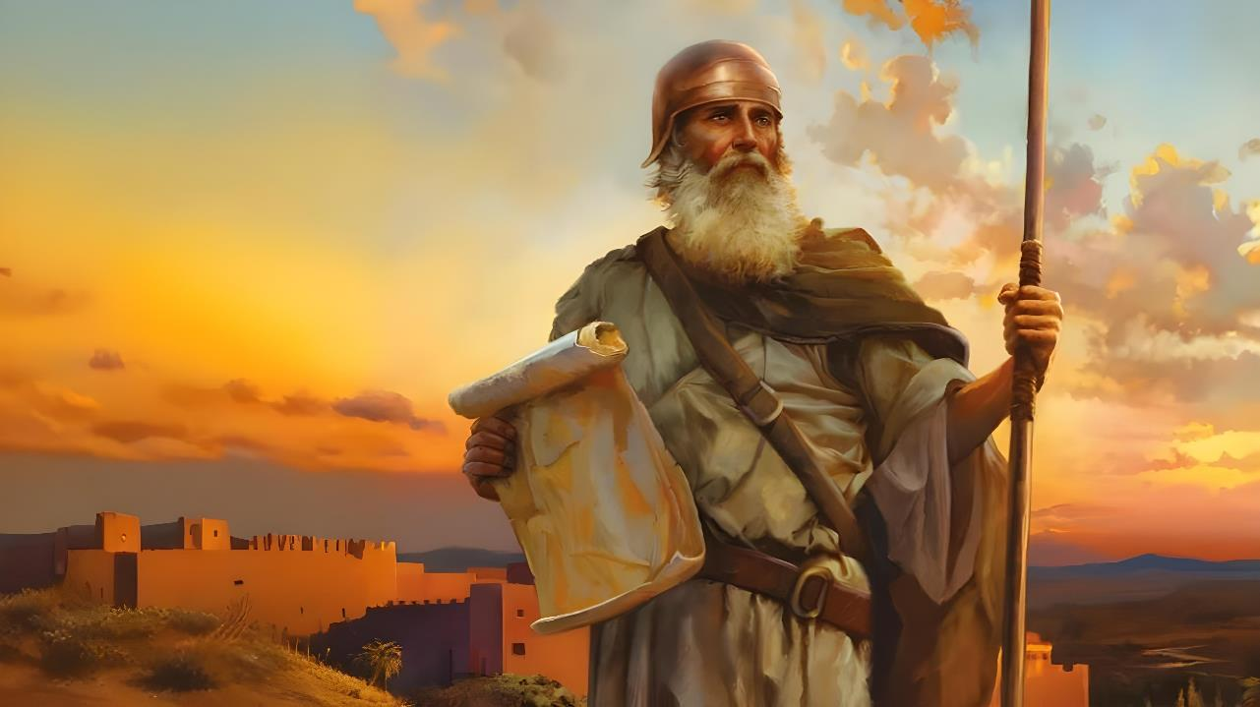

CHINSINSI CHA CHIPAMBANO
Phunziro 1, October 4, 2025

Slide 2
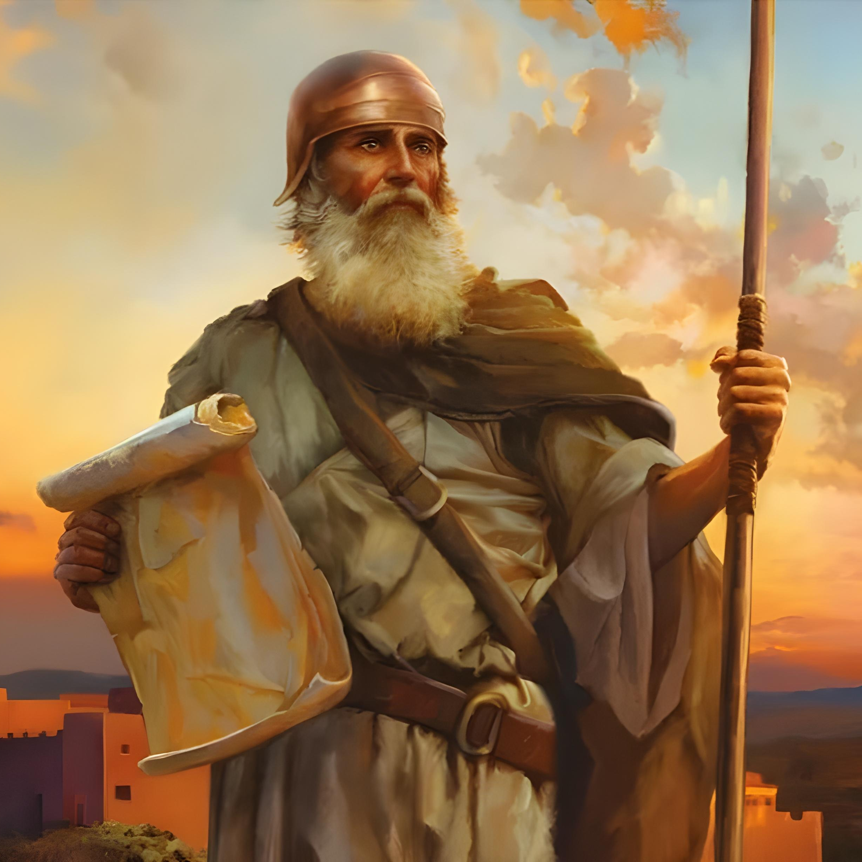
“Ukhale wamphamvu ndi wolimba mtima kwambiri. Usamale ndithu kuti umvere malamulo onse amene mtumiki wanga Mose anakupatsa. Usachoke pa malamulo anga ndipo kulikonse kumene udzapite udzapambana.”
Yoswa 1:7, CCL

Slide 3

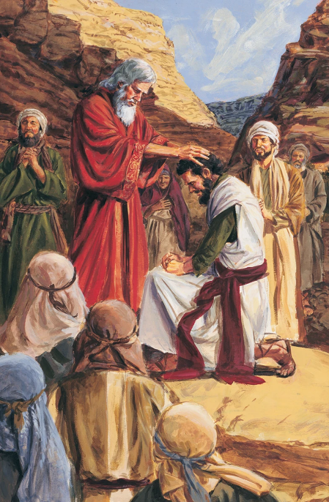
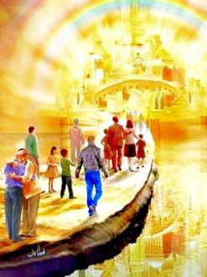


Patapita zaka 40 zoyendayenda, mbadwo watsopano udauka, ndipo nthawi yogonjetsa dziko lolonjezedwa idakwana. Mose anamwalira, ndipo Mulungu adasankha Yoswa kuti atsogolere ana ake.
Yoswa ndi mbadwo watsopano anauzidwa kuti akhulupilire Mulungu kotheratu asanayambe kugonjetsa adaniwo.
Pamene mbadwo wamakono (ife) tiri mmalire a Kanani wakumwamba, Mulungu akuti: “Koma khala wamphamvu ndi olimbikira” (Yoswa 1:7).
Mawu oyamba (Yoswa 1:1-3):
Mose ndi Yoswa
Mmene bukhu la Yoswa liliri
Ntchito ya Yoswa (Yoswa 1:4-9):
Kupitiriza malonjezano
Mphamvu ndi kulimba mtima
Kupambana kwa ntchito

Slide 4

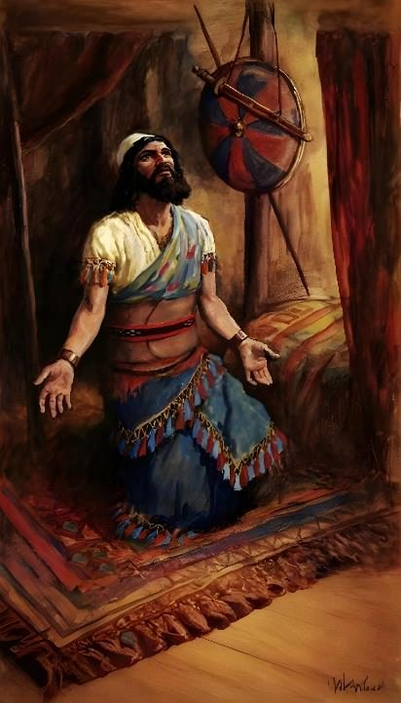
MAWU OYAMBA
(YOSWA 1:1-3)

Slide 5







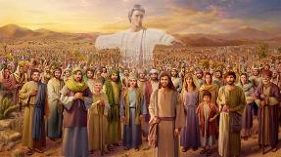
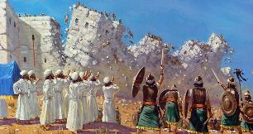








MOSE NDI YOSWA
Mulungu aonekera kwa iwo (Eksodo 3:2-4; Yoswa 5:13-14)
Anapemphedwa kuchotsa nsapato zawo (Eksodo. 3:5; Yoswa 5:15)
Mulungu anawalonjeza kuti akhala nawo (Eksodo 3:12; Yoswa 1:5)
Anakondwerera Pasika (Eksodo 12:21-23; Yoswa 5:10)
Anaoloka m’madzi panthaka youma (Eksodo 14:21-22; Yoswa 3:14-17)
Munyengo ya wina kunali manna, ndipo ya wina manna anasiya (Eksodo 16:4-5, 31; Yoswa 5:11-12)
Anatumiza azondi kuti akazonde dzikolo (Numeri 13:1-3; Yoswa 2:1)
“Ndipo atafa Mose mtumiki wa Yehova, Yehova anati kwa Yoswa mwana wa Nuni mnyamata wa Mose” (Yoswa 1:1)
Muchaputala choyamba cha buku la Yoswa, Mose amatchulidwa nthawi khumi ndi limodzi, ndipo dzina lake likupezeka mobwerezedwa mu bukhu lonselo
Pali zofanana zambiri pakati pa atsogoleri awiriwa:
Ngakhale chaputala choyamba cha bukhu la Yoswa chikulongosola kusinthana kwa utsogoleri pakati pa Mose ndi Yoswa, nkhani yaikulu ndi yokamba za Mulungu. Akulankhula kumayambiriro ndipo akutsogolera nkhani yonse. Kuonetsa kuti Mulungu ndiye mtsogoleri wa ana a Israel.

Slide 6
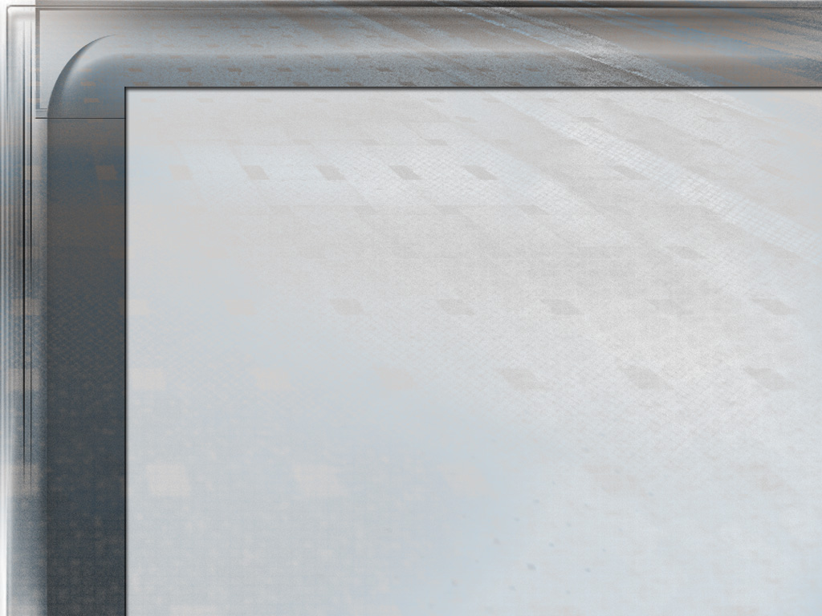
Tsopano Yoswa anali mtsogoleri wovomerezedwa wa Israeli. Amadziwika makamaka ngati msilikali, ndipo mphatso zake ndi makhalidwe ake anali ofunika kwambiri pa nthawi imeneyi mu mbiri ya anthu ake. Anali wolimba mtima, wotsimikiza pa chigamulo, wosakaikaika, wachangu, woona mtima, ankaganizira ena kuposa iyeyo, ndipo koposa zonse, analimbikitsidwa ndi chikhulupiliro chamoyo mwa Mulungu – limeneli linali khalidwe la munthu amene Mulungu anasankha kuti atsogolere gulu la nkhondo la Israeli polowa mudziko lolonjezedwa.
Pamene Aisrayeli anali muchipululu, iye anagwira ntchito ngati mtsogoleri wachiwiri kwa Mose. Ndipo mwa khalidwe lake losalankhula zambiri, kukhazikika kwake pamene ena anali osadalirika, ndi kulimba mtima kwake kutsatira choonadi muthawi ya zovuta, anapereka umboni wa kuyenerera kwake kulowa m’malo mwa Mose. ngakhale Mulungu asanamupatse udindowo
EGW (Patriarchs and Prophets, p. 481)

Slide 7

MMENE BUKHU LA YOSWA LILIRI
“Mose mtumiki wanga wamwalira. Ndipo iwe ndi anthu onsewa, tsopano konzekani kuoloka mtsinje wa Yorodani kupita ku dziko limene ndiwapatse a Israyeli onse.” (Yoswa 1:2)
Bukhu la Yoswa limasonyeza kukwaniritsidwa kwa malonjezano a Mulungu kwa a Israyeli pamene anawatulutsa mu Igupto kumene kuli kuwapatsa dziko la Kanani. Chiyambi (chaputala 1) ndi bukulo lonselo linagawidwa m’magawo anayi akuluakulu:
KUOLOKA kupita ku Kanani
Yoswa 1:1-9
Yoswa 1:1-5:12
KUTENGA Kanani
Yoswa 1:10-11
Yoswa 5:13-12:24
KUGAWA dziko
Yoswa 1:12-15
Yoswa 13:1-21:45
KUTUMIKIRA kudzera mu kumvera LAMULO
Yoswa 1:16-18
Yoswa 22:1-24:33

Slide 8
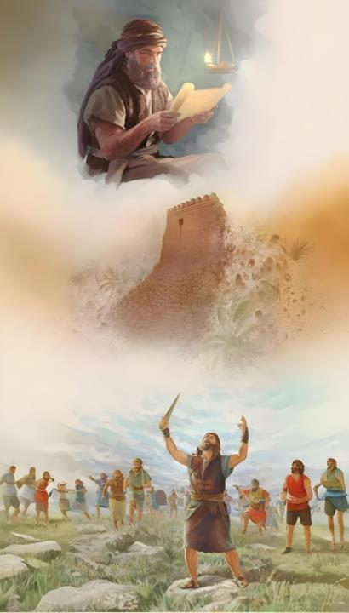
NTCHITO YA YOSWA
(Yoswa 1:4-9)

Slide 9

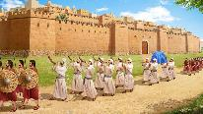
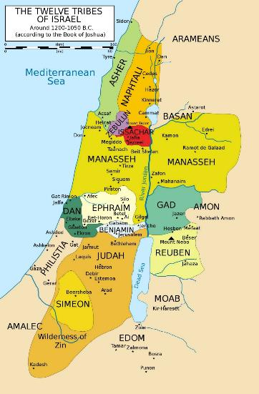
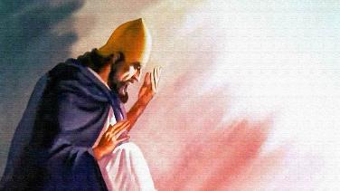
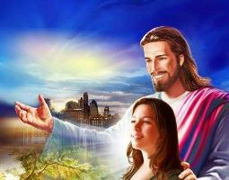
KULANDIRA MALONJEZO
“Paliponse pamene phazi lanu liponde, ndikupatsani monga momwe ndinalonjezera Mose” (Yoswa 1:3)
Pa Yoswa 1:3, Mulungu analakhula mwa ulosi ngati kuti Kanani waperekedwa kale kwa Israyeli. Izi zikutanthauza kuti Mulungu anawapatsa chitsimikizo chokwanira cha kupambana kwa kulanda dzikolo.
YUFURATE
Kenako anawakumbutsa malire achigonjetso chawo (Yoswa 1:4): kachigawo pakati pa mtsinje wa Yorodano (kummawa) ndi nyanja ya Mediterranean (kumadzulo), kuchokera kuchipululu (kummwera) mpake kumtsinje wa Yufurate (kumpoto).
NYANJA YA KUMADZULO
Anatembenukira kwa Yoswa ndi kumutsimikizira kuti ngati ali wamphamvu komanso olimba mtima, palibe amene adzalimbane naye. (Yoswa 1:5-6)
YORDANE
Chipambano sichinali mu mphamvu za Yoswa koma kupezeka kwa Mulungu. Anamutsimikizira, monga mmene akuchitira nafe lero nati: “Ndidzakhala ndi iwe”
CHIPULULU

Slide 10

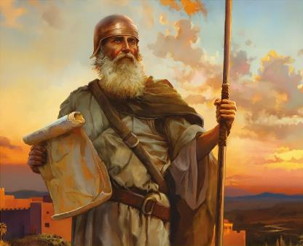
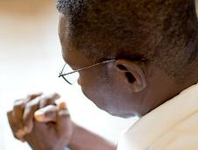
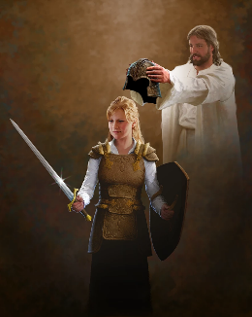
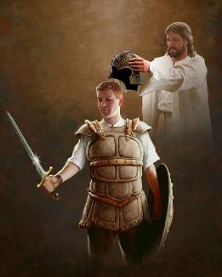
MPHAMVU NDI KULIMBA MTIMA
“Paja ndinakulamula kuti ukhale wamphamvu ndi wolimba mtima. Choncho usamachite mantha kapena kutaya mtima popeza Ine Yehova Mulungu wako ndidzakhala nawe kulikonse kumene udzapite.” (Yoswa 1:9)
Asanapemphe Yoswa kuti akhale ndi mphamvu ndi kulimba mtima pa nkhondo (Yoswa 1:9), Mulungu poyamba anamupempha kuti akhale ndi mphamvu ndi kulimba mtima pakumvera Lamulo (Yoswa. 1:7).
Izi ziri chonchonso masiku ano. Mulungu amatifunsa kuti tiyesetse kusunga malamulo Ake (Chivumbulutso 14:12). Izi zimafuna kulimba mtima kwakukulu ku mbali yathu.
Kumbali Yake, akulonjeza kuti “adzakhala nanu kulikonse kumene mudzapita.” (Yoswa 1:9 ) ndikutikuthandiza kulimbana ndi nkhondo imene tikulimbana nayo. Osati nkhondo yakuthupi, koma “kulimbana ndi maufumu, maulamuliro, mphamvu za dziko la mdima, ndi mphamvu zoyipa kwambiri zauzimu zamlengalenga” (Aefeso 6:12 ). Kuti tichite zimenezi, watipatsa zida zofunika (Aefeso 6:13-17).
Kudalira mwa Mulungu ndiye chinsinsi cha chipambano. Kuti tichite zimenezi, tiyenera kulumikizana naye tsiku ndi tsiku (Aefeso 6:18)

Slide 11


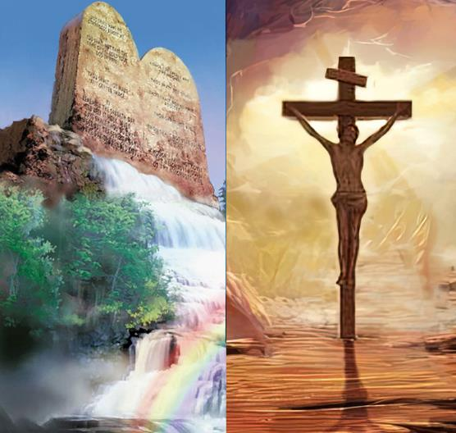
CHIPAMBANO CHA NTCHITO
“Udziwerenga bukhu la Malamuloli, uzilingalira zolembedwa m’menemo usana ndi usiku, kuti uchite zonse zimene zinalembedwamo. Ukamatero udzapeza bwino ndikupambana.” (Yoswa 1:8)
Kupambana kuchokera ku malingaliro aumulungu sikugwirizana ndi kupambana kuchokera ku malingaliro aumunthu.
Chipambano cha dziko lapansi chimakwaniritsidwa pakuswa malamulo a Mulungu ndi a anthu, koma chipambano choona ndi chamuyaya sizingatheke choncho (Yoswa 1:8)
Tidzakwanitsa kupambana tikatsatira mfundo ndi makhalidwe omwe ali mu Lamulo la Mulungu. Koma kodi izi sizikutanthauza chipulumutso kudzera mu ntchito?
Ayi konse. Chikhulupiriro ndi Chilamulo sizikutsutsana, koma zimayendera limodzi mothandizana (Aroma 3:31). Tikamakamba za chilamulo, timakamba za mmene tiyenera kukhalira, osati mmene tingapulumutsidwire. Ubale wathu ndi Mulungu umaonekera mukumvera chifuniro chake.

Slide 12

“Mkristu nthawi zonse amakhala ndi mthandizi wamphamvu mwa Ambuye. Mwina sitingamvetse mmene Iye amathandizira, koma ichi tichidziwa: Iye sadzalephera konse kwa iwo amene amamukhulupirira. Ngati okhulupirira akanadziwa kuti nthawi zambiri Mulungu amawateteza ku zomwe zikanatha kuwaononga, sakanadandaula kapena kutaya chiyembekezo. Chikhulupiriro chawo chikanakhalabe cholimba, ndipo palibe vuto limene likanawagwedeza. Iwo akanadalira Mulungu kuti awapatse nzeru ndi mphamvu, ndipo Iye akanachita zazikulu kupyolera mwa iwo..”
EGW (Prophets and Kings, p. 576)

