Slide 1
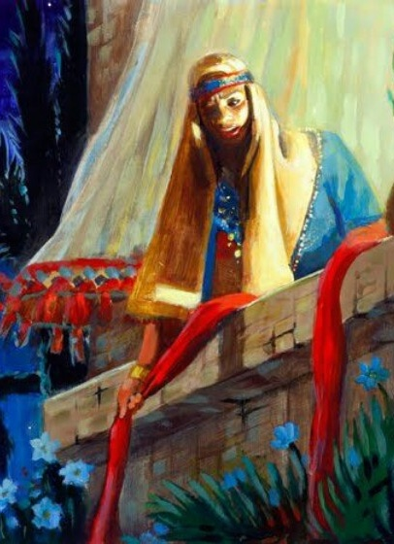
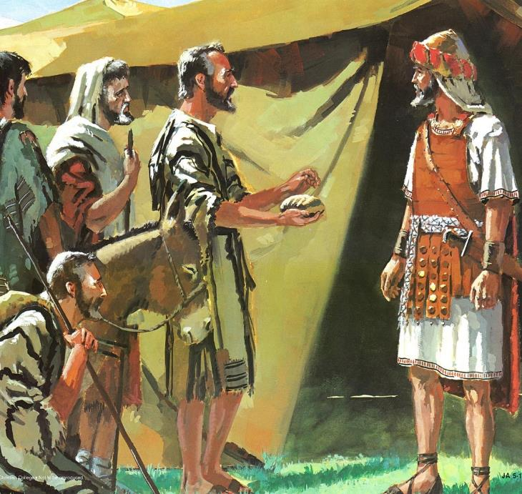
KUDABWITSIDWA NDI CHISOMO
Phunziro 2, October 11, 2025

Slide 2

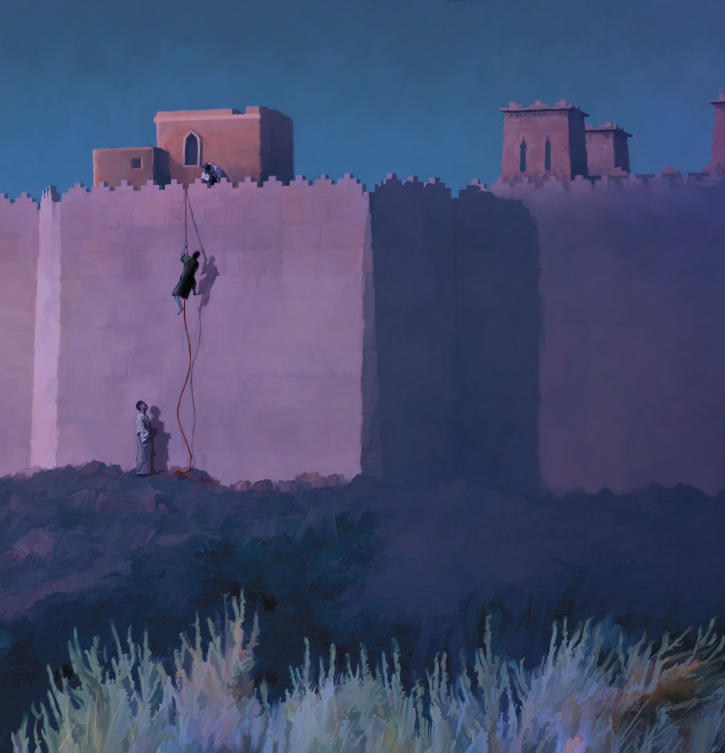
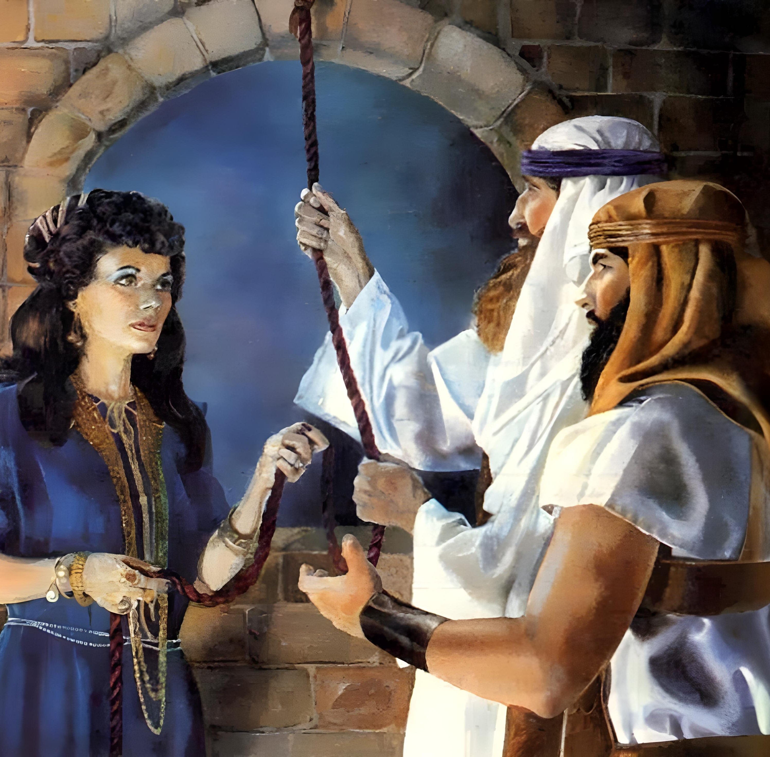
“Ndi chikhulupiriro Rahabe, mkazi wadama sanaphedwe pamodzi ndi osamvera aja chifukwa analandira bwino ozonda aja ku nyumba kwake”
(Ahebri 11:31, CCL)

Slide 3

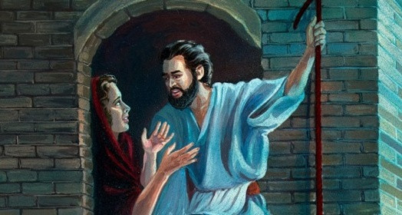
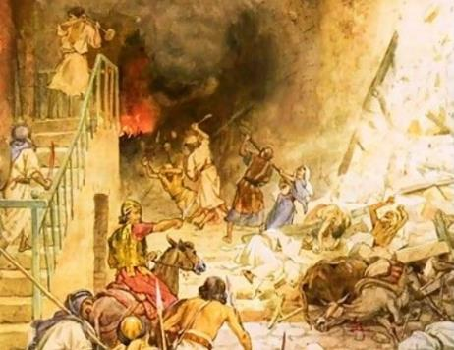



Akanani anali atapitirira malire a chisomo cha Mulungu. Chifukwa cha ichi, lamulo lomwe linaperekedwa kwa Israeli linali: Lowani, muwaphe onse, ndi kulanda chuma chawo.
Komabe, mu Kanani munali anthu amene sanadutse malire amenewo. Onse amene anali okonzeka kulandira chisomo chimene Mulungu anafuna kuwapatsa anapulumutsidwa ku chiwonongekocho.
Chisomo kwa anthu a Israeli (Yoswa 2:1, 22-24):
  Mwayi wachiwiri
Chisomo kwa Rahabe (Yoswa 2:2-21):
  Chikhulupiriro cha kambewu kampiru
  Pangano linalonjezedwanso kwa Rahabe
Chisomo kwa Agibiyoni (Yoswa 9):
  Akazembe achinyengo
  Madalitso ndi temberero

Slide 4
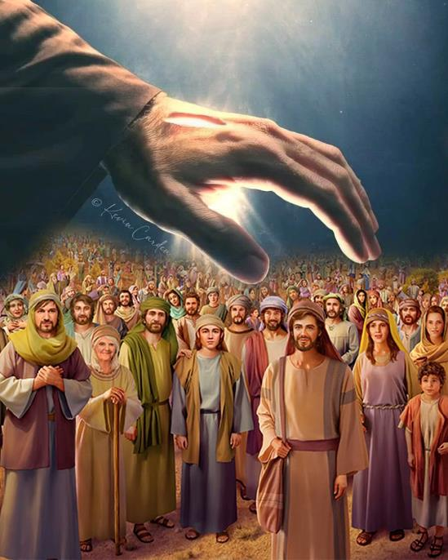
CHISOMO KWA ANTHU A ISRAELI (YOSWA 2:1, 22-24)

Slide 5


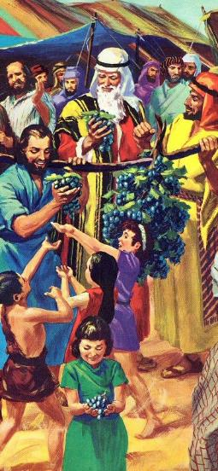
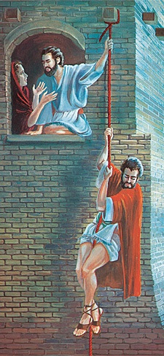
MWAYI WACHIWIRI
“Tsono Yoswa mwana wa Nuni anatuma anthu awiri okazonda dziko mwachinsinsi kuchokera ku Sitimu. Iye anawawuza kuti, “Pitani mukaone dzikolo makamaka mzinda wa Yeriko’ ” (Yoswa 2:1a )
Pamene Mose anatumiza azondi kukafufuza dziko la Kanani, anthu anakana kulilowa. Patapita zaka makumi anayi, anatumizidwanso azondi atsopano, ndipo zotsatira zake zinali zosiyana.
Azondi anatumizidwa
Pagulu (azondi khumi ndi awiri)
Mwachinsinsi (azondi awiri)
Kachitidwe ka azondi
Masiku 40 ofufuza
Masiku atatu obisala
Lipoti la azondi
Anakhumudwitsa anthu
Analimbikitsa anthu
Ngakhale kuti mbadwo watsopanowu unalephera momvetsa chisoni poyesedwa ndi Balaamu, Mulungu anawapatsa mwayi wachiwiri (Numeri 25:1-3, 31:16; Yoswa 2:1).
Pa nthawi imeneyi panalibe mphesa kapena zipatso za m’munda. Panangokhala nkhani ya chikhulupiriro yokha (ya Rahabe), imene inalimbikitsa Aisrayeli kutenga Dziko Lolonjezedwa.

Slide 6
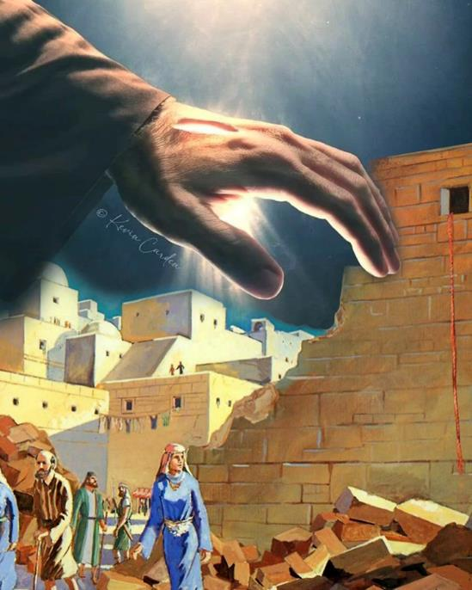
CHISOMO KWA RAHABE
(YOSWA 2:2-21)

Slide 7

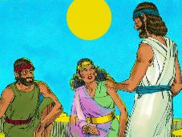
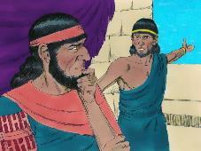
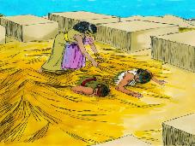
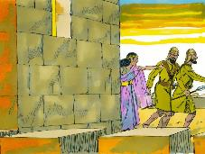
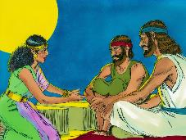
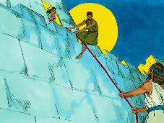
CHIKHULUPILIRO CHA KAMBEWU KA KAMPIRU
“Ndi chikhulupiriro Rahabe, mkazi wadama sanaphedwe pamodzi ndi osamvera aja chifukwa analandira bwino ozonda aja ku nyumba kwake” (Ahebri 11:31)
Kodi chikhulupiriro cha Rahabi chinazikika pa chiyani (Yoswa 2:9-11)?
Onani kuti Rahabe ankatchula zochitika zimene aliyense ankazidziwa, monga kuwoloka pa Nyanja Yofiira. Koma pamene ena onse anangowopa Mulungu wa Aheberi, iye anasankha kuthawira pansi pa mapiko ake kuti apeze chitetezo (Yoswa 2:12-13).
Ndichifukwa chiyani, ngati ankakhulupirira Mulungu, Rahabe anagwiritsa ntchito bodza pothandiza azondi?
Chikhulupiriro cha Rahabe chinali chongoyamba kumene ndipo sichinkatanthauza kuti ankadziwa bwino chifuniro cha Mulungu. Iye anachita zomwe akanatha kuti athandize azondi ndi kupulumutsa moyo wake ndi wa banja lake. Kudziwa choonadi kwathunthu kunabwera pambuyo pake.
Baibulo limamuyamikira Rahabe chifukwa cha chisankho chimene anachita, chifukwa cha mmene anamvetsetsetsera njira za Mulungu, komanso chifukwa cha mmene mawu ake anatsatiridwa ndi zochita zake zenizeni (Yakobo 2:25).
Rahabi ndi chitsanzo cha zimene zikanachitikira munthu aliyense wokhala ku Yeriko amene anadzipereka kwa Mulungu.

Slide 8

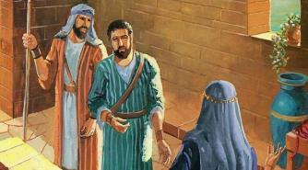
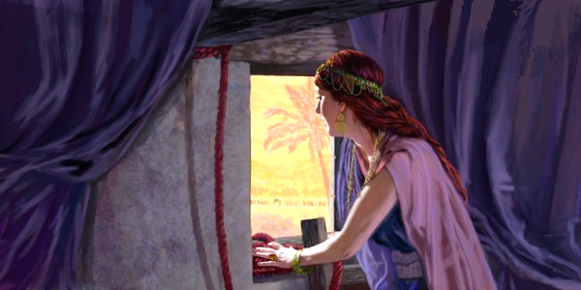
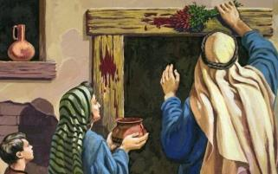
PANGANO LINAPEREKEDWANSO KWA RAHABE
“Ndipo kudzakhala kuti aliyense akadzatuluka pa khomo la nyumba yako kubwalo, imfa imeneyi ndi yake, tilibe kupalamula ife; koma aliyense adzakhala ndi iwe m'nyumba, likamfikira dzanja, imfa imeneyi ndi yathu” (Yoswa 2:19)
Israeli pa Paska
Anayenera kudzoza mphuthu ndi mwazi
(Eksodo 12:7)
Akanatuluka pakhomo, akanafa (Eksodo 12:13)
Rahabi ku Yeriko
Iye anachita kuyika chingwe chofiira pa zenera lake (Yoswa 2:18)
Akanatuluka m’nyumba, akanafa
(Yoswa 2:19)
Nzeru za Rahabe zinali zomveka bwino: ‘Ine ndakuchitirani chifundo [hesed] ndi kukupulumutsani; tsopano inunso muchite chifundo ndi kundipulumutsa ine ndi abale anga (Yoswa 2:12-13).
Ngakhale kuti Rahabe sankazindikira, ankafunsa Aisrayeli kuti amuchitire chimodzimodzi monga momwe Mulungu anachitira Israeli, ndiye kuti, ndi chifundo [hesed](Deutronomo 7:12).
Azondiwo anapempha Rahabe kuti atsate zofunikira zomwezo zimene iwo anatsata kuti apulumuke ku imfa ku Igupto. Mwa njira imeneyi, iye anaphatikizidwa mu pangano la pakati pa Mulungu ndi Israeli.

Slide 9
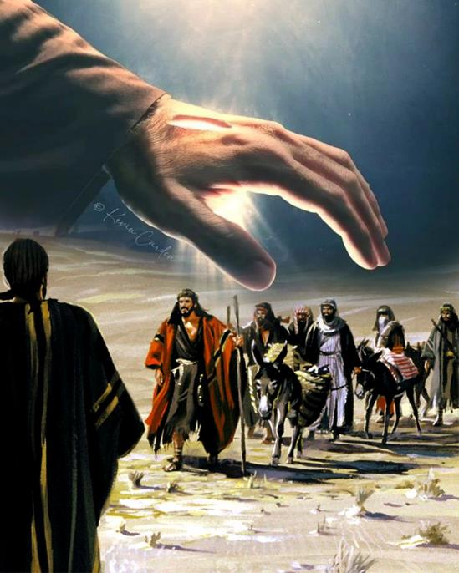
CHISOMO KWA AGEBIYONI
(YOSWA 9)

Slide 10


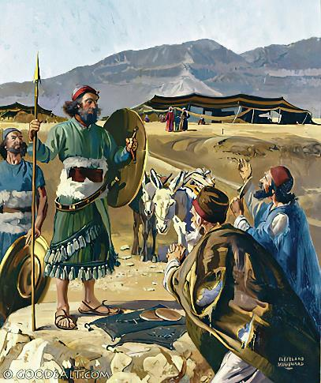
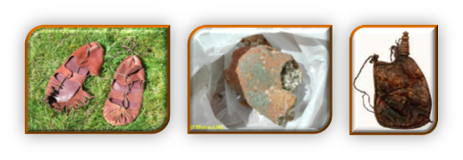
AKAZEMBE ACHINYENGO
“Ndipo anapita kwa Yoswa ku msasa ku Giligala ndikumuwuza kuti, pamodzi ndi Aisraeli onse, ‘Ife tachokera ku dziko lakutali, ndipo tikufuna kuti muchite mgwirizano ndi ife’ ” (Yoswa 9:6)
Taonani zofanana ndi zosiyana pakati pa Rahabe ndi Agibeoni :
Zigawo za Chikhulupiriro | Rahabe | Agibeyoni
Maziko | Kumva (2:10) | Kumva (9:3)
Njira | Bodza (2:4-5) | Bodza (9:4)
Chilinga | Kupulumutsidwa (2:13) | Kupulumutsidwa (9:24)
Zotsatira Zachangu | Chipulumutso (6:23) | Chipulumutso (9:26)
Zotsatira Zanthawi Yaitali | Unzika weniweni(6:25) | Ukapolo (9:27)
Rahabe ananama mwadzidzidzi kuti atulutse azondi. Koma Agibeoni iwo ananama mwadala, ndi cholinga chonyenga, pogwiritsa ntchito nzeru zonyenga (onani Genesis 3:1a). Komanso, atsogoleri a Israeli analephera chifukwa sanapemphe upangiri kwa Mulungu (Yoswa 9:14).
Zimenezi zinawaika m’mavuto: kuwononga Agibeoni, kapena kulemekeza lumbirolo (Yoswa 9:18).

Slide 11

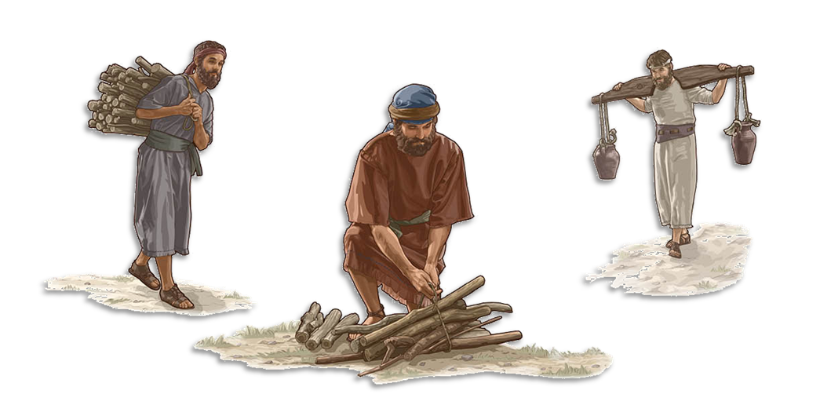
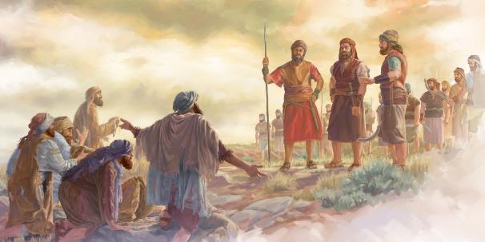
MADALITSO NDI TEMBERERO
“Tsopano popeza mwachita izi, Mulungu wakutembererani ndipo palibe wina mwa inu amene akhale mfulu. Nthawi zonse inu muzidzatidulira nkhuni ndi kutitungira madzi ku Nyumba ya Yehova” (Yoswa 9:23)
Kupulumutsa miyoyo ya Agibeoni kukanakhala kosamvera lamulo lomveka bwino la Mulungu (Deut. 7:1-2). Koma kuswa lumbiro limene analumbira kwa iwo kunalinso tchimo (Yoswa 9:19; Masalmo 15:4b). Kodi vutoli linathetsedwa bwanji?
Miyoyo yawo inapulumutsidwa, koma anatembereredwa (Yoswa 9:20–23). Temberero limenelo linali lakuti azikhala atumiki kuchokera m’badwo ndi m’badwo. Izi zinawapanga kukhala paubale ndi anthu a Mulungu, ndipo sanachotsedwepo pakati pawo (Nehemiya 7:6, 25).
Komanso, kukhala otengera madzi ndi odula nkhuni a nyumba ya Mulungu kunawapatsa mwayi wokhalabe pafupi ndi Mulungu nthawi zonse. Mwa chisomo cha Mulungu, temberero linasandulika m’dalitso. “sindikondwera ndi imfa ya munthu woyipa. Ndimakondwera ndikamaona munthu woyipa akuleka zoyipa zake kuti akhale ndi moyo” (Ezekieli 33:11).

Slide 12

“Ana a Israeli ankayenera kulanda dziko lonse limene Mulungu anawapangira. Mitundu imene inakana kulambira ndi kutumikira Mulungu woona iyenera kuchotsedwa m’dzikomo. Koma cholinga cha Mulungu chinali chakuti kudzera mu kuwonetsera khalidwe lake kudzera mwa Aisraeli, anthu azikopeka kuti abwere kwa Iye. Uthenga Wabwino unayenera kuperekedwa padziko lonse lapansi. […] Onse monga, Rahabe wa ku Kanani ndi Rute wa ku Moabu, anatembenuka ku kusiya kulambira mafano ndikuyamba kulambira Mulungu woona, ankayenera kugwirizana ndi anthu ake osankhidwa.”
EGW (Christ’s Object Lessons, p. 290)

