Slide 1

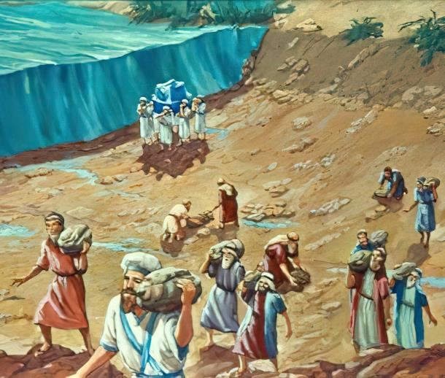
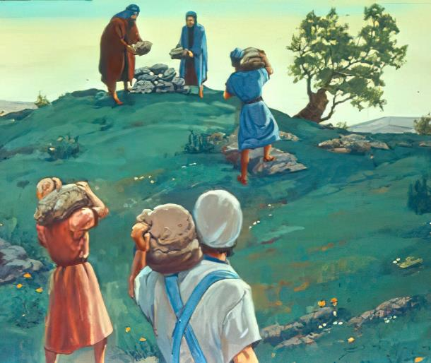

Phunziro 3, October 18, 2025
ZIKUMBUKIRO ZA CHISOMO

Slide 2

“Pakuti Yehova Mulungu wanu anaphwetsa madzi a Yordani pamaso panu, mpaka mutaoloka; monga Yehova Mulungu wanu anachitira Nyanja Yofiira, imene anaiphwetsa pamaso pathu, mpaka titaoloka; kuti mitundu yonse ya pa dziko lapansi idziwe dzanja la Yehova, kuti ndilo lamphamvu; kuti iope Yehova Mulungu wanu masiku onse”
Yoswa 4:23, 24

Slide 3
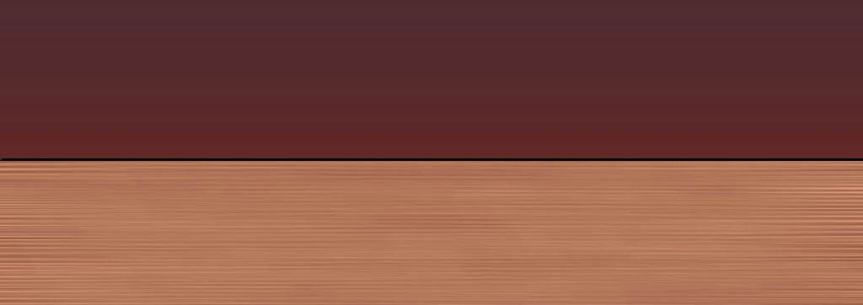
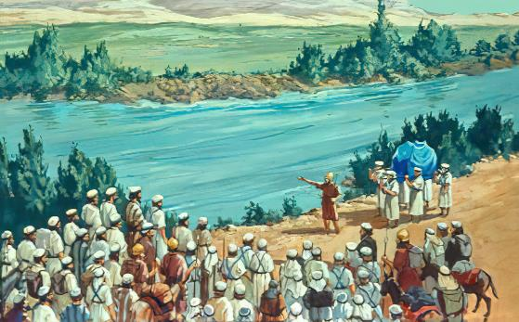
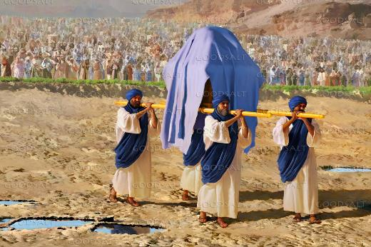







Nyengo ya masika. Mvula ndi chipale chofewa chadzaza Mtsinje wa Yordano mpaka kusefukira. Madzi ake ankayenda mofulumira kwambiri kupita ku Nyanja ya Mchere. Ngakhale m’malo mosazama kwambiri—mowolokera Yordano—kuwoloka mtsinjewo kunali koopsa kwambiri..
Kodi mudzi wonse akanatha bwanji kuwoloka mtsinjewo, atanyamula okalamba, amayi apakati, ana, ndi ziweto?
Kwa munthu, zosatheka. Kwa Mulungu, mophweka: “Dziyeretseni nokha ndipo muwoloke Yordano.”
Kuwoloka Yordano (Yoswa 3):
  Kufunika kwa Chiyero
  Zozizwitsa za Mulungu
Kukumbukira ndi Kuiwala (Yoswa 4):
  Zizindikiro za kukumbukira
  Zoopsa za Kuiwala
Magawo ofunika a Mtsinje wa Yordano.

Slide 4

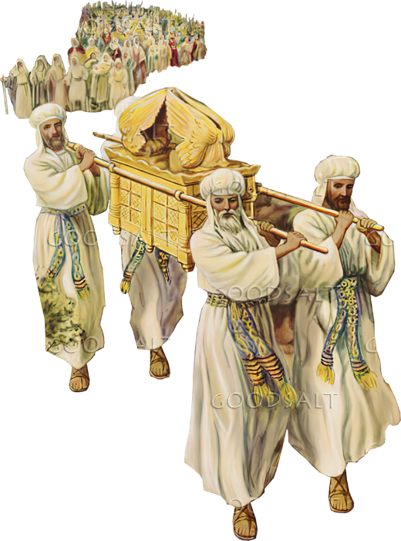
KUWOLOKA YORDANO
(YOSWA 3)

Slide 5
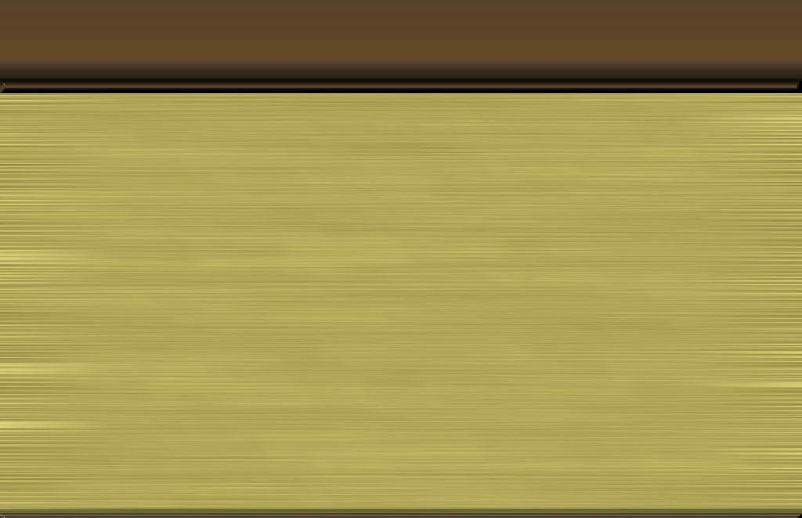
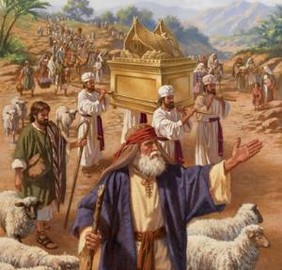
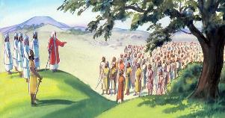
KUFUNIKA KWA CHIYERO
“Ndipo Yoswa ananena kwa anthu, Mudzipatule, pakuti mawa Yehova adzachita zodabwitsa pakati pa inu.’ ” (Yoswa 3:5)
Kwa zaka 40, mtambo unkasonyeza nthawi yochotsa msasa ndi kuyamba ulendo, ndipo likasa la Pangano linkatsogolera Aisiraeli kupita kumalo atsopano (Numeri 9:17; 10:33).
Kutsatira Likasa
Kumvera Mulungu (Malamulo Khumi)
Kudalira chisamaliro cha Mulungu (Chotengera cha mana)
Kulemekeza atsogoleri osankhidwa ndi Mulungu (Ndodo ya Aroni)
Nthawi inakwana yoti asamuke. Anachotsa msasa ku Sitiimu ndipo anamanga msasa wawo kwa masiku atatu kutsidya lina la Yorodano. Kenako analandira lamulo loti atsatire Likasa la Pangano kulowera m’dziko lolonjezedwa (Yoswa 3:1-3).
Koma panali chofunikira choyamba: ayenera kuyeretsedwa (Yoswa 3:5). Kudzipatulira kumeneku kunaphatikizapo kuyeretsedwa mwamwambo (kuchapa zovala ndi kusamba thupi), kusiya tchimo, komanso kukhala ndi mtima wololera womvera malamulo a Mulungu.

Slide 6

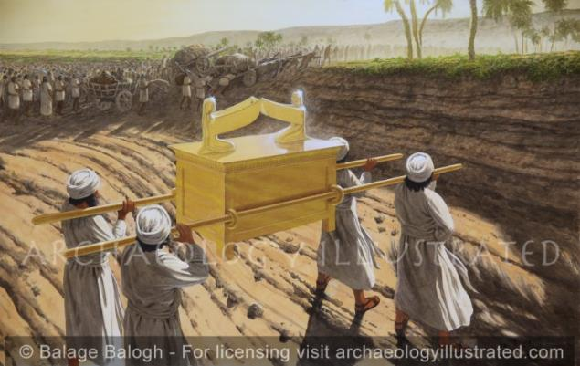
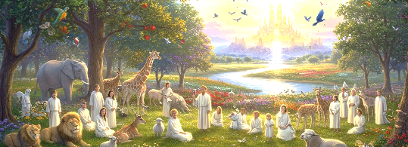
ZOZIZWITSA ZA MULUNGU
“pamenepo madzi ochokera kumagwero anaima, nauka ngati mulu, kutalitu ku Adama, ndiwo mudzi wa ku mbali ya Zaretani; koma madzi akutsikira kunka ku nyanja ya chidikha, ndiyo Nyanja ya Mchere, anadulidwa konse; ndipo anthu anaoloka pandunji pa Yeriko” (Yoswa 3:16)
Mulungu ndi “Iye yekha amene amachita zozizwitsa” (Masalimo 72:18). Choncho timamuzindikira kuti Ndiye Mulungu mmodzi yekha (Masalimo 86:10); timakumbukira zozizwitsa zake (Masalimo 77:11); ndipo timafotokoza za ntchito zake zodabwitsa (Masalimo 96:3).
Palibe chovuta kapena chodabwitsa kwambiri kwa Iye, amene analenga zinthu zonse (Yeremiya 32:17; Luka 1:37). Choncho titha kukhulupilira kuti Iye angachitenso zozizwitsa m’miyoyo yathu (Masalimo 107:8).
Kuwoloka Yordano ndi chimodzi mwa zozizwitsa za Mulungu, zomwe mwaulosi zimalozera chinthu china chachikulu chimene Mulungu walonjeza Mulungu walonjeza kuti adzachita mwa ife: kulowa mu Kanani wakumwamba (Zekaliya 8:6-8).

Slide 7

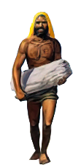
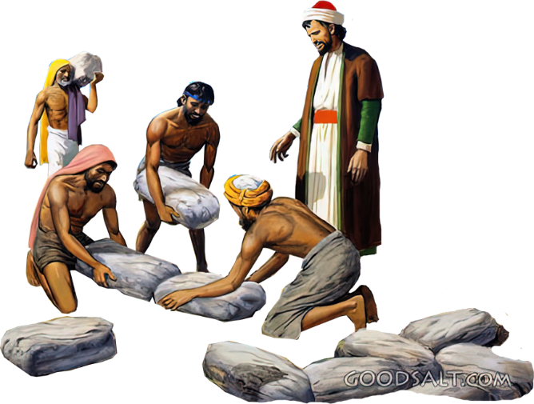
KUKUMBUKIRA NDI KUIWALA
(YOSWA 4)

Slide 8

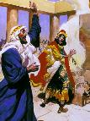
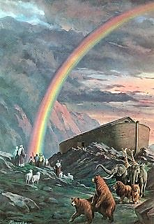
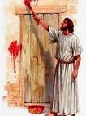

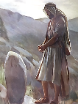
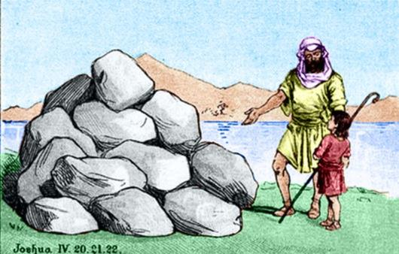
ZIZINDIKIRO ZA KUKUMBUKIRA
“kuti ikhale chizindikiro kwa inu. Mʼtsogolo muno ana anu akamadzakufunsani kuti, ‘Kodi miyala iyi ikutanthauza chiyani?’ Muzidzawawuza kuti…” (Yoswa 4:6-7a)
M’Baibulo, chizindikiro chimatha kukhala ndi matanthauzo angapo:
Chochitika chodabwitsa kwambiri (1 Mafumu 13:3)
Chizindikiro chosonyeza china chake
(Genesis 9:13)
Chizindikiro cha chenjezo (Eksodo 12:13)
Chizindikiro chapadera (Ezekieli 20:20)
Chikumbutso (Genesis 28:18)
Miyala khumi ndi iwiri imene anatengedwa mu Mtsinje wa Yordano, imene Yoswa anaika ngati chizindikiro, inali ya mtundu womalizira: chikumbutso.
Kupatula pa chikumbukirocho, holinga chimene Mulungu anali nacho popempha kuti miyala imeneyi imangidwe chinali chiyani (Yoswa 4:6-7)?
Mibadwo yatsopano inafunika kudziwa zimene Mulungu anachita. Chikhulupiliro chawo chiyenera kukhala chozikika pa zozizwitsa za Mulungu. Udindo wa makolo unali kuphunzitsa ana awo za chiziwitso chimenechi (Deuteronomo 4:9). Podziwa zimenezi, aliyense wa ife ayenera kukhala ndi chikhulupiliro cha iye mwini.

Slide 9
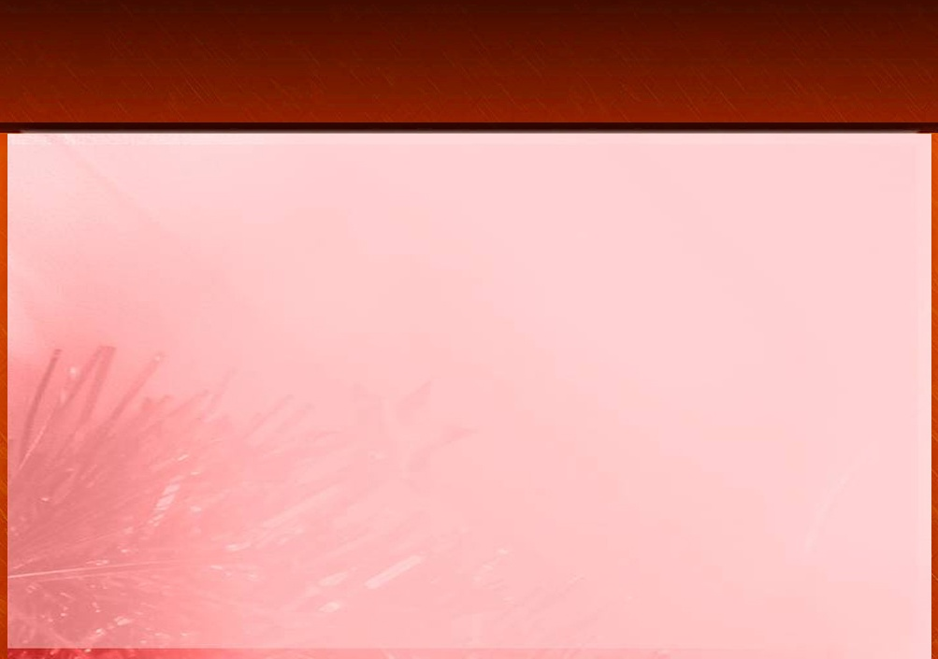
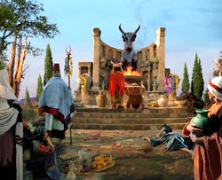
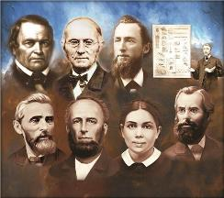
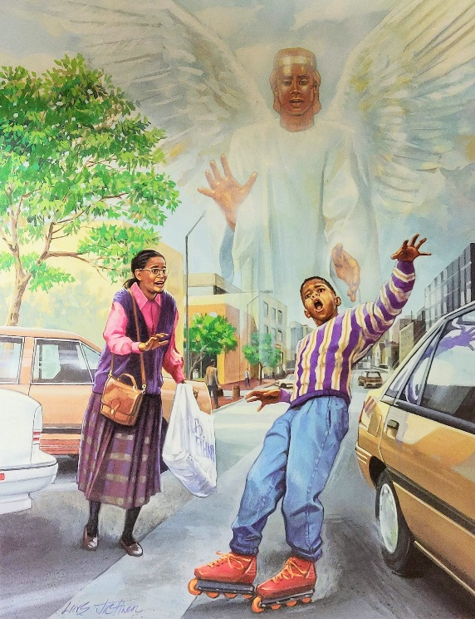
ZOOPSA ZA KUIWALA
“Aisraeli anachita zinthu zoyipira Yehova. Iwowa anayiwala Yehova Mulungu wawo ndi kumatumikira Abaala ndi Asera” (Oweruza 3:7)
Poyika miyala khumi ndi iwiri ya chikumbutso ku Giligala, Yoswa anafotokoza mfundo ziwiri zofunika (Yoswa 4:23):
Mulungu anawumitsa Mtsinje wa Yordano pamaso panu (inu m’badwo watsopano wobadwira m’chipululu, ndipo wokonzedwa kugonjetsa dziko la Kanani)
Mulungu anawumitsa Nyanja Yofiira pamaso pathu (Yoswa, Kalebe, ndi ochepa amene anatsala a m’badwo umene unatuluka ku Igupto)
M’badwo watsopano unali pangozi yochita cholakwika chofanana ndi chomwe makolo awo anachita: kuiwala ntchito zazikulu za Mulungu. Tsoka ilo, anaiwala, ndipo anakumana ndi zotsatira zake (Oweruza 3:7-8).
Ndi kofunika bwanji, kuti tizikumbukira nthawi zonse momwe Mulungu anasamalirira makolo athu, komanso nthawi zimene ife eni tinawona ndi maso athu dzanja lamphamvu la Mulungu!!

Slide 10

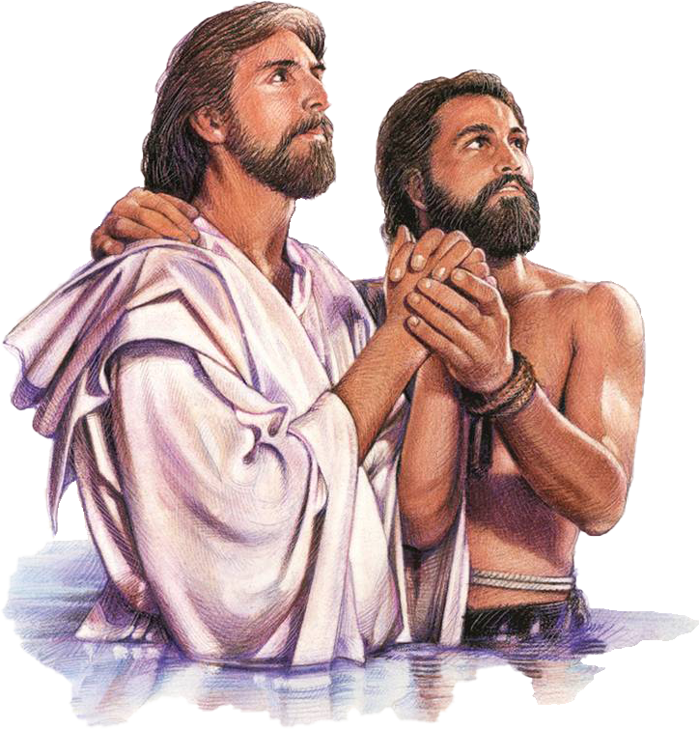
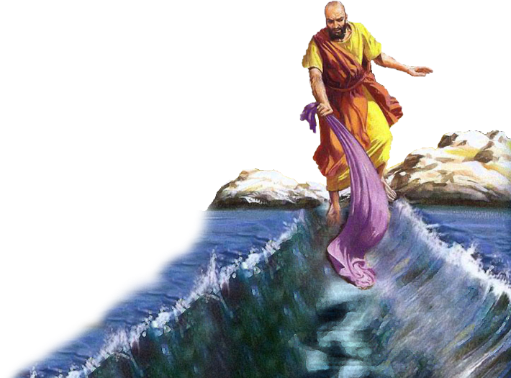
MAGAWO OFUNIKA A MTSINJE WA YORDANO

Slide 11

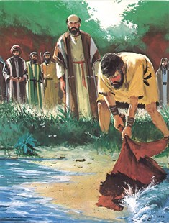
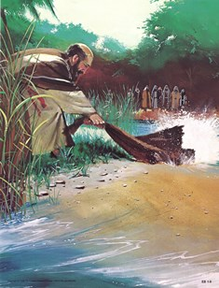
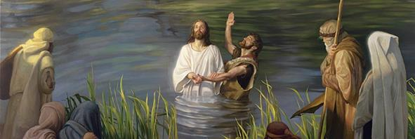
“Iye anasandutsa nyanja kukhala malo owuma, iwo anawoloka pa madzi ndi mapazi. Bwerani, tiyeni tikondwere mwa Iye!” (Masalimo 66:6)
“Nyanja inaona ndi kuthawa, mtsinje wa Yorodani unabwerera mʼmbuyo” (Masalimo 114:3)
Kuwoloka kwa Nyanja Yofiira ndi Yordano ndi zochitika ziwiri za mbiri yakale zomwe zalumikizana monga zochitika zazikulu mu mbiri ya chipulumutso (Masalimo 66:6; Sal. 114). Pamodzi, zimasonyeza kumasulidwa kwathu ku tchimo ndi kulowa m’moyo wosatha.
Kuwoloka Mtsinje wa Yordano mozizwitsa ndi kubwera pamaso pa Mulungu kunakhala chochitika chenicheni kwa mneneri Eliya (2 Masalimo 2:1, 7, 8, 11).
Koma kwa Elisa, chochitikacho chinali chizindikiro cha kulandira Mzimu Woyera, amene anamupatsa mphamvu kuti akwaniritse utumiki wake (2 Mafumu 2:14-15).
Kulowa m’madzi a mtsinje wa Yorodano kunali ndi chikumbukiro chofanana ndi Yesu, amene anapatsidwa mphamvu ndi Mzimu Woyera kukwaniritsa ntchito yake: kutimasula ku uchimo ndi kutipatsa moyo wosatha (Marko 1:9-11;Yohane 1:29; 3:16).

Slide 12

“Choncho, tiyeni, tikumbukire chikondi ndi kukoma mtima kwa Yehova, ndi kuchuluka kwa chifundo chake. Monga ana a Israeli, tiyeni tikhazikitse miyala yathu yochitira umboni, ndipo tilembepo nkhani yamtengo wapatali ya zimene Mulungu watichitira. Ndipo pamene tikuganizira mmene watitsogolera paulendo wathu, tiyeni, ndi mitima yodzaza ndi chiyamiko, tinene kuti: ‘Kodi ndidzabwezera chiyani kwa Ambuye chifukwa cha zabwino zonse zimene wandichitira? Ndidzatenga chikho cha chipulumutso, ndi kuitana pa dzina la Yehova. Ndidzakwaniritsa zowinda zanga kwa Yehova tsopano, pamaso pa anthu ake onse." Masalimo 116:12-14”
EGW (The Desire of Ages, p. 348)

