Slide 1
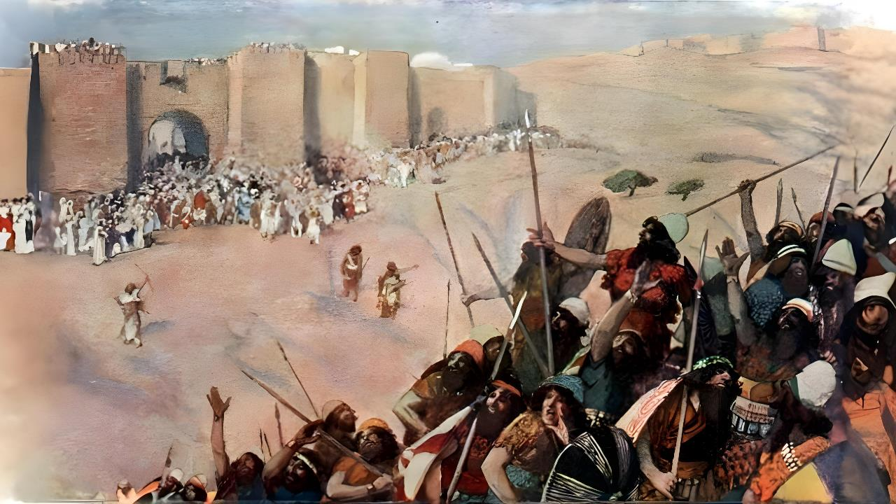
MULUNGU AMAKUMENYERANI NKHONDO
Lesson 5, November 1, 2025

Slide 2

“Yoswa anagonjetsa mafumu onsewa ndi kulanda dziko lawo komodzi ndi kamodzi chifukwa Yehova Mulungu wa Israeli anawamenyera nkhondo”
Yoswa 10:42, CCL

Slide 3

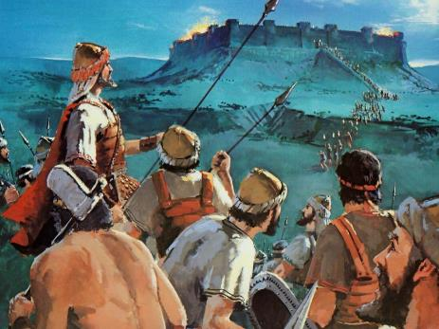
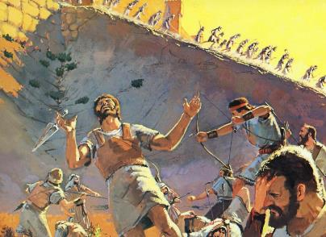
Ndikovuta kumvetsetsa za nkhondo imene ana a Israeli anagonjetsa ndi kutenga dziko la Kanani.
Mulungu sadafune kuti mudziko mukhale uchimo momwemonso sadafune kuti kudzikhala nkhondo.
Nanga n’chifukwa chani anthu ambiri adafa? Tinganene kuti nkhondoyi inali “yopatulika”?
Tingamvetse zavutoli pokhapokha titasanthula zakutanthauza kwa nkhondo mu Baibulo ndi makhalidwe abwino amene anali pachiopsezo munthawi imene izi zimachitika.
Nkhani ya kusaweruzika
Nkhani ya chilungamo
Nkhondo zopezeka mu Baibulo
Kuonongeka ndikusankha kwawo
Funafunani mtendere

Slide 4

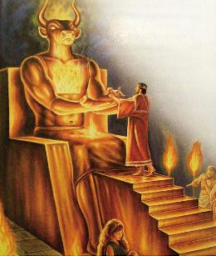
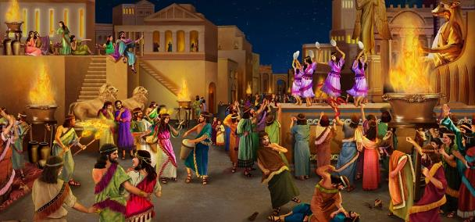
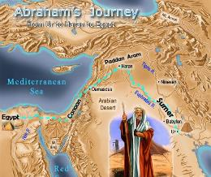
NKHANI YA KUSAWERUZIKA
“Patapita mibado inayi, adzukulu ako adzabwereranso kuno popeza tchimo la Aamori silinafike pachimake kuti alangidwe.” (Genesis 15:16)
Kafukufuku waonetsa kuti chipembedzo chaku Kanani chinali ndendende monga Baibulo lifotokozera: matsenga, kuombedza, kulankhulana ndi akufa, kukhulupilira mizimu…ndi nsembe za ana! (Deutoromo 18:9-12)
Kuonjezera apo anali ndi mwambo wa “chigololo chopatulika” – omwe sunali opatulika konse - umene umachitidwa ansembe aamuna ndi akaz.
Miyamboyi inali yofala mu nthawi ya Abrahamu ndipo Mulungu anawapatsa zaka zoposa 400 kuti akonze khalidwe lawo loyipalo.
Miyambo yopotoka imeneyi inapangitsa anthu kukhala ndimakhalidwe oyipa amitundu yosiyanasiyana yomwe imafunika ithetsedwe. Kuwonongeka kwa Kanani kunali kokonzanso kuti anthu asiye khalidwe loipali.

Slide 5

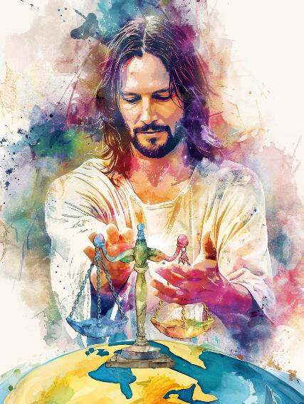
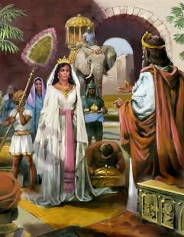
NKHANI YA CHILUNGAMO
“Mulungu amaweruza molungama, amene amaonetsa ukali wake tsiku ndi tsiku. Ngati munthu satembenuka, Mulungu adzanola lupanga lake, iye adzawerama ndikukoka uta” (Masalimo 7:11-12 CCL)
Maziko a khalidwe la Mulungu ndi chikondi ndi chilungamo. Iye ndi oweruza olungama ndi opanda tsankho amene amapereka mpata kuti ochimwa atembenuke koma sadzalekelera zoipa kwamuyaya.
Nkhondo yogonjetsa dziko la Kanani inali kupereka chilango kwa anthu okakamira zoipa osati pazifukwa za ufumu wa dziko.
Chokhumba cha Mulungu chinali kukhazikitsa boma lolungama lomwe lingakhale chitsanzo kwa mitundu yonse ndikhalidwe labwino lodzetsa mtendere ndi kuchita chilungamo padziko lonse (Deuteronomo 4:5-6)
Monga oweruza wachilungamo Mulungu wadzipereka kukhazikitsa, kulimbitsa, ndi kusunga lamulo, lomwe limasonyeza makhalidwe ake.

Slide 6

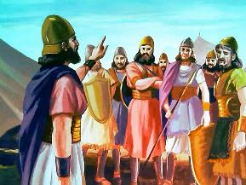
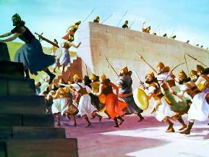
NKHONDO ZOPEZEKA MU BAIBULO
“Koma khulupira lero kuti Yehova Mulungu wako amene ali patsogolo pako ali ngati moto wonyeketsa. Adzawononga iwowo ndipo adzawagonjetsa iweyo ukuona. Pamenepo udzawathamangitsa ndi kuwakantha mwamsanga monga momwe Yehova wakulonjezera” (Deuteronomo 9:3)
Mu Baibulo nkhondo zimachitika monga momwe wanenera Mulungu. Nkhondo zomwe Mulungu walola zimatsatira izi:
Asilikali odziwa ntchito yawo samagwiritsidwa ntchito
Asilikali samalipidwa ndipo osaloledwa kutenga zinthu akagonjetsa
Amatsogozedwa ndi aneneri osankhidwa ndi Mulungu monga Mose ndi Yoswa
Kukonzekera kwauzimu kumafunika nkhondo isanayambe
Mwana wa Israeli aliyense amene amanyozera malamulo ankhondo anali mdani
Nkhondo zambiri Mulungu amalowelerapo
Nkhondo imaloledwa pofuna kugonjetsa kapena kuteteza dziko Lalonjezano mu nthawi imeneyo

Slide 7

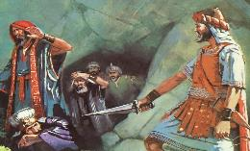
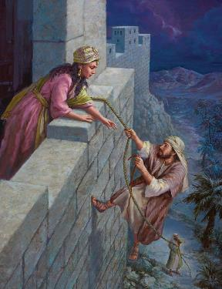
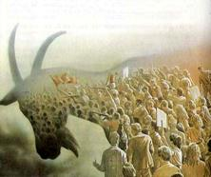
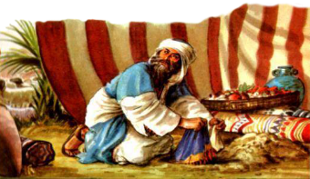
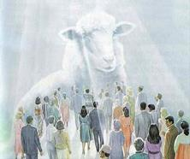
KUONONGEDWA NDI ZISANKHO ZAWO
“Motero Yoswa anagonjetsa dziko lonselo. Anapha mafumu onse a dera la kumapiri, dera la kummwawa, dera la kumadzulo mphepete mwa phiri, ndiponso dera la kumagomo kummwera. Iye sanasiye wina aliyense wamoyo. Anapha onse amene anali moyo monga momwe Yehova analamulira.” (Yoswa 10:40)
Dziko lonse la Kanani linaperekedwa kuchionongeko. Chamoyo chirichonse chinayenera kufa (Deuteromo 20:16-18; Yoswa 10:40
Anthu oyenera kuonongedwa koma kusungidwa amoyo ngati Rahab
Ana a Israeli osamvera ngati Akani anaphedwa
Komabe, panali anthu ena osiyidwa:
Mulungu amawaona a Kanani ndi a Israeli mofanana: mopanda tsankho. Kungoti ena anasankha kupandukira Mulungu ndipo ena anasankha kumumvera Iye.
Panopa, chisankho chiri ndi ife. Yesu akadzabwera tidzapulumutsidwa kapena kuonongedwa malingana ndi kusankha kwathu.

Slide 8

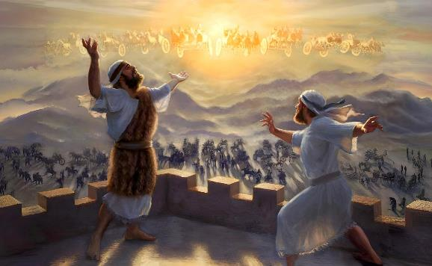
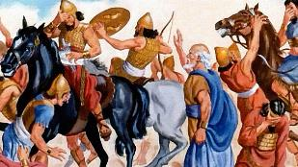
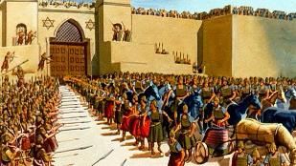
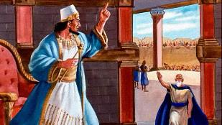
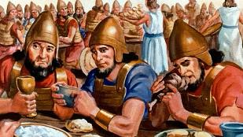
FUNAFUNANI MTENDERE
“Ndidzasandutsa okulamulira kuti akhale achilungamo” (Yesaya 60:17b CCL)
Yesu amatchedwa “Kalonga wa Mtendere” (Yesaya 9:6). Iye anabweretsa mtendere, ndipo amalamulira mwamtendere (Yohane 14:27; Yesaya 60:17)
Mtendere udzakhala weniweni ukadzadza ufumu wake. Pano tiri munthawi yolimbana kwa chabwino ndi choipa.
Panthawi imene a Siriya anazinga Dotani kuti agwire mneneri Elisa, sanapemphe ankhondo a Mulungu kuti aononge a Siriya. Iye anapempha kuti awalondolere a Siriya akhungu ku Samaria, kuti akafika kumeneko pakhale mtendere pakati pamafuko omenyenawa. (2 Mafumu 6:12-23)
Yesu anatiphunzitsa kuti tidzifuna mtendere nthawi zonse. Kugonjetsa choipa ndi chabwino. (Aroma 12:20-21)

Slide 9

“Chionongeko cha anthu aku Yeriko kunali kukwaniritsa malamulo omwe Mose anapatsidwa zokhudza a Kanani. Anthu ena amaona kuti malamulowa samaonetsa chikondi ndi chisomo monga momwe zinalongosoledwa mbali zina za Baibulo. Zinthuzi zinatambasula nzeru zakuya za Mulungu. Yehova amawapatsa boma ndi mtundu wa anthu oti ukhale chitsanzo padziko lino lapansi. Anthu achipembedzo chovomerezeka ndi Mlengi. A Kanani anadzipereka kuchikhalidwe chodziononga okha ndipo zinali zoyenera kuti achotse khalidwe lina lirilonse losokoneza ana ake.”
EGW (Patriarchs and Prophets, p. 492)

