Slide 1
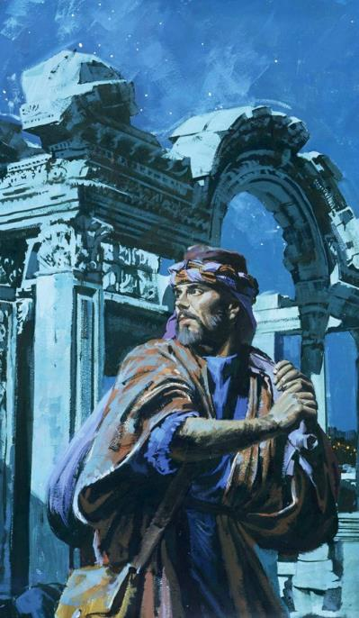
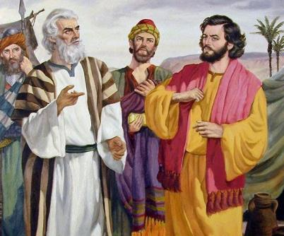
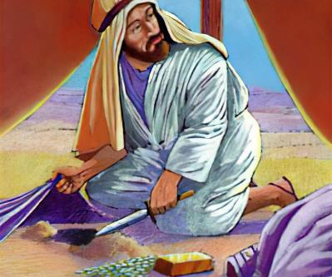
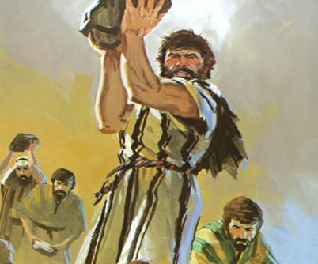
Phunziro 6, November 8, 2025
MDANI PAKATI PATHU

Slide 2


“Ine Yehova ndimafufuza mtima
ndi kuyesa maganizo,
ndimachitira munthu aliyense molingana ndi makhalidwe ake
ndiponso moyenera ntchito zake.” Yeremiya 17:10 CCL

Slide 3


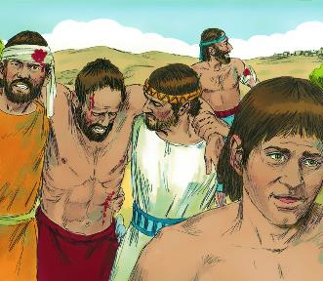
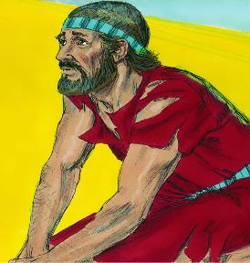





Atagwiritsa ntchito njira yachilendo yosamveka bwino yomenyera nkhondo, makoma a Yeriko anagwa. Aisraeli analowa mumzindawo ndi kuwuwononga mpaka pansi. Kupambana! Koma kwa ndani? Kwa Mulungu, chifukwa Aisraeli sanachite zambiri pankhondoyo.
Atagwiritsa ntchito njira yowerengedwa bwino yomenyera nkhondo, mzinda wa Ai unapambana. Kugonja! Kwa ndani? Kwa Aisraeli, chifukwa sanadalire Mulungu.
Potsiriza, pamene anafunsa Mulungu, yankho linali lomveka: Aisraeli achimwa, ndipo sangathe kupambana motsutsana ndi adani awo. Kodi angabwezeretse bwanji kukoma mtima kwa Mulungu?
Chifukwa cha kugonjetsedwa (Yoswa 7:1-5, 10-13)
Wothedwa nzeru ndi wosautsika (Yoswa 7:6-9)
Kumzindikira wopwanya lamulo (Yoswa 7:14-19)
Tchimo la Akani (Yoswa 7:20-26)
Apambananso (Yoswa 8:1-29)

Slide 4

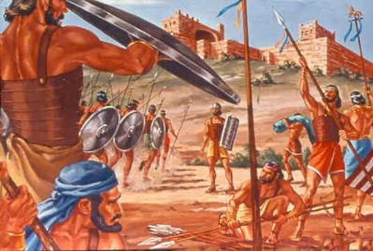
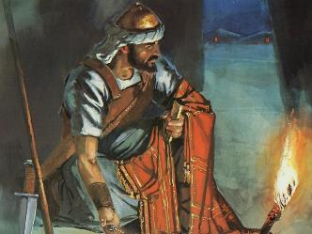
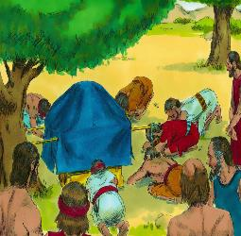
CHIFUKWA CHA KUGONJETSEDWA
“Aisraeli achimwa. Iwo aphwanya pangano limene ndinawalamula kuti asunge. Anatengako zinthu zina zofunika kuwonongedwa. Choncho anabako, ananena bodza ndi kuyika zinthu zakubazo pamodzi ndi katundu wawo.” (Yoswa 7:11)
Atalandira lipoti labwino kuchokera kwa azondi omwe anatumizidwa ku Yeriko, Yoswa anafunsira nzeru kwa Mulungu ndipo analandira kuchokera njira yomenyera kuti atenge mzindawo.
Yoswa akanachita chimodzimodzi atalandira lipoti lochokera kwa azondi omwe anatumizidwa ku Ai, imfa za anthu 36 zikanapewedwa (Yoswa 7:1-5).
Koma kodi chifukwa chenicheni cha kulephera kunali chiyani? Kapena n’chifukwa chiyani Mulungu akanauza Yoswa kuti asalimbane ndi Ai (Yoswa 7:11).
Mulungu anaona kuti “Aisraeli achimwa.” Palibe paliponse m’Baibulo pamene tchimo limafotokozedwa mwatsatanetsatane motere : “aswa pangano... alanda ... aba ... anama ... ndi kusakaniza zinthu zolemekezeka ndi zawo”.
Onani kuti akugwiritsa ntchito mawu oyimirira unyinji. Tchimo linachitidwa ndi munthu mmodzi, koma Mulungu anaimba mlandu anthu onse. Iwo anali ataswa pangano; uchimo unayenera kuzulidwa kuti ubwenzi wawo ndi Mulungu ubwezeretsedwe.

Slide 5

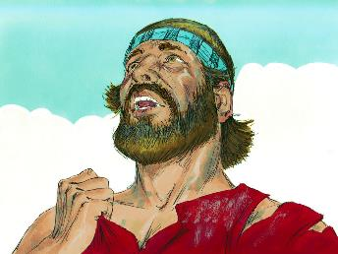
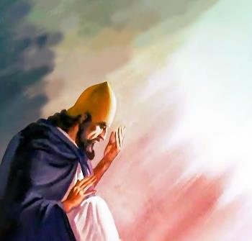
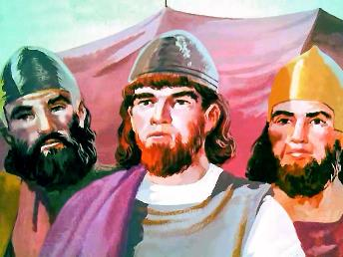
WOTHEDWA NZERU NDI WOSAUTSIKA
“ Ndipo Yoswa anati, “Kalanga ine, Ambuye Wamphamvuzonse chifukwa chiyani munatiwolotsa Yorodani? Kodi mumalinga zotipereka mʼmanja mwa Aamori kuti atiwononge chotere? Kukanakhala kwabwino ife tikanakhala tsidya linalo la Yorodani! ’ ” (Yoswa 7:7)
Yoswa pamodzi ndi akuluakulu anavutitsidwa kwambiri ndi kugonjetsedwa ku Ai, ndipo anasonyeza momveka bwino zizindikiro za chisoni (Yoswa 7:6).
Kenako Yoswa anayamba kulankhula mwaukali, mofanana ndi mmene Aisraeli ankachitira mobwerezabwereza kwa zaka 40 zoyendayenda muchipululu kwawo: ‘Ndichifukwa chiyani munatiolotsa...? Kukanakhala bwino tikanakhala komwekuja…? (Yoswa 7:7 ).
Koma, mzimu wa Yoswa sunali wofanana ndi wa Aisrayeli muchipululu. Kudandaula kwake sanachokere pa kukhumudwa, koma pa mantha oti dzina la Mulungu lingachitidwe manyazi pakati pa amitundu ena (Yoswa 7:8-9 ).
Iye anaona kuti khalidwe la Mulungu adzaweruzidwa ndi osakhulupirira potengera mmene anthu ake amachitira. Lero ifenso tikupitiriza kukhala umboni wa Mulungu padziko lapansi. Uwu ndi udindo waukulu kwambiri!

Slide 6
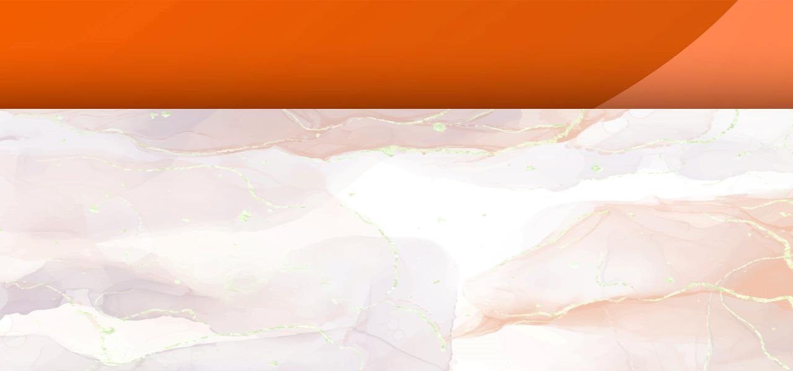
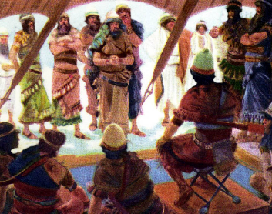
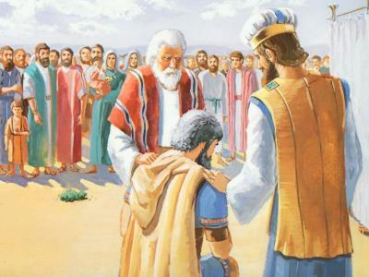
KUMUZINDIKIR AWOPHWANYA LAMULO
“'Mawa mmamawa adzabwere pamaso pa Yehova fuko limodzilimodzi. Fuko limene Yehova adzaliloze lidzabwere patsogolo mbumba imodziimodzi. Tsono mbumba imene Yehova adzayiloze idzabwere patsogolo banja limodzilimodzi. Banja limene Yehova adzaliloze lidzabwere patsogolo munthu mmodzimmodzi.’” (Yoswa 7:14)
Kuti tchimo la anthu onse (mlandu wa mtundu wonse) lichotsedwe, wolakwa ayenera kuchotsedwa pakati pawo (Yoswa 7:15). Kuchotsedwa? Kodi sakanakhululukidwa ngati akanapempha chikhululukiro? Inde, akanakhululukidwa! Koma Akani sanasonyeze chizindikiro chilichonse cha kulapa kochokera pansi pamtima — ngakhale kuti anapatsidwa mwayi wambiri kuti achite zimenezo).
Ntchito yofufuzayo inalengezedwa ndipo inaimitsidwa mpaka tsiku lotsatira (Yoswa 7:14-15).
Fuko la Yuda linatengedwa (Yoswa 7:16 ).
Banja la Zera linatengedwa (Yoswa 7:17a)
Mtsogoleri Zabdi anatengedwa (Yoswa 7:17b )
Akani anatengedwa (Yoswa7:18 ).
Akani adakhala chete
Akani adakhala chete
Akani adakhala chete
Akani adakhala chete
Akani adakhala chete
Posonyeza kukoma mtima ndi chikondi cha Mulungu, Yoswa anapempha Akani kuti aulule tchimo lake (Yoswa 7:19).
Mlandu wa Akani unali utalephera. Anavomereza tchimo lake, koma sanapemphe chikhululukiro (Yoswa 7:20). Komabe Mulungu anachita chisoni chifukwa cha kukoma mtima kwake, komwe kunawonekera nthawi iliyonse imene ankamuitana kuti alape.

Slide 7
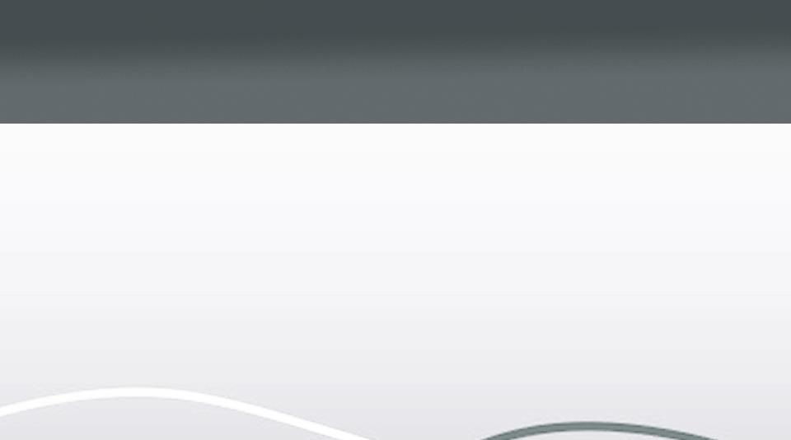
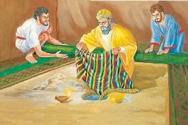

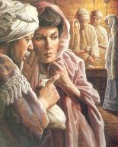
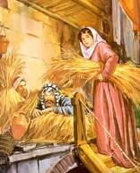
TCHIMO LA AKANI
“Ndinaona mwa zinthu zolanda ku nkhondo zija, mkanjo wokongola wa ku Babuloni, makilogalamu awiri a siliva ndiponso golide wolemera theka la kilogalamu. Zimenezi ndinazikhumba ndipo ndinazitenga. Ndazibisa mʼkati mwa tenti yanga, ndipo siliva ali pansi pake.” (Yoswa 7:21)
Yoswa anapempha Akani kuti apereke ulemerero kwa Mulungu ndi kuvomereza tchimo lake (Yoswa 7:19). Unali mwayi wake womaliza. Ngati, poulula, adapempha chikhululukiro…Koma sanatero, ndipo palibe chikhululukiro kwa iye (Numeri 15:30-31).
Rahabi
Anabisa akazitape aja padenga
Anakomera mtima Israeli
Akani
Zokubazo anazibisa pansi
Zinabweretsa mabvuto kwa Isiraeli
Anakondera chigonjetso chifukwa cha chikhulupiriro
Anagonjetsedwa chifukwa cha ntchito zake
Anachita pangano ndi Isiraeli
Anaswa pangano la Isiraeli
Anapulumutsa moyo wake ndi wa banja lake
Anafa ndi banja lake.
Monga Eva, Akani ‘anaona,’ ‘anafuna,’ ndipo ‘anatenga,’ ndipo tchimo lake linakhudza anthu ambiri (Genesis 3:6). Monga Ananiya ndi Safira, Akani anatenga zinthu zodetsedwa zomwe zinali zopatulira kwa Mulungu, ndipo analipira mtengo wake (Machitidwe 5:1-2).
Zosankha zomwe Akani adapanga ku Yeriko zidatsutsana kwambiri ndi za Rahabu:

Slide 8

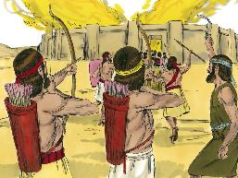
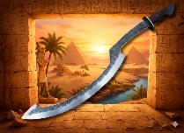
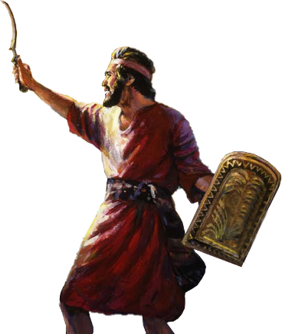
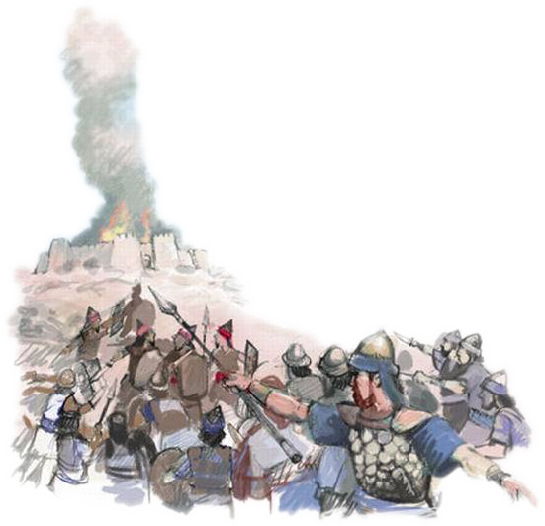
WOGONJETSA KANSO
“Kenaka Yehova anati kwa Yoswa, “Usachite mantha kapena kutaya mtima. Tenga gulu lonse la nkhondo, ndipo upite ku Ai. Taona, ndapereka mfumu ya Ai pamodzi ndi anthu ake, mzinda wake ndi dziko lake lonse mʼmanja mwako.’ ” (Yoswa 8:1)
Monga mmene zinalili ku Yeriko, Mulungu apereka kwa Yoswa njira yomenyera nkhondo kuti agonjetse mzinda wa Ai(Yoswa 8:1-2).
Usiku, abisalira kuseri kwa mzindawo. M’bandakucha, asilikaliwo anafika ku Ai ndikuyamba kuchita ngati athawanso pamaso pawo.
Monga momwe Mose anakwezera ndodo yake kufikira atagonjetsa Aamaleki, potsatira lamulo la Mulungu, Yoswa anakwezanso ‘lupanga lake’ (mwina lupanga lofanana ndi la Aigupto), ndipo anali kuligwira mmwamba mpaka atapeza chigonjetso chathunthu (Yoswa 8:18-22, 26 ) .
Mulungu anapatsanso anthu ake chipambano. Chigwa cha Akori, kumene Akani ndi banja lake anaphedwa, chinatsegula chitseko cha chigonjetso, “khomo la chiyembekezo” ( Hoseya 2:15 ).
Pamene tivomereza chikhululukiro chaumulungu mwa chikhulupiliro, Mulungu amabisa tchimo lathu ku Akori, ndipo amatsegula chitseko cha chiyembekezo.

Slide 9

Chinthu chimene mpingo uyenera kuopa kwambiri si otsutsa poyera, osakhulupirira, kapena ochita chipongwe, koma anthu amene amadzitcha Akhristu koma osakhala okhulupirika. Anthu oterewa ndi amene amasokoneza dalitso la Mulungu wa Israeli, ndipo amabweretsa kufooka mu mpingo — chitonzo chimene ndikovuta kuchotsa… Uchikhristu suyenera kungowoneka pa tsiku la Sabata kapena mu malo opembedzera okha; uli wa masiku onse a pamlungu komanso malo alionse. Zofuna zake ziyenera kuzindikiridwa ndi kutsatiridwa kuntchito, panyumba, komanso pa zinthu zamalonda — ndi abale komanso ndi anthu a padziko lonse
EGW (Conflict and Courage, April 23)

