Slide 1
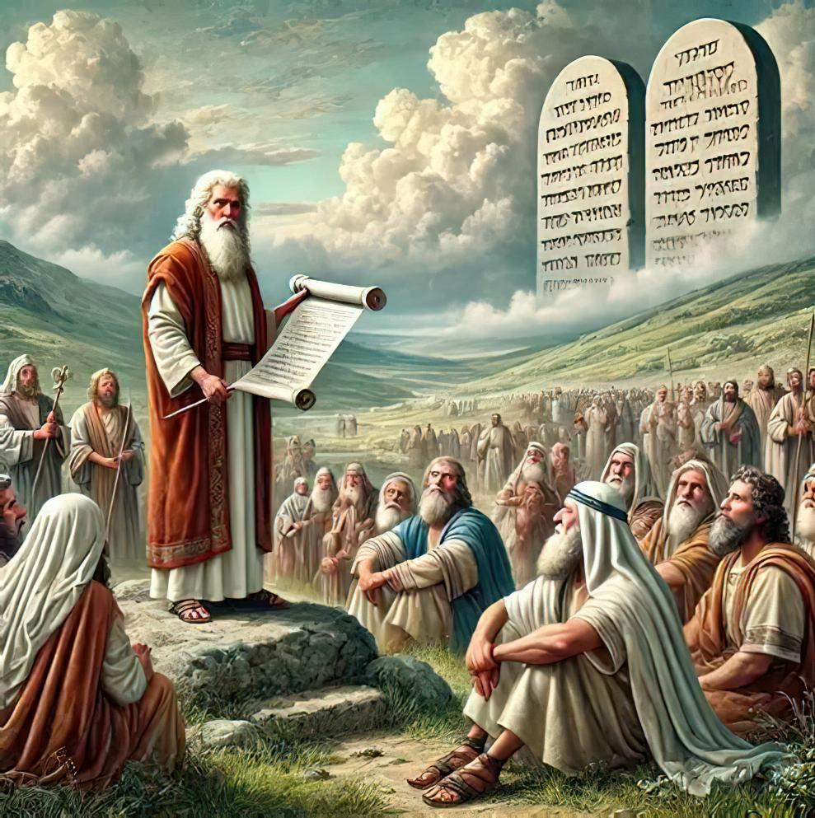
KUKHULUPIRIKA KOPOSA: KUPEMBEDZA MKATI MWA NKHONDO
Phunziro 7 November 15, 2025

Slide 2
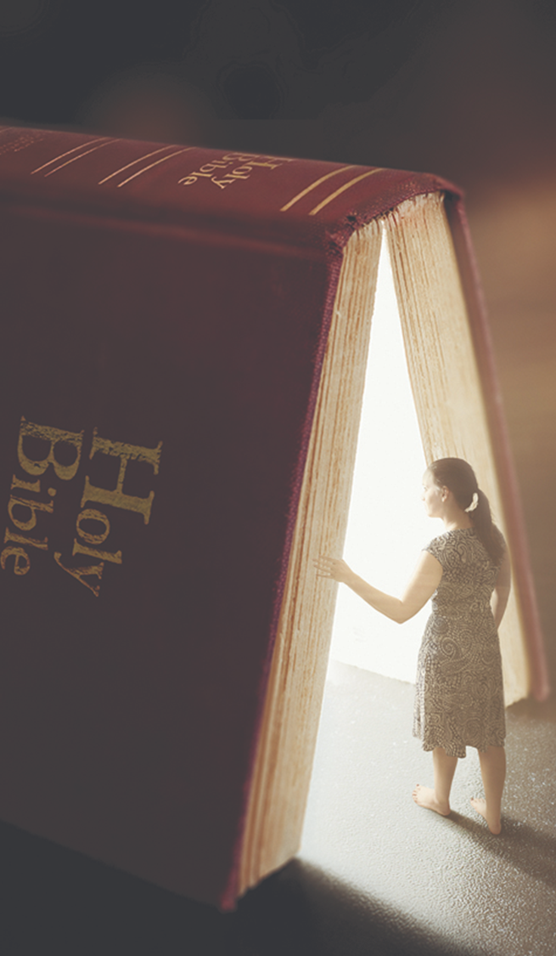


Koma muyambe mwafuna ufumu wake ndi chilungamo chake ndipo zinthu zonsezi zidzapatsidwa kwa inu. ”
Mateyu 6:33, CCL

Slide 3

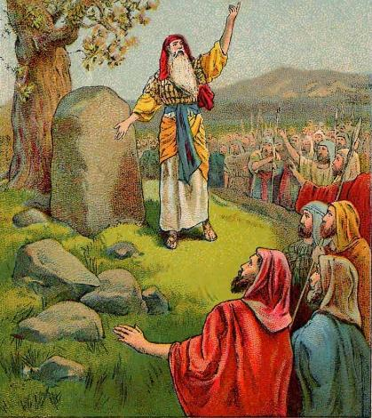
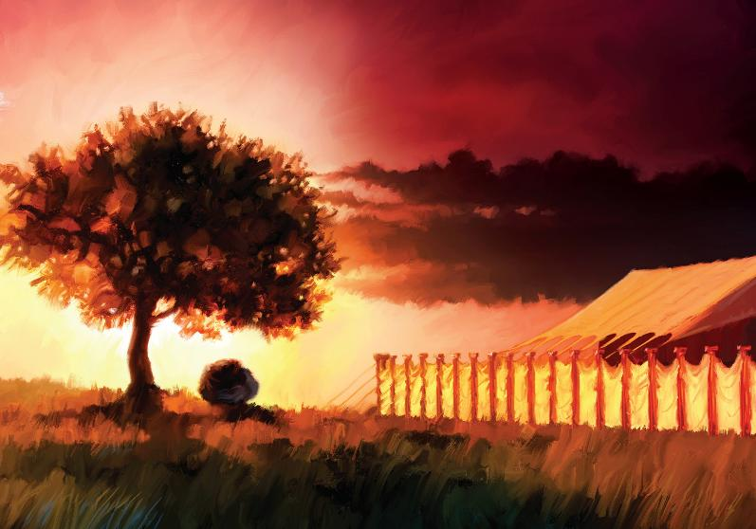








Powoloka mtsinje wa Yorodani mozizwitsa, mafumu onse a ku Kenani anadzazidwa ndi mantha (Yoswa 5:1). Nthaka inakonzedwa kale kuti kugonjetsa kuyambike nthawi yomweyo .
Koma, zimenezi sizinali zofunika kwambiri kwa Aisraeli. Iwo, koyamba anayenera kufunafuna chiyanjano ndi Mulungu.
M’kati mwa chigonjetsocho, anaganiza kutenga nthawi yopuma kuti adzipereke kachiwiri kwa Yehova pa msonkhano waukulu pakati pa mapiri a Ebal ndi Gerizimu.
Atatsala pang’ono kutsiriza kugonjetsa adaniwo, anachita chinthu china chofunika kwambiri pa kulambira: anamanga Malo Opatulika ku Silo.
Kupembedza musanagonjetse :
  Kukonzanso pangano (Yoswa 5:1-9)
  Pasaka Woyamba ku Kanani (Yoswa 5:10-12)
Kupembedza pakati pa mapiri:
  Guwa lopembedzerapo (Yoswa 8:30-31)
  Kumbukirani lamulo (Yoswa 8:32-35)
Malo apadera opembedzera:
  Kukweza Malo Opatulika (Yoswa 18:1)

Slide 4

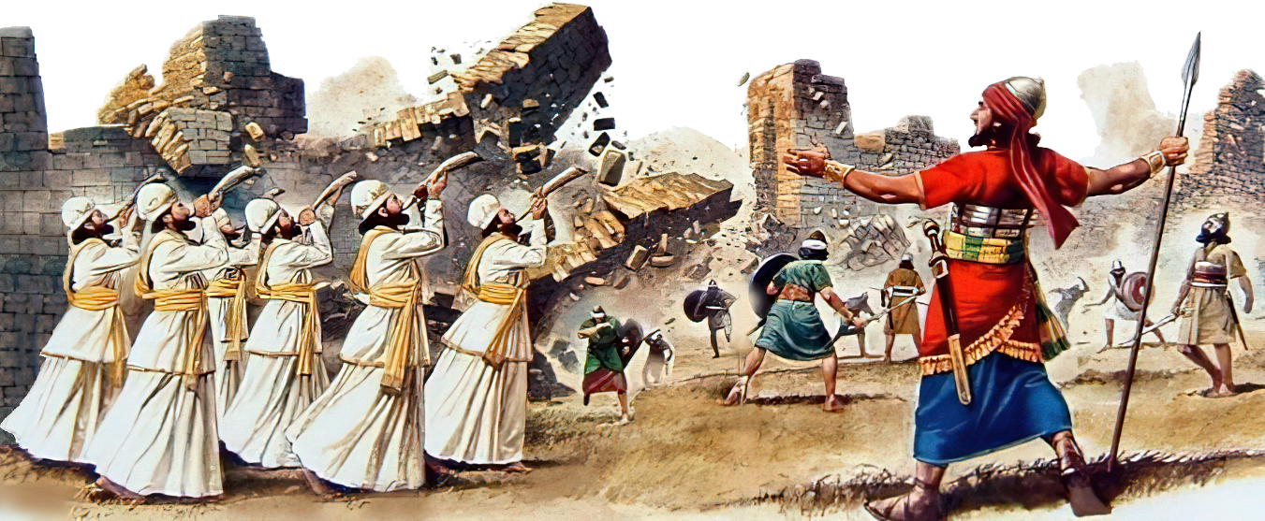
KUPEMBEDZA MUSANAGONJETSE

Slide 5

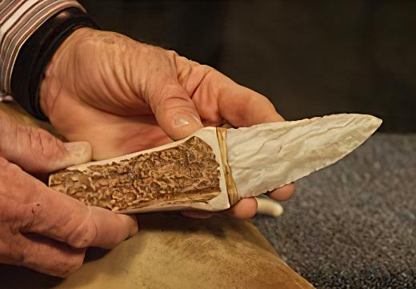
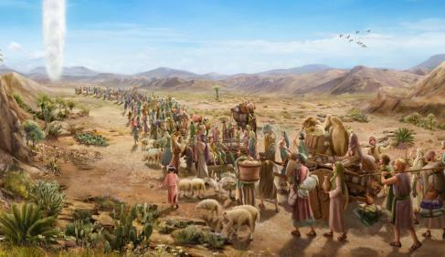

KUKONZANSO PANGANO
“Tsono Yehova anati kwa Yoswa, “Panga mipeni ya miyala ndipo uchitenso mwambo wa mdulidwe pa Aisraeli..’ ” (Yoswa 5:2 )
Giligala ndi dzina loperekedwa ku msasa wa Aisrayeli, malo olamulira m’chigawo choyambirira kugonjetsa. Kodi dzina limeneli linali lofunika bwanji (Yoswa 5:9)?
Ngakhale kuti panali patadutsa zaka 40 kuchokera pamene anatuluka mu Iguputo, Aisiraeli anali asanalowe mu Dziko Lalonjezano. Tsopano mapazi awo anali kuyenda m’dzikolo. Inali nthawi yoti achotse “chitonzo cha ku Igupto” ndi kukonzanso pangano ndi Mulungu.
Asanadye Pasaka woyamba, amuna onse a Israyeli anadulidwa, chifukwa munthu wosadulidwa sankaloledwa kutenga nawo mbali (Eksodo 12:48). Koma popeza anakana kulowa mu Kanani kwa nthawi yoyamba, panganolo linasweka, ndipo panthawi ya ulendo m’chipululu palibe wa Aisraeli amene anadulidwa (Yoswa 5:5).
Kuti akonzenso pangano, kunali koyenera kubwerezanso chizindikiro chakuthupi chimenechi (Genesis 17:10). Ichi chinali chochita choyika zinthu zofunika patsogolo. Kwa ife, ndi chitsanzo chimene tiyenera kutsatira: “Koma muthange mwafuna Ufumu wake ndi chilungamo chake, ndipo zonse zimenezo zidzawonjezedwa kwa inu (Mateyu 6:33 ).

Slide 6

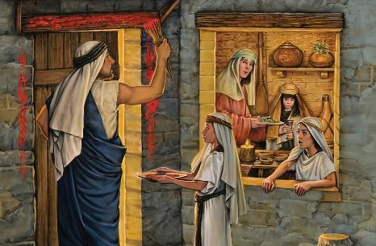
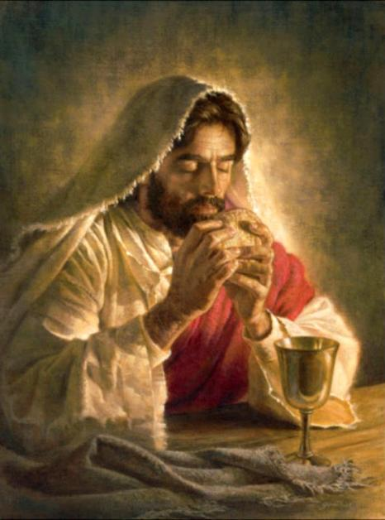
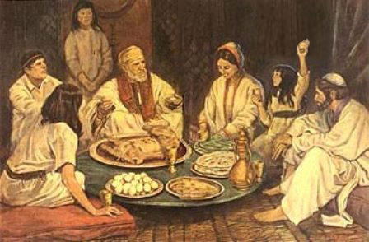
PASAKA WOYAMBA KU KANANI
“Akupumulabe ku Giligala kuja mʼchigwa cha Yeriko, Aisraeli anachita chikondwerero cha Paska madzulo pa tsiku la 14 la mwezi woyamba womwewo. ” (Yoswa 5:10)
Kuchokera ku Igupto kupita ku Kanani, Aisrayeli anayenda njira “yozungulira”, mobwerera mbuyo:
Aiguputo
Mdulidwe ndi Pasaka
Kuwoloka Nyanja yo fiira
Chipilulu
Kuoloka Yolodani
Mdulidwe ndi Pasaka
Kanani
Pasaka woyamba anali chizindikiro cha kumasulidwa ku Igupto. Pasaka wachiwiri, wokondwereredwa ndi m’badwo watsopano, anali chizindikiro cha kulowa ndi kutenga Dziko Lalonjezano.
Atatsala pang’ono kupachikidwa, Yesu anapereka tanthauzo latsopano la mwambo umenewu, wokhala ndi zizindikiro zatsopano: Mwanawankhosa anakhala mkate, ndipo mwazi unasanduka vinyo.
Tsopano ndi zizindikiro za thupi ndi mwazi wa Muomboli wathu, amene anatitulutsa mu Igupto (ndiko kuti, kutichotsa ku uchimo), ndi kutibweretsa ku Dziko Lalonjezano (1 Akorinto 11:23-26) .

Slide 7

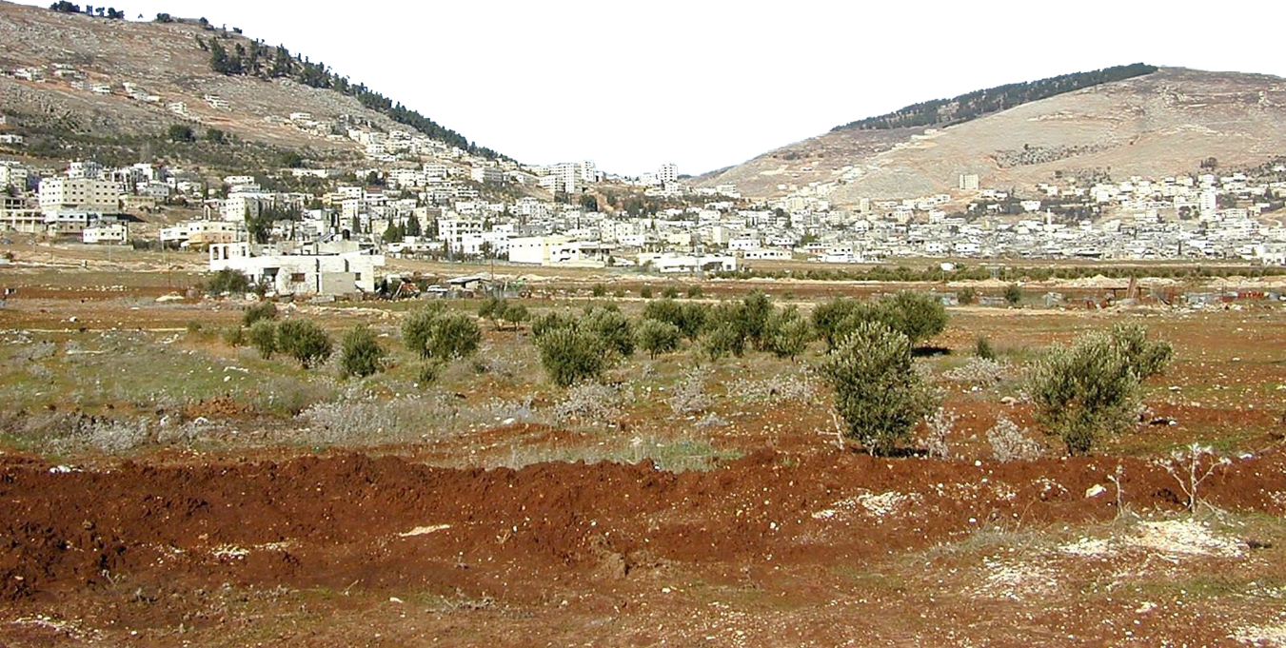
KULAMBIRA PAKATI PA MAPIRI

Slide 8

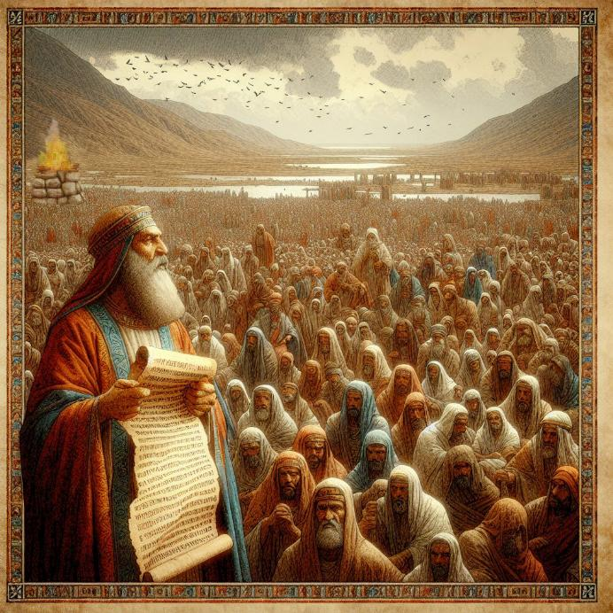
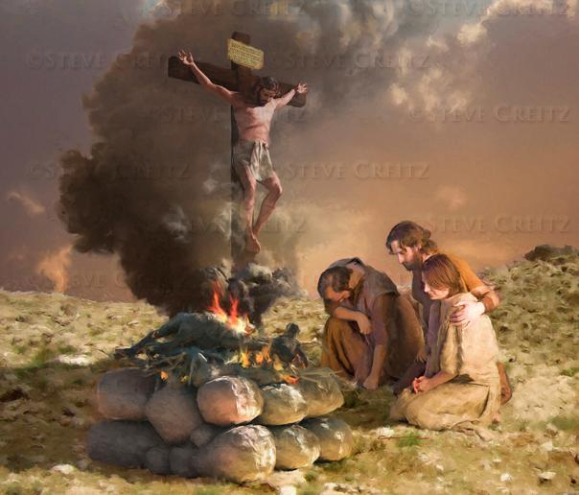
GUWA LAKUPEMBEDZA
“Ndipo Yoswa anamanga guwa lansembe la Yehova Mulungu wa Israeli pa phiri la Ebala.” (Yoswa 8:30)
Mose analamula kuti akalowa mu Kanani, amange guwa la nsembe pa phiri la Ebala, ndipo matamando oyenera anaperekedwa kwa Mulungu (Deuteronomo 27:5-7 ). Koma chifukwa chiyani guwawo linayenera kumangidwa pa Phiri la Ebala osati pa Gerizimu?
Guwa lansembe pamodzi ndi malamulo amene anayenera kulembedwa pa chikumbutso ndi kuwerengedwa kwa anthu, zonse zinali zogwirizana ndi madalitso komanso temberero (Deuteronomo 27:12-13 ). Madalitso ananenedwa pa phiri la Gerizimu, ndipo temberero pa phiri la Ebal.
Yesu anakhala temberero m’malo mwathu, kuti ife tikalandire madalitso (Agalatiya 3:13–14). Guwa lansembe limeneli ndi chithunzi chomveka bwino cha nsembe ya Yesu imene inachitika m’malo mwathu.
M’kati mwakugonjetsa, Aisraeli anapeza nthawi yoti adzipereke kachiwiri kwa Mulungu. Izi zimatipatsa ifenso chiyembekezo chokopera chitsanzo chawo — kudzipereka kachiwiri kwa Mulungu, osati payekha payekha, koma monga anthu osankhidwa a Mulungu.

Slide 9

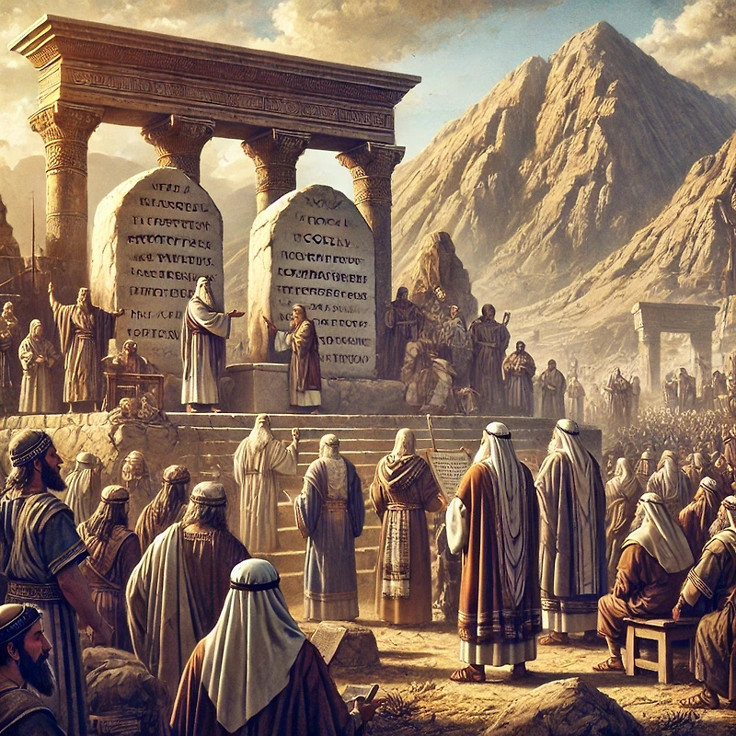
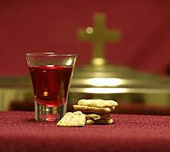
KUMBUKIRANI LAMULO
“Kenaka anthu onse akupenya, Yoswa analemba pa miyala chitsanzo cha malamulo amene Mose analemba.” (Yoswa 8:32)
Atamanga guwa la nsembe pa phiri la Ebala, Yoswa anaimika miyala ndi kuipaka laimu. Kenako analemba pa miyalayo malamulo [bukhu la Deuteronomo, lomwe linali ndi Malamulo Khumi ndi malamulo ena osiyanasiyana, pamodzi ndi madalitso komanso temberero] (Yoswa 8:32; Deuteronomo 27:2–3).
Pomaliza pake, lamulolo linawerengedwa kwa anthu, omwe anagawidwa m'magulu awiri — gulu lina linali mbali imodzi ya phiri, ndipo linzake mbali inayo (Yoswa 8:33–35). Motere, pangano pakati pa Mulungu ndi anthu ake linakonzedwanso..
Uku ndi kuyitanira kwa ifenso. Monga anthu ake a Mulungu otsala, tiyenera kukonzanso pangano lathu ndi Iye nthawi ndi nthawi, tikakumbukira mmene watitsogolera kufikira pano ndi madalitso amene watipatsa.
Kuphatikiza pa kukonzanso ubale wathu, Chikumbutso cha Ambuye (Mgonero Woyera) chimatipatsanso nthawi yapadera yokonzanso pangano lathu monga anthu a Mulungu.

Slide 10
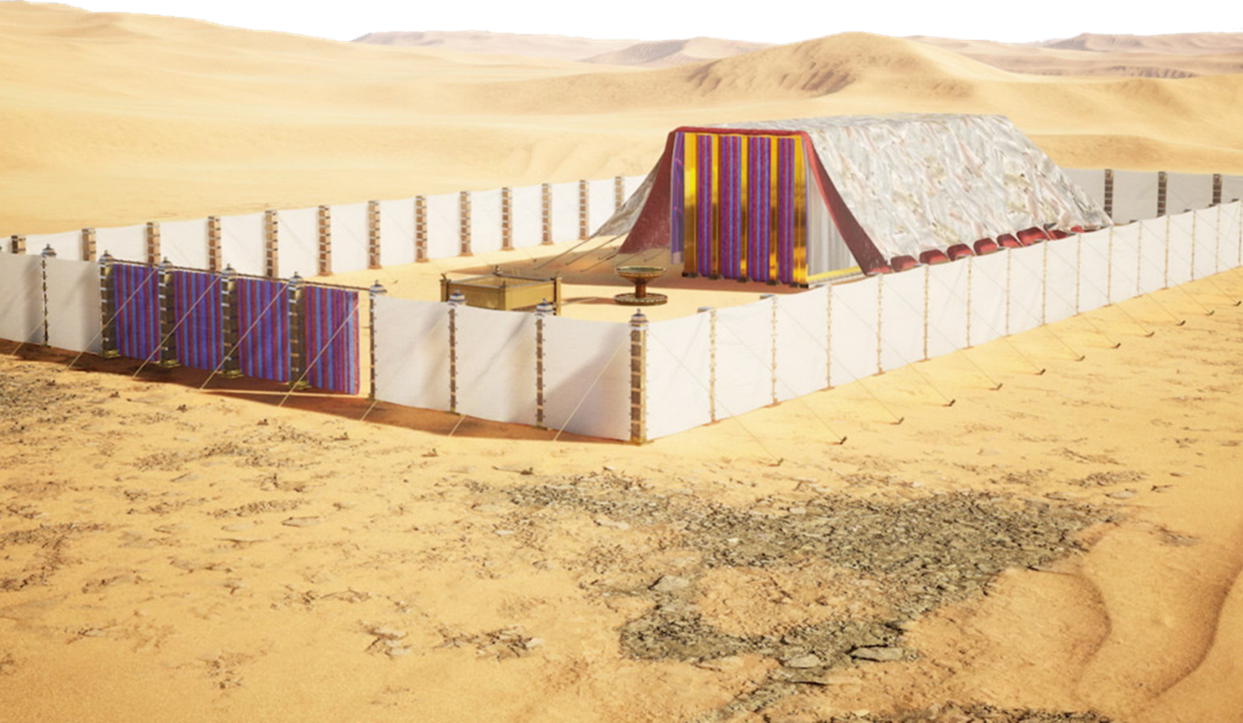
MALO APADERA OPEMBEDZERA

Slide 11

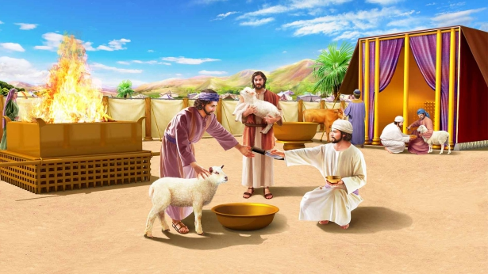
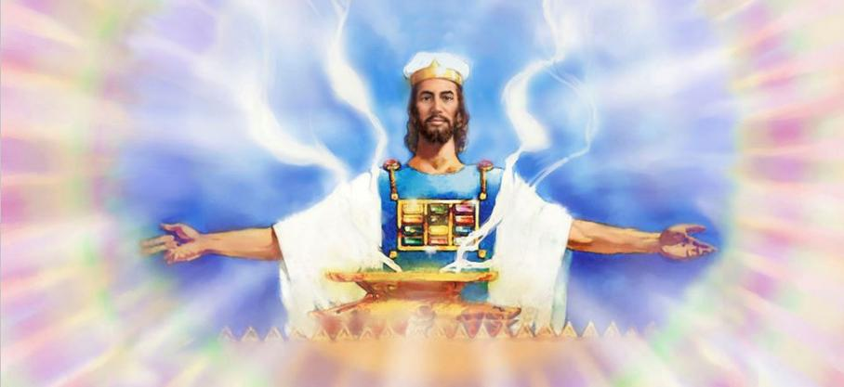
KUWEZA CHIPEMBEDZO
Atagonjetsa dziko lonse Aisraeli anasonkhana ku Silo ndipo anayimikako tenti ya msonkhano.” (Yoswa 18:1)
Dzikolo linali litagonjetsedwa ndi Aisraeli. Malo anagawidwa pakati pa mafuko ofunika kwambiri, ngakhale kuti mafuko asanu ndi awiri anali asanalandebe gawo lawo. Asilikali a fuko la Rubeni, Gadi, ndi theka la fuko la Manase anayenera kutumizidwa kukalandira malo awo omwe anali tsidya lina la mtsinje wa Yorodani..
Asanagawikane mafukowo, panachitika chochita chapadera komanso chofunika kwambiri: anamanga Chihema, chomwe chinali likulu la kulambira kwa Aisrayeli (Yoswa 18:1 ).
Malo Opatulika, monga malo okhalamo Mulungu owoneka ndi maso, nali malo a umodzi, kumene onse ankasonkhana kulambira pamodzi. Popanda kuoezekapo kwa Mulungu, kukhala ndi dzikolo sikukanakhala ndi tanthauzo lililonse.
Masiku ano, pamene kuli zimphona zamakono zomwe tikuyenera kuwagonjetsa, ndikofunika kwambiri kuti tikhazikitse maganizo athu pa Malo Opatulika a Kumwamba, kumene Yesu akutipempherera

Slide 12

“Pasanathe masabata ambiri kuchokera pamene Mose anapereka buku lonse la Deuteronomo pa msonkhano wake ndi anthu, koma tsopano Yoswa anawerenganso lamulo.”
Osati amuna a Israeli okha, koma ‘akazi onse ndi ana ang’onoang’ono’ ankamvetsera kuwerengedwa kwa lamulolo; chifukwa zinali zofunika kuti nawonso adziwe ndi kuchita zomwe zinali udindo wawo.[…]
Chaputala chilichonse ndi ndime ililonse la m'Baibulo ndi mauthenga ochokera kwa Mulungu kupita kwa anthu. Tiyenera kumangirira malangizo ake ngati zizindikilo m’manja mwathu ndiponso ngati chotsogolera maso athu. Ngati tiliphunzira ndi kulitsatira, Baibulo lidzatsogolera anthu a Mulungu monga momwe Aisraeli anatsogoleredwera ndi mtambo masana komanso moto usiku.
EGW (Patriarchs and Prophets, pp. 500-504)

