Slide 1

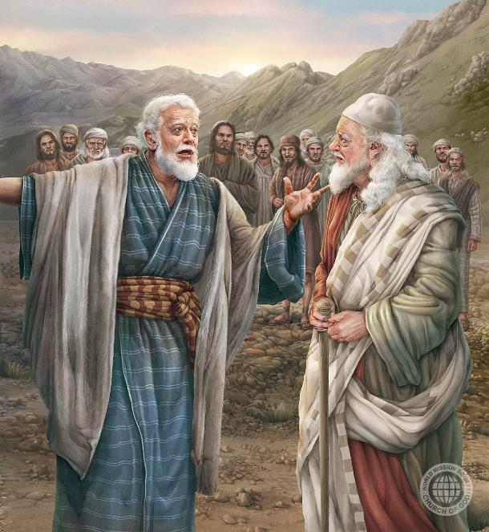
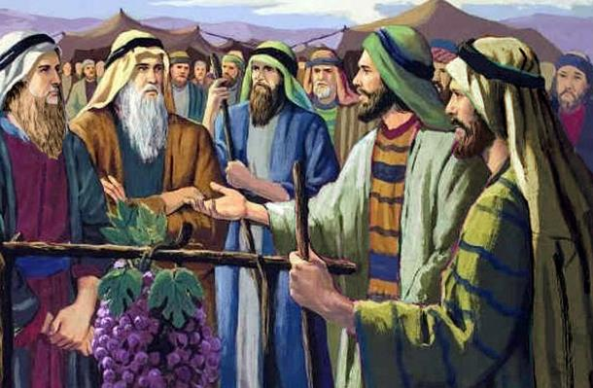
NGWAZI ZA CHIKHULUPIRIRO: YOSWA NDI KALEBE
Phunziro 8, November 22, 2025

Slide 2
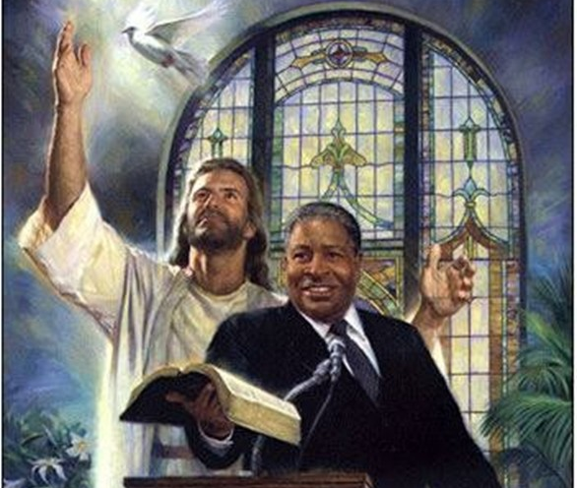
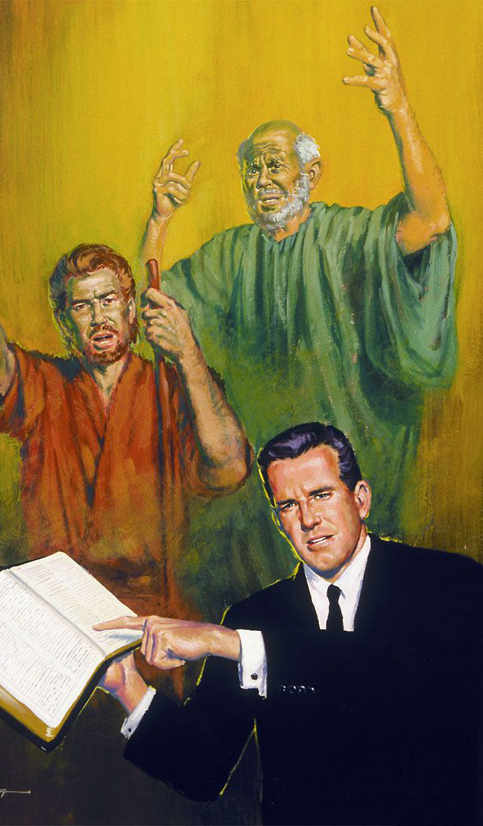
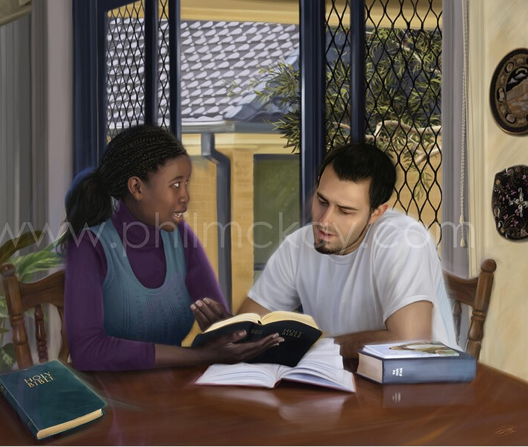
“Muzikumbukira atsogoleri anu, amene amakulalikirani Mawu a Mulungu. Ganizirani zamoyo wawo ndipo tsatirani chikhulupiriro chawo”
(Ahebri 13:7, CCL)

Slide 3


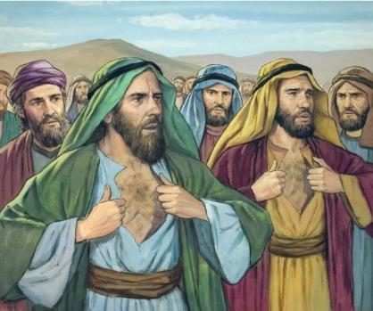




Kodi mumawadziwa anthu khumi awa: Samuwa, Safati, Igala, Palati, Gadiyeli, Gadi, Amiyeli, Seturi, Nabi ndi Geueli?
“Mbiri yake” inali yosakhulupirira mphamvu ya Mulungu, ndipo chifukwa cha zimenezi anabweretsa imfa yake komanso ya mibadwo yonse (Numeri 14:36-37).
Koma mwina munamvapo za anthu awiri awa: Yoswa ndi Kalebe. Iwo anaima nji, anakhulupilira malonjezo a Mulungu, ndipo anakhala ndi moyo kuti aone kukwaniritsidwa kwawo (Numeri 14:38).
Tingayanjanitse bwanji chikhulupiriro chawo ndiponso kukhulupirira mokwanira kuti Mulungu angathe kuchita zosatheka, monga momwe iwo anachitira?
Chikhulupiliro cha Kalebe:
  Kupanga zosatheka kukhala zotheka.
  Chikhulupiriro mu ntchito.
  Kupereka nyali kwa ena.
Chikhulupiliro cha Yoswa.
M’mene tingapezere chikhulupiriro.

Slide 4

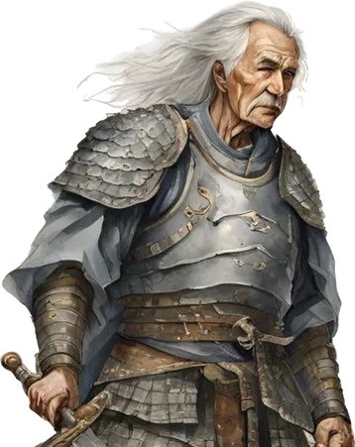
CHIKHULUPILIRO CHA KALEBE

Slide 5

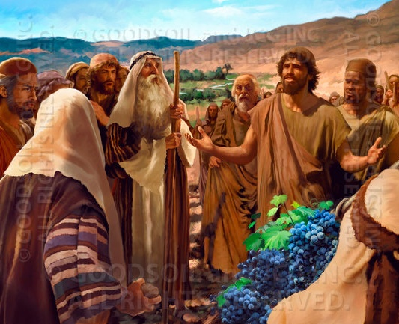
KUPANGA ZOSATHEKA KUKHALA ZOTHEKA
“Koma abale anga amene ndinapita nawo anachititsa anthu mantha. Komabe ine ndinamvera Yehova Mulungu wanga ndi mtima wonse.” (Yoswa 14:8)
Dzina loti “Kalebo” limatanthauza “galu.” Monga momwe moyo wake unasonyezera, iye sanalandire dzina limenelo ngati mawu achipongwe, koma chifukwa cha kukhulupirika kwake kosasunthika. Iye anali wokhulupirika pamene ena anali osakhulupirika. Anakhalabe wokhulupirika kwa Mulungu pamene ena anagonjera mantha.
Pamene azondi khumi anaona mizinda yosatheka kuigonjetsa, ndi zimphona zosatheka kuzigonjetsa, Kalebe anaona mizinda ikugonjetsedwa ndi zimphona ‘zikudyedwa ngati mkate’ (Numeri 13:28-33; 14:6-9).
Limodzi ndi Yoswa (amene anali wamng’ono kuposa iye), anaima nji m’malingaliro ake, ngakhale pamene khamu la anthu linafuna kuwaponya miyala (Numeri 14:10).
Chitsanzo chake chimatilimbikitsa kukhala okhulupirika ndiponso olimba mtima m’chikhulupiliro chathu mwa Mulungu, amene angathe kupanga zosatheka kukhala zotheka kwa ife.

Slide 6

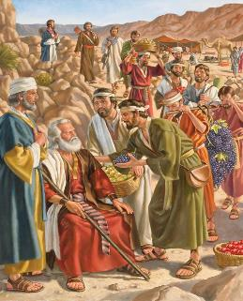
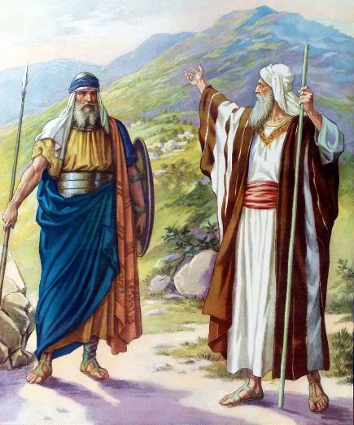

CHIKHULUPILIRO MU NTCHITO
“Tsopano ndipatseni dziko la ku mapiri limene Yehova anandilonjeza tsiku lija. Inu munamva nthawi ija kuti Aanaki anali kumeneko ndipo kuti mizinda yawo inali ikuluikulu ndi yotetezedwa. Komabe Yehova atakhala nane ndidzawathamangitsa monga Iye ananenera.” (Yoswa 14:12)
Malinga ndi zimene Kalebe ananena, pamene Mose anapempha kuti amufotokozere, “ndinamuwuza zoona zokhazokha mogwirizana ndi zimene ndinkakhulupirira” (Yoswa 14:7), ndiponso “Ndinatsata Yehova Mulungu wanga ndi mtima wons” (Yoswa 14:8). Chifukwa cha kukhulupirika kwake, analonjezedwa kuti adzalandira ngati cholowa malo amene mapazi ake anayendapo panthawi ya kufufuzako (Yoswa 14:9).
Kalebe anali ndi zaka 40 pamene anatumizidwa kukhala mzondi. Patatha zaka zisanu chigonjetsere dziko, tsopano anali wokalamba wa zaka 85 (Yoswa 14:10). Thupi lake ndi maganizo ake zinali zikadali ndi mphamvu, ndipo maganizo ake anali adakali omwewo (Yoswa 14:11).
Nthawi inafika kuti alandire lonjezo limene analipereka ndiponso kuwonetsa kuti mawu ake sanali opanda pake. Ndi thandizo la Mulungu, ankatsimikiza kuti adzagonjetsa zimphona ndiponso kulanda mizinda yawo (Yoswa 14:12–14).

Slide 7

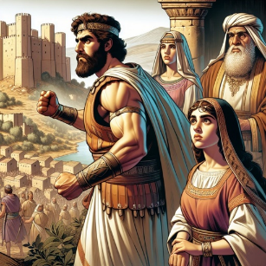
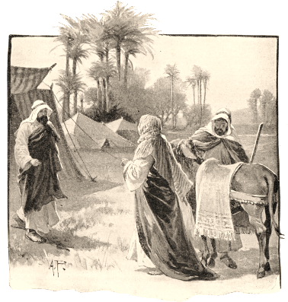
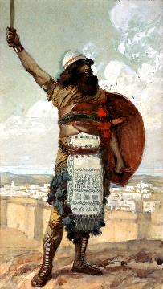
KUPEREKA UDINDO KWA ENA
“Tsono Kalebe anati, “Munthu amene angathire nkhondo mzinda wa Kiriati Seferi ndi kuwulanda, ndidzamupatsa mwana wanga Akisa kuti akhale mkazi wake’ ” (Yoswa 15:16)
Atagonjetsa gawo la dziko limene linali lake mwalamulo, Kalebo anayamba kuganizira za cholowa chimene adzasiye m’mbuyo. Kodi ana ake adzapitiriza kukhulupirira Mulungu monga momwe iye anachitira?
Iye anali atatsimikizira kuti Mulungu akhoza kudaliridwa, tsopano ankafuna kuti apeze munthu amene anali ndi chikhulupiriro chofanana ndi iyeyo, kuti athe kumupatsira ntchito ndi udindo umenewo.
Pachifukwa chimenechi, analonjeza kupereka mwana wake wamkazi kwa aliyense amene angagonjetse Kiriati-seferi, yomwe imatchedwanso Debiri (Yoswa 15:15-16).
Mwana wa mchimwene wake, Otanieli, ndiye anali ngwazi yolimba yomwe inagonjetsa mzindawo, ndipo kenako anamakhala woweruza woyamba wa Israeli (Yoswa 15:17; Oweruza 3:9–1).
Atakwatira Akisa, mwana wake wa Kalebe, iye analimbikitsa abambo ake kuti amulole kuonjezera madera amene angagonjetsedwe (Yoswa 15:18–19). Motero, Otanieli anasonyeza kuti anali wolandira chilowa choyenerera cha Kalebe.

Slide 8

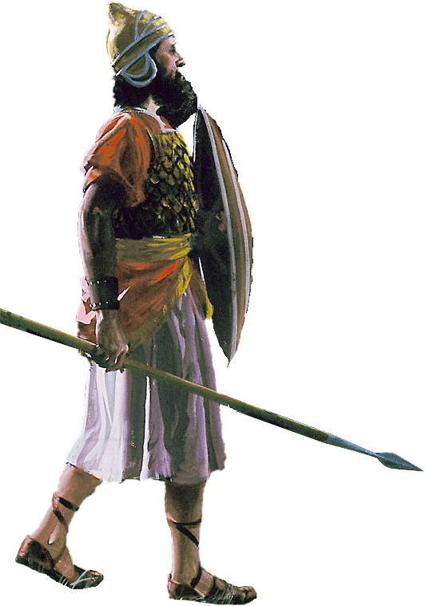
CHIKHULUPILIRO CHA YOSWA

Slide 9

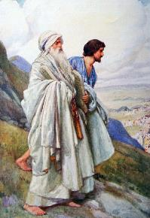
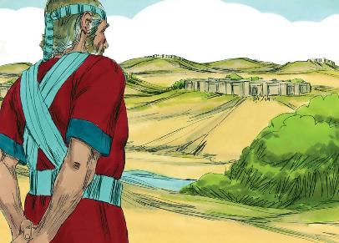
“Atatha kugawana zigawo zosiyanasiyana za dzikolo, Aisraeli anamupatsa Yoswa mwana wa Nuni chigawo chake” (Yoswa 19:49)
Yoswa akadali wachinyamata anasankhidwa ndi Mose kukhala womuthandizira. Iye anasonyeza kuti anali womvera, wolimba mtima, wokhulupirika, wothandiza komanso wokonda zinthu za Mulungu (Eksodo 33:11).
Nthawi itakwana yoti atenge malo ake, anadikira mpaka mafuko onse atalandira cholowa, ndipo anasankha “gawo lotsala” [Timnati-sera] ( Yos. 19:50 ), mzinda womwe unali pafupi ndi Silo, kumene anamangako Malo Opatulika.
Kuchokera munkhani yake, timaphunzira kuti :
Chikhulupiliro sichinyalanyaza mfundo; chimangopereka njira ina yowonera ndi kumvetsa zinthu
Mmalo modandaula, tikuitanidwa kukhulupilira ndi kugonjera zolinga za Mulungu
Madalitso amabwera kwa iwo amene amakhala okhulupirika kwathuthu mwa Ambuye
Mbali zonse za moyo wathu, tiyenera kutsatira dongosolo lomwe Mulungu waika
Ndikwabwino kwambiri kukhala pafupi ndi Mulungu koposa china chilichonse
(Masalimo 84:10)

Slide 10

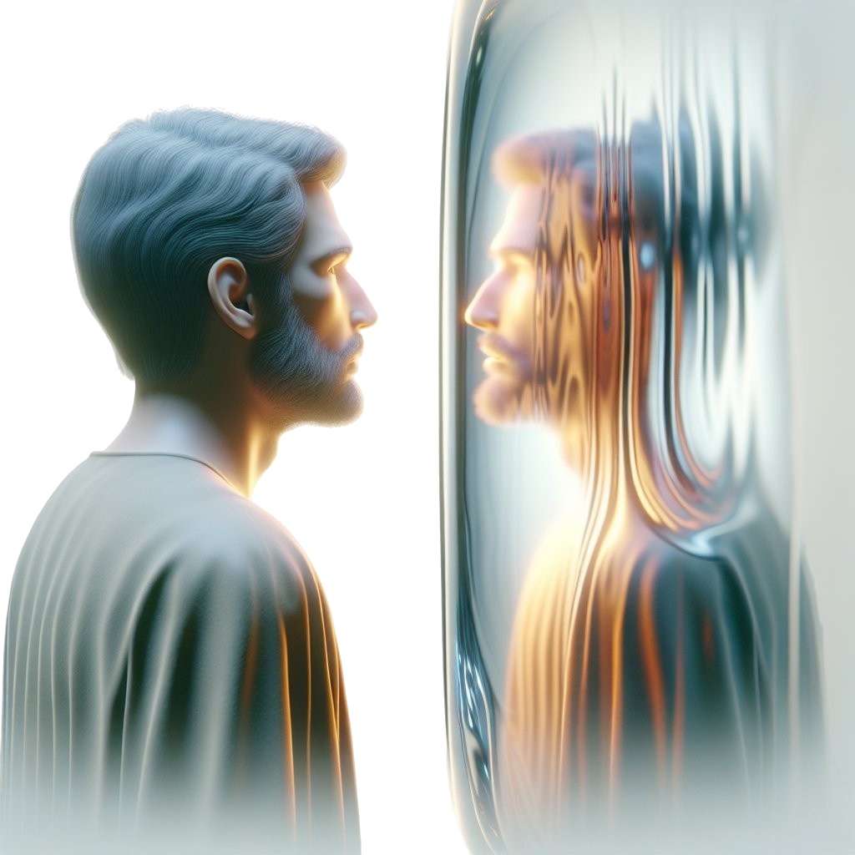
M’MENE TINGAPEZERE CHIKHULUPIRIRO

Slide 11

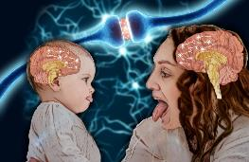
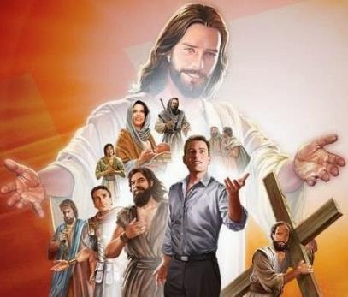

“Tsono popeza ifenso tazunguliridwa ndi gulu lalikulu la mboni, tiyeni titaye chilichonse chimene chimatitchinga, makamaka tchimo limene limatikola mosavuta, ndipo tithamange ndi khama mpikisano umene tayambawu. Tiyeni tiyangʼanitsitse Yesu, amene ndi woyamba ndi wotsiriza wa chikhulupiriro chathu. Chifukwa cha chimwemwe chimene chimamudikira anapirira zowawa zapamtanda. Iye ananyoza manyazi a imfa yotere ndipo tsopano akukhala ku dzanja lamanja la mpando waufumu wa Mulungu.” (Ahebri 12:1-2)
Makhalidwe athu amaonetsera kwambiri zomwe timawona. Palinso zomwe zimatchedwa ‘galasi ya mitsempha,’ zomwe zimapangitsa kusiyana pakati pa kungoonera chinthu ndi kuchichita kukhala kochepa kwambiri.
Baibulo limatilimbikitsa kuyang’ana chitsanzo cha zimphona zachikhulupiliro, makamaka Yesu, amene ndiye chitsanzo chathu chapamwamba ( Ahebri 12:1-2).
Tikamaphunzira za miyoyo ya anthu okhulupirika monga Kalebo ndi Yoswa, timaphunzira kukhulupilira Mulungu monga momwe iwo anachitira; kukhala odzichepetsa monga iwo; komanso kuyima pa choonadi molimba mtima monga momwe iwo anachitira.
Koma tingasinthidwe bwanji? Baibulo limayankhula momveka: ndi kutilola kuti Mzimu Woyera agwire ntchito m’mitima mwathu (2 Akorinto 3:18). Iyi ndi ntchito yoti tichite; ife tiyenera kusankha kusinthidwa ndiponso, monga Kalebo, kuyamba kugwira ntchito. Tayitanidwa kukhala nsembe zamoyo kwa Mulungu (Aroma 12:1–2).

Slide 12
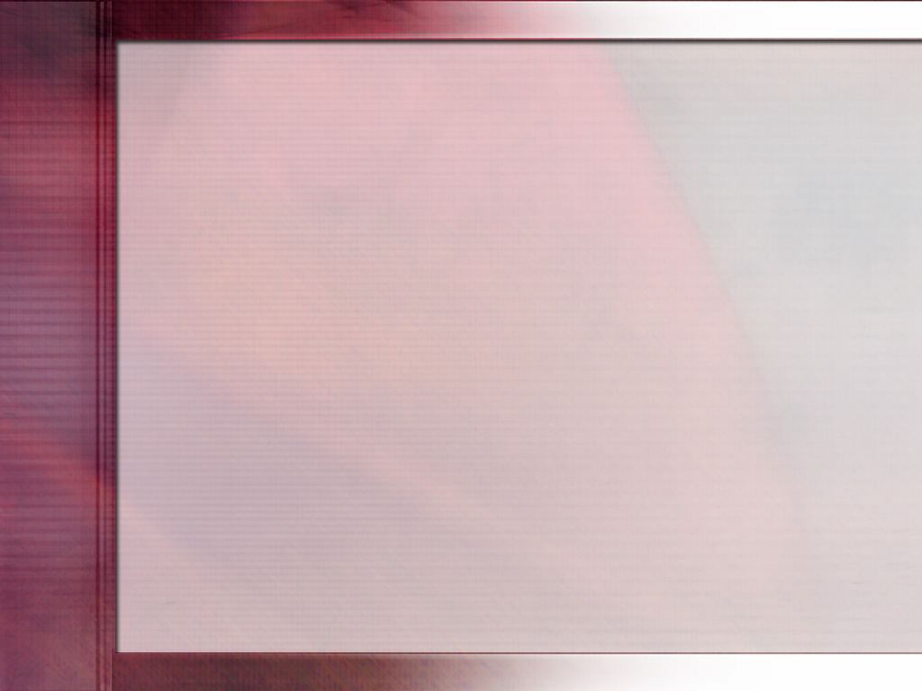
“Masiku ano tikufunikira amuna okhulupirika kwathunthu, amuna otsatira Ambuye ndi mtima wonse, amene samangokhala chete pamene ayenera kulankhula, amene ali olimba ngati chitsulo pa mfundo, osafuna kungoziwonetsera pamaso pa anthu, koma amene amayenda modzichepetsa ndi Mulungu; oleza mtima, ofatsa, othandiza, olemekeza ena—amene amamvetsetsa kuti luso la kupemphera ndiko kuchita chikhulupiliro ndi kusonyeza ntchito zomwe zimabweretsa ulemerero kwa Mulungu ndi ubwino kwa anthu ake…. Kutsatira Yesu kumafuna kusintha kwa mtima kwathunthu kuyambira pachiyambi, komanso kubwerezanso kusintha kumeneku tsiku lililonse.
Chikhulupiriro cha Kalebo mwa Mulungu chinamupatsa mphamvu ndi kulimba mtima, chinamusunga kuti asalole mantha a anthu, ndipo chinamuthandiza kuti ayime molimba ndi osachita mantha poteteza choonadi. Podalira mphamvu yomweyo—ya Mkulu wa Asilikali a Kumwamba—m’busa aliyense woyang’ana pa mtanda angalandire mphamvu ndi kulimba mtima kuti agonjetse zovuta zomwe zimaoneka ngati sizingatheke”.
EGW ( Sons and Daughters of God , July 19)

