Slide 1
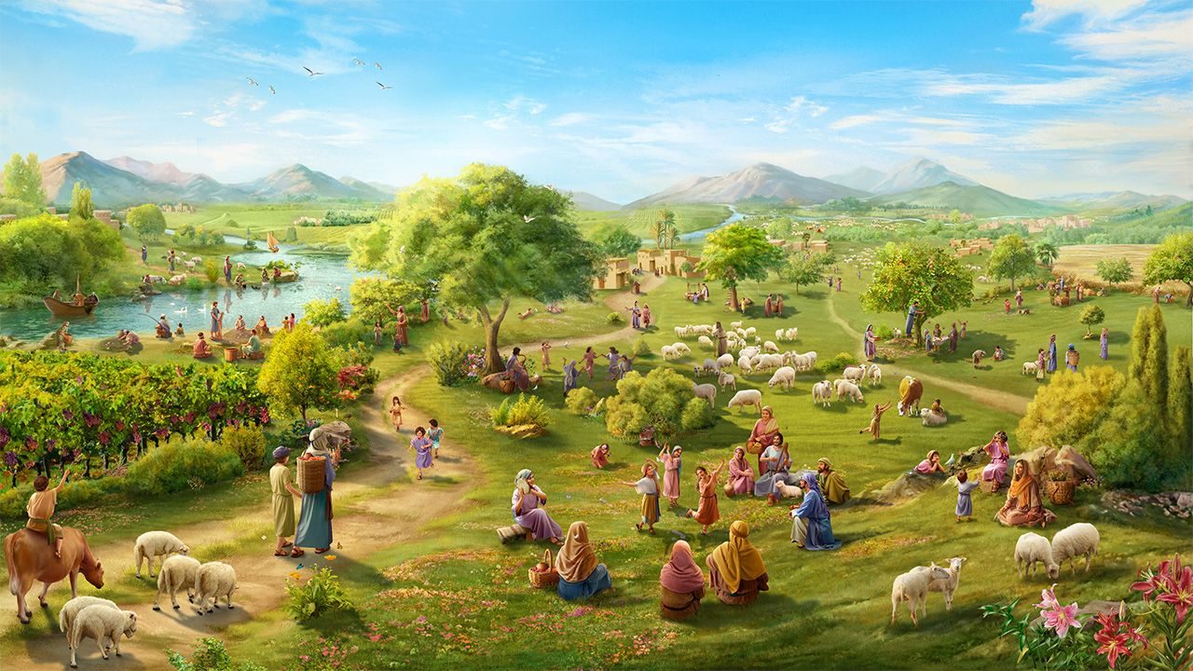
OLANDIRA MALONJEZO, NDI AMNDENDE A CHIYEMBEKEZO
Phunziro 9, November 29, 2025

Slide 2
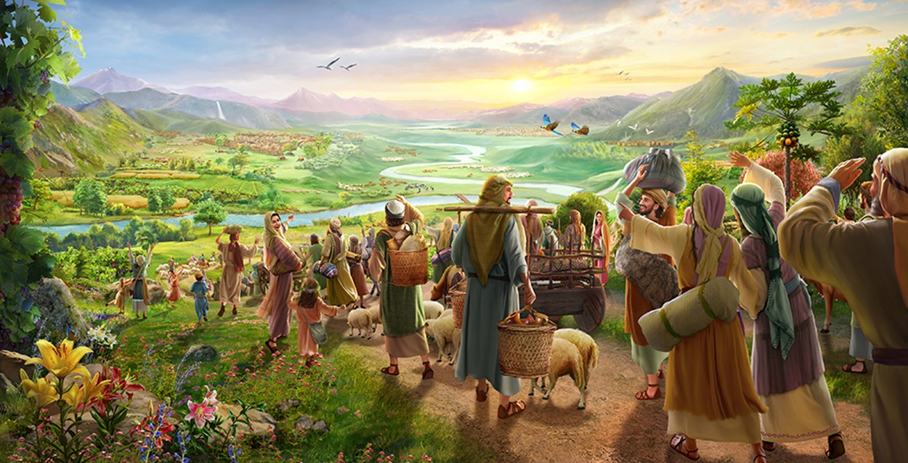
“Bwererani ku malo anu otetezedwa, inu amʼndende achiyembekezo;
ngakhale tsopano ndikulengeza kuti ndidzakubwezerani zabwino mowirikiza.” (Zakariya 9:12, CCL)

Slide 3
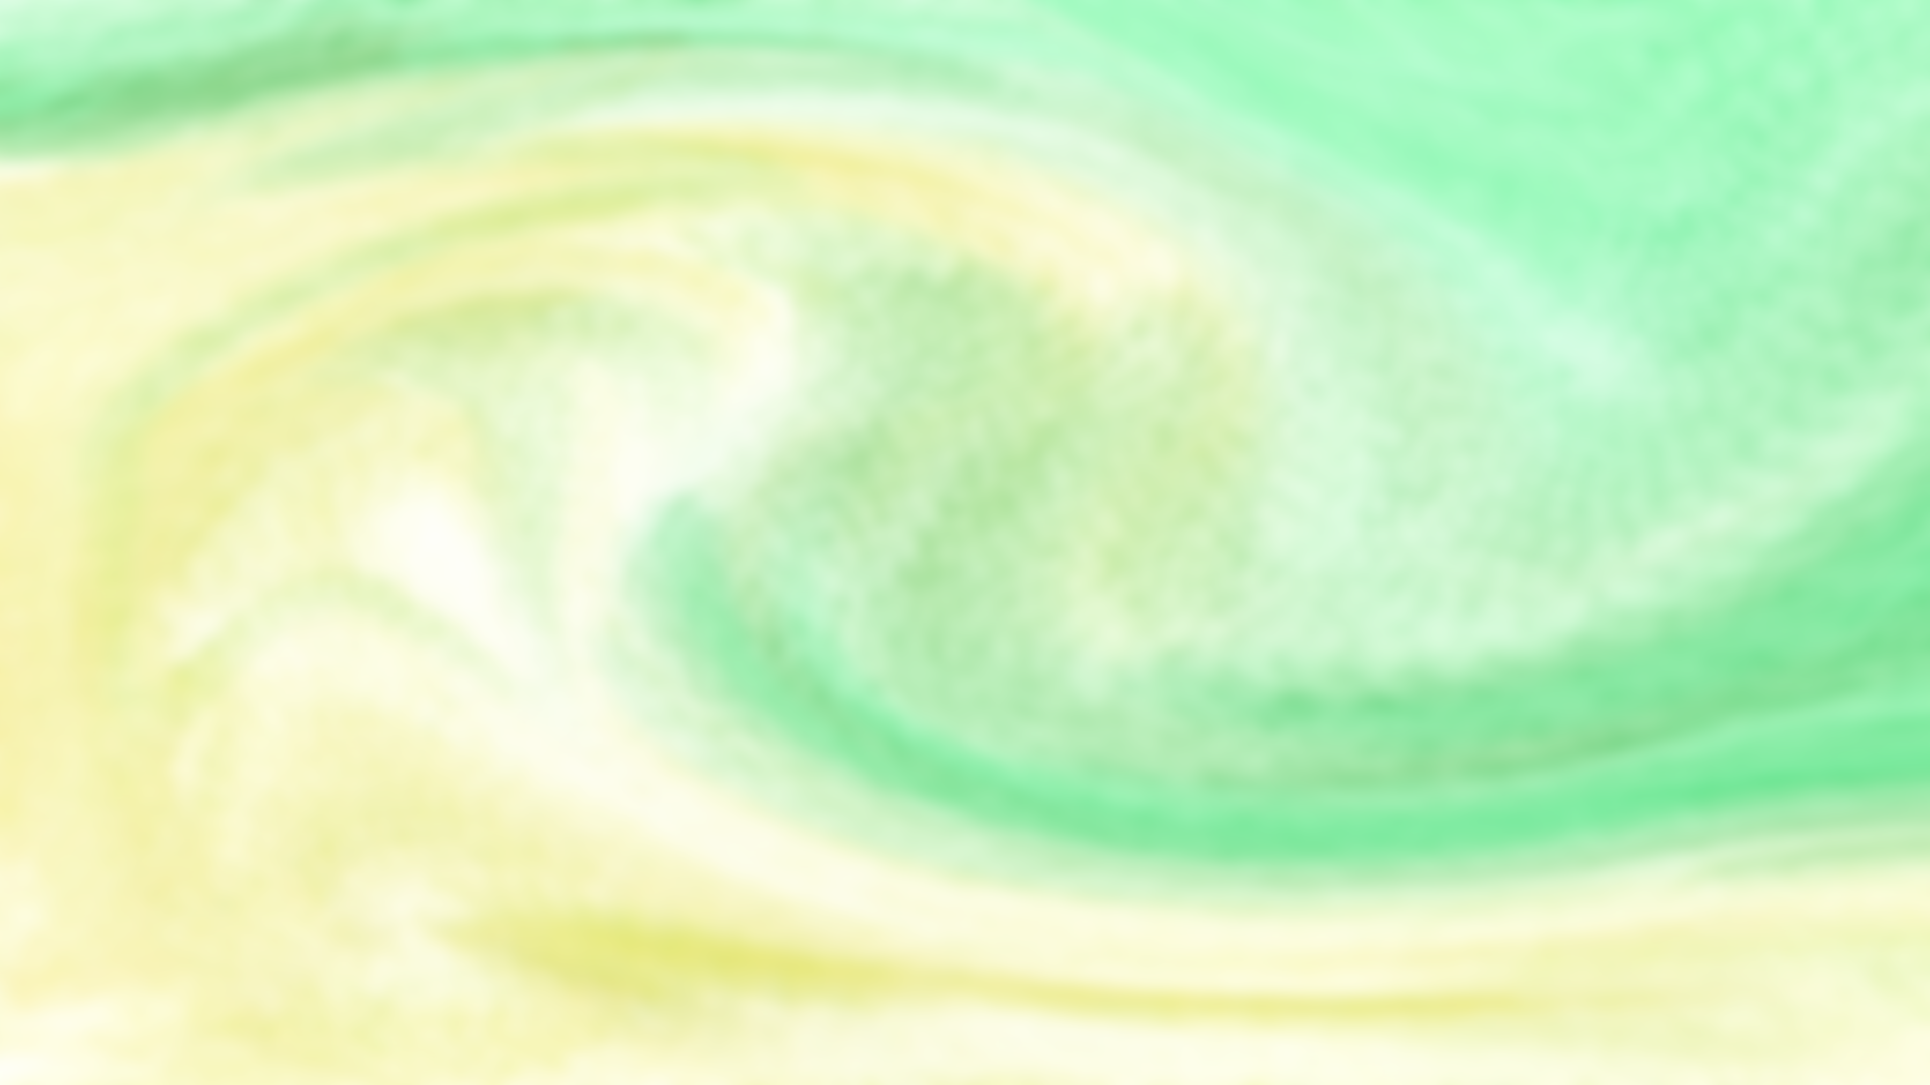
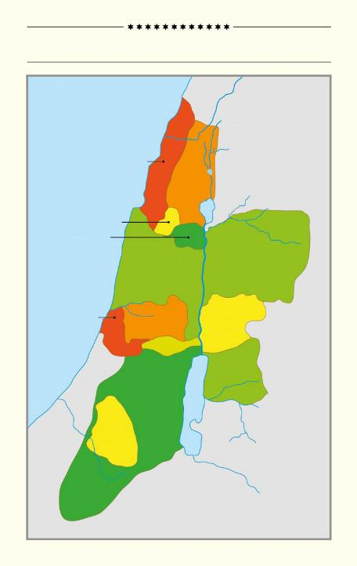
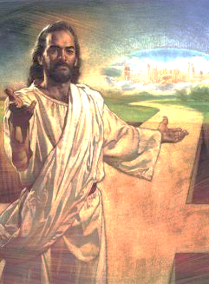
Gawo lalikulu la buku la Yoswa, kuchokera chaputala 13 mpaka 21, limalankhula za kugawa dziko la Kenaani pakati pa mafuko osiyanasiyana a Israeli.
MITUNDU 12 YA AISRAYELI
Mediterranean Sea
Pakati pa kutchula malo, anthu, ndi mafuko, tikutha kuona dziko limene linali kale cholowa cha Israyeli, koma limene panthawi yomweyo sanalilandire kwathunthu.
ASER
NEPHTHALI
Imfa ya Yesu imatitsimikizira kuti tsopano talandira dziko limene Adamu ndi Hava anataya. Komabe, tidakali “akapolo a chiyembekezo” cha kulandira dzikolo kwathunthu.
ZEBULON
ISSACHAR
MANASSEH
MANASSEH
Dziko limene linatayika
Dziko limene Mulungu amapereka
Ligonjetseni dzikolo
Sungani mphatsoyo
Malo obwezeretsedwa
DAN
A
EPHRAIM
GAD
BENJAMIN
RUBEN
B
JUDAH
C
SIMEON
B'
A'

Slide 4



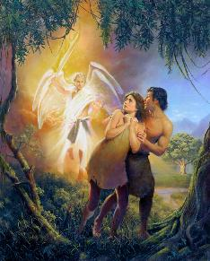
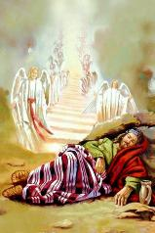
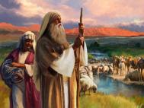

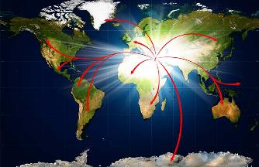
DZIKO LOTAYIKA
“Kotero Yehova Mulungu anatulutsa Adamu Mʼmunda wa Edeni kuti azilima mʼnthaka imene anachokera.” (Genesis 3:23)
Mulungu anasankha Adamu ndi Hava kukhala olamulira a dziko lapansi (Genesis 1:27-28) ndipo anawaika m’munda wa Edeni (Genesis 2:8 ).
Pamene iwo sanamvere Mulungu, anathamangitsidwa m’mundamo(Genesis 3:23). Iwo anali atataya ulamuliro wa Dziko Lapansi.
Koma Mulungu anali ndi dongosolo loti anthu abwezeretsedwe dziko limene anataya. M’gawo loyamba la dongosololi, Iye anapereka kwa Abrahamu, Isake, ndi Yakobo gawo laling’ono la dziko: Kenaani (Genesis13:14-15).
Pang’ono ndi pang’ono, kulanda dzikolo kunayenera kufalikira kufika padziko lonse, pamene chidziwitso cha Mulungu chidzafikira anthu ndi mitundu yonse (Yesaya 11:9).
Kusamvera kwa Israeli kunapangitsa kuti dongosolo loyambirira lisinthe. Mulungu anadzukitsa ana a Abrahamu kuchokera ‘miyala,’ kuti alandire malonjezono ake: ife (Luka 3:8; Ahebri 6:11-12).

Slide 5



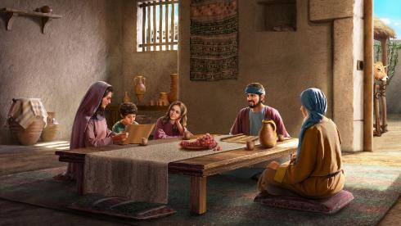
DZIKO LIMENE MULUNGU AMAPEREKA
“Dziko lapansi ndi la Yehova ndi zonse zimene zili mʼmenemo,
dziko ndi onse amene amakhala mʼmenemo;.” (Masalimo24:1)
Monga momwe Adamu ndi Hava sanachite chilichonse choti ayenere kulandira Munda wa Edeni, Abrahamu ndi zidzukulu zake sanachitenso chilichonse choti ayenere kulandira Dziko la Lonjezano. Linali mphatso yochokera kwa Mulungu.
Mphatso imeneyi tingaiyerekeze ndi nyumba ya lendi. Ngakhale kuti Israeli adatha kukhala mu Kanani, dzikolo linakhalabe la Mulungu (Masalmo 24:1).
Mwini nyumba ndi amene amasamalira denga, mipope ndi zina zotero. Momwemonso, Mulungu ndiye amene amapereka mvula, kuteteza zokolola, ndi zina, kuti Israeli akhale m’dziko limene Mulungu anawapatsa mwaulemu komanso mwamtendere..
Monga mu Edeni, panali lendi kuti “alipire”: kumvera (Levitiko 20:22 ). Inali nkhani ya ubale chabe: kukonda Mulungu ndi kusangalala ndi madalitso ake.
Dzulo, monga lero, ndi nkhani ya chikhulupiriro (Ahebri 11:9-13).

Slide 6
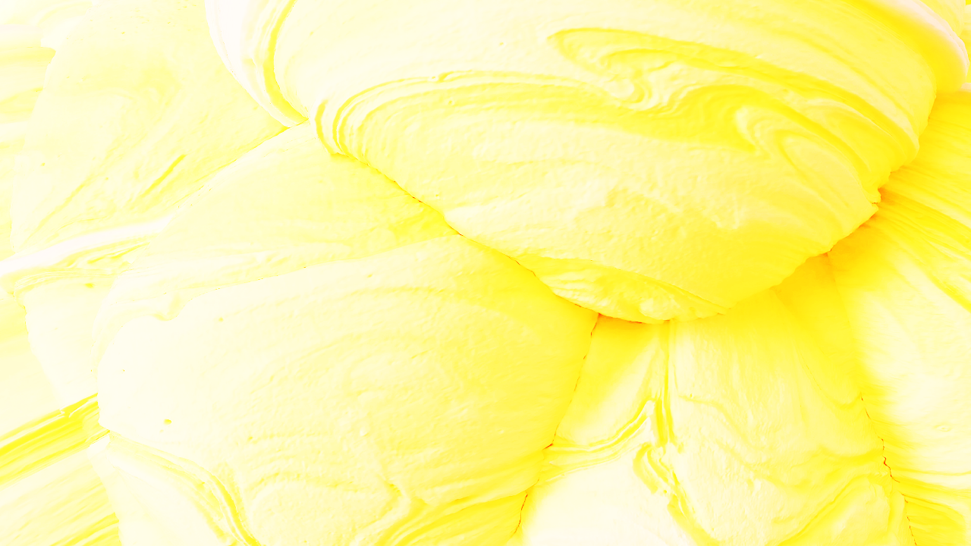

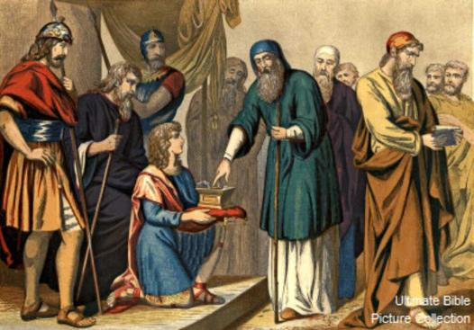
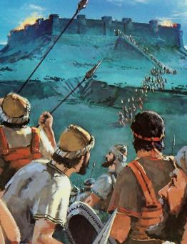
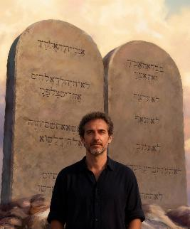

GONJETSA DZIKO
“Tsopano ugawire dziko limeneli mafuko asanu ndi anayi ndiponso theka la fuko la Manase, kuti likhale cholowa chawo.” (Yoswa 13:7).
Pamene Yoswa anali okalamba, Mulungu anamulamula kugawa dzikolo pakati pa mafuko a Israeli, kuphatikizapo madera amene anali asanagonjetsedwe (Yoswa 13:1-7).
Dzikolo linali lawo, koma ankafunikabe kuyesetsa kuti alilande. Mulungu sachita ntchito yekha popanda munthu; amafuna kuti ifenso tichite mbali yathu.
Ngakhale ankamenyera kuti apambane, kupambana kwawo sikunali chifukwa cha mphamvu zawo, koma chifukwa cha Mulungu (Deuteronomo 9:5). Monga Israeli, palibe chimene tingachite kuti tipeze chipulumutso kapena kulandira malonjezo (Aefeso 2:8–9; Agalatiya 3:29). Koma iwo ankamenya nkhondo… ife masiku ano tiyenera kuchita chiyani?
Akapulumutsidwa, Mulungu amafuna zinthu ziwiri kwa opulumutsidwawo: kumvera (Afilipi 2:12 ); ndi chiyamiko (Ahebri 12:28 ).

Slide 7

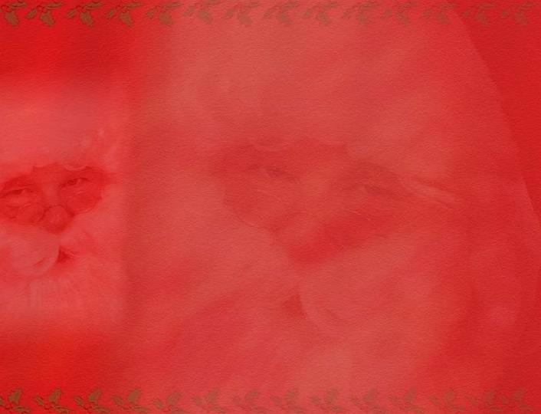
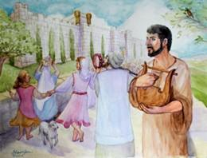
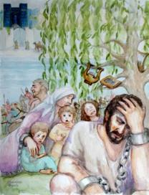
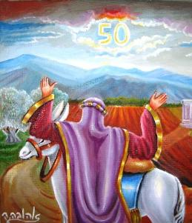
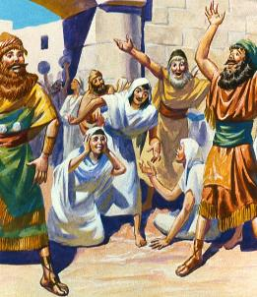
SUNGANI MPHATSO
““ ‘Malo asagulitsidwe mpaka muyaya chifukwa dzikolo ndi langa. Inu ndinu alendo okhala ndi Ine.” (Levitiko 25:23)
Akalandira cholowa, panali malamulo apadera okhudza kagwiritsidwe ntchito ka nthaka: chaka cha sabata ndi chaka choliza Lipenga.
Chaka cha Sabata, chomwe chinali kupititsa patsogolo mfundo ya Sabata pa mlingo waukulu, chinkalola nthaka kupumula (Levitiko 25:2-5 ). Kusasamala lamulo limeneli kunali chimodzi mwa zifukwa zomwe zinachititsa kuti Aisraeli akhale akapolo (2 Mbiri 36:20-21).
Chaka chaufulu chinali kubwezera malo kwa eni ake oyambirira, potero kuchepetsa kusiyana kwakukulu pakati pa anthu (Levitiko 25:10, 23, 40-41 ).
Ichi ndicho cholinga chachikulu cha uthenga wabwino: kuchotsa kusiyana pakati pa olemera ndi osauka, owalemba ntchito ndi wantchito, mwayi ndi osowa, kutiika tonse pamlingo wofanana pozindikira kufunikira kwathu kotheratu kwa chisomo cha Mulungu.

Slide 8

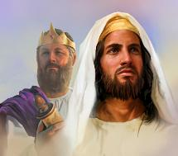
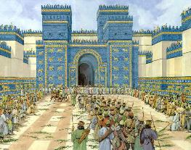
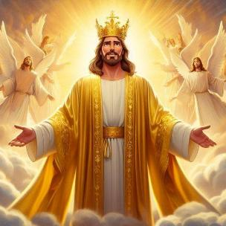
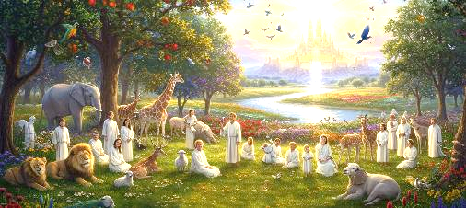
DZIKO LOPATIDWANSO
“They will live in the land I gave to my servant Jacob, the land where your ancestors lived. Iwo adzakhala mʼdziko limene ndinalipereka kwa mtumiki wanga Yakobo, dziko limene makolo anu ankakhalamo. Iwo ndi ana awo pamodzi ndi zidzukulu zawo adzakhala kumeneko ndipo Davide adzakhala mfumu yawo kwa muyaya. ” (Ezekiel 37:25)
Chifukwa cha kusamvera kwawo, Aisraeli anachotsedwa m’dziko lawo ndi kuponyedwa ku Babulo. Koma Mulungu sanawasiye.
Mulungu analonjeza kuwabwezera, kuwapatsa dzikolo kwamuyaya, ndi kuyika Davide monga mfumu yawo (Ezekieli 37:25). Koma Israeli sanalindire ndi dzikolo kwamuyaya, ndipo Davide anali atamwalira kale kwambiri. Kotero, ulosi uwu ukutanthauza chiyani?
Pamenepa Yesu akulengezedwa kuti ndiye Mfumu yeniyeni yolamulira kwamuyaya. Ndi Iye amene, kudzera m’magazi ake, amatitsimikizira cholowa chamuyaya.
Iye ndiye kukwaniritsidwa kwa malonjezano onse (Aroma 15:8; 2 Akorinto 1:20 ). Mwa Iye timalandira madalitso pano, ndipo m’tsogolo tidzalandira cholowa cholonjezedwa (1 Petro 1:3-4). Posachedwapa, mapazi athu adzalowa m’Dziko Lolonjezedwa.

Slide 9

“Pochita kusamvera Mulungu, Adamu ndi Hava anataya Edeni, ndipo chifukwa cha tchimo dziko lonse linatembereredwa. Koma ngati anthu a Mulungu akanatsatira malangizo ake, chonde ndi kukongola kukanabwezeredwanso ku dziko lawo. Mulungu mwiniyo anawapatsa malangizo okhudza kusamalira nthaka, ndipo iwo anayenera kugwirizana ndi Iye pobwezeretsa nthakayo. Kotero kuti dziko lonse, kutchera muchisamaliro cha Mulungu, likanakhala phunziro lamoyo la choonadi chauzimu. Monga mmene dziko limabala zipatso zake pamene titsatira malamulo achilengedwe, chimodzimodzinso mitima ya anthu inayenera kuwonetsa makhalidwe a Mulungu pomvera lamulo lake la chikhalidwe.”
EGW (Christ's Object Lessons, p. 289)

