Slide 1
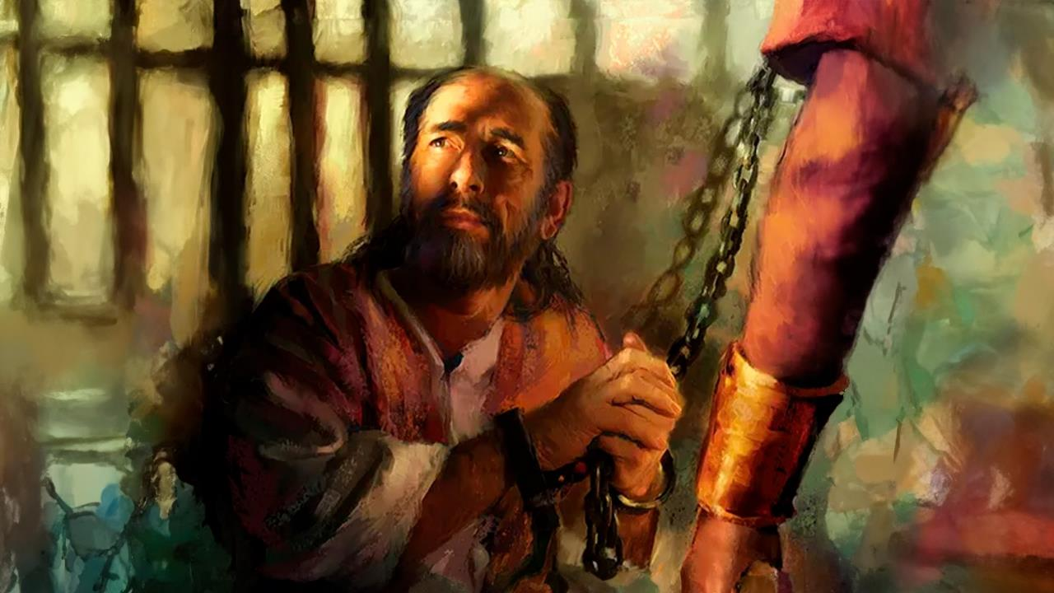
AMAZUNZIDWA KOMA OSATAYIDWA
Phunziro 1 January 3, 2026

Slide 2

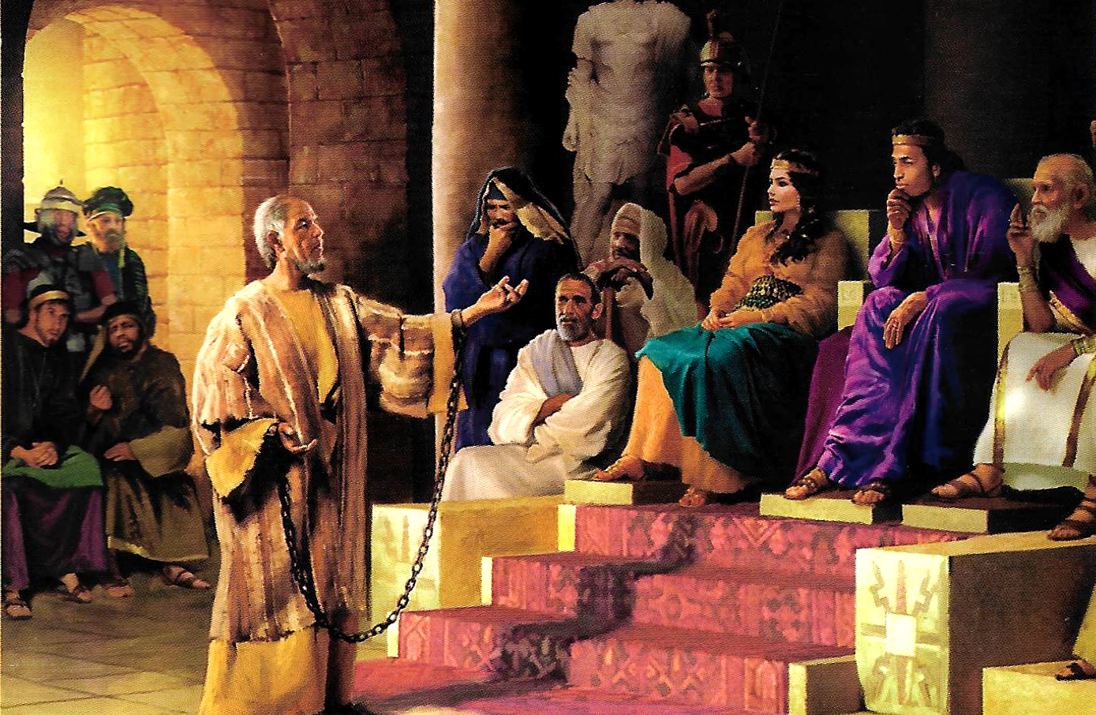
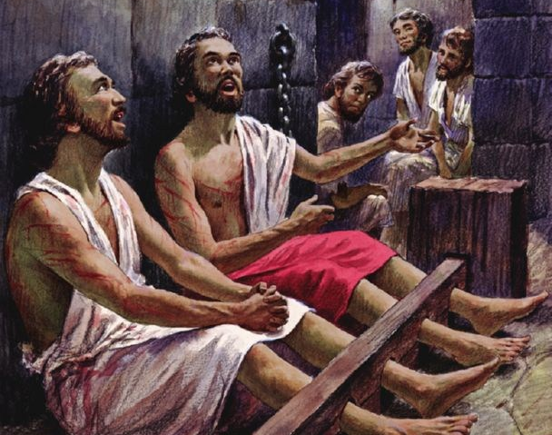
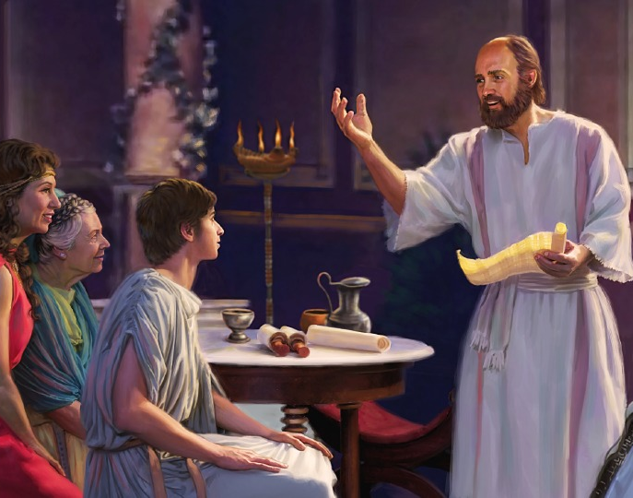
“Nthawi zonse muzikondwa mwa Ambuye. Ndikubwerezanso; muzikondwa!”
Afilipi 4:4, CCL

Slide 3

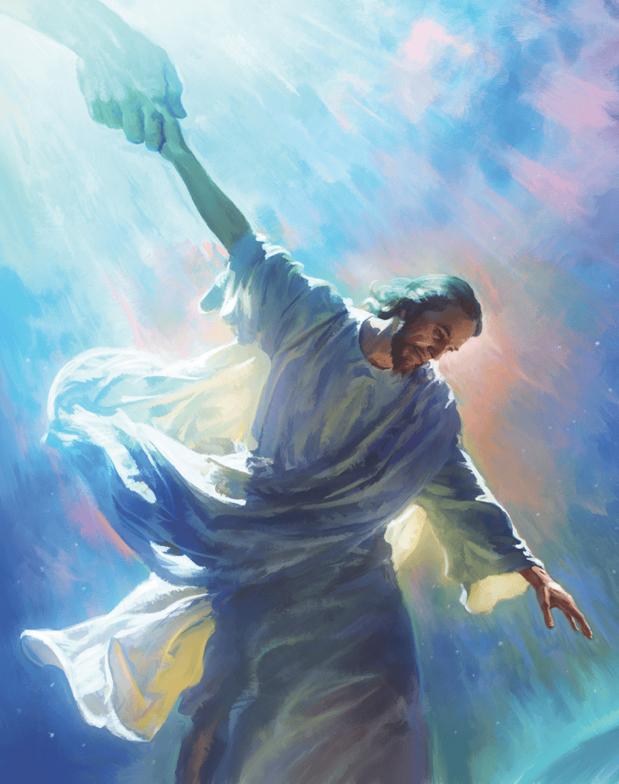


M’nthawi yonse ya utumiki wake, Paulo ankayesetsa kufotokoza kwa onse amene ankafuna kumumvera za Mmodzi yekha amene angathe kugwirizanitsa Kumwamba ndi Dziko lapansi: Yesu Khristu, Mpulumutsi.
Polembela akhristu a ku Filipi ndi a ku Kolose, iye anachita zonse zimene angathe kuti abweretse mpingo pafupi ndi Kumwamba, komanso kuti Akhristu ayandikirane wina ndi mnzake.
Pochita zimenezi, anatisonyeza mmene mpingo wa Mulungu masiku ano ungagwirizane ndi Kumwamba kuti ukwaniritse ntchito imene Yesu anatipatsa padziko lapansi.
Mlembi wa makalata:
Paulo anaikidwa mndende
Kazembe mu unyolo
Olandira:
Mbiri ya Afilpi
Mbiri ya AKolose
Mipingo ya ku Filipi ndi Kolose

Slide 4
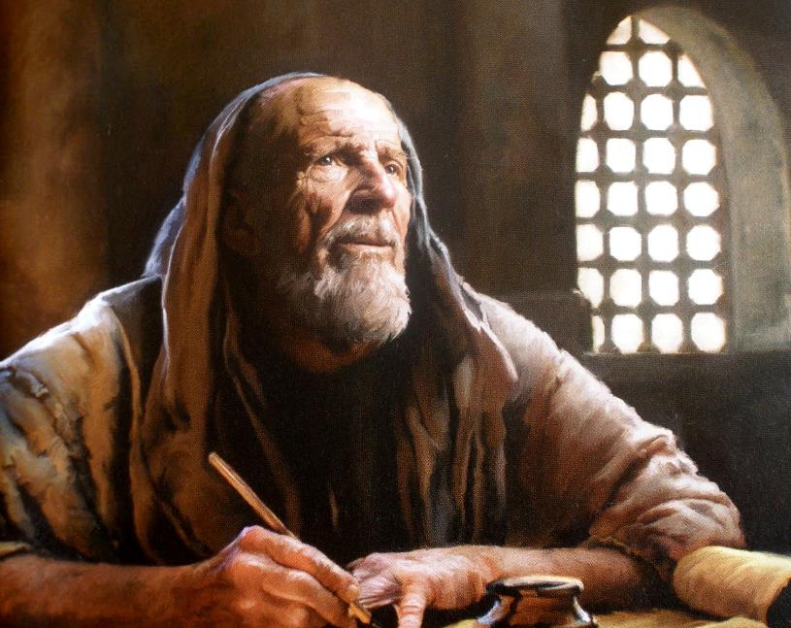

WOLEMBA MAKALATA

Slide 5

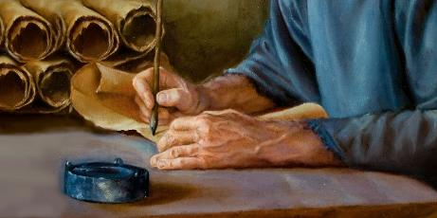
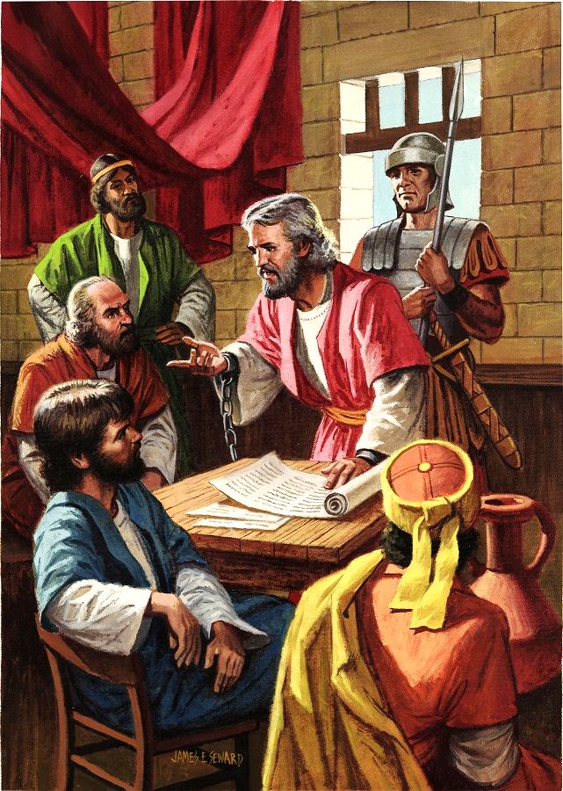
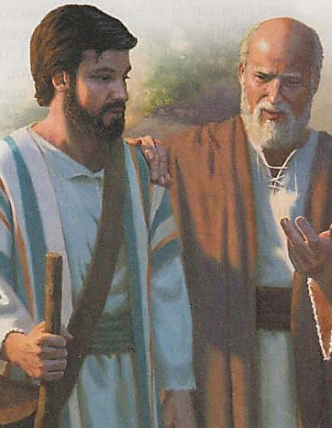
PAULO ANAIKIDWA MNDENDE
“Paulo, wandende chifukwa cha Khristu Yesu, ndi Timoteyo mbale wathu, kwa Filemoni wokondedwa ndi wantchito mnzathu.” (Filimoni 1:1)
Pa nthawi ya kumangidwa kwake koyamba ku Roma – pakati pa chaka cha 60 ndi 62 AD — Paulo analemba makalata osachepera asanu: kwa Aefeso, kwa Afilipi, kwa Akolose, kwa Filemoni, komanso kwa mpingo wa ku Laodikeya (yomwe siinafike kwa ife lero).
Popeza panalibe milandu yayikulu yotsutsana naye, analoledwa kukhala m’nyumba yobwereka, ngakhale ankayang’aniridwa nthawi zonse ndi msilikali wa Aroma (Machitidwe 28:16). Izi zinam’patsa mwayi wopitiriza kulalikira Uthenga Wabwino, ngakhale kwa Alonda a Mfumu (Afil. 1:13).
Tikayang’ana makalata ake, titha kuona kuti Paulo anali ndi abwezi ambiri ogwira nawo ntchito (Akolose 4:7–14; Filemoni 23–24). Ankalumikizananso ndi anthu okhala m’nyumba ya Kaisara (Afilipi 4:22).
Paulo ankayembekezera kuti adzamasulidwa posachedwa (Afilipi 22 ) chiyembekezo chimene analibenso m’ndende yachiwiri ( 2 Timo. 4:6 ).

Slide 6

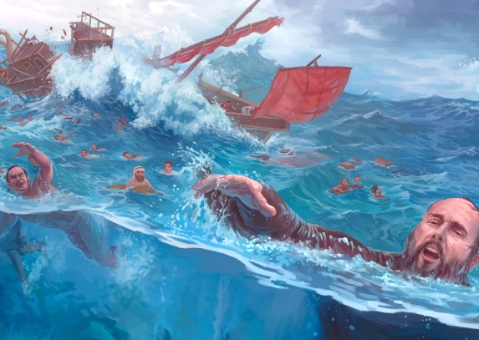
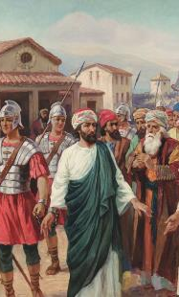
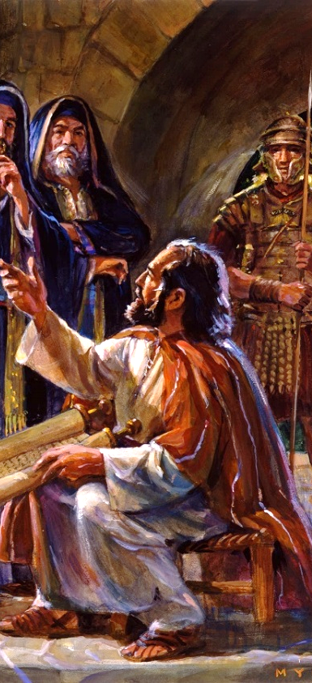
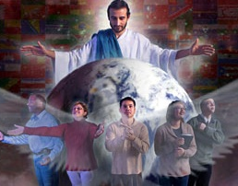
KAZEMBE MU UNYOLO
“Ndine kazembe wa Uthenga Wabwinowu ngakhale ndili womangidwa mʼndende. Pempherani kuti ndilalikire mopanda mantha, monga ndiyenera.” (Aefeso 6:20)
Kuyambira pomwe adasankha kukhala kazembe wa Khristu, moyo wa Paulo sunali wophweka (2 Akorinto 6:4-5).
Baibulo limalemba za kumangidwa katatu kwa Paulo asanapite ku Roma: ku Filipi (Machitidwe 16:22–24), ku Yerusalemu (Machitidwe 23:10), ndi ku Kaisareya (Machitidwe 23:33–35). Koma, n’zoonekeratu kuti panalinso kumangidwa kwina kooposa kumeneku (2 Akorinto 11:23).
M’masautso onsewa, Paulo sanadzionepo ngati munthu wopanda mphamvu (2 Akorinto 4:7–9). Ngakhale sanathe kulalikira momasuka, anadziona ngati ‘kazembe womangidwa ndi unyolo’ (Aefeso 6:20).
Makhalidwe a Paulo amatiphunzitsa kuti pamene tikukumana ndi zovuta chifukwa cholalikira Uthenga Wabwino, tiyenera kudalira Mulungu kwathunthu; kusunga Mawu ake nthawi zonse m’maganizo mwathu (2 Timoteyo 2:15); komanso kumamatira kwa Mzimu Woyera, Mtonthozi amene amatipatsa mphamvu ndi kulimba mtima (Zakariya 4:6, Mtonthozi amene amatipatsa mphamvu ndi kulimbika mtima ( Zekariya 4:6 ).

Slide 7
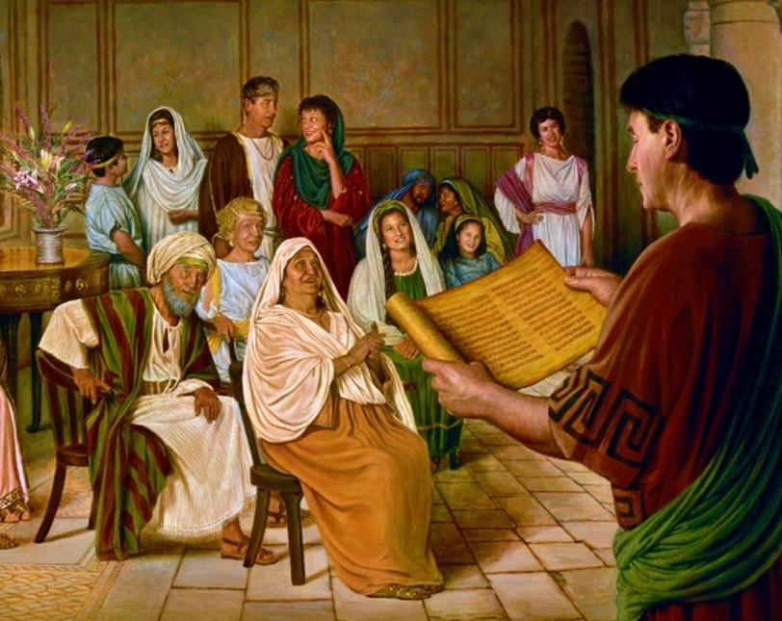

OLANDIRA

Slide 8

“Mtumwi Paulo ankadziona ali ndi udindo waukulu kwambiri kwa anthu amene anatembenukira kwa Mulungu kudzera mu utumiki wake. Koposa zonse, iye ankalakalaka kuti akhale okhulupirika, kuti, monga iye ananenera "kuti ndikondwere m'tsiku la Khristu," iye anati, "kuti sindinathamange pachabe, kapena sindinagwire ntchito pachabe" (Afilipi 2:16). Iye ankachita mantha poganizira zotsatira za utumiki wake. Ankadziwa kuti ngakhale chipulumutso chake chingakhale pa chiopsezo ngati atalephera kuchita udindo wake, komanso ngati mpingo sungagwirizane naye pa ntchito yopulumutsa miyoyo.”
EGW (The Acts of the Apostles, p. 206)

Slide 9

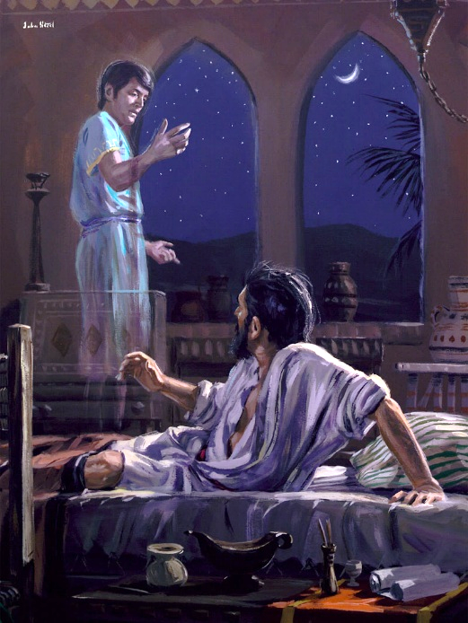
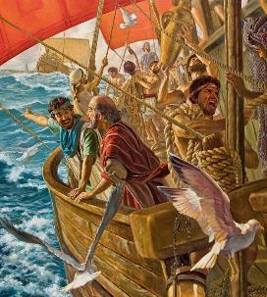
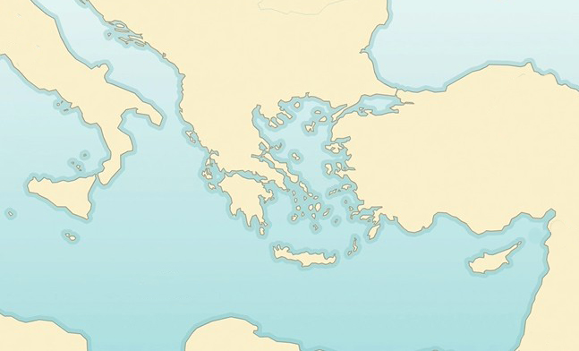

MBIRI YA FILIPI
“Nthawi ya usiku Paulo anaona masomphenya, munthu wa ku Makedoniya atayimirira ndi kumupempha kuti, “Bwerani ku Makedoniya, mudzatithandize.’ ” (Machitidwe 16:9)
Province of Macedonia
Filipi
Neapoli
Bituniya
Paulendo wake wachiwiri wautumiki wake, zokonzekera za Paulo zinasintha. Mzimu Woyera anali kutsogolera mapazi ake (Machitidwe 16: 6-12)
Samotrake
X
Trowa
Musiya
Galatiya
Frugiya
Paulo anapita ku Frugiya (6a)
Sanathe kulalikira kumeneko kapena ku Galatiya (6b)
Anafika ku Musiya (7a)
Anayesetsa kupita ku Bituniya koma sanakwanitse (7b)
Anapita ku Trowa kumene anaona masomphenya (8-10)
Anakwera sitima yapamadzi kupita ku Samotrake (11a)
Kuchokera kumeneko kupita ku Neapoli (11b)
Kumapeto anafika ku Filipi (12)
Machitidwe 16:6-12
Filipi ndi malo amene Mzimu Woyera anasankha kuti uthenga wabwino uyambire kulalikidwa ku Ulaya. Mzindawu unali wa Aroma kwathuthu, ndipo anthu ake anali nzika za Roma mwachibadwa komanso sankalipira msonkho.

Slide 10

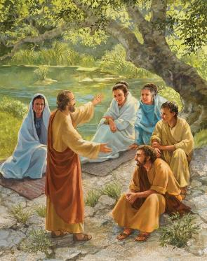
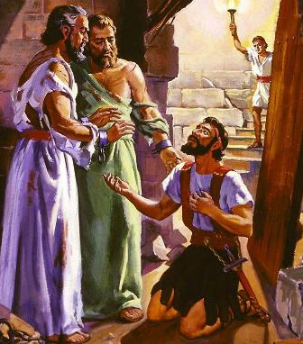
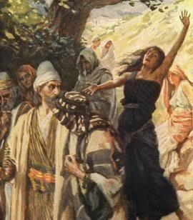
MBIRI YA FILIPI
“Nthawi ya usiku Paulo anaona masomphenya, munthu wa ku Makedoniya atayimirira ndi kumupempha kuti, “Bwerani ku Makedoniya, mudzatithandize.” (Machitidwe 16:9)
Monga mwa chizolowezi Paulo akafika m’mzinda watsopano akapita koyamba ku sunagoge. Koma ku Filipi kunalibe sunagoge! Choncho pa Sabata, iwo anapeza malo opempherera ndipo kumeneko analalikira kwa akazi amene anasonkhana pamalopo (Machitidwe 16:13).
Pamsonkhanowu panatuluka munthu woyamba kutembenuka ku Ulaya : Lydia. Anabatizidwa, pamodzi ndi banja lake lonse (Machitidwe 16:14-15).
Koma mdani sanangokhala chete. Iye anagwiritsa ntchito mtsikana wolosera zam’tsogolo kuti asokoneze maganizo a anthu, podziyesa ngati akuthandiza Paulo (Machitidwe 16:16–17). Mtsikanayo atamasulidwa ku mzimu umenewo, mavuto a Paulo ndi Sila anayamba ( Machitidwe 16:18-24 ).
Zotsatira zake zinali kutembenuka kwa woyang’anira ndende ndi banja lake (Machitidwe 16:25–33). Palibe kukayika kuti Uthenga Wabwino unalowa ku Ulaya ndi mphamvu komanso motsogozedwa ndi Mzimu Woyera.

Slide 11

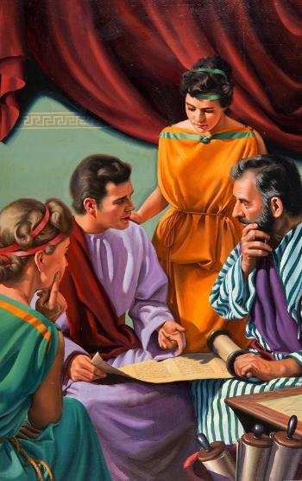
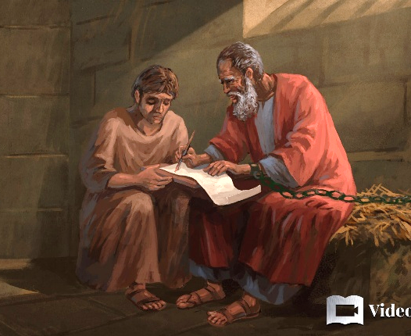
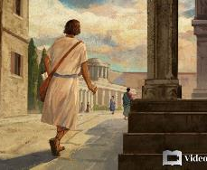
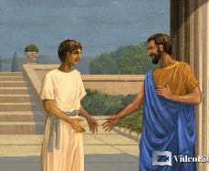
MBIRI YA KOLOSE
“Inu munaphunzira zimenezi kuchokera kwa Epafra, mtumiki mnzathu wokondedwa, amene ndi mtumiki wokhulupirika wa Khristu mʼmalo mwathu.” (Akolose1:7)
Epafra anali mnzake wa Paulo pa nthawi imene anali m’ndende ku Roma (Filemoni 23). Iye anali wochokera ku Kolose (Akolose 4:12), ndipo ndiye amene anayambitsa kulalikira Uthenga Wabwino mumzinda umenewo (Akolose 1:7).
Mzinda wa Kolose unali m’chigawo cha Frugiya, pafupi ndi Laodikeya ndi Heriapoli, kumene Epafra ankalalikiranso Akolose 4:13). Munali Ayuda ambiri mumzindawo. Mmodzi mwa Ayuda odziwika kwambiri amene ankakhala kumeneko anali Filemoni, mnzake wa Paulo pantchito ya utumiki, ndipo mpingo unkasonkhana m’nyumba yake (Filemoni 1–2).
Mmodzi mwa akapolo a Filemoni, dzina lake Onesimo, anathawa kupita ku Roma, kumene anakumana ndi Paulo ndipo analandira Yesu ngati Mpulumutsi wake (Filemoni 10–11). Pobwezera Onesimo kwa mbuye wake, Paulo anasonyeza mmene ubale uyenera kukhalira pakati pa ambuye ndi akapolo, kapena pakati pa akuluakulu ndi amene ali pansi pawo (Filemoni 12–17).

Slide 12

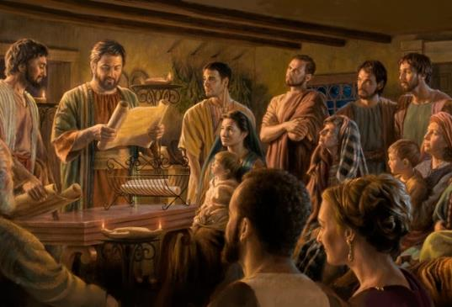
MIPINGO YA KU FILIPI NDI KU KOLOSE
“Paulo ndi Timoteyo, atumiki a Khristu Yesu.
Kulembera anthu onse oyera mtima a ku Filipi amene ali mwa Khristu Yesu, pamodzi ndi oyangʼanira ndi atumiki awo.” (Afilipi 1:1)
Mawu oyamba a makalata a Paulo kwa Afilipi ndi Akolose, omwe ali ofanana kwambiri, amatithandiza kuona zinthu ziwiri zofunika kwambiri (Afilipi 1:1; Akolose 1:1-2 )
Mʼmaso mwa Mulungu, mamembala a mpingo ndi oyera mtima ndi okhulupirika, ngakhale ali ndi zolakwa zawo
Mu mpingo muli dongosolo, pamene ena mwa mamembala ake ali ndi ulamuliro ndi udindo kuposa ena:
Paulo ndi mtumwi, mtsogoleri wapamwamba
Timoteyo ndi wothandizana naye (m'busa)
Akulu ampingo ndi atsogoleri am'deralo (akulu)
Atumiki amayendetsa mpingo (madikoni)
Ali m’ndende, Paulo anathokoza Afilipi chifukwa cha thandizo limene anamutumizira (Afilipi. 4:18 ).
Kwa Akolose, amatumiza anzake kuti akawatonthoze (Akolose 4:7-9).

Slide 13
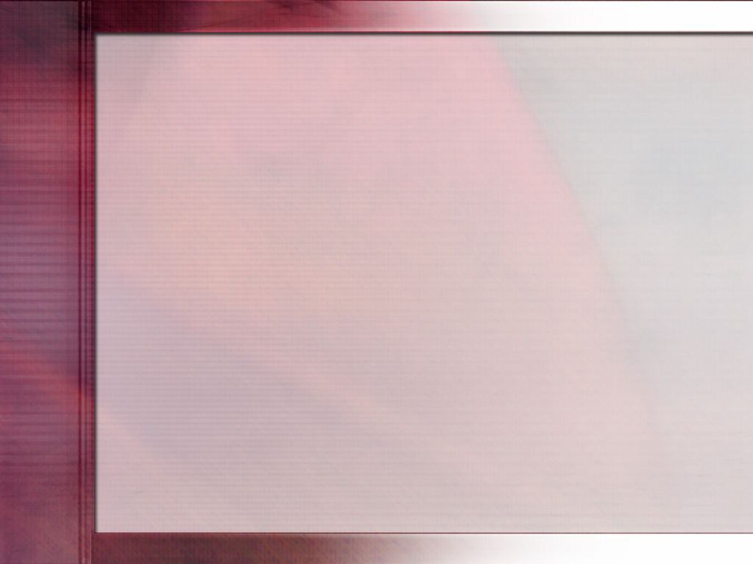
Tiyeni tiyang’ane pang’ono pa zomwe Paulo anakumana nazo. Pa nthawi imene zinkaoneka ngati ntchito ya mtumwiyu inali yofunika kwambiri polimbikitsa mpingo womwe unkavutika ndi kuzunzidwa, ufulu wake unalandidwa ndipo anamangidwa m’ndende. Koma imeneyo inali nthawi yeniyeni imene Ambuye ankagwira ntchito yake. Ndipo panthawiyi panapezeka chipambano chamtengo wapatali kwambiri. Pamene zinkaoneka kuti Paulo sangachite zambiri, ndipamene choonadi chinapeza njira yolowera m’nyumba ya mfumu. Sanali malangizo ake amphamvu amene anakopa anthu akuluakulu amene aja, koma unyolo wake. Kudzera mu kumangidwa kwake, iye anakhala wopambana chifukwa cha Khristu. Kupirira ndi kudzichepetsa kwake pa nthawi yakumangidwa kwake popanda chifukwa kwanthawi yayitali kunapangitsa anthuwo kuyamba kuganizira mozama za khalidwe lake
EGW (Reflecting Christ, December 10)

