Slide 1
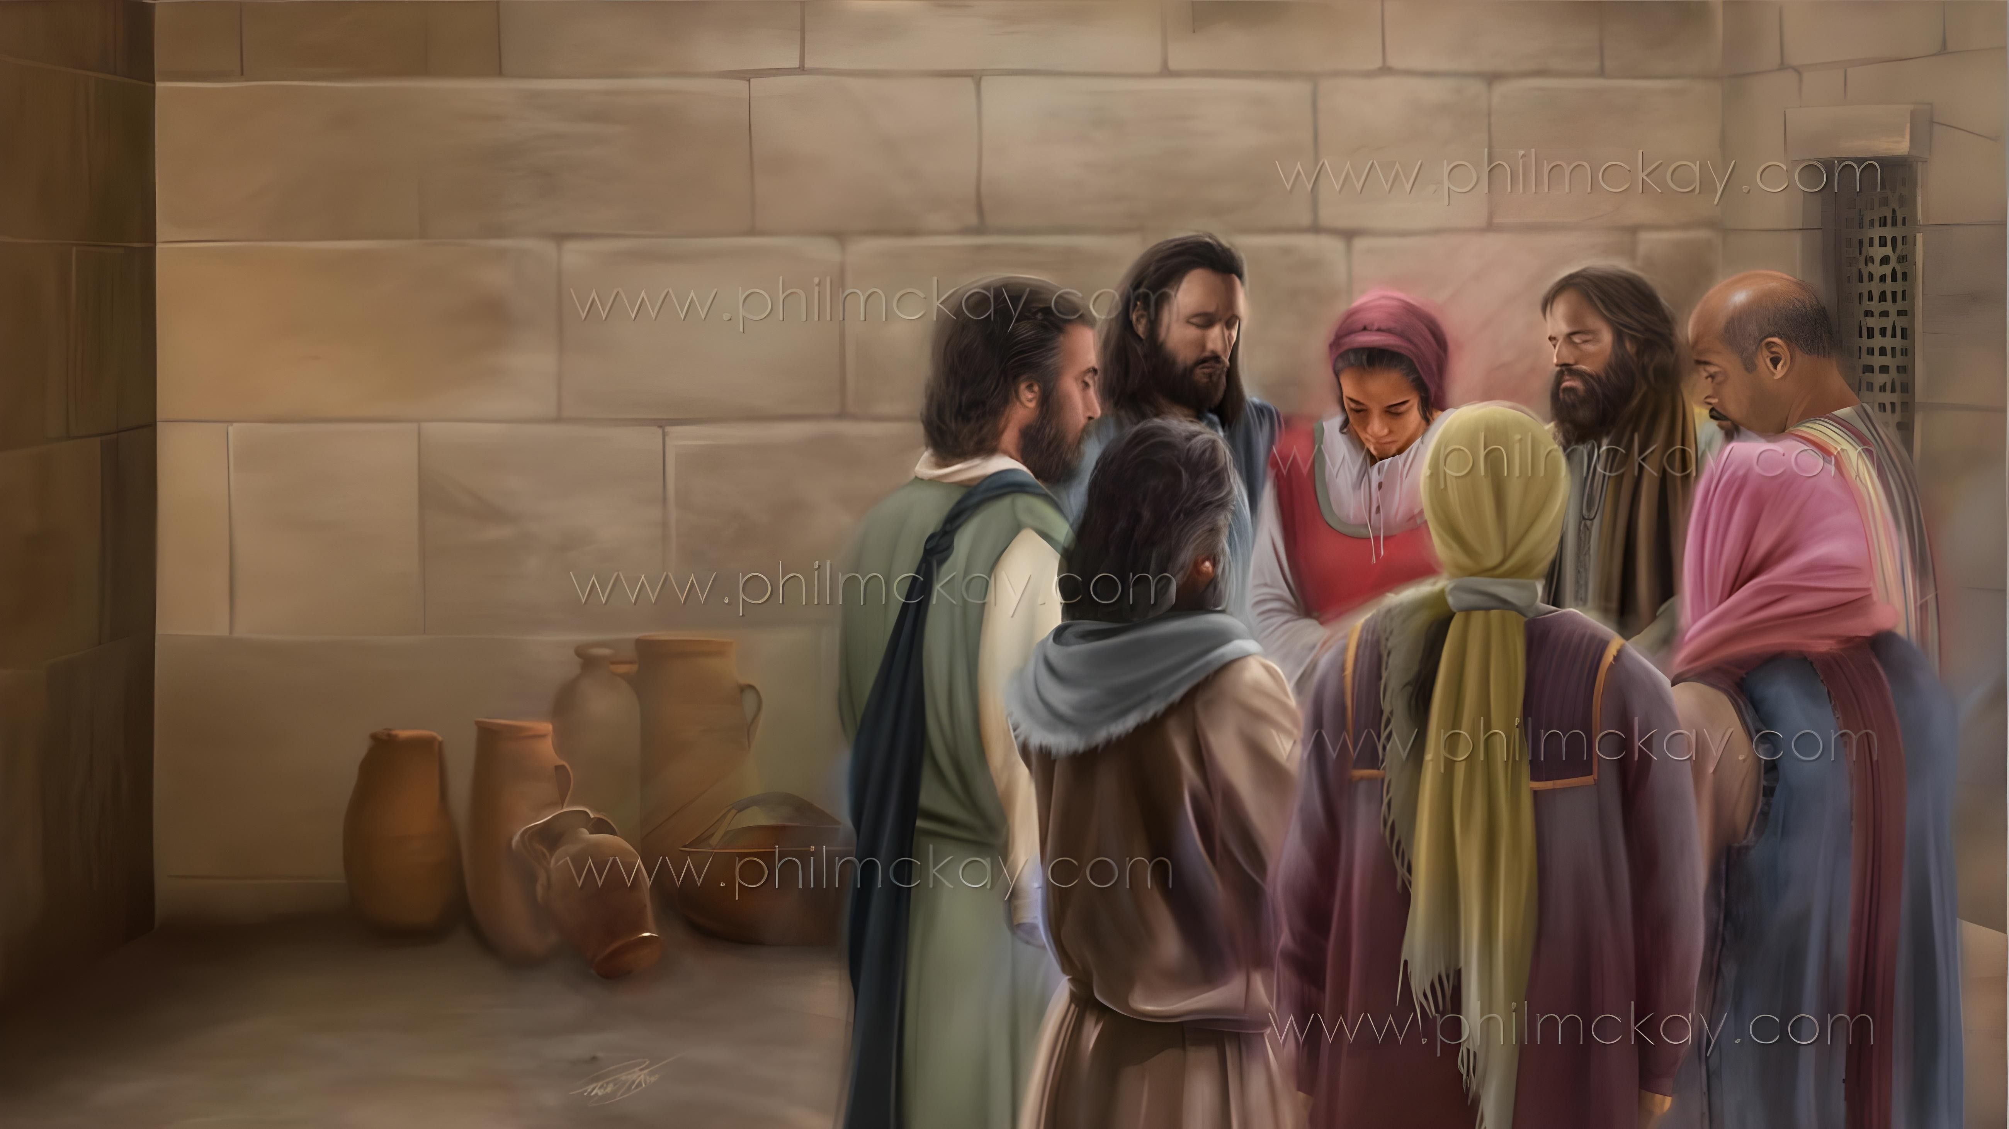
ZIFUKWA ZOPEREKERA CHIYAMIKO NDI PEMPHERO
Phunziro 2, January 10, 2026

Slide 2


“Sindikukayika konse kuti Iye amene anayamba ntchito yabwino mwa inu adzayipitiriza ndi kuyimaliza mpaka pa tsiku la kubweranso kwa Khristu Yesu.”
Afilipo1:6, CCL

Slide 3

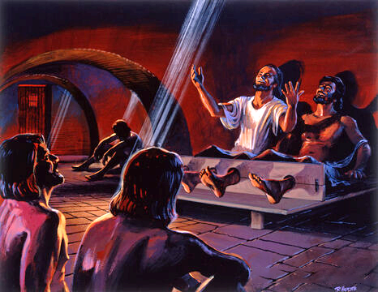
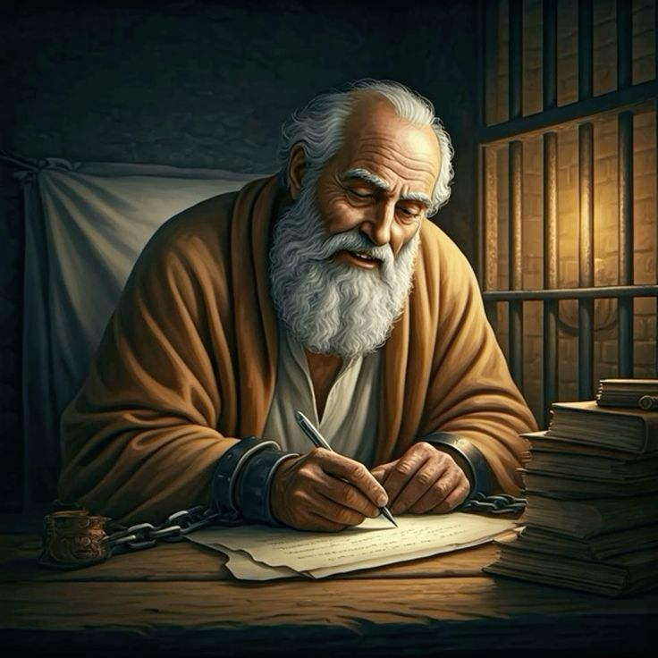







Nthawi zimenezi sizinali zophweka kwa Paulo. Zikanakhala zosavuta kuti ataye mtima chifukwa chotayika ufulu wake.
Koma, monga momwe analira mu nyimbo m’ndende yoopsa ya ku Filipi, Paulo anapezanso zifukwa zambiri zoyamika Mulungu ndi kuzigawana ndi abale ndi alongo ake ku Filipi ndi ku Kolose.
Kumangidwa kwake sikunamulepheretse kulankhulana ndi Atate wake, ndi kupembedzera ena kudzera mu pemphero.
Zifukwa zoyamika ndi kupemphera m’kalata yopita kwa Afilipi:
Zifukwa Zoperekera Chiyamiko (Afilipi 1:3-8)
Zopempha mu Pemphero (Afilipi 1:9-11)
Kuyamika ndi kupemphera pa nthawi zovuta (Afilipi 1:12-18)
Zifukwa zoyamika ndi kupemphera mu kalata yopita kwa Akolose:
Zifukwa zokhalira oyamikira (Akolose 1:3-8)
Zopempha mu Pemphero (Akolose 1:9-12)

Slide 4
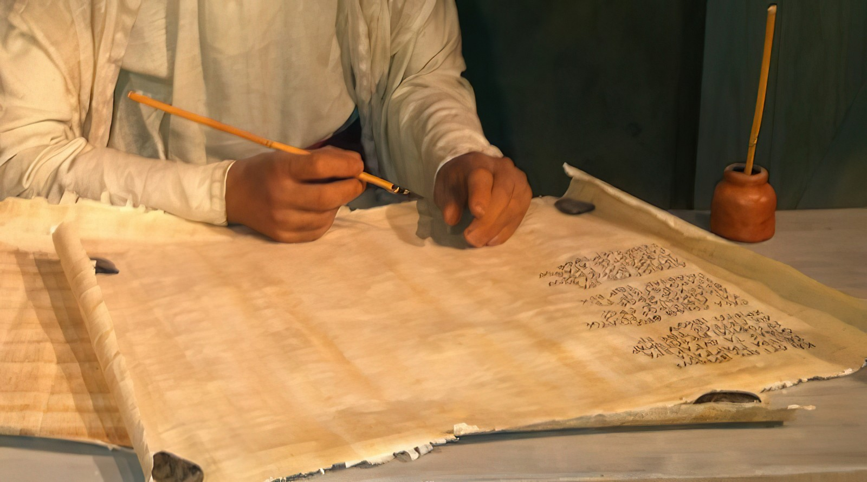
Zifukwa Zoyamika ndi Kupemphera mu Kalata yopita kwa Afilipi

Slide 5


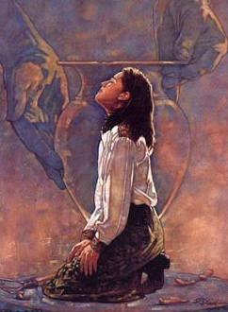
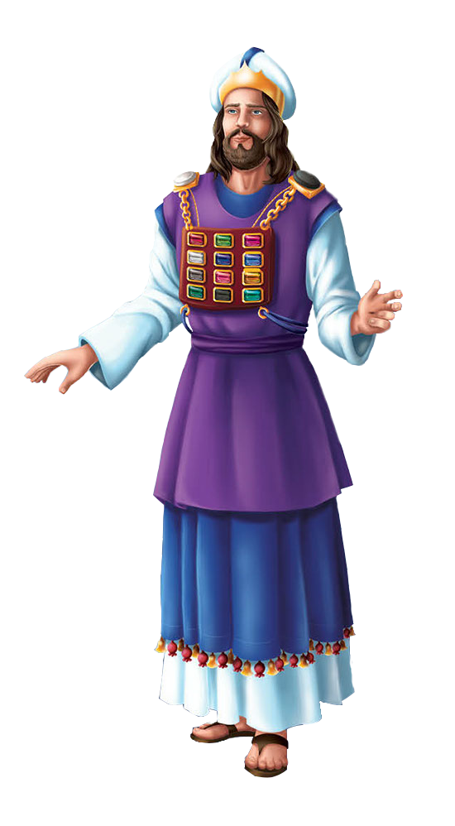
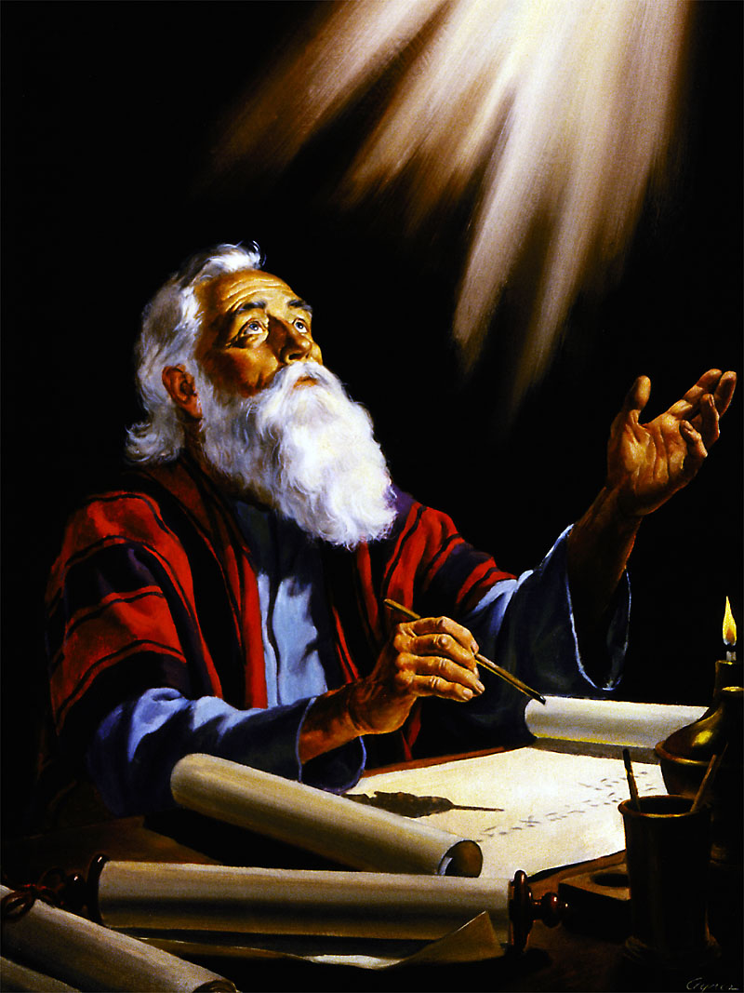
ZIFUKWA ZOPEREKERA CHIYAMIKO
“Sindikukayika konse kuti Iye amene anayamba ntchito yabwino mwa inu adzayipitiriza ndi kuyimaliza mpaka pa tsiku la kubweranso kwa Khristu Yesu.” (Afilipi 1:6)
Paulo anayamba kalata yake poyamika Mulungu chifukwa cha okhulupirira a ku Filipi (Afilipi 1:3), amene ankawakonda kwambiri (Afilipi 1:8).
Monga momwe mkulu wa ansembe ankavala chapachifuwa chake, pafupi ndi mtima wake, mayina a mafuko a Israyeli analembedwa pa miyala yamtengo wapatali pamene ankaima pamaso pa Mulungu, chimodzimodzinso Paulo ankanyamula “m’mtima mwake” chiwalo chilichonse cha mpingo pamene ankawayimira pamaso pa Mulungu m’pemphero (Afilipi 1:7).
Kuyamikira kwake kunaphatikizapo mfundo yakuti Afilipi anakhalabe okhulupirika ku Uthenga Wabwino, ndipo Mulungu ankawakonza ndi kuwayeretsa tsiku ndi tsiku (Afilipi 1:5-6).
Chifukwa chachitatu choyamikira chinali chakuti Afilipi anagawana naye “pa maunyolo ake, m’chitetezo ndi chitsimikiziro cha Uthenga Wabwino.” ( Afilipi 1:7 )

Slide 6


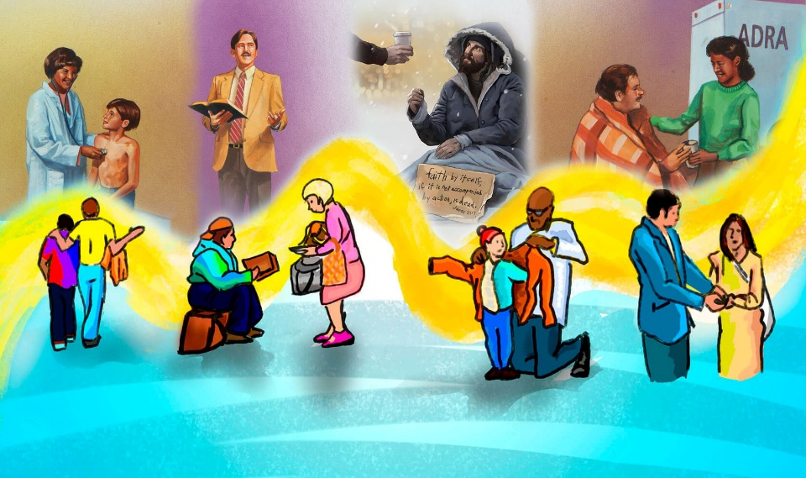
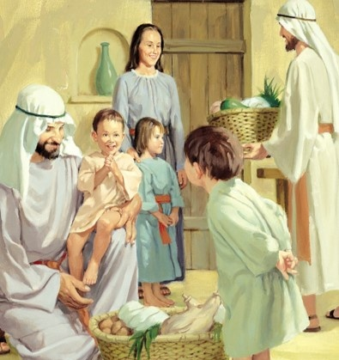
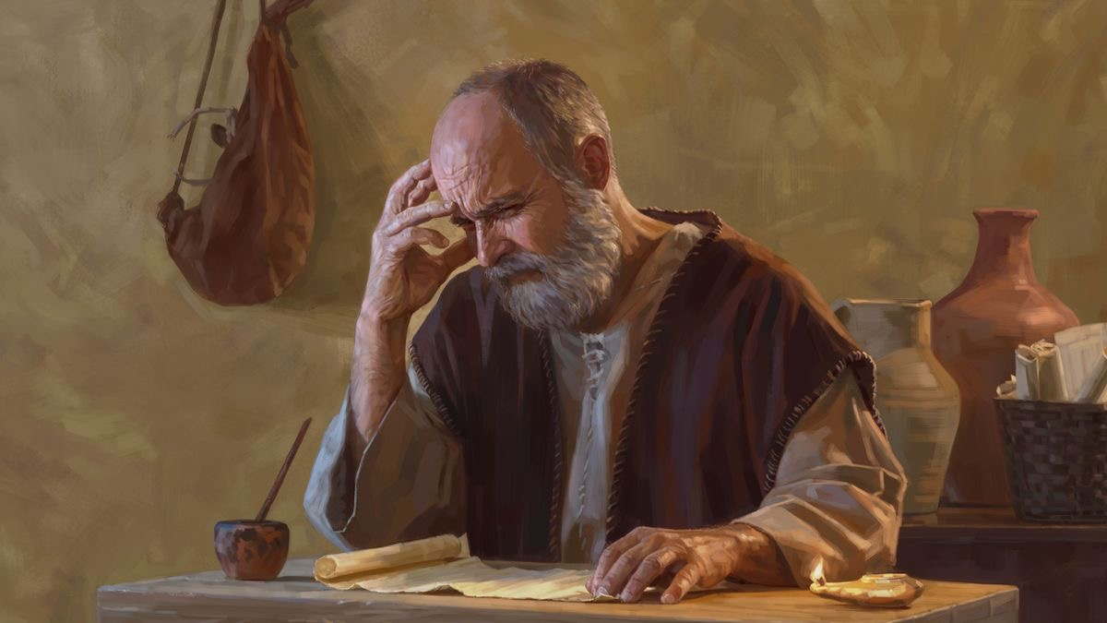
ZOPEMPHA MU PEMPHERO
“Ndipo pemphero langa ndi lakuti chikondi chanu chipitirire kukulirakulira pa chidziwitso ndi kuzama mʼmaganizo, kuti mukhoza kuzindikira chabwino koposa zonse ndi chiti kuti muthe kukhala wopanda chodetsa ndi wopanda chilema kufikira tsiku la Khristu. Ndipo moyo wanu udzakhala odzazidwa ndi chipatso cha chilungamo chimene chimachokera mwa Yesu Khristu. Pakuti zimenezi zidzapereka ulemerero ndi matamando kwa Mulungu. (Afilipi 1:9-11)
Titha kuona chilimbikitso cha pemphero la Paulo ngati “zifukwa zomangilirana” (Afilipi 1:9-11):
Chikondi chanu chichuluke koposa
Izi zidzakupatsani nzeru
Mudzazindikira zabwino kwambiri
mudzakhala oyera ndi owongoka
Mudzabala zipatso kudzera mwa Yesu Khristu
Zimenezi zidzabweretsa ulemerero ndi chitamando kwa Mulungu
Kodi chikondi chathu ‘chingachuluke bwanji’? Ndichifukwa chiyani zimenezi zili zofunika kwambiri pa moyo wachikhristu?

Slide 7
KUYAMIKIRA NDI KUPEMPHERA PANTHAWI YOVUTA

Slide 8

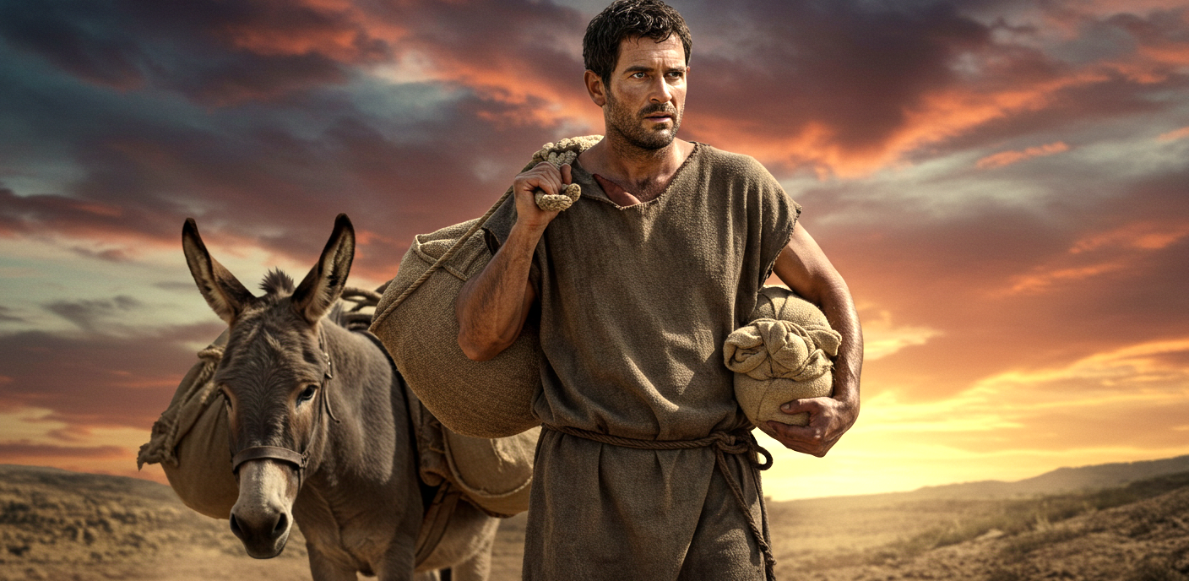
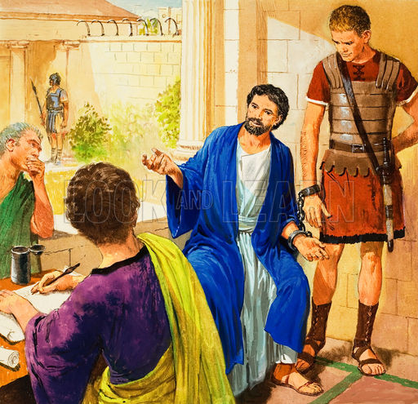
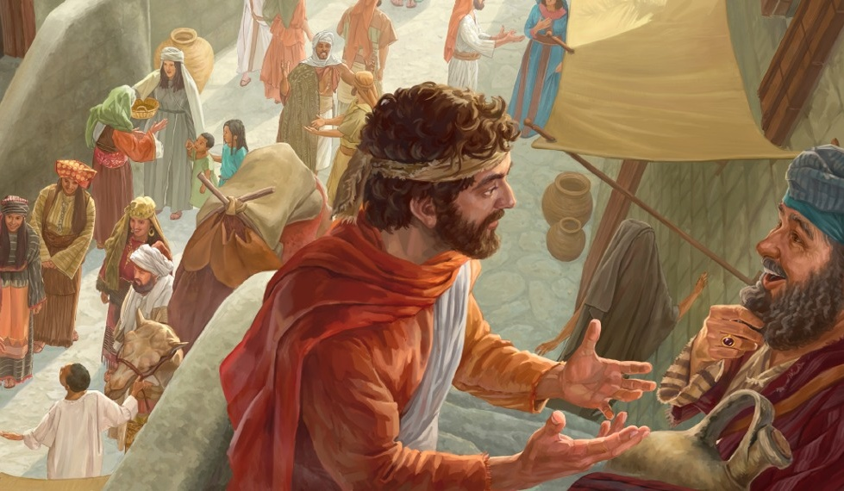
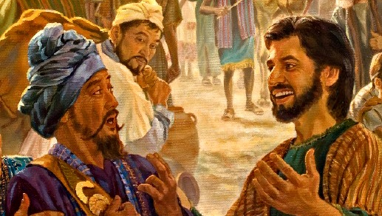
ZIFUKWA ZOTHOKOZA NDI KUPEMPHERA MU KALATA KWA AKOLOSE
“Tsopano abale, ndikufuna mudziwe kuti chimene chandichitikira ine chathandiza kwambiri kupititsa patsogolo Uthenga Wabwino. (Afilipi 1:12)
Afilipi atamva kuti Paulo ali m’ndende ku Roma, anavutika maganizo kwambiri, ndipo anatumiza Epafrodito kuti akathandize mtumwiyu (Afilipi 4:18).
M’malo mokhumudwa, Paulo anathokoza Mulungu chifukwa cha kumangidwa kwake. Chifukwa chiyani akuthokoza? Chifukwa kudzera mmenemo, anatha kulalikira kwa anthu amene sakanamva Uthenga Wabwino kudzera munjira ina (Afilipi 1:13 ).
Komanso, ataona maganizo a mtumwiyu, abale ena okhulupirika analimbikitsidwa, ndipo anayamba kulalikira uthenga wabwino mosasamala kanthu za mavuto amene anakumana nawo (Afilipi 1:14 ).
Ena, poganiza kuti kulankhula momasuka za Uthenga Wabwino kungabweretse mavuto kwa Paulo, anathandizanso—ngakhale mosazindikira—kufalitsa Uthenga Wabwino(Afilipi 1:15-18).

Slide 9
Zifukwa zoyamika ndi kupemphera mu kalata yopita kwa Akolose

Slide 10


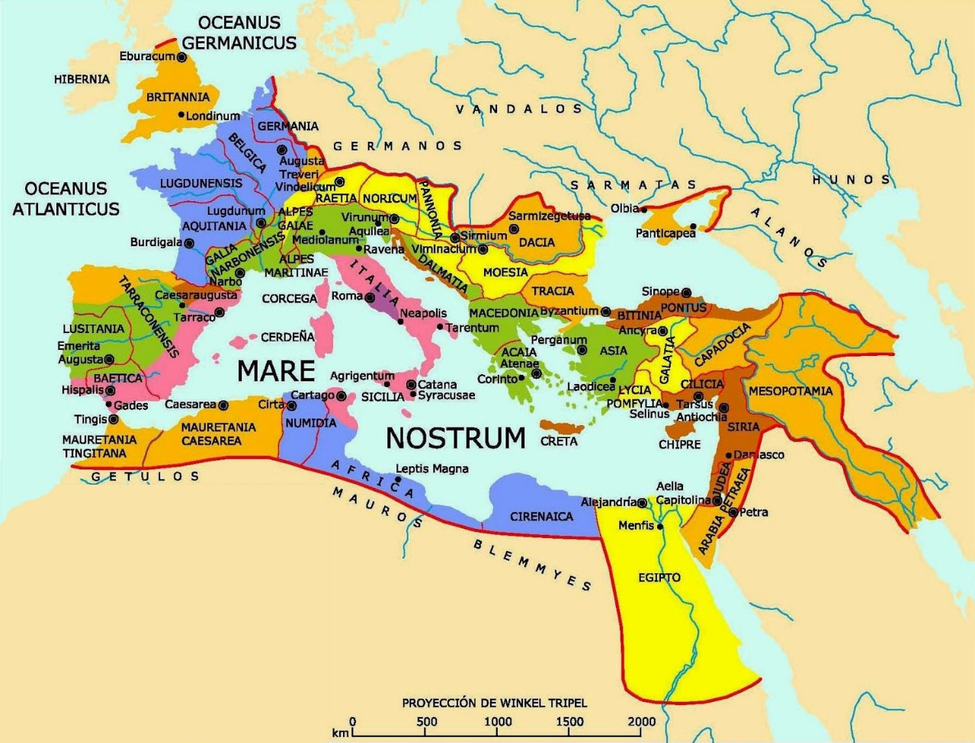
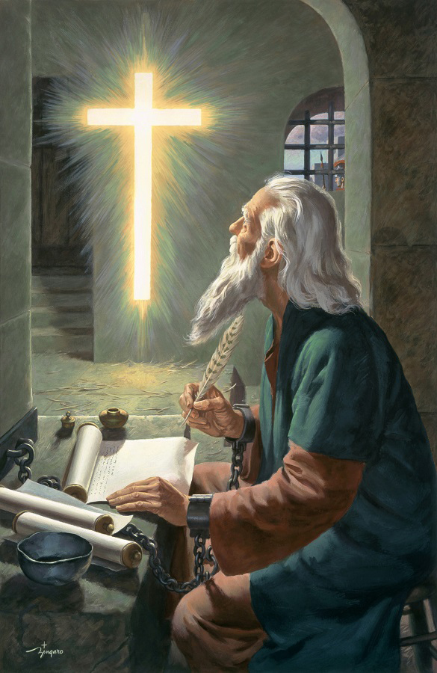

ZIFUKWA ZOKHALIRA OYAMIKIRA
“Timayamika Mulungu Atate wa Ambuye athu Yesu Khristu, nthawi zonse pamene tikukupemphererani.” (Akolose 1:3)
Pobwereza mawu a pa 1 Akorinto 13:13 , Paulo anayamikira Mulungu chifukwa Akolose anali ndi makhalidwe atatu a Mkhristu: chikhulupiriro, chiyembekezo, ndi chikondi (Akolose 1:4–5) .
Makhalidwe amenewa amachokera ‘mwa Khristu Yesu’, amakhudza maubale athu ndi ‘oyera mtima onse’, ndipo afika kwa ife kudzera mu ‘mawu oona a Uthenga Wabwino.”.
Paulo akutsindika kuti uthenga uwu sunalalikidwe kwa Akolose okha, koma “padziko lonse lapansi” (Akolose 1:6 ) ... ndipo m’zaka 30 zokha!
Mphamvu ya Mulungu, imene imafika kwa ife kudzera mu Uthenga Wabwino kudzera mu ntchito ya Mzimu Woyera, imapangitsa Baibulo kukhala ‘Mawu a moyo’ (Afilipi 2:16). Izi zikutanthauza kuti, tikalandira Uthenga Wabwino, timalandira moyo wosatha komanso cholowa chimene ‘chasungidwira kwa inu Kumwamba’ (Akolose 1:5).

Slide 11



ZOPEMPHA MU PEMPHERO
“Chifukwa cha ichi, kuyambira tsiku limene tinamva za inu, sitinasiye kukupemphererani ndi kumupempha Mulungu kuti akudzazeni ndi chidziwitso cha chifuniro chake kudzera mu nzeru yonse yauzimu ndi kumvetsetsa.” (Akolose 1:9)
Pemphero la Paulo likuphatikizapo zinthu zambiri zabwino kwa Akolose (Akolose 1:9-11):
Mulole iwo alandire chidziwitso cha Mulungu, chimene chidzawapatsa iwo nzeru ndi kuzindikira kwauzimu
Khalani monga ana a Mulungu, ndi kumkondweretsa m’zonse
Mulole iwo abale zipatso ndi kukula mu chidziwitso
Alimbikitsidwe ndi mphamvu ya Mulungu kuti apirire
Pempheroli limapangidwa “kuyamika Atate mokondwera” (Akolose 1:12).
Pali njira zinayi zimene Mulungu amagwiritsa ntchito kuti pemphero la Paulo likwaniritsidwe mwa ife:
Baibulo (Masalimo 119:105 )
Mzimu wa chinenero (Chiv. 19:10), wowonetseredwa kudzera mwa Ellen G. White
Chitsogozo cha Mulungu (Akoose 4:3)
Mzimu Woyera (Yesaya 30:21)

Slide 12

“Moyo wathu uyenera kulumikizidwa ndi moyo wa Khristu; tiyenera kumatenga mphamvu nthawi zonse kuchokera kwa Iye, kumulandira Iye monga Mkate wamoyo umene unatsika kuchokera kumwamba, kutunga kuchokera ku kasupe wosatha, womwe umatulutsa chuma chochuluka nthawi zonse. Ngati tipitiriza kuyika Ambuye patsogolo pathu nthawi zonse, kulola mitima yathu kuyamika ndi kutamanda Iye, tidzakhala ndi kutsitsimuka kosalekeza pa moyo wathu wauzimu. Mapemphero athu adzakhala ngati kukambirana ndi Mulungu monga momwe timayankhulira ndi mnzathu wapamtima. Iye adzatilankhula za zinsinsi zake aliyense payekha. Nthawi zambiri tidzakhala ndi chisangalalo ndi kumva kupezeka kwa Yesu mmoyo wathu. Mitima yathu idzayaka mkati mwathu pamene Iye ayandikira kudzacheza nafe monga anachitira ndi Enoki. Pamene izi zizachitika pa moyo wa Mkhristu, m’moyo wake mudzaonekera kudzichepetsa, kufatsa, ndi oleza mtima, zomwe zimaonetsera kwa onse kuti wakumana ndi Yesu ndipo waphunzira kuchokera kwa Iye.”
EGW (Christ’s Object Lessons, p. 129)

