Slide 1
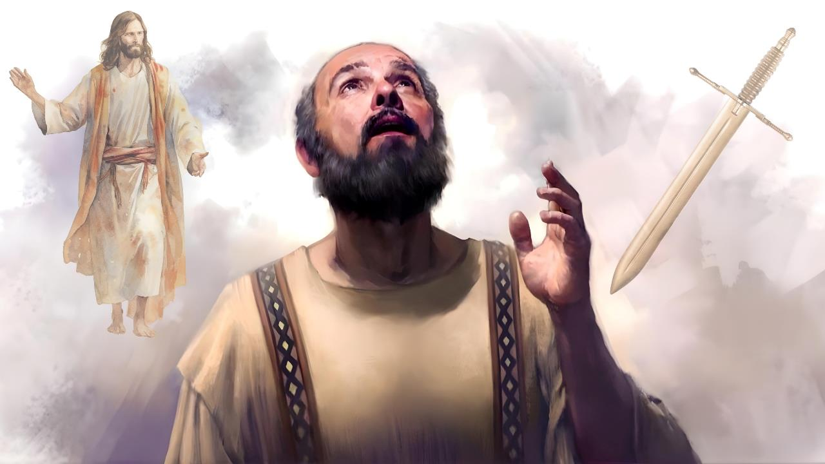
MOYO NDI IMFA
Phunziro 3, January 17, 2026

Slide 2

“Pakuti kwa ine kukhala moyo ndi Khristu ndipo kufa ndi phindu”
Afilipi 1:21, CCL

Slide 3


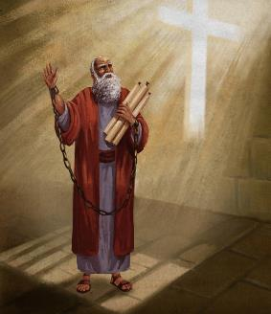


Paulo anali kuyembekezera kuweruzidwa ndi Nero wankhanza. Tsogolo lake linkadalira kwambiri momwe Kaisara amamvera tsikulo osati chilungamo.
Koma iye ankadziwa kuti tsogolo lake silinali m’manja mwa Nero kwenikweni, koma m’manja mwa Mulungu. Choncho, ankatsimikiza kuti kudzera m’mapemphero amene mpingo unkamupereka, adzamasulidwa.
Koma, ngati imfa yake ikanathandiza kufalikira kwa Uthenga Wabwino (monga momwe kumangidwa kwake kunachitira), anali wokonzeka kupereka moyo wake chifukwa cha Khristu..
Kukhala ndi moyo chifukwa cha Khristu Kapena kufa chifukwa cha Khristu?
  Khristu anakwezedwa mwa Paulo (Afilipi 1:10-20, 25-26)
  Kukhala ndi moyo kapena kufa chifukwa cha Khristu (Afilipi 1:21-22)
  Zisankho ziwiri za Paulo (Afilipi 1:23-24)
Kodi kukhala ndi moyo chifukwa cha Khristu kumatanthauza chiyani?
  Khalani ndi moyo wofanana ndi Uthenga Wabwino (Afilipi 1:27a)
  Limbanani limodzi chifukwa cha Uthenga Wabwino (Afilipi 1:27b-30)

Slide 4

KUKHALA NDI MOYO CHIFUKWA CHA KHRISTU KAPENA KUFA CHIFUKWA CHA KHRISTU?

Slide 5



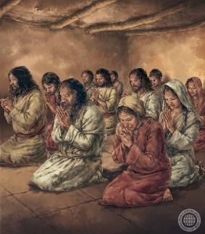
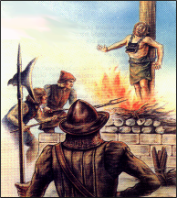
KHRISTU ANAKWEZEDWA MWA PAULO
“Ndili ndi chiyembekezo chonse kuti sindidzachita manyazi ndi pangʼono pomwe, koma ndidzakhala ndi chilimbikitso chokwanira kuti monga mwa nthawi zonse, tsopano Khristu adzakwezedwa mʼthupi langa kaya ndi mʼmoyo kapena mu imfa.” (Afilipi 1:20)
Paulo ankakondwera m’masautso amene ankakumana nawo, ndipo anali ambiri (Akolose 1:24a; 2 Akorinto 11:23–27). Kunena zoona, sankakondwera ndi masautso paokha, koma ankakondwera chifukwa cha zotsatira za kuzunzika kwake—chimodzi mwa izo chinali phindu limene masautso ake ankabweretsa ku mpingo wa Khristu (Akolose 1:24b; 2 Akorinto 11:28).
Potsatira chitsanzo cha Yesu mumasautso ake—ngakhalenso muimfa yake—Khristu anakwezedwa mwa Paulo (Afilipi 1:20).
Mu kalata yake kwa Afilipi, Paulo amafotokoza momveka bwino kuti panthawiyo sanayembekezere kukweza Yesu kudzera mu imfa yake, koma ankayembekezera kuti, kudzera m’mapemphero a mpingo ndi ntchito ya Mzimu Woyera, adzamasulidwa ndi kupitiriza kutumikira Khristu kudzera m’moyo wake (Afilipi 1:19, 25–26).
Chifukwa cha zoipa zimene zafalikira m’dziko lathuli, kukhala ndi moyo monga momwe Khristu ankakhala nthawi zambiri kumaphatikizapo kuvutika monga Khristu anavutikira, ndipo nthawi zina kumafikanso pa kufa momwe Khristu anafera (2 Timoteyo 3:12).

Slide 6



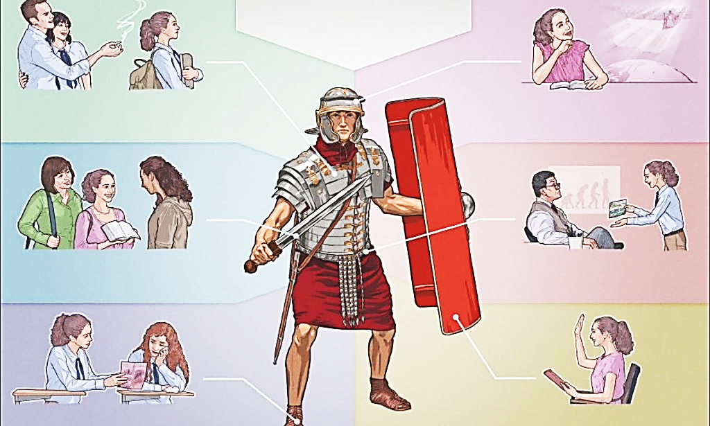

KUKHALA NDI MOYO KAPENA KUFA CHIFUKWA CHA KHRISTU
“Pakuti kwa ine kukhala moyo ndi Khristu ndipo kufa ndi phindu.” (Afilipi 1:21)
Mizu ya masautso onse ili mu nkhondo ya dziko lonse imene ikumenyedwa lerolino pakati pa zabwino ndi zoipa, pakati pa Khristu ndi Satana.
Iyi ndi nkhondo yauzimu, ndipo iyenera kumenyedwa ndi zida zauzimu. Otsatira a mdani amagwiritsa ntchito zida zosayenera polimbana ndi Akhristu, (mabodza, kutsutsa, kukakamizidwa ndi anzawo, ndi zina zotero).
Koma timagwiritsa ntchito zida monga choonadi ndi chilungamo (2 Akorinto 6:4-7). Zida zamphamvu “zogwetsa malinga” (2 Akorinto 10:3-5).
Koma chimachitika n’chiyani pamene zotsatira zankhondo, zikhala imfa ya olungama? Malinga ndi Paulo, zimenezi zimakhala phindu kwa ife (Afilipi 1:21).
Kwa ife amene timakhala okhulupirika kwa Khristu, imfa imatiika kutali ndi mdani, ndipo imatimasula ku masautso onse (Miyambo 14:32; Yesaya 57:1).

Slide 7



ZISANKHO ZIWIRI ZA PAULO
“Ndathinidwa ndi zinthu ziwirizi: Ndikulakalaka kunyamuka kuti ndikakhale ndi Khristu, chimene ndi chinthu chabwino kwambiri. Komanso nʼkofunika kwambiri kuti ndikhalebe mʼthupi chifukwa cha inu.” (Afilipi 1:23-24 CCL )
Ngakhale kuti sanathe kupanga chisankho, Paulo ankavutika m’mtima pakati pa njira ziwiri zosiyana (Afilipi 1:23–24):
Kuchoka
Kukhala ndi Khristu
Kukhalabe
Kuthandiza mpingo
Tikangotenga lemba ili palokha popanda kuliyerekezera ndi mavesi ena, tingaganize kuti Paulo akuphunzitsa kuti munthu akangofa amakwera nthawi yomweyo kupita Kumwamba kukakhala ndi Yesu, zomwe zikutsutsana mavesi ena a m’Baibulo (Mlaliki 9:5; Masalimo 6:5).
Mu kalata yomweyi yopita kwa Afilipi iye akunena, kuti akhale ndi Khristu kwathuthu, ayenera kuyembekezera nthawi ya mzukiro womanalidza (Afilipi 3:8-11).
Pa nthawi ina, Paulo anafanizira thupi ndi hema limene limawonongedwa (kufa) kuti limvekedwe chosafa (2 Akorinto 5:1–4). Koma, iye amafotokoza momveka bwino kuti kuvala chosafa kumeneku kudzachitika pa Kubwera Kwachiwiri kwa Khristu, osati pa nthawi imene munthu wafa (1 Akorinto 15:42, 51–54).

Slide 8

KODI KUKHALA NDI MOYO CHIFUKWA CHA KHRISTU KUMATANTHAUZA CHIYANI?

Slide 9


KHALANI NDI MOYO WOFANANA NDI UTHENGA WABWINO
“Chilichonse chimene chingachitike, chachikulu nʼchakuti mukhale moyo ofanana ndi Uthenga Wabwino wa Khristu” (Afilipi 1:27a)
Mawu akuti ‘khalidwe lanu’ amachokera ku liwu la Chigiriki politeuomai, lomwe limatanthauza ‘kukhala moyo ngati nzika.’ Paulo akulimbikitsa Afilipi (ndi ife tonse) kuti tikhale ndi moyo woyenerera nzika za Kumwamba (Afilipi 3:20).
Osauka mu mzimu
Wofasa
Anjala ndi ludzu la chilungamo
Achifundo
Oyera mtima
Wobweretsa mtendere
Wokonzeka kupereka tsaya lina
Wokonda adani anu
Dalitsani amene amatitembererani
Kuchita zabwino amene amadana nanu
Kukhala wachikondi ndi wowolowa manja
Kukhala wachifundo ndi wodzichepetsa
Ndi zina zotero.
Mu Ulaliki wa pa Phiri, Yesu anatiphunzitsa momwe nzika za Kumwamba ziyenera kukhalira.
Zingafotokozedwe mwachidule motere: ‘kuchita chilungamo, kukonda kukoma mtima, ndi kuyenda modzichepetsa ndi Mulungu wako’ ” (Mika 6:8).
Paulo amagwiritsa ntchito malangizo amenewa ngati chiyambi cha nkhani imene inkam’khudza kwambiri: umodzi mu mpingo.
Iye ankadziwa kuti kusagwirizana nthawi zambiri kumachokera pa kudzikuza ndi khalidwe losayenera pochita zinthu kwa wina ndi mnzake. Chifukwa chake, amatilimbikitsa kuti tichite zinthu mwaulemu.

Slide 10



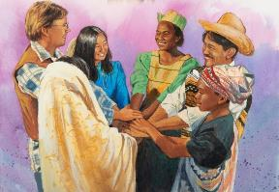
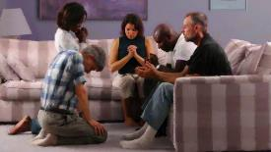
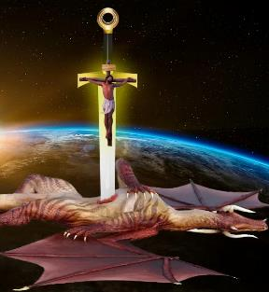

LIMBANANI LIMODZI CHIFUKWA CHA UTHENGA WABWINO
“… Tsono ngati ndingabwere kudzakuonani kapena kumangomva za inu ndili kutali, ndidzadziwa kuti mwayima mwamphamvu mwa Mzimu mmodzi, kulimbika pamodzi ngati munthu mmodzi chifukwa cha chikhulupiriro cha Uthenga Wabwino ” (Afilipi 1:27b)
Kukhala wolungama ndi wowongoka sikutsimikizira moyo wopanda mikangano kapena zovuta (Afilipi 1:30). M’malo mwake, ngakhale Yobu mwini, amene Mulungu ananena kuti ‘ndi wangwiro ndi wowongoka mtima, munthu woopa Mulungu ndi wopewa zoipa’ (Yobu 1:8), anakumana ndi mkangano woopsa kwambiri—ntchito ya mdani.
Mu nkhondo imene tikumenyana, umodzi uli ndi gawo lofunika kwambiri. Paulo amatilimbikitsa kuti timenye nkhondo limodzi, mogwirizana, poteteza Uthenga Wabwino (Afilipi 1:27b).
Umodzi umenewu wa cholinga uyenera kugwirizanitsidwa ndi pemphero ndi kuphunzira Mawu (Aefeso 6:18; Afilipi 2:16).
Tikakumana ndi mkangano ndi choipa, sitiyenera kuopsezedwa ndi amene amatitsutsa (Afilipi 1:28). Tiyeni tikumbukire kuti Satana ndi mdani amene wagonjetsedwa kale, chifukwa Khristu adapambana nkhondoyo kale pa mtanda (Luka 10:18; Akolose 2:15).

Slide 11

“Kodi takhala zaka zingati m’munda wa Ambuye? Ndipo tabweretsa phindu lotani kwa Mwini wake? Kodi tikukumana bwanji ndi maso a Mulungu amene amafufuza zonse? Kodi tikukula mukuopa Mulungu, muchikondi, mukudzichepetsa, ndi muchikhulupiriro chathu mwa Mulungu? Kodi timakhala ndi mtima woyamika chifukwa cha chisomo chake chonse? Kodi tikuyesetsa kudalitsa amene ali motizungulira? Kodi tikusonyeza mzimu wa Yesu m’mabanja athu? Kodi tikuphunzitsa ana athu Mawu ake, ndi kuwafotokozera ntchito zodabwitsa zimene Mulungu wachita? Mkhristu ayenera kuyimira Yesu, pokhala wabwino komanso pochita zabwino. Pamenepo moyo wake udzakhala ndi fungo labwino, ndi kukongola kwa khalidwe, zomwe zidzaonetsa momveka bwino kuti iye ndi mwana wa Mulungu, wolandira cholowa cha Kumwamba.”
EGW (You Shall Receive Power, December 10)

