Slide 1
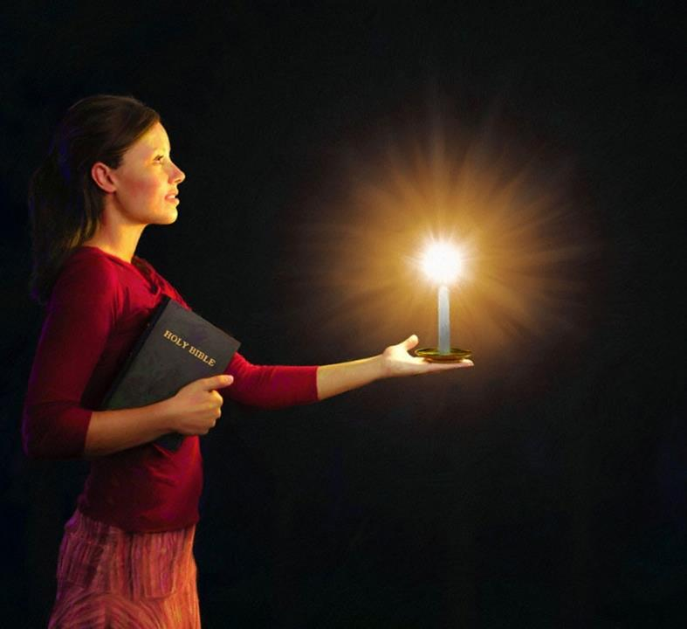


Phunziro 5, January 31, 2024
KUWALA MONGA NYALI MUDIMA

Slide 2

“Kuti mukhale wopanda cholakwa ndi angwiro, ana a Mulungu wopanda cholakwika mu mʼbado uno wachinyengo ndi wosocheretsa. Mukatero mudzawala pakati pawo ngati nyenyezi zakumwamba powawuza mawu amoyo. Ndipo ine ndidzatha kunyadira pa tsiku la Khristu kuti sindinathamange kapena kugwira ntchito pachabe”
Philippians 2:14, 15, CCL

Slide 3

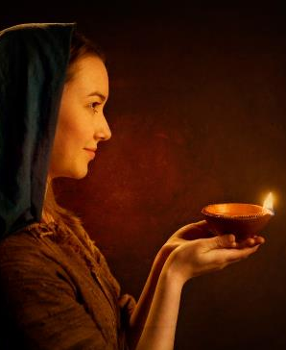



“Momwemonso kuwunika kwanu kuwale pamaso pa anthu kuti aone ntchito zanu zabwino ndi kulemekeza Atate anu akumwamba” (Mateyu 5:16).
Mu Afilipi 2:12–18 tingawerenge lamulo la Yesu limeneli monga mmene Paulo ananenera.
Pokhala mudziko limene Lamulo la Mulungu limanyozedwa nthawi zonse, ife Akhristu amene tikufuna kutumikira Mulungu pokhala mogwirizana ndi lamulolo, ndife kuwunika kumene kumawala mumdima.
Nyenyezi zowala mudziko lapansi:
  Kuwonetsa Khalidwe la Mulungu (Afilipi 2:12-13)
  Kuwala mu Dziko Lapansi (Afilipi 2:14-16)
  Nsembe Yamoyo (Afilipi 2:17-18)
Zitsanzo za kuwala:
  Timoteyo (Afilipi 2:19-24)
  Epafrodito (Afilipi 2:25-30)

Slide 4

NYENYEZI ZOWALA MUDZIKO LAPANSI

Slide 5

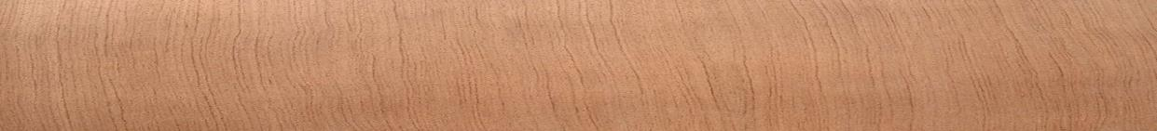


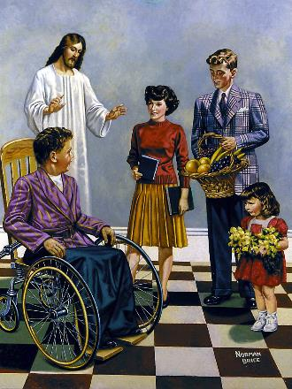
KUWONETSA KHALIDWE LA MULUNGU
“pakuti ndi Mulungu amene amagwira ntchito mwa inu kuti mufune ndi kuchita zimene zimamukondweretsa Iyeyo” (Afilipi 2:13)
Atatha kufotokoza mwanzeru kwambiri za kudzichepetsa ndi kukwezedwa kwa Yesu, Paulo amawonjezera mawu akuti “choncho.” Kusonyeza kuti, popeza Yesu anadzichepetsa ndipo anakwezedwa ndicholinga choti “lilime lililonse livomereze kuti Yesu Khristu ndi Ambuye” (Afilipi 2:11), okhulupilira a ku Filipi (ndipo kufikira kwa ife tonse) tiyenera kuchitapo kanthu pazimenezi.
Ntchito yathu yoyamba ndi kugwira ntchito ya chipulumutso chathu “ndi mantha ndi kunjenjemera” (Afilipi 2:12). Ngati Mulungu ndi amene amatipulumutsa (Tito 2:11), ndichifukwa chiyani tikuyenera kudera nkhawa za chipulumutso chathu?
Mantha ndi kunjenjemera ndi mawu amene amagwiritsidwa ntchito ngati ofanana pofotokoza kutumikira Mulungu (Masalimo 2:11). Choncho, Paulo amatsindika kuti ndi Mulungu amene amapanga mwa ife chikhumbo chofuna kuchita zabwino, ndiponso amatipatsa mphamvu zoti tizikwaniritse (Afilipi 2:13).

Slide 6




KUWALA MUDZIKO LAPANSI
“kuti mukhale wopanda cholakwa ndi angwiro, ana a Mulungu wopanda cholakwika mu mʼbado uno wachinyengo ndi wosocheretsa. Mukatero mudzawala pakati pawo ngati nyenyezi zakumwamba.” (Afilipi 2:15)
Paulo akupereka mfundo zitatu zomwe zingapangitse okhulupirira kuwala padziko lapansi:
Kukhala ogwirizana (Afilipi 2:14)
Pogwira ntchito limodzi, tiyenera kupewa miseche, kutsutsana, mpikisano, ndi mikangano pakati pathu.
Khalani opanda cholakwa (Afilipi 2:15)
Kumvera Atate wathu mosavuta kumasiyana kwambiri ndi kuipa komwe kwatizungulira.
Kukhala okhulupirika pa Mawu a Mulungu (Afilipi 2:16)
Zochita zathu ndi maganizo athu ziyenera kukhala mogwirizana ndi zimene Baibulo limaphunzitsa
Kumene mdima uli waukulu kwambiri, kuunika kumawala kwambiri. Mu dziko limene Mulungu amakanidwa mwadongosolo, ife Akhristu tiyenera kuwala ndi kuunika kwa Khristu.

Slide 7




NSEMBE YA MOYO
“Koma ngakhale ndikuthiridwa ngati nsembe ya chakumwa yoperekedwa pa nsembe ndi pa utumiki wochokera mʼchikhulupiriro chanu, ndine wokondwa ndi wosangalala pamodzi ndi inu nonse.”
(Afilipi 2:17)
Ngakhale Paulo ankayembekezera kumasulidwa, panali kuthekera koti akaweruzidwa. Iye amafotokoza kuthekera kumeneku kusonyeza ngati “akuthiridwa ngati nsembe ya chakumwa” (Afilipi 2:17).
Nsembe ya chakumwa (libation) inkachitika pothira madzi kapena chakumwa pa nsembe imene ikuperekedwa (Eksodo 29:39–40). Pankhaniyi, nsembe yomwe ikukambidwa inali ya Afilipi.
Kodi Afilipi anali oti afe? Ayi, ndithu. Nsembe yawo inali “utumiki wa chikhulupiriro chanu.” Inali nsembe yamoyo, nsembe imene tonsefe tiyenera kupereka kwa Mulungu (Aroma 12:1).
Paulo sanasamalire kufa, chifukwa umboni wake ukanapereka mphamvu zambiri kwa okhulupirira omwe anali kale mboni zokhulupirika za Uthenga Wabwino, kulankhula za Uthenga Wabwino molimba mtima, ndiponso kukhala ndi khalidwe loyenera ana a Mulungu.

Slide 8

ZITSANZO
ZA KUWALA

Slide 9

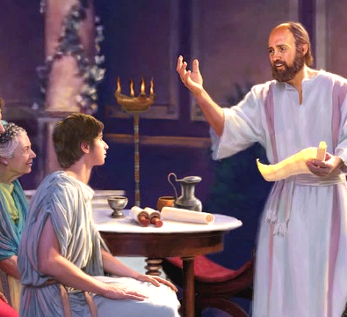


TIMOTEYO
“Koma inu mukudziwa kuti Timoteyo wadzionetsa yekha, chifukwa watumikira ndi ine pa ntchito ya Uthenga Wabwino monga mwana ndi abambo ake” (Afilipi 2:22)
Timoteyo anali mnzake wogwira naye ntchito wa Paulo komanso wolemba naye limodzi makalata asanu ndi limodzi (2 Akorinto, Afilipi, Akolose, 1 Atesalonika, 2 Atesalonika, Filemoni). Paulo mwiniwake anamusankha kukhala mlaliki wa Uthenga Wabwino (Machitidwe 16:1–3). Kodi Paulo anaona chiyani chapadera mwa mnyamata uyu?
Choyamba, aliyense “ankalankhula zabwino za iye.” Kuyenerera kwake pa utumiki kunatsimikiziridwa ndi mawu a uneneri (1 Timoteyo 1:18). Ngakhale anali wachinyamata, Paulo ankamuona ngati mwana wake (1 Timoteyo 1:2; 4:12). Kumbali yake, Timoteyo ankamvera Paulo ndi kumulemekeza ndi chikondi chimene mwana amakhala nacho kwa atate ake (Afilipi 2:22).
Paulo ankamuwona ngati wantchito wothandiza mofanana ndi iye mwini (1 Akorinto 6:10). Anamupatsa udindo wosamalira mipingo ingapo, monga wa ku Korinto (1 Akorinto 4:17), wa ku Filipi (Afilipi 2:19), ndi wa ku Atesalonika (1 Atesalonika 3:2). Iye anavutikanso ndi kumangidwa mʼndende monga Paulo (Ahebri 13:23).

Slide 10

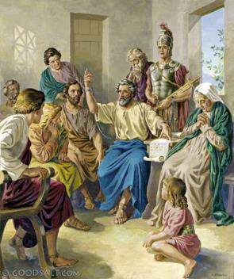


“Koma ndikuganiza kuti nʼkofunika kuti ndikutumizireni mʼbale wanga Epafrodito, mtumiki mnzanga ndi msilikali mnzanga, amenenso ndi mtumiki wanu amene munamutumiza kuti adzandithandize pa zosowa zanga” (Afilipi 2:25)
EPAFRODITO
Pamene Afilipi anamva kuti Paulo anali m’ndende ku Roma, anaganiza zotumiza chithandizo kuti akwaniritse zosowa zake (kubweza renti, chakudya, zovala, ndi zina zotero). Epafrodítusi ndiye amene anali ndi udindo wokapereka thandizoli kwa mtumwiyo (Afilipi 4:18; 2:25).
Epafrodito sanangopereka chithandizo chokha, komanso anatsagana ndi Paulo, anamuthandiza pa zosowa zake, ndiponso anagwira naye ntchito limodzi pofalitsa uthenga wabwino.
Chifukwa cha changu chake pa Uthenga Wabwino, iye anaika moyo wake pachiswe ndipo anadwala kwambiri (Afilipi 2:27, 30). Afilipi atamva zimenezi, anadera nkhawa kwambiri za iye. Ichi chinali chifukwa chachikulu chomwe Paulo anaganizira zomutuma kuti awabweretsere kalatayi (Afilipi 2:26, 28).
Paulo akupempha kuti “anthu onga iyeyu muziwachitira ulemu” (Afilipi 2:29). Epafrodito, mosakayikira, anali Mkhristu wokhulupirika.

Slide 11

“Pamene Yesu, Wotipembedzera wathu, akutipempherera kumwamba, Mzimu Woyera akugwira ntchito mwa ife, kutipatsa chikhumbo ndi mphamvu yochita zimene zimamukondweretsa. Kumwamba konse kuli ndi chidwi pa chipulumutso cha moyo wa munthu. Nanga kodi tili ndi chifukwa chotani chokayikira kuti Ambuye amafuna komanso amatithandiza? Ife amene timaphunzitsa anthu tiyeneranso kukhala ndi mgwirizano weniweni ndi Mulungu. Mu Mzimu ndi MʼMawu tiyenera kukhala kwa anthu monga kasupe wa madzi, chifukwa Khristu ali mwa ife ngati chitsime cha madzi akuphulika kufikira ku moyo wosatha. Chisoni ndi zopweteka zingayese kuleza mtima kwathu ndi chikhulupiriro chathu; koma kuwala kwa kupezeka kwa Wosaonekayo kuli mwa ife, ndipo tiyenera kubisala mwa Yesu.”
EGW (You Shall Receive Power, December 8)

