Slide 1

NZIKA YA KUMWAMBA
Phunziro 7 February 14, 2026

Slide 2

“Musade nkhawa ndi kanthu kalikonse, koma pa china chilichonse, mwa pemphero ndi chidandaulo pamodzi ndi chiyamiko, perekani zopempha zanu kwa Mulungu.
Afilipi 4:6, CCL

Slide 3





M’makalata ake onse, Paulo anafotokoza momveka bwino kuti sitili nzika za dziko lino. Pakuvomera Yesu kukhala Mpulumutsi wathu, timabadwa mwatsopano. Ndi kubadwa kwatsopano kumeneku, timakhala nzika za Kumwamba.
Ngakhale kuti timalemekeza ndi kugonjera ku malamulo ndi miyambo ya dziko lapansi lino, moyo wathu, weniweni, uli wapamwamba kwambiri, wokhala ndi makhalidwe apamwamba kuposa a dziko lapansi.
Unzika wa Kumwamba:
  Tsanzirani okhulupirika (Afilipi3:17-19)
  Ufulu wathunthu wa nzika (Afilipi 3:20-21)
Mpaka titafika kumeneko:
  Chigwirizano ndi chisangalalo (Afilipi 4:1-6)
  Malingaliro abwino (Afilipi 4:7-9)
  Kukhala wokhutitsidwa (Afilipi 4:10-13, 19)

Slide 4

UNZIKA WA KUMWAMBA

Slide 5
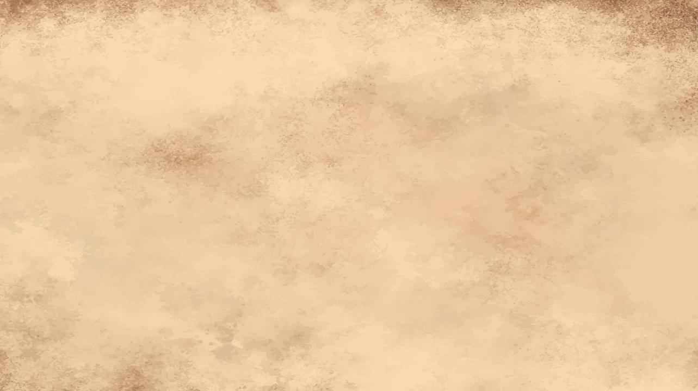

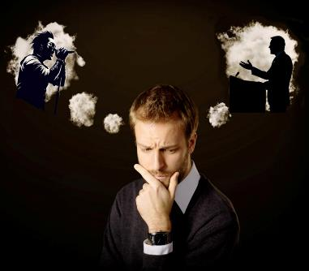
TSANZIRANI OKHULUPIRIKA
“Abale, nonsenu pamodzi mudzinditsanzira ine, ndipo monga inu muli ndi chitsanzo, phunzirani kwa amene akukhala moyo motsatira momwe timakhalira.” (Afilipi 3:17)
Tonsefe tili ndi anthu amene, mwanjira ina Kapena inzake, asintha miyoyo yathu kapena malingaliro athu. Mwinamwake ndi wojambula, wothamanga, woimba. Mwina m'busa, mlaliki, m'bale kapena mlongo wokhulupirika.
Kodi anthu awa amene timawawona ngati zitsanzo za moyo atithandiza kukula monga anthu, kapena atitsogolera mʼnjira zimene sitiyenera nʼkomwe kuyesa kuyendamo?
Paulo amatipempha kutsanzira iwo amene zitsanzo zawo zimatilimbikitsa ndi kutikweza kuti tikhale abwino (Afilipi 3:17). Komanso amatichenjeza kuti, ngakhale pakati pa okhulupirira, pali anthu amene sitikuyenera kuwatsanzira (Afil. 3:18-19).
Ndichiyani chimapangitsa kusiyana? Ena amangoganizira zinthu za dziko lapansi, pamene ena amaika maganizo awo pa Yesu. Zitsanzo zabwino, motero, ndi anthu otsanzira Khristu (1 Akorinto 11:1).

Slide 6

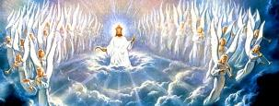

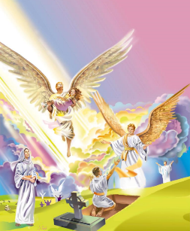
UFULU WATHUNTHU WA NZIKA
“Koma ife ndife nzika za kumwamba ndipo tikudikirira mwachidwi Mpulumutsi wochokera kumeneko, Ambuye Yesu Khristu.” (Afilipi 3:20)
Tiyeni tivomereze. Ife Akhristu tili ndi vuto limodzi: unzika wapawiri. Ndife nzika za dziko lapansi lino komanso nzika za Kumwamba. Izi zimabweretsa mikangano yayikulu mʼmoyo wathu (Aroma 7:22-23).
Thupi lathu lidzakhala lauzimu, losafa, ndi losavunda (1 Akorinto 15:42-44, 50-54 .
Tidzalemekezedwa (Akolinto 3:4;
Afilipi 3:21)
Tidzakhala ndi thupi lenileni, ndipo maso athu eni adzaona Mulungu. (Yobu 19:25-27 )
Kodi tidzapeza liti unzika wathunthu? Kodi tidzasiya liti kukhala nzika za dziko la tchimo lino? Pa Kubwera Kwachiwiri (Afilipi 3:20 ).
Tikadzauka kwa akufa (kapena kusandulika), ndipo imfa sadzakhalanso ndi mphamvu pa ife, chidzachitike ndi chiyani?

Slide 7

MPAKA TIKAFIKA KUMENEKO

Slide 8




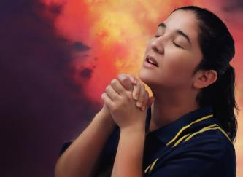
KUGWIRIZANA NDI KUKONDWERERA
“Nthawi zonse muzikondwa mwa Ambuye. Ndikubwerezanso; muzikondwa! Rejoice!” (Afilipi 4:4)
Pomaliza kalata yake, Paulo analumikiza moni ochokera kwa iye ndi malangizo othandiza. Amapempha Sizigusi [mnzake wokhulupirika] ndi Klementi kuti athandize Euodiya ndi Sintike kukhala mogwirizana. Za iwo onse, anzake ogwira naye ntchito, Paulo akunena kuti: “amene mayina awo ali mʼbuku la moyo” (Afilipi 4:2-3 ).
Malangizo otsatirawa angatidodometsa: “Kondwerani nthawi zonse […] Musamade nkhawa ndi kanthu kalikonse” (Afilipi 4:4, 6). Kodi zimenezi zingatheke bwanji m’dziko lodzaza ndi mavuto?
Izi ndizotheka chifukwa chimwemwe chathu chili “mwa Ambuye” (Afilipi 4:4a). Timaika nkhawa zathu pa Iye, tili ndi chikhulupiriro chakuti angathe kuzinyamula chifukwa cha ife (Mateyu 6:31-34; 1 Petro 5:7) .
Nanga timapereka bwanji nkhawa zathu kwa Yesu? Kudzera mu pemphero ( Afilipi 4:6 ).

Slide 9




MAGANIZO OYERA
“Potsiriza, abale, muziyika mtima wanu pa zinthu zilizonse zabwino ndi zotamandika monga, zinthu zoona, zinthu zolemekezeka, zinthu zolungama, zinthu zoyera, zinthu zokongola ndi zinthu zosiririka.” (Afilipi 4:8)
Zotsatira za kupereka nkhawa zathu kwa Yesu ndi kukondwera ndi mtendere (Afilipi 4:7). Mtendere umene dziko silingathe kupereka kapena kuchotsa (Yohane 14:27; 16:33).
Pa zinthu zoona
Moona mtima
Mosakondera
Mu mawonekedwe ake oyera
Mu kukoma mtima
Mu dzina labwino
Malinga ndi Paulo, mtendere umenewu udzakhala chitetezo—mlonda—wa maganizo ndi mitima yathu (Afilipi 4:7b). Kuti mlondayu akhale wothandiza, ndi zinthu ziti zimene tiyenera kuganizira (Afilipi 4:8)?
Mwachidule: “ngati pali chilichonse chabwino kwambiri kapena choyenera kutamandidwa — muziganizira zimenezo.” (Afilipi 4:8b).

Slide 10

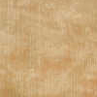




KUKHUTITSIDWA
“Ndipo Mulungu wanga adzakwaniritsa zosowa zanu monga mwa chuma chake chaulemerero mwa Khristu Yesu.” (Afilipi 4:19)
Tili achimwemwe; palibe chimene chimatisokoneza; tili ndi mtendere; maganizo athu ndi oyera. Tili ndi moyo wangwiro komanso wokhutiritsidwa… Ziri motero?
Monga Aguri, timakhulupirira kuti Mulungu sadzatipatsa zochuluka kapena zochepa kuposa zimene zingatipindulitse (Miyambo 30:8-9).
Tikakhala odalira Mulungu, timadziwa motsimikiza kuti “ndingathe kuchita zinthu zonse mwa Iye amene amandipatsa mphamvu” (Afilipi 4:13).
Tingakhale ndi chuma chochuluka; tingakhalenso ndi zosowa kapena mavuto. Monga Paulo, ngati tili ndi chitsimikizo chonse kuti Mulungu amatsogolera moyo wathu, tidzakhala okhulupirika ndi odalira Iye mosasamala kanthu za mmene zinthu ziliri (Afilipi 4:11–12, 19 ).

Slide 11


KUKHUTITSIDWA
“Ndipo Mulungu wanga adzakwaniritsa zosowa zanu monga mwa chuma chake chaulemerero mwa Khristu Yesu.” (Afilipo 4:19)
Kodi chimachitika n’chiyani tikakhala kuti tilibe zimene timaganiza kuti tikuzifuna?
Tiyeni tipemphe kwa Ambuye, ndipo ngati zili monga mwa chifuniro chake, adzatipatsa (Yakobo 4:2b; 1 Yohane 5:14-15).
Sitidziwa nthawi zonse ngati zomwe timapempha zili molingana ndi chifuniro Chake, koma pali zopempha zina zimene timatsimikiza kuti nthawi zonse zimagwirizana ndi chifuniro chake :
Chipulumutso kwa wokondedwa kapena bwenzi ( 1 Timoteyo 2:3, 4 )
Kulimba mtima pouza ena za chikhulupiriro chathu (Chiv. 22:17)
Kukhululukidwa pamene tavomereza ndi kusiya zoipa (1 Yohane 1:9)
Mphamvu yomvera malamulo a Mulungu (Ahebri 13:20, 21)
Kukonda anthu amene amatida ndi kutizunza ( Mateyu 5:44 )
Nzeru pazochitika zovuta (Yakobo 1:5)
Kumvetsetsa choonadi cha m’Mawu a Mulungu (Yohane 8:32)

Slide 12

“Tiyenera kukhala m’moyo wokonzekera dziko lomwe likubwera. Nʼzomvetsa chisoni kwambiri kukhala moyo wosakonzedwa, wopanda cholinga. Tiyenera kukhala ndi cholinga pa moyo — kukhala ndi moyo wokhala ndi tanthauzo. Mulungu atithandize tonse kukhala odzipereka, osadzisamalira kwambiri za ife eni, osaganizira kwambiri za ife eni, komanso kusiya kudzikonda; kuchita zabwino osati chifukwa cha ulemu umene tikuyembekezera kulandira pano, koma chifukwa ichi ndi cholinga cha moyo wathu ndipo chidzayankha ku mapeto a moyo kwathu.”
EGW (Our High Calling, August 24 )

