Slide 1

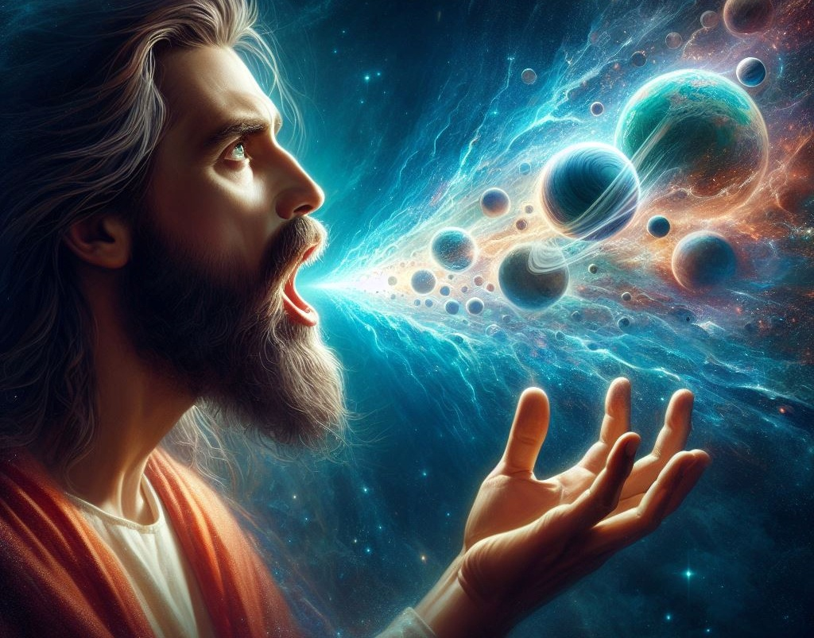
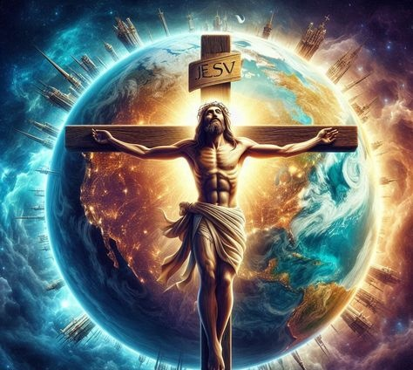
Lesson 8 for February 21, 2026
KUPAMBANA KWA KHRISTU

Slide 2
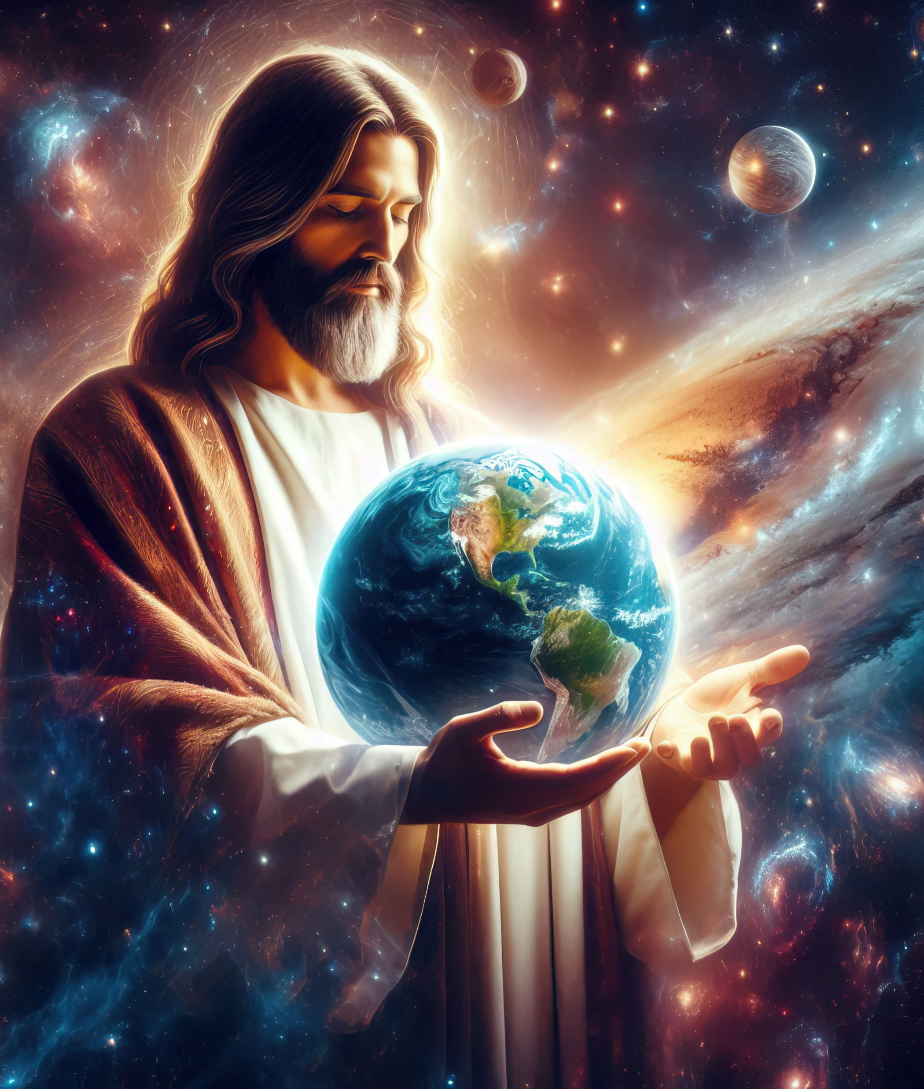
“Amene [Khristu] ali fanizo la Mulungu wosaonekayo, wobadwa woyamba wa chilengedwe chonse; pakuti mwa Iye, zinalengedwa zonse za m'mwamba, ndi za padziko, zooneka ndi zosaonekazo, kapena mipando yachifumu, kapena maufumu, kapena maukulu, kapena maulamuliro; zinthu zonse zinalengedwa mwa Iye ndi kwa Iye. Ndipo Iye ali woyamba wa zonse, ndipo zonse zigwirizana pamodzi mwa Iye”
Akolose 1:15–17, BLBP

Slide 3


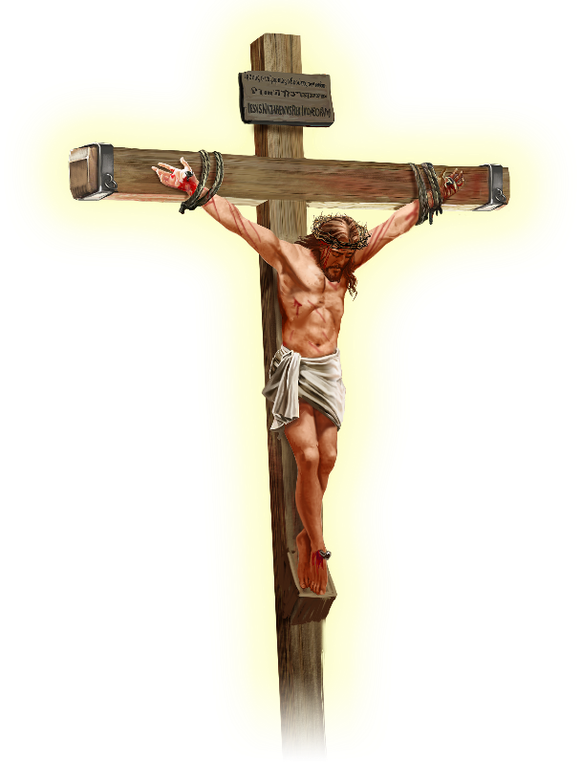






Paulo akulengeza kuti Yesu anabweretsa mtendere ku chilengedwe chonse, “zinthu za pa dziko lapansi, kapena zinthu za kumwamba” (Akolose 1:20 CCL).
Asanafike pa mawu amenewa, mtumwi amatitsimikizira kuti Yesu ndi ndani kwenikweni — osati mphunzitsi wamkulu, kapena nzeru, kapena mneneri, kapena mlaliki, kapena mtumiki wa uthenga wabwino.
Yesu Khristu ndi…
Fanizo la Mulungu (Akolose 1:15a)
Woyamba kubadwa (Akolose 1:15b-17)
Mutu wa Mpingo (Akolose 1:18a)
Chiyambi (Akolose 1:18b)
Woyanjanitsa (Akolose 1:19-20)

Slide 4





FANIZO LA MULUNGU
“Amene ali fanizo la Mulungu wosaonekayo”(Akolose 1:15a)
Fanizo lingakhale chithunzi cha zinthu zenizeni (chithunzi cha kamera, hologramu, kapena fano), kapena chinthu chongopeka m’maganizo (monga chojambula). Koma lingaliro la mʼBaibulo la “fanizo” limaposa zimenezo.
Mulungu analenga Adamu ndi Hava mʼchifanizo chake (Genesis 1:27), ndipo Adamu anabala mwana mʼchifanizo chake (Genesis 5:3). Izi si zitsanzo zokha, kapena zoyeserera kutsanzira, kapena zopangidwa mʼmaganizo. Ndi zofanana zakuthupi, zamaganizo, ndi zachikhalidwe cha anthu…
Paulo akunena kuti lamulo la miyambo linali mthunzi, “ndi chithunzithunzi cha zinthu” (Ahebri 10:1), kutanthauza kuti “fano = chenicheni.”
Funso ndiloti: Kodi Yesu anali wongofanana ndi Mulungu basi, kapena ali chimodzimodzi ndi Mulungu? Kuwonjezera pa kudzitchula dzina la Mulungu mobwerezabwereza kuti Ine Ndine,” Yesu ananenanso momveka bwino kuti: “Ine ndi Atate ndife amodzi” (Yohane 10:30); komanso kuti, “Waona Ine waona Atate” (Yohane 14:9).

Slide 5




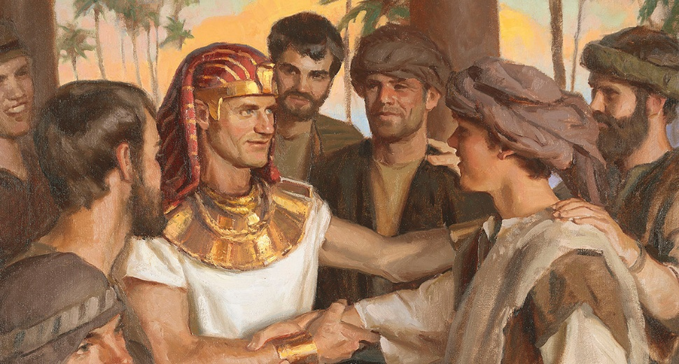
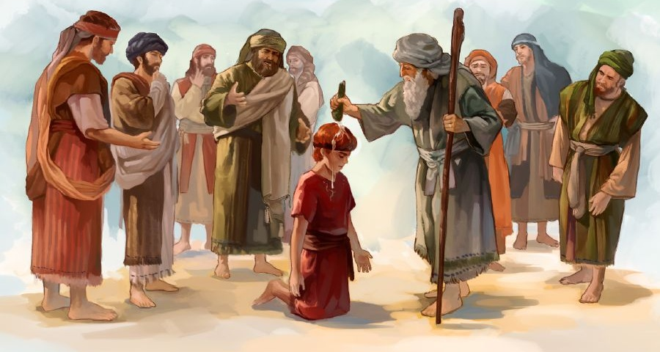


WOYAMBA KUBADWA
“Ndipo Iye ali woyamba wa zonse, ndipo zonse zigwirizana pamodzi mwa Iye.” (Akolose 1:17)
“Woyamba kubadwa” amatanthauza wobadwa koyamba. Chifukwa chake, ena amaphunzitsa kuti Yesu anali cholengedwa choyamba cha Mulungu (Akolose 1:15). Koma monga momwe ziliri ndi mawu akuti “fanizo,” liwu lakuti “woyamba kubadwa” liri ndi tanthauzo lalikulu mʼBaibulo.
Isaki anali woyamba kubadwa m'malo mwa Ismayeli; Yakobo anali woyamba kubadwa m'malo mwa Esau; Yosefe anali woyamba kubadwa m'malo mwa Rubeni; Davide anali woyamba kubadwa m'malo mwa Eliyabu (Masalimo 89:27). Onsewa ankatchedwa oyamba kubadwa chifukwa anali ndi udindo wapamwamba kuposa abale awo, osati chifukwa anabadwa koyamba.
Paulo akutchula ukulu umenewu mʼkalata ya Akolose. Kuti asasiye kukayika kulikonse pa chikhalidwe chake, amamupatsa Yesu makhalidwe awiri aumulungu: kulengedwa kwa zonse zomwe zilipo (Akolose 1:16; Yesaya 45:18); ndi kuchirikiza kwake (Akolose 1:17; Masalimo 119:91).

Slide 6



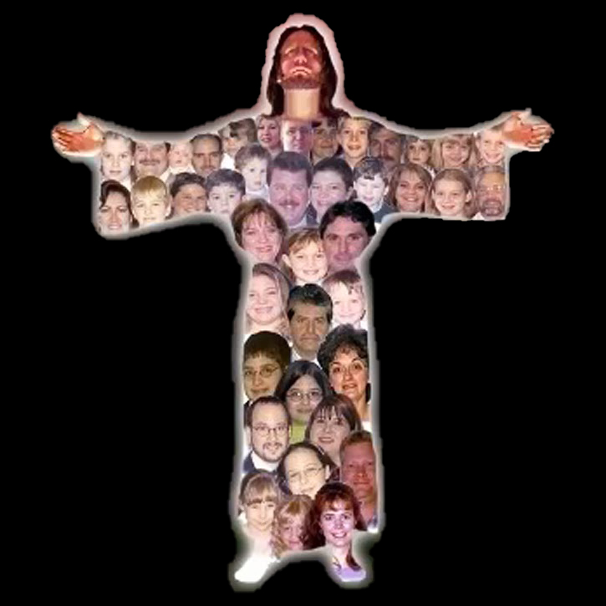
MUTU WA MPINGO
“Iye ndiyenso mutu wa thupi, limene ndi mpingo” (Akolose 1:18a)
Mʼzilankhulo zina (monga Chikatala kapena Chingerezi) liwu lakuti “mutu” limatanthauzidwanso kuti “mtsogoleri” kapena “wamkulu,” chifukwa limenelo ndilo tanthauzo la fanizo la liwu lakuti “mutu.” Zimenezi zili chimodzimodzi mu Chihebri. Mwachitsanzo, mawu akuti “nadzadziikira mkulu mmodzi” (Hoseya 1:11) ayenera kumasuliridwa kuti “adzasankha mtsogoleri mmodzi”.
Tonse ndife ofunika (1 Akorinto 12:15)
Aliyense ali ndintchito yake (1 Akorinto12:17)
Sitinganyoze aliyense pakati pathu (1 Akorinto 12:21)
Palibe wokhulupilira wa pansi koposa ena (1 Akorinto 12:22-24)
Timathandizana (1 Akorinto 12:25-26)
Ili ndilo tanthauzo lomwe Paulo amagwiritsa ntchito liwu limeneli polilumikiza ndi Khristu (Akorinto 1:18a).
Koma Paulo amawonjezeranso tanthauzo la fanizo pa thupi. Ngati Khristu ndi Mutu, ife — mpingo — ndife thupi. Kuchokera pa lingaliro limeneli zikutsatira kuti :

Slide 7


CHIYAMBI
“Ndiye chiyambi, wobadwa woyamba wotuluka mwa akufa; kuti akakhale Iye mwa zonse woyambayamba.”
(Akolose 1:18b)
Liwu limene lamasuliridwa kuti “chiyambi” ndi archē (ἀρχή), liwu la Chigiriki limene limatanthauza chiyambi, gwero, chifukwa choyamba kapena mfundo yoyambira, komanso limatanthauza wolamulira, mphamvu, ulamuliro kapena ufumu, kutengera kwambiri mmene nkhaniyo iliri.
Tinganene kuti liwu limeneli, likagwiritsidwa ntchito pa Khristu, lingakhale ndi matanthauzo onsewa (Akolose 1:18). Yesu ndiye chiyambi cha chilichonse [fanizo la Mulungu], chifukwa chomwe zinthu zonse zinalengedwa [woyamba kubadwa wa chilengedwe chonse], ndi wolamulira wapamwamba [Mutu]. Zonsezi zimamupatsa ukulu wapamwamba koposa zonse.
Paulo amaika mutu wakuti “woyamba kubadwa mwa akufa” apa (ngakhale Yesu sanali woyamba kuukitsidwa kwa akufa, koma Mose). Kupambana kwake pa imfa kumatanthauzanso kupambana kwake pa tchimo ndi mphamvu yake yotirenganso mufanizo lake.

Slide 8

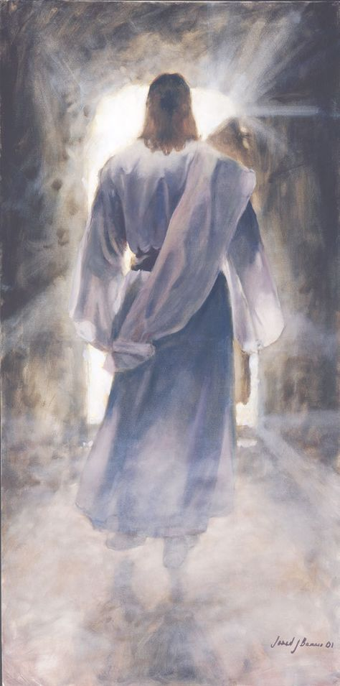



WOYANJANITSA
“mwa Iyenso kuyanjanitsa zinthu zonse kwa Iye mwini, atachita mtendere mwa mwazi wa mtanda wake; mwa Iyetu, kapena za padziko, kapena za m'Mwamba” (Akolose 1:20)
Zimene Yesu anachita zinamupangitsa kukhala woyamba pa zonse. Malinga ndi Paulo, Khristu ndi woyenera kulandira maudindo onsewa “chifukwa Mulungu anakondwera kuti kudzaza kwake konse kukhale mwa Iye” (Akolose 1:19). Mwanjira ina, Yesu anali Mulungu wangwiro ndi munthu wangwiro. “Tinaona ulemerero wake, […] wodzaza ndi chisomo ndi choonadi” (Yohane 1:14).
Pakufa pa mtanda ndi kuukanso, Yesu anakwaniritsa zofunikira zonse zoti abwezeretse chiyanjano pakati pa anthu ndi Mulungu (Akolose 1:20).
Tingamvetsetse kuti Iye anabwezeretsa kwa Mulungu “zinthu za pa dziko lapansi.” Koma anazibwezeretsa bwanji Iye mwini ndi zinthu za kumwamba?
Chilengedwe chonse chatha kuona momveka bwino momwe choipa chiliri. Choncho, khalidwe la Mulungu layesedwa ndi kutsimikiziridwa kukhala lolungama kumwamba komanso pa dziko lapansi.

Slide 9

“Yesu anali ulemerero wa Kumwamba, mtsogoleri wokondedwa wa angelo, amene ankakondwera kuchita chifuniro Chake. Anali amodzi ndi Mulungu, “mʼchifuwa cha Atate” (Yohane 1:18), koma sanawone kukhala wofanana ndi Mulungu kukhala kofunika kwambiiri pamene munthu anali atatayika mu tchimo ndi masautso. Iye anatsika pa mpando wake wachifumu, anasiya korona wake ndi ndodo yake yaufumu, anaveka umulungu wake ndi umunthu. Anadzichepetsa kufikira ngakhale imfa ya pa mtanda, kuti munthu akwezedwe ndikukhala naye pampando wake wachifumu. […] Mʼchikondi Iye amabwera kudzaonetsera Atate, ndi kubwezeretsa munthu kwa Mulungu.”
EGW (Selected Messages, Volume 1, p. 321)

