Slide 1

OKWANIRA MWA YESU
Phunziro 10, March 7, 2026

Slide 2
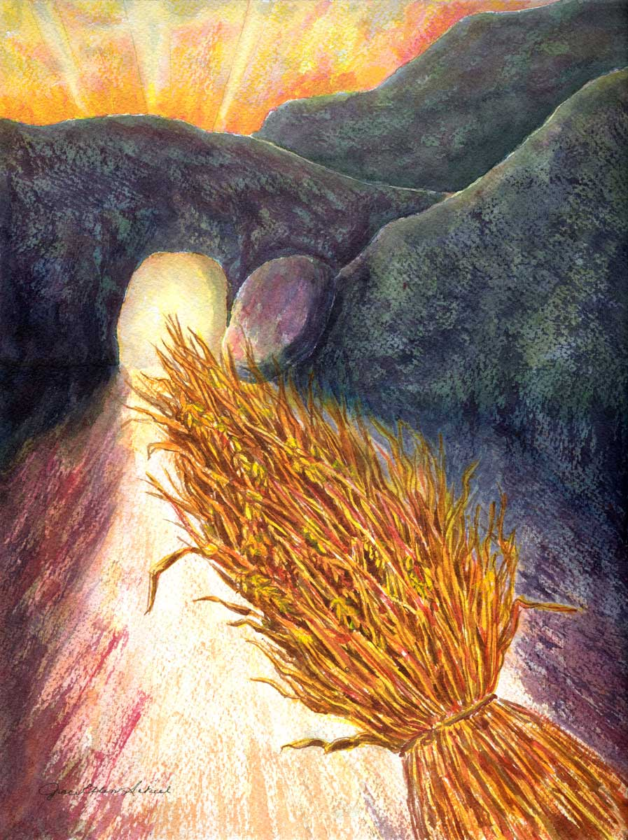
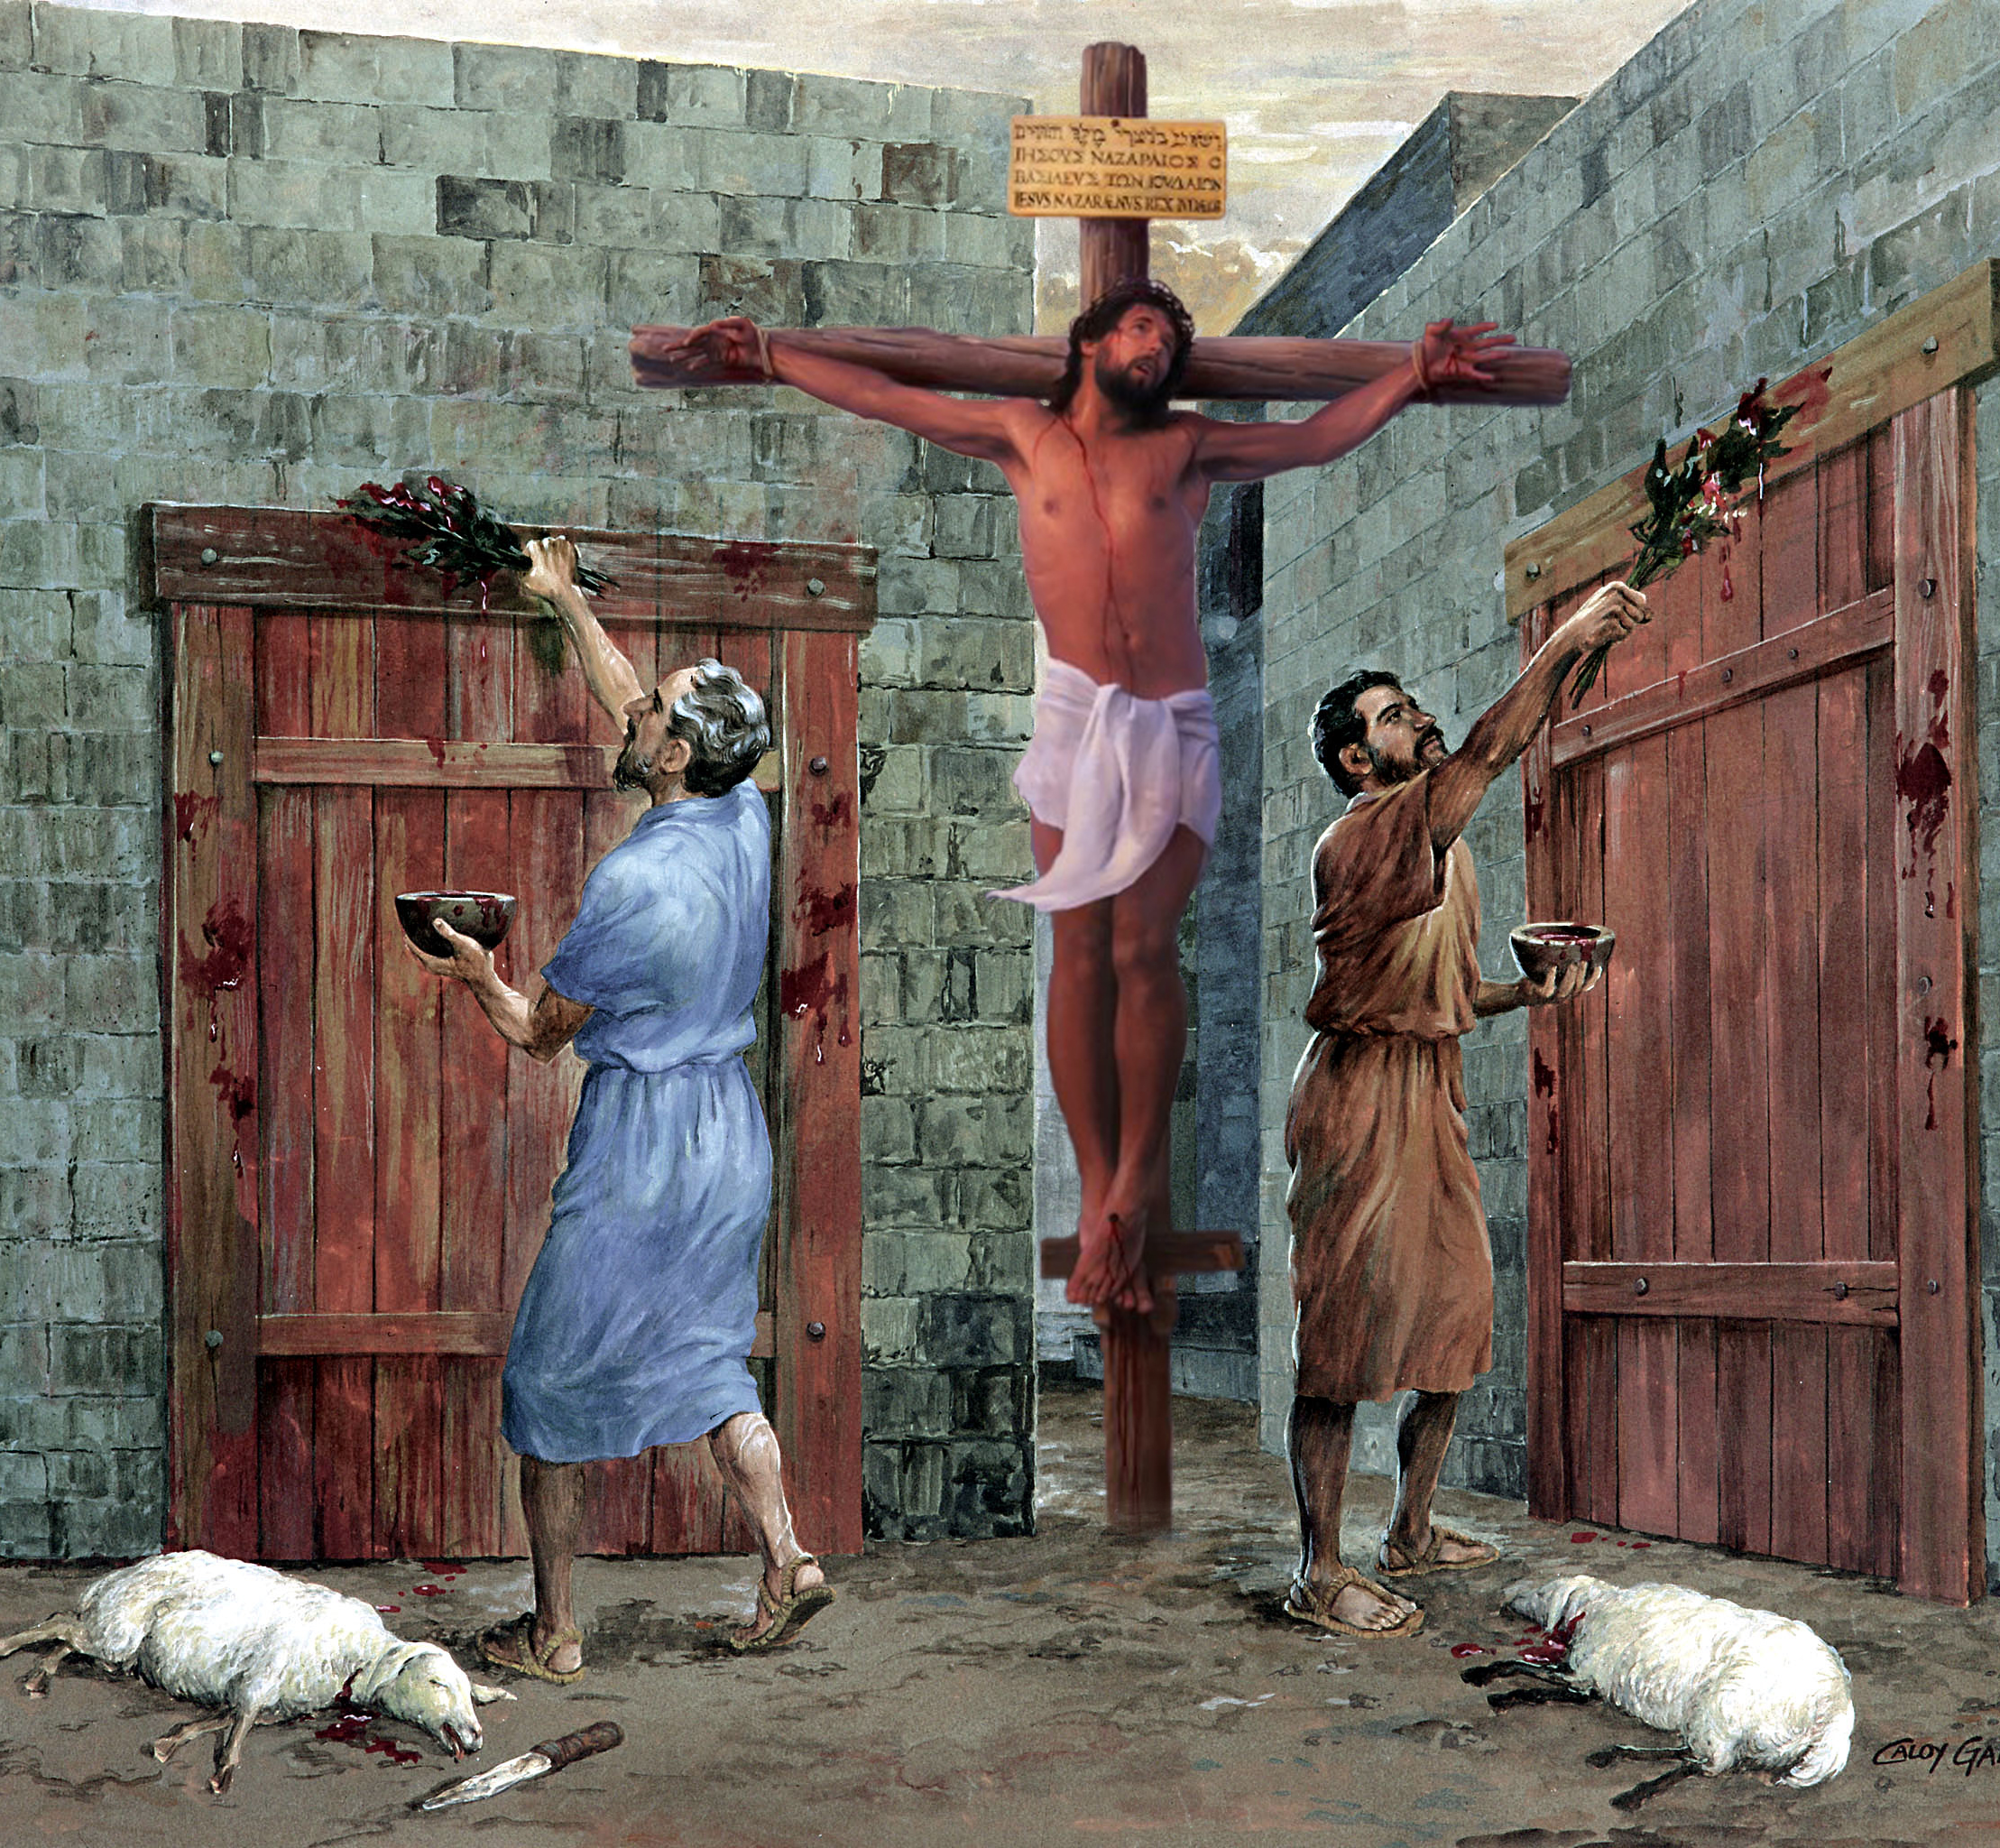
“So let no one judge you in food or in drink, or regarding a festival or a new moon or sabbaths, which are a shadow of things to come, but the substance is of Christ” Akolose 2:16, 17, CCL

Slide 3





Chikhulupiriro mwa Yesu chimabweretsa madalitso akulu kwa ife. Kuwonjezera pa kukhululukidwa kwa machimo athu, timalandiranso chitonthozo, nzeru, ndi zina zambiri.
Paulo akutiyitana kuti tizikike mu chikhulupiliro chimenecho, kuti tikhale ngati mitengo yobala zipatso zabwino za Ufumu wa Mulungu.
Imatichenjezanso mmene tiyenera kukhazikika mizu mwa Iye: osakhazikika pa nzeru za anthu ndi malingaliro awo, koma pa Mawu amoyo a Mulungu okha.
Phindu la chikhulupiriro:
Chitonthozo, matamando, ndi dongosolo (Akolose 2:1-5)
Okhazikika mwa Khristu (Akolose 2:6-8)
Zolemba za malamulo zokhomeredwa pa mtanda wake (Akolose 2:9-15)
Mavuto amene amagwedeza chikhulupiriro :
Masiku opatulika, mwezi watsopano, ndi masiku a Masabata (Akolose 2:16-19)
Malamulo a anthu (Akolose 2:20-23)

Slide 4


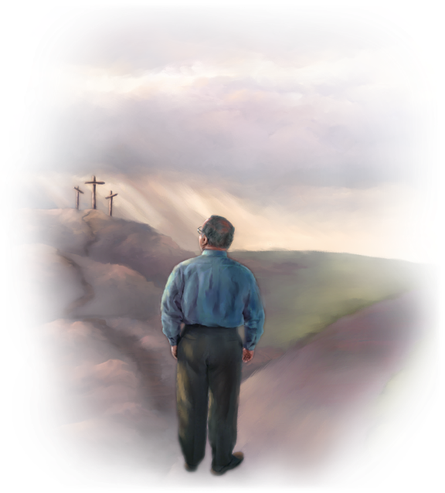
PHINDU LA CHIKHULUPIRIRO

Slide 5

Koma nzeru zingapezeke kuti?
Kodi kumvetsa zinthu kumakhala kuti?
(Yobu 28:12)
Mwa Iyeyu muli chuma chonse chobisidwa cha nzeru ndi chidziwitso (Akolose 2:3)

Slide 6

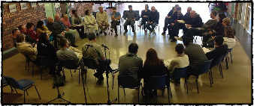
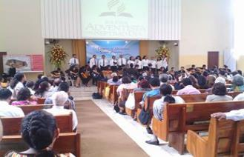
CHITONTHOZO, KUTAMANDA, NDI DONGOSOLO
“Pakuti ngakhale sindili pakati panu mʼthupi, ndili nanu pamodzi mu mzimu, ndipo ndikukondwa kuona kuti mukulongosola bwino zonse ndiponso kuti chikhulupiriro chanu mwa Khristu ndi chokhazikika ndithu.”
(Akolose 2:5)
Ngakhale kuti Paulo sanadziwane nawo yekha mpingo wa ku Kolose, ankadziwa kuti unali kuopsezedwa ndi ziphunzitso zabodza(Akolose. 2:1, 4).
Chifukwa cha zimenezi, iye amawalembera ndi zolinga zitatu zomveka bwino zomwe zidzawathandiza kuthana ndi chiopsezo chimenechi (Akolose 2:2):
kuti alimbikitsidwe m’mitima
ndi kugwirizana mu chikondi
kuti akhale ndi chuma chonse cha kumvetsetsa kwathunthu
kuti adziwe chinsinsi cha Mulungu, chimene ndi Khristu
Asanatchule ziphunzitso zabodza, pali kuyamikira kawiri kwa Akolose: ali ndi dongosolo labwino; ndipo ali olimba m’chikhulupiriro (Akolose 2:5).
“Dongosolo” limene Paulo akunena pano limatanthauza dongosolo pa kulambira komanso mu ntchito zosiyanasiyana za mpingo. Pakhale utsogoleri ndi kugawidwa kwa maudindo; zochitika zichitidwe mwaulemu ndi mokonzeketsera moyenera; ndi zina zotero. Izi zidzathandiza kuti Uthenga Wabwino ulalikidwe bwino kwambiri, ndipo zidzawateteza ku zolakwa zina.

Slide 7



OKHAZIKIKA MWA KHRISTU
“Mukhale ozikika mizu mwa Iye, ndipo moyo wanu umangike pa Iye. Mulimbike mʼchikhulupiriro monga momwe munaphunzirira, ndipo kuyamika kwanu kusefukire.” (Akolose 2:7)
Timapeza chipulumutso polandira Munthu, osati mwa kulandira ziphunzitso (Akolose 2:6). Komabe, ziphunzitsozi ndizofunika. Paulo amatilimbikitsa kuti tiyende mwa Khristu “monga munaphunzirira” (Akolose 2:7b).
Pamene tikuyenda ndi Yesu, timakhazikika mwa Iye mwa Iye. Mwafanizo, ndife “zomera za Ambuye, kuti Iye alemekezedwe” (Yesaya 61:3). Ndifenso “mitengo” imene imagwira ndi kumamatira kwa Yesu ndi ziphunzitso zake (Masalimo 1:3).
Tsopano, pali mitundu iwiri ya ziphunzitso
Malinga ndi Khristu ndi ziphunzitso zake zimene zalembedwa m’Baibulo
Timalimbikitsidwa muchikhulupiriro, ndipo timakula mu kuthokoza (Akolose 2:7)
Malinga ndi nzeru ndi zinthu zopanda pake, malinga ndi miyambo ya anthu
Timanyengedwa, timaweruzidwa, ndipo timalandidwa mphotho yathu (Akolose 2:8, 16, 18)

Slide 8

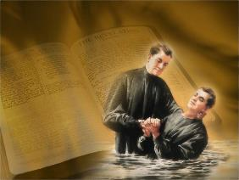

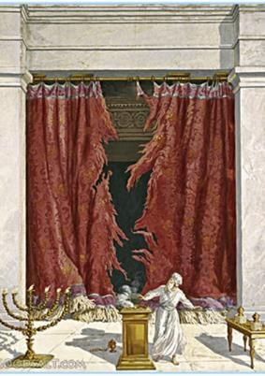
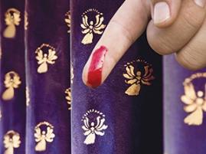
ZOLEMBA ZA MALAMULO ZOKHOMEREDWA PA MTANDA WAKE
“Anafafaniza kalata ya ngongole yathu, pomwe panali milandu yotitsutsa ife. Iye anayichotsa, nayikhomera pa mtanda” (Akolose 2:14)
Abrahamu anatsimikizira pangano lake ndi Mulungu kudzera mu mdulidwe (Genesis 17:11). Ife timatsimikizira pangano lathu ndi Yesu kudzera mu ubatizo, umene ndi “mdulidwe wa Khristu” (Akolose 2:11–12). Izi zikusonyeza kuti mdulidwe wa thupi sudzafunikanso. Atangofotokoza bwino mfundo imeneyi, Paulo akunena za ntchito ya Yesu pa mtanda. Kodi Yesu anakwaniritsa chiyani?
Iye anatipatsa moyo, natikhululukira machimo athu (Akolose 2:13)
Anachotsa mlandu wa ngongole yathu ya malamulo, umene unali kutitsutsa. (Akolose 2:14)
Iye anapambana mphamvu ndi maulamuliro a zoipa (Akolose 2:15)
Aefeso 2:14-15 akufotokoza momveka bwino kuti “malamulo” kapena “zofunikira” zomwe zinali zotsutsana nafe zinali lamulo la miyambo, lomwe linali khoma lolekanitsa Ayuda ndi Amitundu.
Chifukwa cha zimenezi, sitifunikanso kudera nkhawa za kusunga malamulo a miyambo a m’Chipangano Chakale, amene anakwaniritsidwa ndipo anatha mwa Khristu.

Slide 9

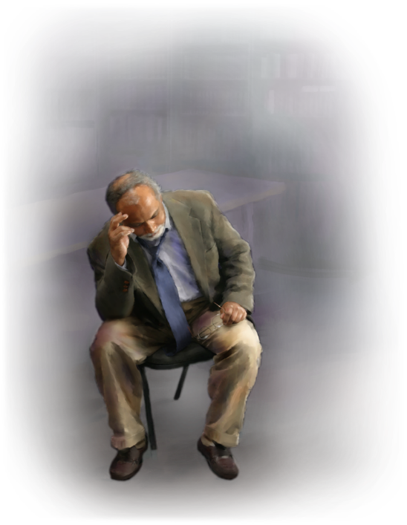
MAVUTO AMENE AMAGWEDEZA CHIKHULUPIRIRO

Slide 10


MASIKU OPATULIKA, MWEZI WATSOPANO, NDI MASIKU A MASABATA
“Nʼchifukwa chake musalole wina aliyense kukuzengani mlandu chifukwa cha zimene mumadya kapena kumwa, kapena za masiku achikondwerero cha chipembedzo, za chikondwerero cha mwezi watsopano, kapena za tsiku la Sabata” (Akolose 2:16)
Pamodzi ndi mdulidwe, panalinso zinthu zina zimene zinkasiyanitsa Ayuda ndi a Mitundu: miyambo ya chipembedzo ndi zikondwerero (madyerero) opatulika.
Paulo anali atafotokoza kale bwino ntchito ya mdulidwe. Tsopano, pogwiritsa ntchito mawu akuti “lolani,” Paulo akusonyeza zotsatira za kuchotsedwa kwa “zolemba” (malamulo a miyambo): sizinalinso zofunika kuti munthu apulumuke kusunga miyambo ndi zikondwerero, zimene Yesu anakwaniritsa pofa pa mtanda (Mateyu 27:51; Akolose 2:16).
Zikuoneka kuti Paulo akutchula mawu a Hoseya 2:11 kuti afotokoze mwachidule dongosolo lonse la miyambo ya Kachisi m’mawu amodzi. Izi zikutanthauza kuti Masabata amene akutchulidwa pano ndi Masabata asanu ndi awiri a miyambo (masabata a nsembe/zikondwerero) amene amasungidwa mosasamala kanthu za tsiku la sabata limene agwere, osati Sabata ya mlungu uliwonse (lomwe lili m'malamulo amakhalidwe abwino, logwiritsidwa ntchito kwa onse, Ayuda ndi Amitundu).

Slide 11


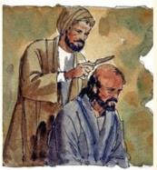

MALAMULO A ANTHU
“Malamulo amenewa amakhudza zinthu zimene zimatha zikamagwiritsidwa ntchito, ndipo malamulo ndi zophunzitsa za anthu chabe” (Akolose 2:22)
Aphunzitsi abodza, omwe Paulo anawatchula kangapo m'kalata yake, anali Ayuda omwe ankaphunzitsa kufunika kotsatira malamulo a Chiyuda kuti apeze chipulumutso (Machitidwe 15:1, 5). Malamulo amenewa analinso ndi malamulo ambiri omwe arabi ankapanga.
Titsatire maganizo a Paulo. Mu ubatizo tinafa ku “khalidwa la dziko” ndipo tikukhala kwa Khristu. Ngati tipitiriza kudera nkhawa, mwachitsanzo, za zodetsedwa za miyambo, tikadali kukhala m’dziko, ndipo timadandaula za zinthu zimene zimatha ndi kugwiritsidwa ntchito (Akolose 2:20-22).
Koma, Paulo akufotokoza kuti kwa Ayuda amene anazolowera miyambo imeneyi ili ndi phindu linalake m’makhalidwe kwa iwo eni, ngakhale kuti sili yothandiza kusintha mtima konse (Akolose 2:23).
Mwachidule, tiyenera kutsogoleredwa ndi ziphunzitso zomwe zili m’Malemba—zouziridwa ndi Mulungu—osati ndi nzeru ziphunzitso za anthu kapena kulingalira kwa anthu.

Slide 12

“Mkristu amafanizidwa ndi mkungudza wa ku Lebanoni. Ndawerenga kuti mtengo umenewu umachita zambiri kuposa kungotumiza mizu yochepa m’nthaka yofewa. Umatumiza mizu yamphamvu kwambiri, ndipo umagunda pansi kwambiri pofuna malo olimba kwambiri. Ndipo mphepo yamphamvu ya mkuntho ikabwera, umaimirira molimba, chifukwa umamangidwa ndi maukonde a “zingwe” zake pansi.
Choncho Mkhristu amatenga mizu yakuya mwa Khristu. Iye ali ndi chikhulupiriro mwa Momboli wake. Iye amadziwa amene akumukhulupirira. Iye amatsimikiza kotheratu kuti Yesu ndi Mwana wa Mulungu ndi Mpulumutsi wa ochimwa. … … … Mizu ya chikhulupiriro imalowa pansi pokuya. Akhristu enieni, monga mkungudza wa ku Lebanoni, sakula m'nthaka yofewa, koma amakhala ndi mizu mwa Mulungu, okhazikika m'ming'alu ya miyala ya m'mapiri.”
EGW (Our High Calling, November 21)

