Slide 1
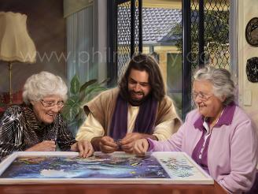
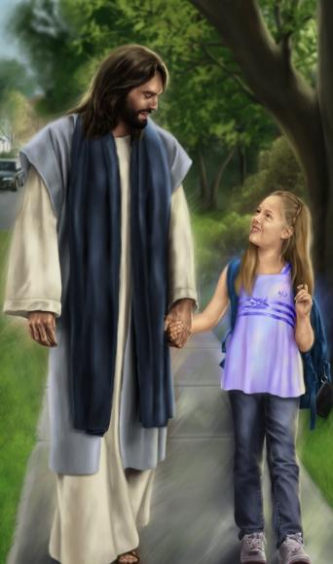
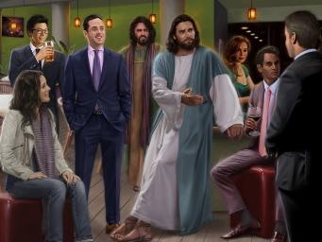
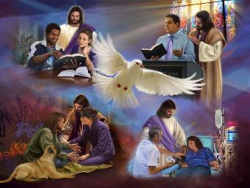
KUKHALA NDI
YESU
Phunziro 11, March 14, 2026

Slide 2

“Ndipo kuwonjezera pa zonsezi valani chikondi, chimene chimangirira zonsezi pamodzi mu mgwirizano wangwiro”
Akolose 3:14, CCL

Slide 3

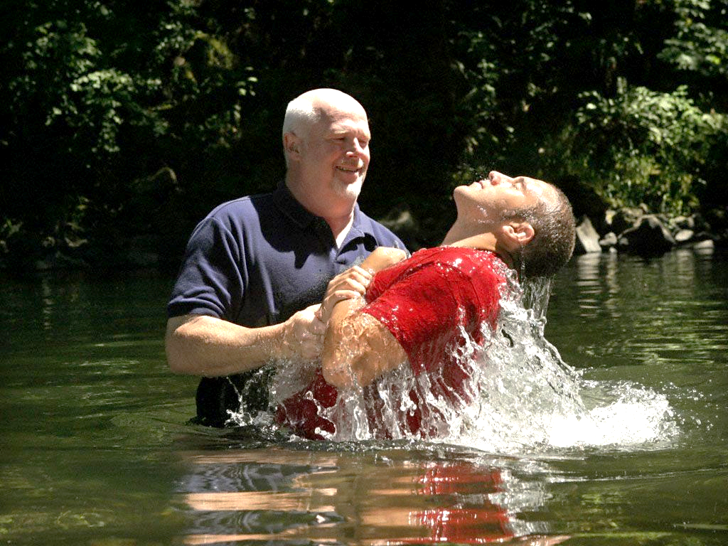






Tikamizidwa m’madzi a ubatizo, timafa ku moyo wathu wakale wa uchimo. Tikachoka m’madzimo, timauka monga zolengedwa zatsopano.
Tinasiya moyo wathu wakale komanso kaganizidwe kathu ka kale. Kuyambira pamenepo, tinakhala moyo wosiyana ndi kuganiza mosiyana. Tinasiya kukhala ndi maganizo a dziko lapansi ndipo tinakhala ndi maganizo akumwamba.
Pazifukwa zina, njira zathu zakale zimapitilizabe kuyesetsa kubwereranso. Ndicho chifukwa chake mtumwi Paulo akutilimbikitsa kuti tiyang'ane kumwamba ndikusiya zinthu zapadziko lapansi.
Maganizo a dziko lapansi kapena a kumwamba?
Cholinga chathu (Akolose 3:1-4)
Kufa kuzinthu za dziko lapansi (Akolose 3:5-6)
Kuvala zinthu zakumwamba (Akolose 3:7-11)
Makhalidwe a moyo watsopano mwa Khristu:
Mgwirizano wangwiro(Akolose 3:12-14)
Chakudya Chakumwamba (Akolose 3:15-17)

Slide 4


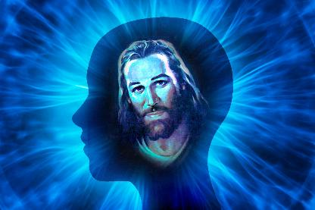
MAGANIZO A DZIKO LAPANSI KAPENA A KUMWAMBA?

Slide 5

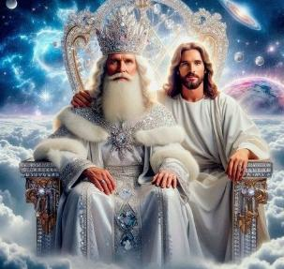


CHOLINGA CHATHU
“Set your minds on things above, not on earthly things.” (Akolose 3:2)
Kuyambira pa mfundo yakuti tinaukitsidwa ndi Khristu mu ubatizo (Akolose 2:12), Paulo akutilimbikitsa kutsatira Yesu kupita kumalo kumene anapita ataukitsidwa: mpando wachifumu wa Mulungu (Akolose 3:1).
Inde, tidzatha kuchita zimenezi m’thupi pamene Yesu adzatitenga kupita kumeneko pa Kubwera Kwake Kachiwiri (Akolose 3:4). Koma pakadali pano tiyenera kuika maso athu—cholinga chathu—pa zinthu za kumwamba (Akolose 3:2).
"Tafa," ndipo moyo wathu "wabisika ndi Khristu mwa Mulungu" (Akolose 3:3). Moyo womwe ukunenedwa pano ndi umene timalandira tikalandira Khristu.
Koma moyo umenewo, kuti ukhalebe wamoyo, uyenera kudyetsedwa tsiku ndi tsiku (2 Akorinto 4:16). Tsiku lililonse tiyenera kufunafuna “zinthu za kumwamba,” “kuika maso athu pa Yesu” (Heb. 12:2).

Slide 6






KUFA KUZINTHU ZA DZIKO LAPANSI
“Chifukwa chake fetsani ziwalozo zili padziko; dama, chidetso, chifunitso chamanyazi, chilakolako choipa, ndi chisiriro, chimene chili kupembedza mafano.” (Akolose 3:5 BLP-2018)
Popeza tinaaukitsidwa pamodzi ndi Khristu ndipo tikukhala tili ndi maganizo a kumwamba, tiyenera kupha (kuletsa/kuchotsa) zimene zimatilepheretsa kukwaniritsa cholinga chathu: zinthu za dziko lapansi.
Kuti wina asamachite cholakwa, Paulo akunena mizati yayikulu ya maganizo a dziko lapansi (imene pambuyo pake adzafotokoza mwatsatanetsatane): “chigololo, chodetsedwa, chilakolako, zilakolako zoipa, ndi umbombo, zimene zili kupembedza mafano” (Akolose 3:5).
Chikhalidwe cha munthu sichinasinthe kwambiri kuyambira nthawi ya Paulo, popeza tikadali ozunguliridwa ndi zilakolako zomwezi zimene zimaphwanya zonse ziwiri: lemba lenileni ndi mzimu wa Malamulo Khumi.
Ndipo n’chifukwa chiyani tiyenera “kupha”—kusiya, kuchotsa—zinthu zimenezi m’maganizo ndi m’zochita zathu? Chifukwa chakuti zimabweretsa “mkwiyo wa Mulungu” ndipo motero sizigwirizana ndi chibadwa chathu chakumwamba (Akolose 3:6). Iphani zapadziko lapansi zisanakupheni!

Slide 7




KUVALA ZINTHU ZAKUMWAMBA
“ndipo mwavala munthu watsopano, amene nzeru zake zikukonzedwanso kuti afanane ndi Mlengi wake.” (Akolose 3:10 CCL)
Kudzera mu mawu a mwambi, Paulo awonjezera pa mizati isanu ya maganizo a dziko lapansi zochita zina zisanu za dziko lapansi zimene tiyenera kuzipewa: “mkwiyo, ukali, zoyipa (chidani), kunyoza, ndi mawu onyansa ochokera m’kamwa mwanu” (Akolose 3:8). Ndipo anamaliza ndi chochita chachisanu ndi chimodzi—choipa koposa zonse—: “Musamanamizirane” (Akolose 3:9).
Paulo akuganiza kuti tachotsa kale “umunthu wanu wakale ndi machitidwe ake” (Akolose 3:9). Tachotsa “zovala zathu zonyansa” pamene talola Yesu kuti achotse machimo athu (Zekariya. 3:4).
Titavula zovala zimenezo, tiyenera kuvala “zovala zabwino.” Titavala zovala zatsopanozi, timapitiriza kukhala atsopano, tikukula mu chiyero tsiku ndi tsiku (Akolose 3:10).
Pamene tikukonzedwanso ndi ntchito ya Mzimu Woyera komanso kuphunzira Mawu, zopinga zimene zimatilekanitsa wina ndi mnzake zimachoka (Akolose 3:11).

Slide 8


MAKHALIDWE A MOYO WA TSOPANO MWA YESU

Slide 9

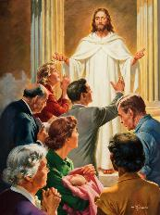


MGWIRIZANO WANGWIRO
“Ndipo kuwonjezera pa zonsezi valani chikondi, chimene chimangirira zonsezi pamodzi mu mgwirizano wangwiro” (Akolose 3:14)
Ife ndife “anthu osankhidwa a Mulungu, oyera ndi okondedwa kwambiri” (Akolose 3:12). Petro akutiuza kuti zimenezi zimatibweretsera madalitso akulu komanso udindo waukulu (1 Petro 2:9). Koma munthu mmodzi waosankhidwa a Mulungu amakhala bwanji (Akolose 3:12-13)?
1
2
3
4
Ndi chifundo chachikulu
Ndi kukoma mtima
Ndi kudzichepetsa
Ndi kufatsa
Ndi kupirira
Kulolerana wina ndi mnzake
Kukhululukirana wina ndi mnzake
5
6
7
Ndipo zonsezi zichitike m’kati mwa mgwirizano wangwiro : chikondi (Akolose 3:14). Izi ndiye madalitso ndi maudindo athu :
Dalitso
Udindo
Tikakhala motere, timakhala dalitso kwa ena komanso kwa ife eni
Khalidwe lathu lilemekeze Mulungu, ndipo lilimbikitse ena kukhulupirira ndi kutsatira Yesu

Slide 10


CHAKUDYA CHAKUMWAMBA
“Mawu a Khristu akhazikike kwathunthu mʼmitima mwanu. Muziphunzitsana ndi kulangizana wina ndi mnzake ndi nzeru zonse pamene mukuyimba Masalimo, nyimbo zotamanda ndi nyimbo zauzimu, kuyimbira Mulungu ndi mitima yoyamika.” (Akolose 3:16)
Akolose 3:15-17 amationetsa mmene tingadyetsere chikhalidwe chathu cha kumwamba (ndipo zikuoneka kuti sitingachite izi patokha, koma tifunika chiyanjano cha mpingo kuti tichite zimenezi):
Kulola mtendere wa Mulungu utitsogolere
Kukhala ogwirizana monga thupi limodzi
Kukhala woyamika
Kuphunzira Baibulo mozama
Kuphunzitsana zimene taphunzira
Kuimba masalimo, nyimbo zotamanda, ndi nyimbo zauzimu
Kuchita zonse m’dzina la Yesu
“Nyimbo ndi chida chomwe tingagwiritse ntchito nthawi zonse polimbana ndi zokhumudwitsa. Pamene tikutsegula mtima wathu ku kuwala kwa dzuwa la Mpulumutsi, tidzakhala ndi thanzi ndi madalitso Ake” (Ellen G. White, “The Ministry of Healing,” p. 254) .

Slide 11

“Khalani wokoma mtima, wofatsa, wachifundo, komanso womvera ena, ndipo musatchule makhalidwe amenewa kuti ndi kufooka, chifukwa ndi khalidwe la Khristu. Samalani za mmene mumakhudzira ena. Lolani kuti mukhale a khalidwe lonunkhira bwino kwambiri kotero kuti simudzachita manyazi ngati zikaonekera mwa ena.
Monga madontho a madzi amapanga mtsinje, momwemonso zinthu zazing’ono zimapanga moyo. Moyo ndi mtsinje—wamtendere, wodekha, wosangalatsa—kapena ndi mtsinje wosokonekera, womwe nthawi zonse umatulutsa matope ndi zonyansa. M’moyo uno mutha kudziyika pansi pa chitsogozo cha Mzimu Woyera. Kudzera mu kuyeretsedwa kwa Mzimu, motero mudzakula mofanana ndi Khristu.
EGW ( That I May Know Him , July 22)

