Slide 1
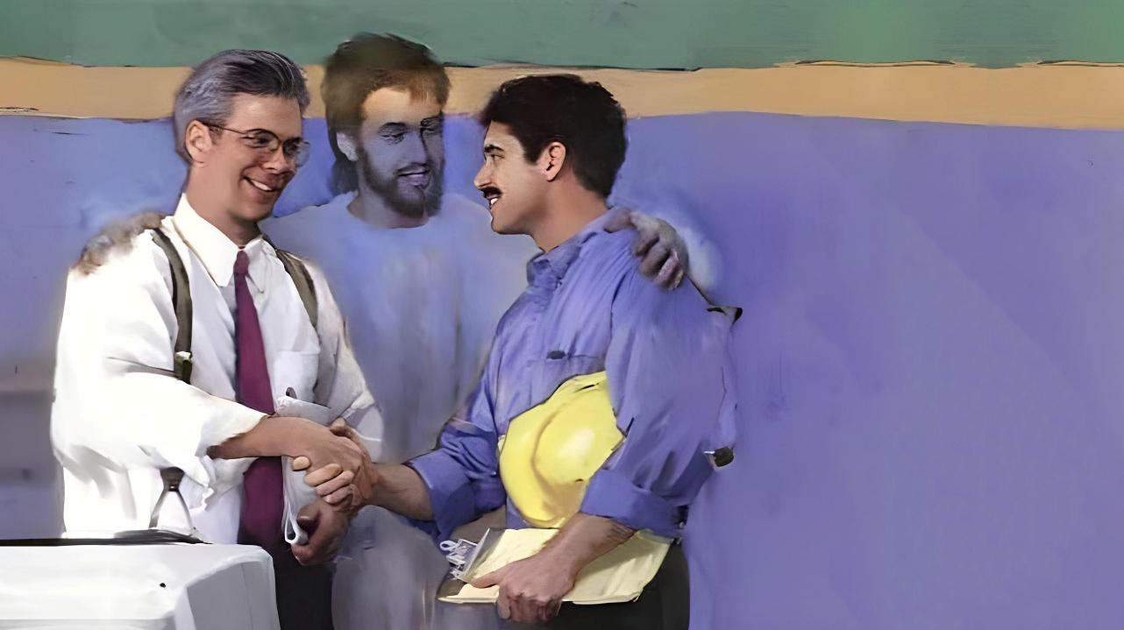
Phunziro 12, March 21, 2026
KUKHALA LIMODZI WINA NDI MNZAKE

Slide 2

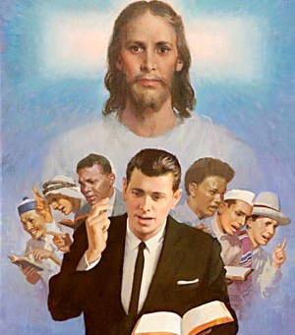
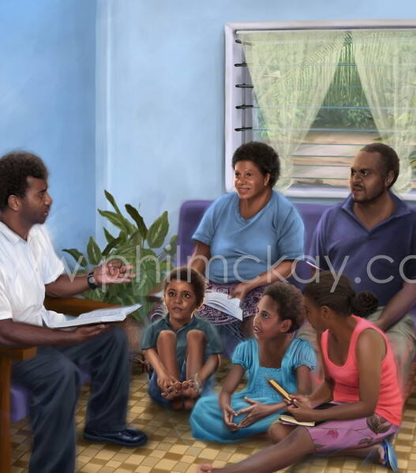
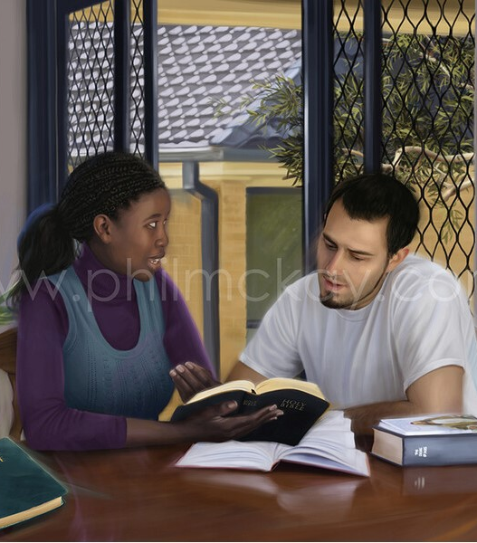
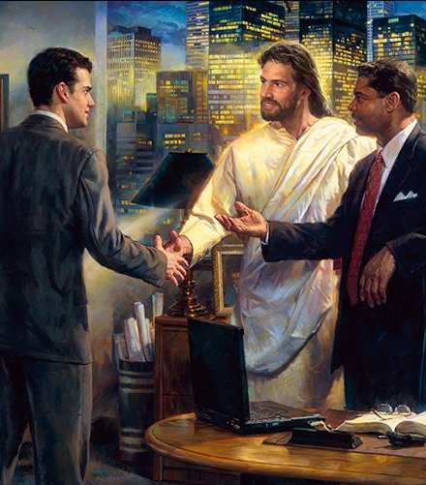

“Mayankhulidwe anu nthawi zonse akhale odzaza ndi chisomo ndi okoma, kuti mudziwe kuyankha aliyense”
Akolose 4:6, CCL

Slide 3




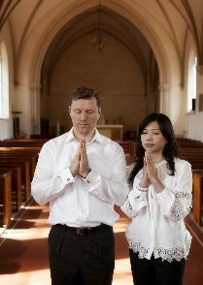

Mugawo la kalatayi lofotokoza zinthu zothandiza pa moyo, Paulo akuyankha nkhani ya maubwenzi a anthu m’malo osiyanasiyana amene timakhala ndi chikoka.
Maubwenzi nthawi zambiri amabweretsa kusamvetsetsana komanso mikangano. Choncho, pakufunika umodzi, komanso mgwirizano pa mfundo, pa zolinga, ndi pa zimene mukufuna kukwaniritsa.
Paulo amatipatsa mfundo zothandiza pofuna kukonza ubwenzi wa pakati pa okwatirana, pakati pa makolo ndi ana, pakati pa mabwana ndi antchito, pakati pa abale ndi azilongo mu mpingo, komanso pakati pa okhulupirira ndi osakhulupirira.
Ubwenzi wa pakati pa okwatirana (Akolose 3:18-19)
Ubwenzi wa pakati pa makolo ndi ana (Akolose 3:20-21)
Ubwenzi wa pakati pa mabwana ndi antchito (Akolose 3:22-25; 4:1)
Ubwenzi wa pakati pa abale ndi alongo mu mpingo (Akolose 4:2-4)
Ubwenzi wa pakati pa okhulupirira ndi osakhulupirira (Akolose 4:5-6)

Slide 4




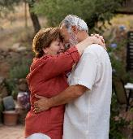


UBWENZI WA PAKATI PA OKWATIRANA
“Akazi inu, muzimvera amuna anu, monga kuyenera mwa Ambuye. Amuna inu, kondani akazi anu, ndipo musawawire mtima iwo (Akolose 3:18-19 BPL)
Makalata opita kwa Akolose ndi Aefeso, omwe analembedwa pa nthawi imodzi, ali ndi uphungu ofanana (komanso ogwirizana) okhudza anthu okwatirana (Akolose 3:18-19; Aefeso 5:21-33).
Akazi akhale omvera amuna awo (Akolose 3:18; Aefeso 5:22–24)
Kumvera kumeneku kuli mkati mwa kugonjera kwa onse (Aefeso 5:21), ndipo kuyenera kukhala “monga momwe kuyenerera mwa Ambuye.
Amuna ayenera kukonda akazi awo (Akolose 3:19; Aefeso 5:28)
Awakonde ndi chikondi chomwecho chimene Khristu anatikonda nacho (Aefeso 5:25)
Iwo ali ndi udindo osalira moyo wawo (Aefeso 5:29)
Musakhale “okalipa” (musawakhumudwitse, musakhale ankhanza kapena achiwawa, ndipo musakhale olamulira mwankhanza)
Onse awiri m’banja ayenera kugwira ntchito limodzi, kukambirana, komanso kupanga zisankho mogwirizana, uku mwamuna akukhala mtsogoleri wabwino wa banja. Aliyense azifunira mnzake zabwino nthawi zonse.

Slide 5

“Aliyense apereke chikondi osati kungofuna kulandira chikondi. Limbikitsani makhalidwe abwino mwa inu nokha, ndipo khalani ofunitsitsa kuzindikira zabwino zomwe mnzanu ali nazo. Kudziwa kuti kuyamikiridwa kunapereka chilimbikitso chachikulu ndi kukhutira. Chifundo ndi ulemu zimalimbikitsa kufunafuna zabwino, ndipo chikondi chimawonjezeka pamene chimalimbikitsa zolinga zabwino[…]
Mkazi ayenera kulemekeza mwamuna wake. Mwamuna ayenera kukonda ndi kusamalira mkazi wake; ndipo monga momwe lumbiro lawo la ukwati limawagwirizanitsa kukhala amodzi, momwemonso chikhulupiriro chawo mwa Khristu chiyenera kuwapangitsa kukhala amodzi mwa Iye. Ndichiyani chingakondweretse Mulungu kuposa kuona amene alowa m’banja la ukwati akufunafuna limodzi kuphunzira za Yesu ndi kudzazidwa kwambiri ndi Mzimu Wake?”
EGW (The Christian Home, pp. 107, 114)

Slide 6




UBWENZI WA PAKATI PA MAKOLO NDI ANA
“Inu ana, mverani makolo anu mu zonse pakuti izi zimakondweretsa Ambuye. Inu abambo, musakwiyitse ana anu, kuti angataye mtima”. (Akolose 3:20-21)
Masiku ano, mawu oti "makolo" ayenera kugwiritsidwa ntchito polankhula za mabanja a ukwati wokhazikika komanso pa mabanja a kholo limodzi. Malinga ndi Paulo, ubale wabwino si udindo wa makolo okha, komanso wa ana..
Udindo wa ana aamuna ndi aakazi (Akolose 3:20; Aefeso 6:1-3)
Kumvera kwa ana sikosankha ai
Kumvera kumeneku kumachokera pa lamulo lachisanu
Komanso, kumvera kumabwera ndi mphotho yake
Maudindo a Makolo
(Akolose 3:21; Aefeso 6:4)
Aphunzitseni popanda kuwakhumudwitsa kapena kuwakwitsa, kuti asataye mtima
Musawakwiyitse pochita zinthu mosaleza mtima kapena mopanda kuganizira bwino
Aphunzitseni njira za Mulungu (Deutronomo 6:6-7; Miyambo 22:6)
Kulambira kwa banja m'mawa ndi madzulo ndikofunika kwambiri kuti ana athu aphunzire za Mulungu ndikupanga zisankho zopezera moyo wosatha. Ndipo tisaiwale kuti chitsanzo chathu ndi mphunzitsi wamkulu wa ana athu.

Slide 7

“Makolo, lolani ana anu aone kuti mumawakonda ndiponso kuti mudzachita zonse zomwe mungathe kuti muwasangalatse. Mukatero, malamulo ndi zoletsa zanu zofunika zidzakhala ndi mphamvu yayikulu kwambiri m'maganizo awo aang’ono. Lamulirani ana anu mofatsa ndi mwachifundo, mukukumbukira kuti “angelo awo nthawi zonse amaona nkhope ya Atate wanga wa kumwamba.” Ngati mukufuna kuti angelo awachitire ana anu ntchito yomwe Mulungu anawapatsa, gwirizanani nawo pochita gawo lanu.”
EGW (The Christian Home, p. 193)

Slide 8



UBWENZI WA PAKATI PA MABWANA NDI ANTCHITO
“Inu antchito, mverani mabwana anu mu zonse, ndipo muzichita zimenezi osati nthawi yokhayo imene akukuonani kuti akukondeni, koma muzichite moona mtima ndi mopereka ulemu kwa Ambuye.” (Akolose 3:22)
Ubale wa utumiki umene unalipo m’nthawi ya Paulo uli ndi kufanana kochepa kwambiri ndi mitundu ya ukapolo yomwe, mwatsoka, ikadalipobe masiku ano. Choncho, tiyenera kumvetsa uphungu umenewu mkati mwa ubale wa bwana ndi wantchito.
Makhalidwe a antchito kwa mabwana awo (Akolose 3:22-25; Aefeso 6:5-8)
Muzigwira ntchito ndi mphamvu zanu zonse nthawi zonse, ngakhale pamene palibe amene akukuonani
Yesetsani kuchita zinthu mwaluso kwambiri pa ntchito yanu, ngati kuti mukuchitira Mulungu
Landirani kudzudzulidwa pamene kuli koyenera
Ntchito yabwino imabala zipatso
Kukhala ndi bwana woipa sikutipatsa chifukwa choti tisamumvere (1 Petro 2:18)
Makhalidwe a mabwana
(Akolose 4:1; Aefeso 6:9)
Kutsogolera mwachilungamo komanso mofatsa
Musagwiritse ntchito kuwopseza kapena kufuna zinthu zosayembekezereka
Bwana aliyense ali ndi Bwana wamkulu pamwamba pake, amene adzayenera kumufotokoza mmene anachitira zinthu
Ife tonse, kaya tili mabwana kapena antchito, tili atumiki (akapolo) a Khristu, chifukwa timatumikira Iye.

Slide 9

“Sizinali ntchito ya mtumwiyo kugwetsa dongosolo lokhazikika la anthu mwachisawawa kapena mwadzidzidzi. uyesa kuchita zimenezi kukanalepheretsa kupita patsogolo kwa uthenga wabwino. Koma iye anaphunzitsa mfundo zimene zinagwetsa maziko enieni a ukapolo, ndipo mfundozo zikagwiritsidwa ntchito, zikanathetsadi dongosolo lonselo. […]
Chikhristu chimapanga mgwirizano wolimba pakati pa mbuye ndi kapolo, mfumu ndi womvera, mtumiki wa uthenga wabwino ndi wochimwa wonyozeka amene wapeza mwa Khristu kutsukidwa ku uchimo. Iwo atsukidwa ndi mwazi omwewo, apatsidwa moyo ndi Mzimu yemweyo; ndipo apangidwa kukhala amodzi mwa Khristu Yesu.
EGW (The Acts of the Apostles, p. 460)

Slide 10


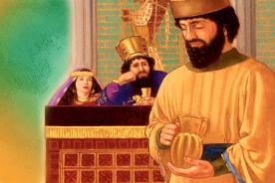
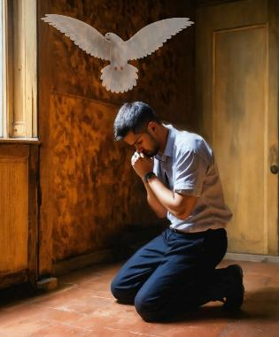
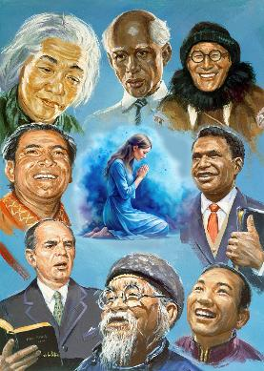
UBWENZI WA PAKATI PA ABALE NDI ALONGO MU MPINGO
“Pempherani modzipereka, mukhale atcheru ndiponso oyamika” (Akolose 4:2)
Tikulimbikitsidwa “kupemphererana” chifukwa “Pemphero la munthu wolungama lili ndi mphamvu ndipo limagwira ntchito” (Yakobo 5:16).
Kupatula mapemphero a m’mawa ndi a madzulo, Paulo akupempha kuti tizipemphera nthawi zonse (Akolose 4:2; Aefeso 6:18; 1 Atesalonika 5:17). Monga momwe Nehemiya anapemphera mwakachetechete pamaso pa mfumu (Nehemiya 2:4), ifenso tili ndi mwayi wopemphera kulikonse ndi pa nthawi iliyonse.
Kuwonjezera apo, tili ndi chitsimikizo chakuti Mzimu Woyera adzasandutsa pemphero lathu kuti likhale lothandiza (Aroma 8:26).
Paulo akupempha mwapadera kuti tizipempherera amene amalalikira Uthenga Wabwino (Akol. 4:3-4; Aef. 6:19). Ziribe kanthu kuti mlaliki ali ndi chidziwitso chochepa kapena chochuluka pa ulaliki; palibe amene ali wokwanira pa ntchito imeneyi. Paulo mwini sanangopemphera yekha, koma anapemphanso abale kuti amupempherere, kuti mawu ake akhale oyenera.

Slide 11

“Pa khama lililonse komanso pa malo aliwonse pamene choonadi chikuphunzitsidwa, pakufunika maganizo osiyanasiyana, mphatso zosiyanasiyana, ndiponso ndiponso njira ndi ndondomeko zosiyanasiyana za ntchito zimene zaphatikizidwa pamodzi. Onse ayenera kukhala ndi cholinga chopangana limodzi komanso kupemphera limodzi. Khristu akuti, “Ngati awiri a inu adzagwirizana padziko lapansi pa chinthu chilichonse chimene adzapempha, Atate wanga wa Kumwamba adzachichita.” (Mateyu 18:19)”
EGW (Selected Messages, vol. 3, p. 24)

Slide 12

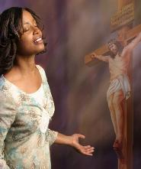
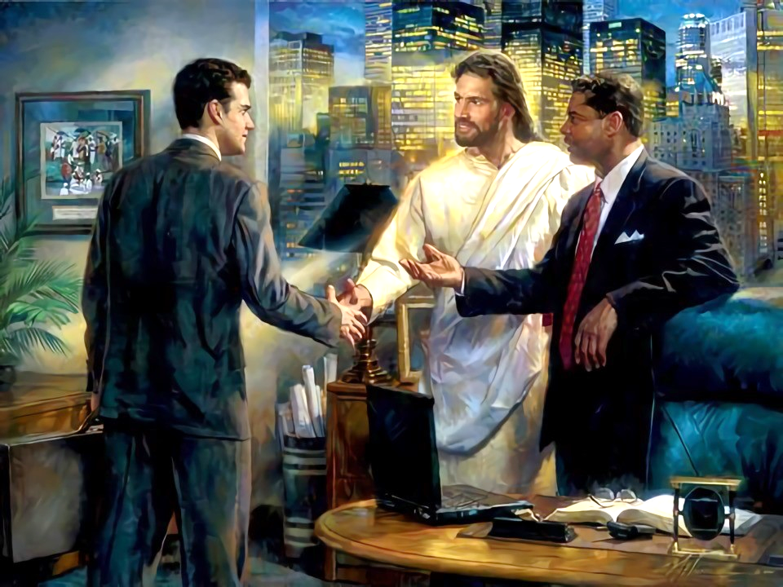
UBWENZI WA PAKATI PA OKHULUPIRIRA NDI OSAKHULUPIRIRA
“Mayendedwe anu pakati pa akunja, akhale anzeru ndipo mugwiritse ntchito mpata uliwonse umene muli nawo.” (Akolose 4:5)
Tili ndi madalitso aakulu: taphunzira zimene Yesu anatichitira; tavomereza ndipo tili ndi chitsimikizo cha chipulumutso.
Tikudziwa zimenezi chifukwa wina anatiuza uthenga umenewu. Momwemonso, nafenso tiyenera kugawana ndi ena. Kodi Paulo akunena kuti tiyenera kukhala bwanji ndi “akunja,” omwe sakudziwa Yesu (Akolose 4:5-6)?
Mwa Mzeru
Tikusowa “nzeru zochokera kumwamba” (Yakobo 3:17) pa ubale wathu ndi anthu amene sanamudziwebe Yesu
Ndi maulenu
Mawu athu ayenera kukhala aulemu nthawi zonse kuti atimvetsere mosangalala.
Ndi mawu “okometsedwa ndi mchere.”
Zokambirana ziyenera kukhala zoyenera komanso zosinthidwa mogwirizana ndi munthu komanso malo amene ali.
Kuyankha aliyense m’njira yoyenera
Popeza munthu aliyense ndi wosiyana, Mzimu Woyera adzatitsogolera pa zomwe tingayankhe pa nthawi iliyonse

Slide 13

“Ulemu weniweni wosakaniza choonadi ndi chilungamo umapangitsa moyo kukhala wothandiza komanso wokongola ndi wonunkhira bwino. Mawu okoma, maonekedwe ansangala, ndi nkhope yachimwemwe, zimamupatsa Mkhristu mphamvu yokopa imene imakhala yovuta kuikana. Podziyiwala mwiniwake, komanso m’kuunika, mtendere, ndi chimwemwe zimene amapereka kwa ena nthawi zonse, iye amapeza chimwemwe chenicheni.
Tiyeni tikhale odziyiwala tokha, ndikukhala tcheru nthawi zonse polimbikitsa ena, ndi kupeputsa akatundu awo kudzera m’machitidwe a chifundo chachikulu ndi ntchito zachikondi.”
EGW (In Heavenly Places, June 22)

