Slide 1
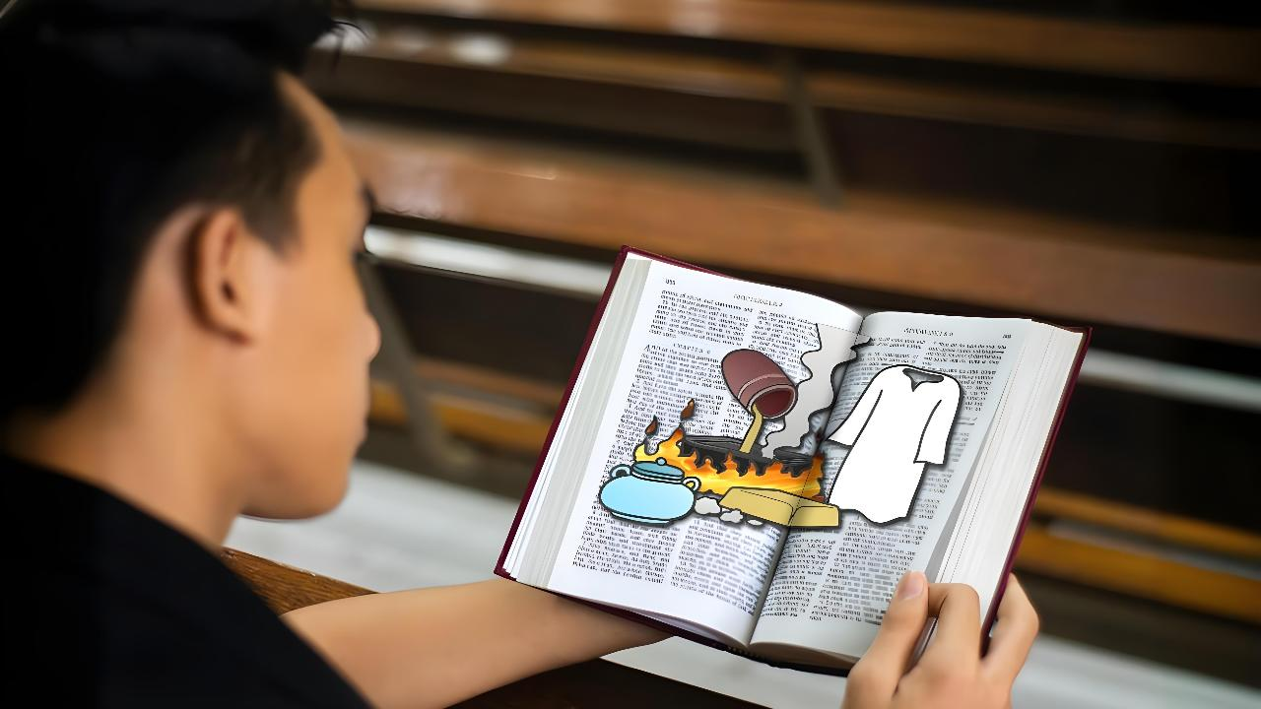
FUFUZANI ZOONA
Phunziro 1, April 4, 2026

Slide 2
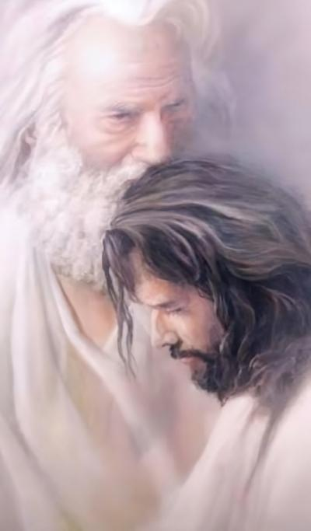
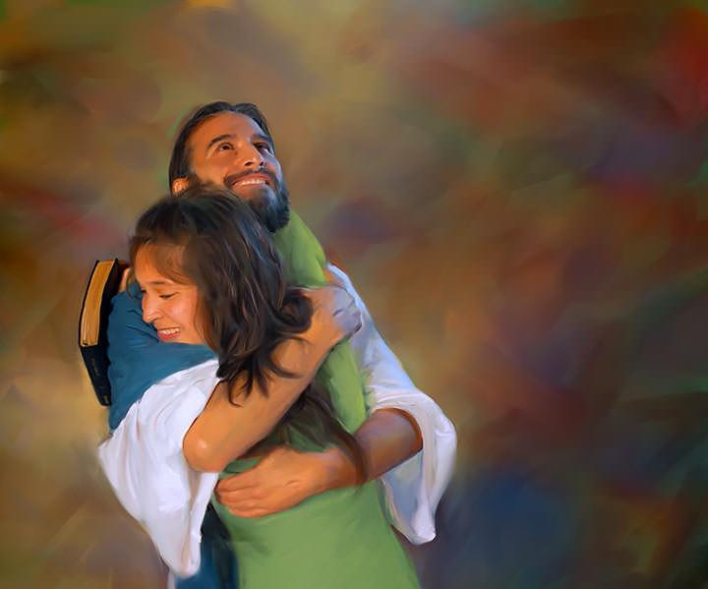
“Monga momwe Atate amandikondera Ine, Inenso ndakukondani. Tsopano khalani mʼchikondi changa.”
(Yohane 15:9 CCL)

Slide 3

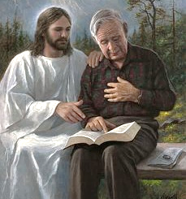



Aliyense wa ife ali ndi ubale wake ndi Mulungu umene uli wosiyana ndi wa mnzake. Koma tonse timagwirizana pa chinthu chimodzi: ubale umeneu ukhoza (ndipo uyenera) kukula.
Gawo loyamba limene tiyenera kutenga kuti tikule ndilo kuzindikira mmene zinthu ziliri pa moyo wathu panopa.
Mulungu watipatsa uthenga wonse wonena za mmene mkhalidwe la mpingo liliri muuzimu m’nthawi ino ya ku mapeto a dziko. Tsopano zili kwa ife kudzifufuza tokha kuti tione mbali ya uthengawo imene ikugwira ntchito kwa ife, komanso mmene tingalimbitse ndi kuzamitsira ubale wathu ndi Mulungu.
Uthenga wa Mulungu (Chivumbulutso 3:14-22):
Kuyeza (vv. 14-17)
Yankho (v. 18)
Zotsatira (vv. 19-20)
Chisangalalo (vv. 21-22)
Kufufuza Zoona (Yohane 15:1-11):
Nthambi ndi mpesa
Utomoni

Slide 4

UTHENGA WA MULUNGU
(Chibvumbulutso 3:14-22)

Slide 5




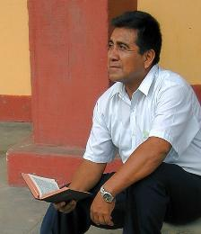
KUYESA
“Iwe umati: ‘Ndine wolemera, ndine wachuma ndipo sindisowa kanthu.’ Koma sudziwa kuti ndiwe wovutika, womvetsa chisoni, waumphawi, wosaona ndi wamaliseche. ” (Chivumbulutso 3:17)
Uthenga wopita ku mipingo isanu ndi iwiri uwu ukuonetsa mmene mpingo wa pa dziko lonse lapansi uliri, kuyambira nthawi ya atumwi mpaka lero lino(Chivumbulutso 2-3). Potipatsa uthenga wa masiku athu ano (Laodikaya), Yesu akudziwonetsera yekha monga “Ameni [Choonadi], mboni yokhulupirika ndi yoona " (Chivumbulutso 3:14).
Tikadziyang’ana tokha, timaona choonadi cha mmene tiliri: " Ndine wolemera, ndine wachuma ndipo sindisowa kanthu " (Chivumbulutso 3:17a).
Koma Yesu amaona chowonadi, chenicheni cha mmene tiliri : “Ndiwe wovutika, womvetsa chisoni, waumphawi, wosaona ndi wamaliseche” (Chivumbulutso 3:17b).
Tsopano ndi nthawi yoti tidziyese tokha. Kodi ndikudziwa zimene ndili nazo zenizeni, komanso zimene ndikuzisowabe? Kodi ndakula bwanji mu ubale wanga ndi Yesu? Kodi ndikusintha n’kukhala munthu wabwino?

Slide 6


YANKHO
“Ndikukulangiza kuti ugule kwa Ine golide woyengedwa ndi moto kuti ukhale wolemera. Ugule zovala zoyera kuti uvale ndi kuphimba umaliseche wako wochititsa manyaziwo. Ndiponso ugule kwa Ine mankhwala a mʼmaso kuti uwone.” (Chivumbulutso 3:18)
Chifukwa chakuti kukhutira ndi mmene tiliri kumapangitsa kuti tikhale osasamala (ofunda), Yesu akutilangiza kuti tichite zinthu zitatu :
Gulani golidi woyengeka
Sitiyenera kukhudzika ndi mfundo zongopeka chabe kapena kuphunzira Baibulo mwachiphamaso. Tiyenera kutaya ziphunzitso za anthu (tinsel) ndi kulowa mozama mu phunziro lathu la Baibulo kuti tichotse kupanda ungwiro konse (zinyalala) pakumvetsetsa kwathu.
Gulani zovala zoyera
Kuvomereza chilungamo cha Yesu monga njira yokhayo yopezera chipulumutso. Kuyesera kudzionetsera tokha kwa Mulungu ndi ntchito zathu zolungama ndiko kudzionetsera tiri maliseche pamaso pake.
Gulani mankhwala a maso
Landirani Mzimu Woyera. Ndi Iye yekha amene angatipatse kuzindikira kwauzimu ndi kutitsimikizira za mkhalidwe wathu weniweni (Yohane 16:8).

Slide 7

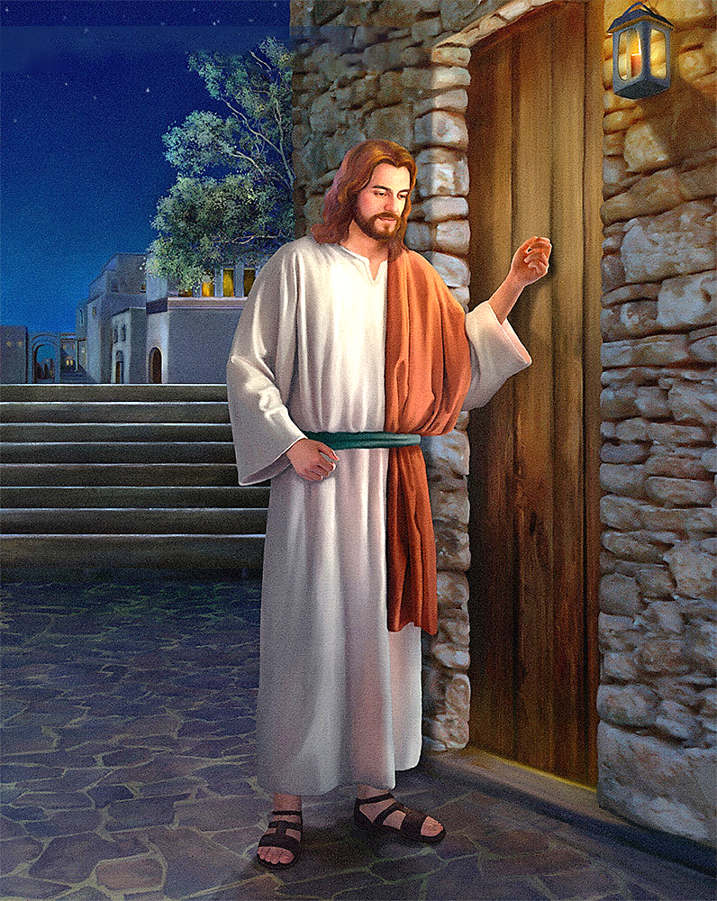
ZOTSATIRA
“Taonani ndayima pa khomo ndikugogoda. Ngati wina amva mawu anga natsekula chitseko, Ine ndidzalowamo ndi kudya naye, Ine ndi iyeyo.” (Chibvumbulutso 3:20)
Pali vuto. Ine ndikuona ngati ndili bwino muuzimu, koma Yesu akufuna kuti ndisintha kuti ndikhale wabwino kwambiri. Koma, ngati sindikuzindikira kuti ndiyenera kusintha, sindidzasintha konse. Sindingafune kugula chinthu chimene ndikuganiza kuti ndili nacho kale.
Pofuna kuthetsa vutoli, Yesu ali ndi njira zake: “Onse amene ndiwakonda, ndiwadzudzula ndi kuwalanga”; ndipo akuwonjezera kuti: “Lapani” (Chivumbulutso 3:19).
Chidzudzulo ndi chilango cha Yesu sicholakwika konse. Iye amakonda njira ya kukambirana. Akufuna kukhala nafe mwakachetechete n’kumayankhula nafe… “Taonani, ndaima pakhomo ndipo ndikugogoda. Ngati munthu wina amva mawu anga natsegula khomo, ndidzalowa kwa iye ndi kudya naye limodzi, nayenso adzadya nane” (Chivumbulutso 3:20).
Yesu akugogoda pa chitseko cha mtima wanga ndipo akudikira moleza mtima. Iye salowerera moyo wanga kuti andikakamize kukhala naye pa ubale. Chisankho chotsegula khomolo chili kwa ine.

Slide 8


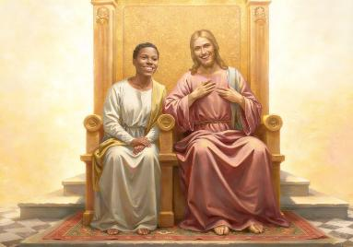
KUSANGALATSIDWA
“Amene adzapambana, ndidzamupatsa ufulu wokhala nane pamodzi pa mpando wanga waufumu monga mmene Ine ndinapambana ndi kukhala pansi ndi Atate anga pa mpando wawo waufumu.” (Chibvumbulutso 3:21)
Yesu akudziwa kuti njirayi si yofewa. Iye akudziwa khama lathu lofuna kugula golide, chovala, ndi mankhwala a m’maso. Akudziwa kulimbana kwathu kuti tisiye kukhala ofunda, tsegule chitseko, ndi kulumikizana naye. N’chifukwa chake akutiuza kuti: Mukhoza kugonjetsa, monga momwe Ine ndinagonjetsera (Chivumbulutso 3:21).
Iye akudziwanso kuti ife sitidzatengapo gawo loyamba patokha. Mulungu ndiye amene nthawi zonse amayamba kutitsata..
Anaganiza kutilenga
( Gen. 2:7 )
Amatifunafuna tikachimwa (Gen. 3:8-9)
Anadzipereka yekha kuti atipulumutse (Yohane 3:16)
Amafuna kutipatsa mphoto: kukhala naye limodzi, ndi kusangalala naye kwamuyaya (Chiv. 3:21)
Chinsinsi cha khalidwe la Mulungu limeneli (limene sitiliyenera) ndi chikondi: ‘Ndakukonda iwe ndi chikondi chosatha’ (Yeremiya 31:3). Iye amafuna kukhala pa ubale ndi ife. Kodi ineyo ndikufuna kukhala pa ubale naye? Kodi ndidzamutsegulira mtima wanga n’kumamukonda monga mmene Iye amandikondera?

Slide 9

KUFUFUZA ZOONA
(Yohane 15:1-11)

Slide 10

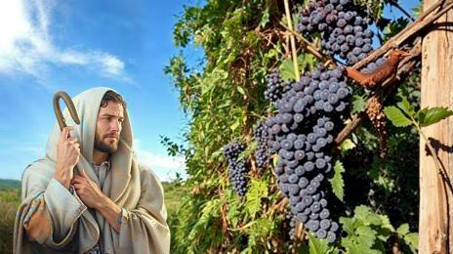
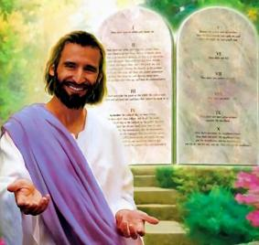

NTHAMBI NDI MPESA
“Ine ndine mpesa; inu ndinu nthambi zake. Ngati munthu akhala mwa Ine ndi Ine mwa iye, adzabereka zipatso zambiri; popanda Ine simungathe kuchita kanthu.” (Yohane 15:5)
Pathala nthawi yochepa kuti amwalire, Yesu adalengeza kuti Iye ndiye “mpesa,” ndipo ophunzira ake ndi “nthambi.” Kodi Iye ankatanthauza chiyani pamenepa?
Nthambi ikhoza kukhala ndi moyo kwa nthawi yochepa popanda kukhala yolumikizidwa ku mpesa, koma m’kupita kwa nthawi imafota. Kuti tisataye moyo wosatha, Yesu amatipempha kuti: “Khalani mwa Ine” (Yohane 15:4). Mundime 11 m’mene Yesu akufotokoza fanizo la mpesa ndi nthambi, anagwiritsa ntchito mawu oti “khalani” nthawi 10. Ziyenera kukhala zinthu zofunika kwambiri.
Kukhala mwa Yesu ndi mankhwala ochiritsira kufunda kwa Laodikaya. Komanso, ndi gwero la chimwemwe (Yohane 15:11). Koma tingakhale bwanji mwa Yesu?
Pochita zimene zimamukondweretsa, ndiye kusunga malamulo ake (Yohane 15:10). Uku ndi kuyankha mwachikondi ku chikondi chimene Mulungu watisonyeza (1 Yohane 4:19).

Slide 11


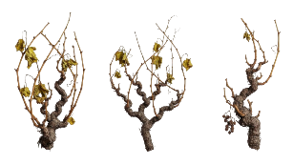

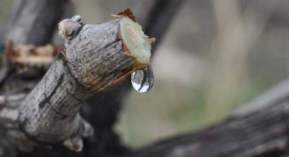
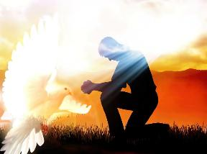
KUYAMWA
“Khalani mwa Ine, monga Ine ndili mwa inu. Palibe nthambi imene ingabereke chipatso pa yokha ngati sinalumikizike ku mpesa. Chomwechonso inu simungathe kubereka chipatso pokhapokha mutakhala mwa Ine.” (Yohane 15:4)
M’nyengo ya chisanu, nthambi zimakhala zolumikizidwa ku mpesa, koma sizibala chipatso. Chifukwa chiyani? Chifukwa chakuti sizitenga madzi a mpesa.
Pokhapokha pamene masika afika ndi pamene zimayamba kulandira madzi ochokera ku mpesa, ndipo mphukira zimamera. Mawu a Chigiriki amene Yohane amagwiritsa ntchito angatanthauzenso nthambi zimene zinadulidwa kenako n’kulumikizidwanso ku mpesa.
Kaya ndife mphukira zanthete kapena nthambi zosweka, chinthu chimodzi chikuwonekera: timafunikira kuyamwa ku mpesa. Kodi kuyamwa kumeneku tingakuyerekezere ndi chiyani?
Munkhani yomweyi (Yohane 14-17), Yesu akutifotokozera motere: Mzimu Woyera ndi amene akugwira ntchito mwa ife kutipatsa moyo, ngati tifuna.
Iye ndiye Mtonthozi wathu (Yohane 14:16-17)
Amavumbulutsa Yesu kwa ife (Yohane 15:26)
Amatitsutsa ife za uchimo (Yohane 16:8)
Amatitsogolera m’choonadi chonse (Yohane 16:13)

Slide 12

“Golide amene akulimbikitsidwa pano ngati woyesedwa m’moto ndi chikhulupiriro ndi chikondi. Izi zimapangitsa mtima kukhala wolema; pakuti ayeretsedwa kufikira atakhala woyera, ndipo pamene ayesedwa kwambiri, m’pamenenso amanyezimira kwambiri. Zovala zoyera ndizo kuyera kwa khalidwe, chilungamo cha Khristu chimene chimaperekedwa kwa wochimwa. Ichi ndi chovala ndithu chopangidwa kumwamba, chimene chingagulidwe kuchokera kwa Khristu kokha kudzera mu moyo wa kumvera mosakakamizidwa. Mankhwala a m’maso, nzeru ndi chisomo zimene zimatithandiza kuzindikira pakati pa choipa ndi chabwino, ndi kuzindikira tchimo mu maonekedwe alionse. Mulungu wapereka ku mpingo wake maso amene amafuna kuti awadzoze ndi nzeru, kuti athe kuona bwinobwino; koma ambiri angafune kutseka maso a mpingo ngati akanatha, chifukwa safuna kuti ntchito zawo zibwere ziwale, kuopedwa kuti angadzidzulidwe. Mankhwala a m’maso a Mulungu adzapereka kumvetsetsa bwino kwa zinthu. Khristu ndiye chosungiramo cha chisomo chonse. Iye akuti: “Gula kwa Ine” (Chivumbulutso 3:18 ).”
EGW (Testimonies for the Church, vol. 4, p. 88)

