Slide 1

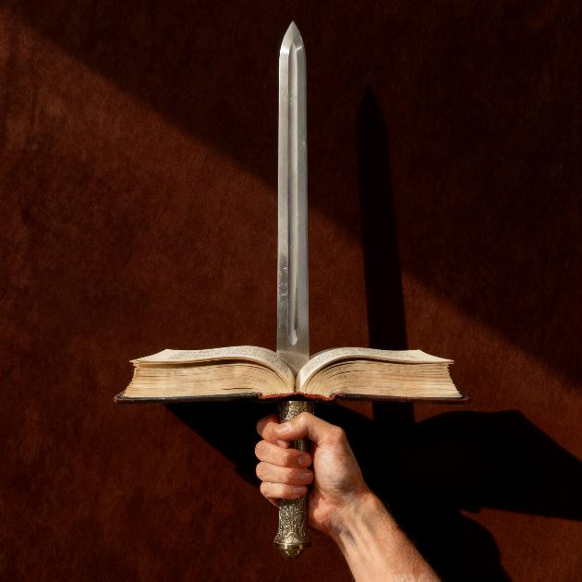

UDINDO WA BAIBULO
Phunziro 4 April 25, 2026

Slide 2

“Paja Mawu a Mulungu ndi amoyo ndi amphamvu. Ndi akuthwa koposa lupanga lakuthwa konsekonse. Amalowa mpaka molumikizirana moyo ndi mzimu, ndiponso molumikizirana fundo ndi mafuta a mʼmafupa. Amaweruza malingaliro ndi zokhumba za mʼmitima.” (Ahebri 4:12, CCL)
Notes:
Buscar en biblia-espada

Slide 3


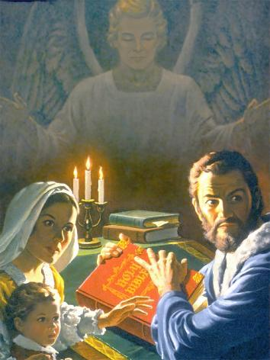
Baibulo ndilo buku limene limagulitsidwa kwambiri padziko lonse lapansi, ndipo limagulidwa kuposa buku lachiwiri pa mndandanda kasanu konse. Koma sizinali choncho nthawi zonse.
Panali nthawi imene kukhala ndi Baibulo, kuliwerenga, kapena kulankhula za ilo kumatha kupangitsa munthu kuponyedwa mundende, kuzunzidwa, kapena kuphedwa kumene.
Pakadapanda chitetezo chapadera cha Mulungu, Baibulo likanasowa kalekale. Chifukwa chiyani? Kodi pali chiyani chapadera kwambiri pa buku limeneli chimene chikupangitsa kuti likhale lokondedwa ndi kudedwa kwambiri?
Mdani wa Baibulo
Njira zolondola komanso zolakwika zowerengera Baibulo
Kodi Baibulo ndichiyani?
Zotsatira zabwino za kuwerenga Baibulo
Abwenzi a Baibulo

Slide 4


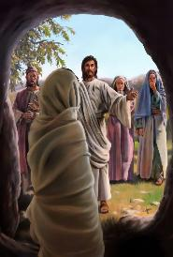
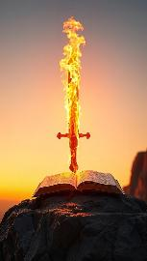

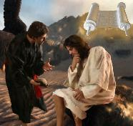
M’DANI WA BAIBULO
“Valani… lupanga la mzimu, limene ndi Mawu a Mulungu.” Aefeso 6:17
Ganizirani zomwe mawu olankhulidwa a Mulungu angathe kuchita: kulenga ndi kupereka moyo (Masalimo 33:6), kapena kuukitsa akufa (Yohane 5:28-29).
Kodi Baibulo, mawu olembedwa a Mulungu, lingachite chiyani? Liri ndi mphamvu yotiteteza (Aefeso 6:17b) ndi kutisintha (Ahebri 4:12). Yesu anagwiritsa ntchito Baibulo podziteteza ku mayesero (Mateyu 4:4, 7, 10).
Satana amadziwa kuti alibe mphamvu pamaso pa mphamvu ya Baibulo. Choncho, iye ayesetsa kuliwononga kotheratu. Koma analephera, pamene mabungwe a Baibulo anayamba kutsindikiza mabuku zikwi zambiri. Pambuyo pake anayesanso kulinyoza kudzera mu njira zotsutsa mfundo za m’Baibulo. Panopa akuyesetsa kutilepheretsa kuliwerenga potitanganidwitsa ndi zinthu zina.
Kodi ndidzalola iye kupambana pa zimenezi? Kodi sindingapeze nthawi mu ndondomeko za ntchito zanga kuti ndiwerenge Baibulo? Kuwerenga kumatipangitsa kusintha ndi kutipatsa mphamvu yolimbana ndi mdani wathu wamkulu: mdyerekezi.

Slide 5

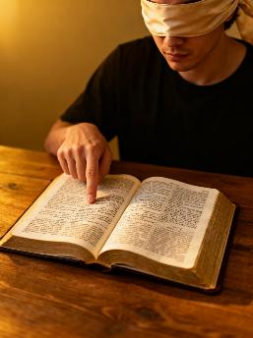



NJIRA ZOYENERA NDI ZOSAYENERA ZOWERENGA BAIBULO
“Uyesetse kukhala wovomerezeka pamaso pa Mulungu monga wantchito wopanda chifukwa chochitira manyazi amene amalalikira mawu achoonadi molondola. “(2 Timoteyo 2:15)
Njira yosayenera
kupeza chinthu chomwe chikugwirizana ndi malingaliro athu
Kusankha malemba mwachisawawa, popanda cholinga
Njira yoyenera
Yesetsani kuphunzira chifuniro cha Mulungu
Chitani kafukufuku mwadongosolo
Kusankha zigawo zomwe timakonda, ndikupewa zigawo zotidzudzula.
Musakane malemba aliwonse, koma sankhulani onse mosamala.
Kuphunzira kwathu Baibulo kuyenera kukhala koyenera, koma kulingalira kwathu kuyenera kugonjera ku mphamvu ya Mzimu Woyera kuti tizindikire molondola uthenga wa m'Baibulo.
Chifukwa chiyani? Chifukwa chakuti nzeru zathu zimakhala zochepa ndipo nthawi zonse sizimakhala zodalirika. Ndicho chifukwa chake, tikamaphunzira Baibulo, tiyenera kufunafuna nzeru za Mlembi wake.

Slide 6


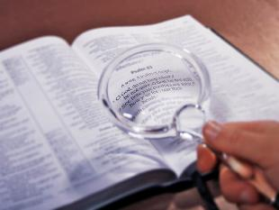
KODI BAIBULO NDI CHIYANI?
Pali anthu ambiri, ngakhalenso Akhristu amane amakhulupilira kuti choonadi chimasintha malinga ndi mmene munthu akuonera, komanso kuti palibe choonadi chimene chimakhala chosasinthika komanso chokhazikika pakapita nthawi.
“Mawu anu onse ndi choonadi;
Ndipo maweruzo anu onse olungama amakhala kosatha.” (Welengani Masalimo 119:160)
Koma, Baibulo —monga mawu a Mulungu—limati liri ndi chowonadi chenicheni ( Masalimo 119:160; Yohane 17:17; Yakobo 1:18 ). Limati ndi loyera ndi chishango chotchinjiriza ku nzeru za anthu (Miyambo 30:5). Ngati tiwonjezera “choonadi” chathu pa icho, tingayesedwe abodza pamaso pa Mulungu (Miyambo 30:6).
Mfundo iliyonse, kapena choonadi chilichonse, chiyenera kuyesedwa ndi Baibulo. Pamene pali kusiyana pakati pa zimene tikuona kuti ndi zoona ndi zimene Baibulo limanena, pali zinthu ziwiri zimene zingachitike: mwina tikulakwitsa, kapena tikutanthauzira Baibulo molakwika.

Slide 7


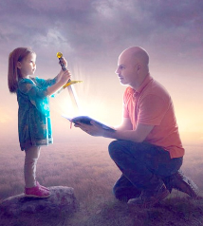



UBWINO WOWERENGA BAIBULO
“Ndasunga mawu anu mu mtima mwanga kuti ndisakuchimwireni.” (Masalimo 119:11)
Chinthu chimodzi chimene ngakhale adani aakulu a Baibulo sangathe kuchitsutsa ndi mphamvu yake yosinthira anthu. Paulo akuliyerekeza ndi lupanga limene liri ndi mphamvu yaikulu.
Limatipangitsa kuti tidziwone mmene tiliri ndendende (Ahebri 4:12)
Limatiteteza ku uchimo
(Masalimo 119:11
Ndi chakudya cha moyo wathu (Yeremiya 15:16).
Limatipangitsa kukula muuzimu (1 Petro 2:2)
Iye amatipatsa moyo
(Yohane 6:63)
Palibe buku lina lirilonse limene lingathe kutikhudza monga momwe limachitira Baibulo. Tikakhala okonzeka kuphatikiza ziphunzitso zake m’miyoyo yathu, timasinthidwa kukhala abwino.
Tikawerenga ndi mtima wotseguka ndi kupempha Mulungu kuunika kwa Mzimu Woyera, moyo wathu umasinthidwa.

Slide 8

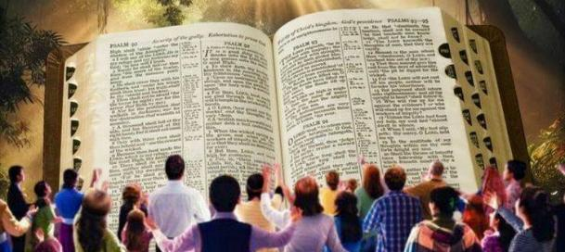
'Ndipo ifenso tikuyamika Mulungu kosalekeza chifukwa mutalandira Mawu a Mulungu, amene munawamva kuchokera kwa ife, munawalandira osati ngati mawu a anthu, koma monga momwe alili, Mawu a Mulungu, amene akugwira ntchito mwa inu amene mukhulupirira.’ 1 Atesalonika 2:13
ABWENZI A BAIBULO
Tikalandira Baibulo motere
Limationetsera mmene ubale wathu ndi Mulungu uliri
Limatiuza mmene tingalimbitsire ubale umenewu
Timakumana ndi kusintha pang'onopang'ono
Timayandikira kwa Yesu
Limatipanga kukhala anzeru kuti tidzapulumuke
Tikukula m’chidziwitso cha choonadi
Chikhulupiriro chathu chimakula ndi kulimba
Tiri ndi chiyembekezo
Tikudziwa kuti moyo wabwino, wosatha, komanso wozizwitsa ukutidikirira
Abwenzi a Baibulo amalifikira ali ndi chidziwitso chakuti ilo ndi Mawu Amoyo a Mulungu (1 Atesalonika 2:13). Koma kodi ndingafike bwanji pa chikhulupiriro chimenechi?
Paulo amatiuza kuti, pa chifukwa chimenechi, tifunikira kuzindikira kwa uzimu, kutanthauza kuti, luso lomvetsa zinthu zauzimu (1 Akorinto 2:14). Choncho, kuzindikira uthenga waumulungu m’Baibulo ndi ntchito ya Mzimu Woyera amene akugwira ntchito mwa ife.

Slide 9

“Baibulo limavumbulutsa choonadi m’njira yosavuta komanso yogwirizana ndendende ndi zosowa komanso zolakalaka za mtima wa munthu. Zimenezi zadabwitsa komanso kusangalatsa anthu ophunzira kwambiri, pamene pa nthawi yomweyo, limathandiza anthu odzichepetsa komanso osaphunzira kwambiri kuzindikira njira ya chipulumutso. Komabe, choonadi chosavuta chimenechi chimakhudza zinthu zazikulu kwambiri, zozama, komanso zopitirira nzeru za anthu, moti titha kungozivomereza chifukwa chakuti Mulungu ndi amene wanena [...] Pamene munthu akufufuza kwambiri m'Baibulo, m'pamenenso amakhulupirira kwambiri kuti amenewa ndi mawu a Mulungu wamoyo, ndipo nzeru za munthu zimagwadira ulemerero wa vumbulutso laumulungu.”
EGW (Steps to Christ, p. 107)

