Slide 1
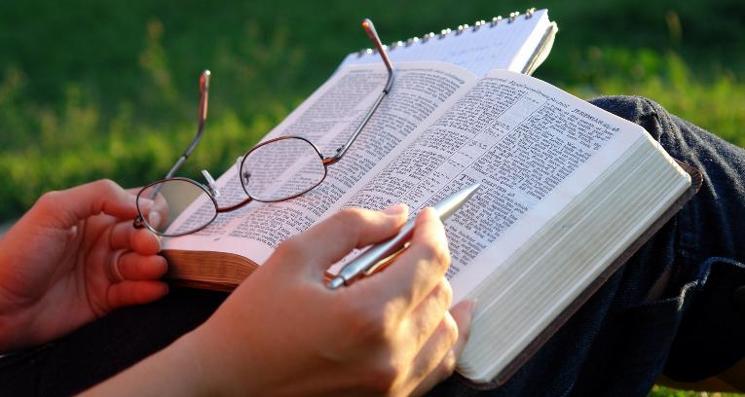
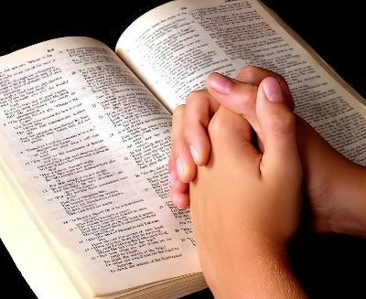

MMENE TINGAPHUNZIRIRE BAIBULO
Phunziro 5 May 2, 2026

Slide 2

“Ndi mmenenso amachitira mawu ochokera mʼkamwa mwanga. Sadzabwerera kwa Ine kopanda phindu lake, koma adzachita zonse zimene ndifuna, ndipo adzakwaniritsa cholinga chimene ndinawatumira.” (Yesaya 55:11, CCL)

Slide 3

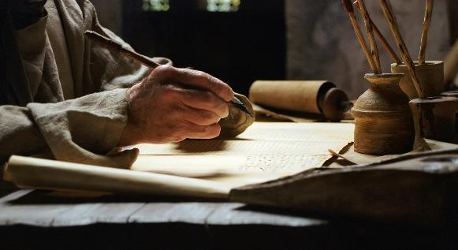

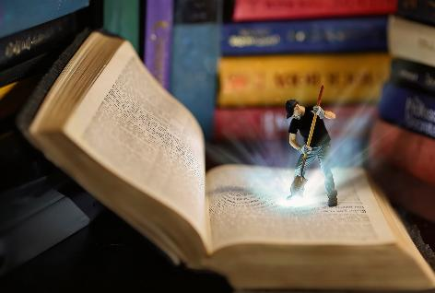
“Anthu oyera a Mulungu adalankhula motsogoleredwa ndi Mzimu Woyera” (2 Petro 1:21), ndipo adalemba uthenga wawo m’masamba a Baibulo.
M'menemo timapezamo miyala yamtengo wapatali imene imapereka moyo, chiyembekezo, chilimbikitso, komanso chitonthozo, ... ina imawoneka nthawi yomweyo, ina iyenera kufufuzidwa mosamala kwambiri.
Kodi tingazifukule bwanji miyala yamtengo wapatali imene Mulungu atisungira m’Baibulo, nanga timapindula phindu lanji tikamaliphunzira?
M’mene tingaphunzirire Baibulo:
Nthawi
Malo
Njira
Ubwino wophunzira Baibulo
Ubwino wogawana ndi ena
Phindu la kulidya

Slide 4

M’MENE TINGAPHUNZIRIRE BAIBULO

Slide 5

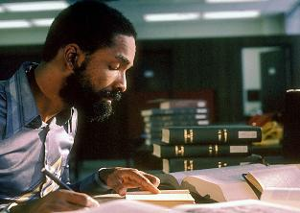
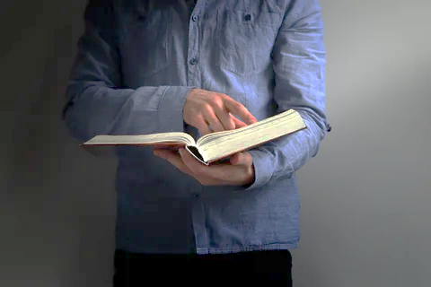

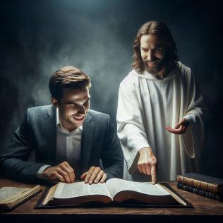
NTHAWI
“Mudzandifunafuna ndipo mudzandipeza. Mukadzandifuna ndi mtima wanu wonse” (Yeremiya 29:13)
Nthawi yabwino kuphinzira Baibulo ndi iti?
Tiyenera kusanthula yankho lathu poganizira zinthu ziwiri: nthawi ndi ubwino wake.
N’zoonekeratu kuti tidzapindula kwambiri tikapatula ola limodzi pa ndandanda yathu pa kuphunzira Baibulo, kusiyana ndi kudzipereka mphindi zisanu zokha.
Komabe, nthawi yomwe timapatula pophunzira siyenera kukhala yowerenga chabe mwapamwamba. Apa ndi pamene cholinga chathu chimagwira ntchito. N’chifukwa chiyani ndimawerenga Baibulo? Kodi ndikungofuna kudziwa zinthu, kapena kodi ndili ndi chilakolako chozama chofuna kudziwa zambiri za Mulungu?
Tidzapindula kwambiri ndi kuphunzira kwathu Baibulo pamene kukhala nthawi yocheza ndi Mulungu (Yeremiya 29:13), ndi kusangalala mwa Iye (Masalimo 37:4); tiyang’ana m’masamba ake uthenga wapadera wa Mulungu kwa ife.

Slide 6




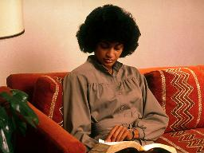
MALO
“Mmamawa, kukanali kamdima, Yesu anadzuka, nachoka pa nyumbapo kupita kumalo kwa yekha, kumene anakapemphera. ” (Marko 1:35)
Pamene Yesu ankafuna nthawi yapadera yolumikizana ndi Mulungu, ankadzuka m’mawa kwambiri ndi kufunafuna malo chete (Marko 1:35). Izi zingagwiritsidwe ntchito pa pemphero komanso kuphunzira Baibulo.
N’zovuta kuika maganizo onse pa kuphunzira m’malo aphokoso kapena otanganidwa. N’kosavuta kutero m’malo omasuka, abata komanso odzipatula.
Maola oyambirira kapena omaliza a tsiku, pamene pali bata lochuluka, angakhale nthawi imene tingathe kuika maganizo athu pa Mulungu mosavuta.
Tikapeza nthawi ndi malo oyenera, tiyeni tichipange ichi kukhala chochitika chanthawi zonse. Mwina zochitika zina zapadera zingatipangitse kuphonya nthawi imeneyo, koma tisalole kuti nthawi yaitali ipite tisanaphunzire Baibulo tsiku ndi tsiku.

Slide 7



NJIRA (1)
Ndi mmenenso amachitira mawu ochokera mʼkamwa mwanga.Sadzabwerera kwa Ine kopanda phindu lake, koma adzachita zonse zimene ndifuna, ndipo adzakwaniritsa cholinga chimene ndinawatumira. (Yesaya 55:11)
Kuphunzira Baibulo mozama kuli ndi magawo anayi
Pempherani
Kuwerenga ndi kumvetsa [njira zomwe zaperekedwa]
Pempherani
Gawani
Itanani Mzimu Woyera kuti akhale mtsogoleri wanu mu maphunziro anu
Sankhani vesi kapena ndime ya m’Baibulo
Adzakhudza mtima ndi maganizo anu kuti mumvetse zimene mukuwerenga
Lembani kuti zisindikizike m'maganizo mwanu
Lembani mzere pa mfundo zazikuluzikulu
Lembani maganizo amene amalimbikitsa mfundo zazikuluzo
Pemphani Mulungu kuti akuthandizeni kugwiritsa ntchito mfundo zimene mwaphunzira
Ganizirani za yemwe mungamuuze zomwe mwaphunzira

Slide 8

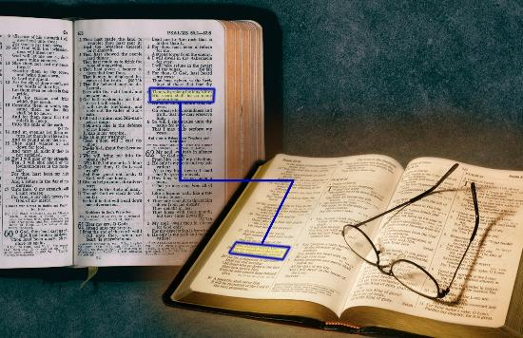
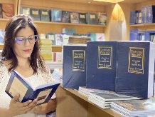
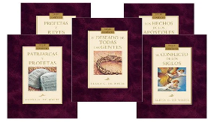
NJIRA (2)
“Ndi mmenenso amachitira mawu ochokera mʼkamwa mwanga. Sadzabwerera kwa Ine kopanda phindu lake,koma adzachita zonse zimene ndifuna, ndipo adzakwaniritsa cholinga chimene ndinawatumira.…” (Yesaya 55:11)
Njira zina zophunzirira Baibulo
Yerekezerani vesi ndi vesi (Yesaya 28:10)
Phunzirani ndime kapena mabuku onse
Kuphunzira mutu kapena mawu pogwiritsa ntchito concordance
Funsani m’mabuku ofotokoza nkhani za m’Baibulo kapena m’mamatanthauzo a mawu a m’Baibulo
Werengani limodzi ndi mavesi ochokera m'mabuku a mndandanda wa "Conflict of the Ages" lolembedwa ndi Ellen White

Slide 9

PHINDU POPHUNZIRA BAIBULO

Slide 10






UPHINDO WOGAWANA
“Ambuye Yehova anandiphunzitsa mawu oyenera kuyankhula kudziwa mawu olimbitsa mtima anthu ofowoka. Mmawa mulimonse amandidzutsa, amathwetsa khutu langa kuti ndimve monga amachitira munthu amene akuphunzira.” (Yesaya 50:4)
Mukupemphedwa kukonzekera ulaliki wa utumiki wa Loweruka. Mumapatula nthawi yapadera kuphunzira mwapemphero mutu womwe Mzimu Woyera wakuuzirani kuti musankhe. Loweruka, mumalalikira ndi mphamvu. Kodi ndani amene akupindula kwambiri ndi ulaliki umenewu?
Phunziro la Baibulo limene timagawana ndi ena - kaya mu ulaliki kapena payekha - limakhala ndi phindu lowirikiza.
Choyamba, timapindula ndi zimene taphunzira. Chachiwiri, anthu amene timagawana nawo chidziŵitsochi amapindula ndipo akulimbikitsidwa kuti afufuze mozama m’chidziŵitsocho.
M’zochitika zonse ziŵiri, unansi ndi Mulungu umalimba ndi kulimba. Imeneyi ndi mphamvu ya Mawu a Mulungu, amene “sadzabwerera kwa Ine opanda kanthu” ( Yesaya 55:11 ).

Slide 11

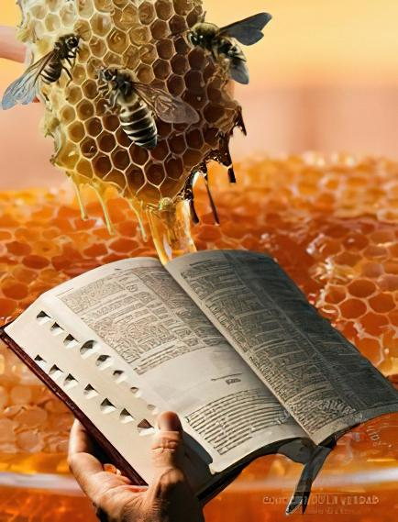

PHINDU LA KULIDYA
“Mawu anu ndi otsekemera ndikawalawa,
otsekemera kuposa uchi mʼkamwa mwanga!!” (Masalimo 119:103)
Tiyenera kudya Mau A Mulungu(Yeremiya 15:16)!
Ngakhale kuti ndiwokoma kuposa uchi, sitiyenera kudya m’masamba enieni (Masalimo 119:103). Kuwerenga Baibulo ndi chakudya cha moyo, chotsitsimutsa chenicheni chomwe chimachiritsa mizimu yathu ndiponso kusintha khalidwe lathu.
Ndipo koposa pamenepo, chakudya chimenechi ndi chaulere (Yesaya 55:1)
Timangofunika kuyandikira ndi kumvetsera zimene Mulungu amatiuza kudzera m’Baibulo (Yesaya 55:3). Tikamakhala ndi nthawi yochuluka tikufufuza m’masamba ake, ndipamenenso tidzalandire chakudya chauzimu chochuluka, ndipo tidzalandira madalitso ochuluka.
"Mosasamala kanthu za kupita patsogolo kwa luntha la munthu asaganize ngakhale kwa kanthawi kuti palibe chifukwa chofufuza mozama ndi mosalekeza m’Malemba kuti apeze kuunika kwakukulu. Monga anthu, tayitanidwa aliyense payekha kukhala ophunzira a ulosi.” Ellen G. White, Counsiels to Writers and Editors, p. 41

Slide 12

“Kungowerenga Mawu sikungakwaniritse cholinga chimene Kumwamba kunakonza; ayenera kuphunzidwa ndi kusungidwa m’mtima. Chidziwitso cha Mulungu sichimapezedwa popanda kuyesetsa kuganiza. Tiyenera kuphunzira Baibulo mwakhama, kupempha Mulungu thandizo la Mzimu Woyera kuti timvetsetse Mawu ake. Tiyenera kutenga vesi limodzi, ndi kuika maganizo athu pa ntchito yofufuza ganizo limene Mulungu wayika mu vesi limenelo kwa ife […]
Mawu a Mulungu ndicho chakudya cha moyo. Iwo amene amadya ndi kugaya Mawu amenewa, kuwapanga kukhala mbali ya zochita zawo zonse ndiponso mbali ya khalidwe lawo lonse, amakula mu mphamvu ya Mulungu. Amapatsa moyo nyonga yosatha, kukonza zochitika za m’moyo komanso kubweretsa chimwemwe chomwe chidzakhalapo mpaka kalekale.
EGW (Lift Him Up, April 7)

