Slide 1

TCHIMO MU MPINGO
Phunziro 4, July 25, 2026

Slide 2

“Kapena simudziwa kuti thupi lanu lili Kachisi wa Mzimu Woyera, amene ali mwa inu, amene muli naye kwa Mulungu? Ndipo simukhala a inu nokha. Pakuti munagulidwa ndi mtengo wake wapatali; chifukwa chake lemekezani Mulungu m'thupi lanu”
(1 Akorinto 6:19, 20, BLP)

Slide 3




M’machaputala 5 mpaka 7 a mu 1 Akorinto, Paulo makamaka akuyesetsa kuthetsa tchimo lomwe lidazika mizu mumpingo wa Korinto: chiwerewere.
Tchimo limeneli linakulirakuliranso chifukwa cha machimo ena, monga kulakwirana ndi kuchitirana zachinyengo pakati pa abale, zomwe ankazitengera ku makhoti a boma.
Pogwiritsa ntchito mawu omveka bwino komanso achindunji, Paulo sanangowulula tchimo lokha, koma anaperekanso njira zothetsera tchimolo ndi momwe angapewere kugwera mmenemo.
Tchimo mu mpingo
Tchimo lovomerezeka
Kuchotsa tchimo
Kuthana ndi mavuto amkati
Mmene tingapewere tchimo mu mpingo
Makachisi a Mzimu Woyera
Kugonana kovomerezeka mulamulo

Slide 4

TCHIMO MU MPINGO

Slide 5



TCHIMO LOVOMEREZEKA
“Ndipo inu mukudzitukumulabe. Kodi simukanayenera kudzazidwa ndi chisoni ndipo mukanamuchotsa pa chiyanjano chanu munthu wochita zimenezi?” (1 Akorinto 5:2 CCL)
Mu mpingo wa ku Korinto munapezeka kuti “pakati panu pakuchitika chigololo. Ndipo chigololo cha mtunduwu ngakhale pakati pa akunja sichingapezeke” (1 Akorinto 5:1 CCL).
Kupezeka kwa maubwenzi a chiwerewere pakati pa abale mumpingo kunali tchimo lalikulu kwambiri. Koma zinthu zinaipiratu chifukwa, m'malo moti mamembala azinyansidwa ndi tchimo limeneli, anali onyadira kulekerera tchimoli (1 Akorinto 5:2 CCL).
Mpingo umenewu unali wopangidwa makamaka ndi Amitundu. Chikumbumtima chawo chomwe chinkawauza kuti ubwenzi wa pachibale wachiwerewere suyenera kulekereredwa. Komanso, kudziwa kwawo Malemba kunalimbikitsa mfundo imeneyi (Levitiko 18:8).
Ngati ankadziwa bwino kuti ubale umenewu unali tchimo… n’chifukwa chiyani anali onyadira nawo (1 Akorinto 5:6)? Kodi banja lomwe linkakhudzidwa ndi tchimoli linali ndi chikoka mumpingo? Kapena ankadzitamandira kuti mpingo wawo unali wololera anthu ochita machimo?…?

Slide 6

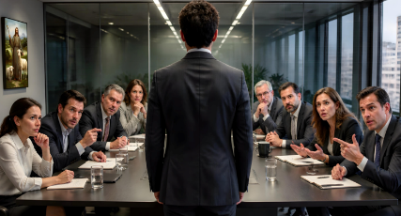



KUCHOTSA TCHIMO
“Mulungu adzaweruza akunja. “Chotsani woyipayo pakati panu.” (1 Akorinto 5:13 CCL)
Nkhani ya ubwenzi wa pachibale wachiwerewerewu inali itadziwika kale kwa anthu onse (1 Akorinto 5:1). Choncho, panali pofunika kuchitapo kanthu mwachangu kuti dzina labwino la mpingo lisawonongeke. Kodi ndi njira ziti zimene ziyenera kutengedwa?
Kupereka chiweruzo chotsimikizira ngati munthuyo ali wolakwa kapena ayi (1 Akorinto 5:3)
Musamayanjane ndi munthu wochita tchimo limenelo, ngakhale kudya naye limodzi, ngati akuumirirabe kudziyesa chiwalo cha mpingo pamene sakufuna kusiya tchimo lake (1 Akorinto 5:11)
Kuchotsa wochimwayo mumpingo ndi kumupereka ‘kwa Satana,’ chifukwa, popitiriza kusunga tchimo limeneli, iye mwini mwaufulu wasankha kudziyika pansi pa ulamuliro wa Satana (1 Akorinto 5:2b, 5a, 13b)
Chilango cha mpingo (mosasamala kanthu za kukula kwa tchimolo) chikuyenera kukhala ndi cholinga cha chiombolo nthawi zonse. Cholakwa cha munthuyo chiyenera kufotokozedwa momveka bwino kuti achizindikire, alape, kuti ‘adzapulumuke pa tsiku la Ambuye Yesu’ (1 Akorinto 5:5).

Slide 7



KUTHETSA MAVUTO AMKATI
“Pamene wina wa inu ali ndi mlandu ndi mnzake, nʼchifukwa chiyani amatengera nkhaniyo kwa anthu akunja kuti akawaweruze mʼmalo mopita nayo kwa oyera mtima?” (1 Akorinto 6:1 CCL)
Atafotokoza momwe angathetsere tchimo mumpingo, Paulo anawadzudzula chifukwa chosatsatira njira yoyenera komanso chifukwa chotengera mikangano pakati pa okhulupirira ku makhoti a dziko (1 Akorinto 6:1–6). Koma Paulo sanangoyima pamenepo; anadzula muzu wa vutolo.
Choyamba, sipayenera kukhala mikangano pakati pa ziwalo za mpingo (1 Akorinto 6:7a). Ndipo, chiwalo cha mpingo sichiyenera kulakwira kapena kuchitira chinyengo mnzake (1 Akorinto 6:8).
Chachiwiri, abale ayenera kukhala okonzeka kukhululukirana zolakwa zimene achitirana (1 Akorinto 6:7b).
Chachitatu, ngati ziwalo zilephera kugwirizana, mpingo uyenera kuweruza kapena kuyanjanitsa pakati pawo (1 Akorinto 6:2).
Pokhapokha ngati nkhaniyo ndi ya mlandu waupandu (Aroma 13:1–5), mavuto amkati mwa mpingo ayenera kuthetsedwa mumpingo momwemo.

Slide 8
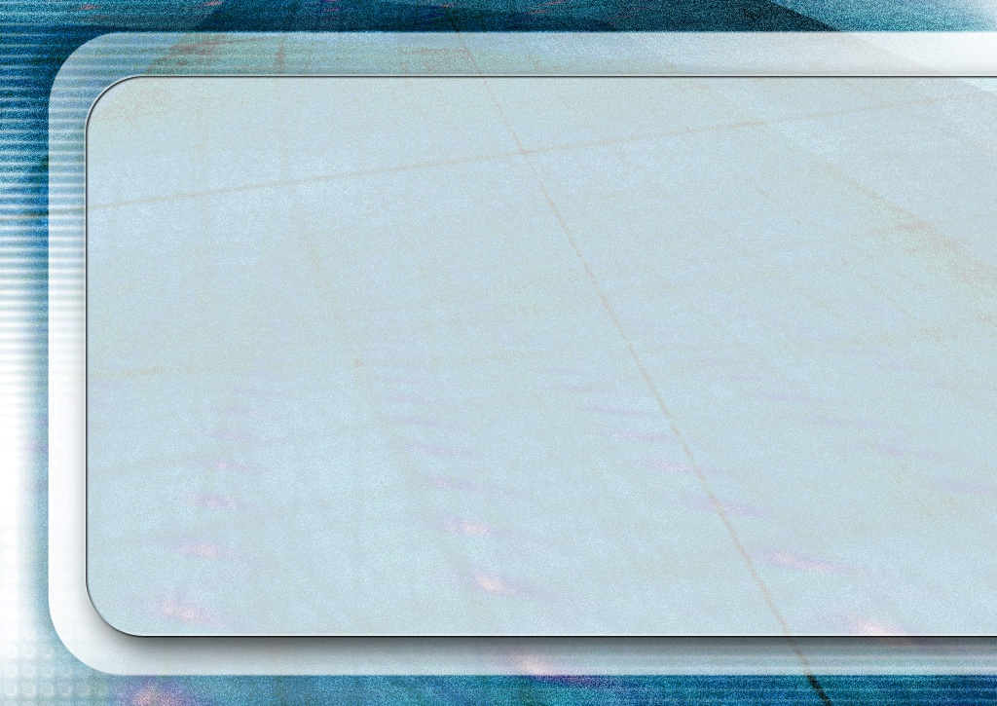
“Ndi ntchito yathu kuzindikira zofooka zathu zapadera ndi machimo athu, amene amabweretsa mdima ndi kufooka kwa uzimu, ndipo amazimitsa chikondi chathu choyamba. Kodi ndi kukonda dziko? Kodi ndi kudzikonda? Kodi ndi kukonda kudzitamandira? Kodi ndi kufuna kukhala woyamba? Kodi ndi tchimo la zilakolako za thupi limene likugwira ntchito mwamphamvu? Kodi ndi tchimo la Anikolaiti, lotembenuza chisomo cha Mulungu kukhala chifukwa chochitira chiwerewere? Kodi ndi kugwiritsa ntchito molakwa kuunika kwakukulu, mwayi ndi madalitso amene Mulungu wapereka, podzitamandira kuti muli ndi nzeru ndi chidziwitso cha chipembedzo, pamene moyo ndi khalidwe lanu sizikugwirizana ndi zimene mumaphunzitsa, ndipo zili zauchimo? Chilichonse chimene mwachisunga ndi kuchilera mpaka chakhala champhamvu ndi kukulamulirani, yesetsani mwakhama kuchigonjetsa; apo ayi mudzatayika.”
EGW (Ye Shall Receive Power, December 18)

Slide 9
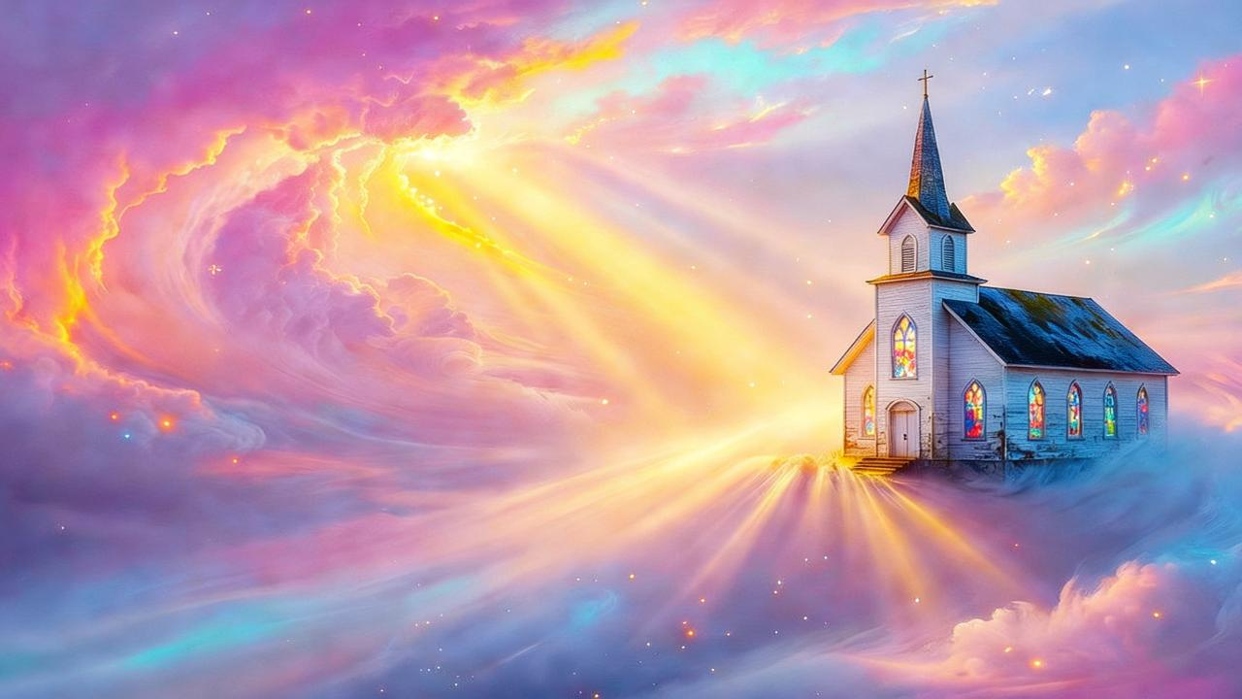
MMENE TINGAPEWERE TCHIMO MU MPINGO

Slide 10




MAKACHISI A MZIMU WOYERA
“Kapena simudziwa kuti thupi lanu lili Kachisi wa Mzimu Woyera, amene ali mwa inu, amene muli naye kwa Mulungu? Ndipo simukhala a inu nokha” (1 Akorinto 6:19 BLP)
Atamaliza kuyankhula za nkhani ya kupita ku makhoti, Paulo anabwereranso pa nkhani yake yayikulu: chiwerewere mumpingo. Ndichifukwa chiyani chinalipo?
Akhristu adayitanidwa kukhala opatulika (1 Akorinto 6:11), ndipo izi zikuyenera kuchotsa machimo onse. Koma ena ankatsutsa kuti, popeza machimo awo anakhululukidwa kale, akhoza kuchita chilichonse chomwe akufuna ndi mathupi awo. Ndiye chifukwa hake Paulo anawafotokozera momveka bwino kuti, ‘thupi silinapangidwe kuti lichitire chiwerewere’ (1 Akorinto 6:12-13).
Mfundo ya Paulo ndi iyi: matupi athu ndi ziwalo za Khristu. Choncho sitingatenge chiwalo cha Khristu ndikukachiphatikiza ndi hule kapena mkazi wachigololo (1 Akorinto 6:15–18).
Pomaliza, Paulo amatitsogolera kuganizira nkhani yofunika kwambiri: matupi athu ndi akachisi wa Mzimu Woyera, choncho si athu ayi, koma ndi a Mulungu (1 Akorinto 6:19). Mulungu anatigula ndi mwazi wamtengo wapatali wa Mwana wake. Chifukwa chake tiyenera kulemekezetsa Mulungu m’thupi lathu ndi mu mzimu wathu (1 Akorinto 6:20).

Slide 11





KUGONANA KOVOMEREZEKA MULAMULO
“Koma chifukwa choti chigololo chawanda, mwamuna aliyense akhale naye mkazi wakewake ndipo mkazi aliyense akhale naye mwamuna wakewake.” (1 Akorinto 7:2 CCL)
Poyankha mafunso ena amene mpingo wa ku Korinto unamufunsa, Paulo amatithandiza kumvetsa mmene tingathawire chiwerewere (1 Akorinto 7:1).
Mwachidule: anthu okwatiwa ayenera kusangalala ndi kugonana kovomerezeka ndi mwamuna kapena mkazi wawo; anthu osakwatiwa sayenera kugonana ndi aliyense.
Okwatirana sayenera kumanirana pa nkhani ya kugonana, kuopa kuwasonkhezera kutheka kuchita chigololo (1 Akorinto 7:3–5).
Anthu osakwatiwa amene ali ndi mphatso yodziletsa angagwiritse ntchito bwino mwayi wotumikira Mulungu, chifukwa saletsedwa ndi nkhawa za banja (1 Akorinto 7:6–8, 32–34).
Anthu osakwatiwa amene alibe mphatso yodziletsa ayenera kuyesetsa kukwatira kuti apewe mayesero (1 Akorinto 7:9).

Slide 12

Potumikira anthu olakwa, maso a aliyense ayenera kuyang’ana pa Khristu. […] Alankhule ndi wolakwayo za chifundo chokhululuka cha Mpulumutsi. Alimbikitse wochimwayo kulapa ndi kukhulupirira Iye amene angakhululukire. […]
Kulapa kwa wochimwayo kulandiridwe ndi mpingo ndi mitima yodzaza ndi chiyamiko. Wolapayo atsogoleredwe kuchoka mu mdima wa kusakhulupirira kupita ku kuunika kwa chikhulupiriro ndi chilungamo. Dzanja lake lonjenjemera liyikidwe m’dzanja lachikondi la Yesu. Kukhululukidwa kotereku kumatsimikiziridwa kumwamba.
.
EGW (The Desire of Ages, p. 806)

