Slide 1



CHITHUNZI CHA CHIKONDI
Phunziro 7, August 15, 2026

Slide 2

“Ndipo tsopano zatsala zinthu zitatu: chikhulupiriro, chiyembekezo ndi chikondi. Koma chachikulu pa zonsezi ndi chikondi” (1 Akorinto 13:13, CCL)

Slide 3



1 Akorinto 13 imadziwika kuti ‘mutu wa chikondi.’ Sikunena za chikondi cha pakati pa anthu okondana, koma chikondi chozama kwambiri: chikondi cha Mulungu.
Paulo akufotokoza bwino kwambiri mmene tingasonyezere m’miyoyo yathu chikondi cha Mulungu chimene chatsanulidwa m’mitima mwathu (Aroma 5:5).
Chikondi ndi chimene chimatilimbikitsa pa zochita zathu zonse, ndipo ndi chifukwa chake timachita zinthu zimene zimapindulitsa anthu amene timachita nawo zinthu.
CHITHUNZI CHA CHIKONDI
Kupambana kwa chikondi
Njira yopambana koposa
Makhalidwe a chikondi
Zimene chikondi chimachita
Zimene chikondi sichima-chita
Chithinzi cha Yesu
Kupirira kwa chikondi
Makhalidwe opambana

Slide 4


KUPAMBANA KWA CHIKONDI

Slide 5




NJIRA YOPAMBANA KOPOSA
“Koma funitsitsani mphatso zopambana.Tsopano ndikuonetsani njira yopambana kwambiri.” (1 Akorinto 12:31 CCL)
Kodi Paulo akufotokoza chikondi chotani mu 1 Akorinto 13, ndipo ndichifukwa chiyani chikondi chimenechi chimaposa mphatso iliyonse ya uzimu? (1 Akorinto 12:31–13:3)
MuChigiriki muli mawu angapo ofotokoza chikondi. Paulo akusankha mawu akuti agape (chikondi chosadzikonda, chopanda malire, chimene chimaganizira ena ndipo chimangofunafuna ubwino wa wokondedwayo). Ndi mawu omwewo amene Yohane amagwiritsa ponena kuti ‘Mulungu ndiye chikondi’ (1 Yohane 4:8).
Palibe mphatso ya Mzimu imene imakhala yothandiza ngati siigwiritsidwa ntchito motsogozedwa ndi chikondi choterechi. Ndipotu, zochita ndi maganizo athu onse ziyenera kudzazidwa ndi chikondi cha agape.
Yesu anatichenjeza kuti, chifukwa cha kuchuluka kwa zoipa, chikondi chimenechi chidzazirala (Mateyu 24:12). Koma tisalole kuti zimenezi zichitike kwa ife, m’mabanja mwathu, kapena m’mipingo mwathu.

Slide 6

MAKHALIDWE A CHIKONDI

Slide 7


ZOMWE CHIKONDI CHIMACHITA
“Chikondi nʼcholeza mtima, chikondi nʼchokoma mtima; […] chimakondwera ndi choonadi; Chimatchinjiriza nthawi zonse, chimakhulupirika nthawi zonse, chimakhala ndi chiyembekezo nthawi zonse, chimapirira nthawi zonse.” (1 Akorinto 13:4-7 CCL)
Ndicholeza Mtima
Ndichokoma mtima
Chimakondwera ndi choonadi
makrothymeō: Kukhala woleza mtima, kupirira, ndi kukhala wopirira kwa nthawi yaitali
Kukhala woleza mtima ndi kupirira zolakwa za ena
jrēsteuomai : Kuchitira ena zabwino
Ndichachifundo ndipo chimamvera ena chisoni
synjairō: Kusonyeza chifundo ndi kukondwera limodzi ndi ena
Chimakondwera limodzi ndi amene amachirikiza choonadi
Chimatchinjiriza nthawi zonse
stegō: Kusalankhula za zolakwa za ena (koma kuzipirira moleza mtima)
Chimabisa zolakwa za ena ndi kukhala chete osaziulula
Chimakhulupirika nthawi zonse
pisteuō: Kukhala ndi chikhulupiriro, kukhulupirira, ndi kudalira
Sichifulumira kuweruza ena, koma chimawapatsa mwayi poganiza kuti mwina sanalakwitse
Chiyembekezo nthawi zonse
Elpizō: Kuyembekezera kapena kudalira
Nthawi zonse chimayembekezera kuti zinthu zabwino zichitike
Chimapirira nthawi zonse
hypomenō: Kupirira, kulimbana ndi zovuta, kukhala wolimba mtima, ndi kupitirizabe osafooka
Chimapirira mavuto, mayesero, ndi mazunzo

Slide 8


ZOMWE CHIKONDI SICHIMACHITA
Chilibe nsanje
zeloō: Kukhala ndi mtima woyaka
Sichichita nsanje ndi omwe ali ndi mphatso kapena makhalidwe ena abwino
Sichidzikuza
perpereuomai : Kudzitamandira kapena kudzikweza
Sichifuna kutamandidwa ndi ena
Sichidzitama-ndira
fysioō: Kudzikuza kapena kukhala wonyada
Sichidziona kukhala opambana kuposa m'mene mwini aliri
Chilibe mwano
asjēmoneō: Kuchita zinthu mosayenera
Sichichita zinthu zosemphana ndi makhalidwe abwino ndiponso miyambo yoyenera ya anthu
Sichodzikonda
zēteō: Kufufuza
Chimalolera kusiya ufulu wake kuti ena apindule
Sichipsa mtima msanga
paroxynō : Kukwiyitsa, kuputa, kapena kuchititsa munthu kukwiya kwambiri
Sichifulumira kukwiya, ndiponso sichikhumudwa mosavuta
Sichisunga mangawa
logizomai : Kusunga chiwerengero cha zolakwa
Chimakhululuka ndipo sichisunga mumtima zolakwa zimene ena achita
Sichikondwera ndi zoyipa
jairō: Kukhala wokondwa, kusangalala, kapena kumva bwino
Sichikondwera ndi zolakwa za ena, koma chimayesetsa kuwathandiza kuti akonze zolakwazo
“[…] chilibe nsanje, sichidzikuza, sichidzitamandira. Chikondi chilibe mwano, sichodzikonda, sichipsa mtima msanga, sichisunga mangawa. Chikondi sichikondwera ndi zoyipa[…]” (1 Akorinto 13:4-7 CCL)

Slide 9
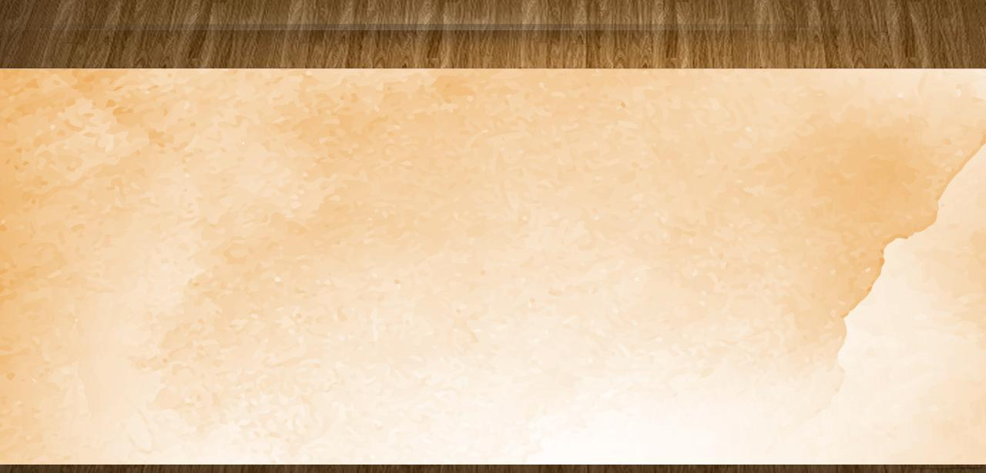
CHITHUNZI CHA YESU
“Lamulo langa ndi ili: ‘Kondanani wina ndi mnzake monga Ine ndakonda inu.” (Yohane 15:12 CCL)
Anapirira kumenyedwa, kunyozedwa, ndi kuchitidwa chipongwe
(Mateyu 27:27-31)
Ndiokoma mtima
Ankasamala za aliyense amene anali kuvutika
Ndioleza Mtima
Amakondwera ndi choonadi
Ankaphunzitsa choonadi momveka bwino komanso motsimikiza
Amatchinjiriza nthawi zonse
Iye sanaweruze mkazi wochimwayo koma anamukhululukira (Yohane 8:10-11)
Amakhulupirika nthawi zonse
Anakhulupirira kuti kulapa kwa Zakeyu kunali koona
(Luka 19:8-9)
Ali ndi chiyembekezo nthawi zonse
Anakonzekeretsa amuna 12 kuti agwire ntchito imene inkaoneka ngati ‘yosatheka’
Amapirira nthawi zonse
Anapirira njala, kukanidwa, zowawa, ndi masautso

Slide 10

CHITHUNZI CHA YESU
“Lamulo langa ndi ili: ‘Kondanani wina ndi mnzake monga Ine ndakonda inu.” (Yohane 15:12 CCL)
Sachita nsanje
Sanafune ulemu, ndipo ankacheza ndi anthu odzichepetsa
Sadzionetsera yekha
Ngakhale kuti anali Mfumu ya Chilengedwe Chonse, sanadzitamandire chifukwa cha zimenezo
Sadzikuza
Anali wokonzeka kugwira ngakhale ntchito zonyozeka kwambiri
Sachita zinthu mwamwano
Ankachitira aliyense zinthu mwaulemu ndi moyenera
Sasamala zake zokha
Ankachita chifuniro cha Atate wake nthawi zonse (Yohane 6:38)
Sakwiya msanga
Ngakhale pamene anamumenya, anayankha mwaulemu
(Yohane 18:22-23)
Saganiza zoyipa
Anapempha kuti amene anamupachika akhululukidwe
(Luka 23:34)
Sakondwera ndi zosalungama
Analankhula mwamphamvu kwa Afarisi osalungama
(Mateyu 23:27-28)

Slide 11


KUPIRIRA KWA CHIKONDI

Slide 12




MAKHALIDWE OPAMBANA
“Ndipo tsopano zatsala zinthu zitatu: chikhulupiriro, chiyembekezo ndi chikondi. Koma chachikulu pa zonsezi ndi chikondi.” (1 Akorinto 13:13 CCL)
Akorinto, mwa khalidwe lawo, anali kusonyeza zinthu zimene chikondi sichichita: anali ansanje; odzitamandira; odzikuza; ankachita zinthu mosayenera; anali odzikonda; ankakwiya msanga; anali ndi mtima wosunga zakukhosi; ndipo ankalekerera tchimo
Monga iwo, ifenso tiyenera kusiya makhalidwe oipawa ndi kukhala ndi makhalidwe a chikondi mochuluka, monga Paulo akutiphunzitsira, kuti tigwiritse ntchito mphatso za Mzimu moyenera. Akutilimbikitsanso kuti tikhalebe ndi makhalidwe ena awiri: chikhulupiriro ndi chiyembekezo.
Yesu akadzabwera, tchimo lidzatha, ndipo tidzasangalala ndi moyo wosatha limodzi ndi Iye. Pamenepo, uneneri, malilime, ndi mphatso zina, kuphatikizirapo chikhulupiriro ndi chiyembekezo, sizidzafunikanso. Koma chikondi chidzakhalapo mpaka muyaya (1 Akorinto 13:8).

Slide 13

“Mulungu ndiye chikondi. Chikondi cha Atate ndi cha Mwana ndi khalidwe limene liyenera kuoneka mwa wokhulupirira aliyense. Mawu a Mulungu ndi njira imene chikondi cha Mulungu chimafikira kwa munthu. Choonadi cha Mulungu ndi njira imene imafikira maganizo a munthu. Mzimu Woyera amaperekedwa kwa munthu amene amagwira ntchito mogwirizana ndi mphamvu za kumwamba. Iye amasintha maganizo ndi khalidwe la munthu, ndikumuthandiza kupirira ngati akuona Iye amene saoneka. Chikondi changwiro tingakhale nacho ngati tikhulupirira choonadi ndi kulandira Mzimu Woyera.”
EGW (Our Father Cares, October 9)

