Slide 1

UTUMIKI WODZAZA NDI CHIKONDI
Phunziro 9, August 29, 2026

Slide 2

“Pakuti ndinakulemberani kalata ija ndili wopsinjika ndi wowawidwa mtima kwambiri ndi kutuluka misozi yambiri, osati pofuna kukumvetsani chisoni koma kuti ndikudziwitseni kuti ndimakukondani kwambiri.”
(2 Akorinto 2:4, CCL)

Slide 3









Pamene tikufufuza mozama Kalata Yachiwiri ya Paulo kwa Akorinto, tikuona kuti mtumwiyu ali ndi chidwi chachikulu pa ubwino wa mpingo.
Ngakhale kuti kutsatira njira za Mulungu sikunakhalepo kophweka m’dziko lodzala ndi uchimoli, mu zaka za zana loyamba za utumiki, kuvomereza poyera kuti munthu ndi Mkhristu kukanabweretsa mavuto aakulu.
Paulo akukonzekeretsa mpingo kuti ukumane ndi mavuto amenewa, kaya ochokera mkati kapena kunja, ndipo akuphunzitsa anthuwo kukhala thupi limodzi logwirizana mwa chikondi chopanda dyera. Kuchokera pa malangizo amenewa, ifenso masiku ano tingaphunzire kukhala “fungo la moyo lotsogolera ku moyo” (2 Akorinto 2:16).
Chitonthozo cha Mulungu m’masautso
Chiyero ndi kutsimikiza mu utumiki
Kuchita zinthu mwanzeru
kukhululukidwa ndi kubwezeretsedwa
Fungo lokoma la Khristu

Slide 4


CHITONTHOZO CHA MULUNGU M’MASAUTSO
“Iye amatitonthoza ife mʼmavuto athu onse, kuti ifenso tithe kutonthoza amene ali pavuto lililonse ndi chitonthozo chimene ife tilandira kwa Mulungu. ” (2 Akorinto 1:4)
Kalata Yachiwiri ya Akorinto ndi kalata imene Paulo amalankhula kwambiri za chitonthozo. Mpingo unali kudutsa m’nthawi yovuta, ndipo kalata ya Paulo yapita ija inawapangitsa kukhala achisoni kwambiri.
CHITONTHOZO CHA MULUNGU
Chimatimasula ku mantha
Chimatikumbutsa nthawi zomwe Iye anatithandiza
Chimatithandiza kupirira masautso
Chimatitsogolera ku kukhwima muzimu
Chimatilimbikitsa kupempherera ena.
Timatonthozana monga momwe Mulungu anatonthozera ife
Koma chisoni chimenecho chinali “cha Umulungu,” chimene chinawatsogolera ku kulapa (2 Akorinto 7:10). Choncho, Paulo sanafune kuti chisonicho chiwalemetse kwambiri, koma kuti atonthozedwe.
Iye mwini anadutsapo m’nthawi imene moyo wake unali pachiswe ndipo anataya mtima (2 Akorinto 1:8-10). Koma Mulungu anamutonthoza, ndipo tsopano akupereka chitonthozo chimenecho ku mpingo (2 Akorinto 1:6).

Slide 5




CHIYERO NDI KUTSIMIKIZIKA MU UTUMIKI
“Tsono chonyadira chathu nʼchakuti, chikumbumtima chathu chimatitsimikizira kuti timakhala bwino mʼdziko lapansi, makamaka pa ubale wathu ndi inu. Takhala moona mtima ndi oyera mtima. Sitinachite chomwechi mwa nzeru ya dziko lapansi koma monga mwa chisomo cha Mulungu.” (2 Akorinto 1:12 CCL )
Anthu ena ankamunyoza Paulo, ankamunene kuti anali wofooka komanso wosakhazikika pa maganizo ake (2 Akorinto 10:10). Pa chifukwa chimenechi, komanso kuti uphungu wake ulandiridwe ndi kuvomerezedwa, zinali zofunika kuti mtumwiyo adziteteze ku zoneneza zoterezi.
Monga munthu, iye anadziona ngati wosafunika kwenikweni (Aefeso 3:8). Koma, chifukwa cha chisomo cha Mulungu, anatha kunena modzitamandira kuti anali ndi chikumbumtima choyera (2 Akorinto 1:12).
Iye pamodzi ndi anzake akanatha kunena molimba mtima kuti khalidwe lawo linali loyera ndi loona mtima, mu mpingo komanso kunja kwa mpingo.
Pachifukwa chimenechi, zolemba za Paulo zinalibe zolinga zobisika. Iye ankayembekezera kuti makalatawa aziwerengedwa ndi kumvedwa podziwa kuti analembedwa ndi mtima woyera ndi woona—kutanthauza kuti analembedwa chifukwa cha chikondi pa iwo komanso pofuna kuwapindulitsa (2 Akorinto 1:13-14).

Slide 6



KUCHITA ZINTHU MWANZERU
“Mulungu ndi mboni yanga kuti sindinabwererenso ku Korinto kuno kuti ndisakumvetseni chisoni.” (2 Akorinto 1:23 CCL)
Mukalata yake yoyamba, Paulo anauza Akorinto za njira imene anakonza kuti adzadutse (1 Akorinto 16:5-11):
Efeso
Masedonia
Akorinto
Yudeya
Mukalata ina imene analemba pambuyo pake (imene inatayika, 2 Akorinto 7:8), anawauza kuti adzawachezera kawiri (2 Akorinto 1:15-16):
Efeso
Masedonia
Akorinto
Yudeya
Akorinto
Komabe, iye anasintha zolinga zake ndipo adaganiza zoti apange ulendo woyamba umenewo (2 Akorinto 1:23). Kusintha kumeneku kunachititsa ena kumudzudzula kuti anali wosakhazikika komanso wosintha maganizo pafupipafupi. Ndichifukwa chiyani anasintha maganizo ake?
Zinkaoneka kuti kunali kofunika kuti Paulo apite ku Korinto chifukwa cha mavuto amene analipo. Koma kutsutsidwa kumene akanakumana nako kukanayambitsa mkangano umene ankafuna kuupewa, chifukwa cha chikondi chachikulu chimene anali nacho pa iwo (2 Akorinto 2:1-4).

Slide 7

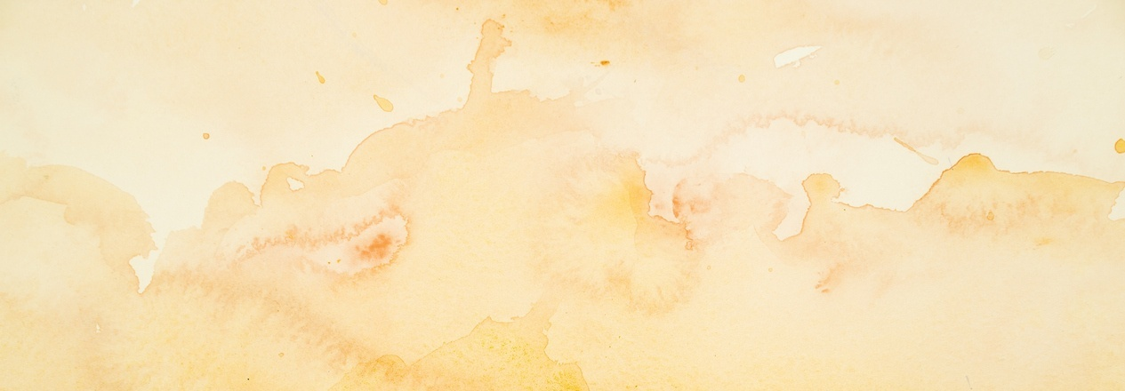



KUKHULULUKIDWA NDI KUBWEZERETSEDWA
“Aliyense amene mumukhululukire, inenso ndimukhululukira. Ndipo ndikakhululukira, ngati pali kanthu koti ndikhululukire, ndiye kuti ndakhululuka chifukwa cha inu pamaso pa Khristu,” (2 Akorinto 2:10)
Pamene Paulo anali paulendo wopita ku Troas, Tito anapita ku Korinto. Kuchokera ku Troas, Paulo anapita ku Masedonia. Koma anali ndi nkhawa kwambiri chifukwa chakuti Tito sanakumane naye ku Troas kuti amupatse uthenga wokhudza mpingo wa ku Korinto (2 Akorinto 2:12-13).
Patangopita nthawi yochepa, Tito anakumana ndi Paulo ku Masedonia. Anamuuza mmene mpingo unalandirira bwino kwambiri malangizo ndi machenjezo a mtumwiyu (2 Akorinto 7:5-9, 13-16).
Imodzi mwa nkhani zimene ankafunika kuthetsa inali yokhudza chilango cha mu mpingo. Pomvera mtumwiyu, munthu amene analakwa anadzudzulidwa, ndipo anavomera kudzudzulidwako. Tsopano Paulo akuwapempha kuti achite chinthu chotsatira: kumukhululukira ndi kumulandiranso mu mpingo (2 Akorinto 2:5-11

Slide 8





KUNUNKHIRA KWA KHRISTU
“Pakuti kwa Mulungu ndife fungo labwino la Khristu pakati pa iwo amene akupulumutsidwa ndi amene akuwonongeka. ” (2 Akorinto2:15)
Pofotokoza mmene Mulungu “anatsegulira khomo” kuti uthenga wabwino ulalikidwe bwino ku Troa, Paulo akufuula mawu a chiyamiko ndi chigonjetso kuti: “Koma ayamikike Mulungu, amene nthawi zonse amatitsogolera monga akapolo mu ulendo wachigonjetso wa Khristu, ndipo amatigwiritsa ntchito kufalitsa ponseponse fungo lokoma la kumudziwa Iye” (2 Akorinto 2:14).
Monga fungo limene limafalikira paliponse, chidziwitso cha Khristu chimafikira munthu aliyense. Kwa Akorinto, monganso kwa ife, fungo limeneli ndi la moyo wosatha. Koma kwa iwo amene amakana kuitana kwa Mulungu, ndi fungo la imfa (2 Akorinto 2:15-16).
Poganizira za udindo umene zimenezi zikubweretsa, Paulo akufotokoza kuti uthengawo uyenera kuperekedwa moona mtima, popanda kufuna phindu lililonse la munthu mwini, koma chipulumutso cha cha omvera(2 Akorinto 2:17).

Slide 9

“Mtumiki wokhulupirikayu anabweretsa uthenga wosangalatsa wakuti kusintha kodabwitsa kunachitika pakati pa okhulupirira a ku Korinto. Ambiri anavomera malangizo amene anali mu kalata ya Paulo ndipo analapa machimo awo. Miyoyo yawo sinalinso yochititsa kuti Chikhristu chitonzedwe, koma inali ndi chikoka champhamvu cholimbikitsa kukhala ndi moyo weniweni wopembedza Mulungu. […]
Kulapa kumene kumabwera chifukwa cha mphamvu ya chisomo cha Mulungu pa mtima kumatsogolera munthu kuvomereza ndi kusiya tchimo. Izi ndizo zipatso zimene mtumwiyu ananena kuti zinaoneka m’miyoyo ya okhulupirira a ku Korinto.”
EGW (The Acts of the Apostles, pp. 324)

