Slide 1

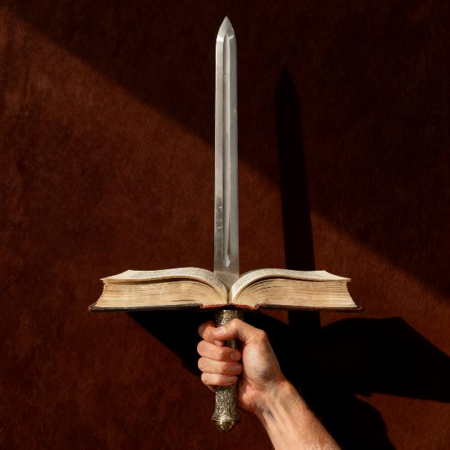
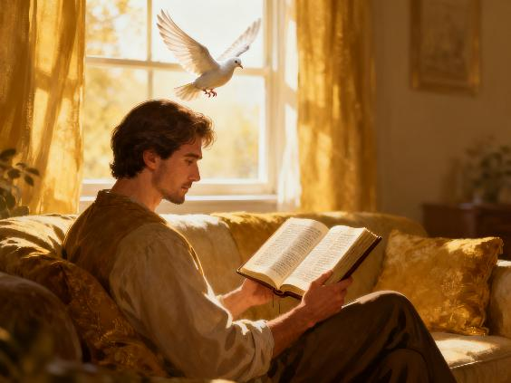
GA’EE MACAAFA QULQULLUU
Lesson 4 for April 25, 2026

Slide 2

“Dubbiin Waaqayyoo jiraataadhahoo, humna qabeessasihoo. Muruufis gara lama kan qabu billaa qaramaarra caala. Keessa in lixas; lubbuudhaa fi hafuura gidduutti gargar baasuudhaaf. Ribuudhaa fi lafees, yaada garaas, mari’aa isaas in qora.” (Ibr. 4:12)
Notes:
Buscar en biblia-espada

Slide 3


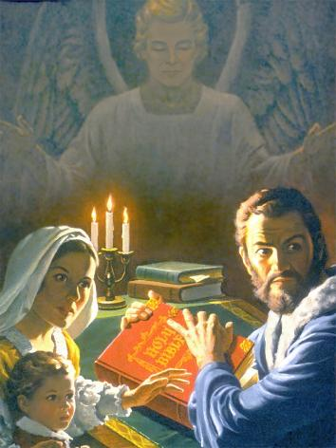
The Bible is the best-selling book in the world, outselling the second-ranked book five times. But this wasn't always the case.
There was a time when owning a Bible, reading it, or even talking about it could be grounds for imprisonment, torture, and even death.
If it weren't for God's special protection, the Bible would have disappeared long ago. Why? What is so special about this book that makes it both so loved and so hated?
The enemy of the Bible
Correct and incorrect ways to read the Bible
What is the Bible?
Positive effects of reading the Bible
Friends of the Bible

Slide 4


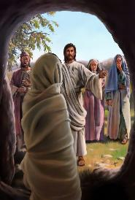
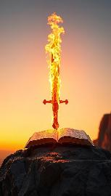
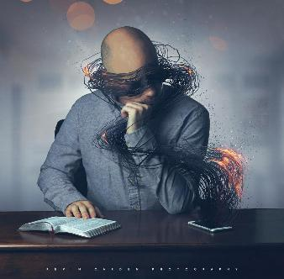
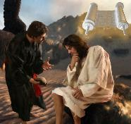
THE ENEMY OF THE BIBLE
“…Billaa Hafuuraas fudhadhaa, Innis Dubbii Waaqayyooti.” (Efees. 6:17)
Think about what the spoken word of God is capable of doing: creating and giving life (Psalm 33:6), or raising the dead (John 5:28-29).
What can the Bible, the written word of God, do? It has the power to defend us (Eph. 6:17b) and transform us (Heb. 4:12). Jesus used the Bible to defend himself against temptation (Matt. 4:4, 7, 10).
Satan knows he is powerless against the power of the Bible. Therefore, he has tried to physically destroy it. He failed, as Bible societies began distributing thousands of copies. Then he tried to discredit it with higher criticism. Now he seeks to prevent us from reading it by occupying our time with other things.
Am I going to let him get away with it? Can't I find some time in my schedule to read the Bible? Reading it transforms us and makes us strong against our worst enemy: the devil.

Slide 5

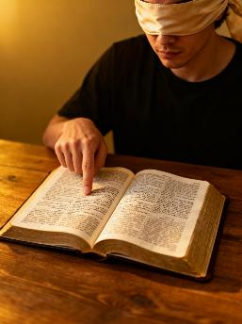
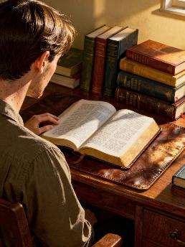


CORRECT AND INCORRECT WAYS TO READ THE BIBLE
“Atis dubbii dhugaa sana sirriitti qabachuudhaan hojjetaa qoratamee fudhatame kan itti hin qaanofne ta’iitii fuula Waaqaa duratti of dhi’eessuuf tattaafadhu.” (2 Ximot. 2:15)
Incorrect forms
Find something that aligns with our point of view
Choosing texts at random, without purpose
Correct forms
Seek to learn God's will
Conduct a systematic study
Choose the parts we like, and reject the parts we dislike.
Do not reject any text, but analyze them all.
Our study of the Bible should be rational, but our reason must submit to the power of the Holy Spirit in order to correctly discern the biblical message.
Why? Because our reason is limited and not always reliable. That's why, when studying the Bible, we must seek the wisdom of its Author.

Slide 6
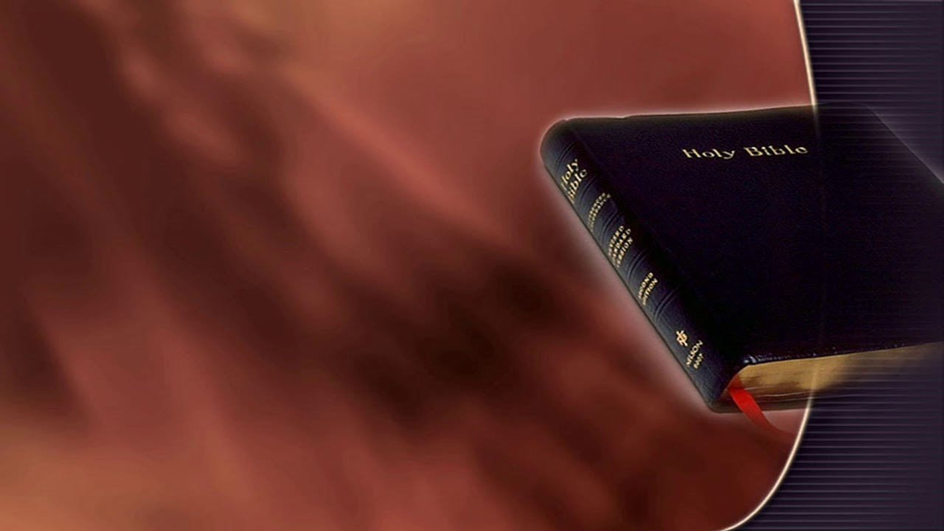
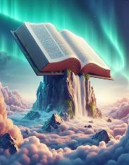
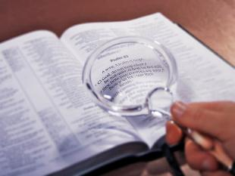
WHAT IS THE BIBLE?
In our society, and even among Christian circles, there is a belief that truth is relative, that there is no truth that remains constant and unchanging over time.
“Dubbiin kee hundinuu dhugaa dha; seerri kee qajeelaan hundinuus bara baraan jiraata.” (Faars. 119:160)
However, the Bible—as the word of God—claims to possess absolute truth (Psalm 119:160; John 17:17; James 1:18). It claims to be pure and a protective shield against human sophistry (Proverbs 30:5). If we add any of our own “truths” to it, we may be considered liars before God (Proverbs 30:6).
Any claim, any truth, must be tested by the Bible. When there is a contradiction between what we consider true and what the Bible states, there are two possibilities: either we are mistaken, or we are misinterpreting the Bible.

Slide 7


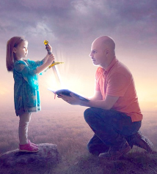

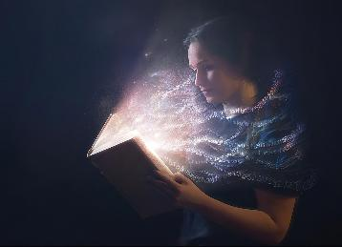
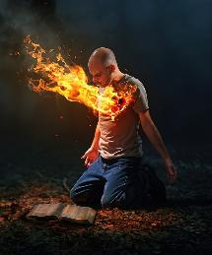
POSITIVE EFFECTS OF READING THE BIBLE
“Ani akkan cubbuu sitti hin hojjenneef, dubbii kee garaa koo keessa dhokfadheera.” (Faars. 119:11)
Something that even the most ardent enemies of the Bible cannot deny is its power to transform people. Paul compares it to a sword that possesses great power.
It makes us see ourselves as we truly are (Heb. 4:12)
It keeps us from sin (Psalm 119:11)
It is food for our soul (Jer. 15:16)
It makes us grow spiritually (1 Peter 2:2)
He gives us life (John 6:63)
No other book can impact us like the Bible. When we are willing to incorporate its teachings into our lives, we change for the better.
When we read it with an open heart and ask God for the illumination of the Holy Spirit, our life is transformed.

Slide 8

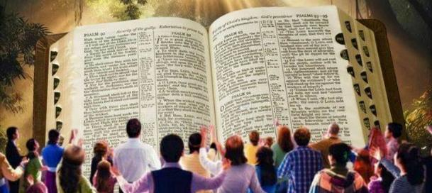
“Dubbii Waaqayyoo isa nuy lallabnu yeroo argattan, akka dubbii namaatti utuu hin ta’in akka dubbii Waaqayyootti fudhattaniittu; innoo dhuguma dubbii Waaqayyoo ti. Waaqayyos isin warra amantan keessatti in hojjeta; kana hundumaaf ittuma fufnee Waaqayyoon in galateeffanna.” (1 Tasal. 2:13)
FRIENDS OF THE BIBLE
When we receive the Bible in this way…
It shows us the state of our relationship with God
It tells us how to strengthen that relationship
We are experiencing a gradual transformation
We draw near to Jesus
It makes us wise for salvation
We are growing in the knowledge of the truth
Our faith grows and strengthens
We have hope
We are aware that a better, eternal, wonderful life awaits us
Friends of the Bible approach it with the awareness that it is the Living Word of God (1 Thessalonians 2:13). But how can I reach that conviction?
Paul tells us that, for this, we need spiritual discernment, that is, the ability to understand spiritual things (1 Corinthians 2:14). Therefore, discerning the divine message in the Bible is the work of the Holy Spirit acting within us.

Slide 9

“The Bible unfolds truth with a simplicity and a perfect adaptation to the needs and longings of the human heart, that has astonished and charmed the most highly cultivated minds, while it enables the humblest and uncultured to discern the way of salvation. And yet these simply stated truths lay hold upon subjects so elevated, so far-reaching, so infinitely beyond the power of human comprehension, that we can accept them only because God has declared them. […] The more he searches the Bible, the deeper is his conviction that it is the word of the living God, and human reason bows before the majesty of divine revelation.”
EGW (Steps to Christ, p. 107)

