Slide 1
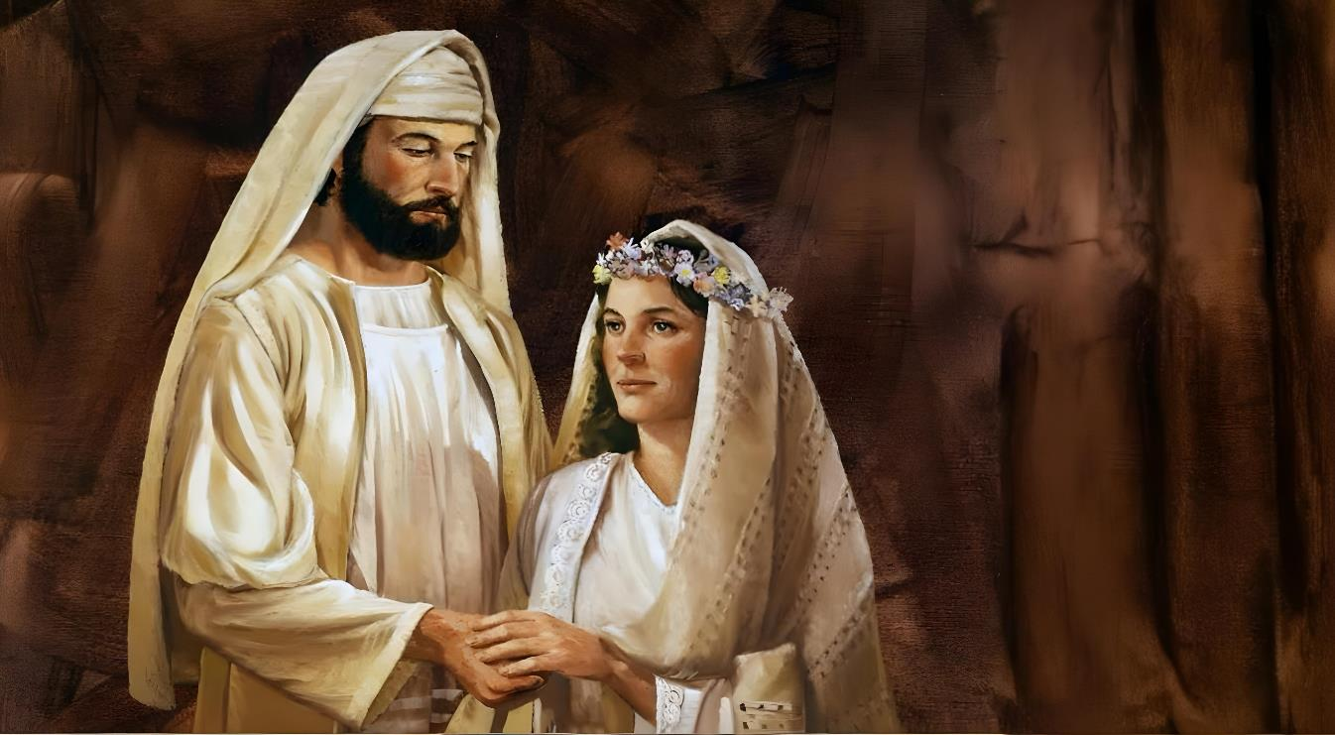
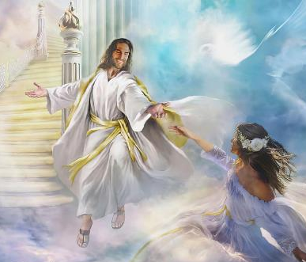
Icigwa ca 3 co kuwa 19 Ndamukiza 2025
AMASHUSHO AVUYE KU BUGENI

Slide 2
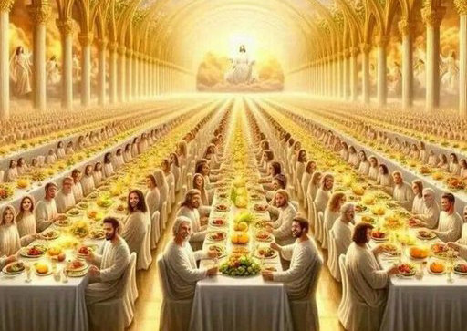
“Umumarayika arambarira, at' Andika, uti Hahirwa abatorewe gutaha ubukwe bga wa Mwagazi. Kand' arambarira, at' Ayo n'amajambo y'ukuri y'Imana.”
Ivyahishuriwe Yohana 19:9

Slide 3

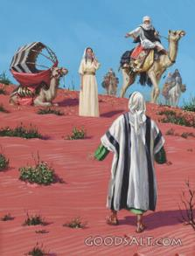
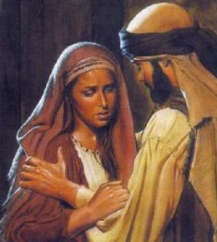
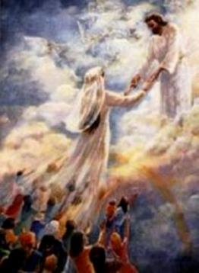
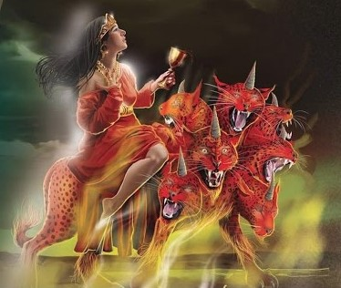








Incuro nyinshi, mw’Isezerano rya Kera no mu Isezerano Rishasha, abantu b’Imana bagereranywa n’umugore canke umugeni.
Rimwe na rimwe turabona ubwo bumwe bugereranywa n’ubugeni bw'aho abagore babaye abizigirwa (nka Rebeka) canke abahemu (nka Gomeri).
Mu bindi bihe, ibimenyetso vy’abagore b’intahemuka (umugeni w’Umwagazi w’intama,) canke abagore b’abasambanyi (Babuloni hahambaye) birakoreshwa ata guca ku ruhande.
Ikigereranyo c’ubugeni.
Abagore b’abahemu:
Umugore akiri muto yahebwe.
Umugore wa Hoseya.
Babuloni hahambaye.
Abagore b’intahemuka:
Rebeka.
Umugeni w’Umwagazi w’Intama.

Slide 4

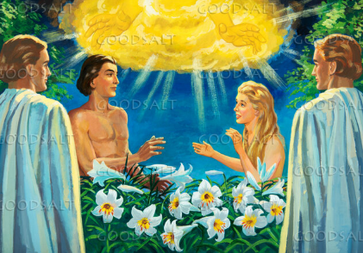
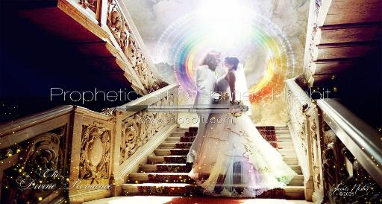
IKIGERERANYO C’UBUGENI
“Ni co gituma umuntu azosiga se na nyina, akabana n'umugore wiwe akaramata, bakaba umubiri umwe.” (Itanguriro 2:24)
Igihe Imana yarema abantu, yaduhaye ingabire zibiri: Isabato (Itanguriro 2:2-3) n’ubugeni (Itanguriro 2:24). Vyompi bifitaniye isano n’imigenderanire: imigenderanire n’Imana, no hagati y’umugabo n’umugore.
Mu gutungana kwabwo, ubugeni bwagaragaza ubucuti butunganye hagati y’abagize Ubumana. Inyuma y’icaha, bugereranya ubumwe hagati y’Umugabo atunganye—Yesu—n’Umugore wiwe adatunganye—Ishengero (Ef. 5:31-32).
Babarira uwo mwubakanye, naho yoba atabibereye.
Nk’uko Kristo aduharira, n’ubwo tutabibereye
Emera uwo mwubakanye, amakosa n’ibindi vyose
Nk’uko Kristo atwemera n’amakosa yacu, n’ibindi
Muri Bibiliya yose, turabona ingene abagabo bihatira gutunganya abagore babo maze bagatuma abagore babo babakunda. Muri aka karorero k’ubugeni, turashobora kandi kwiga ingene twovyifatamwo mu bukwe bwacu bwite (hagati y’abantu babiri badatunganye):
Shira imbere yawe uwo mwubakanye
Nk’uko Kristo aduha ikibanza imbere yiwe

Slide 5

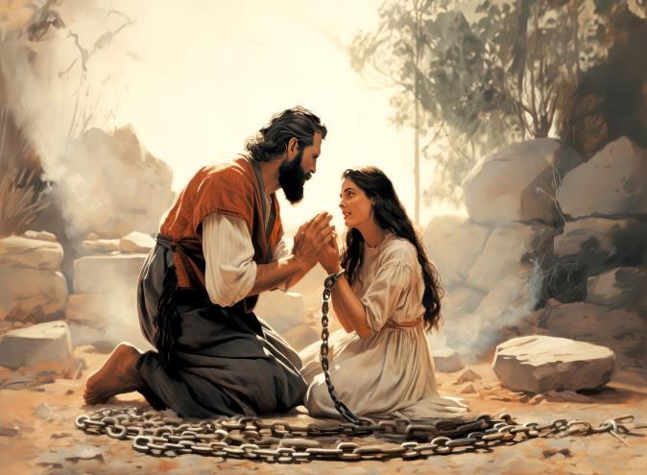
ABAGORE BAHEMUKA

Slide 6


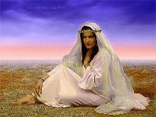
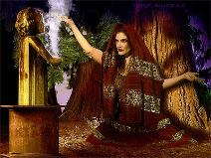
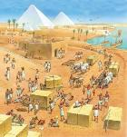
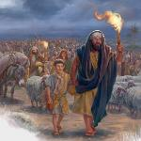
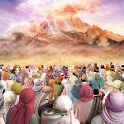
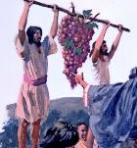
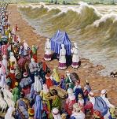
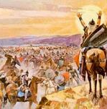
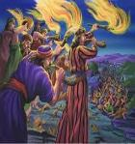
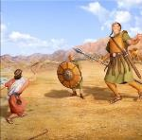
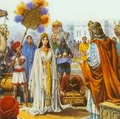
UMUGORE AKIRI MUTO YATAWE
“Maze ndaguserukako, ndakwitegereza, mbona yuk' ushitse mu gihe uteye igomwe; maze ngutererak' umwambaro wanje, nambika ubgambure bgawe; mbere narakurahiye, nsezerana nawe isezerano, ucika uwanje, ni k'Umwami Uhoraho agize.” (Ezekiyeli 16:8)
Mu iyerekwa, Ezekiyeli yeretswe ingene Imana yatoye uruyoya rw’umukobwa rwatawe (Isirayeli); aruha ubuzima bwiwe; arufasha gukura; yagiranye na we isezerano ry’ubugeni; aca aba umwamikazi ashimwa na bose (Ezk. 16:1-14).
Ivyo bihurikiyemwo inkuru y’urukundo hagati y’Imana n’abantu b'Abisirayeli kuva bava mu Misiri gushika ku ngoma y’ubutunzi ya Dawidi na Salomo, igihe Isirayeli yashimwa n’amahanga yose (1 Abami 10:1).
Ariko Isirayeli yibagiye ko ubwiza bwayo ari ingabirano iva ku Mana, ari ikimenyetso c’ubwiza bw’Imana (Ezk. 16:14,) ica irahindukira iva ku Mugabo wayo, irasambana akurikira izindi mana (Ezk. 16:15-17).
Twaremwe kugira ngo tugaragaze ubugwaneza n'ubwiza bw’Imana. Iyo twiyumvira ko ubugwaneza bwacu ari icamwa cacu ubwacu, ingorane ziba zitanguye.

Slide 7

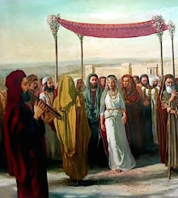
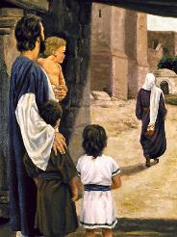

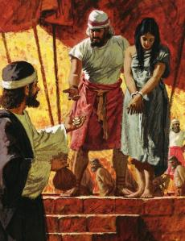
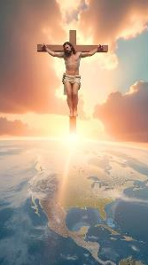
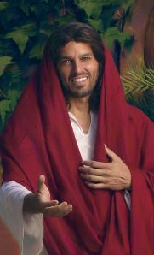
UMUGORE WA HOSEYA
“Igihe Uhoraho yatangura kuvugisha Hoseya ubga mbere, aramubarira, ati Genda, wabire umugore maraya afise abana b'abasambanano: kukw iki gihugu cagize ubumaka bukomeye bgo kureka Uhoraho.” (Hoseya 1:2)
Kuva mu ntango, Imana iratomora neza ko itegeko ryahawe Hoseya ryo kurongora Gomeri (yari yacitse maraya, agaheba umugabo wiwe) ryari ikigereranyo c’ubucuti buri hagati y’Imana na Isirayeli (Hos. 1:2).
Hoseya yarakoresheje uburyo butandukanye kugira ngo umugore wiwe asubire kumukunda (Hos. 2:6-7, 14-15). Kubera ko ata na bumwe muri ubwo buryo bwamufashije, yategerezwa kumuha incungu (Hos. 3:2-3).
Ego ni ko, ugucungurwa kwacu kwatwaye Imana amahera menshi cane kuruta “intete z'ifeza cumi na zitanu, n'ingero yitwa homeru ya sayiri imwe n'igice.”
Ikibabaje ni uko Ishengero ryakurikiye inzira y’ubuzimire nk’iyo Isirayeli yakurikiye. Ariko urukundo rw'Imana rukomeza kudahindagurika (Hos. 11, 4). Iguma itwinginga ngo tureke "ubusambanyi" tuyihindukirire. (Hos. 14:1-2; Ivyah.18:2-4).

Slide 8

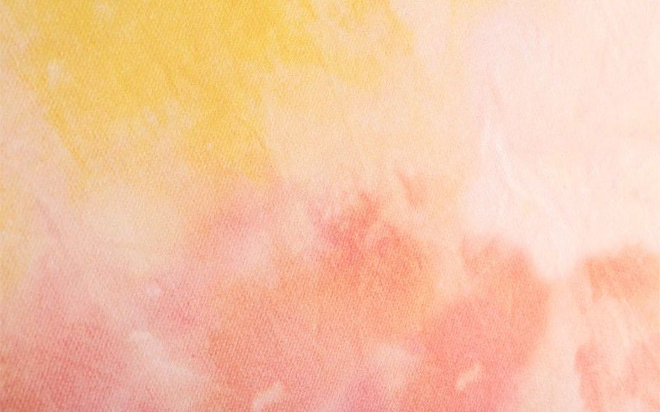
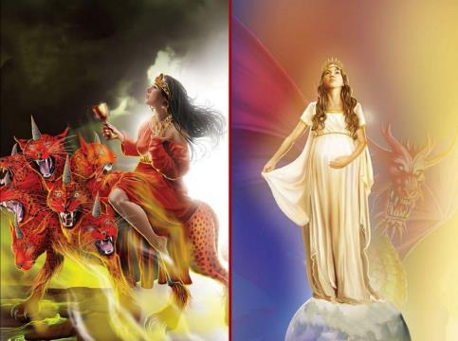
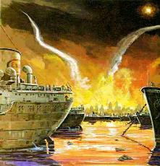
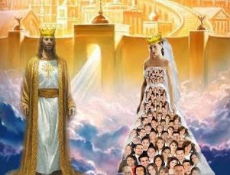
BABULONI HAHAMBAYE
“Mu ruhanga afise izina ry'akabanga, ryanditswe ngo BABULONI HAHAMBAYE, NYINA WA BA MARAYA, KANDI NYINA W'IBIHUMANYA VYO MW ISI.” (Ivyahishuriwe Yohana 17:5)
Babuloni ni nde canke ni iki?
Umugore atunganye agereranya abantu b’Imana b’intahemuka (Ivyah. 12:1; Ef. 5:25-27). Babuloni, nyina w’abamaraya, agereranya abantu b’Imana bayiheba bakizigira abami bo kw’isi (Ivyah. 17:1-5).
Ukwo guhemuka kw’abantu bayo gutuma Imana ibabara cane. Imaze ibinjana n’ibindi igerageza gusubiza Ishengero ryiwe mu gutungana, ariko bake ni bo bavyakiriye. Kw'iherezo, izobatera akamo ka nyuma (Ivyah. 18:4).
Inyuma yo guhemuka, gusubiza hamwe kurashoboka. Ariko ikibabaje ni uko rimwe na rimwe umuntu ashika ku rwego rwo kutigarura, aho gusubiza hamwe kuba kutagishoboka.
Igihe kizoshika aho Babuloni n’abazoba bayisigayemwo bazocirwa urubanza bagahanwa (Ivyah. 19:1-5). Ariko abizigirwa, umugeni w’Umwagazi w’intama, bazobana na Yesu ibihe bidashira (Ivyah. 19:6-8).

Slide 9

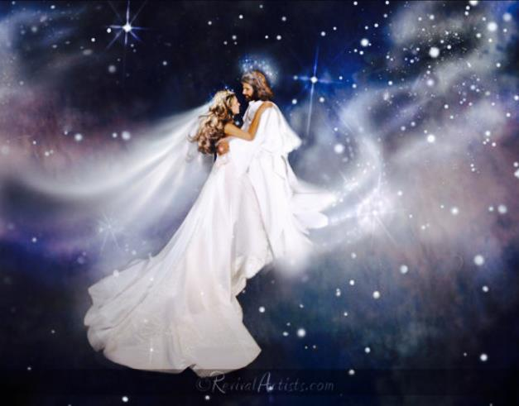
ABAGORE B’INTAHEMUKA

Slide 10
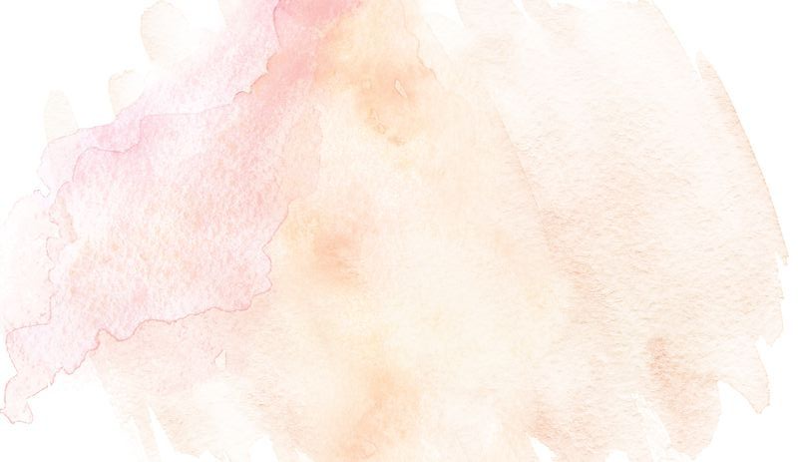

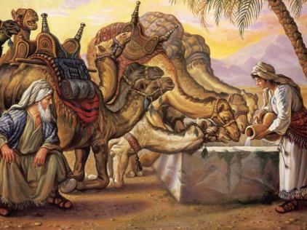
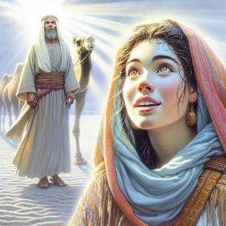
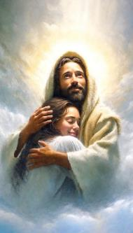
REBEKA
“Bahamagara Rebeka, baramubaza, bat' Uremera kujana n'uyu mugabo? arabishura, ati Ndemeye.” (Itanguriro 24:58)
Hakurikijwe umugenzo wo mu gihe ciwe, Aburahamu yaragiye kuronderera umugore umuhungu wiwe Isaka. Ariko ntiyashaka ko umuhungu wiwe arongora n’umwe mu bagore b'abanyakananikazi, ahubwo yashaka ko arongora umwe mu ncuti ziwe, baba ku bilometero ibihumbi n’ibihumbi (Itanguriro 24:2-3).
Impamvu y’ivyo yari iyihe? Naho bari abanyagasembwa, imiryango yiwe yasenga Imana y’ukuri, mu gihe Abanyakanani bo bari barayihevye. Iyo Isaka yubakana n'umugore w’Umunyakananikazi, ubuzima bwiwe bwo mu vy’idini bwari kugabanuka kubera ubwaku bubi bw’umugore wiwe.
Uko ni ko amateka y'Ishengero yagenze igihe ryagirana amasezerano y'"ubugeni" n'amahanga y'iyi si. Buhorobuhoro, ryitandukanije n’ukwizera kw’ukuri.
Ikindi kintu kidasanzwe muri iyo nkuru ni uko Rebeka abazwa nimba ashaka kurongorwa, kuko nk’uko umugenzo ubivuga, nta mahitamwo yari afise (Itanguriro 24:50-51, 57-59).
Kuba mu bagize umugeni w’Imana w’umwizigirwa ni igikorwa umuntu akora abikunze. Reka twemere urukundo rwa Yesu n'ijambo ritomoye ngo "Ndagenda."

Slide 11

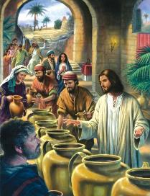
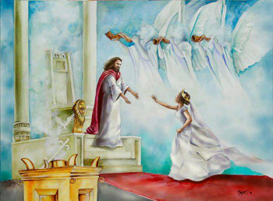
UMUGENI W’UMWAGAZI W’INTAMA
“Tunezerwe, duhimbarwe, tuyihe icubahiro, kuk' ubukwe bga wa Mwagazi w'Intama bushitse, umugeni wiwe ariteguye.” (Ivyahishuriwe Yohana 19:7)
Yesu yakoze igitangaro ciwe ca mbere mu bukwe (Yohana 2:1-11). Dufatiye ku vyo tubona, ico gikorwa gifise ikigereranyo kinaka kidufasha gutahura Umugambi w’Agakiza.
Ni igiki twigira kuri iyo migani?
Inkumi 10
(Mt. 25, 1-13)
Gufita Mpwemu Yera
Kwemera ihamagarwa ryawe
Abashitsi batabibereye (Mt. 22, 1-14)
Buri wese yaratumiwe mu bukwe
Dutegerezwa kwambara Kristo
Kumbure ikiruta vyose ni uko, kugira ngo umugeni (twebwe) abe yiteguye, akeneye vino Yesu atanga, ni ukuvuga amaraso yiwe ahumanura (Yoh. 2:6; Ivyah. 7:14).
Yesu yarakoresheje kandi imigani ijanye n’ubugeni kugira ngo yerekane imice imwimwe y'umwiteguro dutegerezwa gukora ku bijanye n’ukuza kwiwe kwegereje. Muri iyo yose, umugeni nta na rimwe avugwa, ahubwo ni abashitsi. None abo bashitsi boba ari bo umugeni ubwiwe?

Slide 12

“Kristo yabaye incuti ya buri musi hamwe n'umugenzi amenyerewe. Babayeho mu bucuti bwa hafi, mu gusabana ubudasiba n'Imana. Kuri bo icubahiro c'Umwami carashizwe hejuru. Muri bo umuco wo kumenya ubwiza bw'Imana mu nyonga ha Yesu Kristo waragaragaye. Ubu baranezererewe imishwarara itazima y'uguyangana n'ubwiza vy'Umwami mu cubahiro ciwe. Bariteguriye ugusabana n’ijuru; kuko barafise ijuru mu mitima yabo.”
EGW (Reflecting Jesus, Mukakaro 17)

