Slide 1
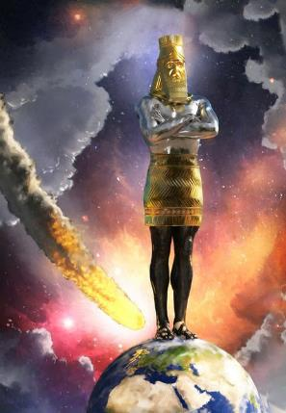
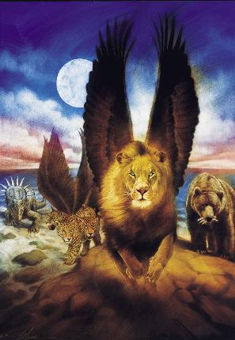
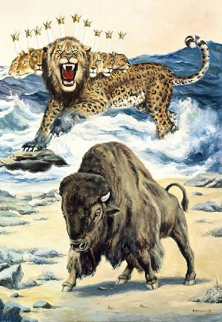
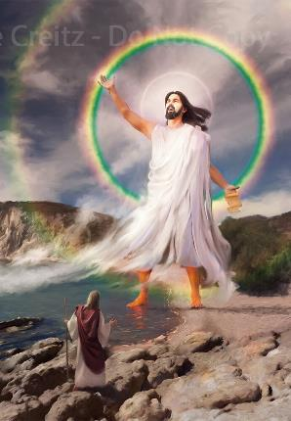
AMAHANGA: IGICE CA 2
Icigwa ca 5 co kuwa 3 Rusama 2025

Slide 2
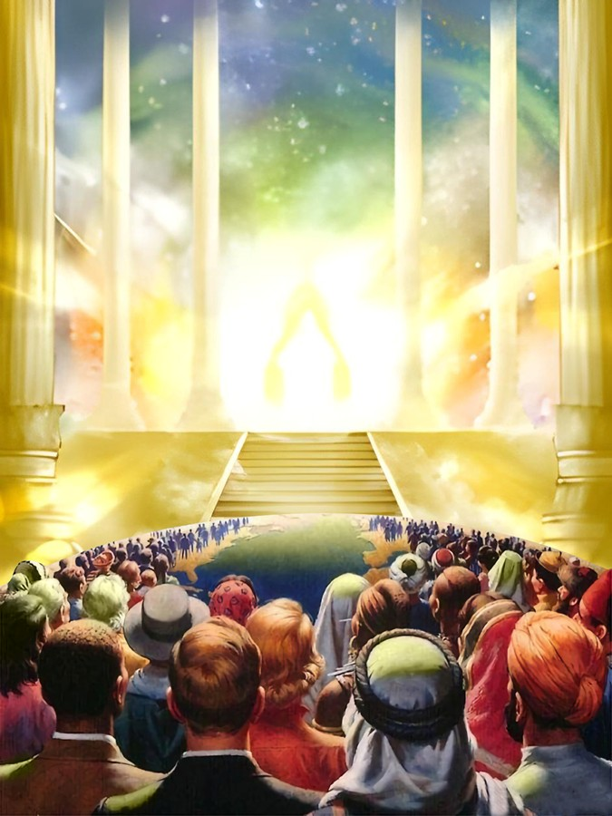
“ Ni mwisigireho, mumenye kw ari jewe Mana; Nzoshirwa hejuru mu mahanga, nzoshirwa hejuru mw isi.”
Zaburi 46:10

Slide 3

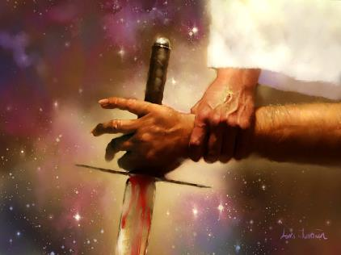
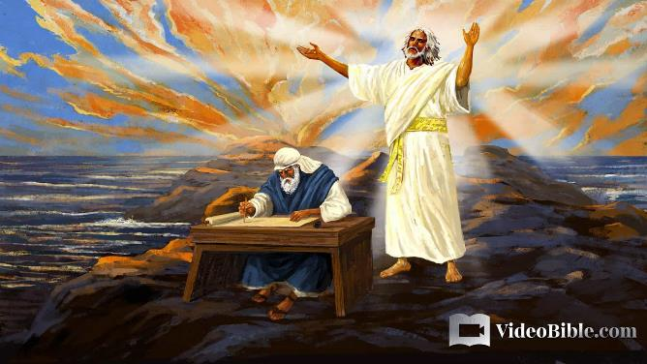



Imana ishaka ko tumenya iterambere ry’amateka y'intambara yo ku mugaragaro hagati y’iciza n’ikibi, hagati ya Kristo na Satani.
Ni co gituma yeretse abavugishwa intambwe zitandukanye z’intambara, cane cane izerekeranye n’uruhara rw’amahanga.
Isoko nyamukuru y’ubwo bumenyi iboneka mu gitabu ca Daniyeli, hamwe na Yohana—mu gitabu c’Ivyahishuriwe Yohana—ari na we yaronse amakuru menshi yerekeye intambuko ya nyuma y’intambara.
Ubumenyi bw’iciza n’ikibi
Ubumenyi bw’amateka:
Ivyuma vy’agaciro
Ibikoko bitangaje
Ubumenyi bw’igihe c’iherezo:
Isi hamwe n’ikiyaga
Ubwoko bwasigaye

Slide 4

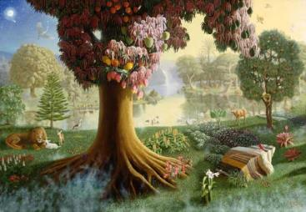
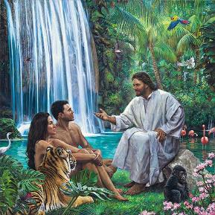
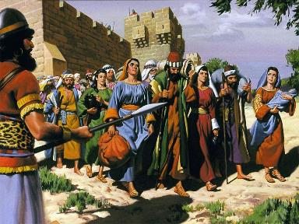
UBUMENYI BW’ICIZA N’IKIBI
“kukw Imana izi yuk' umusi mwabiriyeko, amaso yanyu azokwihweza, mukamera nk' Imana ku vyo kumenya iciza n'ikibi.” (Itanguriro 3:5)
Eva yageragereshejwe ku kuba yongana n’Imana, aronka ubumenyi bw’iciza n’ikibi. Kandi, biboneka ko yaroraniwe ( Itang. 3:5, 22 ).
Ubwo bumenyi bwari bwarihanijwe n’Imana mu buryo butomoye ( Itang. 2:16-17 ). Ni kuki Imana yankiye umugabo n’umugore ba mbere kumenya iciza n’ikibi?
Niwasoma Itanguriro 3, uzobona ko ubwo bumenyi ata ciza na kimwe bwabazaniye. Kumbure ingorane ntiyari ubumenyi ubwabwo, ahubwo ni uburyo bwakiriwemwo. Imana yashaka kwigisha uwo mugabo n'umugore intambuko ku yindi, nk’uko abana bigishwa mw’ishure. Ariko bize ikibi biciye ku vyo baciyemwo.
Iryo kosa ryasubiwemwo na Isirayeli igihe yasaba umwami. Amaherezo, Imana yarabemereye kuyoborwa nk’ayandi mahanga kugira ngo bamenye ico bisobanura kuyikorera n’ico bisobanura gukorera amahanga (2 Ngoma 12:8).

Slide 5
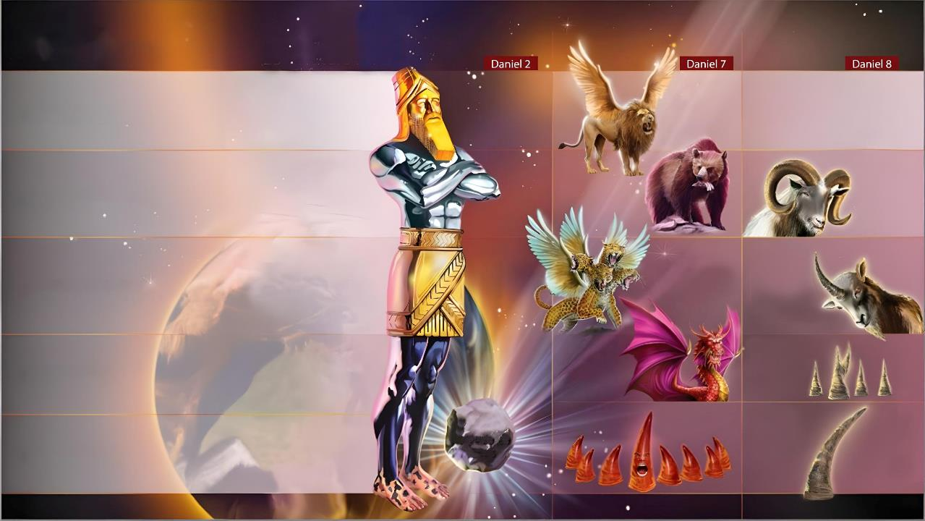
UBUMENYI BW’AMATEKA

Slide 6

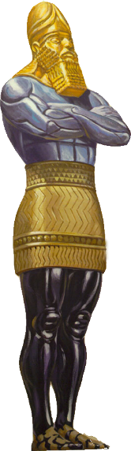
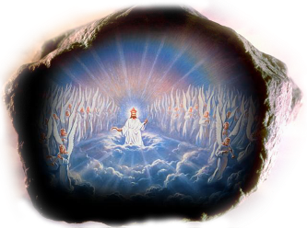

IVYUMA VY’AGACIRO
“Ico gishushanyo, umutwe waco war' izahabu nziza, kand' igikiriza n'amaboko vyar' ifeza, inda n'ibibero vyar' imiringa, amaguru yar' ivyuma, ibirenge vyar' ikivange c'ivyuma n'ibumba. 2:32-33” (Daniyeli 2:32-33)
Umwami Nebukadineza yeretswe amateka y’amahanga biciye ku gishushanyo giteye ubwoba (Dan. 2:31-45).
Babuloni (605 BC-539 BC)
Itituka ry’agaciro k’ivyuma kwamenyesha uko abantu bagiye basubira inyuma.
Abamedi n’Abaperesi (539 BC-331 BC)
Impinduka mu nganda, hamwe n’ivyiyumviro vy’abantu nka Darwin na Marx, vyatumye twizera ko umuntu ashobora gutera imbere gushika ashitse ku kibano gitunganye ata Mana. None amahoro n’umutekano vyari vyitezwe mu ntango z’ikinjana ca 20 vyagenze gute?
Ubugiriki [Makedoniya] (331 BC-168 BC)
Roma (168 BC - 476 AD)
Ubuhanuzi bwaramaze kutuburira, kandi ibintu biriko biraba muri iki gihe biravyemeza: abantu bariko barasenyuka vuba na bwangu, cane cane mu vy’inyifato runtu. Nimba ivyo vyarashitse kugeza kuri urwo rugero, turashobora kwizigira ko n'ivyitezwe kuba bizoshitswa.
Ubwami buzokwamaho
Roma yigabanije (476 AD-???)

Slide 7

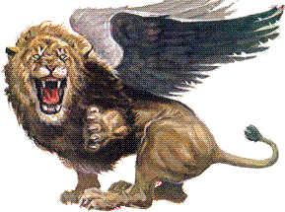
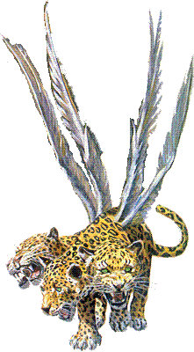
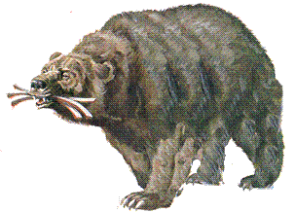
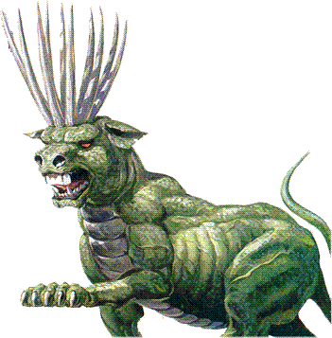
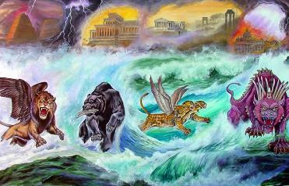

IBIKOKO BITANGAJE
“Nuko Daniyeli aravuga, ati Mu vyo neretswe mw ijoro, nagize ntya, mbona imiyaga ine yo mu kirere isenyeranira ku kiyaga kinini. Mur' ico kiyaga hiburukamw' ibikoko binini bine bidasangiye ubgoko.” (Daniyeli 7:2-3)
Ni kuki hasubiwemwo uko ingoma z’isi zakurikiranye mu rindi yerekwa ( Dan . 7:2-3, 16-18 )?
Babuloni (605 BC-539 BC)
Ubwa mbere, ni ukugira ngo umuntu asobanukirwe neza ukuntu bizoshitswa ata gukekeranya ( Itanguriro 41:32 ). Ubwa kabiri, n'ukugira ngo vyerekane isano abantu b’Imana bafitaniye n’amateka y’amahanga, kuko iryo yerekwa ryahawe umuhanuzi w’Umuheburayo, atari umwami w’umupagani, nk’uko vyanditswe muri Daniyeli 2.
Abamedi n’Abaperesi (539 BC-331 BC)
Ayo mahanga ntiyari kuzamuka mu mahoro, ahubwo yazamuye kubwo intambara (raba Yes . 17:12).
Ubugiriki [Makedoniya] (331 BC-168 BC)
Isirayeli nta ruhara ifise muri iyo ntambara; ni inzirakarengane gusa; intara ivanwa ku bwami ijanwa ku bundi; ata kwigenga.
Roma ya gipagani (168 BC-476 AD)
Ese ukuntu vyari kure cane y’iciyumviro Imana yari ibafitiye! (Yer. 29:11).
Roma ya gipapa (476 AD-???)

Slide 8

“Mu mateka y’amahanga, umwigishwa w’ijambo ry’Imana arashobora kubona ishitswa imbonankubone ry’ubuhanuzi bw’Imana. Babuloni, amaherezo yarakomvomvotse kandi irakomvomvorwa burundu, yishwe kubera ko mu guter'imbere abategetsi bayo bari bibona ko bigenga ku Mana, kandi bari bashize icubahiro c’ubwami bwabo ku vyo abantu bashitseko. Ubwami bw'Abamedi n'Abaperesi bwashikiwe n'uburake mvajuru kuko muri bwo itegeko ry’Imana ryari ryarahonyanzwe.Ugutinya Uhoraho ntikwari kwaronse ikibanza mu mitima y’abantu benshi cane. Ububisha, ugucokora Imana n'igiturire vyari vyiganje. Ubwami bwakurikiyeho bwari hasi cane kandi bwari bwarononekaye; kandi mbere bwakomeje kuja hasi cane mu vy’inyifato runtu.
EGW (Abahanuzi n’Abami, pg. 501-502)

Slide 9

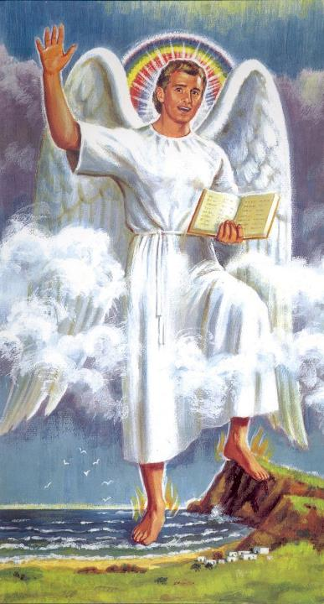
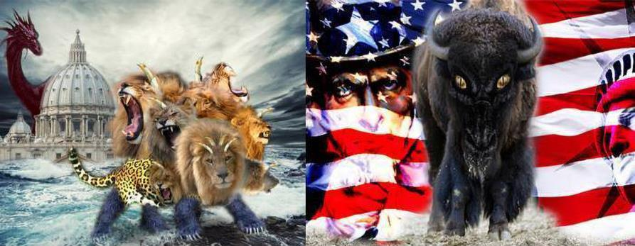
UBUMENYI BW’IGIHE C’IHEREZO

Slide 10

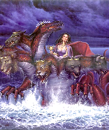
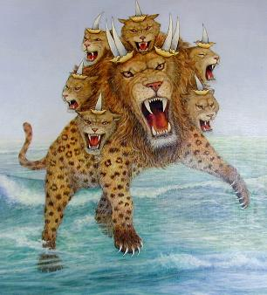
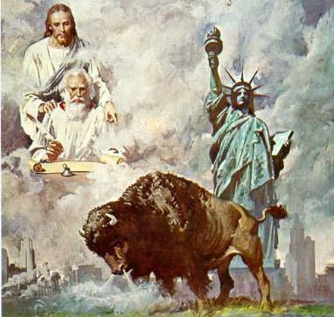
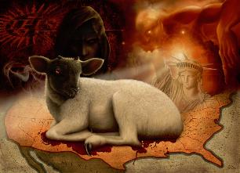
ISI HAMWE N’IKIYAGA
“[…] Mbona igikoko ciburuka kiva mu kiyaga […] Kandi mbona ikindi gikoko gisokorotse mw isi […]” (Ivyahishuwe 13:1, 11)
Nk’uko twabibonye, ​​ikiyaga kigereranya intambara n’akaduruvayo. Mu Vyahishuriwe Yohana 17:15 haragura ico ciyumviro mu kuvuga ko ayo mazi agereranya amahanga, amasinzi atayoborwa n’Imana ariko ari munsi y’ububasha bwa wa mubi.
Mu kiyaga niho hava igikoko kirwanya abantu b’Imana kw’iherezo ry’ibihe (Ivyah. 13:1, 17).
Ku rundi ruhande, isi yo ituwe n'abantu bake. Ni akarere aho ishengero ry’abizigirwa ryajanywe igihe amasinzi y'abantu batahindutse barondera kurisambura (Ivyah. 12:15-16); igihugu c’umwidegemvyo (Leta Zunze Ubumwe za Amerika).
Mw'isi ni ho havuye igikoko kimeze nk’umwagazi w’intama (mu ntango cari cizigiwe ku Mana), ariko mu kuvuga nk’Igisato, kizototeza ishengero ry’abizigirwa mu gihe c’intambara ya nyuma kw’isi (Ivyah. 13:11-15).

Slide 11
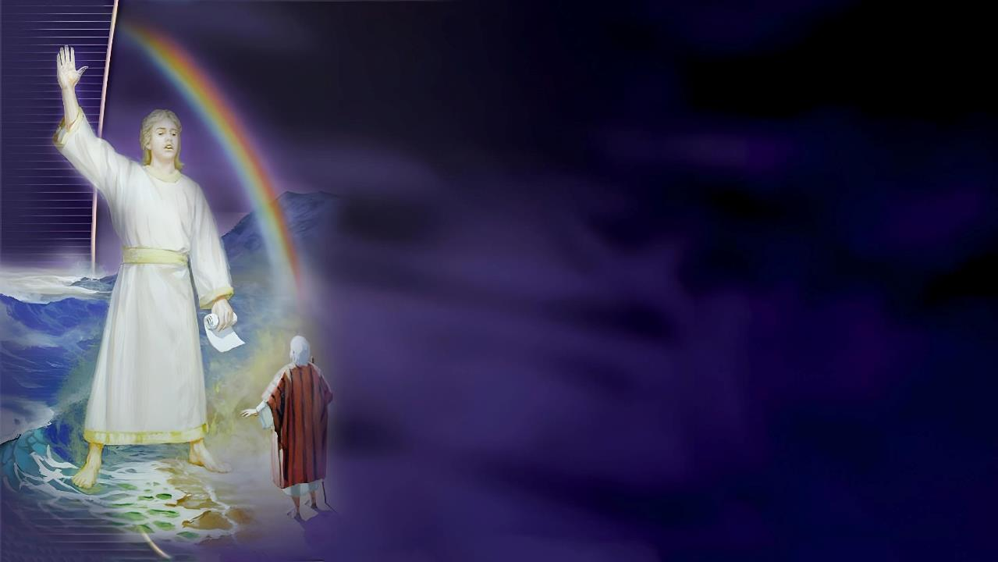
UBWOKO BW’AMASIGARIRA
“Barambarira, bat' Ukwiye kuzosubira kuvugishwa ivy' amoko menshi n'amahanga menshi n'indimi nyinshi n'abami benshi.” (Ivyahishuriwe Yohana 10:11)
Ivyahishuriwe Yohana 13 hatwereka ububasha buzototeza abantu b’Imana buzananye kw’isi no mu kiyaga. Ivyahishuriwe Yohana 10 hatwereka abantu b’Imana bamamaza ubutumwa bwa nyuma kw’isi n’ikiyaga.
Ivyah. 10:1
Umumarayika w’inkomezi
Kristo ubwiwe
Ivyah. 10:2
Atwaye ubutumwa bwo kwamamaza ku kw’isi n’ikiyaga
Ubutumwa bwo mu gitabo ca Daniyeli
Ivyah. 10:3-4
Ubusobanuro bw'“ikidodo”
Igihe co kumenya ubusobanuro bwa Daniyeli nticari bwagere
Ivyah.10:5-7
Hashirwamwo indahiro, nk’iyo muri Daniyeli 12:7
Ubutumwa bwari ubw'igihe c'iherezo
Ivyah. 10:8-10
Ubutumwa bwari busosa, ariko bukagira ingaruka zisharira.
Ukwamamaza ukuza kwa kabiri kwavuyemwo ukuvunika umutima gukomeye.
Ivyah. 10:11
Ni ngombwa kwongera kuvugishwa
Ishengero ry'Abadivantiste, ryavuye mu mubabaro ukomeye, ritegerezwa kwamamaza ubutumwa bwa nyuma kw’isi

Slide 12

“Ubutumwa bwo mu Vyahishuriwe Yohana 14, bumenyesha ko isaha y’urubanza rw’Imana ishitse, bwatanzwe mu gihe c’iherezo. Umumarayika wo mu Vyahishuriwe Yohana 10 yerekanywe ashinze ikirenge kimwe mu kiyaga ikindi ku butaka, vyerekana ko ubutumwa buzojanwa mu bihugu vya kure, ko amabahari azojabukwa, kandi n'amazinga azokwumva ukwamamazwa kw'ubutumwa bwa nyuma bwo kugabisha isi yacu [...] Nta gicu na kimwe caguye kw’ishengero Imana ititeguriye; nta nguvu na zimwe zirwanya zahagurutse ngo zirwanye igikorwa c’Imana itabonye imbere y’igihe. Vyose vyabaye nk’uko yabivuze biciye ku bahanuzi bayo. Ntiyatetse ishengero ryayo ngo riheberwe mu mwijima, ahubwo yarakurikiranye mu vyavuzwe n’abahanuzi, kandi biciye mu burinzi bwayo, yakoze mu kibanza cayo cashinzwe muri kahise k’isi, yarashizeho ivyo Mpwemu wiwe Yera yahumekeye abahanuzi kuvuga imbere y’igihe. Imigambi yiwe yose izoranguka kandi ishingwe”.
EGW (Kristo Umuneshi, kuwa 29 Munyonyo)

