Slide 1
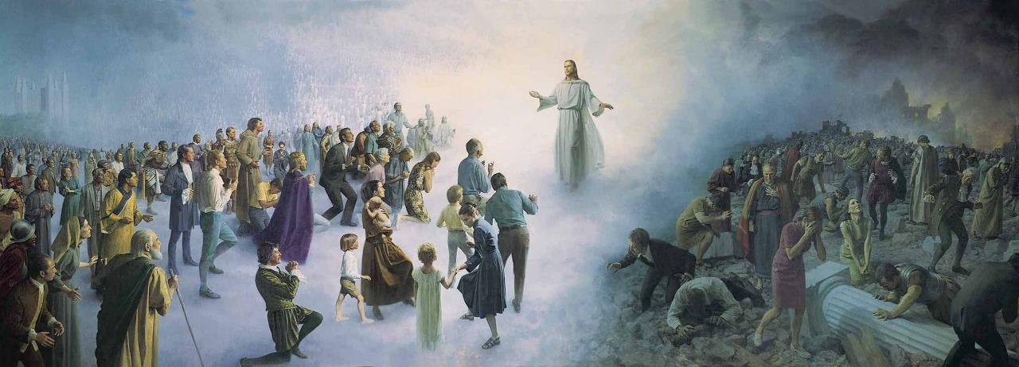
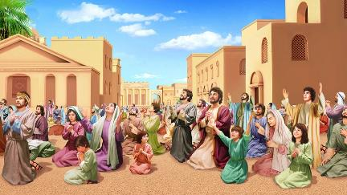
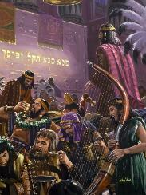
Icigwa ca 13 co kuwa 28 Ruheshi 2025
IHEREZO MU MASHUSHO

Slide 2
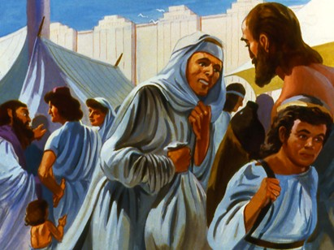
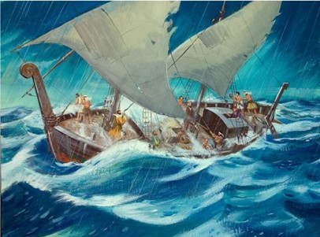
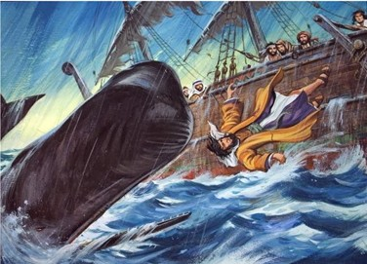
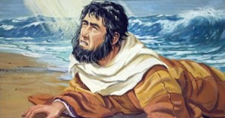
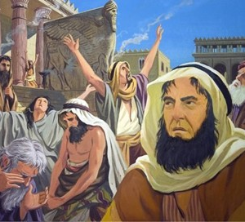
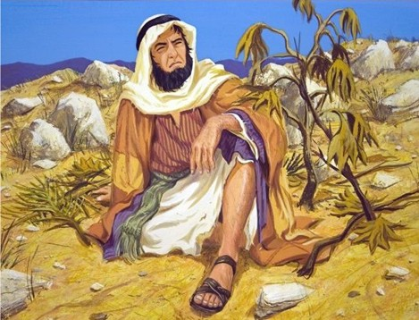
“Arabishura, ati Nd' Umuheburayo, nubaha Uhoraho, Imana Nyen' ijuru, yaremye ikiyaga n'i musozi.” Yona 1:9

Slide 3

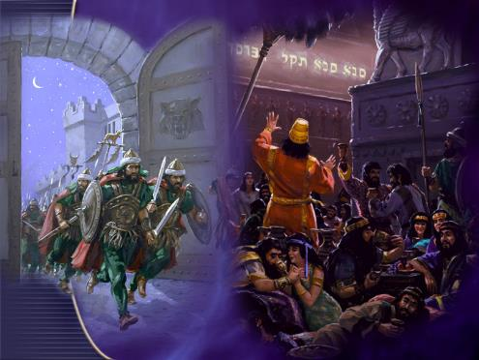
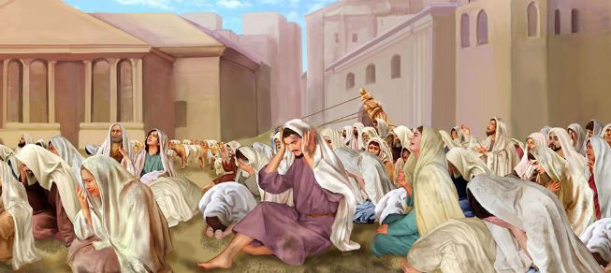
Igitabo ca Yona na Daniyeli ikigabane ca 5 bitwereka amashusho abiri ahushanye, ariko yuzuzanya, y’ibintu bizoshika mu gihe c’iherezo.
Ninewe yaronse umuhamagaro wo kwihana biciye ku muhanuzi w’umunyamakenga, maze irakizwa agatikizo.
Babuloni yaragabishijwe incuro nyinshi, ariko amaherezo yanka Imana maze irakomvomvorwa.
Imbere y’umuhero, hazoba akamo gakomeye, umuhamagaro uhambaye w’ukwihana. Bamwe bazokwihana, nka Ninewe; abandi bazoguma ari intabarirwa, nka Babuloni. Igihe Yesu Umwami/Umukiza azoba aje, uzoba uri mu murwi uwuhe?
Amashusho ya Ninewe:
Intumwa.
Inyishu ku butumwa.
Amashusho ya Babuloni:
Ikibano gifise ingorane.
Iherezo ritunguranye.
Umwami w’umukiza.

Slide 4

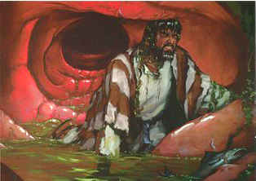
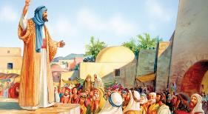
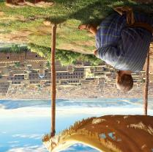
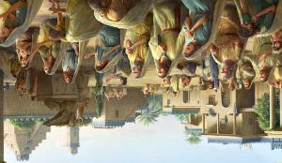
AMASHUSHO YA
NINEWE

Slide 5

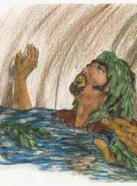
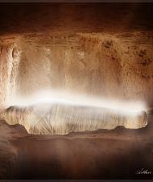

INTUMWA
Yona
Ikoreshwa ry’ijambo Umuremyi: “nubaha Uhoraho, Imana Nyen' ijuru, yaremye ikiyaga n'i musozi.” (Yona 1:9)
Umuhamagaro wo kwihana : “Bahindukiye, bakareka inzira yabo mbi” (Yona 3:9-10)
Mu gihe c'iherezo
Ikoreshwa ry’ijambo Umuremyi:“Nimusenge uwaremye ijuru n’isi n’ikiyaga n’amasōko y’amazi” (Ivyah. 14:7).
Umuhamagaro wo kwihana: “Babuloni yaraguye, [...] Nimuyivemwo, bantu banje” (Ivyah. 14:8; 18:4).
Imburi yerekeye ukurimbuka: “Hasigaye imisi mirongwine, Ninewe hagakomvomvorwa.” ( Yona 3:4 ).
Imburi yerekeye ukurimbuka: ““Na we azonywa kuri vino, ni yo burake bw'Imana” (Ivyah. 14:9-10).”
“Nk'uko Yona yabaye ikimenyetso ku Banyaninewe, ni k'Umwana w'umuntu azoba ku b'iki gihe.” (Luka 11:30)
Yesu yagereranije ivyo yaciyemwo n’ivya Yona, naho nyene hari itandukaniro rigaragara (Mt. 12, 40-41).
Yona
Yamaze imisi 3 mu nda y’urufi kubera ivyaha vyiwe.
Yesu
Yamaze imisi 3 mu mva kubera ivyaha vyacu.
Ntiyashaka kuja i Ninewe ngo ayirokore.
Yaje ku bushake mw'isi yacu kugira ngo adukize.
Hariho kandi ibintu bigaragara bisa n’ivyo Yona yaciyemwo be n’ivyo mu bihe vy’iherezo.

Slide 6


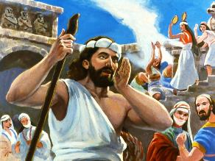
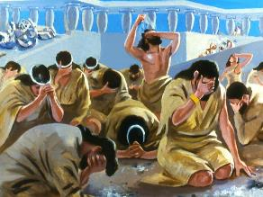
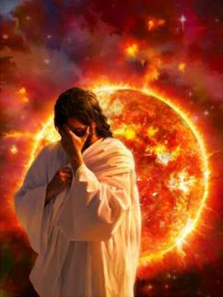
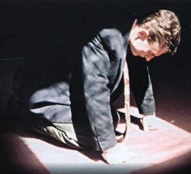
INYISHU KU BUTUMWA
“Abagabo b'i Ninewe bazovana hasi n'ab' uru runganwe ku musi w'amateka, babatsindishe: kuko bihannye aho bumviye ubutumwa buvuzwe na Yona; kandi raba, uruta Yona ari hano.” (Matayo 12:41)
Igitabo ca Yona kiduha gusa incamake y’ubutumwa bwarungitswe i Ninewe: “Hasigaye imisi mirongo ine, Ninewe hagakomvomvorwa” (Yona 3:4). Ariko ukuntu Abanyaninewe bavyakiriye be n’uko Yona ubwiwe yavyifashemwo, vyose vyerekana ko vyarimwo n’ubushobozi bwo kwirinda ukwo gutikizwa (Yona 3:9; 4:2).
None ivyo nyene vyoshobora gushika no ku butumwa bw’imvura bwa nyuma? Mbega birashoboka ko umuntu wese yihana, Imana ntisambure umubumbe wacu?
Hazobaho benshi bihana. Ariko ugutikizwa kwa nyuma ntigushingiye ku ngingo y'urunganwe rumwe. Ico Imana izorandura ni ikibi.
Nk’uko ubuhanuzi bumenyesha ukuza kw’Umukiza butagira ico busaba, n'ubwerekeye ukurandurwa kw’ikibi na bwo nyene ntibushingiye ku vyangombwa vyuzuzwa. Ikibi gitegerezwa gukurwaho.

Slide 7

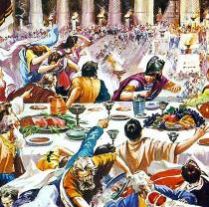
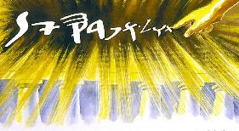
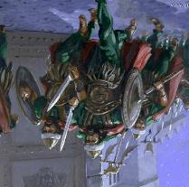
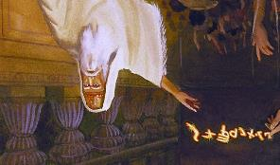
AMASHUSHO YA BABULONI

Slide 8


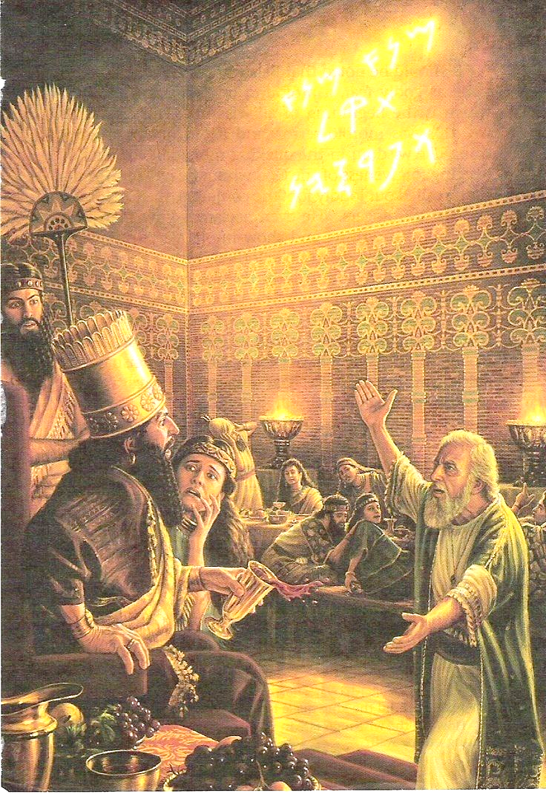
IKIBANO GIFISE INGORANE
“ariko winantaje ku Mwami Nyen' ijuru, uzanirwa ibintu vyo mu ngoro yiwe, kugira ngo wewe n'abaganwa bawe n'abamikazi bawe n'incoreke zawe z'intoni mubinyweremw' ibiturire; maz' uhimbaza imana z'ifeza n'iz' izahabu n'iz' imiringa n'iz' ivyuma n'iz' ibiti n'iz' amabuye, zidashobora kubona canke kwumva canke kumenya; arikw Imana Rurema ifise impwemu zawe mu kuboko kwayo, ari yo igaba inzira zawe zose, ntiwayihaye icubahiro.” (Daniyeli 5:23)
Amaherezo, Ninewe yarasubiye mu vyaha vyayo, iratikizwa mu kwiyunga n’Abamedi hamwe n’Abanyababuloni. Haciye igihe gitoyi, Babuloni yaracitse ubwami bw’isi yose butagira aho bugarukira. Nebukadineza yiyeguriye Imana araheza aratera imbere. Ariko abamukomotseko bari bafise intege nke, maze ubwami burakomvomvorwa.
Nk’uko Daniyeli yamwibukije, Belushaza yari azi ivyashikiye Nebukadineza kandi yararonse akaryo ko kumenya Imana nk’uko nawe yabikoze (Dan. 5:18-23). Ariko…
Yarirengagije ivyashikiye Nebukadineza
Yarateye akagere Imana ku mugaragaro.
Yakoresheje mu buryo buhumanye ibikoresho vyo mu Rusengero
Yasenga izindi mana imbere y’Imana nyene
Ikizokwisungwa mu gukizwa canke gucirwa urubanza si ubumenyi dufise ku Mana, ahubwo ni inyishu dutanga kuri ubwo bumenyi.

Slide 9
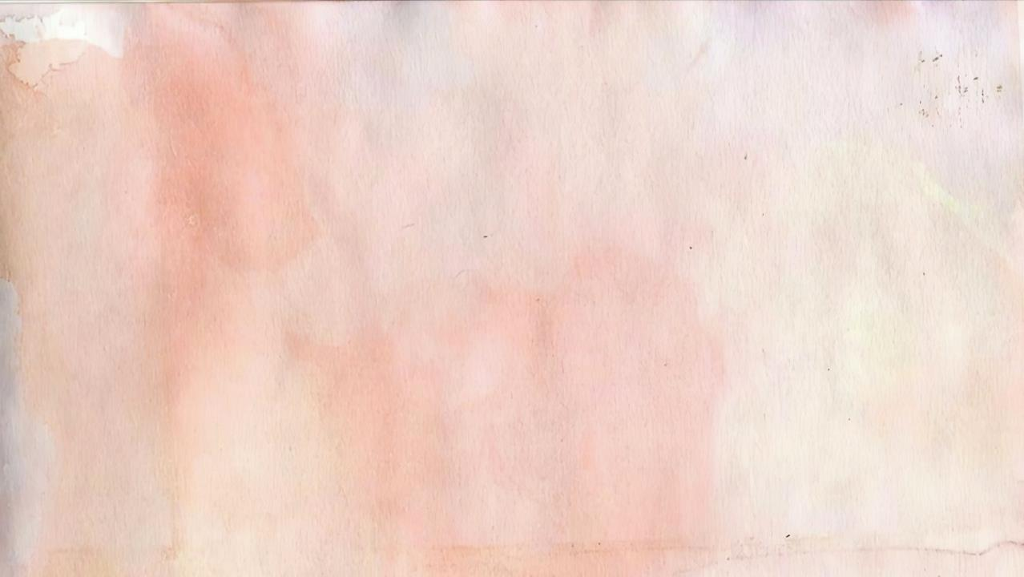

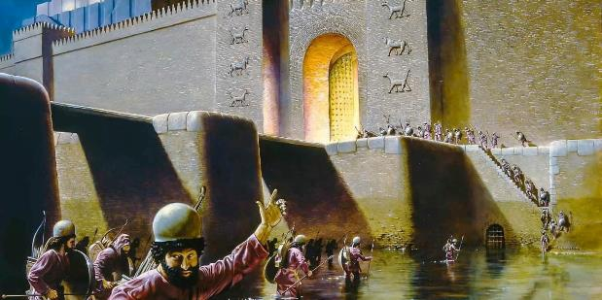
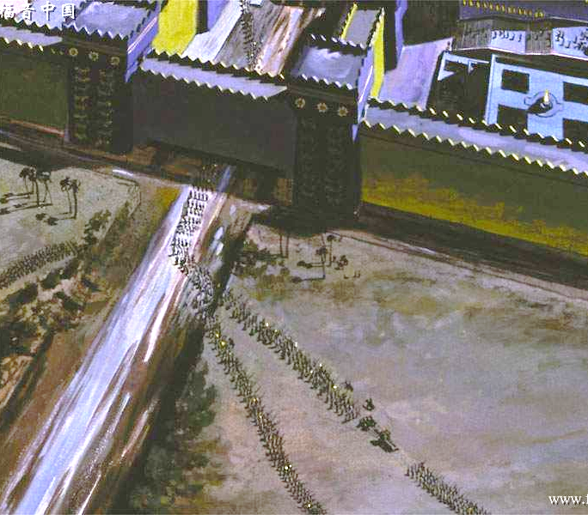
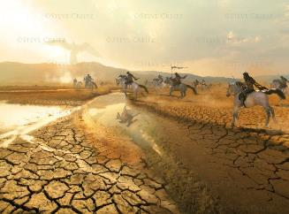
IHEREZO RITUNGURANYE
“Mbarira idamba, nti Kama, kandi nzokamya inzuzi zikujamwo; mvuga ivya Kuro, nti N'umwungere wanje, azoshitsa ivyo ngomba vyose; nkavuga ivya Yerusalemu, nti Hazokwubakwa; nkabarira urusengero, nt' Itanguriro ryawe rizoshirwaho.” (Yesaya 44:27-28)
Biciye kuri Yesaya, Imana yaramenyesheje ingene Babuloni izokomvomvoka kugira ngo ikure Isirayeli mu buja. Yaranamenyesheje umuntu azoshira mu ngiro ico gikorwa (Yes. 44:27-28).
Kuro yakoze urugomero kugira ngo uruzi Efurate rugabanuke. Ingabo ziwe zinjirana mu ruzi, zisanga igisagara kiri mu minezero. “mur' iryo joro nyene Belushaza umwami w'i Bukaludaya aricwa.”(Dan. 5:30).
Icago ca gatandatu ca nyuma gisubiramwo ico kintu nyene: ugukama kw’uruzi Efurate gutegura ukuza kwa Yesu (Ivyah. 16:12).
Babuloni yo muri iki gihe izotungurwa kuko ata n’umwe azoba maso. Nta n’umwe azoba arindiriye Umwami wiwe. Bazoba bafashe ingingo yo kutamwizera ahubwo bagasenga ibishushanyo vyakozwe n’abantu (Ivyah. 13:14).

Slide 10

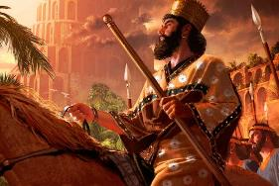
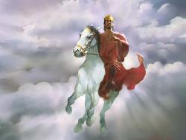
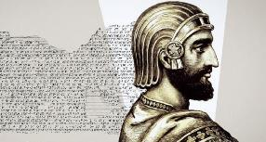
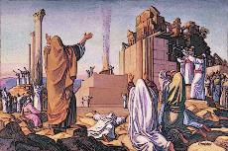
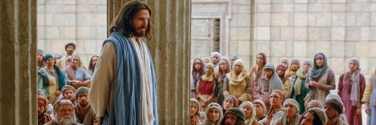
UMWAMI W’UMUKIZA
“Ibi ni vyo jewe Uhoraho mbgira uwo narobanuje amavuta, ni we Kuro, uwo mfashe ukuboko kw'i buryo, kugira ngo nsiribange amahanga imbere yiwe, kandi nzokenyurura inkindi z'abami, kugira ngo ndamwugururire inzugi imbere yiwe, kand' amarembo ntazokwugarirwa:” (Yesaya 45:1)
Ikintu gitangaje cane ku bijanye n’ubuhanuzi bwerekeye Kuro ni uko bwita umwami w’umupagani “uwarobanuwe.” Ikindi, arahabwa uburanga busanzwe ari ibwa Yesu : Umwungere; umukiza wa Isirayeli; umwubatsi w’Ingoro; uwugurura ntihagire uwugara; uwumenyekanisha Imana (Yes. 44:28-45:7).
Bibiliya y’igiheburayo irangizwa n’igitabo ca 2 c’Ingoma (ntabwo ari Malaki). Iki gitabo gisozerwa n’itegeko rya Kuro ryo gusubira kwubaka urusengero. Isezerano Rishasha ritangura n’ukuza kwa Yesu, uwo na we yari gutuma urwo Rusengero nyene rugira ubwiza (Hag. 2:7), kandi we, ikirenze ivyo, yatanguje Urusengero rufise ubwiza kuruta kure: Urusengero rwo mw’Ijuru (Heb. 9:24).
Ivyo vyose bituma Kuro aba ikigereranyo ca Kristo. Ivyo vyose vyari vyaravuzwe kuri bompi vyarasohoye. Turashobora kwizigira ko Imana izoshitsa n’amasezerano ataraja mu ngiro.

Slide 11

“Amateka y'amahanga avugana na twe uyu musi. Kuri buri hanga ryose n'umuntu wese Imana yabiteguriye ikibanza mu mugambi wayo uhambaye. Uyu musi abantu n'amahanga bariko barageragezwa n'inkoni y'icuma iri mu kuboko kwa wa Wundi atigera yibesha. Buri wese arafata ingingo igenga iherezo ryabo, kandi Imana iriko irayobora vyose kugira ngo imigambi yayo iranguke.
Ubuhanuzi NDIHO mukuru yatanze mw’ijambo ryiwe, buhuza ingingo ku ngingo uruhererekane rw’ibintu bishika, kuva mu bihe bidahera muri kahise gushika mu bihe bidahera muri kazoza, buratubwira aho turi uno musi mu rukurikirane rw’ibihe n’ivyo twoshobora kwitega mu gihe kizoza. Ivyo ubwo buhanuzi bwose bwavuze ko bizoshika, gushika n’ubu, vyaranditswe ku mpapuro z’amateka, kandi turashobora kwizigira yuko ivyo vyose bizoshika bizoranguka nk’uko bikurikirana.”
EGW (Abahanuzi n’Abami, p. 536)

