Slide 1

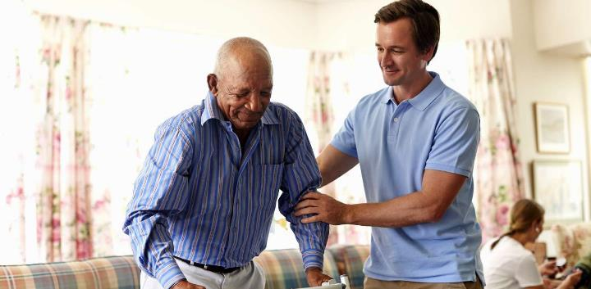
IZINGIRO RY'IKIBAZO:
URUKUNDO CYANGWA KWIKUNDA?
Icyigisho cya 2 cyo ku wa 13 Mata 2024

Slide 2
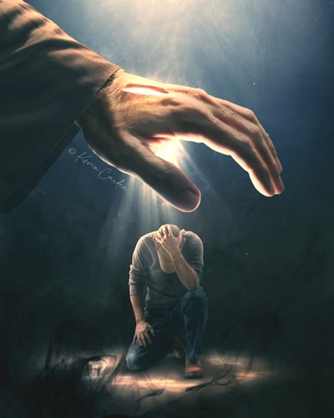
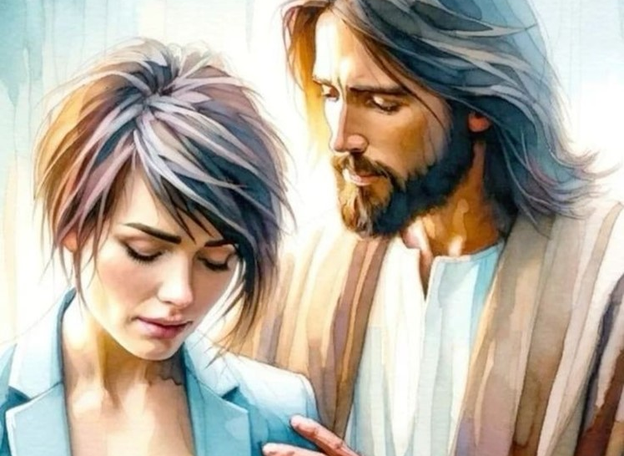
“Ntutinye kuko ndi kumwe nawe, ntukihebe kuko ndi Imana yawe. Nzajya ngukomeza, ni koko nzajya ngutabara kandi nzajya nkuramiza ukuboko kw’iburyo, ari ko gukiranuka kwanjye.” (Yesaya 41:10)

Slide 3

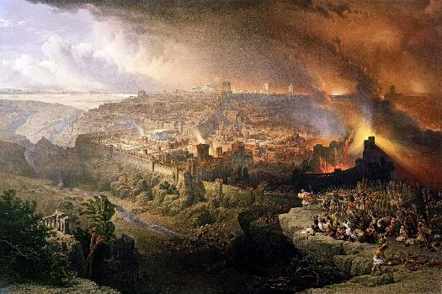
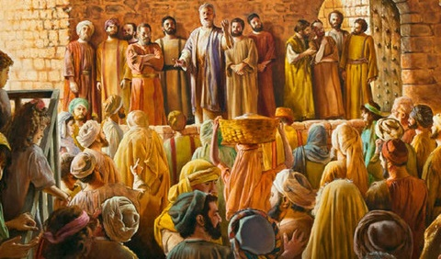


Umwaka wa 70 waranzwe n’ihanguka rya Isirayeli nk’ishyanga. Nubwo Roma ari yo yarimbuye Yerusalemu n’Urusengero, hari izindi mbaraga zagize uruhare muri iyo ntambara.
Ku ruhande rumwe, Satani yateye Isirayeli kwanga Mesiya, hanyuma abyitwaza nk’uwemerewe kurimbura iryo shyanga.
Ku rundi ruhande, Imana yababuriye inshuro nyinshi ku ngaruka zo kuyanga; itinza gusohozwa kw’igihano; kandi itegura abantu (Itorero), bagomba kwakira itabaza ry’ukuri no kumurikishiriza isi ubutumwa bw’urukundo rw’Imana.
Ibyigisho dukura mu kurimbuka kwa Yerusalemu:
  Kwanga urukundo rw’Imana.
  Imana yita ku bwoko bwayo.
Amasomo dukura ku Bakristo ba mbere:
  Gukiranuka mu gihe cy’akarengane.
  Gufasha abakennye.
  Urukundo: ikimenyetso cyacu kituranga.

Slide 4

IBYIGISHO DUKURA MU KURIMBUKA KWA YERUSALEMU

Slide 5

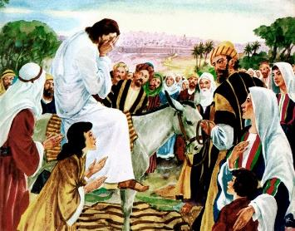
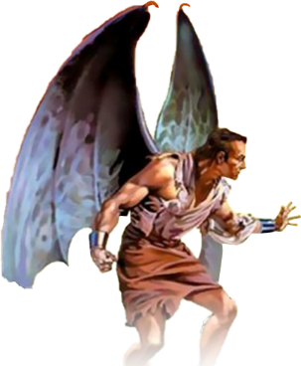
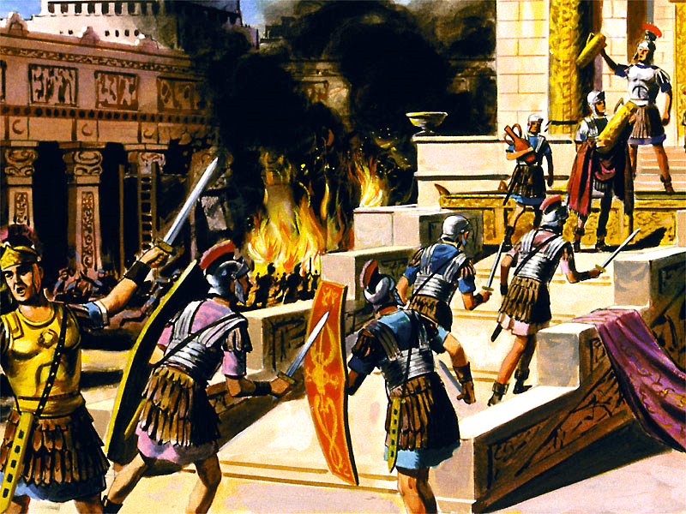
KWANGA URUKUNDO RW’IMANA
“Yerusalemu, Yerusalemu, wica abahanuzi ugatera amabuye abagutumweho, ni kangahe nshaka kubundikira abana bawe, nk’uko inkoko ibundikira imishwi yayo mu mababa yayo ntimunkundire!” (Matayo 23:37)
Yesu yararize ubwo yari hafi yo kugera i Yerusalemu (Luka 19: 41–44). Yari azi ko bajyaga kugerwaho n’ingaruka bakwiriye zo kwanga irarika ry’Imana (Matayo 23:37).
Yarajijwe n’uko ako kaga kashoboraga kwirindwa. Kuko Imana idukunda cyane ku buryo idashaka ko hagira n’umwe urimbuka, ahubwo kugira ngo abantu bose babone ubugingo buhoraho (Yohana 5:39–40; Ezekiyeli 18:31–32).
Amateka atubwira ko mu mwaka wa 66 Abayuda bigometse barwanya guhohoterwa n’Abaroma. Imitwe itandukanye y’Abayuda yasubiranyemo, mu gihe Abaroma bagose uwo murwa. Mu mwaka wa 70 ibintu byaradogereye. Titusi yasenye Yerusalemu n’urusengero. Miliyoni imwe y'Abayuda bararimbutse.
Ariko amateka ntatubwira uburyo Satani yashishikarije Abayuda kwigomeka, n’Abaroma kwihorera. Kurimbuka kwa Yerusalemu byari umurimo utaziguye wa Satani. Ubwo Isirayeli yateraga umugongo isōko y’ubugingo, bahindutse umuhīgo w’umwanzi ubashakira gusa kurimbuka n’urupfu.

Slide 6

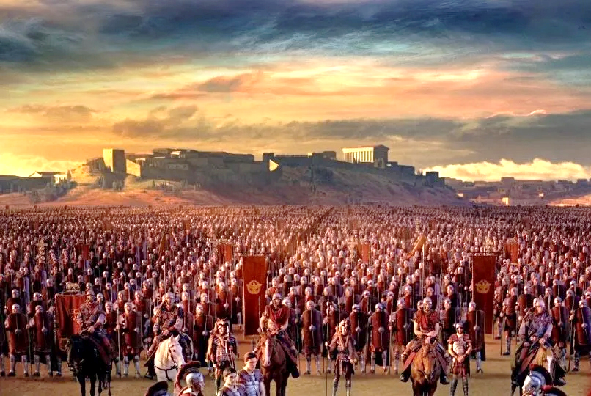
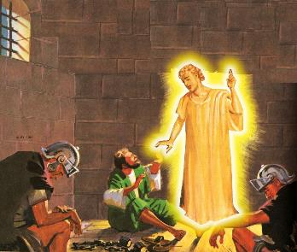
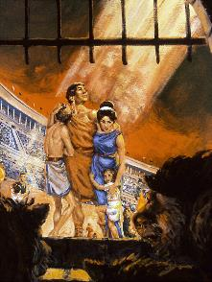
IMANA YITA KU BWOKO BWAYO
“Ntutinye kuko ndi kumwe nawe, ntukihebe kuko ndi Imana yawe. Nzajya ngukomeza, ni koko nzajya ngutabara kandi nzajya nkuramiza ukuboko kw’iburyo, ari ko gukiranuka kwanjye” (Yesaya 41:10)
Imana, mu rukundo rwayo, yahaye amahirwe abantu bose bashaka guhunga iryo rimbuka. Yabahaye ikimenyetso: Yerusalemu igoswe n’ingabo (Luka 21:20).
Gayo Sesitiyo Galusi yasohoje icyo kimenyetso mu mwaka wa 66. Abaroma bahagose baje kubireka, maze Eliyazari Simoni umuyobozi w’Abazelote, akurikirana Abaroma umugēnda, arabanesha.
Umuntu wese wizeraga amagambo ya Yesu yifashishije ako kanya igihe Yerusalemu itari igoswe, arahunga.
Nyuma y’amezi make, Nero yohereje Vesipasiyani guhosha ubwigomeke. Kuva mu mwaka wa 67 kugeza muri 70, Yerusalemu yagoswe ubutagoheka.
Imana ishobora kandi ishaka kurinda abana bayo, ndetse no mu bihe bishishana cyane (Zaburi ya 46:1; Yesaya 41:10). Nyamara benshi babuze ubuzima kubera kubaha Imana kwabo (Abaheburayo 11:35–38).
Kuki bamwe barinzwe naho abandi bigasa naho baretswe n’Imana?

Slide 7

“Uburinzi bw’Imana bukomeye bwemera ko intungane zirenganywa n’inkozi z’ibibi bwagiye buyobera abantu benshi bafite intege nke mu byo kwizera. Bamwe bageza n’aho benda kureka kwiringira Imana kwabo kuko ireka abantu basaye mu byaha bakaba abakire mu gihe abeza kandi b’intungane bo bababazwa kandi bagashinyagurirwa n’ubushobozi bw’abo banyabibi. Baribaza bati ‘bishoboka bite ko Imana ikiranuka, y’inyambabazi kandi ifite ubushobozi butagira iherezo, yakwihanganira akarengane n’ubugome bimeze bityo?’ Icyo ni ikibazo tudashobora gukemura. Imana yaduhaye ibihamya bihagije by’urukundo rwayo, bityo ntitugomba gushidikanya ubugwaneza bwayo kuko tudashobora gusobanukirwa uburyo iturinda.”
E.G. White, Intambara Ikomeye, igice cya 2, p. 45

Slide 8

AMASOMO DUKURA KU BAKRISTO BA MBERE

Slide 9

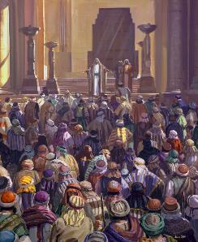
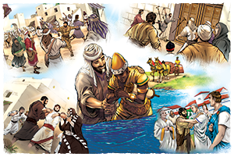
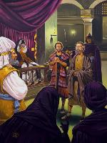
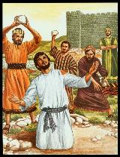
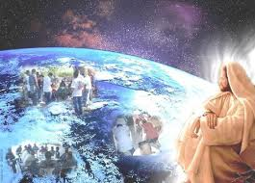
GUKIRANUKA MU GIHE CY’AKARENGANE
“Ariko Sawuli we akomeza guca igikuba mu Itorero no kuryonona cyane, akinjira mu mazu yose agafata abagabo n’abagore, akabakurubana mu nzu y’imbohe” (Ibyakozwe 8:3)
Intangiriro yatangaga ibyiringiro rwose: abahindukaga babarirwaga mu bihumbi (Ibyakozwe 2:41; 4: 4); abizera babwirizaga Ijambo mu mbaraga (Ibyakozwe 4:31; 5:42).
Ariko umwanzi ntiyagohekaga. Yatangiranye iterabwoba (Ibyakozwe 4:17–18), hakurikiraho ibihano (Ibyakozwe 5:40); amaherezo, urupfu (Ibyakozwe 7:59).
Kubera akarengane kazanywe na Sawuli, abigishwa baratatanye (Ibyakozwe 8:1). Ariko, aho kugira ngo umucyo uzime, gukiranuka kw’abizera kwateye umucyo kumurikana ubwiza buhebuje ku isi yose izwi (Ibyakozwe 8:4; 11:19–21; Abaroma 15:19; Abakolosayi 1:23).
Yesu yari yarahaye Itorero Rye inshingano n’imbaraga zo kujyana ubutumwa (Ibyakozwe 1:8). Nta mbaraga, zaba izigaragara cyangwa izo mu bya mwuka, zishobora kubuza ubutumwa bwiza kujya mbere (Matayo 16:18). “Ubwo Imana iri mu ruhande rwacu umubisha wacu ni nde!” (Abaroma 8:31)

Slide 10

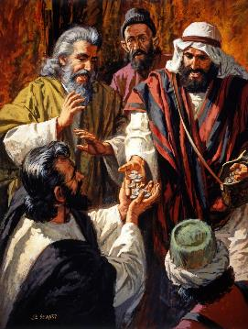
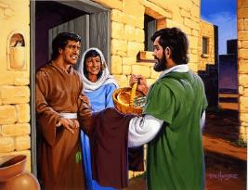
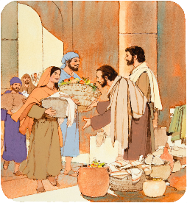
GUFASHA ABAKENNYE
“Ubutunzi bwabo n’ibintu byabo barabiguraga, bakabigabanya bose nk’uko umuntu akennye” (Ibyakozwe 2:45)
Ni izihe ngaruka ubutumwa bwiza bwagize ku Bakristo ba mbere (Ibyakozwe 2:42-47)?
Bizeraga inyigisho za Yesu
Basangiriraga hamwe ibintu byose
Basangiraga ibyabo n’abakennye
Bateraniraga hamwe ku ka rubanda
Bateraniraga mu miryango, aho bizihizaga Ifunguro Ryera
Babagaho bafite ibyishimo no kwiyoroshya mu mutima
Bahimbazaga Imana
Ababiherewe impano bakizaga abarwayi.
Nk’intumwa mu cyimbo cya Kristo, bīgānaga Yesu. Mu kwita ku byo ababakikije bakeneye, bashimwaga n’abo mu murwa bose.
Nk’uko byari muri icyo gihe, Itorero rigomba kurangwa n’urukundo rw’Abakristo hagati yabo, no kwita ku muryango mugari.

Slide 11
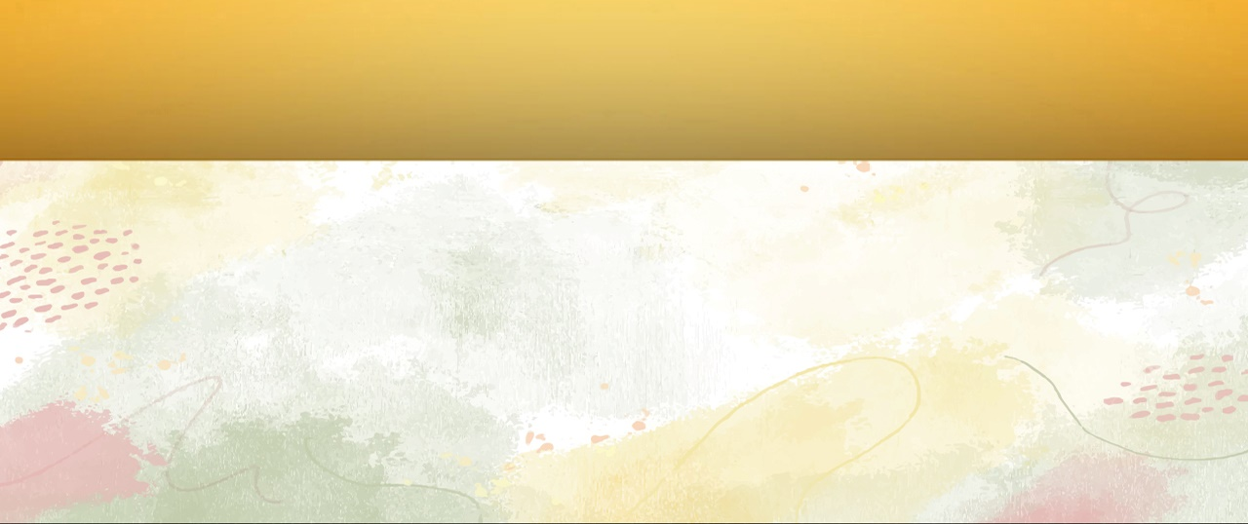
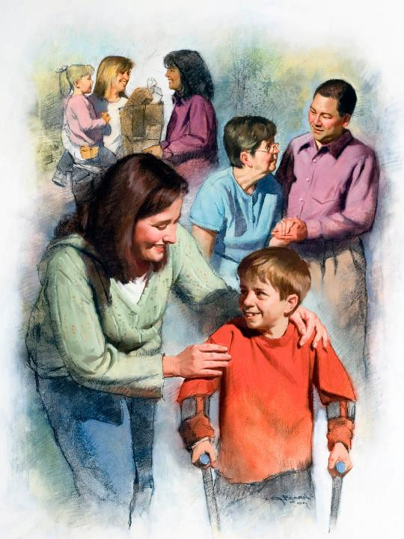
URUKUNDO: IKIMENYETSO CYACU KITURANGA
“Ibyo ni byo bose bazabamenyeraho ko muri abigishwa banjye, nimukundana” (Yohana 13:35)
Buri ruhande mu ziri mu ntambara ikomeye rusanzwe rufite ibiruranga: Satani arangwa n’urwango no kurimbura; Imana irangwa n’urukundo no kōmora.
Abayoboke b’uruhande rumwe cyangwa urundi babaho bakurikije uyu mujyo. Nituyoboka Imana, tuzabigaragariza mu rukundo twereka abandi (1Yohana 4:20–21).
Abakristo bo mu kinyejana cya 2 n’icya 3 bashyize mu ngiro urukundo ruzira kwikunda. Mu gihe cy’ibyorezo bibiri bikomeye (mu myaka ya 160 na 265), bitangiye kwita kubo byazahaje, batitaye ku mutekano wabo bwite.
Baritanze kubera urukundo, kandi bigirira umumaro za miliyoni z’abantu. Ariko ntibigeze bihatira kurangamirwa ubwabo, ahubwo baharaniye ko Urangamirwa aba Uwo bifuzaga guhara amagara kubwe, ari We Mukiza wabo: Yesu.

Slide 12

“Buri muntu afite amahirwe yo kuba umuyoboro Imana ishobora kunyuzamo ubutunzi bw’ubuntu bwayo, ngo bugere ku isi, ari bwo butunzi butarondoreka bwa Kristo. Nta kintu na kimwe Kristo yifuza cyane nko kugira abakozi bazagaragariza isi Umwuka We n’imico Ye. Nta kintu isi ikeneye cyihutirwa cyane nko kwigaragaza k’urukundo rw’Umukiza binyuze muri mwene muntu. Ijuru ryose ritegereje imiyoboro ishobora gusukwamo amavuta yera azabera imitima y’abantu intandaro y’umunezero n’umugisha.”
E.G. White, God's Amazing Grace - Unsearchable Riches, June 28; Umurimo wa Gikristo, igice cya 1, p. 18

