Slide 1
GUKOMEZWA N'IBYIRINGIRO
Icyigisho cya 7 cyo ku wa 18 Gicurasi 2024

Slide 2
“Nuko uwo munsi bazavuga ngo “Iyi ni yo Mana yacu twategerezaga, ni yo izadukiza. Uyu ni we Uwiteka twategerezaga, tuzanezerwa twishimire agakiza ke.” (Yesaya 25:9)

Slide 3
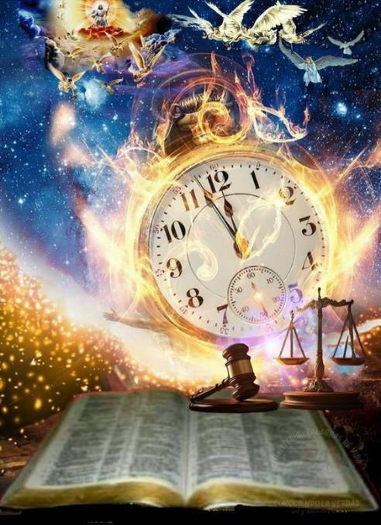
Uko ibintu byahanuwe byagendaga bisohora, abantu bo hirya no hino ku isi batangiye kujambura no kubwiriza ku byerekeye ukwegereza ko Kugaruka kwa Yesu.
Muri bo harimo Yohana Aluberekiti Bengeli (1687–1752) mu Budage; Manuweli Lakunza (1731–1801) muri Shili; Wiliyamu Mileri (1782–1861) muri Amerika y’Amajyaruguru; Yosefu Wolufu (1821–1845) wagejeje ubutumwa muri Afurika, Egiputa, Abisiniya, Aziya, Palesitina, Siriya, U Buperesi, Uzubekisitani n’U Buhinde.
Bo, n’abandi bari baranditse mbere, bageze ku mwanzuro umwe: Yesu yajyaga kugaruka hagati mu kinyejana cya 19!
Kugaruka kwa Yesu:
Ibyiringiro by’umugisha.
Yesu azaza ate?
Wiliyamu Mileri:
Uburyo bwo gusobanura Bibiliya.
Igihe cya gihanuzi.
Ubuhanuzi bw’iminsi 2.300.

Slide 4
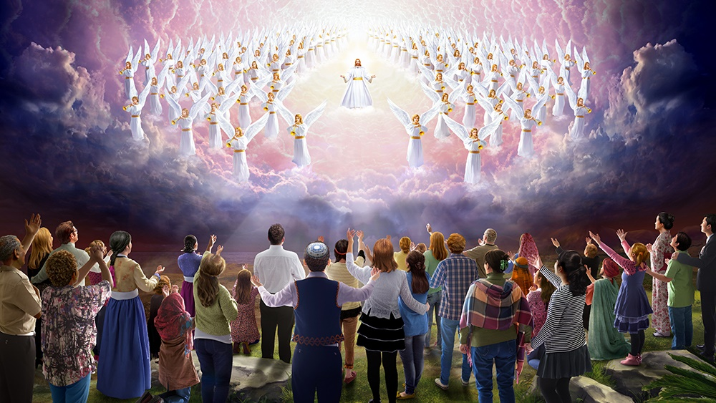
KUGARUKA KWA YESU

Slide 5
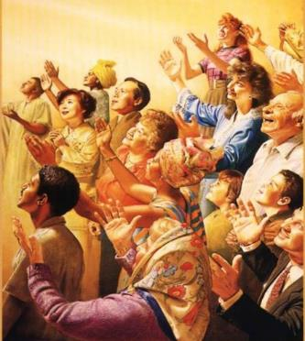
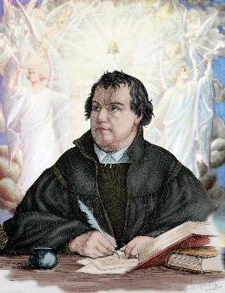
IBYIRINGIRO BY’UMUGISHA
“Dutegereje ibyiringiro by’umugisha, ari byo kuzaboneka k’ubwiza bwa Yesu Kristo, ari we Mana yacu ikomeye n’Umukiza” (Tito 2:13)
Kuva Yesu adusezeranije kugaruka (Yohana 14:1–3), ibi byabaye ibyiringiro by’abizera bose kugeza uyu munsi (Tito 2:13).
Ibi byiringiro bigaragarira mu myizerere ya Kiliziya Gatolika y’i Roma ndetse na Kiliziya y’Aborutodogisi; yigishwa kandi n’Itorero ry'Abangilikani; nk’uko yigishijwe na Luteri, Kaluvini, n’abandi bagorozi.
Ni iki kigira Kugaruka kwa Yesu ikintu gitegerejwe cyane bene aka kageni?
Kumenyesha iherezo ry’indwara, imibabaro n’urupfu
Gusobanuye iherezo ry’ubukene, akarengane n’ikandamiza
Gushyira iherezo ku ihangana, amakimbirane n’intambara
Fungurira imiryango isi y’amahoro, umunezero no gusabana n’Imana iteka ryose

Slide 6
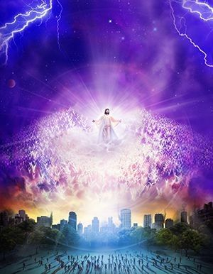
YESU AZAZA ATE?
“Kuko nk’uko umurabyo urabiriza iburasirazuba ukabonekera aho rirengera, ni ko no kuza k’Umwana w’umuntu kuzaba” (Matayo 24:27)
Mu kinyejana cya 19, Abaporotesitanti bagoretse inyigisho yo Kugaruka kwa Yesu bigisha ko Yesu azashyiraho ubwami bwo ku isi bw’imyaka igihumbi y’amahoro (Kugaruka mbere y’imyaka 1.000 y’amahoro ku isi), cyangwa ko hazabaho igihe cy’imyaka igihumbi cy’amahoro mbere yo Kugaruka kwa Yesu (Kugaruka nyuma y’imyaka 1.000 y’amahoro ku isi).
Ariko abagorozi bigishije ko ikinyagihumbi kizabanzirizwa no Kugaruka kwa Yesu, kandi ko ibyo byajyaga kubaho:
Mu buryo butari ibimenyetso. “Dore ndaza vuba” (Ibyahishuwe 22:20)
Mu buryo bugaragara. “Amaso yose azamureba” (Ibyahishuwe 1:7; Matayo 24:27)
Mu buryo bwumvikana mu matwi. “aranguruye ijwi rirenga, hamwe n’ijwi rya marayika ukomeye n’impanda y’Imana” (1Abatesaloniki 4:16; 1Abakorinto 15:52)
Mu buryo bw’icyubahiro. Abapfuye bazazuka, abakiriho bahindurwe, maze tuzamuranwe n’Umwami (1Abatesaloniki 4:13–18; 1Abakorinto 15:51–55)

Slide 7
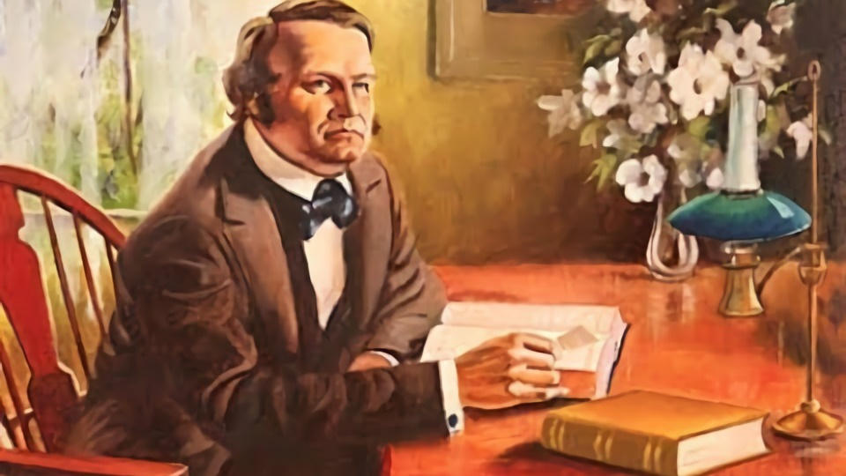
WILIYAMU MILERI

Slide 8
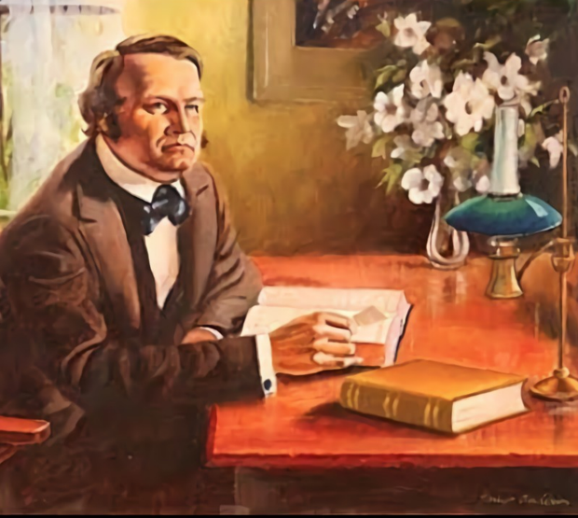
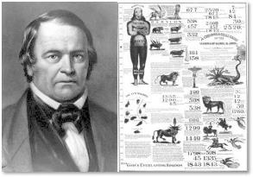
UBURYO BWO GUSOBANURA BIBILIYA
“Kuko ibye ari ugutoza itegeko rikurikirwa n’irindi, itegeko ku itegeko, umurongo ku murongo, n’umurongo ku murongo, aha bikeya, hariya bikeya” (Yesaya 28:10)
Wiliyamu Mileri ashingiye ku magambo ya Yesaya (Yesaya 28:9–10), yanzuye ko Bibiliya yisobanura ubwayo.
Inyamaswa zigereranya ubwami cyangwa abami (Daniyeli 7:17, 23)
Umuyaga ugereranya kurimbuka (Yeremiya 49:36)
Amazi agereranya abantu benshi (Ibyahishuwe 17:15)
Abagore bagereranya amatorero (Ezekiyeli 23:4; 2Abakorinto 11:2)
Iminsi igereranya imyaka isanzwe (Kubara 14:34; Ezekiyeli 4:6)
Yahereye mu Itangiriro, yiga buri murongo wa Bibiliya. Aho atasobanukirwaga neza, yashakiraga ubusobanuro mu yindi mirongo ya Bibiliya.
Muri ubwo buryo, Umwuka Wera yaramumurikiye kugeza igihe Bibiliya yamufunguriwe.
Ageze mu bice by’ubuhanuzi, yavumbuye ko iryo hame rishobora gukurikizwa no muri bwo:
Wiliyamu Mileri yashyize mu bikorwa iryo hame, atungurwa n’ibyo yavumbuye.

Slide 9
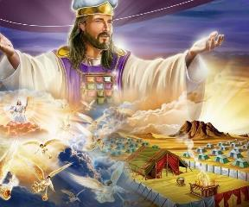
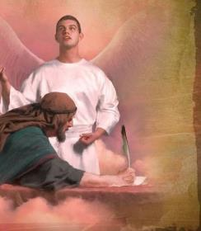
IGIHE CYA GIHANUZI
“Aransubiza ati ‘Bizageza iminsi ibihumbi bibiri na magana atatu uko bukeye bukira, nyuma ubuturo bwera buzabone kwezwa’” (Daniyeli 8:14)
Hamwe n’ibyo, mu gihe cya Mileri, isi yatekerezwaga ko ari bwo buturo, maze Mileri yemeza ko ubuhanuzi bujyanye no kwezwa k’ubuturo (Daniyeli 8:14) bwerekezaga ku gihe cyo Kugaruka kwa Yesu.
Yabonye ko Gaburiyeli yasobanuriye Daniyeli aka na kariya ku iyerekwa:
Impfizi y'intama= U Bumedi n’U Buperesi (Daniyeli 8:20)
Isekurume y’ihene= U Bugiriki (Daniyeli 8:21a)
Ihembe ryavunitse= Alegizanderi n’abamuzūngūye (Daniyeli 8:21b–22)
Agahembe gato= Roma, yaba iy’ibya politiki n’iy’iby’idini (Daniyeli 8:23–25)
Nyamara, iminsi 2.300 yari yasigaye idasobanuwe (Daniyeli 8:26–27).
Nyuma y’imyaka runaka, Gaburiyeli yongeye koherezwa gusobanura Daniyeli kuri iyo ngingo (Daniyeli 9:21–23). Yasobanuye ko hari igihe runaka cyangwa “cyakaswe”, kandi ko kizatangirana no “gutangazwa kw’iteka ryo gusana no kubaka Yerusalemu” (Daniyeli 9:24–25). Mileri aramutse abonye iri teka, yajyaga kumenya intangiriro y’iminsi/imyaka 2.300.

Slide 10
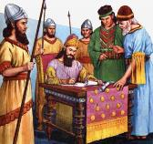
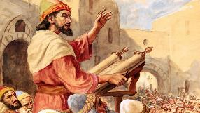
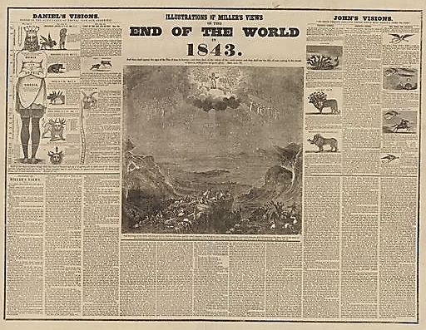
UBUHANUZI BW'IMINSI 2.300
“Kandi nawe Ezira, uko ubwenge bw’Imana yawe bukurimo, uzatoranye abatware n’abacamanza bo gucira imanza abantu bo hakurya y’uruzi, abazi amategeko y’Imana yawe bose, n’utayazi muzajye muyamwigisha” (Ezira 7:25)
Mu mwaka wa karindwi wa Aritazerusi umwami w’U Buperesi, Ezira yahawe itegeko ryo kujya i Yerusalemu kandi akagira ubwigenge busesuye bwa politiki bwo kurangiza gusana umurwa (Ezira 7:7, 11–14, 20–21, 24–25) ). Hari mu mwaka wa 457 MK.
Nk’uko ubuhanuzi bw’ibyumweru 70 bubyerekana, kongera kubaka Yerusalemu neza byatwaye imyaka 49, maze hashira indi myaka 434 kugeza ku kuza kwa Mesiya (Daniyeli 9:25). Iyi mibare ishyira umubatizo wa Yesu mu mwaka wa 27 NK, n’irangira ry’ibyumweru 70 mu mwaka wa 34 NK.
Mileri yashyize hamwe ibika by’indangaminsi ya gihanuzi, yanzura avuga ko Kugaruka kwa Yesu kwajyaga kubaho mu gihe runaka cy’umwaka w’1843.
Nyuma yo kubona ko batigeze bita ku mateka agaragaza ko nta mwaka wa “zeru” wabayeho, hemejwe ko Yesu yajyaga kugaruka mu w’1844.

Slide 11
UBUHANUZI BW'IMINSI 2.300
“Ibyumweru mirongo irindwi byakatiweho ubwoko bwawe n’umurwa wawe wera” (Daniyeli 9:24 ingeri ya RV2000 )
“Bizageza iminsi ibihumbi bibiri na magana atatu uko bukeye bukira, nyuma ubuturo bwera buzabone kwezwa.”
Imyaka 2.300
Ibyumweru 7
Ibyumweru 62
Icyumweru 1
Imyaka 49
Imyaka 434
Imyaka 3½
Imyaka 3½
Imyaka 1.810
457 MK
408 MK
27 NK
31 NK
34 NK
1844 NK
Itegeko rya Aritazerusi
Yerusalemu yarubatswe
Yesu yarasīzwe
Yesu yaraba-mbwe
Sitefano yatewe amabuye
Ubutumwa Bwiza ku Banyama-hanga
Kwezwa k’Ubuturo Bwera
Ibyumweru 70
Imyaka 490

Slide 12
“﻿Umugabane umwe w’ukuri kw’ingenzi kandi kunejeje bihebuje kwahishuwe na Bibiliya, ni ukuvuga ibyo Kugaruka kwa Kristo aje gusoza umurimo ukomeye wo gucungura umuntu. Ubwoko bw’Imana bwabaye mu rugendo, bukamara igihe butuye mu ‘gihugu no mu gicucu cy’urupfu’, bufite ibyiringiro bishyitse kandi bitera ibyishimo bakura mu isezerano ryo Kugaruka kwa Kristo, We ‘kuzuka n’ubugingo’, ubwo azaba aje ‘kugarura imuhira abe bagizwe ibicibwa’. Inyigisho yo Kugaruka kwa Kristo ni yo pfundo rw’Ibyanditswe Byera.”
E.G. White, Intambara Ikomeye, igice cya 17 (Integuza za mu gitondo), p. 218

Slide 13
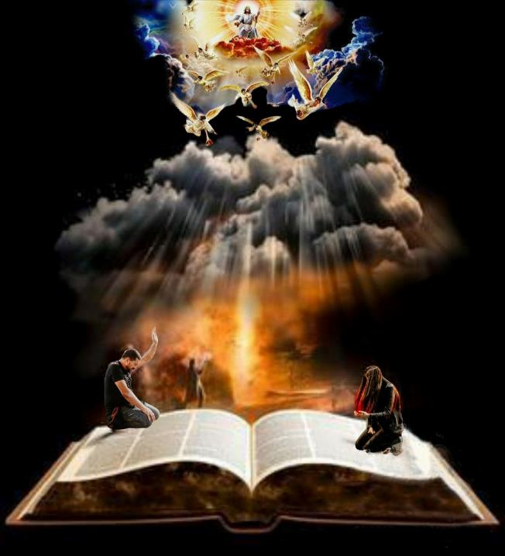
“Icyo tugomba kwitaho ni uyu munsi umwe. Uyu munsi tugomba kuba indahemuka kubyo twizeye. Uyu munsi tugomba gukunda Imana n’umutima wose kandi tugakunda bagenzi bacu nk’uko twikunda. Uyu munsi tugomba kurwanya ibishuko by’umwanzi, kandi kubw’ubuntu bwa Kristo tukanesha. Nibwo tuzaba maso tugategereza Kugaruka kwa Kristo. Buri munsi dukwiriye kubaho nk’aho tuzi ko uyu waba umunsi wa nyuma turi kuri iyi si. Turamutse tuzi ko Kristo azaza ejo, mbese ntitwahundagaza muri uyu munsi amagambo meza yose, imirimo yose izira inarijye, mu buryo bwose twabishobozwa?”
E.G. White, In heavenly places, December 14 p. 355

