Slide 1
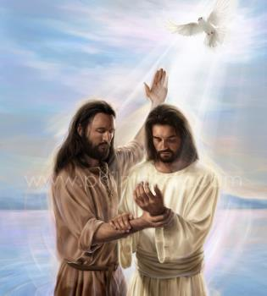
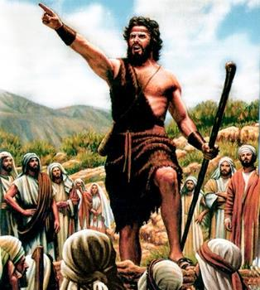
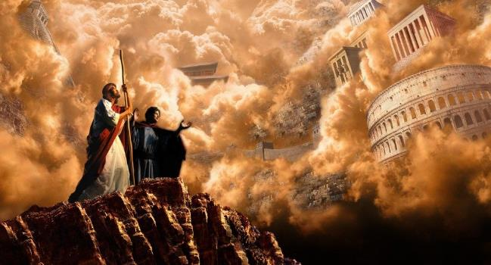
ITANGIRIRO RY'UBUTUMWA BWIZA
Icyigisho cya 1 cyo ku wa 6 Nyakanga 2024

Slide 2
“Nuko bamaze kubohesha Yohana, Yesu ajya i Galilaya avuga ubutumwa bwiza bw’Imana ati ‘Igihe kirasohoye, ubwami bw’Imana buri hafi. Nuko mwihane, mwemere ubutumwa bwiza.’ ”
(Mariko 1:14, 15)

Slide 3
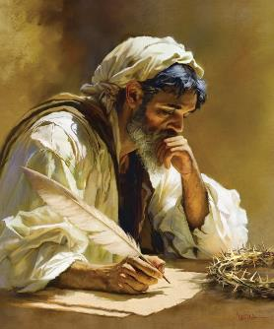
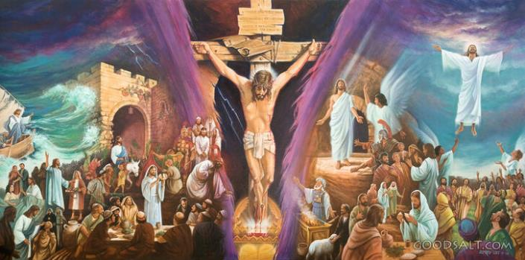
Ubutumwa Bwiza bwanditswe na Mariko ni bwo bugufi muri bune buvuga ku mibereho ya Yesu.
Ni inkuru yihuta, ibāngutse, ifite imbaraga, kandi ivunaguye. Ibivugwamo bigaragara neza imbere y’amaso yacu. Ntushobora kuburamo ubusobanuro ubwo ari bwo bwose, kuko iby’ingenzi gusa ari byo birimo.
Muri make, Mariko ni ubutumwa bwiza bw’ikinyejana cya 21, aho ibintu byose byihuta vuba na bwangu, aho igihe ari amafaranga. Mutyo dukoreshe icyo gihe twiga igihebuje ibindi agaciro: “Ubutumwa Bwiza bwa Yesu Kristo, Umwana w’Imana” (Mariko 1:1).
Umwanditsi w’Ubutumwa Bwiza:
Umuvugabutumwa wacogoye.
Ingirakamaro mu murimo.
Itangiriro ry’Ubutumwa Bwiza:
Kwitegura. Mariko 1:1–8.
Umubatizo. Mariko 1:9–13.
Ubutumwa. Mariko 1:14–15.

Slide 4
UMWANDITSI W’UBUTUMWA BWIZA

Slide 5
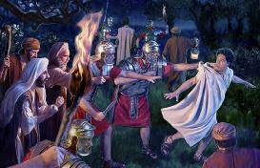
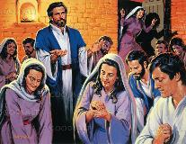
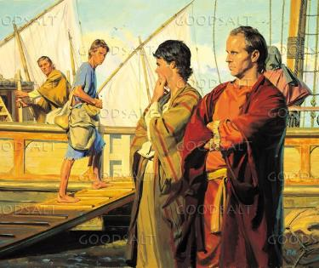
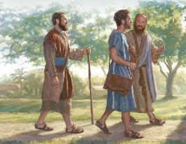
UMUVUGABUTUMWA WACOGOYE
“Kandi Barinaba na Sawuli bamaze kubashyikiriza za mfashanyo bahawe, bava i Yerusalemu basubirayo, bajyana Yohana wahimbwe Mariko” (Ibyakozwe 12:25)
Mariko, kimwe n’abandi banditsi b’Ubutumwa Bwiza, ntabwo yivugiye izina ubwe. Yari umwana igihe ibintu avuga byabaga; bityo birashoboka ko yabimenye binyuze mu mubano we wa hafi n’intumwa Petero (1 Petero 5:13).
Nyina wa Yohana Mariko yari nyir’ahantu h’i Yerusalemu aho itorero ryateraniraga risenga igihe Petero yashyirwaga mu nzu y’imbohe (Ibyakozwe 12:12).
Nyuma yaho gato, Barinaba na Sawuli (bari barajyanye i Yerusalemu amaturo) bajyanye na Yohani Mariko muri Antiyokiya (Ibyakozwe 12:25).
Muri Antiyokiya, igihe Umwuka Wera yahamagariraga Barinaba na Sawuli kuba ababwirizabutumwa mu banyamahanga, bajyanye na Yohani Mariko nk’ubafasha (Ibyakozwe 13:2–5).
Ariko ubuzima bw’ivugabutumwa bwagaragariye umusore Mariko ko bugoye cyane, ahitamo gusubira i Yerusalemu (Ibyakozwe 13:13).

Slide 6
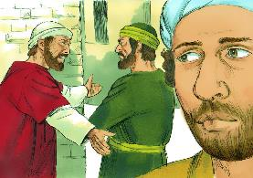
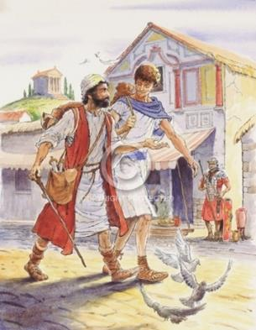
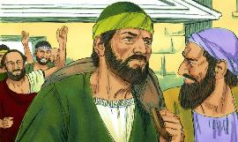
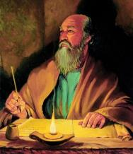
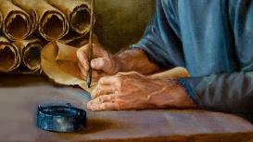
INGIRAKAMARO MU MURIMO
“Luka ni we wenyine ukiri kumwe nanjye. Shaka Mariko umuzane, kuko angirira umumaro wo kunkorera”
(2 Timoteyo 4:11)
Igihe Pawulo yateguraga urugendo rwe rwa kabiri rw’ivugabutumwa, yanze gukorana na Mariko nk’ūmufasha (Ibyakozwe 15:36–38). Pawulo yari akeneye abamufasha b’abanyembaraga, inkomezi aho kumubera umutwaro. Mariko ntabwo yari abyujuje.
Ariko Barinaba yari azi neza ko mwishywa we Mariko yari afite ubushobozi buhagije bwo kuba umuvugabutumwa mwiza. Ni ko kujyana na Mariko muri Kupuro, naho Pawulo na Sila berekeza muri Aziya (Ibyakozwe 15:39–41).
Ntabwo tuzi ibyakurikiyeho, ariko tuzi ko Barinaba yari mu kuri. Mu bihe bitatu Pawulo avuga kuri Mariko mu nzandiko ze, yaje guhamya ko Mariko “ari ingirakamaro mu murimo”, ūbafasha neza (Abakolosayi 4:10; Filemoni 24; 2 Timoteyo 4:11).
Ni kubw’aya mahirwe ya kabiri uyu munsi dufite umugisha wo kwishimira inkuru ishimishije y’Ubutumwa Bwiza bwanditswe na Mariko.

Slide 7
ITANGIRIRO RY’UBUTUMWA BWIZA

Slide 8
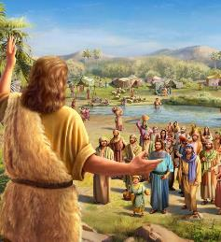
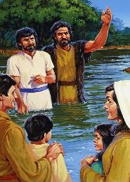
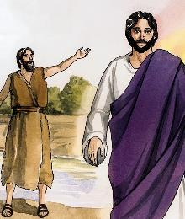
KWITEGURA
“Yabwirizaga avuga ati ‘Undusha ubushobozi azaza hanyuma yanjye, ntibinkwiriye kunama ngo mpfundure udushumi tw’inkweto ze’ ” (Mariko 1:7)
Mariko atangira atwereka Imana itegura urugendo rw’Umwana wayo (Mariko 1:1–2; Malaki 3:1). Urugendo rutangirira mu bikāri byo mu ijuru, kandi rukazageza Yesu Kristo ku musaraba, ndetse akazongera kwākīrwa mu Ijuru (Mariko 16:19).
Mu gutegura uru rugendo, Imana itoranya Yohana Umubatiza, “ijwi ry’urangurura mu butayu” (Mariko 1:3; Yesaya 40:3).
Mbere yuko Yesu atangira urugendo Rwe ngo atangire ubugingo Bwe ku bwacu, Yohana yateguye imitima y’abantu abayobora ku kwihana anabararikira kubatizwa (Mariko 1:4–6).
Yabateguriye kwakira umwana w’Imana: ukomeye kuruta Yohana ubwe, ukwiriye kurushaho, kandi ubatirisha umubatizo urushaho gukomera (Mariko 1:7–8).

Slide 9
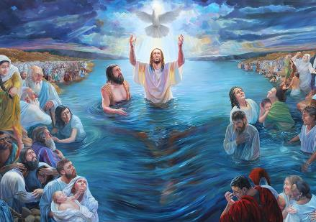
UMUBATIZO
“Muri iyo minsi Yesu ava i Nazareti y’i Galilaya, araza abatirizwa na Yohana muri Yorodani” (Mariko 1:9)
Yesu atangira urugendo Rwe mu buryo buhebuje: Imana Data imugaragaza nk’Umwana wayo, kandi Umwuka Wera agaragaza ukuhaba Kwe mu buryo bugaragara (Mariko 1:10–11). Kuva mu ntangiriro, Yesu yerekanwe nk’ufite ubumana, Umwana w'Imana. Ariko kandi anagaragazwa nk’umuntu:
Yabatijwe na Yohana, ntabwo ari We wabatije Yohana (Mariko 1:9)
Yajyanywe n’Umwuka Wera (Mariko 1:12)
Akenera kwihererana n’Imana bonyine (Mariko 1:13a)
Ageragezwa na Satani (Mariko 1:13b)
Ahura n’ibirushya bigaragara (Mariko 1:13c)
Abamarayika baramukorera (Mariko 1:13d)
Uku ni ko Yesu yerekanwe kuri twe: ubumana bwuzuye ndetse n’ubumuntu bwuzuye. Ni Umukiza n’Umuvandimwe, Umwami n’Urugero. Ni ihishurwa ryuzuye ry’urukundo rw’Imana ku nyokomuntu.

Slide 10
“Ubwiza bwari kuri Kristo ni igihamya cy’urukundo Imana idukunda. Butubwira imbaraga z’isengesho–uburyo ijwi ry’umuntu rishobora kugera mu gutwi kw’Imana kandi ibyifuzo byacu bikemerwa mu bikāri byo mu ijuru .... Umucyo waviriye mu marembo afunguye ukarasira ku mutwe w’Umukiza wacu natwe uzaturasira igihe dusenga dusaba ubufasha bwo kunesha ibishuko. Ijwi ryabwiraga Yesu rinabwira buri muntu wese wizera riti: ‘Nguyu Umwana wanjye nkunda nkamwishimira.’ ”
E.G. White, In the Heavenly Places – God Has Chosen Me, January 20

Slide 11
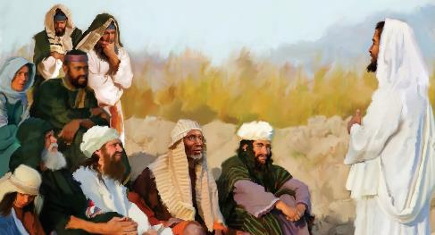
Ibyumweru 70 = imyaka 490
UBUTUMWA
Ibyumweru 7
Ibyumweru 62
Icya ½ cy’icyumweru
Icya ½ cy’icyumweru
Imyaka 49
Imyaka 434
Imyaka 7
“Nuko bamaze kubohesha Yohana, Yesu ajya i Galilaya avuga ubutumwa bwiza bw’Imana” (Mariko 1:14)
Ubutumwa bwa mbere bwa Yesu bukubiyemo ibintu bitatu (Mariko 1:15)
“Ubwami bw’Imana buri hafi”
“Mwihane, mwemere ubutumwa bwiza”
“Igihe kirasohoye”
Byerekeza ku buhanuzi bw’ibyumweru 70 (Danieli 9:24).
Kuva ku itegeko rya Aritazeruzi, muri 457 MK, kugeza ku gusīgwa kwa Mesiya, hari ibyumweru 69 (umur. 25).
Ibi byasohoye ku mubatizo wa Yesu, muri 27 NK. Nyuma ya ½ cy’icyumweru, muri 31 NK, Yesu arapfa (umur. 27).
Ibyerekana ko isezerano ry’agakiza ryari ritangiye gusohora.
Irarika ryo kugira uruhare rugaragara mu isezerano, twākīra imbabazi kubwo kwizera Yesu.
Ubutumwa bwacu bw’iki gihe nabwo bukubiyemo ibi bintu bitatu: Igihe cyarasohoye; Yesu araje; kandi tugomba kwihana no kwizera kugira ngo dushobore kujyana na We.

Slide 12
“Umutwaro wari uremereye Kristo mu kwigisha Kwe wari uyu ngo ‘Igihe kirasohoye, ubwami bw’Imana buri hafi. Nuko mwihane, mwemere ubutumwa bwiza.’ Kubw’ibyo, ubutumwa bwiza, nk’uko Umukiza ubwe yabwigishaga, bwari bushingiye ku byahanuwe. ‘Igihe’ yavugaga ko gisohoye ni cya gihe marayika Gaburiyeli yamenyesheje Daniyeli…
Nk’uko ubutumwa bwo kuza kwa mbere kwa Kristo bwatangazaga ubwami bw’ubuntu Bwe, ni nako ubutumwa bwo kuza Kwe kwa kabiri butangaza ubwami bw’ubwiza Bwe. Kandi kimwe n’ubwa mbere, ubutumwa bwa kabiri na bwo bushingiye ku byahanuwe."
E.G. White, Uwifuzwa Ibihe Byose, igice cyaa 23, p. 147, 148

