Slide 1
UMUNSI MU MURIMO WA YESU
Icyigisho cya 2 cyo ku wa 13 Nyakanga 2024

Slide 2
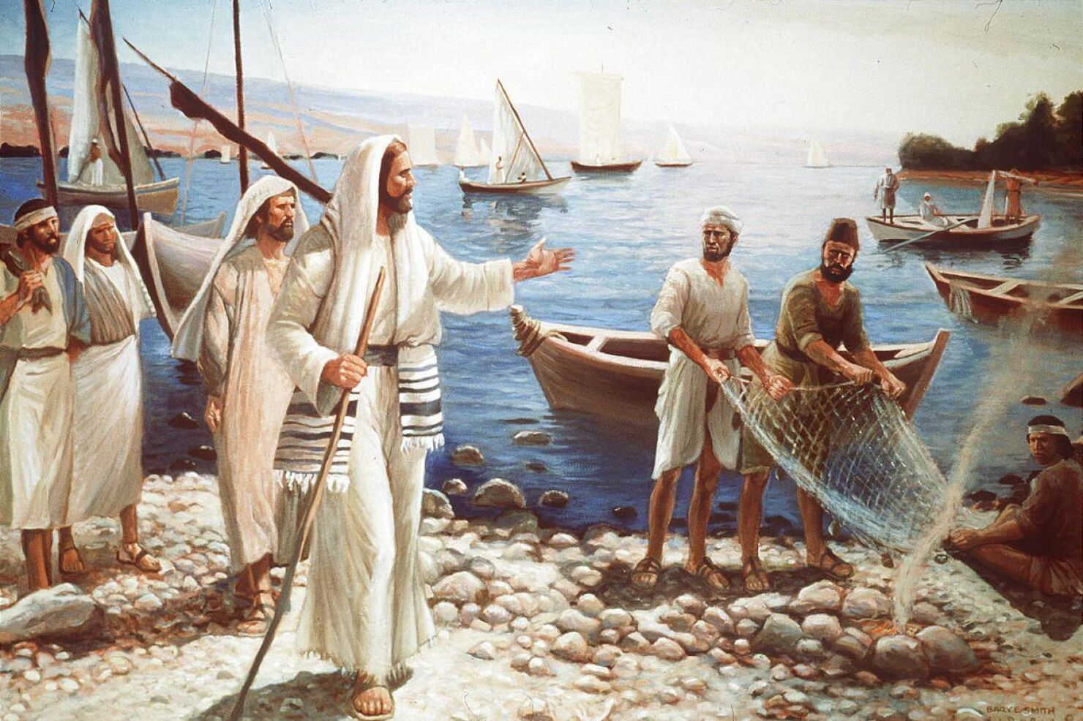
“Yesu arababwira ati ‘Nimunkurikire, nzabagira abarobyi b’abantu.’ ”
(Mariko 1:17)

Slide 3
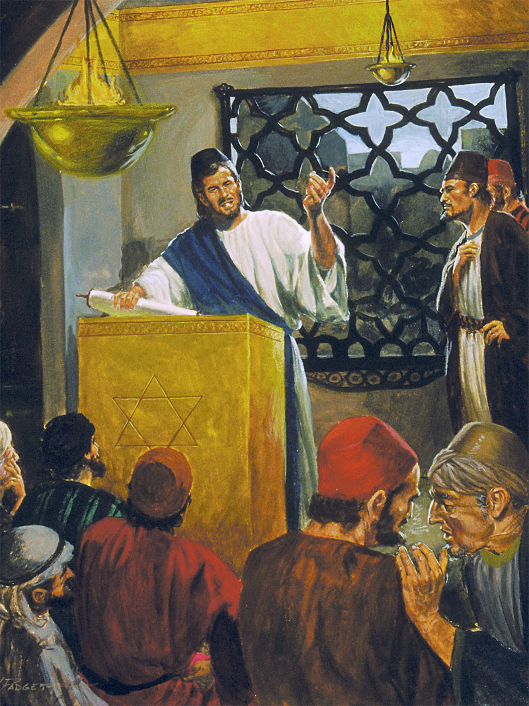
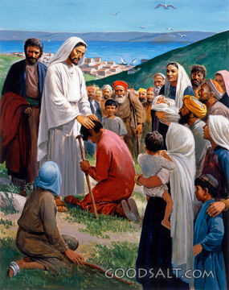
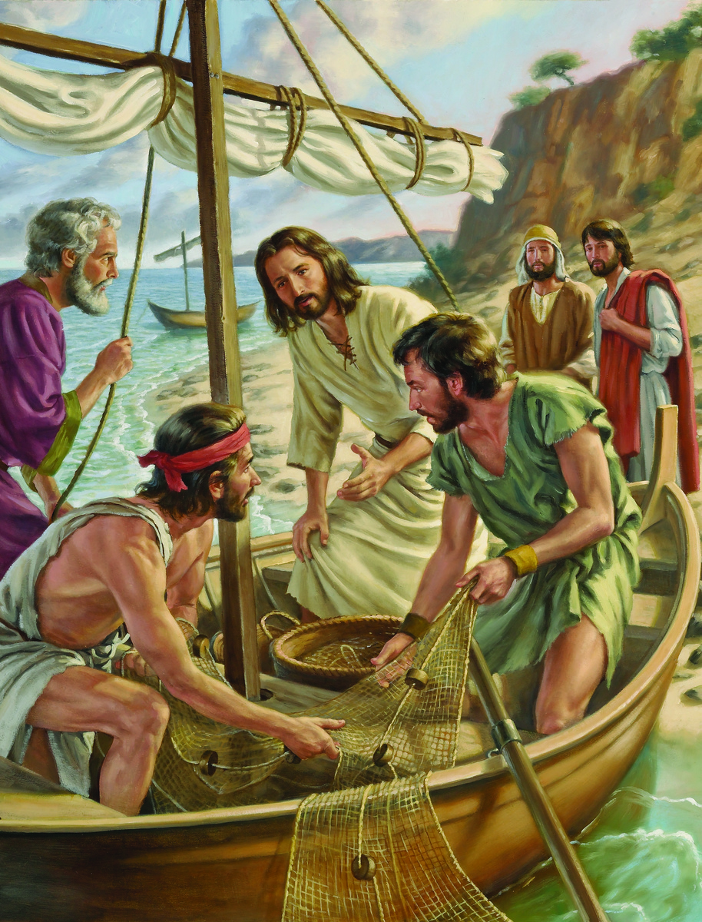
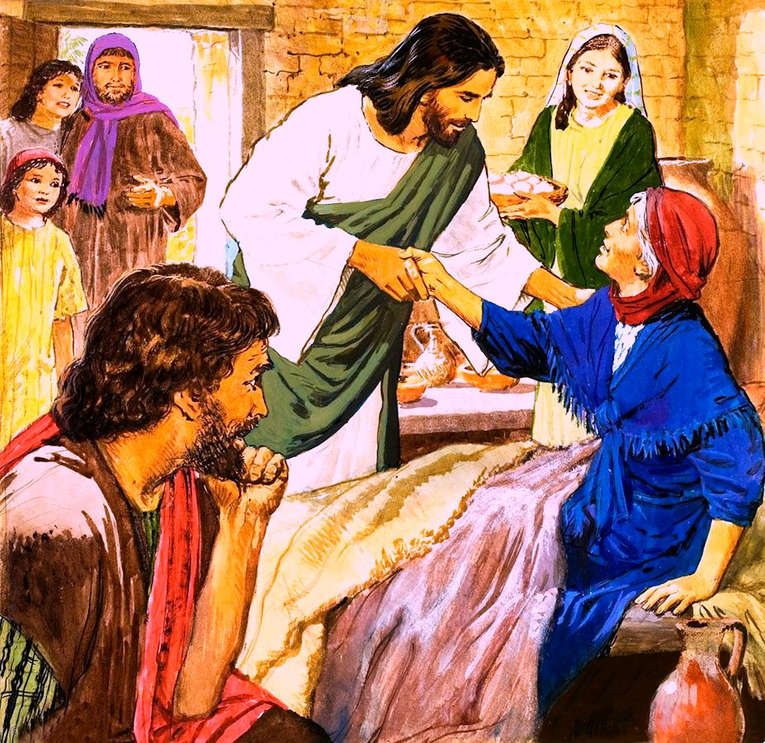
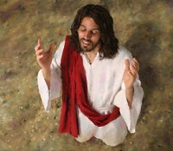
Umunsi mu mibereho ya Yesu wabaga umeze ute? Byajyaga kugenda bite tumukurikiye icyumweru cyose?
Mu mugabane uheruka w’igice cya mbere cya Mariko hadufasha kumva uko byabaga bimeze (Mariko 1:16–45).
Tujyanirane na Yesu ahamagarira itsinda ry’abarobyi kumukurikira iminsi yose; kwizihira umunsi w’Isabato urimo gahunda yinshi; hanyuma turebe akamenyero kabo ka buri munsi.
Ibikorwa bidasanzwe:
Guhamagara abigishwa. Mariko 1:16–20.
Ibikorwa byo ku Isabato:
Kwigishiriza mu isinagogi. Mariko 1:21–28.
Gukiza indwara. Mariko 1:29–34.
Ibikorwa bya buri munsi:
Gusenga no kubwiriza. Mariko 1:35–39.
Gukiza indwara no gukomeza Amategeko. Mariko 1:40–45.

Slide 4
IBIKORWA BIDASANZWE

Slide 5
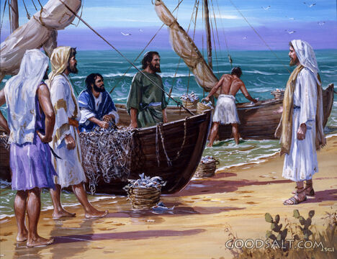
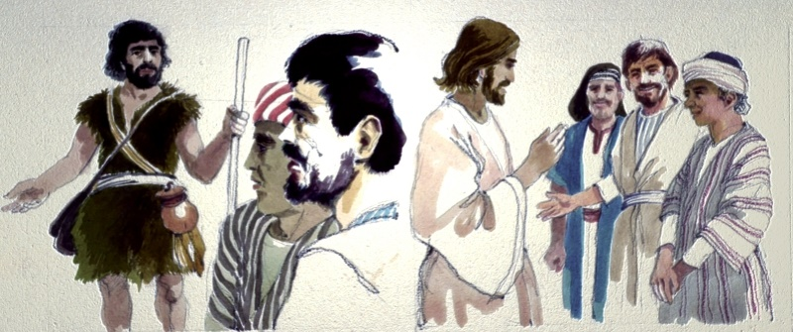
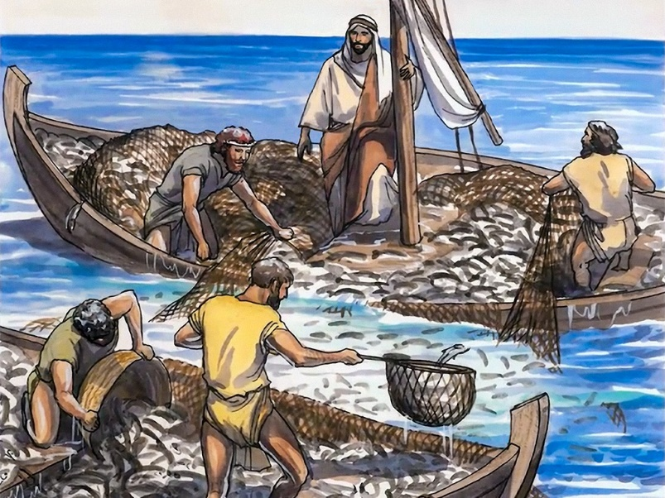
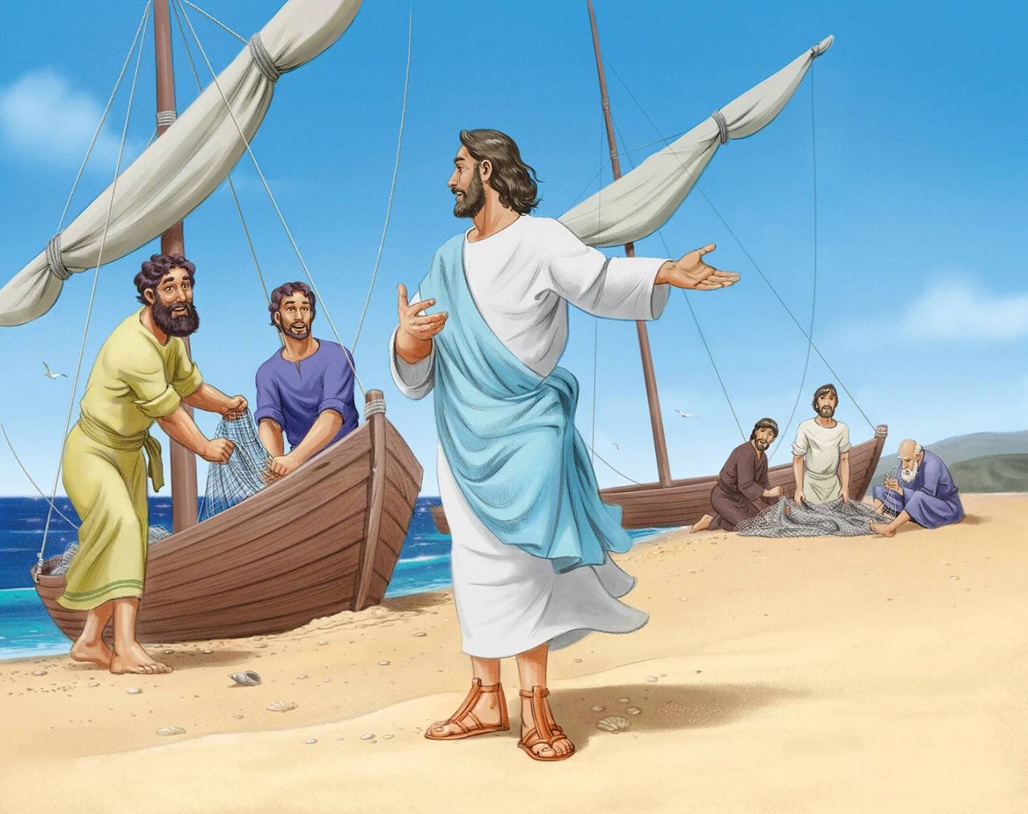
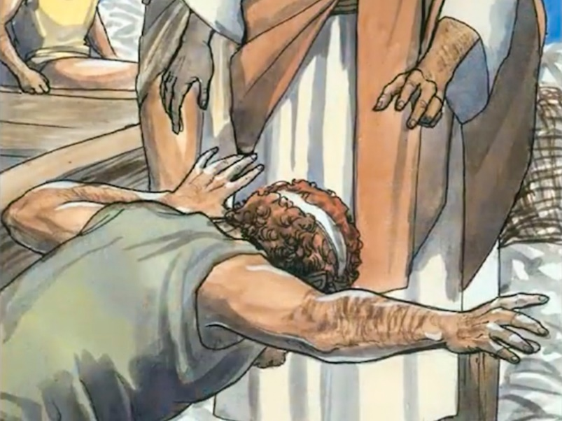
GUHAMAGARA ABIGISHWA
“Yesu arababwira ati ‘Nimunkurikire, nzabagira abarobyi b’abantu.’ ” (Mariko 1:17)
Igitabo cya Mariko kirangwa no kuba kigufi. Tudasomye ubundi Butumwa Bwiza, dushobora kwibwira ibitari byo ku byerekeye uku guhamagarwa kw’abigishwa.
Ntabwo bwari ubwa mbere aba bagabo bahuye na Yesu. Nk’abigishwa ba Yohana Umubatiza, bari baramwumvise avuga kuri Yesu, maze baramukurikira. Aba mbere babikoze ni Andereya na Yohana, bakurikirwa n’abavandimwe babo (Yohana 1:35–42).
Yesu abwiriza ari mu bwato bwa Petero, hanyuma habaho igitangaza mu burobyi. Urushundura rw’abavandimwe bane rwendaga gutanyurwa n’ubwinshi bw’amafi (Luka 5:1–7). Mu gihe Yakobo na Yohana bakururaga inshundura, Petero yijugunye ku birenge bya Yesu (Luka 5:8–11).
Yakobo na Yohana bahariye se inshingano zo kwita ku muryango, naho Petero na Andereya basiga ingo zabo kugira ngo baronke imitima. Mu kumvira irarika rya Yesu, bahinduye imibereho yabo, n’iy’abo ku isi yose.

Slide 6
IBIKORWA BYO KU ISABATO

Slide 7
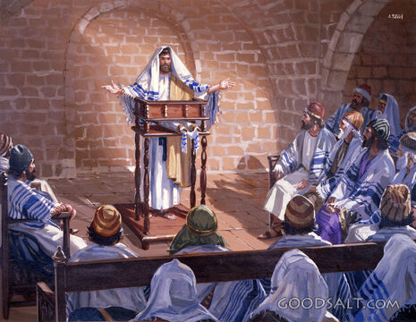
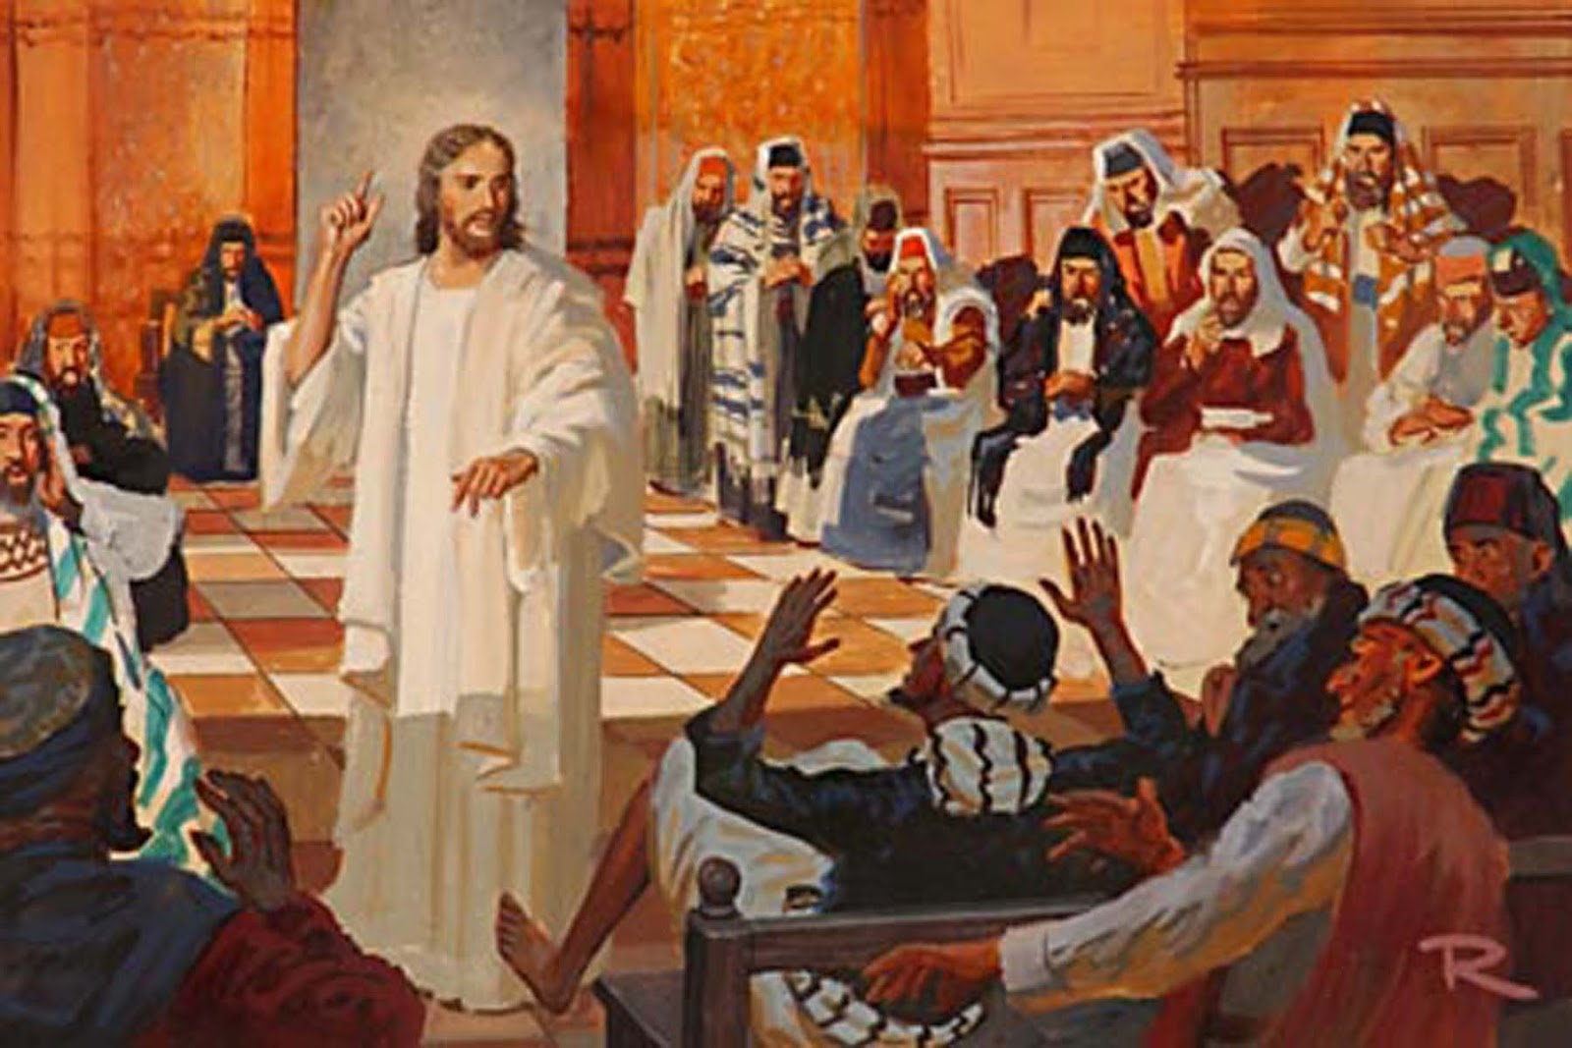
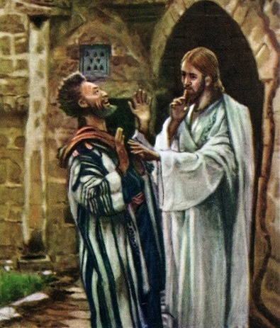
KWIGISHIRIZA MU ISINAGOGI
“Bagera i Kaperinawumu, nuko ku isabato yinjira mu isinagogi arigisha” (Mariko 1:21).
Ibitabo by’Ubutumwa Bwiza byose bisobanura neza ko kujya mu isinagogi ku Isabato kuri Yesu byari akamenyero ntabwo byari ibintu bidasanzwe (Luka 4:16).
Abantu bakiriye bate ubutumwa bwa Yesu? (Mariko 1:22).
Ariko si ko abantu bose bari bishimye. Umwanzi yahisemo kurogoya iteraniro, yizeye kuburizamo umurimo wa Yesu (Mariko 1: 23–26). Kidobya itunguranye ahubwo yatumye abantu barushaho kwemera Yesu (Mariko 1:27–28).
Ibintu bitatu bigaragara muri iyi nkuru:
Muri iryo torero harimo umudayimoni. Mu itorero harimo “urukungu”, kandi ntidushobora kurutandukanya n’amasaka (Matayo 13:24–30).
Umudayimoni yari azi Yesu uwo ari We, ashakisha uburyo bwo gutesha agaciro umurimo We.
Yesu yamutegetse guceceka. Ntabwo cyari igihe cyo gutangaza ku mugaragaro ko ari Mesiya.

Slide 8
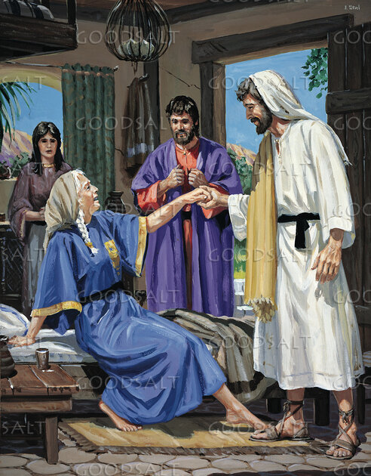
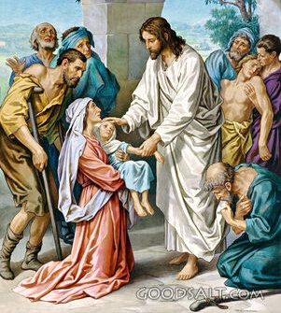
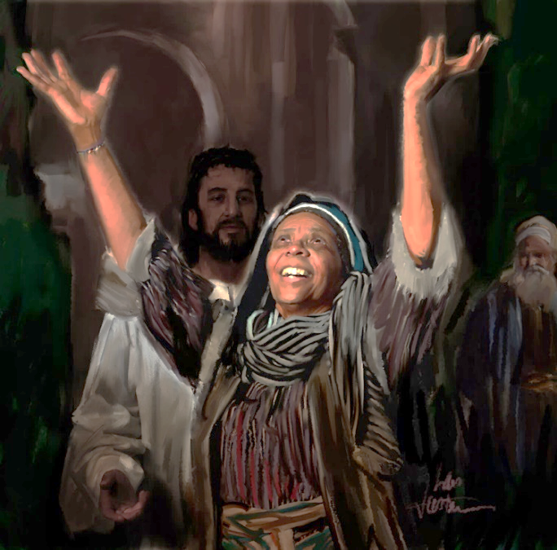
GUKIZA
“Nimugoroba izuba rirenze, bamuzanira abarwayi bose n’abatewe n’abadayimoni” (Mariko 1:32)
Iteraniro ryo mu isinagogi rirangiye, Yesu yajyanye n’abigishwa Be bane kuruhukira no gusangirira ahiherereye kwa Petero (Mariko 1:29).
Mu gihe barimo bategura ameza, babwiye Yesu ibya nyirabukwe wa Petero, wari wibasiwe n’ubuganga (Mariko 1:30). Uyu mugore amaze gukira, yashishikariye kwita ku bashyitsi (Mariko 1:31). Imigisha Yesu aduha itera muri twe icyifuzo cyo kuyisangiza abandi.
Igitangaza cyo gukiza uwari atewe n’abadayimoni cyabaye ingingo iganirwaho cyane mu ngo nyinshi z’i Kaperinawumu. Bityo, nyuma y’amasaha yera y’Isabato, izuba rirenze, bazaniye Yesu abarwayi benshi kugira ngo abakize (Mariko 1:32–34).
Mbega ibyishimo! Mbega urusaku rw’ishimwe rwumvikanye mu nzu ya Simoni! Kandi ntabwo ari abakijijwe bishimye gusa, na Yesu ubwe yishimiye kubazanira gukira.
Nyuma y’umunsi wakozwemo byinshi, Yesu yashoboye kuruhuka bitinze nijoro.

Slide 9
IBIKORWA BYA BURI MUNSI

Slide 10
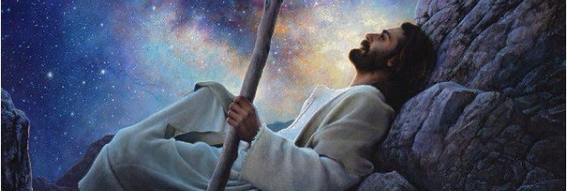
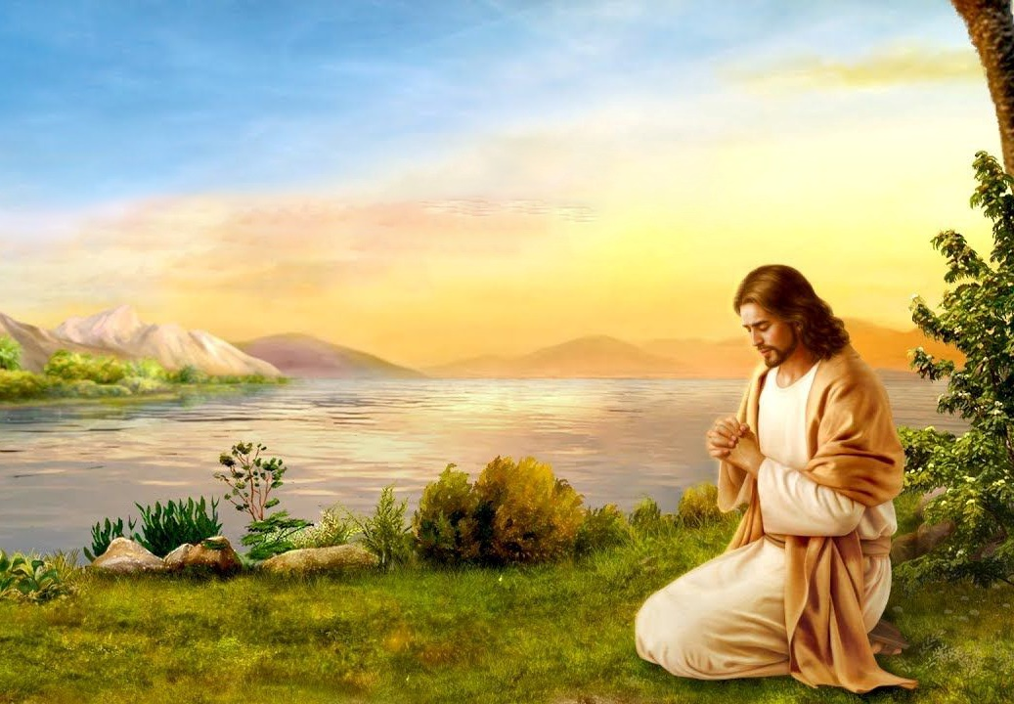
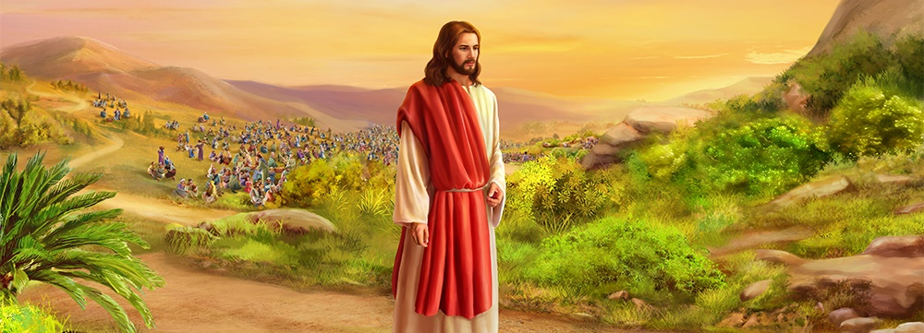
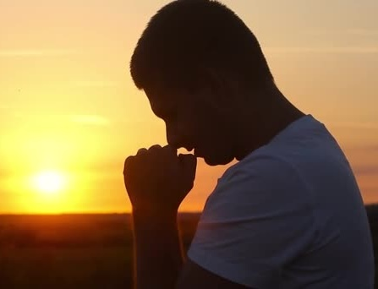
GUSENGA NO KUBWIRIZA
“Nuko mu museke arabyuka, arasohoka ajya mu butayu asengerayo” (Mariko 1:35)
Ku wa mbere w’icyumweru, abigishwa bategereje ko Yesu abwiriza muri uwo murwa. Ariko Yesu yari afite indi gahunda. Yagombaga guhesha abandi benshi umugisha kubw’amagambo Ye n’ibikorwa Bye (Mariko 1:36–39).
Ariko Yesu ntiyakoraga ibyo yishakiye. Nk’ibisanzwe, yabanje kujya kuganira na Se kugira ngo amubwire icyo agomba gukora uwo munsi (Mariko 1:35; Yohana 8:28).
Buri munsi Yesu yakundaga gushaka Imana asenga, kandi aturarikira kumwigana (Mariko 6:46; Luka 3:21; 5:16; 9:18; 11:1; 18:1). Mu bihe bidasanzwe, yakeshaga amajoro asenga (Luka 6:12–13; Matayo 14:21–23).
Ese natwe ntidukwiriye kwigana Yesu dushaka Imana buri munsi dusenga kugira ngo tumenye ubushake bwayo? Ese ntibikwiriye ko mu bihe bidasanzwe, tuyishaka cyane cyane dusenga?

Slide 11
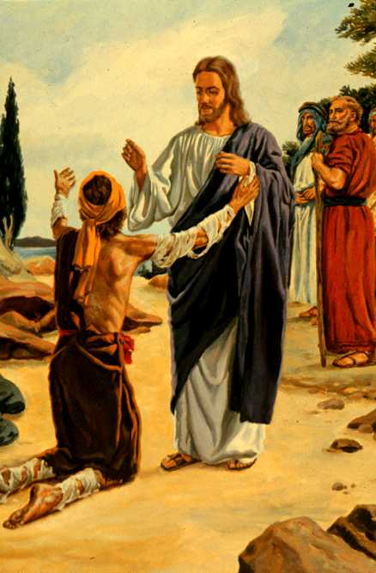
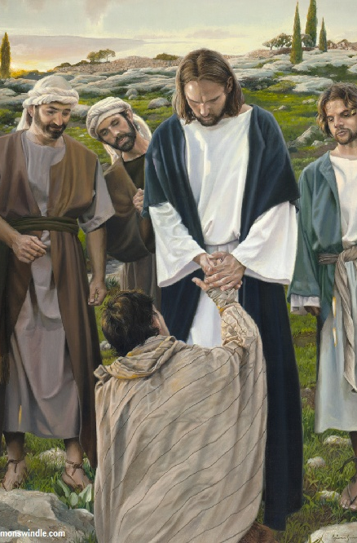
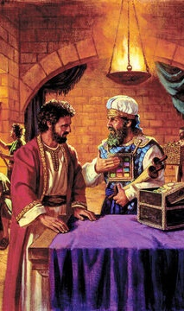
GUKIZA INDWARA NO GUKOMEZA AMATEGEKO
“Uramenye ntugire uwo ubibwira, ahubwo ugende wiyereke umutambyi, uture n’ituro ryo kwihumanura nk’uko Mose yabitegetse, kugira ngo bibabere ikimenyetso cyo kubahamiriza yuko ukize.” (Mariko 1:44)
Umubembe, washyizwe mu kato n’abantu bose kubera uburwayi bwe, yapfukamye imbere ya Yesu asaba gukira (Abalewi 13:45; Mariko 1:40).
Yesu yakoreye imbere y’imbaga y’abantu ikintu gihabanye n’amategeko: akora ku mubembe bityo afatwa nk’uhumanye. Ariko, aho kugira ngo Yesu yandure uguhumana k’umubembe, umubembe yakiriye gukiza kwa Yesu.
Iyo tuzaniye Yesu ibyaha byacu n’ibizinga byacu, ntatwītāza. Aduha imbabazi no gukira, akatweza nk’uko yera.
Amaze kumukiza, yatanze amabwiriza abiri afite intego ebyiri (Mariko 1:44)
Wiyereke abatambyi
Yagaragaje ko akomeza amategeko
Yahaye abatambyi amahirwe yo kumwakira nka Mesiya.
Ntugire uwo ubibwira
Yaburijemo ko umutambyi yagira urwikekwe ku byerekeye uwo mubembe
Yirinze gukangura muri rubanda ibitekerezo byerekana ko ari Mesiya

Slide 12
“Umukiza wacu, akiri muri iyi si, ntiyagize ubuzima bworoshye. Ahubwo yakoraga ubudahwema kugira ngo akize abazimiye. Kuva ku kuvuka kugeza ku gupfa, yabayeho imibereho izira inarijye. Ntiyigeze yihunza imirimo irembya n’ingendo zikomeye zitera kugwa agacuho. Yavuze ko “Umwana w’umuntu ataje gukorerwa, ahubwo yaje gukorera abandi no gutangira ubugingo bwe kuba incungu ya benshi” (Matayo 20:28). Uwo ni wo mugambi rukumbi Yesu yari afite mu kubaho Kwe kose. Ibindi byose babikoreraga kugira ngo asohoze uwo mugambi wo kuba inshungu yabo. Gukora icyo Se ashaka no gusohoza umurimo yaje gukora byamuberaga nk’ibyokurya n’ibyokunywa. Mu murimo We ntihabayeho igitekerezo cyo kwihugiraho."
E.G. White, Kugana Yesu, igice cya 9, p. 38

